Slide 1
Occupational Specialism: Plumbing & Heating Engineering
K1.7 Plumbing and heating systems
K1.8 Components used in plumbing and heating systems
Circulating pumps

Slide 2
Starter
Knowledge recap
Sketch a simple 2-pipe heating system from memory.
Compare drawings with peers.
Provide feedback on flow and return routes.

Slide 3
Objectives
You should be able to:
Explain principles of circulation pumps
Identify different types of circulators and impellers
Understand pump orientation and positioning
You might also be able to:
Review manufacturers’ instructions for safe installation
Carry out installation and replacement procedures

Slide 4
Introduction to circulation pumps
Circulation pumps are essential for moving heated water around a central heating system. Without a pump, water flow would rely only on gravity, limiting performance and efficiency.
Pumps ensure that water reaches all radiators and returns to the boiler for reheating. They allow sealed and fully pumped systems to operate effectively.
Modern pumps are designed for efficiency and quiet operation, with electronic controls improving performance.

Slide 5
Pump principles
Create flow by converting electrical energy into mechanical energy.
Motor drives an impeller to push water around the system.
Overcome frictional resistance in pipework and fittings.
Maintain steady circulation of hot water.
Enable balanced heating output across radiators.
Question: Why is a circulation pump essential in modern sealed heating systems?

Slide 6
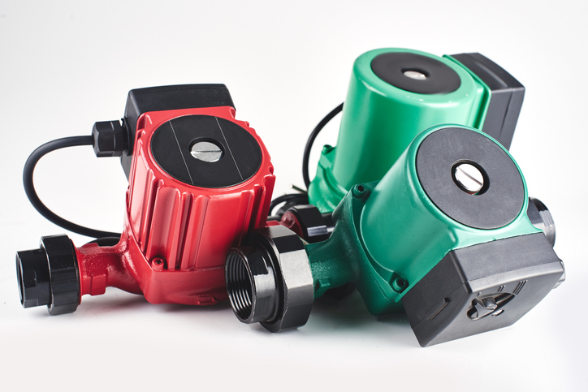
Tutor demonstration – pump principle
Tutor shows a disassembled pump.
Students observe how the motor shaft rotates the impeller.
Class discusses how this generates pressure and flow in the system.

Slide 7
Types of circulator – overview
Fixed-speed pumps.
Variable-speed pumps.
Smart or electronically controlled pumps.
Domestic vs commercial applications.
In-line vs glandless designs.

Slide 8
Types of circulator
Fixed-speed pumps run constantly at one output, regardless of demand. Variable-speed pumps adjust speed to system resistance, improving efficiency.
Smart pumps, such as the Grundfos MAGNA3 and Wilo Yonos PICO range, use sensors and programming to optimise performance automatically.
Each type has advantages depending on system design and demand.

Slide 9
Impeller design – overview
Radial impellers for general use.
Axial flow impellers for high volume, low head.
Mixed flow impellers combining both principles.
Domestic circulators usually radial designs.
Efficiency depends on impeller shape and size.

Slide 10
Pump orientation
Correct orientation critical for performance.
Motor shaft must remain horizontal in most designs.
Incorrect orientation causes bearing wear and failure.
Manufacturers’ instructions always specify installation angles.
Example: Grundfos MAGNA3 installation guide.
Question: What might happen if a pump is installed with the shaft vertically?

Slide 11
Tutor activity – impeller & manufacturer instructions
Tutor provides pumps that can be split down into impeller and motor.
Students observe impeller shape and discuss how design affects water flow.
Tutor distributes installation manuals such as MAGNA3 Operating Instructions.
Students highlight orientation diagrams and discuss why these rules exist.

Slide 12
Pump positions within system
Pump can be installed on flow or return.
Position chosen based on manufacturer guidance.
Flow-side pumps push hot water from boiler.
Return-side pumps draw cooled water back in.
Placement affects system pressure balance.

Slide 13
Positive and negative pressure effects
Pumps create pressure differences in system.
Positive pressure assists flow to radiators.
Negative pressure on suction side risks air ingress.
Incorrect placement can cause cavitation and noise.
Careful siting prevents operational issues.
Question: What problem can occur if negative pressure on suction side draws in air?

Slide 14
Knowledge check 1
What is the role of a circulation pump?
Name two types of pump commonly used in heating systems.
What does an impeller do inside a pump?
Why must motor shafts usually be horizontal?
What issue arises from incorrect pump placement?

Slide 15
Knowledge check 1 – answers
Moves heated water around system.
Fixed-speed, variable-speed, smart.
Pushes water by converting rotational energy into flow.
Prevents bearing wear and premature failure.
Air ingress, cavitation, or imbalance.

Slide 16
Pump installation – tutor demo
Tutor demonstrates removing and reinstalling a pump.
Students observe safe isolation, draining, removal, sealing, and refitting.
Emphasis on manufacturer instructions and correct torque.
Pairs of students practise installing a small pump on a decommissioned system. Focus on correct orientation, sealing, and alignment.
Tutor supervises and gives feedback.

Slide 17
Pump maintenance
Modern pumps require little routine maintenance.
Check for leaks, noise, overheating.
Clean filters and strainers in system.
Ensure system water quality is maintained.
Replace faulty seals or bearings when required.
Question: Why is water quality important for pump longevity?

Slide 18
Case study – pump failure
Example:
Pump installed vertically fails after two years.
Students analyse what caused the failure and how it could have been avoided.
Discussion reinforces importance of orientation and manufacturer’s guidance.

Slide 19
Energy efficiency & smart pumps
Smart pumps reduce energy consumption by automatically adjusting speed. They save homeowners money and comply with energy efficiency regulations.
Many can connect to building management systems for monitoring. This makes them the preferred choice in modern installations.

Slide 20
Knowledge check 2
What is the difference between fixed-speed and variable-speed pumps?
What type of impeller is most common in domestic pumps?
Why do manufacturers specify pump orientation?
Which type of pump uses sensors to optimise performance?
What is cavitation?

Slide 21
Knowledge check 2 – answers
Fixed runs constantly; variable adjusts to demand.
Radial impeller.
To prevent damage, noise, and failure.
Smart/electronically controlled pumps.
Formation and collapse of air bubbles, damaging pump.

Slide 22
Activity – manufacturer comparison & selection
Tutor provides manuals from several pump manufacturers.
Students compare orientation diagrams, wiring instructions, and flow direction arrows.
Students discuss which pump type they would recommend for:
A small two-bed home
A large office building
An energy-efficient modern home.

Slide 23
Fault diagnosis
Common faults: noise, vibration, leaks, no flow.
Causes: air locks, debris, worn bearings, electrical faults.
Correct diagnosis requires visual checks and testing.
Replacement often quicker than repair in domestic pumps.
Question: What fault might be indicated by noisy cavitation in a pump?

Slide 24
System efficiency
Correctly installed and controlled pumps improve system efficiency. Oversized or incorrectly set pumps waste energy. Smart pumps reduce power use by 30–50% compared to older fixed-speed models.
Students write a short note: “What three key checks would I make before installing a pump?”
Share answers with peers.

Slide 25
Industry standards
Pumps must meet energy efficiency regulations.
Electrical connections follow IET Wiring Regulations.
Safety devices must be fitted as per standards.

Slide 26
Student task – sketch exercise
Students sketch a pump installed in a two-pipe heating system, showing flow, return, and orientation.
Tutor collects sketches and provides quick feedback. Common errors are addressed with whole group.
Students write one key point about pump orientation and why it matters.

Slide 27
Knowledge check 3
Explain why circulation pumps are essential in heating systems.
List two advantages of smart pumps.
Why must impeller design be matched to system requirements?
What could happen if pump orientation is incorrect?
Where can you find guidance on pump positioning?

Slide 28
Knowledge check 3 – answers
Ensure heated water is circulated efficiently through system.
Energy savings, automatic optimisation, quieter operation.
Ensures correct flow and head, maximising efficiency.
Bearing failure, noise, cavitation, leaks.
Manufacturer’s installation instructions.

Slide 29
Summary
You should be able to:
Explain principles of circulation pumps
Identify different types of circulators and impellers
Understand pump orientation and positioning
You might also be able to:
Review manufacturers’ instructions for safe installation
Carry out installation and replacement procedures

Slide 30
Any questions?
Copyright in this document belongs to and is used under licence from the Department for Education, © 2025.
‘T-LEVELS’ and ‘T Level’ are registered trademarks of the Department for Education.
WJEC is authorised by the Department for Education to develop and deliver this T Level Technical Qualification.
WJEC operates in England under the name Eduqas which is a registered trademark of WJEC.

