Slide 1
Occupational Specialism: Plumbing & Heating Engineering
K1.7 Plumbing and heating systems
K1.8 Components used in plumbing and heating systems
Below ground drainage systems: Principles & combined systems

Slide 2
Starter
Warm-up:
Why do properties need below ground drainage systems
What might happen if one is not present or fails?

Slide 3
Objectives
You should be able to:
Explain the need for below ground drainage systems
Identify components, pipe sizes, and gradients
Understand combined drainage system layouts
You might also be able to:
Apply Building Regulation requirements for drainage
Compare rainwater and wastewater discharges

Slide 4
The need for drainage systems
Drainage systems remove waste and surface water safely from buildings. They protect public health, prevent flooding, and reduce pollution. Without effective drainage, properties may suffer structural damage, dampness, and contamination.
Systems must comply with regulations to ensure water is safely transported to treatment plants or soakaways.
Proper design supports sustainability and environmental protection.
Notes:
Note to tutor: Link to YouTube video to show how waste water is treated.
https://www.youtube.com/watch?v=2dzWBJqIBlk

Slide 5
Pipe sizes in drainage
Domestic foul drainage: typically 100–110mm diameter.
Rainwater connections: 68–100mm depending on roof area.
Larger properties may require 150mm+ pipes.
Inspection chambers and manholes sized for access.
Pipe materials: clay, PVC-u, concrete.
Question: Why are minimum pipe sizes specified in regulations?

Slide 6
Components of drainage systems
Drainage systems include pipes, inspection chambers, traps, gullies, and manholes. Each plays a role in carrying or controlling water flow.
Traps prevent odours escaping into properties.
Gullies collect water at ground level. Inspection chambers allow cleaning and maintenance access.

Slide 7
Traps and gullies
Traps hold a water seal to block foul air.
Common trap depth: 75mm.
Road gullies collect surface water from paved areas.
Bottle gullies used around homes.
Must be sited to intercept surface run-off effectively.

Slide 8
Tutor demonstration – components
Tutor: shows students sample pipe fittings, traps, and gullies.
Students: identify each component and discuss its function.

Slide 9
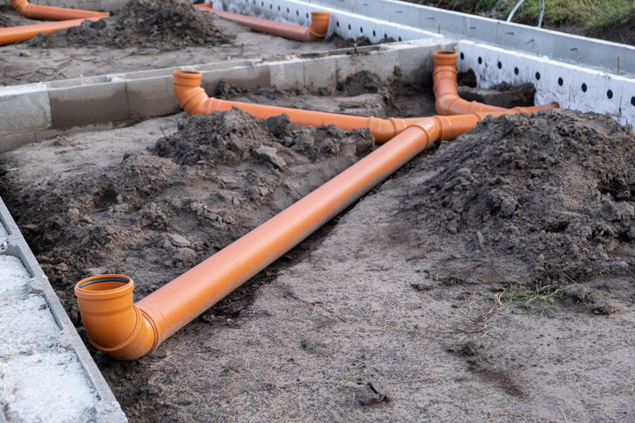
Falls and gradients – principles
Drainage relies on gravity to carry waste. Pipes must be laid at correct falls to maintain flow. Too shallow a gradient risks blockages; too steep a fall causes separation of solids and liquids.
Regulations specify gradients for different pipe sizes to ensure efficient self-cleansing.

Slide 10
Example gradients
100mm pipe: 1 in 40 (25mm per metre).
150mm pipe: 1 in 60 (17mm per metre).
Maximum gradient usually 1 in 10.
Must be consistent across pipe runs.
Checked with levels during installation.
Question: What might happen if a drain is installed too steeply?

Slide 11
Combined drainage systems
Combined systems carry both foul sewage and surface water in the same pipe.
They are common in older towns and cities. They reduce pipe numbers but increase risk of overloading treatment plants during storms.
New systems usually separate foul and surface water to improve efficiency.

Slide 12
Combined system layout
One main sewer receives both foul and surface flows.
Gullies and rainwater pipes connected into same line as appliances.
Inspection chambers provide access.
Must be sized for maximum load.
Connection controlled by local authority.
Notes:
Tutor to show typical combined system layout

Slide 13
Advantages of combined systems
Only one drainage network required.
Lower initial construction cost.
Simple design and layout.
Easier to connect existing properties.
Question: Why are combined systems less common in modern housing?

Slide 14
Disadvantages of combined systems
Storms overload treatment plants.
Higher risk of pollution.
Maintenance more complex.
Difficult to retrofit separation later.
Risk of foul water flooding.

Slide 15
Building regulation requirements
Part H covers drainage and waste disposal.
Requires adequate foul and surface drainage.
States minimum pipe sizes and gradients.
Mandates access for maintenance.
Requires separation of rainwater and foul in new systems.

Slide 16
Rainfall and surface water management
Surface water should be directed to soakaways where possible.
Sustainable Urban Drainage Systems (SuDS) encouraged.
Combined systems only allowed with local authority consent.
Must protect against backflow and flooding.
Question: What is one environmental risk of discharging surface water into a combined drain?

Slide 17
Building regulations part H – key points
Approved Document H1 requires that foul water drainage must:
Convey flows effectively to sewer or treatment system.
Prevent blockages and leakage.
Stop foul air from entering buildings.
Be ventilated and accessible for clearing blockages.
Avoid increasing flood risk to properties.

Slide 18
Pipe fittings and connections
Bends, junctions, and access points must allow flow without blockage.
Long radius bends preferred.
Inspection chambers required at changes of direction.
Proper jointing prevents leaks and root ingress.

Slide 19
Minimum pipe sizes and gradients
Part H states:
100mm minimum where WCs connect.
75mm possible for small waste appliances.
100mm pipes = 1:40 fall
150mm pipes = 1:150 fall
Correct gradients prevent silt build-up and ensure self-cleansing.

Slide 20
Depth of cover
Part H states:
Under gardens/fields: minimum 0.6m.
Under roads: minimum 1.2m.
Shallower pipes must be protected with reinforced slabs.
Prevents pipe crushing from loads.

Slide 21
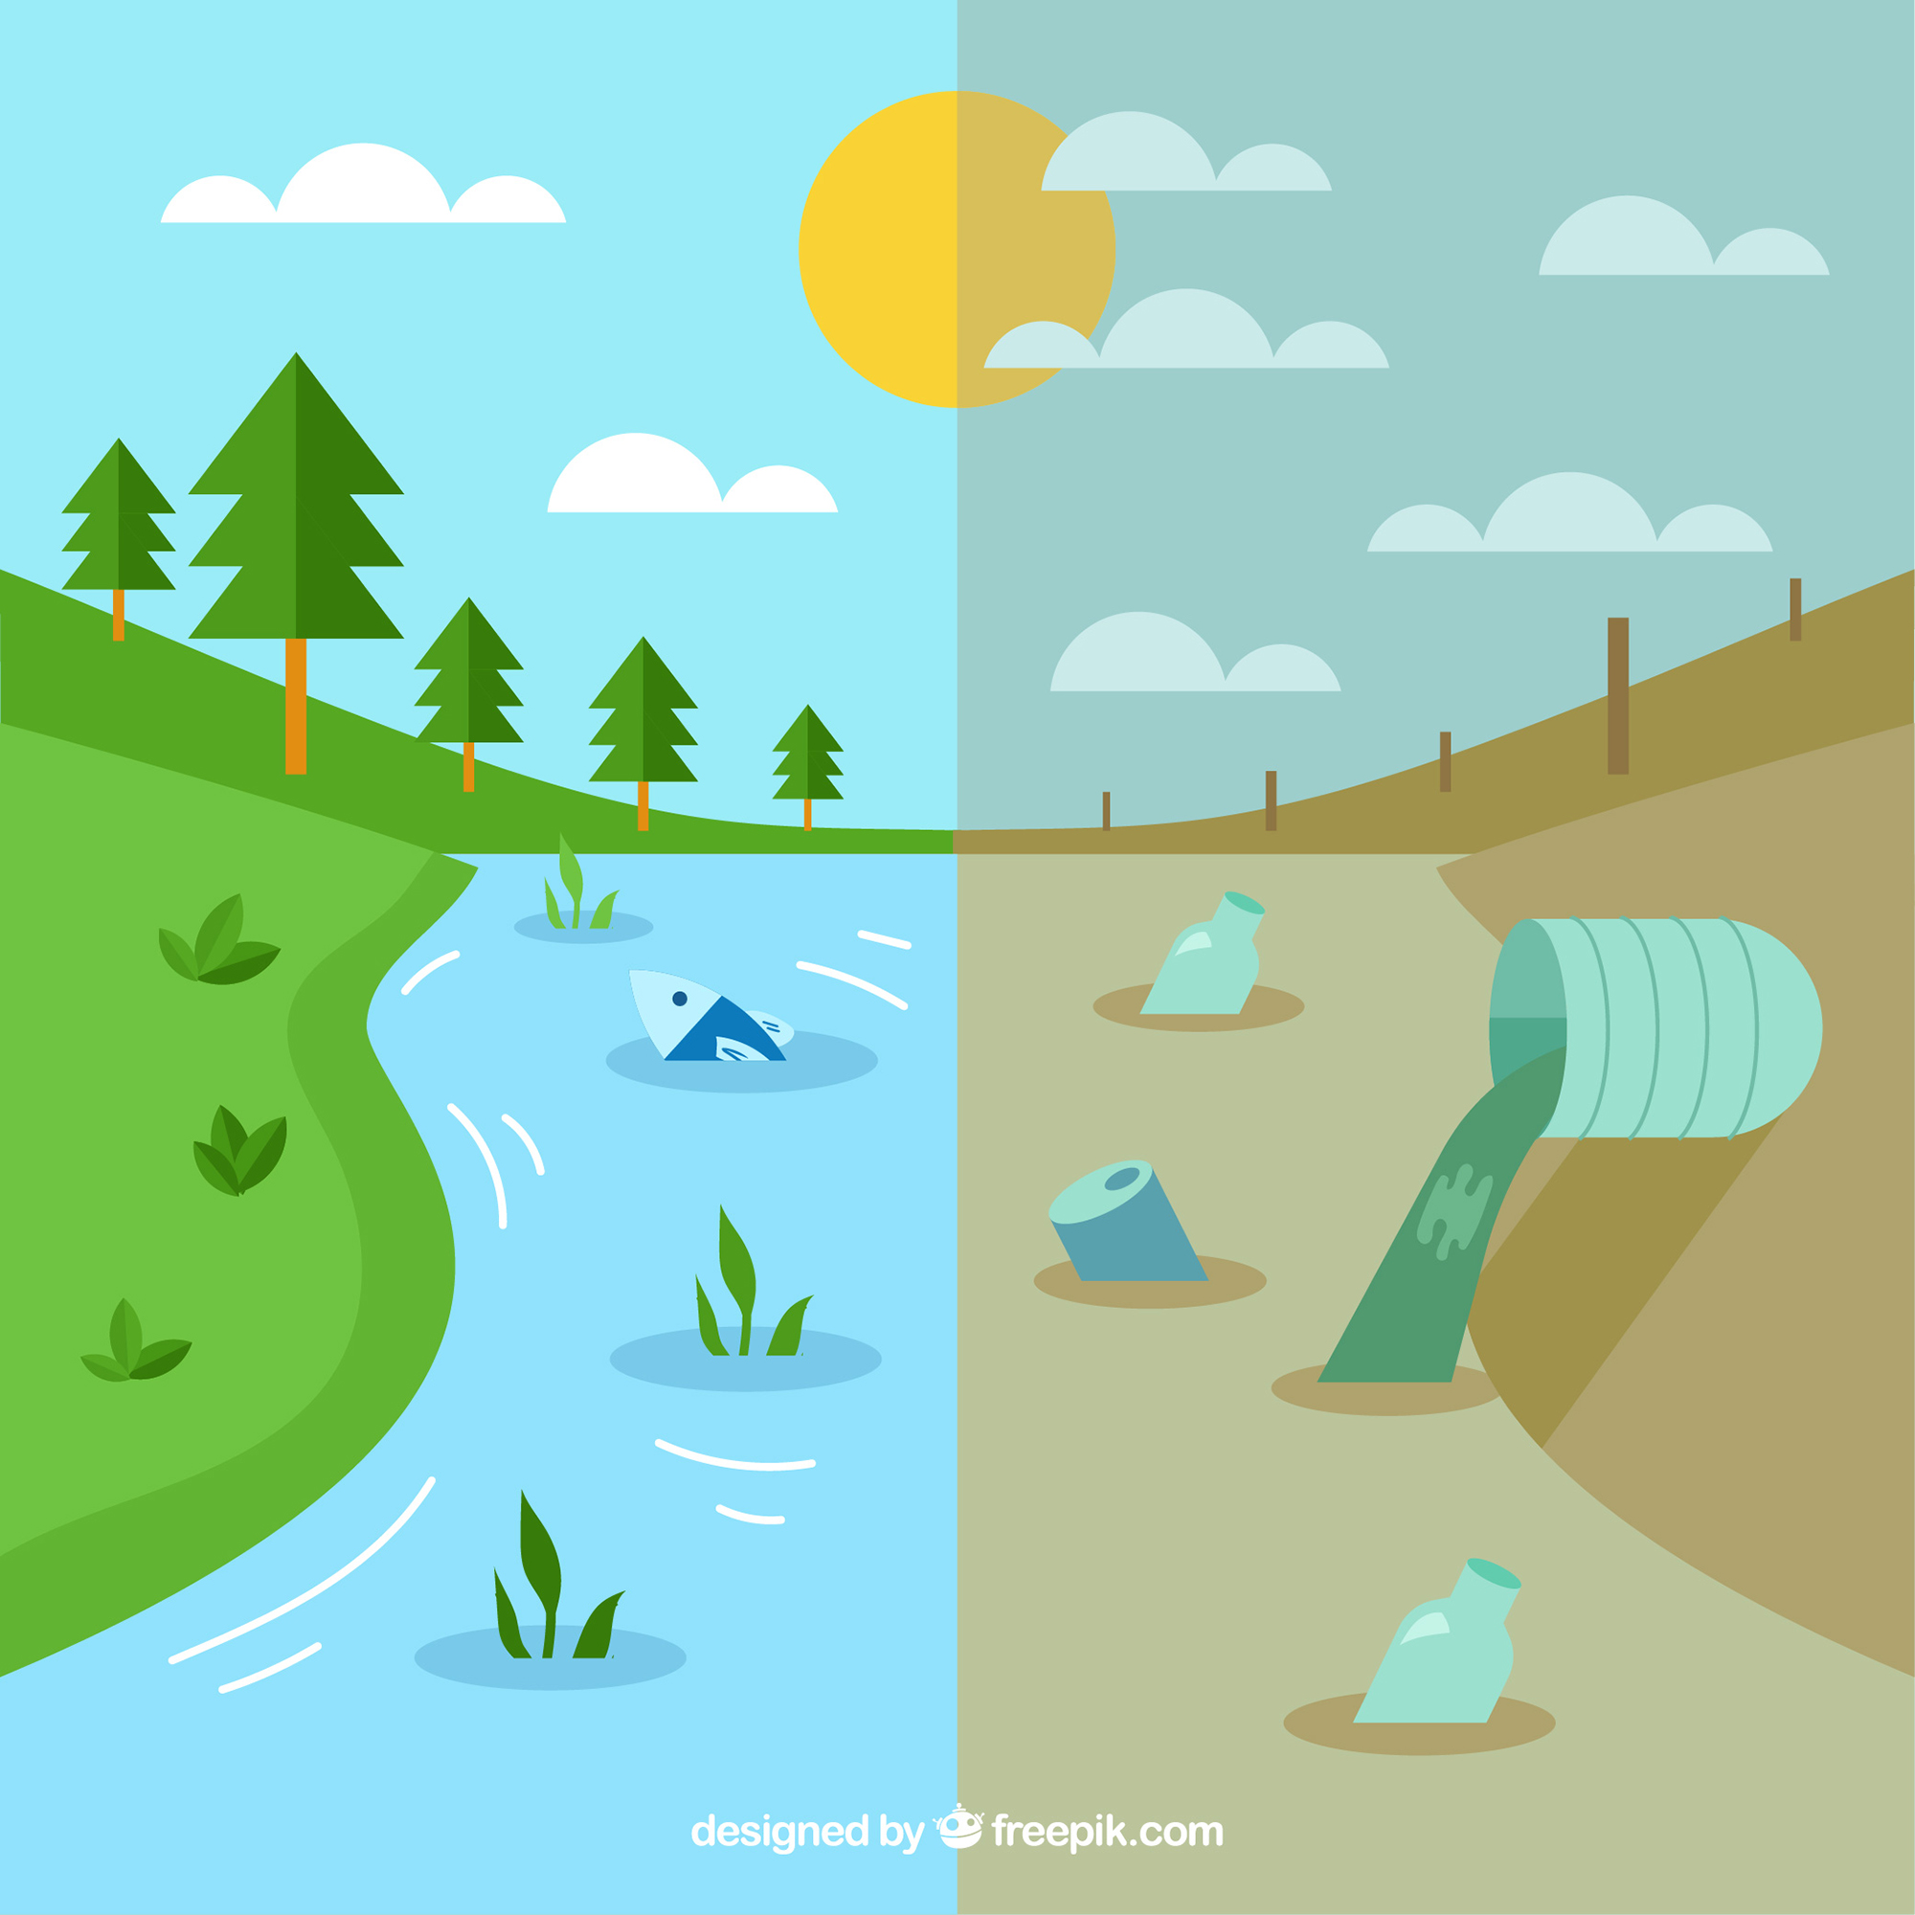
Environmental impacts of drainage
Wastewater contains pollutants that must be treated before discharge.
Rainwater runoff carries debris, oils, and chemicals.
Combined systems risk untreated discharge during heavy storms. Correct system design protects rivers, lakes, and ecosystems.

Slide 22
Knowledge check 1
What is the usual diameter of domestic foul drains?
What is the minimum trap seal depth?
Why must pipes be laid to correct gradient?
What is a combined drainage system?
Which Building Regulation covers drainage?

Slide 23
Knowledge check 1 – answers
100–110mm.
75mm.
To maintain flow and avoid blockages.
Single pipe carrying foul and surface water together.
Part H.

Slide 24
Tutor discussion & demo
Rainwater is relatively clean but may contain debris. Appliance water includes detergents, grease, and sewage.
Students to discuss the environmental impact if both enter rivers untreated.
Tutor to show correct method for connecting rainwater pipes to a combined drain.
Highlights inspection points and correct junction fittings.

Slide 25
Falls and gradients – recap
Too shallow = blockages.
Too steep = solids left behind.
Consistency is key.
Must be checked during installation.
Question: Why is consistency of gradient more important than maximum steepness?

Slide 26
Ventilation of drains
Prevents trap seals breaking from pressure.
Vent pipes extend 900mm above openings if within 3m.
AAVs allowed if accessible (internal and ventilated).
Ventilation stops foul gases escaping.
AAV further guidance

Slide 27
Access points
Access points required at head of drain, junctions, and bends.
Max 45m spacing in straight runs.
Rodding eyes, inspection chambers, and manholes all acceptable.
Ensures maintainability and compliance.

Slide 28
Student task – sketch exercise
Students to sketch a combined drainage system showing:
Appliances
Rainwater inlets
Inspection chambers
Depths and connections.
Notes:
Tutor to review sketches. Common errors corrected, such as missing traps or incorrect gradient.

Slide 29
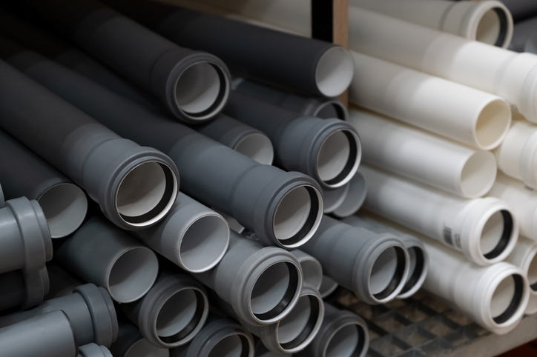
Materials used in drainage
PVC-u most common for domestic drains.
Clay used historically and for heavy-duty sites.
Concrete for large sewers.
Joints: push-fit rubber rings or solvent weld.

Slide 30
Case study – misconnected drainage
Household mistakenly connects washing machine to rainwater drain.
Consequence: untreated greywater discharges to the local stream.
Students to discuss prevention methods.

Slide 31
Protection from settlement and rodents
Flexible joints needed under buildings
Compressible seals where ground may settle
Intercepting traps and grilles stop rodent entry

Slide 32
Knowledge check 2
What gradient is required for a 100mm pipe?
Name one advantage of combined systems.
What is the main disadvantage of combined systems?
Where should access chambers be located?
Name two common drainage materials.

Slide 33
Knowledge check 2 – answers
1 in 40.
Simple, one system to build.
Risk of overloading/pollution in storms.
At junctions, changes of direction, intervals.
PVC-u, clay, concrete.

Slide 34
Testing and inspection
Section 2.59 of Part H states;
Water tightness – after laying, including any necessary concrete or other haunching or surrounding and backfilling, gravity drains and private sewers should be tested for water tightness using either an air test or a water test.
Information on test requirements is given in paragraphs 2.60 and 2.61 for pipe sizes up to 300mm.
For further information and for larger sizes see BS 8000 Part 14 or BS EN 1610.

Slide 35
Testing and inspection
Section 2.60 of Part H states;
Air test – for pipes up to 300mm diameter, the pipe should be pressurised up to a pressure of 110mm water gauge and held for approximately 5 minutes prior to testing.
Following this the pipe should be able to hold an initial 100mm pressure with a maximum loss of head on a manometer of 25mm in a period of 7 minutes.

Slide 36
Testing and inspection
Water test – For pipes up to 300mm diameter, the system should be filled with water up to a depth of 5m above the lowest invert in the test section and a minimum depth of 1m measured at the highest invert in the test section. This may then be left for a period (one hour is generally sufficient) to condition the pipe.
The test pressure should then be maintained for a period of 30 minutes, by topping up the water level as necessary so that it is within 100mm of the required level throughout the test. The losses per square metre of surface area should not exceed 0.15 litres for test lengths with only pipelines, or 0.20 litres for test lengths including pipelines and manholes, or 0.40 litres for tests with only manholes and inspection chambers alone (i.e. no pipelines).

Slide 37
Knowledge check 3
Why are drainage systems essential?
What trap depth is required?
Why must gradients be correct?
What is one risk of combined systems?
What regulation covers drainage design?

Slide 38
Knowledge check 3 – answers
To remove waste and surface water safely.
75mm.
Prevent blockages and maintain flow.
Pollution, overloading, flooding.
Part H of Building Regulations.

Slide 39
Summary
You should be able to:
Explain the need for below ground drainage systems
Identify components, pipe sizes, and gradients
Understand combined drainage system layouts
You might also be able to:
Apply Building Regulation requirements for drainage
Compare rainwater and wastewater discharges

Slide 40
Any questions?
Copyright in this document belongs to and is used under licence from the Department for Education, © 2025.
‘T-LEVELS’ and ‘T Level’ are registered trademarks of the Department for Education.
WJEC is authorised by the Department for Education to develop and deliver this T Level Technical Qualification.
WJEC operates in England under the name Eduqas which is a registered trademark of WJEC.

