Slide 1
Occupational Specialism: Plumbing & Heating Engineering
K1.7 Plumbing and heating systems
Direct cold water systems

Slide 2
Starter
Warm-up:
What do you know about direct cold water systems?
Sketch a quick comparison between a direct system and an indirect system, even if you are unsure.

Slide 3
Objectives
You should be able to:
Explain principles of direct cold water supply
Identify layouts and component positions
Recognise valves used in direct systems
You might also be able to:
Evaluate advantages and disadvantages
Sketch and label a compliant layout

Slide 4
Introduction to direct systems
Direct systems are one of the simplest arrangements for supplying potable water. Water is delivered directly from the rising main to every outlet at mains pressure.
No storage cistern is required, which saves space and reduces contamination risks.
The design is straightforward, requiring fewer components, but its reliability depends entirely on the local mains supply. They are widely used in modern housing where mains pressure is generally adequate.

Slide 5
Principles of direct supply
Outlets connected directly to mains.
No loft cistern required.
All taps/appliances supplied with potable water.
Pressure determined by water authority supply.
Must comply with Water Supply (Water Fittings) Regulations 1999.
Question: What is one immediate benefit of not having a storage cistern?

Slide 6
Sources of water
Water sources include surface water (rivers, lakes) and groundwater (aquifers).
Around 70% of UK drinking water comes from surface water.
Groundwater sources are common in the south-east and drier areas.
Rainwater plays a vital role in replenishing all water sources.
All drinking water must meet UK Water Supply (Water Quality) Regulations.

Slide 7
Sources of water
The UK benefits from a range of natural water sources, with most drinking water supplied from either rivers or underground aquifers. Water begins as rain, progressing through the natural hydrological cycle.
It collects in reservoirs or underground strata before being treated for public supply. These sources are carefully monitored and controlled to ensure water quality and adequate supply across the country.
Question: Can you name two natural sources of drinking water and describe how water from each is collected?

Slide 8
Distribution from source to property
Treated water is pumped through a national mains network.
Water mains vary in size – from large trunk mains to local service mains.
Water companies are responsible for supply to the property boundary.
A boundary stop tap allows isolation for maintenance.
Pipe materials include polyethylene (MDPE) and older lead or iron types.

Slide 9
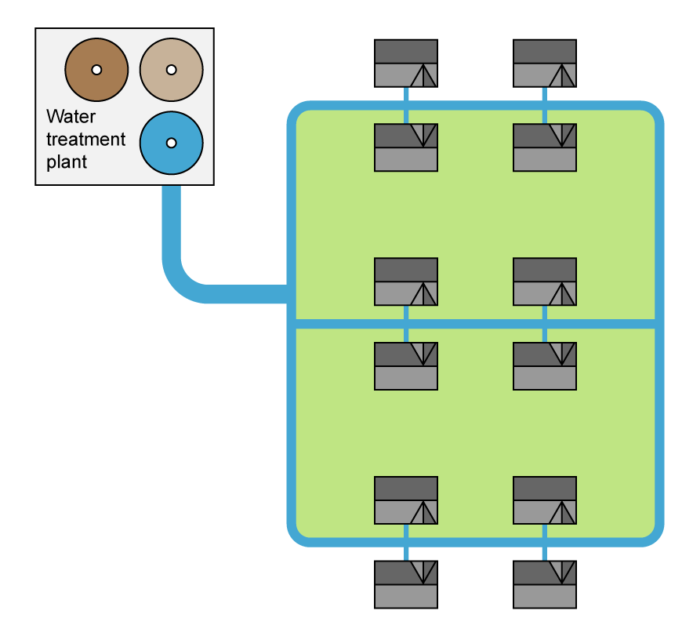
Distribution from source to property
Once water has been treated, it enters a pressurised network of trunk and distribution mains. These networks carry water across vast areas and down to local streets. The water supply company maintains the system up to the point where it reaches the customer’s property boundary.
Older systems may still contain lead or iron pipes, though these are gradually being replaced with safer modern materials such as MDPE.

Slide 10
Service pipe and internal connection
The service pipe connects the property to the public main.
It passes through the external wall into the internal stop tap.
The pipe must be buried at least 750mm deep to avoid freezing.
The internal stop tap allows the user to isolate water supply inside.
Proper installation reduces the risk of contamination and damage.

Slide 11
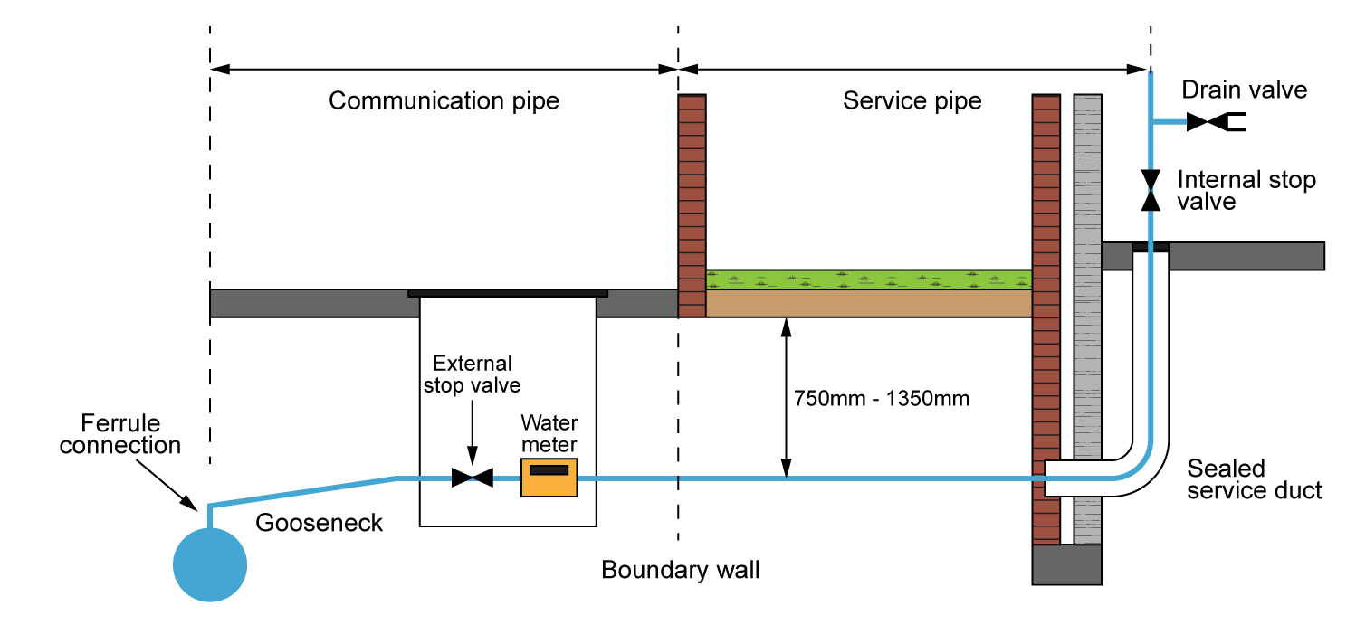

Slide 12
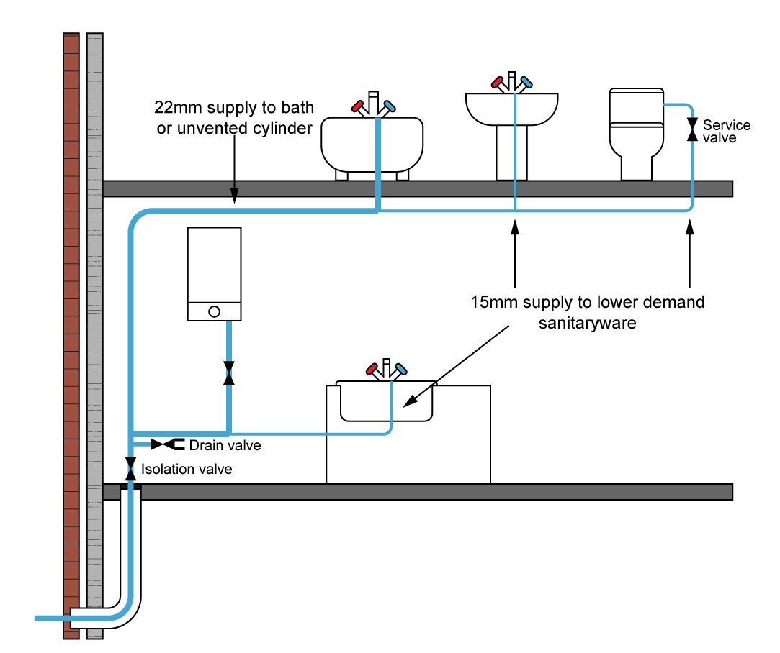
Key components – direct system
Older properties are usually fed with 15mm copper, while modern homes are often supplied with 20mm MDPE.

Slide 13
Direct system layout
Rising main enters property through stop valve.
Kitchen sink usually first outlet connected.
Branches feed WCs, baths, basins, appliances.
Service valves fitted on appliance branches.
Drain-off installed at lowest point.

Slide 14
Tutor diagram – direct system
Tutor shows a schematic layout of a direct system.
Students follow the route from rising main to appliances, noting stop valves, service valves, and drain-offs.
Discussion focuses on why branches must be short and direct to prevent stagnation.
Question: Why is it important to minimise long branches in a direct system?
Notes:
Tutor highlights compliance with WRAS-approved fittings.
Students are asked to consider how water pressure is distributed across multiple outlets.

Slide 15
Component position – stop valve
The stop valve is fitted at the point where the rising main enters the building, often in the kitchen or hallway. It allows the whole system to be isolated for emergencies, repairs, or servicing.
Regulations require that the valve is accessible, labelled, and of WRAS-approved standard.
A drain-off is fitted immediately downstream to allow the system to be emptied. Without an accessible stop valve, isolating the supply could be dangerous and time-consuming.

Slide 16
Component position – service valves
Fitted to appliance branches (WCs, washers, dishwashers).
Allow isolation of individual fittings.
Enable easy maintenance without shutting system down.
Must be WRAS-approved and accessible.
Quarter-turn spherical plug valves are common.
Question: Why is it useful to fit a service valve to each appliance branch?

Slide 17
Component position – drain-offs
Drain-offs are small fittings placed at the lowest points of a system. Their purpose is to allow the entire system to be emptied for repairs, frost protection, or maintenance.
They may be screw-down or push-fit fittings, but in all cases, they should be capped when not in use.
Regulations require them to be positioned so water can fully drain away. Without a properly sited drain-off, servicing would be far more disruptive and time-consuming.

Slide 18
Student task – types of common valves used
Students: research what each of the following valves looks like.
Stop valve
Drain valve
Service valve
Gate valve
Washing machine valve
Isolation valve
Surestop remote valve.

Slide 19
Tutor demonstration – valves
Tutor shows students a selection of valves used in direct systems, including stop valves, spherical plug valves, and non-return valves.
Students handle each fitting, identifying its purpose and correct application.
Tutor explains how Surestop valves allow quick remote isolation and why WRAS approval is essential.
Students compare the advantages of traditional and modern valve designs.
Question: What could happen if an appliance was installed without an isolation valve?

Slide 20
Water fittings regulations
Governed by Water Supply (Water Fittings) Regulations 1999.
All fittings must be of appropriate quality and WRAS-approved.
Must prevent waste, misuse, and contamination.
Non-return valves required for backflow prevention.
Local water authority enforces compliance.

Slide 21
Pipework design
Pipe sizing and routing are crucial in direct systems to ensure adequate flow and avoid stagnation. Main runs should be large enough to handle peak demand, while branch pipes can be smaller for individual fittings.
Long unused branches must be avoided, as they can create dead legs where water stagnates. Pipework should be properly clipped and supported to prevent movement and noise.
Both copper and plastic are suitable materials, provided inserts and joints are installed correctly. Good design reduces noise, ensures reliable supply, and protects water quality.

Slide 22
Student task – pipe sizing discussion
In small groups, students are given a scenario:
A two-bathroom property with a washing machine and dishwasher running during peak demand.
Consider what would happen to flow and pressure if undersized pipes were installed. Propose suitable pipe sizes and present your reasoning.
Tutor to provide access to simplified pipe sizing method and loading units from BS EN 806-3 page 6.
Question: What is one potential problem of undersized pipework in a direct system?

Slide 23
Installation requirements
Accessible stop valve fitted at mains entry.
Service valves installed on appliance branches.
Drain-offs at lowest points.
Pipework insulated in unheated areas.
System pressure tested before use.

Slide 24
Advantages of direct systems
Direct systems offer several key benefits for domestic use. Potable water is available at every outlet, so users can drink safely from any tap. They are simple to design and install, as no loft cistern is required.
Fewer fittings mean reduced installation time and cost, which benefits both clients and installers. They take up less space, particularly valuable in modern homes with small lofts.
There is also less maintenance, as no tank cleaning is needed. Overall, they provide a safe, efficient, and low-maintenance solution where mains pressure is good.

Slide 25
Disadvantages of direct systems
Despite their simplicity, direct systems also have drawbacks. They rely entirely on mains pressure, so if pressure is low, performance suffers across all outlets. A mains supply interruption means no water at all, since there is no stored reserve.
Large households with high demand may experience poor flow during simultaneous use.
Noise and water hammer are more likely because of high-pressure appliances. In some cases, booster pumps or accumulators must be added, increasing cost and complexity. These issues make them less suitable for larger or older properties.
Question: What is one reason why a direct system may not be suitable for a large property?

Slide 26
Case study – pressure problems
A family living in a semi-detached property with a direct system reported weak showers every morning. Investigation showed that mains pressure dropped during peak demand.
List some solutions to this issue.
Notes:
Solutions include installing a pumped accumulator tank or partially converting to an indirect system. This case highlights the importance of assessing local supply before choosing a system.
Engineers must consider not only the layout but also how it will perform under real-life conditions.

Slide 27
Building regulations & byelaws
Water Fittings Regs 1999 apply.
Prevents contamination and misuse.
Mandates non-return valves where risk of backflow exists.
Hot and cold water must be kept separate.
Insulation required to prevent freezing.

Slide 28
Knowledge check
What is the main source of supply in a direct system?
Why is a drain-off required?
Name one advantage of direct supply.
Name one disadvantage of direct supply.
Which regulation governs fittings and contamination prevention?

Slide 29
Knowledge check – answers
The rising main.
To empty the system for maintenance/repair.
Potable water at all outlets.
Dependent on mains pressure.
Water Supply (Water Fittings) Regulations 1999.

Slide 30
Regulation reference
Using suitable classroom literature or online resources, look up specific installation requirements within Water Supply (Water Fittings) Regulations 1999 or the Water Regulations Guide.
Students are shown how to identify clauses related to valves, drain-offs, and contamination prevention.
Question: Why is WRAS approval important when selecting fittings?

Slide 31
Environmental considerations
Reduced contamination risk compared to cisterns.
Reliance on pressurised mains increases vulnerability.
Booster systems consume additional energy.
Insulation prevents waste from burst pipes.
Water efficiency remains essential.

Slide 32
Pipe materials
Copper: durable, traditional, easy to solder.
Plastic: lightweight, easier to install, requires inserts.
Both must be WRAS-approved.
Pipe clips needed at specified spacing.
Insulation required in exposed areas.
Question: What is one common mistake when installing plastic pipework?

Slide 33
Noise and water hammer
Direct systems offer several key benefits for domestic use. Potable water is available at every outlet, so users can drink safely from any tap. They are simple to design and install, as no loft cistern is required.
Fewer fittings mean reduced installation time and cost, which benefits both clients and installers. They take up less space, particularly valuable in modern homes with small lofts.
There is also less maintenance, as no tank cleaning is needed. Overall, they provide a safe, efficient, and low-maintenance solution where mains pressure is good.

Slide 34
Tutor discussion – water authority role
Enforces Water Fittings Regulations.
Can inspect installations for compliance.
Issues rectification notices if systems fail.
Can refuse connection to mains if unsafe.
Protects public mains and users.

Slide 35
Safety & hygiene
Direct systems must prevent contamination and maintain wholesome water quality. Non-return valves stop backflow into the mains, protecting public health. Appliance hoses must have built-in backflow protection.
Cross-connections with non-potable water are strictly prohibited. Regulations make these requirements legally enforceable.
Failure to comply can result in penalties or forced corrective action.

Slide 36
Identify risks
What is the risk associated with the following installation issues?
Long dead legs
Lack of insulation
Missing service valves
Non-approved fittings
Incorrectly fitted non-return valves.

Slide 37
Pressure testing
Before commissioning, direct systems must be pressure tested to check for leaks. This involves filling the system and monitoring for drops in pressure.
Engineers must confirm that all joints and fittings are watertight and that valves operate correctly. Test results should be recorded in line with best practice.
This ensures the system is safe, compliant, and ready for use. Pressure testing also helps avoid costly call-backs due to undetected leaks.

Slide 38
Knowledge check 2
What component isolates the whole system?
What must every appliance branch include?
Why is WRAS approval important?
How can noise in direct systems be reduced?
Who enforces Water Regulations?

Slide 39
Knowledge check 2 – answers
Stop valve.
Service (isolation) valve.
Ensures compliance and safety.
Shock arrestors, correct pipe clipping.
Local water authority.

Slide 40
Student sketch task – detailed
Draw the incoming main and stop valve.
Include service valves on appliance branches.
Show drain-offs at low points.
Label outlets (kitchen, bathroom, appliances).
Compare with peers and correct mistakes.

Slide 41
Control of dead legs
Avoid long unused pipe runs.
Design short branches to outlets.
Flush outlets regularly if not in use.
Regulations prohibit excessive dead legs.
Prevents hygiene issues and stagnant water.
Question: What is one regulation-compliant method to control dead legs?

Slide 42
Student discussion – advantages vs disadvantages
Students form groups and make two lists: benefits and drawbacks of direct systems.
Each group then shares one advantage and one disadvantage with the class.
Tutor consolidates findings on the board, highlighting issues of water quality, reliability, and pressure.

Slide 43
Health & safety
Water Supply (Water Fittings) Regulations 1999.
Building Regulations Part G – Sanitation, Hot Water Safety and Water Efficiency.
WRAS approval for fittings and materials.
BS EN standards for installation.

Slide 44
Summary
You should be able to:
Explain principles of direct cold water supply
Identify layouts and component positions
Recognise valves used in direct systems
You might also be able to:
Evaluate advantages and disadvantages
Sketch and label a compliant layout

Slide 45
Any questions?
Copyright in this document belongs to and is used under licence from the Department for Education, © 2025.
‘T-LEVELS’ and ‘T Level’ are registered trademarks of the Department for Education.
WJEC is authorised by the Department for Education to develop and deliver this T Level Technical Qualification.
WJEC operates in England under the name Eduqas which is a registered trademark of WJEC.

