Slide 1
Occupational Specialism: Plumbing & Heating Engineering
K1.7 Plumbing and heating systems
Backflow prevention (non-mechanical)

Slide 2
Starter
Warm-up:
Why is backflow prevention essential in protecting public health in water systems?

Slide 3
Objectives
You should be able to:
Define backflow, back siphonage, and back pressure
Identify non-mechanical methods of preventing backflow
You might also be able to:
Understand the role of fluid categories in determining protection
Apply UK regulations to non-mechanical backflow prevention

Slide 4
What is backflow?
Backflow is the unwanted reversal of water flow within a plumbing system, which can cause contamination of drinking water. It occurs when water or other fluids flow backwards into the potable water supply.
This can happen due to either back siphonage or back pressure. The consequences of backflow can range from minor contamination to serious public health risks.
Preventing backflow is a key requirement under the Water Supply (Water Fittings) Regulations 1999.

Slide 5
Causes of backflow
Back siphonage – negative pressure in the supply.
Back pressure – downstream pressure exceeds mains pressure.
Burst mains causing suction.
Pumped systems creating pressure surges.
Cross-connections between potable and non-potable supplies.

Slide 6
Air gap definitions
Air gap – vertical distance between water outlet and spillover level.
Type A – standard gap for domestic fittings.
Type AA, AB – larger gaps for higher fluid risk categories.
Measured vertically from outlet to spillover level.
Must comply with BS EN 13076 and Water Regulations.

Slide 7
Fluid category risk levels
The Water Regulations define fluid categories from 1 to 5, with 1 being wholesome water and 5 being the highest risk, such as water containing faecal matter or dangerous chemicals.
The higher the fluid category, the greater the protection required.
Non-mechanical solutions such as larger air gaps are essential for high-category risks. Installers must always identify the fluid category before selecting a backflow prevention method.

Slide 8
AA air gap
The AA air gap is one of the most common non-mechanical backflow prevention methods. It is simply the unobstructed vertical distance between the lowest point of discharge and the spillover level of the receiving vessel.
AA air gaps are widely used in domestic and agricultural settings, such as in animal drinking troughs.
They are effective against back siphonage and can protect up to fluid category 5 risks when correctly installed.

Slide 9
AA air gap applications
Agricultural use – animal troughs.
Domestic cisterns and tanks.
General-purpose installations requiring reliable protection.
Prevents contamination from open vessels.
Simple and durable design.
Question: Why is an AA air gap suitable for agricultural use?

Slide 10
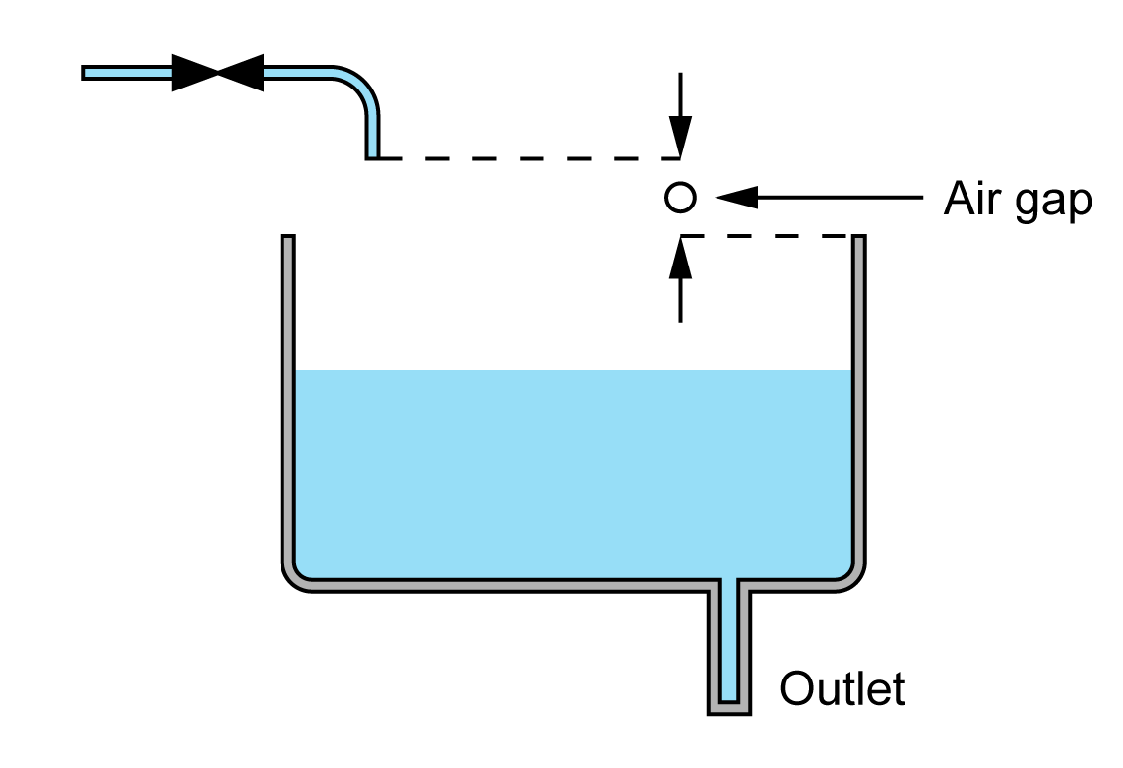
AA air gap

Slide 11
AB air gap
The AB air gap is designed for high-risk fluid category 5 situations. It features a weir overflow arrangement, making it highly resistant to contamination from vermin, insects, and dust.
A typical application is in dental surgeries, where high-quality water is required.
The AB air gap ensures that even in challenging environments, back siphonage cannot compromise the water supply.

Slide 12
AB air gap applications
Dental surgeries
Healthcare facilities
High-risk laboratories
Systems requiring maximum protection
Protects against fluid category 5.

Slide 13
AD air gap with injector
This design, also known as a “jump jet”, uses a horizontal injector to discharge water into a receiving vessel. The design provides a minimum 20mm air gap or twice the inlet diameter, whichever is greater.
This arrangement offers non-mechanical protection up to fluid category 5.
It is commonly found in commercial dishwashers and washing machines where contaminated water must never re-enter the potable supply.

Slide 14
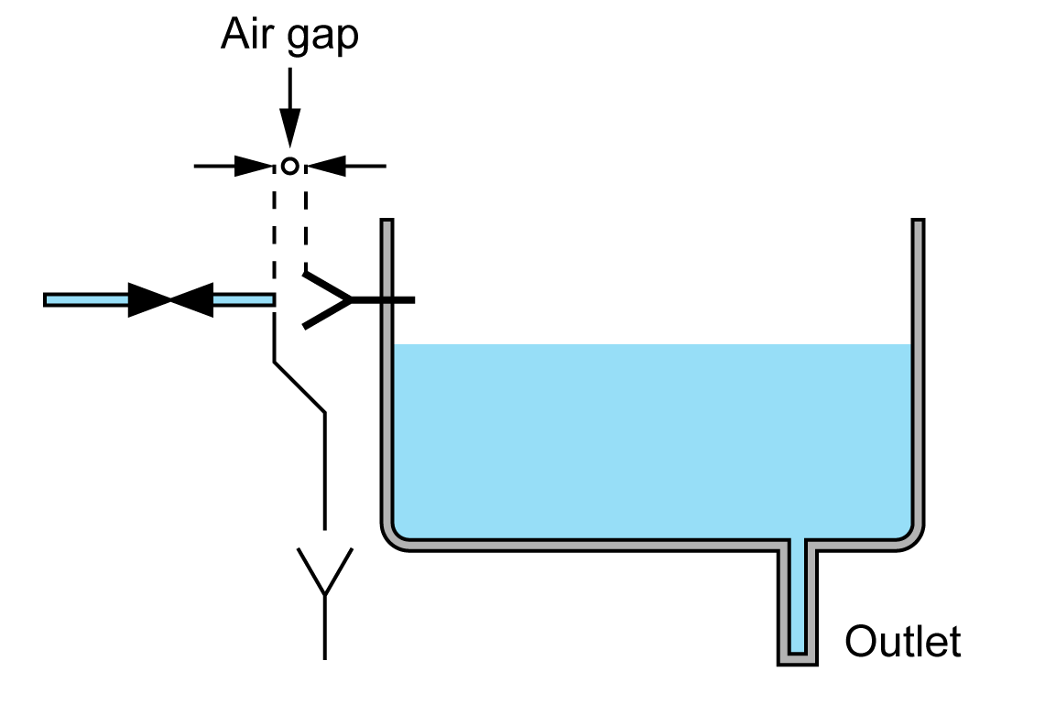
AD air gap with injector

Slide 15
AG air gap
Open to atmosphere within a cistern.
Distance between outlet and critical water level must meet regulatory table.
Protects against back siphonage.
Requires correct cistern sizing and design.
Widely used in storage tank applications.
Question: Why must AG air gaps meet minimum dimension requirements from the air gap table?

Slide 16
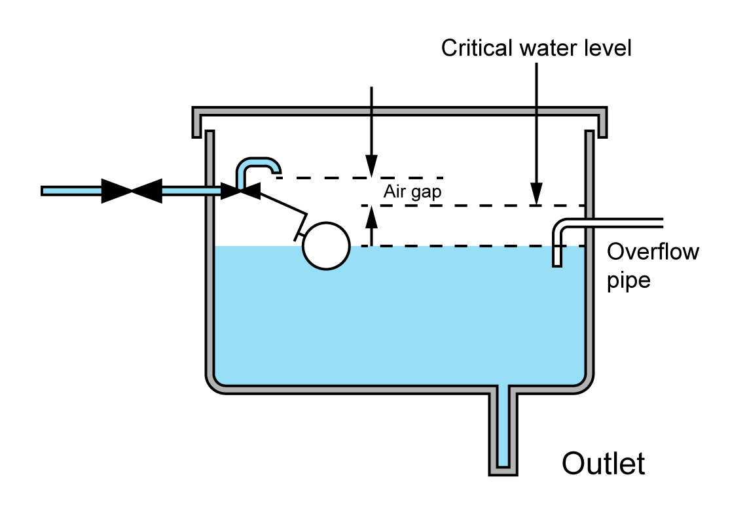
AG air gap

Slide 17
AUK1 example
A typical close-coupled WC incorporates an AUK1 air gap. The cistern holds wholesome water (category 1) while the pan holds foul water (category 5).
The design ensures no possibility of cross-contamination, as the discharge point of the cistern is safely above the spillover level of the WC pan.
This makes AUK1 a standard and essential part of sanitary installations in the UK.

Slide 18
AUK1 air gap with interposed cistern
Combines a cistern with AG overflow and air gap.
Spillover level of receiving vessel ≥ 300mm below overflow pipe.
Often used in WCs where cistern contains fluid category 1 and pan contains category 5.
Provides safe separation between cistern and WC pan water.
Must be installed to exact dimensions for compliance.

Slide 19
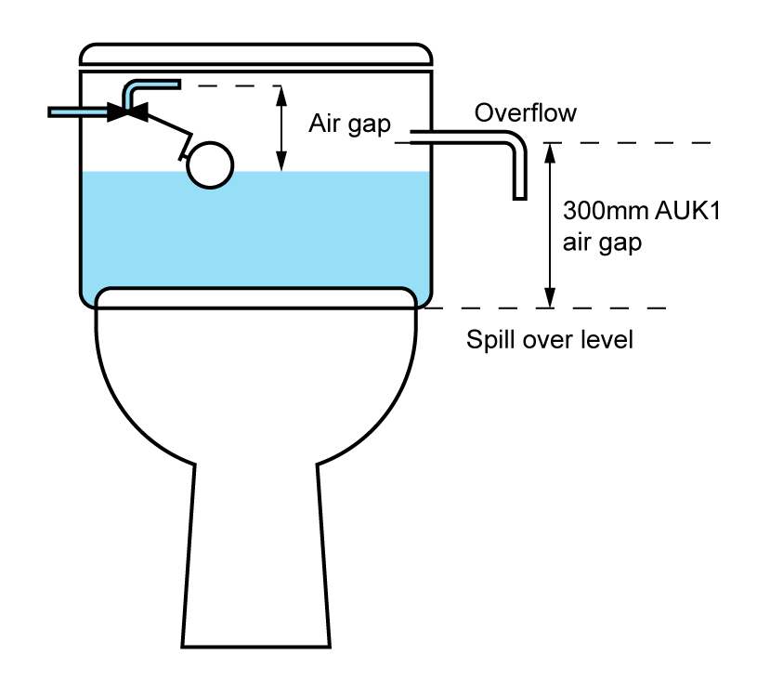
AUK1 air gap with interposed cistern

Slide 20
AUK2 air gap
Used in taps and combination fittings.
Protects against fluid categories 2 and 3.
Outlet must discharge above spillover level of appliance.
Found in over-rim bidets and sanitary fittings.
Regulated by UK air gap standards.

Slide 21
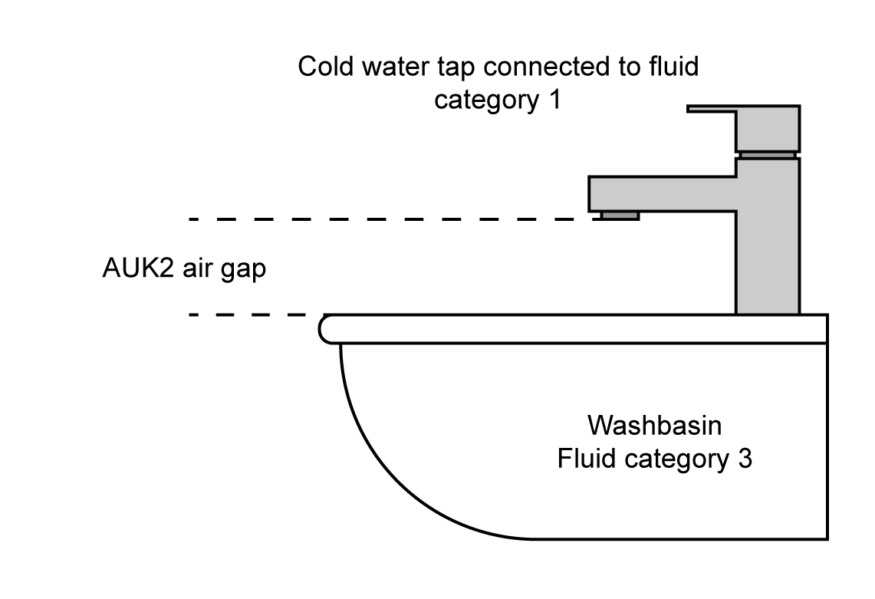
AUK2 air gap

Slide 22
AUK3 air gap
AUK3 air gaps are typically found in kitchen and utility sinks, often in the form of monobloc mixer taps, high-necked pillar taps, or correctly positioned outlets over Belfast or London sinks.
The raised outlet provides sufficient air gap to prevent back siphonage.
AUK3 gaps are important in commercial cleaning and catering environments where high-risk contamination could otherwise occur.

Slide 23
AUK3 applications
Kitchen sinks
Cleaner’s sinks
Belfast and London sinks
Monobloc or high-neck taps
Commercial catering environments.

Slide 24
Spillover level
The point at which water would overflow from a fitting or vessel.
Used to determine air gap measurement.
Critical in ensuring effective separation.
Incorrect measurement can invalidate compliance.
Must be physically unobstructed by fittings.

Slide 25
Whole site vs zoned protection
Whole site protection: one device or air gap at entry point.
Zoned protection: separate measures for different areas or equipment.
Fluid category may vary across a site.
Zoning avoids over-protecting low-risk areas.
Both approaches must comply with regulations.

Slide 26
Regulations
The Water Supply (Water Fittings) Regulations 1999 require adequate protection against backflow for all plumbing systems. Non-mechanical methods are preferred where practical, especially for high-risk fluids.
The regulations reference BS EN standards for air gap dimensions and installation practices.
Failure to comply can result in enforcement action by the local water authority.

Slide 27
Brief context – mechanical devices
Include check valves, double check valves, RPZ valves.
Used where non-mechanical options aren’t practical.
Require regular testing and maintenance.
Not the focus of this session – our priority is non-mechanical solutions.
Question: Why are non-mechanical solutions generally preferred over mechanical devices?

Slide 28
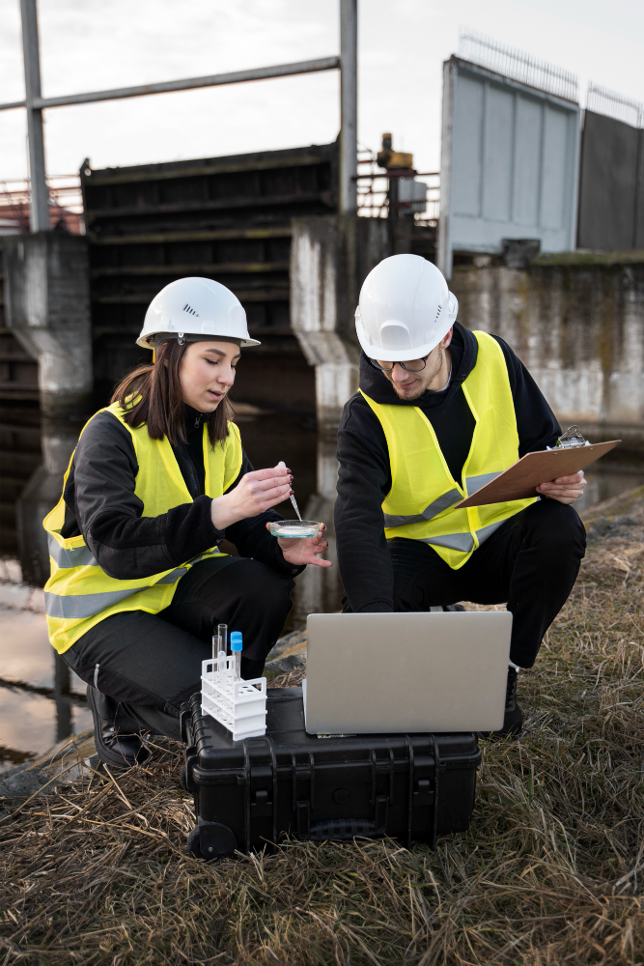
Site survey for backflow risk
Before installing backflow prevention, a survey should identify potential cross-connections, fluid categories, and system pressures.
The installer should assess each outlet’s intended use to determine the appropriate protection method.
Documentation of findings supports compliance and can be referenced in future maintenance.

Slide 29
Correct air gap installation
While many appliances and components are designed in such a way that breaching of an air gap is almost impossible, some appliances such as CWSC will need to be assembled and the location of the float valve is determined by the installer. The main installation points are:
Measure from outlet to spillover level.
Ensure no attachments or hoses bypass the gap.
Maintain unobstructed vertical clearance.
Secure fittings to prevent repositioning.
Inspect regularly to ensure continued compliance.

Slide 30
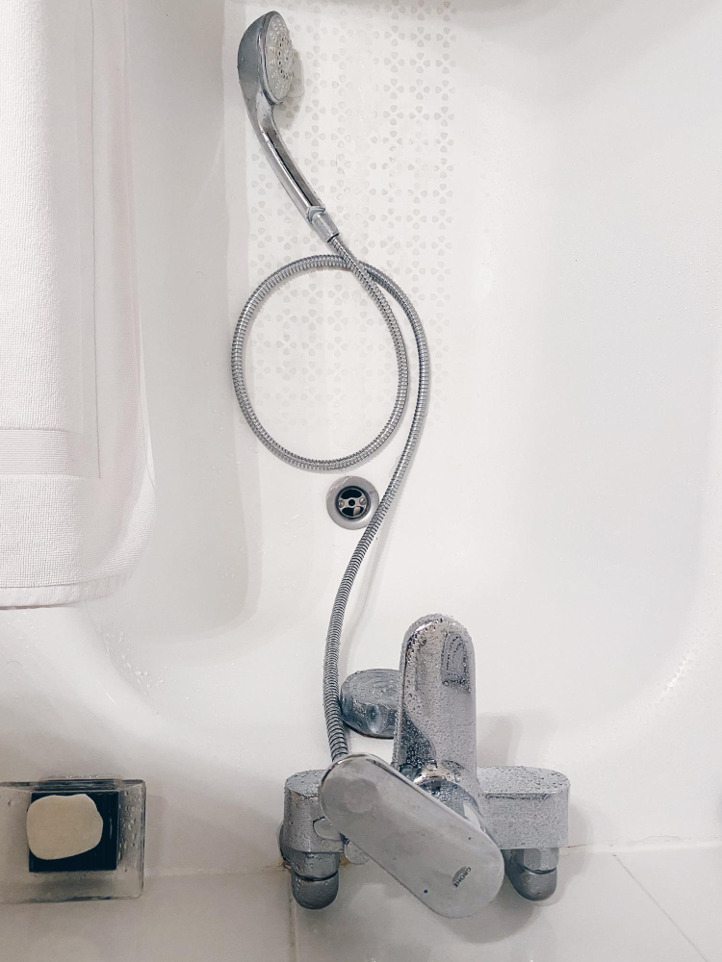
Installation errors to avoid
Common errors include fitting tap outlets too close to the water surface, using hoses without approved backflow prevention, and ignoring overflow levels. Flexible hoses submerged in basins or tanks can easily create a cross-connection.
Another error is modifying fixtures after installation in ways that reduce the air gap. All work must be signed off by a competent installer familiar with the regulations.

Slide 31
Midpoint knowledge check
Define backflow in your own words.
Name the two main causes of backflow.
What is an air gap?
Which fluid category is the highest risk?
Why is physical separation considered the safest prevention method?

Slide 32
Midpoint knowledge check – answers
Unwanted reversal of water flow into potable supply.
Back siphonage and back pressure.
Vertical separation between outlet and spillover level.
Category 5.
No moving parts to fail, permanent protection.

Slide 33
High-risk applications
Certain applications present a higher risk of contamination and require larger air gaps. Examples include animal troughs, chemical mixing tanks, hospital equipment, and industrial cleaning stations.
In these situations, fluid category is usually 4 or 5, meaning maximum protection is needed.
Non-mechanical solutions are especially important here because mechanical devices may be vulnerable to chemical attack or biological fouling.

Slide 34
Commercial systems
Commercial premises such as catering kitchens, laboratories, and abattoirs often have multiple high-risk outlets. These may require Type AA or AB air gaps, or dedicated break tanks.
The system must be designed to keep potable and non-potable supplies separate at all times.
Site zoning is common to ensure high-risk areas receive maximum protection while low-risk areas remain compliant without excessive cost.

Slide 35
Break tanks
Provide physical separation between mains and process water.
Incorporate air gap at inlet.
Often used in commercial and industrial systems.
Sized for demand to avoid stagnation.
Require regular cleaning and inspection.

Slide 36
Inspection and maintenance
Although non-mechanical devices require little ongoing maintenance, periodic inspection is still necessary. Air gaps should be visually checked for obstructions, changes in outlet height, or attached hoses that could bypass protection.
Spillover levels must remain clear and unobstructed.
Break tanks should be cleaned at intervals recommended by the manufacturer to prevent sediment or bacterial growth.

Slide 37
Common non-compliance issues
Flexible hoses left submerged in sinks.
Tap spouts extended below spillover level.
Overflow pipes without screening.
Break tank lids missing or damaged.
Outlets fitted with attachments that bypass air gap.
Question: Why is a submerged hose a serious backflow risk?

Slide 38

Record keeping
Backflow prevention devices, including non-mechanical ones, should be documented in system drawings and maintenance logs. This includes location, type, fluid category served, and installation date.
Accurate records assist with inspections, help trace faults, and prove compliance to water authorities.

Slide 39
Role of the water authority
Inspect and enforce compliance with regulations.
Approve high-risk installations.
Issue notices for non-compliance.
Provide technical guidance on backflow prevention.
Maintain public safety by protecting the mains supply.
Question: What might happen if a water authority finds a high-risk outlet without proper backflow prevention?

Slide 40
Final knowledge check
What is the preferred non-mechanical backflow prevention method?
How is an air gap measured?
Give an example of a category 5 application.
Why are non-mechanical solutions often used in high-risk situations?
What is the role of a break tank?

Slide 41
Final knowledge check – answers
Air gap.
From outlet to spillover level.
Animal trough, chemical mixing tank, hospital sluice.
They have no moving parts and provide permanent protection.
To provide physical separation between mains and process water.

Slide 42
Summary
You should now be able to:
Explain backflow, back siphonage, and back pressure
Identify and install non-mechanical prevention methods
Apply correct fluid category protection levels
You might also be able to:
Survey a site for backflow risks
Recommend upgrades for non-compliant systems
Advise clients on ongoing compliance and inspections

Slide 43
Any questions?
Copyright in this document belongs to and is used under licence from the Department for Education, © 2025.
‘T-LEVELS’ and ‘T Level’ are registered trademarks of the Department for Education.
WJEC is authorised by the Department for Education to develop and deliver this T Level Technical Qualification.
WJEC operates in England under the name Eduqas which is a registered trademark of WJEC.

