Slide 1
Occupational Specialism: Plumbing & Heating Engineering
K1.25 Pipework, Fittings and Fixings
Characteristics of different types of pipework

Slide 2
Introduction
Warm-up:
Why might a heating system installer choose plastic pipework over copper?

Slide 3
Objectives
You should be able to:
Identify types of pipework and materials used in plumbing.
Understand the properties and suitability of copper and plastic systems.
You might also be able to:
Describe differences between prefabricated, modular, and on-site installation.
Match pipe characteristics with appropriate applications.

Slide 4
Categories of pipework
Prefabricated components.
Modularised assemblies.
On-site installation and adaptation.
Materials include copper, plastic, lead and modern composites. Each has specific strengths and installation considerations.

Slide 5
Prefabricated pipework
Prefabricated pipework is assembled off-site in a controlled environment. It improves accuracy and saves time on-site. Common in large-scale installations or repeated layouts. Reduces human error and waste. Must be designed carefully to match site conditions.
Off-site fabrication allows for better quality control, as work is carried out under consistent conditions with access to specialised tools and skilled labour. It also minimises disruption and labour requirements on busy or constrained construction sites.

Slide 6
Modular pipework systems
Modularised systems are delivered in sub-assembled modules. These can include pipe runs, valves, and insulation. They simplify site installation and allow parallel working. Modular design is especially useful in commercial and plant room installations. By assembling key components off-site, project timelines can be shortened, and on-site labour requirements reduced.
Modules are often built to standard specifications, ensuring consistency and simplifying future maintenance or upgrades.
Question: What might be a disadvantage of using prefabricated systems on a complex site?

Slide 7
On-site pipework installation
Traditional approach.
Components measured and cut on site.
Allows flexibility to site conditions.
Slower than modular systems.
Requires skilled labour and accurate planning.

Slide 8
Copper grades – overview
Copper tube for plumbing is categorised by mechanical properties:
R220: Soft (annealed) coils
R250: Half-hard, straight lengths
R290: Hard drawn (tempered) copper
Each type is suited to different bending and installation techniques.

Slide 9
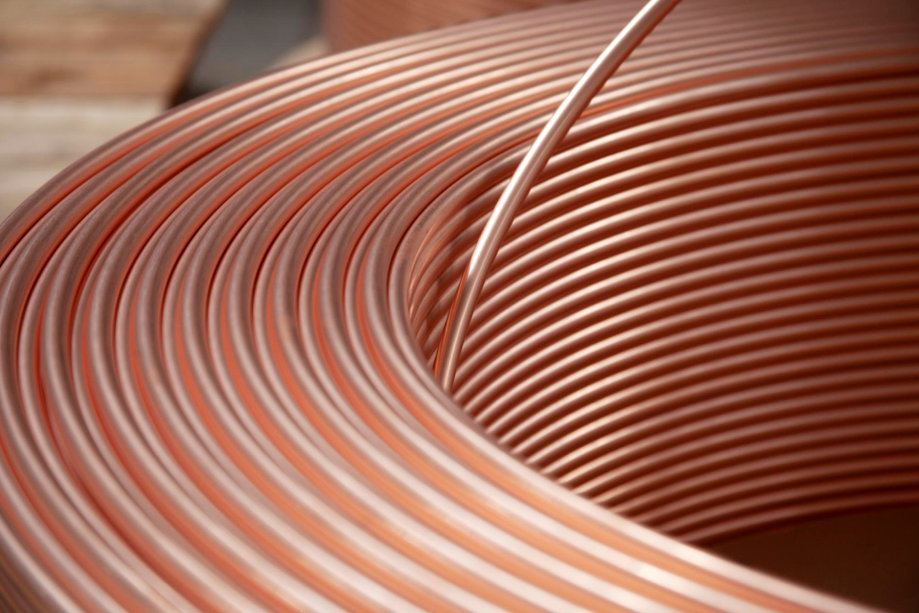
R220 – soft copper coils
Flexible and can be bent manually.
Ideal for awkward routes.
Commonly supplied as 6mm, 8mm & 10mm.
Used for central heating and tight spaces.
Supplied in 10m, 25m or 50m rolls.
Requires pipe inserts for push-fit systems.
Question: Why might soft copper be used behind kitchen units or under floors?

Slide 10
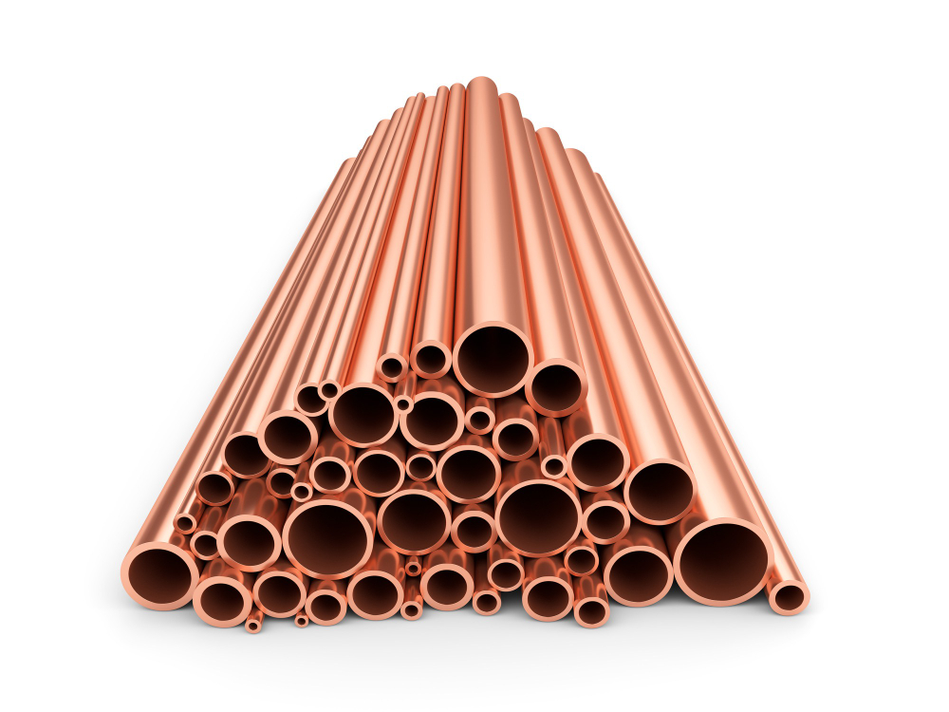
R250 – half-hard copper lengths
More rigid than R220.
Comes in straight lengths (typically 3m).
Still allows some hand bending.
Common in visible pipework installations.
Good compromise between strength and flexibility.

Slide 11
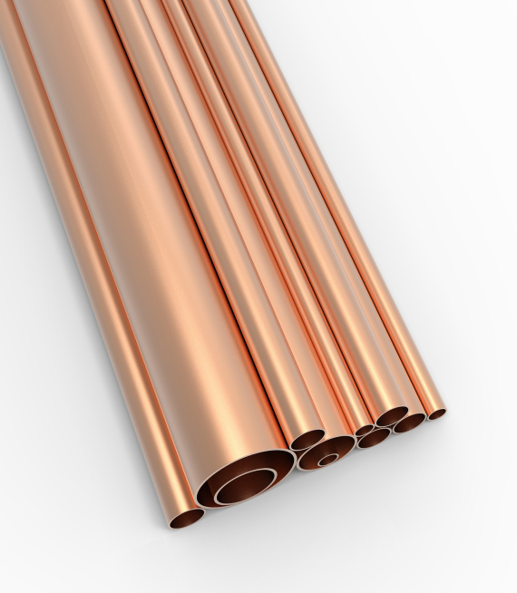
R290 – hard copper
Strongest form of copper pipe.
Cannot be bent without annealing.
Used where straight runs are common.
Suitable for press or compression fittings.
Highly durable and dimensionally stable.

Slide 12
Plastic pipework introduction
Plastic pipe is now widely used in domestic and commercial systems. It’s lightweight, flexible, and often easier to install than copper. Different plastic types suit different water systems and pressures. Most use push-fit or crimped fittings.
Common materials include MDPE, polybutylene and PEX (multi-layer polyethylene), each chosen based on temperature tolerance and application.
Plastic piping is resistant to scale and corrosion, making it ideal for long-term use in hard water areas. However, it must be installed carefully to avoid UV exposure, high temperatures, or mechanical damage that could reduce its lifespan.

Slide 13

MDPE – Medium Density Polyethylene
Used for underground water supply.
Usually blue in colour.
Durable and flexible.
Resistant to impact and chemical corrosion.
Not used inside buildings.
Question: Why is MDPE not suitable for internal pipework?

Slide 14
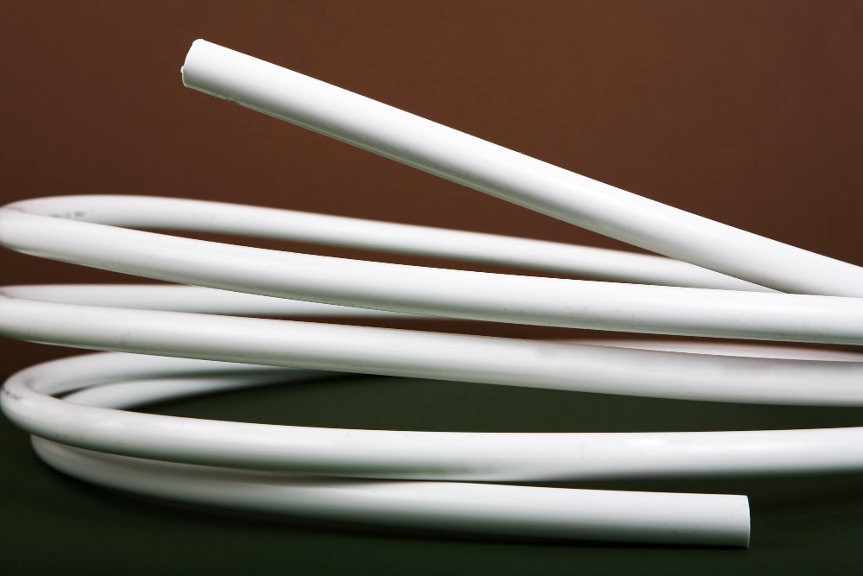
PEX – Cross-Linked Polyethylene
Flexible and suitable for hot and cold water.
Maintains shape after bending.
Resistant to scale and chlorine.
Suitable for underfloor heating.
Often used in barrier pipe form to reduce oxygen ingress.

Slide 15
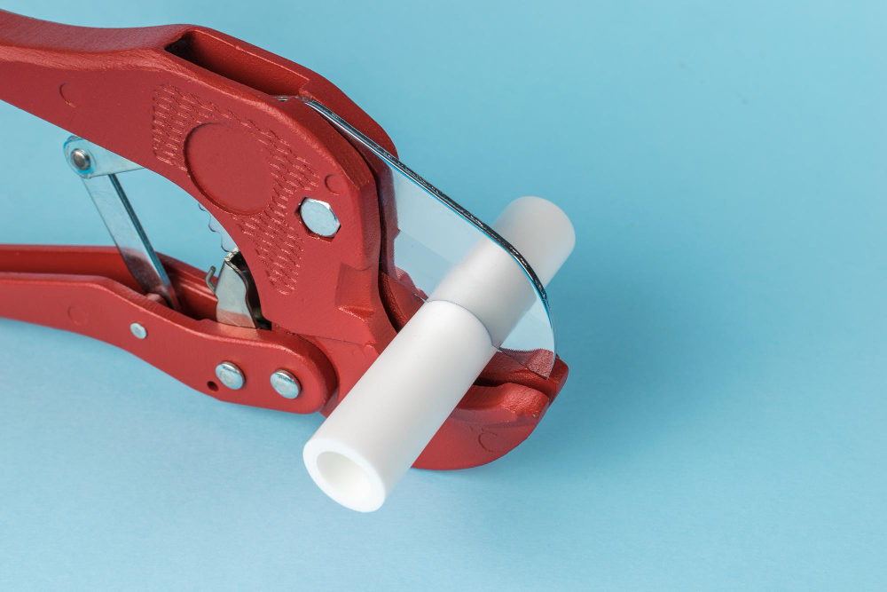
Polybutylene (PB)
Flexible, easy to install.
Used in heating and hot water systems.
Cheaper than PEX but lower temperature tolerance.
Common in push-fit systems.
Prone to long-term degradation at high temperatures.
Notes:
Image not ideal

Slide 16
PVC-u (Unplasticised PVC)
Rigid plastic used in drainage and cold water systems.
High chemical resistance.
Common in waste systems and external soil stacks.
Not suitable for hot water applications.
Suitable for solvent weld assembly.

Slide 17
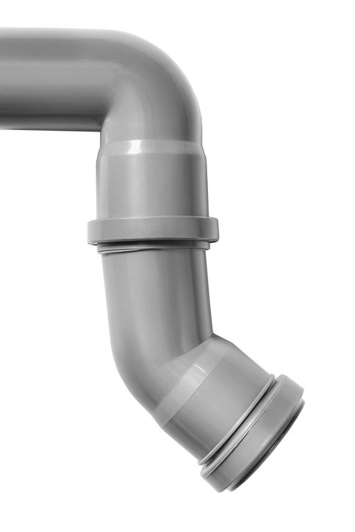
Polypropylene (PP)
Commonly used for waste systems.
Lightweight and chemically resistant.
Requires solvent welding or push-fit fittings.
Resistant to most household chemicals.
Cannot be used for hot water supply.
Not suitable for solvent weld - push-fit or compression fittings only.

Slide 18
MUPVC – Modified Unplasticised PVC
Improved version of PVC-u with better strength and impact resistance
Used in industrial and commercial settings
Suitable for pressure applications
More robust than traditional PVC-u

Slide 19
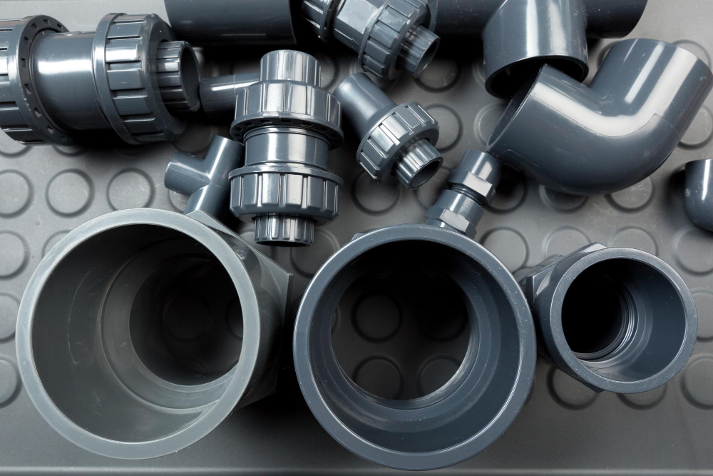
ABS – Acrylonitrile Butadiene Styrene
Used for high-strength plastic pipework.
Suitable for pressure systems.
Good for chemical resistance and temperature tolerance.
Less brittle than PVC in cold weather.
Common in swimming pool plant rooms, laboratory or industrial waste systems.

Slide 20
Legacy materials – lead
Lead was historically used in domestic water systems. It is now banned in new installations due to toxicity. Old lead systems may still be encountered. Plumbers must know how to identify and replace it. Water companies offer replacement schemes.
Lead can leach into drinking water, posing serious health risks, particularly to young children and pregnant women. Identification involves checking pipe colour, softness, and joint types, often found in properties built before the 1970s. When found, lead pipework should be fully replaced from the main supply to internal plumbing to ensure water safety.

Slide 21
Health risks from lead pipework
Lead can leach into drinking water.
Especially dangerous for children and pregnant women.
Legal limits for lead in water are strictly enforced.
Pipework must be replaced with approved materials.
Question: Why is it important to correctly identify legacy lead pipework during renovations?

Slide 22
Midpoint knowledge check
Name three types of copper pipe grades.
What colour is MDPE pipe?
Which plastic is commonly used for underfloor heating?
Why is PVC-u unsuitable for hot water?
What are the risks of lead pipework?

Slide 23
Midpoint knowledge check - answers
R220, R250, R290
Blue
PEX
It deforms at high temperatures
Lead toxicity – can leach into water

Slide 24
Installation considerations – copper
Requires tools for cutting and bending.
Soldering or press-fit joints.
Needs protection from freezing and corrosion.
Must be clipped securely to avoid expansion noise.
More labour-intensive than plastic.
Must be WRAS & Part G compliant.

Slide 25
Installation considerations – plastic
Quicker to install using push-fit or crimp joints.
Flexibility makes it suitable for retrofits.
Must use inserts to support joints.
Expansion must be accounted for.
Not suitable for direct sunlight unless UV protected.
Must be WRAS & Part G compliant.

Slide 26
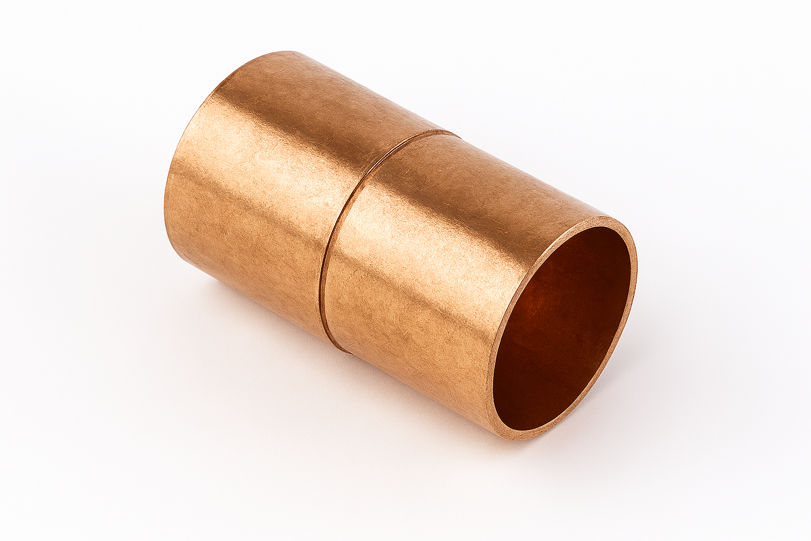
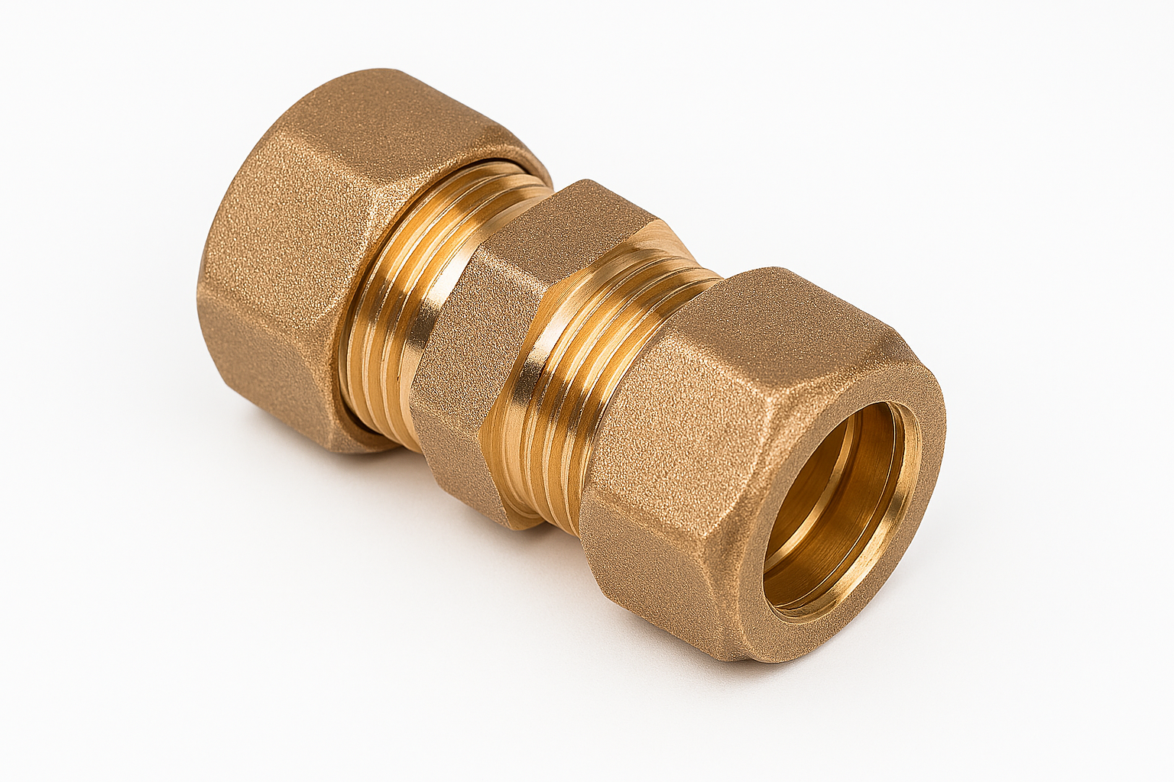
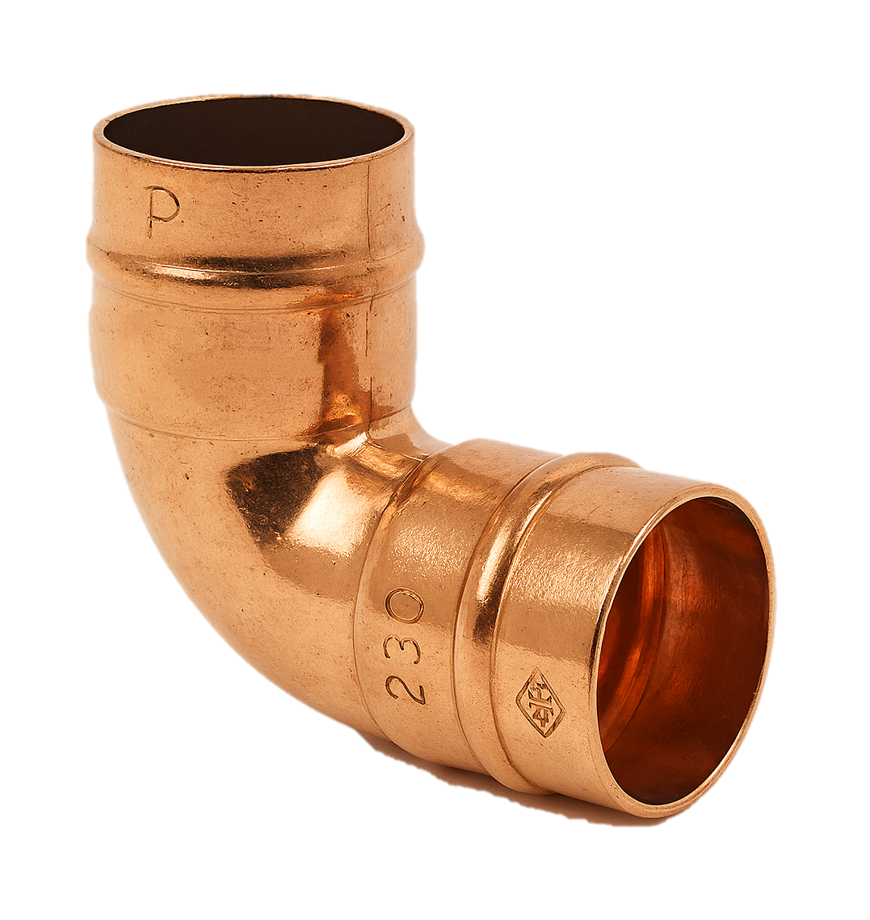
Jointing methods for copper
Capillary soldering: neat, permanent joint.
Compression fittings: easy and demountable.
Press-fit systems: no flame, faster install.
Must be clean and burr-free before jointing. Press fittings must be depth marked.
Use flux and heat evenly when soldering.

Slide 27
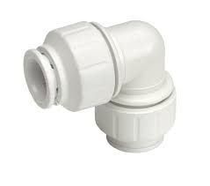
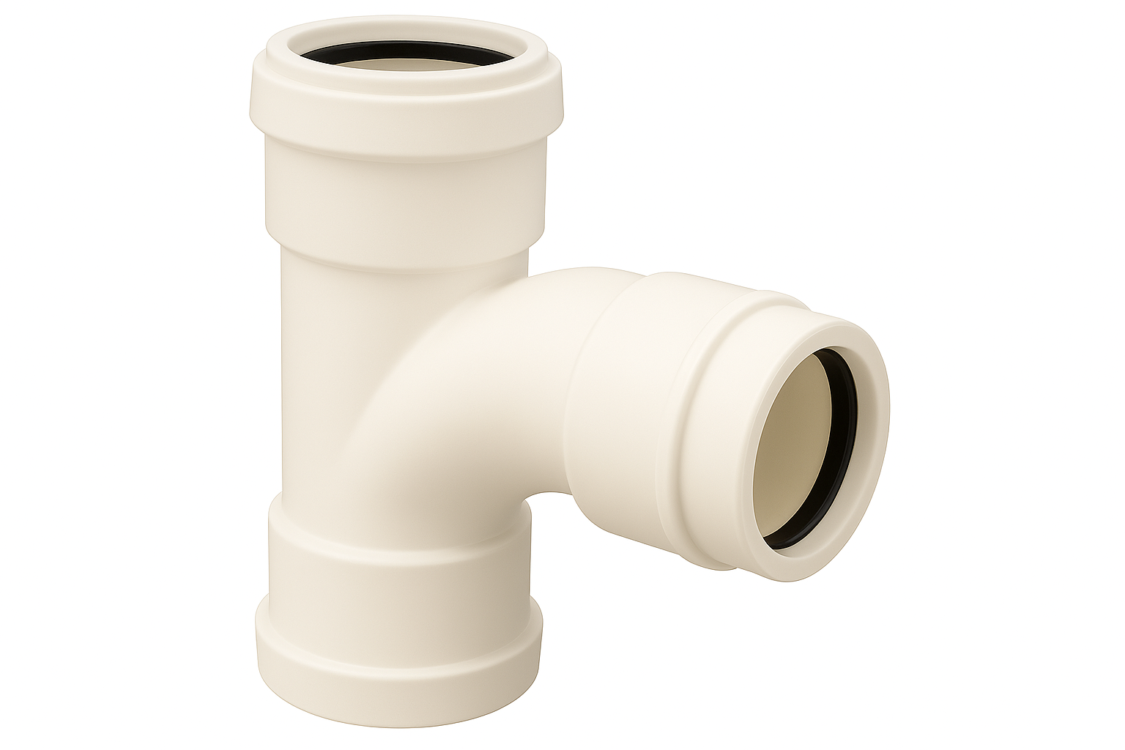
Jointing methods for plastic pressure pipe
Push-fit: simple and quick.
Crimp fittings: require specialist tools (not widely used in the UK).
Compression fittings: easy and demountable.
Solvent weld (commercial water systems such as swimming pools).
Always use inserts where required. Ensure full pipe insertion depth.
Question: Why must inserts be used in plastic pipe systems?

Slide 28
Applications – copper vs plastic
Application | Copper | Plastic
Central heating | ✔ | ✔
Potable water | ✔ | ✔
Underground | ✘ | ✔ (MDPE)
Visible pipework | ✔ | ✔ (limited)
External use | ✔ (coated) | ✘ (unless UV)

Slide 29
Flexibility in pipe routes
Plastic is easier to route around corners or through joists. Copper requires joints or bending equipment. Fewer joints reduce the risk of leaks. Plastic flexibility saves time and minimises damage to structures.
It also allows for quicker installation in tight or awkward spaces, making it ideal for retrofit work.
Plastic pipes can expand slightly under pressure or temperature changes, helping to absorb stress and reduce the risk of bursts or fractures. This adaptability makes plastic a practical choice in modern plumbing systems.

Slide 30
Thermal performance
Plastic expands more than copper with heat. Needs allowance for movement. Use expansion loops or sleeves through joists. Failure to account can lead to noise, joint stress, or distortion. Copper is more dimensionally stable.
Copper is non-combustible. Plastic pipes can burn and release fumes. Fire collars may be required on plastic in penetrations. Plastic must be shielded from heat sources. Always follow fire safety building regulations.

Slide 31
Manufacturer requirements
Always use components from same manufacturer.
Follow fitting instructions exactly.
Use approved tools for crimp or press systems.
Mixing systems can void warranty.
Check for WRAS approval for potable systems.

Slide 32
Common pipework faults
Poor jointing technique.
Incorrect pipe support.
Over-tightening compression fittings.
Using incompatible materials.
Not following temperature/pressure ratings.

Slide 33
Pipe identification on site
Colour coding (blue, red, grey, white).
Labelling and marking with tape.
Avoid confusion with electrical conduit or data cabling.
Gas, water, and heating lines must be clearly distinguished.
Follow site conventions and standards.

Slide 34
Environmental considerations
Copper is recyclable and has a long lifespan. Plastic creates more waste but can be low-impact during manufacture. Site policies may favour sustainable materials. Reduce offcuts and select durable materials.
Choosing materials with a lower environmental footprint can contribute to green building certifications and long-term cost savings. Proper planning and accurate measurements help minimise waste and promote efficient use of resources.
Sustainability in plumbing is not just about material choice, but also about responsible installation and lifecycle impact.

Slide 35
Scenario task – material selection
You are installing a heating system in a loft conversion with limited access. What pipework material would you choose and why?
Consider flexibility, joints, insulation, and fire performance.

Slide 36
Scenario task – material selection
A customer wants visible pipework in their kitchen to match a modern industrial design.
What material and fittings would be appropriate?
Think about aesthetics and longevity.

Slide 37
Summary table – plastic pipe types
Type | Use | Notes
MDPE | Underground mains | Blue, external only
PEX | Heating, potable water | Barrier form preferred
PB | Heating systems | Flexible, less durable
PVC-u | Waste, cold water | Not for hot or pressure
MUPVC | Commercial, pressure | Tougher than PVC-u
ABS | Waste, industrial | Good temp and impact

Slide 38
Summary table – copper grades
Grade | Flexibility | Use Case
R220 | High | Coils for concealed routes & microbore
R250 | Medium | Straight visible pipework
R290 | Low | Fixed installations, press fit

Slide 39
Final knowledge check
Which plastic pipe is used underground?
What are two types of jointing for copper?
Why is fire safety a concern with plastic?
Name one benefit and one limitation of R220 copper.
Why must pipes be properly supported?

Slide 40
Final knowledge check – answers
MDPE
Soldered (capillary), compression, press fit
It can burn and release toxic fumes
Benefit: flexibility; Limitation: needs support and prone to flattening/blockages
Prevent sagging, strain, and noise from movement

Slide 41
Summary
You should now be able to:
Identify pipework types and characteristics.
Compare copper and plastic systems.
Understand installation methods and safety requirements.
You might also be able to:
Select appropriate materials for complex jobs.
Justify choices based on function and regulation.

Slide 42
Any questions?
Copyright in this document belongs to and is used under licence from the Department for Education, © 2025.
‘T-LEVELS’ and ‘T Level’ are registered trademarks of the Department for Education.
WJEC is authorised by the Department for Education to develop and deliver this T Level Technical Qualification.
WJEC operates in England under the name Eduqas which is a registered trademark of WJEC.

