Slide 1
Occupational specialism: Low Carbon Engineering
PowerPoint K1.5 / K1.6: F-Gas regulations (awareness) and Manufacturer’s information

Slide 2
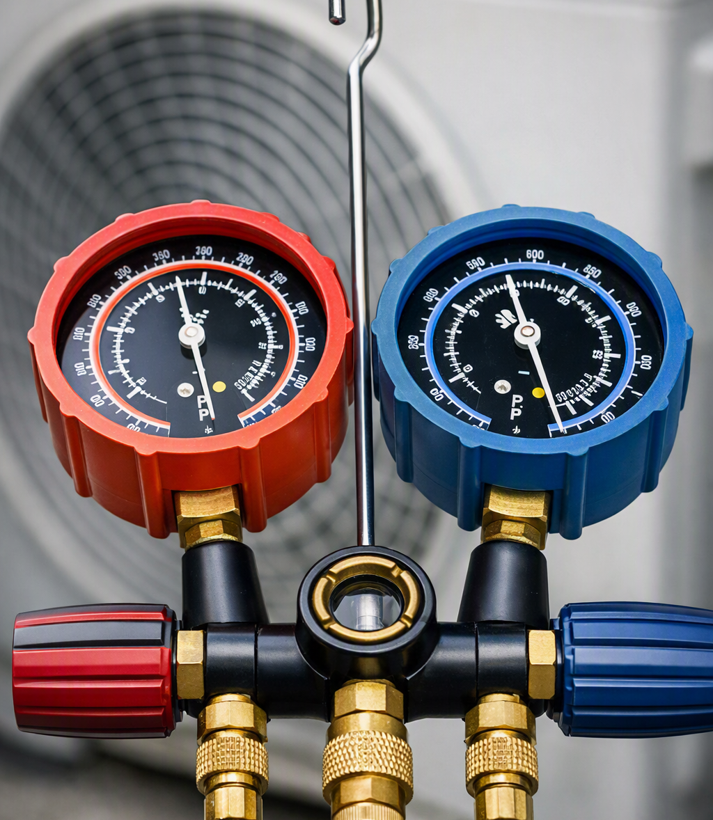
Introduction / Starter
Warm-up: Why might a 'low carbon' heating system still harm the environment if handled incorrectly?
Think, pair, share:
What do you already know about refrigerants in heat pumps?
What does 'sealed refrigerant circuit' mean in practice?
Notes:
Image suggestion (Freepik search): https://www.freepik.com/search?query=refrigerant%20warning&type=vector

Slide 3
Objectives (K1.5)
Recall what F-gases are and why they are regulated.
Explain ODS and GWP (awareness level).
Recognise hazards and practical limits of refrigerants.
Identify who needs F-Gas certification and when to refer.

Slide 4
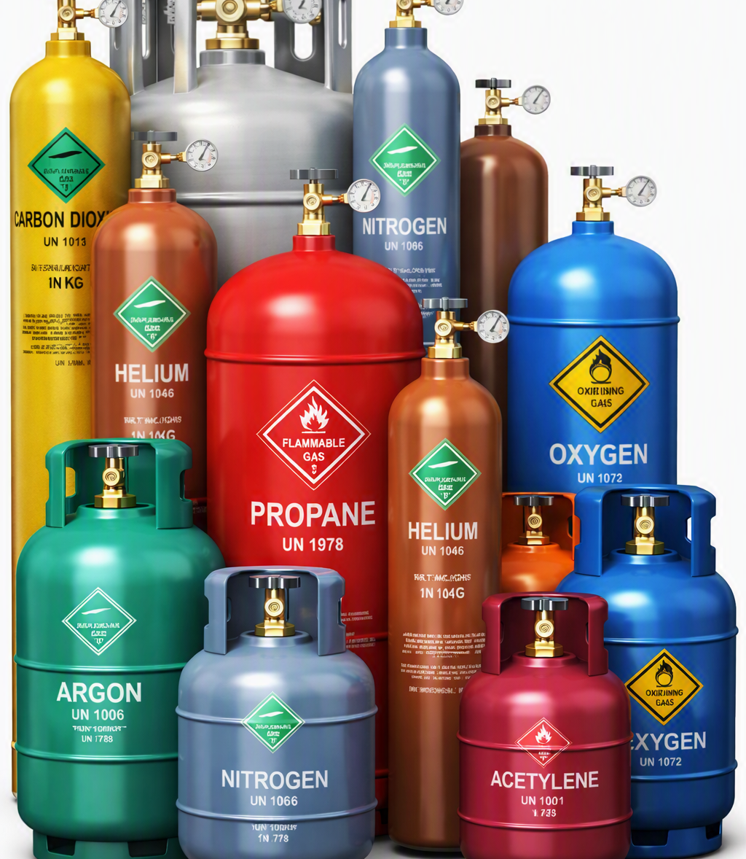
Fluorinated gases (F-gases)
F-gases are man-made greenhouse gases developed as alternatives to older ozone-depleting substances.
They are used in refrigeration, air conditioning, heat pumps, electrical insulation, aerosols and some industrial processes.
The main types are:
HFCs – commonly used as refrigerants in cooling and heat pump systems
PFCs – used in specialist industrial applications
SF₆ – used in high-voltage electrical equipment
Notes:
Keep this at awareness level: “refrigerant = working fluid that makes heat transfer possible.”
Stress the low-carbon link: leakage undermines environmental benefit, so regulations focus on reducing emissions.
Source: Mitsubishi Electric CPD Guide Issue 63, background and examples table (pp.5–10).

Slide 5
Fluorinated gases (F-gases)
They are a concern because many have a very high Global Warming Potential (GWP) and can remain in the atmosphere for a long time if released.
For engineers and businesses, this means working compliantly, checking equipment labels, and increasingly moving towards lower-GWP alternatives such as CO₂, ammonia and hydrocarbons.
Notes:
Keep this at awareness level: “refrigerant = working fluid that makes heat transfer possible.”
Stress the low-carbon link: leakage undermines environmental benefit, so regulations focus on reducing emissions.
Source: Mitsubishi Electric CPD Guide Issue 63, background and examples table (pp.5–10).

Slide 6
Fluorinated gases (F-gases)
Key Characteristics & Function
• Man-made greenhouse gases used primarily as refrigerants in heat pumps.
• Enable heat transfer via the refrigeration cycle by changing phase (liquid ↔ vapour).
• Adopted as safer alternatives to ozone-depleting substances like CFCs.
• Generally contained in sealed circuits but pose high climate risk if leaked.
Common Refrigerant Examples
R410A: Standard in AC/VRF and various heat pumps.
R32: Increasingly used due to lower GWP than R410A.
R744 (CO₂): Utilised in air-to-water heat pump systems.
Notes:
Keep this at awareness level: “refrigerant = working fluid that makes heat transfer possible.”
Stress the low-carbon link: leakage undermines environmental benefit, so regulations focus on reducing emissions.
Source: Mitsubishi Electric CPD Guide Issue 63, background and examples table (pp.5–10).

Slide 7
Purpose and applications of F-Gas regulations
F-Gas Register (UK) – what it is and what it does
The UK database used to support compliance for businesses working with fluorinated greenhouse gases.
Demonstrates company registration/link to certified personnel for refrigerant work.
Allows customers to check registration and supports compliance assurance.
Part of a wider system aimed at reducing emissions (competence, containment, recovery, record keeping).
Key Objectives of F-Gas Controls
• Reduce emissions from refrigerant leakage
• Support safe working & environmental protection
• Require competent handling and disposal
• Encourage good maintenance & leak prevention
Notes:
Keep this at awareness level: learners should know why registration exists and what it’s for (compliance visibility and verification), not become experts in the admin process.
Tie back to K1.5: if a job involves refrigerant handling, the engineer/business must ensure appropriately qualified/certified personnel are used and that business compliance requirements (including any registration expectations) are met.
Tutor prompt question: “If you were a customer or main contractor, why would you want proof of registration/certification before allowing refrigerant work on site?”
Website link
https://fgasregister.com/

Slide 8

Types of F-gas: ODS and GWP (awareness)
ODS: Ozone Depleting Substances (historic context)
Older refrigerants (e.g. CFCs/HCFCs) damaged the ozone layer, increasing harmful UV exposure.
Phased out via global agreements; industry transitioned to replacements like HFCs.
Key message: Explains why refrigerants changed and why current regulations exist.
GWP: Global Warming Potential (climate impact vs. CO₂)
Measures heat trapped in the atmosphere compared to CO₂ = 1 over 100 years.
Compares refrigerants by climate impact if released, not cooling performance.
Used with CO₂-equivalent to drive adoption of cleaner alternatives.

Slide 9

Types of F-gas: ODS and GWP (awareness)
Higher GWP = greater harm if leaked
If two systems leak the same mass of refrigerant, the one with higher GWP causes a much larger climate impact.
This is why phase-down policies target high-GWP refrigerants first, and why leak prevention, correct servicing and recovery are critical.
Practical takeaway: even “small leaks” can have a large environmental consequence when the refrigerant has high GWP.
Low carbon link: refrigerant leaks reduce carbon savings
Heat pumps reduce emissions by operating efficiently, but leaks can undermine the low-carbon benefit.
Poor installation/maintenance can turn a “low carbon” system into a higher-impact system.
Priority for engineers: Correct installation, safe diagnosis, escalation to certified F-Gas personnel, and accurate records.

Slide 10
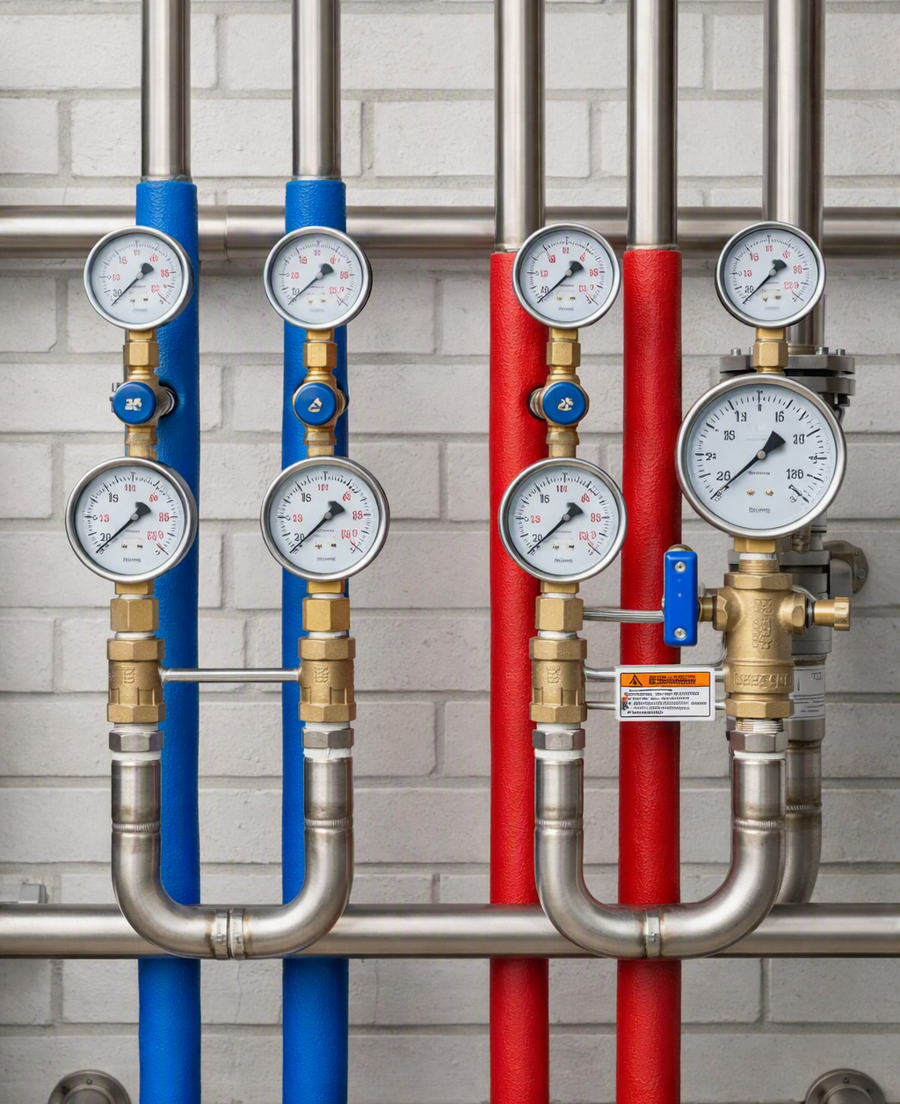
Practical limits, dangers and properties (awareness)
Pressurised systems: sudden release risk
Refrigerant circuits operate under pressure; failures can cause rapid, violent release.
Hazards: flying debris, oil spray, or shock.
Low-carbon link: Poor installation increases risk—follow manufacturer requirements.
Cold burns / frostbite from rapid expansion
Escaping refrigerant cools quickly, causing freeze burns to skin and eyes.
Vapour and cold surfaces cause tissue damage even with brief exposure.
Low-carbon link: Reinforce PPE awareness; isolate and refer to certified personnel.
Notes:
Awareness only—do not teach procedural refrigerant handling in this KC.

Slide 11
Practical limits, dangers and properties (awareness)
Asphyxiation risk in enclosed spaces
Refrigerants are typically heavier than air and can displace oxygen, especially in small plant rooms, basements, or poorly ventilated areas.
Creates serious risk of dizziness, collapse, or unconsciousness without obvious warning signs.
Low-carbon link: Recognise confined area risk, avoid working alone where required, and escalate per site safety procedures.
Flammability (extra controls required)
Lower-GWP refrigerants are mildly flammable, introducing ignition risk if leaked.
Controls: restricted ignition sources, specialist procedures, and exact adherence to manufacturer instructions.
Low-carbon link: Follow manufacturer guidance and escalate to appropriately trained/certified personnel.
Notes:
Awareness only—do not teach procedural refrigerant handling in this KC.

Slide 12
Recap checkpoint 1 (5 mins)
1) What does GWP stand for?
2) Why are F-gases regulated?
3) Name one refrigerant hazard.
Stop point: Wordwall/Quizizz (definitions match)
Notes:
Suggested answers:
GWP=Global Warming Potential.
Regulated to reduce emissions & ensure competent handling.
Hazards: pressure/cold burns/asphyxiation/flammability.
Quiz created separately.

Slide 13
Contractors working with F-gases (awareness)
Work categories exist for different F-gas activities
F-Gas qualifications are split into categories depending on what you do: leak checking only vs recovery vs install/service/maintenance.
Example:
      category 1 certificate to carry out all activities
      category 2 certificate to install, maintain, service and recover refrigerant from systems containing less than 3kg of F gas, or less than 6kg of F gas if hermetically sealed
      category 3 certificate to recover refrigerant from systems that contain less than 3kg of F gas, or less than 6kg of F gas if hermetically sealed
      category 4 certificate to check equipment for leaks if you do not break into the refrigeration circuit
Registration & Certification for Businesses
In the UK, it’s not just the engineer: the company (including sole traders) may need to be certified by an approved body to service stationary equipment containing F-gas.
Practical Rule: Stop and Refer
Only certified personnel should handle refrigerants. Appropriate UK qualifications are mandatory for equipment containing F-gas.
If task involves handling or opening circuit STOP and refer to a certified person.
Service, Repair & Refrigerant Handling
Jobs become regulated if they require recovery, leak repair, or opening the circuit.
Critical Boundary: Electrical/hydraulic work may be within scope, but circuit work triggers F-Gas requirements.
Notes:
Key teaching aim: Learners don’t need to memorise every category, but must understand (1) categories exist, (2) company certification can be required, (3) many service jobs cross the line into refrigerant handling, and (4) they must escalate appropriately.
Simple “decision rule” to repeat:
Hydraulic/electrical task and sealed circuit untouched → may proceed within competence
Refrigerant handling / recovery / leak repair / opening sealed circuit → refer to F-Gas certified personnel/company
Mini-check questions (2 mins):
What type of work can Category IV cover? (Leak checking only, without breaking into the circuit.)
Who may need certification besides the engineer? (The company/sole trader for certain work.)
Give one service task that might cross into refrigerant handling. (Recovery/leak repair/opening circuit.)
Stop point (Wordwall/Quizizz): “Refer or Proceed?” (quiz created separately)
Links for tutor (do not put on slide):
GOV.UK – Qualifications required to work on equipment containing F gas: https://www.gov.uk/guidance/qualifications-required-to-work-on-equipment-containing-f-gas
GOV.UK – Company certification to work on equipment containing F gas: https://www.gov.uk/guidance/certification-for-companies-working-on-equipment-containing-f-gas

Slide 14
When and who must hold F-Gas certification?
Refrigerant Handling
Certification is mandatory for recovery, charging, and leak repair on stationary equipment.
Takeaway: Moving refrigerant = Specialist work.
Circuit Boundaries
Tasks that require breaking into the sealed circuit are regulated. Category 4 only covers leak checks without circuit entry.
Takeaway: "Opened" vs. "Untouched" is the critical line.
Certificate Categories
Cat 1: All activities
Cat 2/3: Restricted charge/recovery
Cat 4: Leak checking (no circuit entry)
Reporting & Escalation
Record fault codes, symptoms (e.g. reduced output), and checks completed before handing over to certified personnel.
If unsure: STOP, check scope, and refer.

Slide 15
Video break + discussion (5–8 mins)
Topic: refrigerants, safety awareness and competence boundaries.
Discuss: What is GWP? Why does it matter?
Discuss: What should a non-certified engineer do if refrigerant work is indicated?
Notes:
YouTube Link;
https://www.youtube.com/watch?v=xmVVUhIMlTw
https://www.youtube.com/watch?v=RShmCx21vMU
Example: Heat Pump Association refrigerant awareness session.

Slide 16
Scenario activity (10–15 mins): refer to F gas Qualified or proceed?
1
Replace outdoor temperature sensor
2
Repair refrigerant leak on pipework
3
Clean coil/fins and clear condensate drain
4
Recover refrigerant during decommissioning
If refer, what category of qualification would be required?
Notes:
Suggested answers: 1 OK, 2 REFER, 3 OK, 4 REFER.
Stop point: Wordwall/Quizizz (created separately).

Slide 17
Objectives (K1.6)
Product vs. Package Labels
Product label shows the declared efficiency/performance of the individual unit (e.g. the heat pump only).
Combined System Performance
Package label shows declared performance of a combined system (e.g.,heat pump + controls + cylinder).
Seasonal Efficiency Impact
Packages can change overall ratings because controls and system components affect seasonal efficiency.
Control Strategy Advantage
Higher control class strategies can improve declared package efficiency compared to the product alone.
Whole-System Selection
Package labels support selecting the whole system, not just finding the “best heat pump” in isolation.
Key Learner Skill
Identify unit vs. system performance and record it accurately within the project job file.

Slide 18
Manufacturer information
Installation, Operation & Maintenance
Safe Installation: Clearances, pipework, wiring, water quality, and condensate.
Operating Limits: Correct use of controls, setpoints, and modes for efficiency.
Maintenance: Cleaning, testing, and component protection schedules.
Includes approved spare parts, service kits, and procedures to keep systems safe and within warranty.
Definitive Source Mandate:
Follow Building Regs, but use the manufacturer manual as the definitive source for unit-specific tasks.
Commissioning & Service
Commissioning: Verification of flows, pressures, and safety device operations.
Service Schedules: Routine intervals for filters and record keeping.
Compliance: Protects warranty and reduces callbacks.
Notes:
Image suggestion (Freepik): https://www.freepik.com/search?query=technical%20manual&type=vector

Slide 19
Why manufacturer instructions matter
Safety
Manuals specify safe limits and required safety devices (e.g. pressures, temperatures, electrical protection, discharge/condensate arrangements).
Performance
Correct settings, clearances, pipework/insulation requirements and control setup are needed to achieve efficient operation.
Compliance
Manuals support meeting regulations/standards by giving the exact installation and commissioning method for that model.
Warranty & Support
Many manufacturers require evidence the system was installed/commissioned/serviced to their instructions for warranty validity.
Correct Servicing
Manuals define maintenance intervals, checks and approved spare parts, reducing faults and repeat call-backs.
Consistency
Following one agreed method ensures consistent quality across installers and sites, improving customer outcomes.

Slide 20
Finding critical information quickly
1. Safety Section
Warnings, PPE, isolation requirements, and any prohibited actions.
2. Installation Requirements
Clearances/airflow, siting limits, pipework routes, condensate handling, and permitted materials.
3. Electrical Requirements
Supply characteristics, protective devices, cable sizing, isolation, and earthing notes.
4. Commissioning Procedure
Required checks, settings to confirm (temps/flows), calibration, and pass/fail criteria.
5. Controls & Operation
Mode setting, weather compensation, DHW priority, and recommended setpoints/limits.
6. Maintenance & Faults
Service intervals, cleaning points, filters, approved spares, and fault-finding guidance.
Search & Index Strategy:
Use contents, index, and PDF terms like: "clearance", "commissioning", "fault code", "service"

Slide 21
Installation requirements: what to check
Siting & Clearances
Minimum distances, airflow, servicing access, and noise considerations.
Mounting & Supports
Base/brackets, vibration isolation, level requirements, and lifting guidance.
Pipework requirements
Materials, sizing, insulation, routing/protection, and run limits.
Condensate Management
Drainage route, fall, freeze protection, and disposal requirements.
Water Quality (Wet Side)
Flushing, inhibitor/antifreeze, filters, and safety devices.
Electrical Requirements
Supply, isolator, protective devices, wiring, and commissioning checks.
Pre-commission checks
Fill/pressure guidance, leak checks, air removal/venting, and “do not energise until…” warnings.
Notes:
Do not copy manual text verbatim. Summarise in your own words.

Slide 22
Operation requirements: what users need
System Control & Normal Operation
How to control: Basic use of controller/thermostat (modes, schedules, setpoints, DHW boost).
What is "normal": Longer run times, quieter steady operation, defrost cycles for ASHP.
Efficiency & Hot Water Guidance
Efficiency tips: Avoid overrides; use weather compensation; keep flow temps as low as practical.
Hot water: DHW setpoints, recovery times, and hygiene/Legionella settings.
Support & Troubleshooting
What to check first: Power, controller settings, error codes, and obvious leaks.
When to call engineer: Persistent faults, loss of heating/DHW, unusual noises, trips.
Documentation to keep
Ensure the user retains the User Guide, Commissioning/Handover Sheet, Warranty Info, and Service Schedule (job file items).

Slide 23
Maintenance requirements
Service intervals and checklists
Manufacturer manuals set minimum service intervals (e.g. annual checks) and a checklist of required tasks to keep the system safe, efficient and reliable.
Filters/strainers and cleaning checks
Manuals often require routine inspection/cleaning of strainers/filters (and sometimes coils/fins/condensate routes) to prevent restricted flow, poor heat transfer, noise and breakdowns.
Antifreeze checks (where applicable)
Where glycol/antifreeze is used (e.g. some external pipework/GSHP circuits), manuals may specify concentration testing, freeze protection limits and safe top-up procedures (within competence).
Record keeping to support warranty and safety
Service records should show what was checked, readings taken, parts replaced and any faults found; this supports safe operation and warranty.
Maintenance requirements (what the manual will specify)
The manufacturer manual is the primary source of instruction for ensuring long-term system performance and safety compliance.

Slide 24
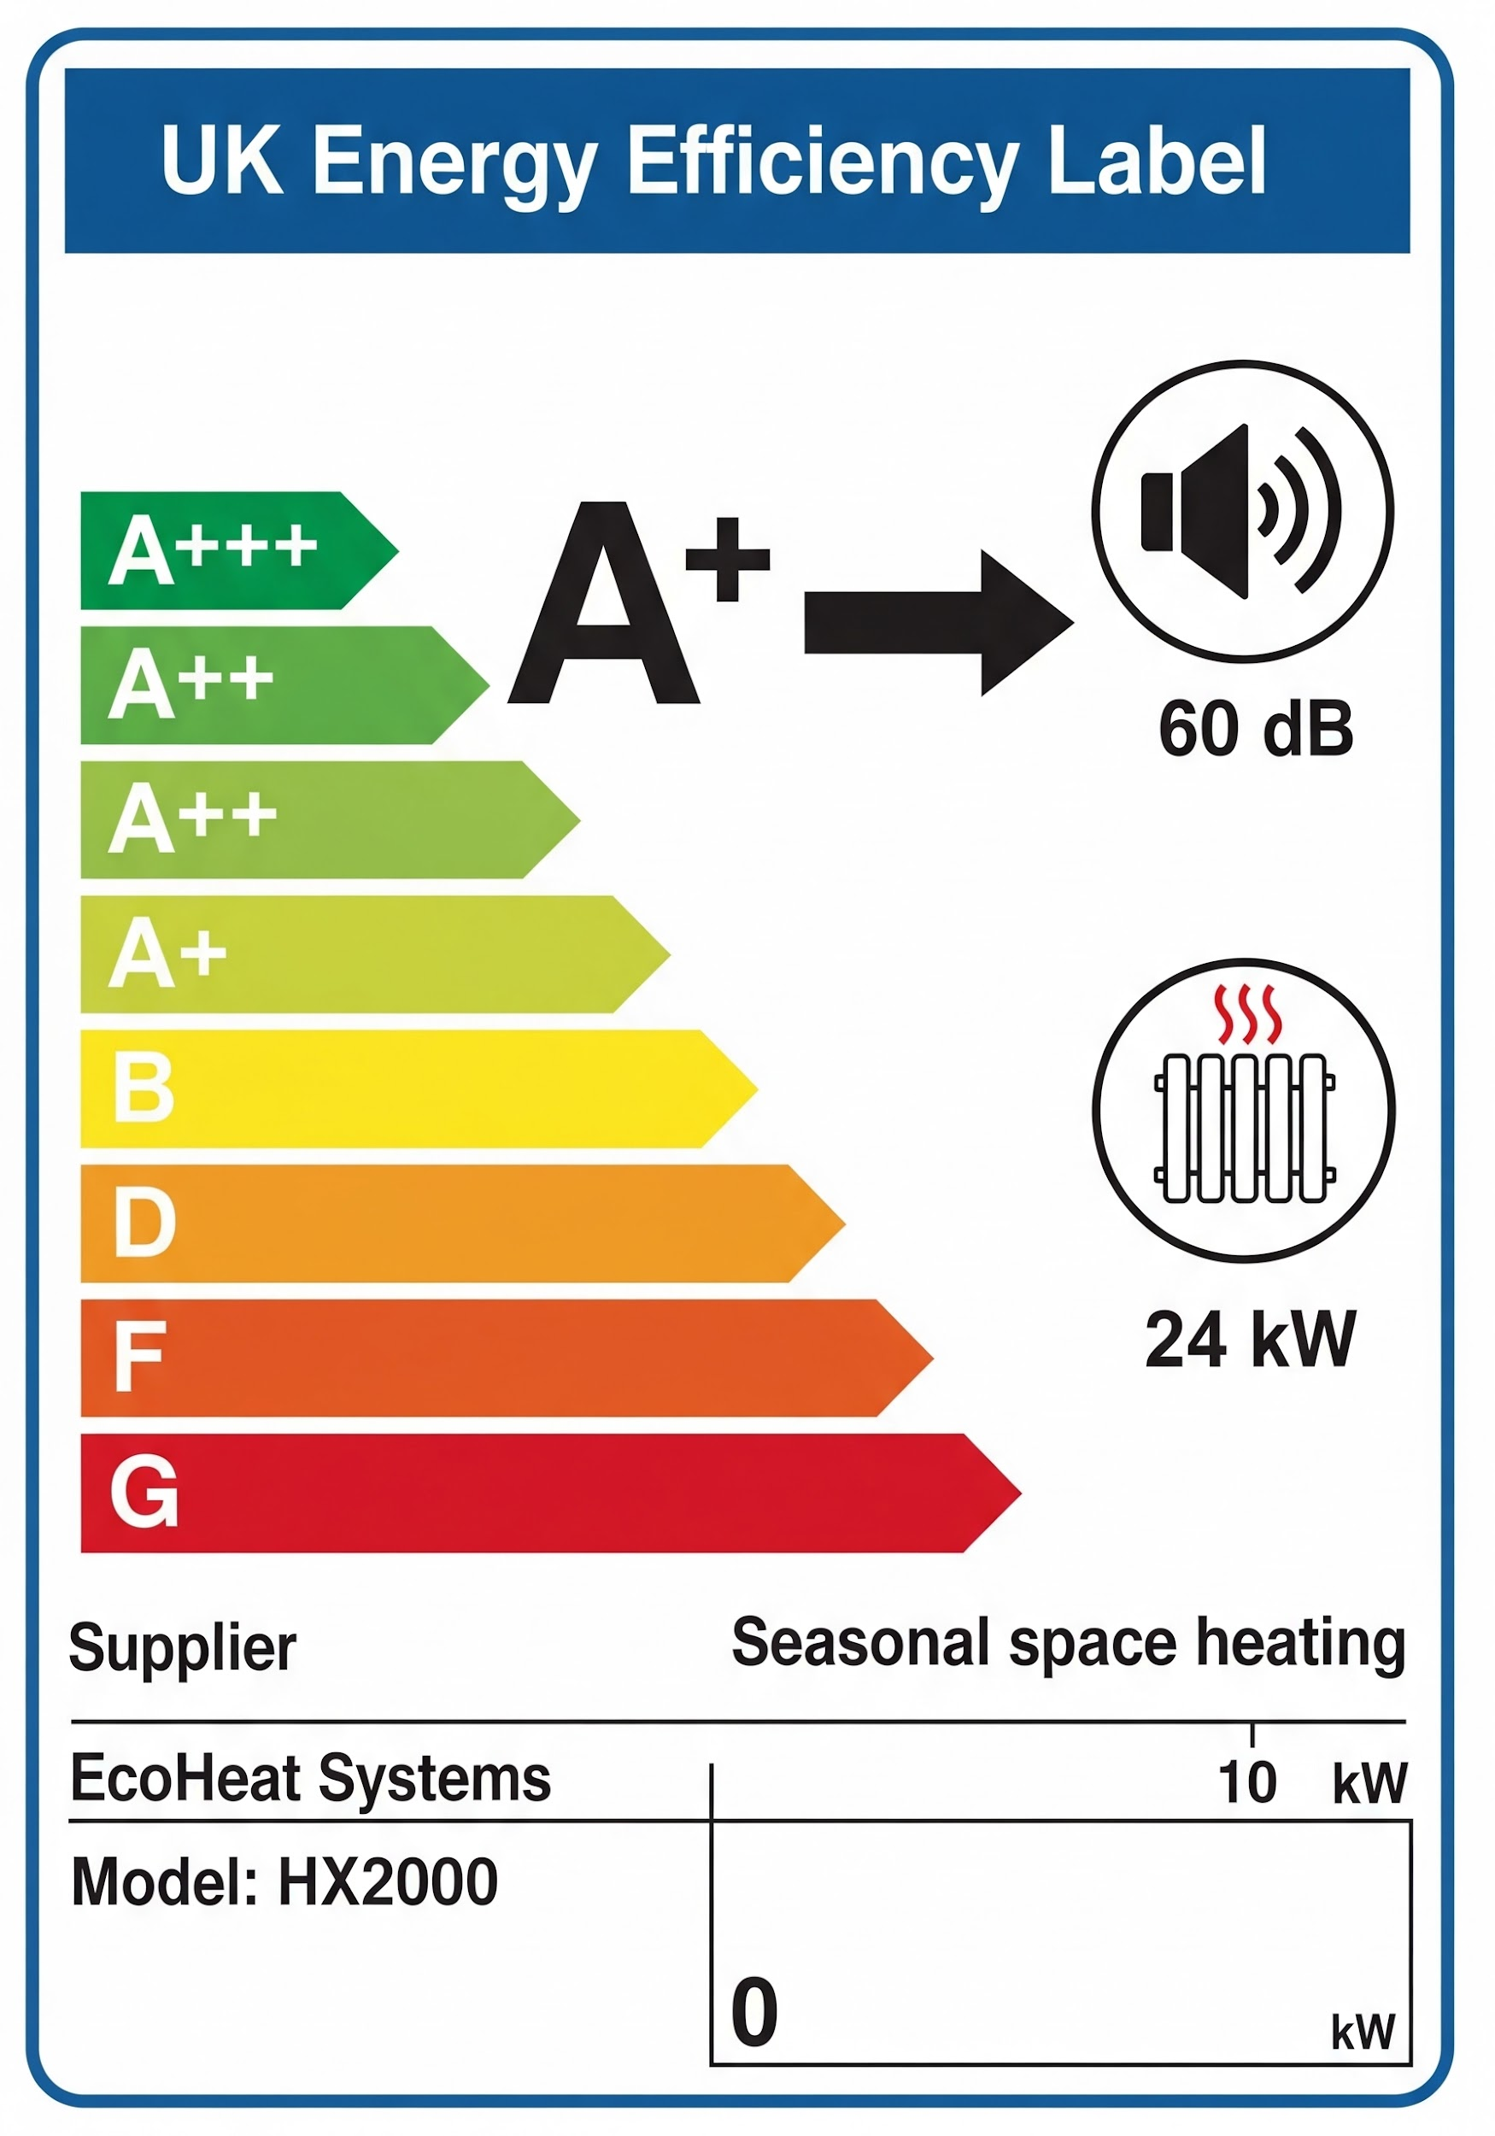
UK Energy Label: what it tells you
Efficiency class & performance
Shows the unit’s or package’s energy efficiency rating and key declared figures measured under standard conditions.
Product vs. package
Compare individual heat pumps against combined systems (e.g. pump + controls + cylinder) using consistent label standards.
Selection decisions
Helps choose equipment matching the design aim and provides evidence for why a specific product or package was selected.
Customer communication
Explains efficiency simply: "higher rating means lower running costs". Notes that real performance depends on installation.
Notes:
If you add a label image: use manufacturer brochure or approved illustration source; log URL in Artlog.

Slide 25
Product label vs. package label
Product label
Shows declared efficiency of the individual unit (e.g. the heat pump only).
Package label
Shows performance of a combined system (e.g. heat pump + controls + cylinder/solar).
A better control strategy (e.g. higher control class) can improve the declared package efficiency compared with the product alone.
Whole-system selection: Package labels support choosing the best overall system, not just the "best heat pump".
Key learner skill: Identify if you’re looking at unit vs. system performance and record it correctly.
Link forward: declared labels help selection; real performance depends on design and commissioning.
Notes:
Product label (individual unit):
This label relates to the single product being sold (for example, a specific heat pump model).
It gives declared performance/efficiency information for that unit under the label scheme rules.
It’s useful when comparing two heat pumps as products.
Package label (combined system):
A package label represents a system combination assembled from more than one part.
In low carbon heating, this can mean a heat pump plus controls (and sometimes hot water components), where the package label reflects the declared effect of those components on overall seasonal efficiency.
The key message is that heating performance is system-based, not “box-based”.
Why packages can change the rating:
Controls can materially influence efficiency by improving temperature control, reducing cycling, and optimising operation (this is why “control classes” exist in many schemes).
A package label accounts for these declared improvements, so the package rating may be better than the unit alone if higher-performing controls are included.

Slide 26
Product fiche (datasheet)
The product fiche is the manufacturer’s standardised technical sheet supporting the UK Energy Label.
Contains declared performance figures measured under controlled conditions.
Used to compare products and justify selection in the design pack / job file.
COP = Coefficient of Performance.
SCOP = Seasonal Coefficient of Performance.
Includes COP/SCOP values to understand efficiency.
COP/SCOP are efficiency measures: they show how effectively a heat pump turns electricity into heat (higher = more efficient).
Declared COP/SCOP values help comparison: they’re published on labels/fiches under set conditions to compare products, while the deeper “why it changes in real homes” is covered later.
Key Skill: Extract figures and record as evidence in the job file.
Mini activity (5–10 mins): Extract the following from a sample fiche and write a 4-bullet "job file justification note":
• Model/type | • Declared efficiency (COP/SCOP/seasonal)
• Declared output/capacity | • Installation parameter (e.g. sound level)
Notes:
What a fiche is (simple definition):
A product fiche is the declared technical information that sits behind the energy label. It’s designed to make performance information comparable because it is based on standardised testing and reporting.
Declared vs. real-world performance (important distinction):
The fiche values are “declared” based on test conditions in standards-based testing (controlled lab-like conditions).
Real-world performance will vary with: building heat loss, emitter sizing, flow temperature, control strategy, commissioning quality, and user behaviour.
This is why the fiche supports selection and justification, but does not guarantee the same performance in every property.
Where COP/SCOP fit (and where to teach them):
The fiche often includes COP and/or seasonal metrics (e.g. SCOP / seasonal space heating efficiency).
In K1.6, keep it practical: “COP/SCOP appear on the fiche and help compare options.”
The deeper science (why COP changes, refrigeration cycle, flow temperature impacts) belongs in K1.22.
Tutor prompt (2 minutes):
Ask learners:
“Is this value declared under test conditions or measured in the customer’s home?”
“What conditions does it apply to?” (e.g. stated temperatures)
“What design choices will increase or reduce real COP?” (flow temps, emitters, controls)
Stop point (Wordwall/Quizizz – created separately):
“Match the fiche item to its purpose.” (e.g. COP/SCOP, sound power, output)

Slide 27
Declared vs. real performance – what changes COP in homes?
Declared performance (on the fiche/label) is measured at standard test conditions so products can be compared fairly.
Real performance will vary because every home/system is different — COP is affected by design choices and installation quality.
Heat Pump Efficiency
Lower flow temperatures generally improve efficiency (higher COP) but require suitable emitters and good controls.
Fabric & Heat Loss
Building heat loss and fabric (insulation, ventilation) strongly affect how hard the system must work.
Commissioning
Controls and commissioning matter: weather compensation, settings, flow rates, and handover all influence real efficiency.
Key message: the fiche helps selection, but good design & commissioning are what deliver the performance in real life.
Notes:
Purpose of this slide:
Learners often assume the label/fiche equals guaranteed real efficiency. This slide corrects that without going deep into thermodynamics.
Explain with a simple example:
Two identical heat pumps installed in two different houses can have very different performance:
House A: insulated, low heat loss, low flow temps, weather comp enabled → higher real COP
House B: poor insulation, high flow temps to “force heat”, poor balancing → lower COP
Key factors to call out (awareness level):
Flow temperature: higher flow temp increases compressor work and reduces COP.
Heat emitters: undersized radiators push flow temp higher; UFH often supports lower flow temp.
Heat loss & ventilation: more losses = more energy needed = heat pump works harder.
Hydraulics/flow rate: poor flow, air, blockages, incorrect pump setup can reduce output/efficiency.
Controls: weather compensation + correct schedules reduce cycling and improve stability.
Commissioning: correct settings, recorded checks, and user guidance lock in performance.
Link forward:
Tell learners: “We’re keeping this practical here. In K1.22 we’ll explain the refrigeration cycle and why COP changes with temperatures.”

Slide 28
Recap checkpoint & stop point (5 mins)
1) Name two examples of info in manufacturer instructions.
2) Product vs. package label – what is the difference?
3) Where would you find service intervals?
Stop point: Wordwall/Quizizz (manual terms match)
Notes:
Suggested answers:
Clearances/commissioning steps/electrical requirements/service schedule.
Product = unit; Package = combined.
Service schedule/maintenance section.
Quiz created separately.

Slide 29
Activity: Understand information (15 mins)
Using a centre-provided manual for an air source heat pump, find the following items:
Siting & Clearance
Find 3 requirements for the physical installation location.
Commissioning
Find 3 checks or settings required before hand-over.
Maintenance
Find 2 regular maintenance requirements for the unit.
Task: Record findings as a job-file checklist
Notes:
Tutor: provide real manual (printed/PDF).
Workbook tasks referenced in SoW (created by others).

Slide 30
Summary & questions
K1.5: F-Gases Overview
• What F-gases are
• Why they are regulated
• Hazards & referral points
K1.6: Manufacturer Info
• Install, commission & maintain
• Label awareness
Notes:
Add any useful links here in tutor notes (not on slides).

Slide 31
Any questions?
Copyright in this document belongs to and is used under licence from the Department for Education, © 2025.
‘T-LEVELS’ and ‘T Level’ are registered trademarks of the Department for Education.
WJEC is authorised by the Department for Education to develop and deliver this T Level Technical Qualification.
WJEC operates in England under the name Eduqas which is a registered trademark of WJEC.

