Slide 1
Occupational specialism: Low Carbon Engineering
PowerPoint K1.41: Documentation required for commissioning and verification of commissioning

Slide 2
Introduction / Starter
Warm-up
What paperwork proves a heat pump system was commissioned correctly?
Pair-share
List three documents a customer should receive at handover.
Tutor Prompt
"Documentation is evidence — not an admin extra."
Notes:
Stop point: 3–5 minute discussion. Draw out commissioning record, Benchmark/manufacturer checklist, warranty information, user guide, service schedule and certificates.

Slide 3

Objectives (K1.41)
Identify documentation required for commissioning and verification
Explain the content and purpose of commissioning records
Recognise service sheets, warranties and manufacturer guarantees
Explain self-certification and compliance evidence routes
Describe the handover pack, instructions, user guides and service requirements
Verify that documentation is complete before handover
Notes:
Learners should understand when each document is used, who uses it and why it matters to safety, performance, warranty and future maintenance.

Slide 4
Documentation: what are we trying to prove?
The system was installed and commissioned to manufacturer instructions
Safety, water quality, controls and performance checks were completed
Settings and readings were recorded for future comparison
Customer was given clear instructions and service requirements
Compliance and warranty evidence is available if requested
Any limitations, variations or referrals are documented
Notes:
Tutor note: link back to K1.38. Commissioning checks generate the evidence; K1.41 focuses on the documentation that captures and verifies that evidence.
British Standards/context to mention: BS EN 14336 for installation/commissioning of water-based heating/cooling systems; BS 7593 for preparation, commissioning and maintenance of domestic heating/cooling water systems; manufacturer instructions are model-specific and must be followed.

Slide 5
Commissioning record: purpose
Primary Evidence & Handover
The commissioning record proves the system was inspected, tested, and operating safely before handover.
Data Capture
Records key evidence: flow/return temps, system pressure, DHW/pump/control settings, water treatment, and safety checks.
Checklist Formats (Benchmark/MCS)
Benchmark meets Part L Building Regulations. Records include manufacturer sheets, MCS forms, or company checklists.
Warranty & Audit Support
Completed records are vital for warranty validity, business audits, and provide baseline readings for future fault-finding.
Quality Management (QMS)
MCS 001 requires a consistent, standardised approach: controlled templates, version control, and audit-ready records.
Real-time Recording
Records MUST be completed at commissioning. Recording from memory increases risk and weakens the evidence trail. It also includes company details, commissioning engineer details, date and engineer signature.
Notes:
Tutor depth:
A commissioning record should be a live record completed as checks are carried out. It should not be retrospectively completed after leaving site.
Prompt: 'If there is no commissioning record, how would you prove the system was left operating correctly?'

Slide 6
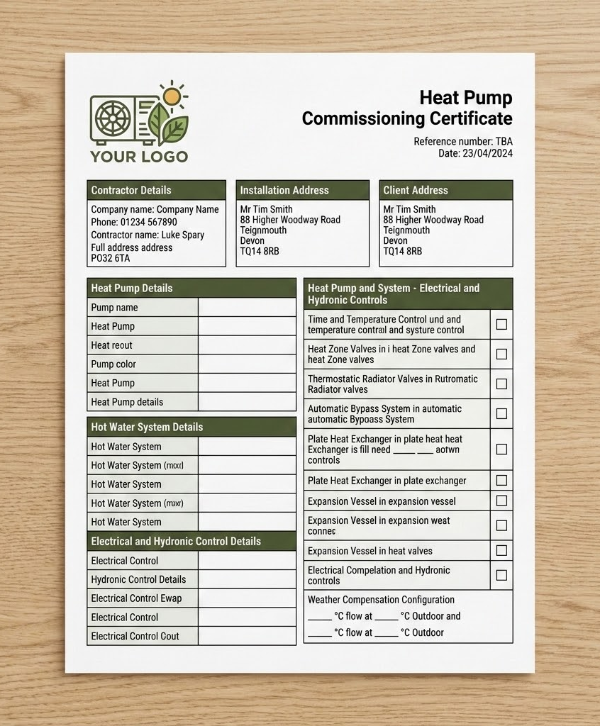
Commissioning record: typical content
Site & Product Details
Record address, contact, date, and installer details. Include heat pump, cylinder, and controller models/serials.
Design & Standards
Reference design documents. Key standards: BS EN 14336:2025 (Heating/Cooling) and BS 7593:2019+A1:2024 (Water Treatment).
Readings & Settings
Record flow/return temps, ΔT, pressures, flow rates, and control setpoints (compensation curves/schedules). Electrical information, Kw output, RCD Fuse size.
DHW & Hygiene
Cylinder setpoint, outlet temps, TMV settings, and anti-Legionella strategy. Manage customer recovery expectations.
Water Quality & Safety
Cleaning method, inhibitor/glycol, filter checks. Include safety checks: PRVs, discharge, and electrical isolation.
Sign-off & Handover
Engineer/company details, customer sign-off. Ensure pack includes user guide, warranty, and Benchmark/MCS records.
Notes:
Tutor note:
The exact content depends on manufacturer/scheme requirements, but the principle is consistent: the record should prove what was checked, what values were observed, what settings were left and what evidence supports handover.
Stop point: learners mark which items are readings, settings, safety evidence or customer handover evidence.

Slide 7
Verification of commissioning: how records are checked
Comparative Analysis
Compare recorded readings with manufacturer/design expectations.
Completeness Check
Check required sections are complete, dated and signed where required.
Action & Variation Audit
Confirm corrective actions and variations are clearly documented.
Referrals & Attachments
Check certificates/referrals are attached or referenced.
Handover Verification
Verify customer handover documents match the installed system.
Safety Compliance
Do not hand over with missing safety-critical information.
Notes:
Tutor depth:
Verification is the quality check that the commissioning evidence is complete and credible. It may be done by the commissioning engineer, supervisor, scheme auditor, employer, manufacturer/warranty team or future service engineer.
Activity prompt: provide a sample checklist with missing items; learners identify what prevents handover.

Slide 8
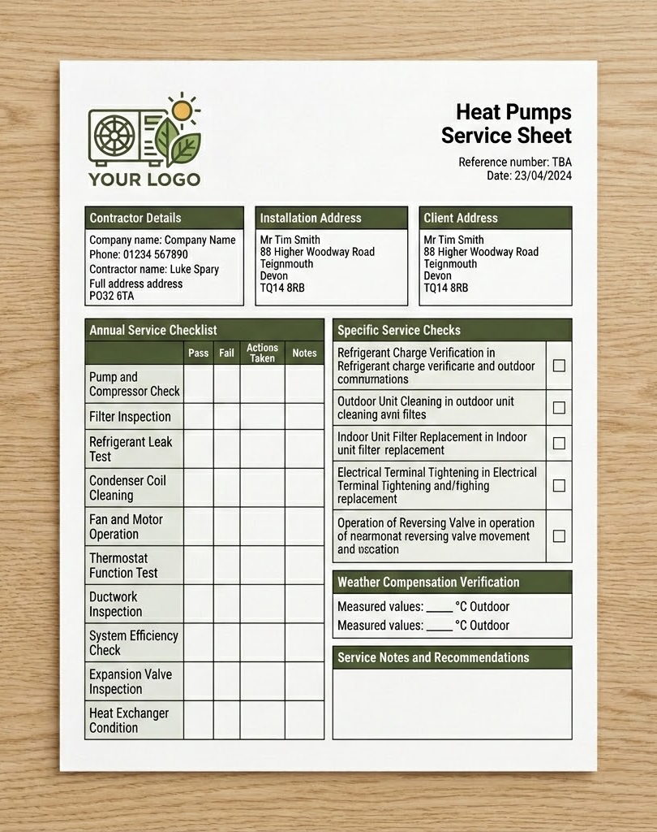
Service sheet: what it is used for
Routine Service Evidence
Evidence of checks during planned maintenance or fault visits. Shows adherence to manufacturer instructions and warranty.
Records & Readings
Tracks flow/return temps, pressure, pump ops, and settings. Records date, engineer name, and site details.
Water Quality & Protection
Monitors filters, inhibitor levels, and signs of sludge or corrosion. Supports BS 7593:2019+A1:2024 compliance.
Safety Device Integrity
Inspection of PRVs, expansion vessels, and safety controls. Critical issues are recorded and escalated immediately.
Baseline Comparison
Compare current readings against commissioning baseline. Identifies trends like pressure loss or rising ΔT.
Warranty & Handover
Maintains warranty cover and creates a clear fault-finding history. Records user advice and outstanding actions.
Notes:
Tutor note:
A service sheet is not the same as the initial commissioning record. It is used during maintenance visits to prove the system continues to operate safely and efficiently.
Example: compare current pressure, ΔT, filter condition and control settings with commissioning data.

Slide 9
Warranty information and manufacturer guarantees
Scope & Process
Warranty explains what is covered, duration, exclusions and claim process.
Installation Requirements
Manufacturer guarantees may depend on correct installation and commissioning.
Registration Timeline
Registration may be required within a set time after installation.
Maintenance & Parts
Extended warranties often require annual servicing and approved parts.
Critical Evidence
Missing commissioning/service records may affect warranty support.
Notes:
Tutor depth:
Many heat pump manufacturers offer long warranties or extended guarantees, but these are usually conditional. Learners must understand that paperwork protects the customer and installer.
Learner question: what evidence might a manufacturer ask for before approving a warranty claim? Suggested answers: serial number, install date, commissioning record, service history, water treatment evidence, photos, fault code history.

Slide 10
Self-certification and compliance evidence (1 of 2)
The Building Regulations Route
Self-certification allows authorised installers to certify work complies without a separate Building Control application.
Confirms work follows correct standards and regulations (Manufacturer instructions, BS, etc.).
Competent Person Schemes (CPS)
Providers like BPEC, NICEIC, APHC, or OFTEC allow installers to self-certify compliance in England and Wales.
Used for heat pumps, electrical work, and unvented hot water cylinders.
MCS Certification Route
Often required for grants like the Boiler Upgrade Scheme.
Direct: Company holds its own certification.
Umbrella: Working under another organisation's framework.
Notes:
Tutor note:
Keep this awareness-level. Link back to K1.4 and K1.8 competence boundaries.
Examples: electrical certification by competent electrician; Building Control route; heat pump certification scheme evidence; F-Gas documentation where refrigerant work occurs.
Make clear that self-certification is not the same as “signing it because you did the job”. It means the installer or company is registered/authorised under a recognised route and can notify/certify the work against the relevant requirements. For heat pumps, the documentation may include Building Regulations notification, MCS certificate/evidence, customer handover pack, warranty registration and commissioning records. A company working under MCS — either directly or through an umbrella scheme — must follow controlled processes so every job file contains consistent evidence.
Prompt: 'What should you do if a customer asks you to sign off work outside your competence?'

Slide 11
Self-certification and compliance evidence (2 of 2)
Required Compliance Evidence
Customers need certificates for: warranty support, grant claims, property sales, future maintenance, and audits.
Evidence proves notification of Building Regulations has been completed correctly.
Mandatory Rule: Authorised Persons Only
Only certify work within your authorised competence or registration scope.
If outside your scope, stop and refer to the correct scheme provider or Building Control.
Key Compliance Categories
Heat Pumps Electrical Installations Hot Water Cylinders Regulated Heating
Notes:
Tutor note:
Keep this awareness-level. Link back to K1.4 and K1.8 competence boundaries.
Examples: electrical certification by competent electrician; Building Control route; heat pump certification scheme evidence; F-Gas documentation where refrigerant work occurs.
Make clear that self-certification is not the same as “signing it because you did the job”. It means the installer or company is registered/authorised under a recognised route and can notify/certify the work against the relevant requirements. For heat pumps, the documentation may include Building Regulations notification, MCS certificate/evidence, customer handover pack, warranty registration and commissioning records. A company working under MCS — either directly or through an umbrella scheme — must follow controlled processes so every job file contains consistent evidence.
Prompt: 'What should you do if a customer asks you to sign off work outside your competence?'

Slide 12
Handover pack: what good looks like
Comprehensive Documentation
A complete set of documents given to the customer at handover, ensuring all records are in one place.
Core Components
Includes commissioning records, certificates, warranty details, user guides, and service schedules.
Operational Guidance
Quick-start controls guidance, agreed settings, limitations, and essential contact details.
Clarity & Utility
Designed to be clear for the customer and highly useful for any future maintenance engineers.
Professionalism
A high-quality handover pack reflects your professionalism and builds customer trust.
Quality Assurance
Essential for meeting the mandatory quality assurance requirements of MCS registration.
Notes:
Tutor depth:
A good handover pack reduces callbacks because the customer knows how to operate the system and who to contact.
Suggested pack contents: commissioning checklist, Benchmark record, manufacturer manuals, warranty registration, controls quick guide, service requirements, compliance certificates, water treatment evidence, user demonstration confirmation.

Slide 13
Instructions and user guides
Manufacturer & Installer Guidance
User guide explains safe day-to-day operation.
Installer highlights: schedules, temperature, DHW boost, and holiday mode.
Operational Knowledge
Explain normal behaviours: steady operation, defrost, DHW recovery, and alarms.
Identify user-adjustable vs. restricted settings.
Handover Strategy
Use Teach-back: Customer demonstrates key actions before final handover.
Mandatory User Education
Explain that systems should run continually for comfort; do not turn on/off from cold.
Efficiency & Cost Management
Low carbon heating systems behave differently to traditional systems due to low and steady temperatures. Installers must guide users to ensure effective use without additional electrical costs. Emphasise that continuous operation prevents the system from going completely cold, which is inefficient to reheat.
Notes:
Tutor note:
Instructions must be practical, not just handed over unread. Tie to K1.9 communication and K1.15 controls.
Teach-back examples:
- Show me how you would boost hot water.
- Show me how you would change tomorrow’s schedule.
- What will you do if this fault message appears?

Slide 14
Service requirements
Service Intervals & Checks
State required intervals and expected checks.
Include filter cleaning, water quality, and antifreeze checks.
Parts & Manufacturer
Record approved spare parts and consumables.
Adhere to specific manufacturer requirements.
Customer Responsibilities
Explain duties: access, fault reporting, and record keeping.
Service history supports warranty and safety.
Value of Service Logging
Logging info allows installers to build repeat work through annual servicing packages, supporting long-term performance.
Remote Surveillance
Aids in rapid fault finding, minimising downtime and unnecessary costs for both customers and installers.
Service history is vital for maintaining warranty coverage and ensuring long-term system safety and efficiency.
Notes:
Tutor depth:
Service requirements should be realistic and linked to the actual equipment installed. If glycol is used, specify test requirements. If filters/strainers require cleaning, explain why.
Link to BS 7593: water treatment and ongoing maintenance requirements for domestic heating/cooling water systems.

Slide 15
Documentation workflow: when each document is used
At Verification
Review completion, signatures, certificates and evidence pack
After Handover
Service sheets update the record over system life
Before Commissioning
Design file, manuals, certificates needed, checklist prepared
During Commissioning
Record readings, settings, checks and corrections live
At Handover
Customer receives pack, demonstration and service expectations
Notes:
Tutor note:
This slide helps learners see the timeline. Documentation starts before commissioning and continues through the system life.
Stop point: ask learners to place documents on a timeline: design file, commissioning record, warranty registration, handover pack, first service sheet.

Slide 16
Common documentation failures and consequences
Missing commissioning record
Consequence: No proof system was checked correctly, leading to safety and performance concerns.
Incomplete water treatment evidence
Consequence: Potential warranty or performance disputes with manufacturers or clients.
Wrong manuals/user guide
Consequence: Leads to customer misuse, system inefficiency, and repeat call-backs.
No variation record
Consequence: Causes disagreement over project scope, final cost, or system performance.
No service evidence
Consequence: Warranty claims may be rejected by the manufacturer without proper logs.
No certificate/referral evidence
Consequence: Significant compliance and safety risks; may result in legal issues.
Notes:
Tutor depth:
Use this as a scenario discussion. Ask learners: which failures are customer-service issues, which are safety risks, and which are warranty/compliance risks?
Key message: missing paperwork can be as damaging as a technical fault.

Slide 17
Scenario activity: incomplete handover pack (15 mins)
Scenario: ASHP commissioned, but customer later reports poor DHW recovery
Missing items: DHW settings, cylinder sensor record and service sheet
Task
Identify what evidence should have been recorded in the first place.
Decide
What can be verified now and what must be escalated immediately.
Output
Corrective documentation action list
Collaborate with your team to finalise the action list.
Notes:
Suggested learner outputs:
- Check original commissioning record for DHW temperature, cylinder setpoint, DHW priority, immersion/pasteurisation settings.
- Check user handover guidance and service requirements.
- Record current readings and compare against commissioning baseline.
- Escalate if design/installation evidence is missing or unsafe.
Workbook task created separately.

Slide 18
Activity: Build a Commissioning Evidence Pack
Using a sample job, choose the documents needed for handover and mark each item as Required, Useful, or Not applicable.
Commissioning record
Warranty/manufacturer guarantee details
Self-certification/compliance evidence
User guide and instructions
Service requirements and first service sheet template
Mark each item: Required / Useful / Not applicable
Notes:
Tutor circulates and checks learners can justify why each document is needed.
Stop point: compare group evidence packs and identify any missing items.
Wordwall/Quizizz idea: 'Document → purpose' matching activity.

Slide 19
Recap checkpoint
Question 1
What is the purpose of the commissioning record?
Question 2
Why are warranty and service records important?
Question 3
What should a handover pack include?
Question 4
What does self-certification evidence show?
Question 5: Name one documentation failure that could affect warranty.
Be prepared to share your answers.
Notes:
Suggested answers:
1) Proves checks/readings/settings were completed before handover.
2) Supports ongoing support, warranty, maintenance and fault finding.
3) Commissioning record, certificates, warranty, user guides, controls guidance, service requirements.
4) Required work certified through authorised/competent route.
5) Missing commissioning record, missing water treatment evidence, missing service history.
Wordwall/Quizizz recap created separately.

Slide 20
Summary and questions
Key Focus: K1.41
Evidence that proves commissioning was completed and verified.
Key Documents
Handover Pack
Commissioning Record
Service Sheet & Warranty
Guarantees & Certification
Full Instructions
User Guides
Service Requirements
Purpose: Documentation protects the customer, engineer, business and warranty.
Notes:
Final tutor prompt: ask learners to finish the sentence: 'A good commissioning document pack proves…'.

Slide 21
Any questions?
Copyright in this document belongs to and is used under licence from the Department for Education, © 2025.
‘T-LEVELS’ and ‘T Level’ are registered trademarks of the Department for Education.
WJEC is authorised by the Department for Education to develop and deliver this T Level Technical Qualification.
WJEC operates in England under the name Eduqas which is a registered trademark of WJEC.

