Slide 1
Occupational specialism: Low Carbon Engineering
PowerPoint K1.4: Key requirements of legislation, regulations, standards and Approved Codes of Practice (CoP)

Slide 2
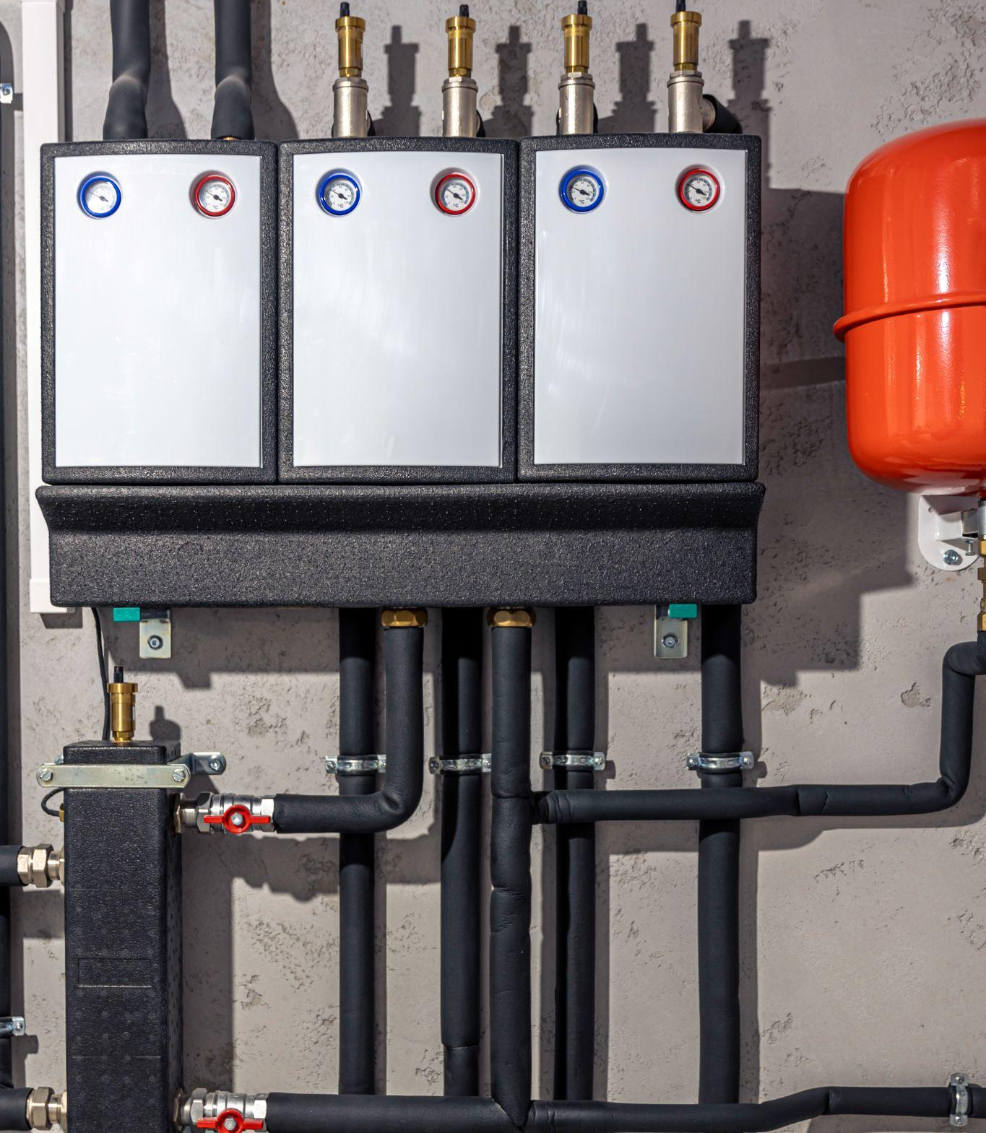
Introduction / Starter
Warm-up: What could go wrong if a system is installed without following the regulations?
In pairs: list three 'regulations' you think apply (energy, electrics, hot water safety).
Share back with your tutor: which stage of a project is highest risk? Design, install or commissioning? And why?
Notes:
Aim: activate prior knowledge and frame why compliance matters.

Slide 3

Objectives
You should be able to:
Recall the main requirements affecting low carbon heating systems.
Explain how regulations, standards and manufacturer instructions work together to ensure project compliance.
Apply requirements across the main stages: design → install → commission → maintain.
You might also be able to:
Justify what evidence/records demonstrate compliance for a job.

Slide 4

What counts as a requirement when installing low carbon heating systems?
Legislation and regulations (legal duties)
Approved Documents (Building Regulations guidance)
British/European Standards (methods and specifications)
Approved Codes of Practice (ACOP) (accepted safe practice)
Manufacturer instructions (must-follow install/operate/maintain requirements)
Notes:
Key message: compliance uses ALL of these—together.

Slide 5
Building Regulations: Key Approved Documents (slide 1 of 2)
Part L – conservation of fuel and power (efficiency expectations): sets energy efficiency requirements to reduce heat loss and improve overall building/system performance.
Part P – electrical safety (safe design/installation/testing): covers electrical safety for installation work, including safe design, connection, isolation and testing.
Part G – hot water safety and water efficiency (scald prevention): focuses on hot water safety and water efficiency, including measures to prevent scalding.
Notes:
Show link – https://www.gov.uk/government/collections/approved-documents

Slide 6
Building Regulations: Key Approved Documents (slide 2 of 2)
Part F – ventilation (affects heat loss and IAQ): sets ventilation requirements to maintain indoor air quality and manage moisture, impacting heat loss.
Part H – drainage and waste (condensate/pipework interfaces): covers drainage and waste systems, including safe disposal of condensate and correct pipework connections.
Part J – combustion appliances (hybrid/existing systems context): covers combustion appliances and flues, relevant where existing boilers remain or hybrid systems are used.
Notes:
Show link – https://www.gov.uk/government/collections/approved-documents

Slide 7
Recap checkpoint 1 (5 mins)
Quick questions:
1) Which Approved Document links most to electrical work on a heat pump?
2) Which Approved Document links most to hot water safety on an Unvented cylinder?
3) Give one reason Part F (ventilation) matters to heating design?
4) What’s the risk of relying on memory or past installations instead of checking requirements?
Notes:
Suggested answers:
1) Part P
2) Part G
3) Ventilation affects heat loss and IAQ
4) Non-compliance, safety risk, poor performance, failed inspection.
Optional: run a 3–5 minute Wordwall/Quizizz using these questions (quiz built separately).

Slide 8
Video break
Video 1: UK Building Regulations Explained Simply (6 minutes)
After the video, discuss:
What are building regulations and why do they exist?
Video 2: PART P WHAT IS IT? The Building Regulations and Approved Document P. (17 minutes)
After the video, discuss:
What electrical work is controlled?
What evidence/certification might be needed?
Notes:
https://www.youtube.com/watch?v=NaOjeAxZbFs
https://www.youtube.com/watch?v=mX_BZynfUdg

Slide 9
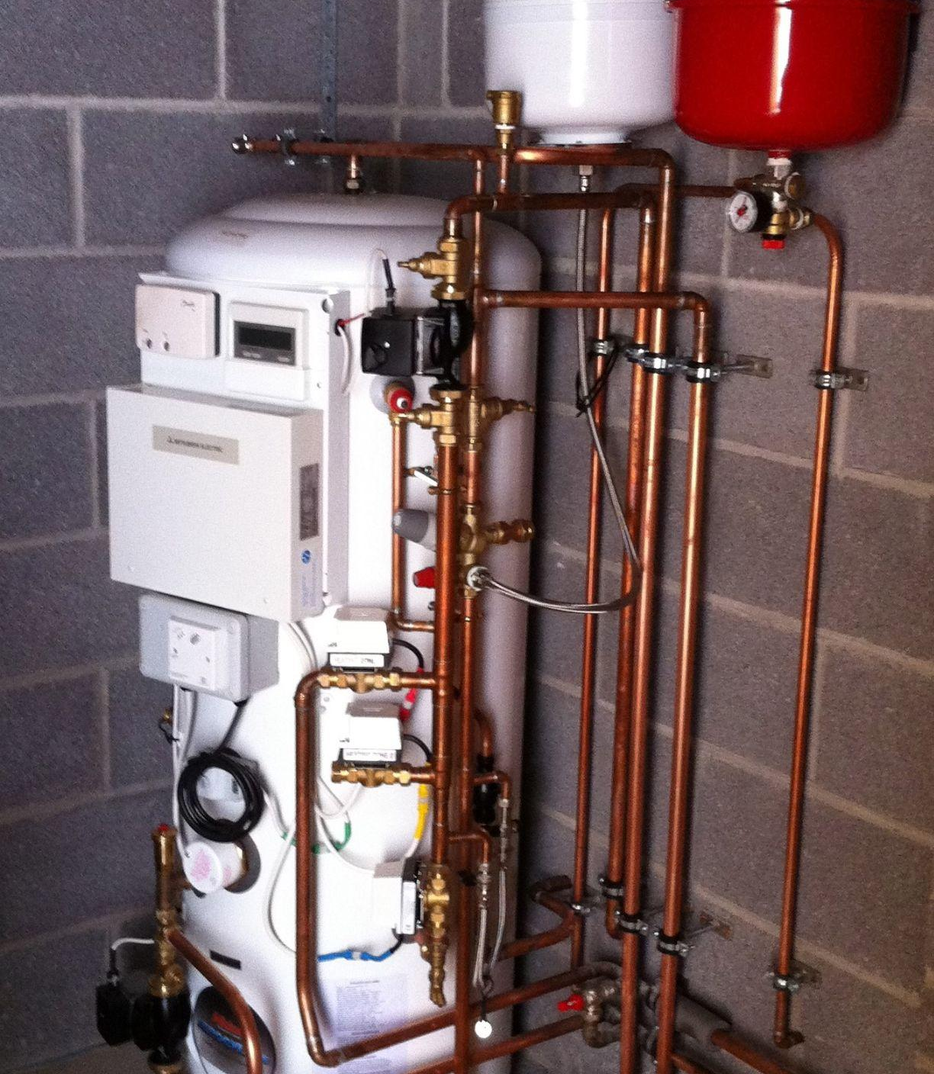
Water systems: safety and compliance (slide 1 of 5)
Water Supply (Water Fittings) Regulations: prevent contamination/backflow. Heat pump and hot water systems connect into the cold-water supply, so the Water Supply (Water Fittings) Regulations ensure installations include correct backflow prevention and approved fittings to stop contaminated water (e.g. from heating circuits, inhibitors/antifreeze, filling loops) flowing back into the mains.
Unvented hot water systems – correct safety controls and installation, must be installed with the correct multi-stage safety controls (thermostat, overheat cut-out, and temperature/pressure relief) and the work must be notified to Building Control (or self-certified via a Competent Person Scheme with the appropriate certificate) to confirm it meets Building Regulations.

Slide 10
Water systems: safety and compliance (slide 2 of 5)
Legionella awareness: HSE ACOP L8 – control measures and regimes – see next slide
https://www.hse.gov.uk/pubns/priced/l8.pdf
Temperature control devices: TMVs / blending valves / anti-scald, thermostatic valves that blend hot and cold to deliver a safe outlet temperature.
TMV1 for single-outlet applications (e.g. one basin)
TMV2 for multi-outlet/domestic use (e.g. bathrooms with multiple taps/showers), supporting scald prevention while allowing higher storage temperatures where required
TMV3 – healthcare/high-risk use, higher performance and fail-safe protection

Slide 11
Water systems: safety and compliance (slide 3 of 5)
Legionella control (ACOP L8) – key temperatures & design link
Avoid 20–45°C standing water (Legionella growth range)
Hot water storage: aim for ≥60°C
Hot water at outlets: ≥50°C within 1 minute (manage scalding with TMVs where required)
Cold water: keep ≤20°C
Low carbon heating: heat pumps often run at lower temps, so design/controls must include a clear Legionella control approach (settings/schedules) and record it in commissioning/handover docs
If not managed: lukewarm stored water + low turnover can increase health risk and lead to remedial works (re-commissioning/control changes)
Notes:
ACOP L8 is the HSE’s recognised guidance for controlling Legionella risk in water systems. The key point for learners is that Legionella can multiply when water sits for long periods in the “growth zone” (roughly 20–45°C). In low carbon heating, this matters because heat pumps often run efficiently at lower temperatures, and if a hot water cylinder is set too low or oversized for the demand, water can remain warm and stagnant for longer. Good design and handover therefore need a clear control strategy: keep hot water storage at around 60°C (where applicable), ensure hot water reaches 50°C at outlets within 1 minute, and keep cold water at or below 20°C. Where higher hot water temperatures create scald risk, thermostatic mixing valves (TMVs) can be used at outlets to protect users while still allowing safe storage temperatures. A simple scenario is a home with low hot water demand and a large cylinder: if the system is left running at lukewarm temperatures to improve efficiency, the risk increases. The “design link” is that installers must consider and document the Legionella regime (settings, schedules, and user guidance) during commissioning/handover so the system can be operated safely over time.

Slide 12
Water systems: safety and compliance (slide 4 of 5)
If not managed: A heat pump system is set up to run hot water at low temperatures to maximise efficiency, and a large cylinder stores warm water for long periods with little turnover.
Without a suitable Legionella control approach, conditions can allow bacteria to multiply, leading to a serious health risk, customer complaints, and remedial work (e.g. temperature adjustments, disinfection, re-commissioning, and revised user guidance).
Notes:
ACOP L8 is the HSE’s recognised guidance for controlling Legionella risk in water systems. The key point for learners is that Legionella can multiply when water sits for long periods in the “growth zone” (roughly 20–45°C). In low carbon heating, this matters because heat pumps often run efficiently at lower temperatures, and if a hot water cylinder is set too low or oversized for the demand, water can remain warm and stagnant for longer. Good design and handover therefore need a clear control strategy: keep hot water storage at around 60°C (where applicable), ensure hot water reaches 50°C at outlets within 1 minute, and keep cold water at or below 20°C. Where higher hot water temperatures create scald risk, thermostatic mixing valves (TMVs) can be used at outlets to protect users while still allowing safe storage temperatures. A simple scenario is a home with low hot water demand and a large cylinder: if the system is left running at lukewarm temperatures to improve efficiency, the risk increases. The “design link” is that installers must consider and document the Legionella regime (settings, schedules, and user guidance) during commissioning/handover so the system can be operated safely over time.

Slide 13
Water systems: safety and compliance (slide 5 of 5)
Design link (how it must be considered): As part of system design and handover, Legionella risk must be considered by planning an appropriate control strategy for domestic hot water (e.g. correct storage/distribution temperatures where required, cylinder sizing to match demand and avoid long stagnation periods, and an agreed ‘Legionella regime’/pasteurisation approach where specified by manufacturer or site policy).
This should be reflected in commissioning records and user guidance so the system can be operated safely.
Notes:
ACOP L8 is the HSE’s recognised guidance for controlling Legionella risk in water systems. The key point for learners is that Legionella can multiply when water sits for long periods in the “growth zone” (roughly 20–45°C). In low carbon heating, this matters because heat pumps often run efficiently at lower temperatures, and if a hot water cylinder is set too low or oversized for the demand, water can remain warm and stagnant for longer. Good design and handover therefore need a clear control strategy: keep hot water storage at around 60°C (where applicable), ensure hot water reaches 50°C at outlets within 1 minute, and keep cold water at or below 20°C. Where higher hot water temperatures create scald risk, thermostatic mixing valves (TMVs) can be used at outlets to protect users while still allowing safe storage temperatures. A simple scenario is a home with low hot water demand and a large cylinder: if the system is left running at lukewarm temperatures to improve efficiency, the risk increases. The “design link” is that installers must consider and document the Legionella regime (settings, schedules, and user guidance) during commissioning/handover so the system can be operated safely over time.

Slide 14
Video break (5–8 mins)
Topic:
Water regulations
Unvented hot water cylinder safety controls (G3 context)
After the video, discuss:
• What are the key safety devices?
• Why is correct installation critical?
Notes:
YouTube link (Baxi Training Tuesday – unvented cylinder safety tiers):
https://www.youtube.com/watch?v=NhF5RtMDEoQ
Water regulations
https://www.youtube.com/watch?v=bU4MXaXk1Es&t=876s
Unvented
https://www.youtube.com/watch?v=NhF5RtMDEoQ
Do not show link on slide; open from notes.
Keep at awareness level: safety devices + importance of compliance.

Slide 15
Standards and guidance referenced in the specification
BS EN 12831-1: method for calculation of design heat load – ensures heat pumps are sized from an accurate heat loss figure, preventing oversizing/undersizing and improving efficiency.
EN 8558: water services design/installation/testing/maintenance guidance: guides compliant cold/hot water service design (e.g. correct pipe sizing, backflow prevention, commissioning), which affects heat pump hot water systems.
Domestic Building Services Compliance Guide: benchmarks and evidence – drives the need for proper commissioning settings/records (e.g. temperatures, controls) as evidence the low carbon system meets Building Regs.
Other relevant BS/EN standards for components and installation practices, influence correct selection/installation of components (e.g. valves, safety devices, pipework materials/insulation), reducing faults and improving performance.

Slide 16
Stop point: Quiz / Wordwall (5–10 mins)
Suggested quick quiz: 'Match the requirement to the job stage'
Examples:
• Part L → design efficiency decisions
• Manufacturer instructions → install/commission settings
• BS EN 12831-1 → heat loss method
Tutor: run a Wordwall/Quizizz here (quiz built separately).
Notes:
Purpose: break up theory and check understanding.

Slide 17

Planning and permitted development (slide 1 of 2)
Permitted development is a set of UK planning rules that allow certain types of home improvements (including some heat pump outdoor units) to be installed without applying for full planning permission, as long as the work meets specific conditions and limits (e.g. location, size/position, and impact such as noise). If the install doesn’t meet those conditions, you may need to submit a planning application.
Permitted development may apply to domestic heat pump outdoor units, allowing installation without full planning in some cases (subject to conditions).
Notes:
Planning portal website
https://www.planningportal.co.uk/permission/interactive-guidance

Slide 18
Planning and permitted development (slide 2 of 2)
Siting constraints matter (e.g. distance to boundaries/other dwellings) to minimise neighbour impact and meet scheme/planning requirements.
Noise must be designed-in — unit selection, location, mounting and screening can affect compliance and complaints.
Always confirm local requirements with the local authority/Planning Portal before finalising design and positioning.
Further details on planning requirements can be found within the planning portal website.
Notes:
Planning portal website
https://www.planningportal.co.uk/permission/interactive-guidance

Slide 19
Mini case study: existing system / hybrid context (task 1 of 2)
Planning & legal compliance
Scenario: A homeowner wants an air source heat pump installed on the side of a semi-detached property, close to the boundary and near a neighbour’s bedroom window. The customer wants it fitted ‘as soon as possible’ without delays.
Task 1: learners to identify and discuss the following:
Check whether the proposal is likely to fall under permitted development or may require planning permission.
Identify key siting constraints (e.g. proximity to boundaries/other dwellings) and noise considerations that could affect compliance.
Identify any other relevant legal / regulatory requirements that might apply (e.g. Building Regulations areas, manufacturer instructions, certification scheme evidence).
Decide what evidence you would collect and record before confirming the final location.
Notes:
Tutor prompts:
Direct learners to use the Planning Portal and local authority guidance; remind them to work within competence and escalate where needed. Encourage learners to reference evidence (not assumptions) and to record sources used.
- Part J relevance is contextual (existing/hybrid systems).
- Keep to awareness level: identify applicable regs and the need to refer to competent persons when appropriate.

Slide 20
Mini case study: existing system / hybrid context (task 2 of 2)
Scenario: A homeowner wants an air source heat pump installed on the side of a semi-detached property, close to the boundary and near a neighbour’s bedroom window. The customer wants it fitted ‘as soon as possible’ without delays.
Task 2: Learners to record the following:
A short Compliance & Siting Summary (bullet list) stating:
  planning route (PD vs. planning) and why
  risks/constraints found
  actions required (e.g. consult local authority, adjust sitting, use mitigation)
  what you would document for the job file.
Notes:
Tutor prompts:
Direct learners to use the Planning Portal and local authority guidance; remind them to work within competence and escalate where needed. Encourage learners to reference evidence (not assumptions) and to record sources used.
- Part J relevance is contextual (existing/hybrid systems).
- Keep to awareness level: identify applicable regs and the need to refer to competent persons when appropriate.

Slide 21

Certification Scheme Standards (Examples)
Installer certification schemes (MCS / Flexi-Orb) – why they matter
MCS and Flexi-Orb set installation standards and specify evidence for compliant, quality work.
Why become registered?
What schemes typically require
Builds trust and supports consistent quality assurance
Supports access to consumer protections and recognised pathways
Often required for funding routes or market access
Reduces callbacks via strong design + commissioning
Evidence Pack Contents:
Design: Heat loss/sizing, component rationale
Commissioning: Test results, flow/temps, balancing
Handover: User guidance, settings, maintenance
Applies across the full job cycle:
Design → Install → Commission → Handover
Umbrella Schemes:
Larger organisations hold registration; smaller installers work under their processes. Must still meet the same standards, keep records, and follow rules for sign-off.
Notes:
Resources;
MCS Website
Video Overview
Keep this practical: explain that scheme standards typically define minimum evidence for quality installations and often tie directly to how a job is audited. Use examples learners recognise: “If heat loss isn’t evidenced, the heat pump selection can’t be justified; if commissioning records aren’t complete, performance and warranty/certification can be challenged.” For umbrella arrangements, stress boundaries: learners must understand who can sign off and what documentation must be stored in the job file.

Slide 22
What evidence demonstrates compliance?
Flexi-Orb (Flexible Energy Oversight Registration Body)
A UK installation standards certification scheme (UKAS-recognised) designed to improve installation quality and consumer protection.
INS-001 Installation Scheme covers:
  Solar PV (up to 50 kW)
  Electrical Energy Storage Systems (EESS) (up to 50 kWh)
  EV Charge Points (EVCP) (up to 22 kW)
Heat pumps (link to low carbon heating): Flexi-Orb has a Heat Pump Code of Practice, but it covers the ‘wet side’ only (hydronic/heating-water side). Refrigerant circuit work is excluded and must be covered by separate refrigerant-handling competence/qualification.
Why it matters (same principle as MCS): scheme standards typically require evidence (design decisions, commissioning records, handover information) and promote consistent, compliant installations.
Further information can be found within the Flexi-orb website
Notes:
Show link – What is Flexi-Orb? A quick introduction
Keep this slide general and aligned to K1.4 (how requirements are applied across stages). Avoid diving into K1.41 detail here—just awareness of evidence types.

Slide 23
Recap checkpoint 2 (5 mins)
Check for understanding:
1) Give two types of evidence often required for quality assurance under MCS registration.
2) Name one siting/planning factor checked before installation.
3) What document must you always follow during installation and commissioning?
Notes:
Suggested answers:
1) Design calcs + commissioning records (examples)
2) Boundary distance / permitted development / noise
3) Manufacturer instructions (plus applicable regs/standards).
Optional: quick Wordwall/Quizizz (quiz built separately).

Slide 24
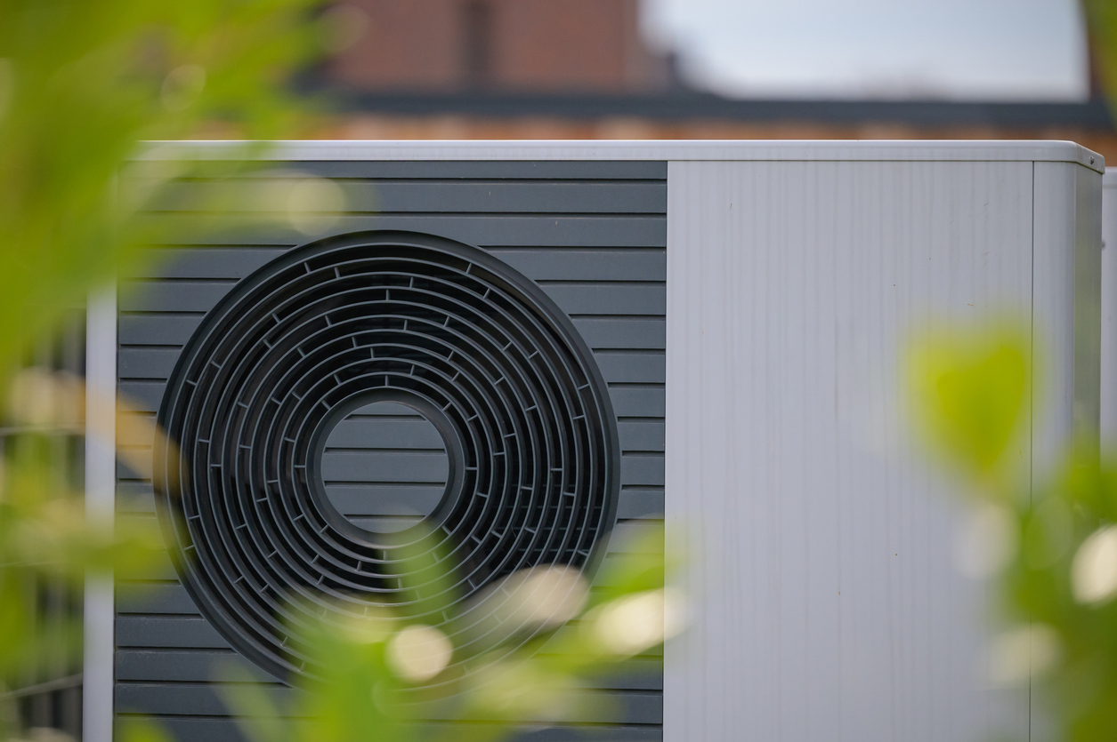
Applying requirements across the job stages (slide 1 of 2)
How requirements are applied across the job stages (low carbon heating & hot water)
Design: apply regs/standards to heat loss and sizing, and check siting/planning constraints
  e.g. use a recognised heat loss method, select suitable emitters/flow temps, and confirm location/noise/planning considerations.
Install: apply manufacturer instructions plus relevant regs/standards to ensure compliant workmanship
  e.g. install components exactly to manuals, use correct materials/pipework/insulation, and follow safe electrical and hot water safety requirements.
Continued on next slide

Slide 25
Applying requirements across the job stages (slide 2 of 2)
How requirements are applied across the job stages (low carbon heating & hot water)
Commission: apply industry checks/testing and complete accurate records to verify performance and compliance
  e.g. confirm temperatures/flows/pressures/controls, complete soundness/performance testing as required, and produce commissioning and handover documentation.
Maintain: apply service requirements and documentation to keep the system safe, efficient and compliant over time
  e.g. routine servicing to manufacturer guidance, methodical fault diagnosis, record keeping, and escalation to competent specialists where required.

Slide 26
Stop point: 3-minute speed round
Tutor-led rapid questions (hands-up or mini whiteboards):
1) Which document tells you what 'good practice' looks like?
2) Which documents guide compliance with Building Regulations?
3) What do standards help with?
4) What overrides your 'usual way'?
Notes:
1. (ACOP)
2. (Approved Docs)
3. (consistent methods/specifications)
4. (manufacturer instructions)
Suggested answers in brackets.
Optional: convert into a quick quiz tool (Wordwall/Quizizz).

Slide 27
Responsibility and accountability (slide 1 of 2)
Responsibility for safety & compliance (who does what?)
HASWA 1974 (Health and Safety at Work etc. Act 1974) is the main UK law that sets out who is responsible for health and safety at work
Employer / company (organisation / duty holder): must provide safe systems of work (policies, RAMS/permits), competent supervision/training, suitable equipment, and ensure work is planned and managed to meet legal duties and codes of practice.
Contractor / installer: must deliver work to relevant regulations, standards and manufacturer instructions, manage risks on site, coordinate other trades, and ensure required notifications/certification routes are followed (e.g. Building Control or Competent Person Scheme where applicable).
Continued on next side

Slide 28
Responsibility and accountability (slide 2 of 2)
Responsibility for safety & compliance (who does what?)
Individual engineer: must work safely, follow procedures, use PPE correctly, stay within competence, and refuse/stop work if it becomes unsafe or beyond scope; report hazards/near misses and cooperate with site rules.
Competent person: only appropriately certified persons should carry out work in regulated areas (e.g. Gas Safe, OFTEC, F-Gas, and certain electrical/unvented works depending on scheme/role). If it crosses into regulated scope → escalate.
Sign-off & evidence: only sign/certify what you are competent and authorised to sign; keep clear records (design evidence, commissioning results, handover info, maintenance logs) – this protects the customer, the business, and the engineer.

Slide 29

Implications of non-compliance
Safety risks to occupants and installers
Poor system efficiency and complaints
Invalid warranty/certification; failed audits/inspections
Rework costs, delays and reputational damage
Potential legal consequences where duties are breached

Slide 30
Activity (10–15 mins): compliance mapping
Match each scenario to the main requirement(s):
1) Outdoor unit close to neighbour boundary
2) Unvented cylinder lacks correct safety controls
3) Electrical supply altered for heat pump connection
4) Commissioning record incomplete at handover
Discuss: what evidence would you keep? who might you involve?
Notes:
Suggested mapping (high level):
1) Planning/permitted development + siting/noise considerations
2) Part G + manufacturer instructions (and competence requirements)
3) Part P + safe isolation/testing + competent electrician if needed
4) Manufacturer/scheme requirements + commissioning documentation.

Slide 31
Knowledge check (end of session)
1) Name 3 Approved Documents relevant to low carbon heating installations.
2) Why must manufacturer instructions be followed?
3) Give two examples of compliance evidence produced at commissioning/hand over.
4) When should you stop and refer to another competent person?
Notes:
Use for short written responses or discussion.
Keep answers aligned to K1.4.

Slide 32
Summary of session
You should now be able to:
Recall key UK requirements affecting low carbon heating systems
Explain why manufacturer instructions matter alongside regulations
Apply requirements across design, installation, commissioning and maintenance
Identify consequences of non-compliance and when to refer

Slide 33
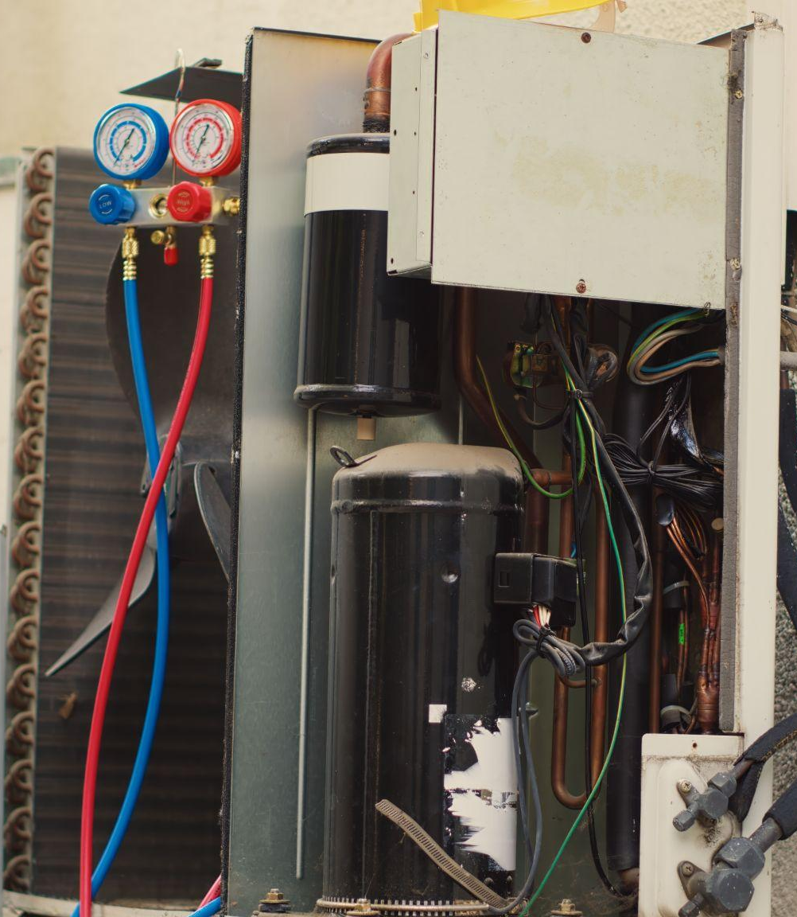
Preview of next session
Next: K1.5 F-Gas regulations (awareness)
What are F-gases and why are they regulated?
When is F-Gas certification required?
Safe behaviours and when to involve a competent F-Gas engineer
Notes:
Reminder: place any video links in notes/SoW only.

Slide 34
Any questions?
Copyright in this document belongs to and is used under licence from the Department for Education, © 2025.
‘T-LEVELS’ and ‘T Level’ are registered trademarks of the Department for Education.
WJEC is authorised by the Department for Education to develop and deliver this T Level Technical Qualification.
WJEC operates in England under the name Eduqas which is a registered trademark of WJEC.
Notes:
Capture misconceptions and signpost where to find requirements (manuals, standards, site procedures).

