Slide 1
Occupational specialism: Low Carbon Engineering
PowerPoint 1.22: Scientific principles and concepts

Slide 2
Specification coverage: What K1.22 requires
Vapour compression system
Four-stage cycle
Heat transfer, pressure and phase change
Heating, DHW, cooling and defrost links.
Refrigerant circuit components
Evaporator
Compressor
Condenser
Expansion valve/phial, drier/receiver
Sight glass
Four-way valve/hot gas bypass.
Sensors, switches and controls
Pressure transducer
RTD
Inverter controls
Low-pressure switch and high-pressure switch
Measurement
Protection
Modulation.
Notes:
Tutor notes / source trail:
Use this slide to show learners that all words in the criteria matter. The deck avoids teaching refrigerant handling procedures because sealed refrigerant work must only be undertaken by competent, qualified personnel. Learners should understand principles, likely symptoms and escalation boundaries.

Slide 3
Specification coverage: What K1.22 requires
Efficiency measurement
COP = useful heat output ÷ electrical input.
SCOP = seasonal view.
Parasitic losses explain the difference between appliance and system performance.
Solar energy principles
System types
Solar radiation
Absorption and conversion
Thermal storage
PV/PVT and thermoelectric conversion awareness.
Explain cause → effect → evidence → action boundary
Notes:
Tutor notes / source trail:
Use this slide to show learners that all words in the criteria matter. The deck avoids teaching refrigerant handling procedures because sealed refrigerant work must only be undertaken by competent, qualified personnel. Learners should understand principles, likely symptoms and escalation boundaries.

Slide 4
Why scientific principles matter on real jobs
Installer decisions are scientific decisions
Flow temperature changes compressor lift
Airflow and water flow affect heat transfer
Sensors change how the controller responds
DHW demand changes operating conditions
Poor insulation and auxiliary loads affect measured performance.
Good evidence prevents guesswork
Record readings:
Outdoor/source temperature
Flow/return temperatures
Cylinder recovery
Compressor status
Pump settings
Pressure/sensor values
Fault history.
A heat pump is a system of physics + controls
+ hydraulics + user behaviour
Notes:
Tutor notes / source trail:
Connect to practical site behaviour: learners should learn to ask what measurement supports an explanation. Energy Saving Trust field trials and installer guidance emphasise design, controls, insulation and user understanding as major factors in installed heat pump performance.

Slide 5


Vapour compression cycle: The core principle
↓ Heat absorbed from source
↑ Heat delivered to heating/DHW
STAGE 01 EVAPORATION
• Low pressure
• Low temperature
• Absorbs heat
STAGE 03
CONDENSATION
• High pressure
• Hot vapour
• Rejects heat
STAGE 02 COMPRESSION
• Pressure rises
• Temperature rises
• Work input
STAGE 04
EXPANSION
• Pressure drops
• Temperature drops
• Cycle resets
Notes:
Tutor notes / source trail:
EHPA describes the refrigerant cycle in four phases: evaporation, compression, condensation and expansion. Emphasise that a heat pump can deliver more heat than the electrical input because it moves environmental heat rather than converting electricity directly into heat.

Slide 6
Vapour compression cycle: The core principle
Key scientific idea
Refrigerants are selected because they boil and condense at useful temperatures. By changing pressure, the system changes the temperature at which the refrigerant evaporates or condenses.
Wording
“The compressor uses electrical work to raise refrigerant pressure and temperature so heat can be rejected at the condenser into the heating or hot-water circuit.”
Notes:
Tutor notes / source trail:
EHPA describes the refrigerant cycle in four phases: evaporation, compression, condensation and expansion. Emphasise that a heat pump can deliver more heat than the electrical input because it moves environmental heat rather than converting electricity directly into heat.

Slide 7

Stage 1: Evaporator - absorbing low-grade heat
What happens scientifically?
Low-pressure refrigerant enters as a cold liquid/vapour mixture
It absorbs latent heat from air, ground, water or exhaust air
It boils into vapour as energy is transferred
Airflow/brine flow and heat-exchanger cleanliness are critical
What can go wrong?
Restricted airflow or dirty coil
Ice build-up or failed defrost
Low source temperature/flow
Incorrect expansion control
Low-pressure faults or reduced output
Inspecting the installation context: airflow, condensate, access and clearances supporting heat transfer.
Notes:
Tutor notes / source trail:
Evaporator focus: In an air-source heat pump during heating mode, the outdoor coil is normally the evaporator. In ground/water systems the evaporator receives heat via brine or source water. Avoid asking learners to perform sealed refrigerant checks; focus on evidence and escalation.

Slide 8
Stage 2: Compressor – pressure lift and temperature rise
Function
Draws in low-pressure refrigerant vapour
Compresses it to high pressure and high temperature
Creates the “lift” needed to move heat from colder source to warmer heating water
Requires oil management and stable vapour return.
Design link
Higher flow temperature usually means higher pressure ratio, more electrical input and lower COP.
Oversized/undersized emitters and DHW settings can therefore affect compressor loading.
Protection link
Poor water flow, sensor faults, refrigerant restrictions or incorrect control setup can lead to high discharge temperatures, cycling, lockouts or long running hours.
Notes:
Tutor notes / source trail:
Compressor principle: increasing gas pressure raises gas temperature. Energy Saving Trust installer toolkit and NIBE explain pressure/temperature as the key principle. Inverter-driven compressors alter speed to better match part-load demand.

Slide 9
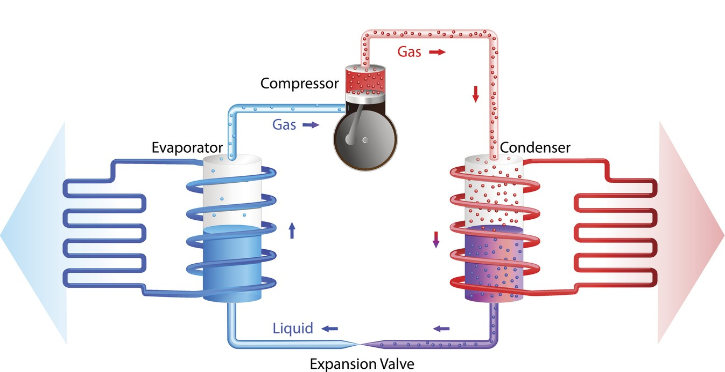
Stage 3: Condenser – rejecting useful heat
What happens scientifically?
Hot high-pressure vapour enters the condenser
Heat transfers into system water or DHW heat exchanger
Refrigerant condenses back to liquid
Condensing temperature rises when water temperature is higher
Notes:
Tutor notes / source trail:
The condenser transfers heat from refrigerant to the heating/DHW circuit. Poor heat rejection increases condensing pressure and can trigger high-pressure protection. This links to commissioning water flow, flushing, filters and hydraulic design.

Slide 10
Stage 3: Condenser – rejecting useful heat
Operating Impact
Poor heat rejection →
higher pressure
high-pressure trips
lower performance
Practical evidence
Check flow and return temperature difference
Confirm pump operation and water flow
Check strainer/filter and system cleanliness
Consider scale/sludge on heat exchangers
Compare live data with manufacturer guidance
Notes:
Tutor notes / source trail:
The condenser transfers heat from refrigerant to the heating/DHW circuit. Poor heat rejection increases condensing pressure and can trigger high-pressure protection. This links to commissioning water flow, flushing, filters and hydraulic design.

Slide 11
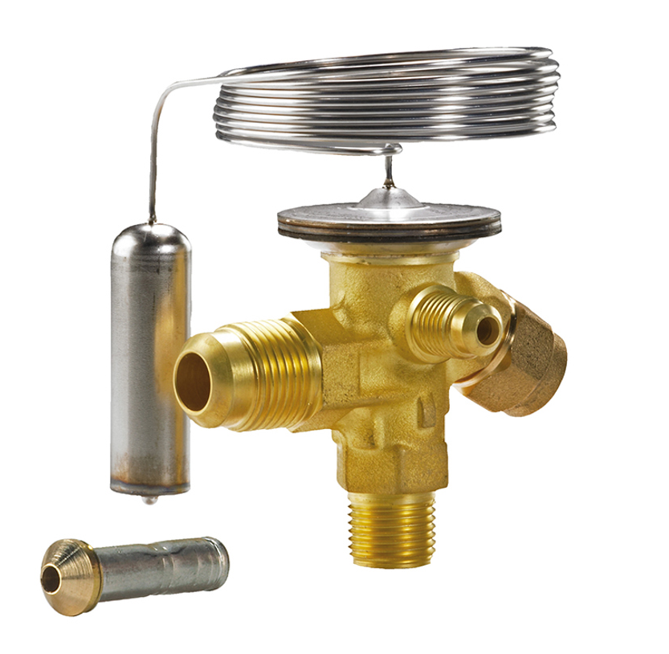
Stage 4: Expansion valve and phial
Expansion valve
Restricts and meters liquid refrigerant
Drops pressure and temperature before the evaporator
Helps maintain correct evaporator feeding
May be thermostatic or electronic
Expansion valve phial
Senses suction-line temperature
Allows thermostatic valve to respond to superheat
Must be correctly located and insulated
Incorrect placement can cause unstable control
Fault thinking
Too much refrigerant feed may risk liquid return; too little feed may starve the evaporator.
Notes:
Tutor notes / source trail:
Danfoss TE2 product imagery used as a representative thermostatic expansion valve. Danfoss describes TE valves as controlling liquid injection into evaporators based on superheat. Note competence boundaries: adjustment and refrigerant-side diagnosis should follow manufacturer instruction and F-Gas competence.
Learners should understand symptoms and escalation, not attempt refrigerant adjustment without competence.

Slide 12
Component map: Refrigerant circuit functions
Heat exchangers
Evaporator
absorbs source heat
Condenser
rejects useful heat
Pressure changing
Compressor
raises pressure
Expansion valve
reduces pressure
Conditioning / stability
Drier/receiver
support liquid quality
Sight glass
visual indication
Measurement / protection
Transducer + RTD
measure live values
LP/HP switches
protect at limits
Evaporator → Compressor → Condenser → Expansion → Evaporator
Delivery activity
Classify every component in the criteria under one of the four groups.
Then ask: “What evidence would prove this component was operating correctly?”
Notes:
Tutor notes / source trail:
This slide fulfils the component list at overview level. The following slides expand the scientific and practical function of sensors, switches, inverter control, liquid-line components and reversing/hot-gas control.

Slide 13
Measurement and protection: Why controls need sensors
Measurement inputs
Pressure transducers
RTDs / thermistors
Flow and return sensors
Outdoor/source sensors
Cylinder/DHW sensors
Compressor discharge temp
Protection inputs
Low-pressure switch
High-pressure switch
Flow switches
Over-temperature protection
Electrical protection
Anti-freeze/frost protection
Controller outputs
Compressor speed, expansion valve position, fan speed, primary pump speed, defrost sequence, three-port valves, DHW priority and backup/immersion decisions.
Notes:
Tutor notes / source trail:
The internal heat pump image shows component density and sensor/control wiring. Use it to emphasise that digital diagnostics are helpful but are not a substitute for checking physical conditions and manufacturer data.

Slide 14
Pressure transducer vs LP/HP switches
Pressure transducer
Gives live pressure signal to controller
Allows modulation and diagnostics
May help calculate saturated temperatures
Faulty signal can mislead control logic
Low-pressure switch
Opens/trips if suction pressure falls below safe limit
Can indicate low source energy, low airflow/brine flow, refrigerant shortage or restriction
Protects against compressor damage
High-pressure switch
Opens/trips if discharge/condensing pressure rises too high
Can indicate poor water flow, blocked filter, high flow set point, fouled exchanger or control problem
Protects components and pipework
Do not reset repeatedly without identifying the cause – protection trips are evidence.
Notes:
Tutor notes / source trail:
Source trail: CAREL/Schiessl product data describes ratiometric pressure transducers used on refrigerant lines. Use manufacturer manuals for exact wiring, calibration and diagnostic values. Emphasise switch vs. transducer distinction.
Learner question
A high-pressure fault appears after DHW heating starts. What evidence would you gather before concluding it is a refrigerant-side fault?

Slide 15
RTD / resistance temperature devices
Scientific principle
Resistance temperature devices change electrical resistance as temperature changes.
The controller interprets this signal as temperature.
Common sensing points
Outdoor air/source, evaporator coil, suction line, discharge line, flow/return water, buffer/low-loss header, DHW cylinder and indoor/room references.
Installation quality
Correct pocket/contact, thermal paste where specified, insulation, cable routing, dry connections and manufacturer-compatible sensor type all matter.
Notes:
Tutor notes / source trail:
Reference note: RTDs such as Pt100/Pt1000 are used in HVAC and industrial automation. Sensor errors can cause false temperatures, unnecessary defrost, incorrect pump operation, DHW overheating/underheating, or compressor protection responses.

Slide 16
Inverter controls: Matching output to demand
Why it helps
Smoother heat output
Less cycling at part load
Better comfort and steadier flow temperature
Potentially improved seasonal performance
What it needs
Accurate temperature and pressure inputs
Correct flow rate and system volume
Compatible controls and settings
Stable heating demand / weather compensation
Practical implication
If minimum output is higher than the building load, cycling may still occur.
Buffer/volumiser, controls and emitter sizing must match the manufacturer’s guidance.
Notes:
Tutor notes / source trail:
An inverter-driven compressor adjusts speed using variable frequency control. It does not solve poor design automatically: minimum modulation, water volume, flow rates and controls still matter. Link to K1.15 control systems and K1.33 design factors.

Slide 17
Liquid line components: Drier, receiver and sight glass
Filter drier
Removes moisture and captures contaminants. Moisture can form acids, freeze at the expansion device and damage compressor oil.
Receiver
Stores liquid refrigerant where system design requires it. Helps maintain a stable supply during changes in operating conditions.
Sight glass
Allows visual checks such as flow condition and moisture indicator colour. Bubbles need careful interpretation and are not a standalone diagnosis.
Notes:
Tutor notes / source trail:
Danfoss reference: filter driers and sight glasses protect refrigeration systems and provide indication of moisture/contamination problems. In heat pump training, avoid simplistic “bubbles = low gas” conclusions; assessment must use manufacturer data and qualified competence.

Slide 18
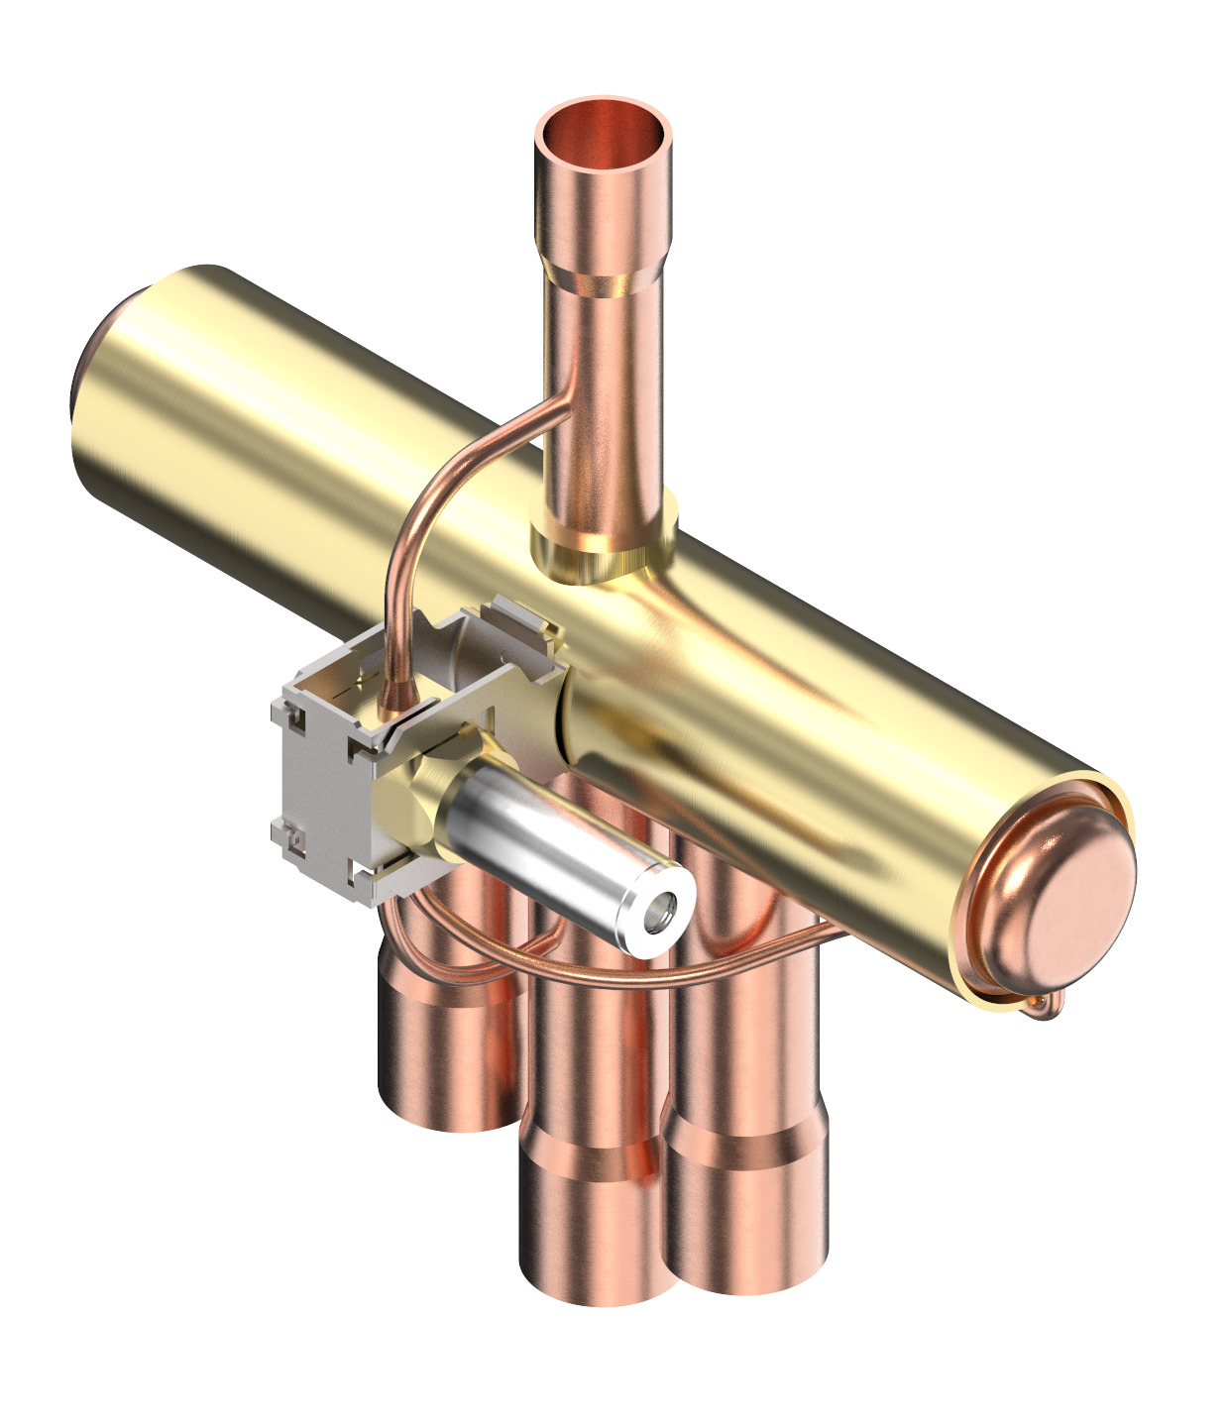
Four-way reversing valve and hot gas bypass
Four-way reversing valve
Changes refrigerant flow direction
Enables reversible heat pump operation
Used for heating/cooling changeover
Often used in reverse-cycle defrost
Hot gas bypass
Routes hot discharge gas to manage operating conditions
May support defrost or low-load protection in some designs
Not present in every domestic heat pump
Defrost link
During cold damp weather, frost on the evaporator reduces heat transfer. The system may temporarily divert heat to melt ice, reducing delivered heat and consuming energy.
Notes:
Tutor notes / source trail:
Danfoss 4-way reversing valve image used as representative. Danfoss states that four-way valves allow inversion of refrigeration cycle in reversible applications such as heat pumps. Connect this to defrost and learner complaints about cold-weather performance.

Slide 19
How components work together under control
Inputs
• Outdoor/source temp
• Flow + return temp
• Cylinder temp
• Pressure transducer
• Switches/protection
• Demand signals
Controller decisions
• Compressor speed
• Expansion valve position
• Fan/pump speed
• Heating vs. DHW priority
• Defrost timing
• Fault lockout
Outputs
• Heat to emitters
• Heat to cylinder
• Cooling if reversible
• Compressor protection
• Fault codes
• Performance data
Important
A control fault can look like a refrigerant fault. A hydraulic fault can look like a control fault. Good diagnosis starts with measured evidence and the manufacturer’s sequence of operation.
Notes:
Tutor notes / source trail:
Use this slide as a bridge to K1.15 controls and K1.44 fault diagnosis. Stress the relationship between measurement, control output and symptoms.

Slide 20
Component symptom matrix
Component
Scientific role
Possible symptom/evidence
Evaporator
Absorbs heat / boiling
Icing, low pressure, poor output
Compressor
Raises pressure/temp
High current, noise, lockout, low lift
Condenser
Rejects useful heat
High pressure, poor ΔT, hot flow
Expansion valve
Meters / pressure drop
Starving, flooding, unstable superheat
Sensors/switches
Measure/protect
False readings, trips, diagnostic codes
Notes:
Tutor notes / source trail:
This slide is intended to move learners from recall to applied thinking. It supports assessment themes around faults, report information and customer communication.

Slide 21
Component symptom matrix
Activity
Pick one symptom and explain:
what data would you record
what safe checks could you complete, and
when would you escalate to a qualified refrigeration engineer or manufacturer?
Notes:
Tutor notes / source trail:
This slide is intended to move learners from recall to applied thinking. It supports assessment themes around faults, report information and customer communication.

Slide 22
Competence boundaries: Understand, record, escalate
Be able to:
Explain component functions
Interpret basic symptoms
Gather readings safely
Use manufacturer documentation
Communicate likely causes
Identify escalation boundaries
Do not imply competence to:
Open refrigerant circuits
Recover or charge refrigerant
Adjust sealed-circuit components outside instructions
Bypass pressure switches
Repeatedly reset safety lockouts
Professional evidence
A competent report separates: observed evidence, measured values, likely causes, safety actions, customer advice and referral to qualified support.
Notes:
Tutor notes / source trail:
Refer to F-Gas competence and manufacturer instructions as appropriate. The learner outcome is to understand principles and communicate competently, not perform specialist refrigerant tasks unless separately trained and qualified.

Slide 23
Competence boundaries: Understand, record, escalate
Important safety principle
Scientific understanding improves safety: protection devices are there for a reason.
Notes:
Tutor notes / source trail:
Refer to F-Gas competence and manufacturer instructions as appropriate. The learner outcome is to understand principles and communicate competently, not perform specialist refrigerant tasks unless separately trained and qualified.

Slide 24
Measuring efficiency: COP
Formula
COP = useful heat output ÷ electrical input
Example:
9 kW heat output ÷ 3 kW electrical input = COP 3.0
Why COP changes
• Outdoor/source temperature
• Flow temperature
• DHW temperature target
• Defrost operation
• Compressor speed/load
• Water/air flow and heat transfer
Do not say “300% efficient” without context
COP above 1 is possible because the heat pump moves environmental heat. COP is not a fixed annual running cost figure.
Illustrative relationship: lower flow temperature usually means lower compressor lift
4.4
3.7
3.0
35°C
45°C
55°C
Not manufacturer data — use specific product tables and BS EN 14825/MCS calculations.
Notes:
Tutor notes / source trail:
Energy Saving Trust installer toolkit describes CoP as heat output per unit of electricity and notes typical values around 2.5–4 in simple terms. ISO 13256 defines COP as net heating capacity divided by effective power input at rating conditions.

Slide 25
Seasonal efficiency: SCOP
Assessment wording
SCOP is useful for comparing expected seasonal performance, but the installed result depends on the property, controls, emitters, DHW demand and parasitic losses.
COP vs. SCOP vs. SPF
COP = snapshot
SCOP = standardised seasonal calculation
SPF = measured seasonal/system performance in use
COP considers:
• Weather / source temperature over time
• Part-load operation
• Cycling and modulation
• Flow temperature profile
• Defrost and standby modes
• Control strategy
Notes:
Tutor notes / source trail:
ETL air-to-water heat pump specification defines SCOP as overall coefficient of performance representative of the heating season, calculated as reference annual heating demand divided by annual energy consumption for heating, with BS EN 14825:2022 as the harmonised measurement standard.

Slide 26
Seasonal efficiency: SCOP
Key Testing Standard
BS EN 14825 is the key seasonal performance testing/rating framework for electrically driven heat pumps.
Notes:
Tutor notes / source trail:
ETL air-to-water heat pump specification defines SCOP as overall coefficient of performance representative of the heating season, calculated as reference annual heating demand divided by annual energy consumption for heating, with BS EN 14825:2022 as the harmonised measurement standard.

Slide 27
Parasitic losses: The hidden performance gap
Thermal losses
• Poorly insulated cylinders
• Uninsulated pipework
• Long external pipe runs
• Poor thermal store stratification
• Unnecessary DHW boosts
`
Electrical auxiliaries
• Circulation pumps
• Outdoor fans
• Controllers and standby loads
• Crankcase heaters
• Trace heating
• Zone valve/actuator loads
`
Design response
• Efficient pump settings
• Good insulation
• Correct controls
• Minimise standing losses
• Avoid competing heat sources
• Commission for actual use
`
System performance rule
System performance = compressor performance minus the losses added by the wider installation.
Notes:
Tutor notes / source trail:
Energy Saving Trust field trials and best-practice guidance link real performance to pipe/cylinder insulation, controls and circulation pump energy. Use this slide to show why appliance COP is not enough for whole-system assessment.

Slide 28
Worked efficiency example
Appliance COP
Heat output = 8 kW
Compressor input = 2 kW
COP = 8 ÷ 2 = 4.0
Add parasitic load
Pumps + controls = 0.3 kW
Total input = 2.3 kW
System COP = 8 ÷ 2.3
= 3.48
Learning point
The customer experiences the system result, not just the compressor test result. Good design reduces avoidable losses.
Discussion
Why could two heat pumps with the same declared COP have different running costs in two different houses?
Notes:
Tutor notes / source trail:
Use calculators sparingly but correctly. Ask learners to state units and assumptions. Reinforce that the formula is simple but the evidence required for real performance is more complex.

Slide 29
Design decisions that improve COP and SCOP
Reduce temperature lift
Lower flow temperature where emitters and comfort allow. Use weather compensation and correctly sized emitters.
Improve heat transfer
Clean filters, correct flow rates, adequate airflow/clearances, suitable cylinder coil and good water quality.
Control the whole system
Avoid unnecessary DHW boosts, poor scheduling, fighting heat sources, excessive set-backs and poor sensor positions.
Illustrative relationship: lower flow temperature usually means lower compressor lift
4.4
COP
35°C
3.7
COP
45°C
3.0
COP
55°C
Not manufacturer data — use specific product tables and BS EN 14825/MCS calculations.
Notes:
Tutor notes / source trail:
Link to K1.32/K1.33 system design. MCS MIS 3005-D and performance estimates rely on system design inputs, not just product selection. Use specific manufacturer data for actual flow-temperature SCOP values.

Slide 30
Solar energy: System types in low carbon projects
Solar thermal
Collectors heat a fluid that transfers heat into a cylinder or thermal store.
Best associated with DHW contribution.
Solar PV
PV cells convert light into electricity.
Electricity can support household loads, heat pump operation, batteries or immersion diverters.
PVT / hybrid panels
Combine PV electricity generation with a thermal collection function.
Design and maintenance requirements are more specialist.
Notes:
Tutor notes / source trail:
Energy Saving Trust describes solar water heating as roof-mounted collectors using energy from the sun to heat water in a cylinder or thermal store, usually alongside another heat source. Include PV/PVT awareness because low-carbon heating designs frequently coordinate electrical and thermal technologies.

Slide 31
Solar radiation: What reaches the collector
Radiation types
• Direct beam radiation
• Diffuse radiation from sky
• Reflected radiation from surfaces
• Seasonal variation
• Weather variation
Site factors
• Orientation and pitch
• Shading from trees/buildings
• Roof area and structure
• Collector angle
• Pipe route and heat loss
• Maintenance access
Design limitation
Solar contribution is variable. It can reduce annual energy use but should not be used to undersize a heat pump for winter design-day space heating.
Critical winter performance
Winter heating demand is often highest when solar availability is lower.
Notes:
Tutor notes / source trail:
Teach solar as a variable resource. South-facing orientation often maximises UK annual yield, but east/west arrangements may still be useful. Avoid oversimplifying; actual performance should be assessed by survey and design calculation.

Slide 32
Solar thermal collectors: Flat plate and evacuated tube
Flat plate collector
Glazed insulated box with dark absorber plate and pipework. Robust, common and suitable for many DHW applications.
Evacuated tube collector
Glass tubes reduce heat loss using a vacuum layer. Often used where higher temperatures or lower ambient losses are important.
System components
Collectors, solar pump station, controller, expansion vessel, safety devices, glycol mix, heat exchanger coil, cylinder/thermal store.
Design checks
Collector area, shading, roof loading, stagnation protection, glycol concentration, cylinder compatibility and safe maintenance access.
Notes:
Tutor notes / source trail:
SEAI and Energy Saving Trust homeowner guidance identify flat plate and evacuated tube collectors and emphasise storage/controls. Connect solar thermal to hot-water systems, glycol and thermal storage rather than space heating load sizing.

Slide 33
Absorption and conversion: Solar thermal vs. PV
Solar thermal conversion
Radiation → absorber plate/tube heat → glycol/water fluid → cylinder coil → stored hot water.
PV conversion
Light → photovoltaic effect → DC electricity → inverter → AC loads / battery / diverter / export.
Efficiency factors
Solar thermal: heat loss from collector and pipework. PV: cell temperature, inverter losses and shading. Both need correct design.
Hybrid approach (PVT)
Solar thermal makes heat. Solar PV makes electricity. PVT attempts to do both.
Notes:
Tutor notes / source trail:
Make the distinction clear. Learners often confuse PV electricity with solar thermal heat. The criteria also mention thermoelectric conversion; that is introduced later as a temperature-difference-to-electricity principle, separate from ordinary PV.

Slide 34
Thermal storage: Cylinders, stores and stratification
Why storage is needed
Solar gain and heat pump operation do not always match hot-water draw-off.
A cylinder or thermal store buffers energy for later use.
Stratification
Hotter water should remain near the top of the store.
Disturbing stratification can reduce usable hot water and increase reheating demand.
Control coordination
Solar thermal, heat pump and immersion/backup must be sequenced so one heat source does not unnecessarily override another.
Design details
Cylinder volume, coil surface area, insulation, sensor positions, anti-legionella strategy, expansion/safety controls and standing losses affect performance.
Notes:
Tutor notes / source trail:
Energy Saving Trust notes that heat can be stored in hot-water cylinders/thermal stores and that solar thermal systems usually heat water in a cylinder/thermal store. Stress heat pump-compatible coils and standing losses.

Slide 35
PV, PVT and heat pump integration
PV can support:
Heat pump electrical demand
Domestic loads
Battery charging
EV charging
Immersion diverter
Export to grid
Control priorities
Maintain comfort
Maintain safe DHW
Operate heat pump efficiently
Use solar/battery where available
Avoid unnecessary import/export
Important design point
PV reduces imported electricity over a year, but the heat pump still needs to be sized from heat loss at design conditions — not from expected solar generation.
Notes:
Tutor notes / source trail:
This slide aligns solar with low-carbon heating design. Solar PV can improve annual energy/carbon performance, but it does not replace the heat pump heat-loss design process.

Slide 36
PV, PVT and heat pump integration
PVT awareness
Photovoltaic-thermal systems may provide electrical output and useful heat, but design, controls, roof loading and maintenance need specific product guidance.
Notes:
Tutor notes / source trail:
This slide aligns solar with low-carbon heating design. Solar PV can improve annual energy/carbon performance, but it does not replace the heat pump heat-loss design process.

Slide 37
Thermoelectric conversion
Principle
Thermoelectric conversion uses a temperature difference to generate voltage/current. This is known as the Seebeck effect.
Different from PV
PV converts light directly into electricity. Thermoelectric conversion converts a temperature difference into electricity.
Low carbon relevance
Solar thermoelectric systems are emerging/specialist. Domestic projects mainly use solar PV, solar thermal or PVT rather than thermoelectric generation.
PV
light → electricity
Solar thermal
radiation → heat
Thermoelectric
ΔT → electricity
Notes:
Tutor notes / source trail:
Nature/Scientific Reports literature describes solar-thermal-electric conversion using thermoelectric converters and storage. For Level 3 domestic low-carbon heating, treat thermoelectric conversion as awareness of the scientific principle rather than mainstream practice.

Slide 38
Integrated low-carbon system example
Example system
ASHP serving low-temperature emitters
Heat-pump-compatible DHW cylinder
PV array and battery
Optional solar thermal coil
Weather compensation and DHW priority
Customer handover and monitoring
What must be coordinated?
Flow temperature
DHW pasteurisation/boosts
Cylinder sensors
PV diversion
Battery strategy
Immersion backup
Pump settings
Customer use patterns
Notes:
Tutor notes / source trail:
Use a domestic scenario: ASHP, 250 litre cylinder, PV, battery/diverter and controls. Ask learners to explain how heat and electricity flow through the system and how controls prevent conflict between sources.

Slide 39
Integrated low-carbon system example
Challenge
Trace the energy pathways:
environmental heat
electrical input
solar electricity
solar heat and stored hot water.
Which measurement would prove each pathway is working?
Notes:
Tutor notes / source trail:
Use a domestic scenario: ASHP, 250 litre cylinder, PV, battery/diverter and controls. Ask learners to explain how heat and electricity flow through the system and how controls prevent conflict between sources.

Slide 40
Scenario: Low-performance investigation
Customer report
“The heat pump runs for long periods and energy bills are high. Hot water sometimes needs an immersion boost.”
Given evidence
Flow temp often 55°C
Outdoor coil frosts frequently
Pump runs continuously
DHW boost scheduled daily
Cylinder recovery is slow
Filters not recently checked.
Possible causes to explore
High compressor lift
Poor heat transfer
Poor DHW coil sizing/control
Parasitic pump losses, sensor or defrost control issue
Customer schedule/boost settings.
Notes:
Tutor notes / source trail:
This scenario combines COP/SCOP, parasitic loads, flow temperature, evaporator heat transfer, DHW storage, control settings and maintenance. It prepares learners for fault-finding and customer communication without requiring refrigerant handling.

Slide 41
Scenario: Low-performance investigation
Task
Write a short technical note separating:
evidence
likely scientific principles
safe checks and
escalation boundaries.
Notes:
Tutor notes / source trail:
This scenario combines COP/SCOP, parasitic loads, flow temperature, evaporator heat transfer, DHW storage, control settings and maintenance. It prepares learners for fault-finding and customer communication without requiring refrigerant handling.

Slide 42
Knowledge check: Explain, do not just recall
1. Cycle
Name the four vapour-compression stages and state what changes in each stage.
2. Components
Explain the function of a pressure transducer, RTD, LP switch and HP switch.
3. Efficiency
Calculate COP for 10 kW output and 2.5 kW input. Then explain why SCOP may differ.
4. Solar
Compare solar thermal, PV, PVT and thermoelectric conversion in one sentence each.
5. Scenario
A heat pump shows high-pressure trips during DHW production. What evidence should be recorded before escalation?
6. Professional boundary
What can a low-carbon heating engineer check safely, and when is specialist F-Gas/ manufacturer support required?
Notes:
Tutor notes / source trail:
Suggested answers: evaporation, compression, condensation, expansion. Pressure transducer gives variable signal; switches protect at thresholds; RTD measures temperature through resistance change. COP = 10 ÷ 2.5 = 4.0. SCOP is seasonal. Solar thermal makes heat; PV makes electricity; PVT combines both; thermoelectric uses temperature difference to make electricity.
Task – Suggested timing: 10–15 minutes, then whole-group feedback.

Slide 43
Summary
Vapour compression uses phase change and pressure/temperature control
Components must be understood as a linked circuit
Sensors and protection devices turn science into safe control
COP is a snapshot; SCOP is seasonal
Parasitic losses affect real performance
Solar technologies use different conversion principles
Task
Complete the sentence: “A low-carbon heating system performs well when the scientific principles are supported by…”
Notes:
Tutor notes / source trail:
Source URLs: EHPA about heat pumps https://ehpa.org/about-heat-pumps/ ; Energy Saving Trust heat pump installer toolkit https://greenheattoolkit.energysavingtrust.org.uk/t/heat-pump-installers-toolkit/why-heat-pumps/what-is-a-heat-pump/ ; Energy Saving Trust solar water heating https://energysavingtrust.org.uk/advice/solar-water-heating/ ; ETL Air to Water Heat Pumps https://etl.energysecurity.gov.uk/products/heat-pumps/air-water-heat-pumps ; ETL Water or Brine to Water Heat Pumps https://etl.energysecurity.gov.uk/products/heat-pumps/water-or-brine-water-heat-pumps ; ISO 13256-1 COP definition as net heating capacity divided by effective power input; BS EN 14825:2022 seasonal testing and rating; MCS Standards and Tools Library for current MIS 3005-D/I and solar standards; Danfoss product store TE expansion valve and four-way valve imagery; CAREL/Schiessl pressure transducer references; Copeland compressor/inverter image; manufacturer instructions remain authoritative for specific products.
Task – Expected answer: good design, commissioning, controls, maintenance, evidence and informed users.

Slide 44
Any questions?
Copyright in this document belongs to and is used under licence from the Department for Education, © 2025.
‘T-LEVELS’ and ‘T Level’ are registered trademarks of the Department for Education.
WJEC is authorised by the Department for Education to develop and deliver this T Level Technical Qualification.
WJEC operates in England under the name Eduqas which is a registered trademark of WJEC.

