Slide 1
Occupational specialism: Low Carbon Engineering
PowerPoint K1.20: Low carbon heating and hot water systems

Slide 2
Introduction / starter
Warm-up: Why are low-carbon systems described as whole-system designs?
Pair-share: Choose one component that can cause a heat pump to perform poorly if wrongly selected.
Stop point: Draw out heat source, emitters, cylinder coil, pump, buffer/volumiser, expansion vessel, controls and water quality.
Learner takeaway: A low-carbon system is an engineered chain: one weak link can reduce comfort, efficiency and reliability.
2
Notes:
Use this activity to establish prior knowledge. Encourage learners to avoid product-name answers and focus on design functions. Reference: MCS/NHBC Domestic Heat Pumps: A Best Practice Guide: https://www.nhbc.co.uk/kontentdocuments/77249bab-687b-4641-8e81-6eb7889fa5b3/heat-pump-guide.pdf
Tutor prompt: A good component can still fail if the heat source, emitters, storage, hydraulics and controls are not matched.

Slide 3
Objectives
Technology and Suitability
Describe characteristics, purpose and suitability of ASHP, GSHP, WSHP, EAHP, hybrid, bivalent, PVT and solar thermal systems.
Data-driven decisions
Use manufacturer data and recognised guidance to justify design choices rather than relying on rules of thumb.
System integration
Explain how heat sources, cylinders, emitters, buffers, pumps, expansion vessels and controls integrate.
Practical application
Apply component science to realistic domestic scenarios and identify evidence needed in the job file.
Component selection
Link component choice to building heat loss, DHW demand, site conditions, budget, disruption and customer needs.
3
Notes:
Make the specification explicit. This deck covers both parts of K1.20: system types and system component integration.
Key references: MCS MIS 3005-D Heat Pump Design Standard: https://mcscertified.com/wp-content/uploads/2025/12/MIS-3005-D-The-Heat-Pump-Design-Standard-V3.0-Final.pdf
MCS 021 Heat Emitter Guide: https://mcscertified.com/wp-content/uploads/2025/06/MCS-021-Issue-2.1-Heat-Emitter-Guide.pdf
Heat Pump Association Controls Guide for Air-Water Heat Pump Systems: https://hpauk.org.uk/wp-content/uploads/2026/03/Heat-pump-controls-guide-FINAL-1.pdf
Learner takeaway: Learners should understand suitability and integration, not just recognise component names.

Slide 4
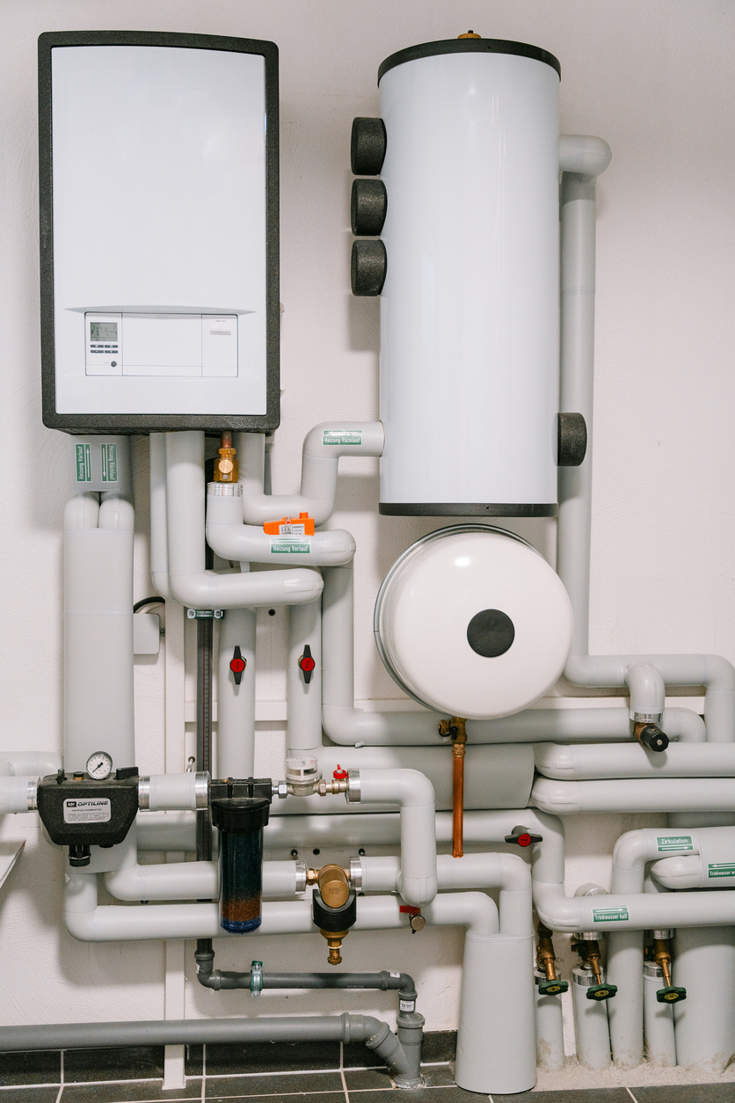
What “systems science” means
• Heat source: where useful low-grade heat is collected, recovered or combined with another source.
• Heat transfer: refrigerant circuit, brine loop, source water or solar fluid moves energy to water/storage.
• Hydraulics: pipework, pumps, valves, vessels and water quality control the movement of heat.
• Emitters and storage: rooms and DHW receive heat only if components are sized for low-temperature operation.
• Controls: coordinate temperatures, priorities, safety, backup heat and efficiency.
Key idea
A heat pump does not work in isolation: every component must support flow, heat transfer and control intent.
4
Notes:
Explain the difference between component recognition and component function. Reference: Caleffi components for heat pump systems: https://www.caleffi.com/sites/default/files/media/external-file/03313_EN_COMPONENTS%20FOR%20HEAT%20PUMP%20SYSTEMS.pdf
Learner takeaway: Systems science explains how components work together, not just what they look like.

Slide 5
Suitability: factors affecting component choice
Building demand
Component selection must be based on the calculated whole-dwelling heat loss, room-by-room emitter demand and the household’s domestic hot-water usage profile.
Site conditions
Assess external space, ground availability, water sources, roof orientation, plant-room capacity, installation access, drainage, noise and neighbour impact.
Operating temperatures
Emitters, cylinders and heat sources must be compatible with the intended flow and return temperatures to achieve comfort without reducing efficiency.
Hydraulic requirements
Confirm required flow rate, pressure loss, minimum system volume, active water volume, zoning arrangements and the need for a buffer or volumiser.
5
Notes:
Activity: learners rank suitability factors for a small terrace, rural detached property and apartment. Reference: Energy Saving Trust heat pump guidance: https://energysavingtrust.org.uk/advice/in-depth-guide-to-heat-pumps/
Learner takeaway: Suitability is evidence-based: the “right” component depends on the dwelling, the user and the whole system.

Slide 6
Suitability: factors affecting component choice
Practical constraints
Consider capital budget, installation disruption, structural limitations, planning requirements, maintenance access and future replacement routes.
Existing-system compatibility
Check whether current pipework, radiators, controls, cylinders and electrical supplies can be retained, upgraded or must be replaced.
Future adaptability
Allow for planned fabric improvements, extensions, solar PV, batteries, EV charging, smart controls or changes in occupancy where these are known.
Compliance and evidence
Selection must follow current manufacturer instructions, relevant Building Regulations, certification-scheme requirements and documented design calculations.
5
Notes:
Activity: learners rank suitability factors for a small terrace, rural detached property and apartment. Reference: Energy Saving Trust heat pump guidance: https://energysavingtrust.org.uk/advice/in-depth-guide-to-heat-pumps/
Learner takeaway: Suitability is evidence-based: the “right” component depends on the dwelling, the user and the whole system.

Slide 7

Air source heat pumps (ASHP)
Purpose: Extract low-grade heat from the outdoor air and raise its temperature through the refrigeration cycle to provide space heating and domestic hot water.
System types:
Monobloc: the complete refrigerant circuit is contained within the outdoor unit, with heating water connected between the unit and the dwelling. External water pipework requires suitable insulation and frost protection.
Split: the refrigerant circuit is divided between outdoor and indoor units, requiring correctly designed refrigerant pipework and appropriately qualified personnel.
.
.
6
Notes:
Tutor example: poor ASHP siting can cause airflow recirculation, excessive defrost and noise complaints even if the unit is correctly sized. Reference: Energy Saving Trust heat pump guidance: https://energysavingtrust.org.uk/advice/in-depth-guide-to-heat-pumps/.
Learner takeaway: An ASHP is often the simplest heat source to apply, but siting and emitter temperature can make or break performance.

Slide 8
Air source heat pumps (ASHP)
Key characteristics: ASHPs use a fan, evaporator, compressor, condenser and expansion device. Their output and efficiency vary with outdoor temperature and the required heating-water flow temperature.
Strengths: Suitable for many new-build and retrofit properties, require less groundworks than GSHP systems and can provide efficient low-temperature heating where the building and emitters are correctly designed.
Limitations: Capacity and COP generally reduce as outdoor temperature falls or flow temperature rises. Defrost cycles temporarily interrupt heating and may increase electrical consumption.
Look for
Fan coil • pipe connections • isolator • mounting • airflow clearance • condensate route
.
6
Notes:
Tutor example: poor ASHP siting can cause airflow recirculation, excessive defrost and noise complaints even if the unit is correctly sized. Reference: Energy Saving Trust heat pump guidance: https://energysavingtrust.org.uk/advice/in-depth-guide-to-heat-pumps/.
Learner takeaway: An ASHP is often the simplest heat source to apply, but siting and emitter temperature can make or break performance.

Slide 9
Air source heat pumps (ASHP)
Siting requirements: Provide manufacturer-specified airflow clearances, avoid discharge-air recirculation and assess noise, vibration, visual impact, maintenance access and neighbour proximity.
Drainage and frost protection: Condensate and defrost water must discharge safely without causing ice on paths or damage to the building. External hydraulic components must be protected against freezing.
System integration: The selected unit must be compatible with the calculated heat loss, emitter outputs, cylinder heat exchanger, circulation flow rate, active system volume, controls and electrical supply.
Selection evidence: Use manufacturer performance data at the actual design outdoor temperature and proposed flow temperature – not the nominal model rating alone.
.
6
Notes:
Tutor example: poor ASHP siting can cause airflow recirculation, excessive defrost and noise complaints even if the unit is correctly sized. Reference: Energy Saving Trust heat pump guidance: https://energysavingtrust.org.uk/advice/in-depth-guide-to-heat-pumps/.
Learner takeaway: An ASHP is often the simplest heat source to apply, but siting and emitter temperature can make or break performance

Slide 10
ASHP integration: Design checks
Unit output
Check the unit output at the actual design outdoor temperature and selected flow temperature.
Hydraulic layout
Confirm minimum flow rate, water volume, frost protection and manufacturer-approved hydraulic layout.
Defrost recovery
Allow for defrost: water must drain safely and the system must maintain enough heat/flow during recovery.
Siting and noise
Noise and vibration are design issues: select quiet equipment and locate it away from sensitive rooms/neighbours.
Refrigerant work
For split systems, refrigerant work must be completed by competent certified personnel.
7
Notes:
Use manufacturer performance tables to show that an “8 kW” model does not always deliver 8 kW at low outdoor temperature and higher flow temperature. Refer to MCS design requirements: MCS MIS 3005-D Heat Pump Design Standard: https://mcscertified.com/wp-content/uploads/2025/12/MIS-3005-D-The-Heat-Pump-Design-Standard-V3.0-Final.pdf
Learner takeaway: Correct ASHP selection combines thermal output, hydraulics, siting, defrost, noise and competence boundaries.

Slide 11

Ground source heat pumps (GSHP)
Purpose: Extracts low-grade heat stored in the ground and upgrades it via a refrigeration cycle to provide space heating and domestic hot water.
Ground collector types:
Horizontal collectors: straight pipe or slinky loops installed in trenches where sufficient land is available.
Vertical boreholes: deep closed-loop collectors used where surface area is limited.
Shared ground arrays: communal boreholes or loops serving several properties through an ambient-temperature network.
8
Notes:
Tutor note: undersized collectors can cool the loop excessively and reduce performance. Discuss horizontal vs. borehole options. Image credit: Harvest Cornwall ground-source trench installation.
Learner takeaway: GSHP design succeeds when the ground array and brine circuit are designed as carefully as the heat pump.

Slide 12
Ground source heat pumps (GSHP)
Key characteristics: Ground temperatures are generally more stable than outdoor air temperatures, helping the heat pump maintain consistent output and seasonal efficiency during colder weather.
Strengths: Can provide high seasonal performance, reduced outdoor noise and visual impact, and long-life ground infrastructure when correctly designed and installed.
Key components
Collector loop • manifold • brine pump • expansion vessel • heat pump • emitter/DHW circuit
8
Notes:
Tutor note: undersized collectors can cool the loop excessively and reduce performance. Discuss horizontal vs. borehole options. Image credit: Harvest Cornwall ground-source trench installation.
Learner takeaway: GSHP design succeeds when the ground array and brine circuit are designed as carefully as the heat pump.

Slide 13
Ground source heat pumps (GSHP)
Limitations: Capital cost, ground investigation, drilling or trenching, access, planning, permissions and installation disruption can be significant. Boreholes may require specialist contractors and detailed design.
Ground-loop design: Collector length, borehole depth, and spacing must match the building's heat demand, ground conditions, thermal conductivity, and annual heat extraction. An undersized array can cause falling brine temperatures and reduced efficiency.
Hydraulic considerations: Brine concentration, antifreeze protection, flow rate, pressure loss, pump duty, air removal and expansion-vessel sizing must be calculated for the source circuit.
Suitability: Particularly appropriate for properties with available land, suitable drilling access, stable long-term occupancy or opportunities for communal and neighbourhood-scale heat infrastructure.
Selection evidence: Design should be supported by site survey data, heat-loss calculations, ground-loop design information, manufacturer performance data and any required environmental or planning approvals.
8
Notes:
Tutor note: undersized collectors can cool the loop excessively and reduce performance. Discuss horizontal vs. borehole options. Image credit: Harvest Cornwall ground-source trench installation.
Learner takeaway: GSHP design succeeds when the ground array and brine circuit are designed as carefully as the heat pump.

Slide 14
GSHP integration: Source-side design
Ground collectors
Horizontal ground loops require adequate land area, trench depth and spacing. Collector length must reflect heat demand, ground type, moisture, and conductivity; undersized loops can cause falling temperatures and reduced performance.
Vertical boreholes reduce surface area but need drilling access and geological info. Larger projects may require a thermal response test to confirm performance and avoid temperature decline.
Shared ground arrays can serve flats or housing estates through an ambient loop while allowing individual in-dwelling heat pumps and billing.
.
9
Notes:
Discuss social housing shared ground loop schemes as a practical example of GSHP scalability. Reference Kensa and MCS guidance where appropriate. MCS MIS 3005-D Heat Pump Design Standard: https://mcscertified.com/wp-content/uploads/2025/12/MIS-3005-D-The-Heat-Pump-Design-Standard-V3.0-Final.pdf
Learner takeaway: The ground loop is the heat source; if it is poorly designed, the heat pump cannot compensate.

Slide 15
GSHP integration: Source-side design
Fluid and Hydraulics
Brine/glycol concentration must provide frost protection without creating excessive viscosity, pressure loss, or pumping energy. Fluid properties must be checked at the lowest expected operating temperature.
Pipework and sizing including source-side pipe diameter, circuit length, manifolds, and circulation pumps must be selected to deliver required flow rate and acceptable pressure loss.
Hydraulic balancing is required for parallel loops. Fill, purge, and air-removal arrangements must allow trapped air to be removed during commissioning.
.
9
Notes:
Discuss social housing shared ground loop schemes as a practical example of GSHP scalability. Reference Kensa and MCS guidance where appropriate. MCS MIS 3005-D Heat Pump Design Standard: https://mcscertified.com/wp-content/uploads/2025/12/MIS-3005-D-The-Heat-Pump-Design-Standard-V3.0-Final.pdf
Learner takeaway: The ground loop is the heat source; if it is poorly designed, the heat pump cannot compensate.

Slide 16
GSHP integration: Source-side design
System commissioning
Ancillary components like expansion vessels, pressure-relief devices, isolation valves, gauges, and suitable test points must be correctly selected for the source circuit and antifreeze fluid.
Commissioning records should include loop pressures, flow rates, brine concentration, entering and leaving temperatures, pump settings, and clear evidence that each circuit is balanced and leak-free.
.
9
Notes:
Discuss social housing shared ground loop schemes as a practical example of GSHP scalability. Reference Kensa and MCS guidance where appropriate. MCS MIS 3005-D Heat Pump Design Standard: https://mcscertified.com/wp-content/uploads/2025/12/MIS-3005-D-The-Heat-Pump-Design-Standard-V3.0-Final.pdf
Learner takeaway: The ground loop is the heat source; if it is poorly designed, the heat pump cannot compensate.

Slide 17
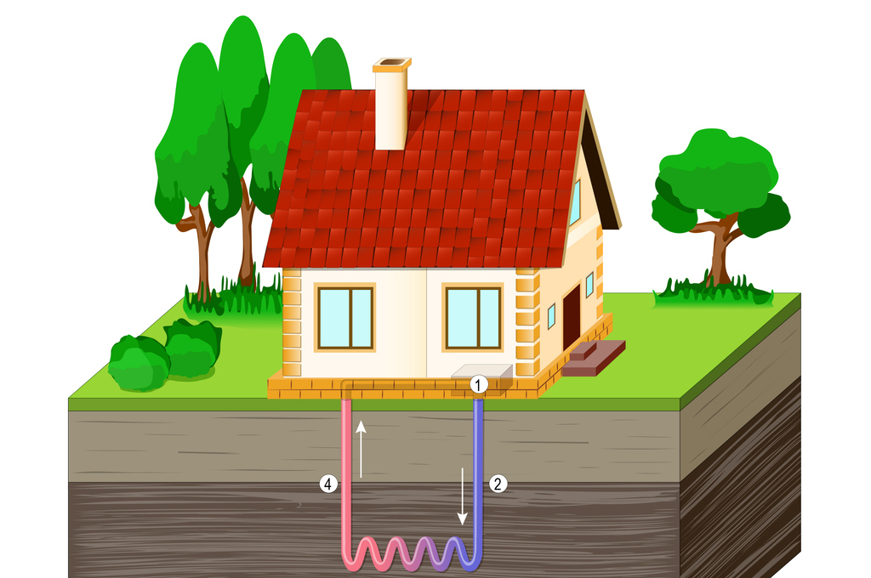
Water and marine source heat pumps (WSHP/MSHP)
Purpose: Extract low-grade heat from lakes, rivers, ponds, wells, aquifers or coastal waters and upgrade it through the refrigeration cycle.
Closed-loop systems: A sealed water/glycol circuit passes through submerged coils, lake collectors or pond mats, transferring heat without directly abstracting the source water.
Open-loop systems: Water is abstracted, passed through a heat exchanger and discharged/reinjected. Requires filtration and environmental approval.
Marine-source heat pumps: Uses seawater or tidal sources. Design must account for salinity, corrosion, tidal variation, marine growth, and coastal exposure.
10
Notes:
Source protection, filtration and environmental approvals may require specialist input. Reference: Kensa water source heat pump guide: https://www.kensaheatpumps.com/water-source-heat-pump/. Image credit: Kensa Heat Pumps water-source heat pump guide illustration.
Learner takeaway: Water can be an excellent heat source, but permissions and water quality can decide suitability.
Tutor-notes case study:
Kimpton – Marine Source Heat Pump at Plas Newydd
Learner takeaway: A stable water source can support efficient heating, but permissions, water quality, corrosion protection and source-side maintenance can determine whether the design succeeds.

Slide 18
Water and marine source heat pumps (WSHP/MSHP)
Strengths: Stable source temperatures support
consistent output and strong seasonal efficiency
compared to air source.
Hydraulic integration: Flow rate, pump duty, pressure loss, heat exchanger selection, and temperature delta must
match heat pump inputs.
Water-quality risks: Silt, debris, minerals, and
biofouling can block filters or reduce heat transfer,
increasing pumping energy.
Permissions: Abstraction, discharge, flood risk,
ecological impact, and land ownership must be cleared
with authorities.
Maintenance: Ensure safe access to strainers, filters, pumps, and heat exchangers with isolation and cleaning arrangements.
10
Notes:
Source protection, filtration and environmental approvals may require specialist input. Reference: Kensa water source heat pump guide: https://www.kensaheatpumps.com/water-source-heat-pump/. Image credit: Kensa Heat Pumps water-source heat pump guide illustration.
Learner takeaway: Water can be an excellent heat source, but permissions and water quality can decide suitability.
Tutor-notes case study:
Kimpton – Marine Source Heat Pump at Plas Newydd
Learner takeaway: A stable water source can support efficient heating, but permissions, water quality, corrosion protection and source-side maintenance can determine whether the design succeeds.

Slide 19
Water and marine source heat pumps (WSHP/MSHP)
Design in Practice: Plas Newydd, Anglesey
The National Trust’s Plas Newydd project uses heat from the Menai Strait to support a 300 kW marine-source heat-pump system.
The design had to accommodate a Grade I listed property, tidal conditions, visual impact and corrosion risk.
The project later highlighted the importance of marine-resistant components, secure BMS controls and effective recommissioning.
Design evidence
Source type • flow/temperature • permissions • filtration • heat exchanger • maintenance access
10
Notes:
Source protection, filtration and environmental approvals may require specialist input. Reference: Kensa water source heat pump guide: https://www.kensaheatpumps.com/water-source-heat-pump/. Image credit: Kensa Heat Pumps water-source heat pump guide illustration.
Tutor-notes case study:
Kimpton – Marine Source Heat Pump at Plas Newydd
Learner takeaway: A stable water source can support efficient heating, but permissions, water quality, corrosion protection and source-side maintenance can determine whether the design succeeds.
Learner takeaway: Water can be an excellent heat source, but permissions and water quality can decide suitability.

Slide 20
Exhaust air heat pumps (EAHP)
Purpose: Recover low-grade heat from warm ventilation air before it leaves the dwelling and upgrade it through the refrigeration cycle to provide domestic hot water and, in some systems, space heating.
Operating principle: Air is continuously extracted from wet rooms such as kitchens, bathrooms and utility areas, passed across the heat pump evaporator, and then discharged outside at a lower temperature.
System integration: EAHPs are closely linked to the dwelling’s mechanical extract ventilation system, so ventilation rates, ductwork, air inlets, controls and heating demand must be designed together.
EAHPs are ventilation-linked heat pumps: the source is limited, so building type and airflow matter.
11
Notes:
Use NIBE F730/F370 examples to explain integrated ventilation, heating and hot water. Reference: NIBE exhaust air heat pump overview: https://www.nibe.eu/en-eu/products/heat-pumps/exhaust-air-heat-pumps.
Learner takeaway: An exhaust air heat pump can perform effectively where ventilation, fabric performance and heat demand are closely matched, but the extract-air supply places a firm limit on the heat available.
Learner takeaway: EAHPs are ventilation-linked heat pumps: the source is limited, so building type and airflow matter.

Slide 21
Exhaust air heat pumps (EAHP)
Key characteristics: Units are generally compact and may combine the heat pump, hot-water cylinder, immersion heater, controls and ventilation fan within one packaged appliance.
Strengths: Particularly suitable for small, highly insulated and airtight homes or flats where ventilation heat is available continuously and space-heating demand is relatively low.
Source limitation: The amount of recoverable heat is restricted by the volume and temperature of the extracted air. Increasing airflow purely to gain more heat may increase ventilation losses and create draughts or noise.
Supplementary heating: During periods of high space-heating or hot-water demand, the system may require an immersion heater, direct electric heating or another supplementary heat source.
11
Notes:
Use NIBE F730/F370 examples to explain integrated ventilation, heating and hot water. Reference: NIBE exhaust air heat pump overview: https://www.nibe.eu/en-eu/products/heat-pumps/exhaust-air-heat-pumps.
Learner takeaway: An exhaust air heat pump can perform effectively where ventilation, fabric performance and heat demand are closely matched, but the extract-air supply places a firm limit on the heat available.
Learner takeaway: EAHPs are ventilation-linked heat pumps: the source is limited, so building type and airflow matter.

Slide 22
Exhaust air heat pumps (EAHP)
Design considerations: Correct airflow commissioning, duct insulation, condensate drainage, filter access, acoustic control and indoor-air-quality requirements are essential.
Suitability limitations: EAHPs are generally unsuitable for larger, poorly insulated or high-heat-loss properties because the available extract-air energy may be insufficient to meet peak demand.
Important distinction: An EAHP actively upgrades recovered heat using a refrigeration cycle; it is not the same as a mechanical ventilation with heat recovery system, which transfers heat directly between air streams.
Check carefully
Ventilation rate • duct routes • indoor air quality • DHW demand • backup strategy
11
Notes:
Use NIBE F730/F370 examples to explain integrated ventilation, heating and hot water. Reference: NIBE exhaust air heat pump overview: https://www.nibe.eu/en-eu/products/heat-pumps/exhaust-air-heat-pumps.
Learner takeaway: An exhaust air heat pump can perform effectively where ventilation, fabric performance and heat demand are closely matched, but the extract-air supply places a firm limit on the heat available.
Learner takeaway: EAHPs are ventilation-linked heat pumps: the source is limited, so building type and airflow matter.

Slide 23
Hybrid heat pumps
Purpose: Combine a heat pump with a secondary heat source – such as a gas or oil boiler, biomass appliance or electric heater – to meet heating and domestic hot-water demand.
Operating strategy: Controls determine whether the heat pump operates alone, alongside the secondary source or hands over completely at a defined balance point.
Strengths: Can reduce fossil-fuel use and carbon emissions while retaining support for peak demand, rapid hot-water recovery or higher-temperature heating circuits.
Suitability: Often considered for retrofit properties with high design heat loss, limited emitter-upgrade options, constrained electrical capacity or planned fabric improvements delivered in stages.
Control priorities: Switchover may be based on outdoor temperature, energy price, carbon intensity, heat-pump capacity or required flow temperature. Incorrect settings can cause excessive boiler or backup operation.
12
Notes:
Link to K1.8 competence: gas/oil/fuel systems require competent trades. A hybrid that defaults to backup too often loses low-carbon benefit. Reference: MCS MIS 3005-D Heat Pump Design Standard: https://mcscertified.com/wp-content/uploads/2025/12/MIS-3005-D-The-Heat-Pump-Design-Standard-V3.0-Final.pdf
Learner takeaway: An exhaust air heat pump can perform effectively where ventilation, fabric performance and heat demand are closely matched, but the extract-air supply places a firm limit on the heat available.
Learner takeaway: Hybrid design should be justified by evidence, not used as a shortcut for poor heat-loss or emitter design.

Slide 24
Hybrid heat pumps
Hydraulic integration: Pipework, pumps, valves, buffers and hydraulic separation must allow both heat sources to operate safely without conflicting flow rates or control commands.
Efficiency risk: A hybrid system should not be used to conceal poor heat-loss calculations, unsuitable emitters or an undersized heat pump. The low-carbon heat source should provide as much of the annual demand as reasonably practical.
Electrical and fuel services: The design must account for the heat pump’s electrical load alongside the existing fuel supply, flue, combustion-air and appliance-safety requirements.
Competence and maintenance: Work involving gas, oil, biomass, refrigerants and electrical systems must remain within the installer’s competence. Two heat sources may also mean additional servicing, warranties and maintenance costs.
Customer handover: Users must understand which heat source is operating, why switchover occurs, how settings affect cost and carbon, and when supplementary heat may be expected.
12
Notes:
Link to K1.8 competence: gas/oil/fuel systems require competent trades. A hybrid that defaults to backup too often loses low-carbon benefit. Reference: MCS MIS 3005-D Heat Pump Design Standard: https://mcscertified.com/wp-content/uploads/2025/12/MIS-3005-D-The-Heat-Pump-Design-Standard-V3.0-Final.pdf
Learner takeaway: An exhaust air heat pump can perform effectively where ventilation, fabric performance and heat demand are closely matched, but the extract-air supply places a firm limit on the heat available.
Learner takeaway: Hybrid design should be justified by evidence, not used as a shortcut for poor heat-loss or emitter design.

Slide 25
Bivalent systems
Bivalent strategy: Bivalent describes an operating strategy in which two heat sources are used to meet the building’s heating demand under different operating conditions. It is not a specific product type; it describes how the heat pump and supplementary heat source are controlled.
Parallel bivalent operation: The heat pump remains the lead heat source, while the secondary source operates at the same time when the heat demand exceeds the heat pump’s available capacity.
Alternative bivalent operation: The heat pump operates until a defined changeover point is reached, after which it stops and the secondary heat source takes over the full heating load.
Part-parallel operation: The secondary source assists the heat pump over part of the operating range but may take over completely below a lower temperature or above a defined load.
13
Notes:
Use an example: ASHP leads above 2°C; boiler assists below 2°C; boiler takes over below –2°C only if the design evidence justifies it.
Learner takeaway: Bivalent design is about deciding when and how two heat sources share the load; successful operation depends on an accurately defined balance point and a control strategy that maximises efficient heat-pump use.
Learner takeaway: Bivalent is a control strategy; hybrid is often the practical system type that uses it.

Slide 26
Bivalent systems
Bivalence or balance point: The condition at which the heat pump can no longer meet the full building demand on its own. This may be linked to outdoor temperature, available output or the required system flow temperature.
Switchover decisions: May also consider energy price, carbon intensity, electrical capacity, comfort requirements and domestic hot-water demand.
Capacity and control settings: Must be based on the building’s calculated heat-loss profile and the heat pump’s actual output at the proposed outdoor and flow temperatures. Poor control logic can cause the backup source to operate unnecessarily, increasing running costs and reducing the proportion of heat supplied by the low-carbon system.
System coordination: Controls, pumps, valves and hydraulic separation must be coordinated so the two heat sources do not create conflicting flow conditions or unstable operation.
Customer handover: Should explain when the secondary source operates, how this affects cost and carbon, and how the system should be monitored.
13
Notes:
Use an example: ASHP leads above 2°C; boiler assists below 2°C; boiler takes over below -2°C only if the design evidence justifies it.
Learner takeaway: Bivalent design is about deciding when and how two heat sources share the load; successful operation depends on an accurately defined balance point and a control strategy that maximises efficient heat-pump use.
Learner takeaway: Bivalent is a control strategy; hybrid is often the practical system type that uses it.

Slide 27
PVT heat pump systems
Purpose: Combine photovoltaic electricity generation and thermal energy collection within the same roof-mounted panel, making dual use of limited roof area.
Operating principle: The photovoltaic cells generate electricity, while heat is removed from the rear of the panel by an air or liquid circuit and transferred to the heat pump’s source side, thermal store or domestic hot-water system.
Heat-pump integration: The collected low-grade heat can improve source temperatures, support evaporator performance and reduce reliance on colder outdoor-air conditions when the system is correctly designed.
Electrical benefit: The PV output can help offset the electricity consumed by the heat pump, circulation pumps, controls and immersion heater, although generation will vary with season, weather, shading and roof orientation.
Thermal benefit: Removing heat from the panel can reduce PV cell temperature and may improve electrical efficiency, while also providing useful thermal energy to the wider system.
14
Notes:
Keep to awareness level unless learners are specialising in PVT. Reference manufacturer technical literature and MCS requirements. Image credit: DHC/Jiangsu PVT heat pump system image result.
Learner takeaway: PVT heat-pump systems can produce both electricity and useful heat from the same roof area, but their success depends on specialist hydraulic, electrical and control integration.
Learner takeaway: PVT systems are specialist: focus on the integration concept and suitability evidence.

Slide 28
PVT heat pump systems
Strengths: Particularly valuable where roof area is restricted, where both heat and electricity are required, or where the building benefits from a highly integrated low-carbon energy strategy.
Limitations: Requires specialist design, compatible controls, suitable roof structure and orientation, correctly sized heat exchangers, pumps, expansion provision and freeze or stagnation protection
where applicable.
Source-temperature management: The design must prevent excessively low or high source temperatures, ensure adequate flow through the thermal circuit and avoid conditions that could reduce heat-pump efficiency or damage components.
Control integration: PV generation, thermal collection, heat-pump operation, domestic hot-water priority, thermal storage and export or battery strategy must be coordinated to avoid conflicting
demands.
Suitability: Best suited to projects where the additional complexity, capital cost and maintenance requirements are justified by limited roof space, high energy demand or whole-building carbon objectives.
14
Notes:
Keep to awareness level unless learners are specialising in PVT. Reference manufacturer technical literature and MCS requirements. Image credit: DHC/Jiangsu PVT heat pump system image result.
Design focus Roof area • panel type • inverter • thermal loop • heat pump/source control • DHW/storage
Learner takeaway: PVT heat-pump systems can produce both electricity and useful heat from the same roof area, but their success depends on specialist hydraulic, electrical and control integration.
Learner takeaway: PVT systems are specialist: focus on the integration concept and suitability evidence.

Slide 29

Solar thermal panels
Purpose: Capture solar radiation and convert it into useful heat for domestic hot water, thermal storage and, in some specialist systems, space-heating support.
Key system components: Collectors, insulated flow and return pipework, circulation pump, controller, temperature sensors, heat-transfer fluid, expansion vessel, safety valve and a compatible cylinder or thermal store with a solar heat exchanger.
System operation: The controller compares collector and cylinder temperatures and operates the solar pump only when useful heat can be transferred into storage.
Strengths: Can significantly reduce the energy needed for domestic hot water, particularly during spring and summer, and can reduce heat-pump or boiler run time.
15
Notes:
Discuss why solar thermal needs a compatible cylinder/store and stagnation strategy. Image credit: 2M Alternativas solar thermal image result.
Learner takeaway: Solar thermal usually supports DHW rather than winter space heating because solar availability and heat demand are mismatched.

Slide 30
Solar thermal panels
Limitations: Output varies with season, roof orientation, pitch, shading and weather. Systems must also manage frost protection, stagnation, overheating, glycol degradation and ongoing maintenance.
Integration: Cylinder volume, solar-coil surface area, control hierarchy and backup heat source must be coordinated so solar energy is prioritised without compromising hot-water availability or hygiene requirements.
Flat-plate collectors: Use a dark absorber plate beneath glazing, with fluid channels carrying heat to the system. They are robust, widely used and generally cost-effective for domestic hot-water applications.
Evacuated-tube collectors: Use rows of glass tubes with a vacuum layer that reduces heat loss. They can perform well in colder or windy conditions and at higher operating temperatures but are usually more expensive and physically delicate.
15
Notes:
Discuss why solar thermal needs a compatible cylinder/store and stagnation strategy. Image credit: 2M Alternativas solar thermal image result.
Learner takeaway: Solar thermal usually supports DHW rather than winter space heating because solar availability and heat demand are mismatched.

Slide 31
Solar thermal panels
Heat-pipe evacuated tubes: Heat is transferred from each tube through a sealed heat pipe into a manifold. Individual tubes can often be replaced without draining the full collector circuit.
Direct-flow evacuated tubes: Solar fluid circulates directly through pipework inside each tube. These can provide effective heat transfer but require careful hydraulic design and frost protection.
Unglazed collectors: Usually made from polymer or rubber and mainly used for low-temperature applications such as swimming-pool heating, where high operating temperatures are not required.
System links
Collector • pump station • controller • solar coil • expansion vessel • glycol/antifreeze
15
Notes:
Discuss why solar thermal needs a compatible cylinder/store and stagnation strategy. Image credit: 2M Alternativas solar thermal image result.
Learner takeaway: Solar thermal usually supports DHW rather than winter space heating because solar availability and heat demand are mismatched.

Slide 32
Heat source selection: Quick comparison
System
Best suited to
Main constraints
Evidence to check
ASHP
Most domestic retrofits and new builds
Siting, noise, defrost, airflow, emitter temperatures
Design heat loss, output at design condition, MCS/noise, manufacturer hydraulic data
GSHP
Homes with land/borehole access; shared loops
Groundworks, cost, specialist design
Loop design, brine, pump head, ground data, permissions
WSHP
Suitable pond/lake/river/aquifer sites
Water quality, permissions, source protection
Abstraction/discharge, filtration, fouling, source temperature
EAHP
Airtight small homes/flats with MVHR/extract strategy
Limited source heat from ventilation airflow
Ventilation design, airflow, DHW demand, backup strategy
Hybrid/bivalent
Difficult retrofits or peak/resilience needs
Control logic, dual maintenance, backup overuse
Bivalence point, fuel/electrical capacity, handover evidence
: Selection is about matching the heat source to the site, demand, user and evidence.
16
Notes:
Use as a recap before moving into component integration. References: Energy Saving Trust heat pump guidance: https://energysavingtrust.org.uk/advice/in-depth-guide-to-heat-pumps/ MCS/NHBC Domestic Heat Pumps: A Best Practice Guide: https://www.nhbc.co.uk/kontentdocuments/77249bab-687b-4641-8e81-6eb7889fa5b3/heat-pump-guide.pdf
Learner takeaway: Selection is about matching the heat source to the site, demand, user and evidence.

Slide 33
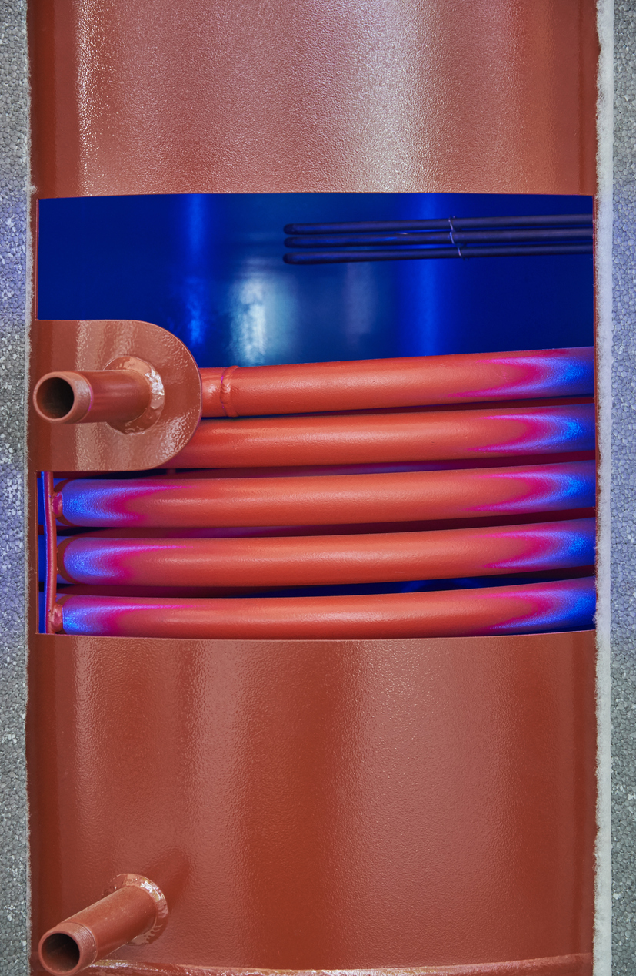
Hot water cylinder: Heat exchanger surface area
Coil surface area: Heat pump cylinders usually need larger coil/heat exchanger surface area than many boiler cylinders.
Purpose: Transfer heat efficiently from lower primary flow temperatures into stored water.
Risk of under-sizing: Small coil area can cause slow DHW recovery, high flow temperatures and excessive immersion use.
Selection criteria: Must consider cylinder volume, coil rating, sensor position, heat-pump output and recovery time.
Documentation: Record compatibility, DHW priority and pasteurisation/immersion assumptions in the job file.
Evidence required
Cylinder volume • coil surface area/rating • sensor position • recovery data • hygiene strategy
17
Notes:
Use the cutaway image to point to coil surface area. Reference: NHBC/MCS guide notes that DHW cylinders must have heat exchangers suitable for heat pump temperatures and output: MCS/NHBC Domestic Heat Pumps: A Best Practice Guide: https://www.nhbc.co.uk/kontentdocuments/77249bab-687b-4641-8e81-6eb7889fa5b3/heat-pump-guide.pdf. Image credit: ManoMano heat pump cylinder cutaway image result.
Learner takeaway: A cylinder that worked with a boiler may not be suitable for a heat pump.

Slide 34
DHW integration: controls and customer experience
System priority and sizing
DHW priority temporarily diverts heat-pump output to the hot-water cylinder, often pausing space heating until the cylinder reaches its target temperature.
Cylinder sizing and recovery performance must reflect the household’s actual demand, including occupancy, shower flow rates, bath volume, simultaneous use and expected recovery time.
Heat-pump cylinders require a suitably sized heat exchanger or coil to transfer heat effectively at lower flow temperatures; an unsuitable cylinder can cause slow recovery and increased immersion use.
18
Notes:
Ask learners to compare a two-person bungalow with a five-person home with two showers and a large bath. Reference: MCS/NHBC Domestic Heat Pumps: A Best Practice Guide: https://www.nhbc.co.uk/kontentdocuments/77249bab-687b-4641-8e81-6eb7889fa5b3/heat-pump-guide.pdf
Learner takeaway: DHW integration must balance recovery time, hygiene, efficiency and what the household actually needs.
Learner takeaway: Good DHW integration balances comfort, hygiene, recovery time and efficiency—and customers must understand how the system is intended to operate.

Slide 35
DHW integration: controls and customer experience
Hygiene and Circulation
Hygiene or pasteurisation cycles may periodically raise stored-water temperature using the heat pump, immersion heater or another heat source, depending on system design and manufacturer guidance.
Thermostatic mixing valves (TMVs) may be required to control outlet temperature and reduce scalding risk where water is stored at higher temperatures.
Secondary circulation can improve response time at distant outlets but increases standing heat loss and pumping energy, so pipe lengths, insulation, controls and operating times must be carefully designed.
18
Notes:
Ask learners to compare a two-person bungalow with a five-person home with two showers and a large bath. Reference: MCS/NHBC Domestic Heat Pumps: A Best Practice Guide: https://www.nhbc.co.uk/kontentdocuments/77249bab-687b-4641-8e81-6eb7889fa5b3/heat-pump-guide.pdf
Learner takeaway: DHW integration must balance recovery time, hygiene, efficiency and what the household actually needs.
Learner takeaway: Good DHW integration balances comfort, hygiene, recovery time and efficiency—and customers must understand how the system is intended to operate.

Slide 36
DHW integration: controls and customer experience
Controls and Handover
Control settings should coordinate DHW temperature, priority periods, weather compensation, smart tariffs, solar PV surplus and immersion operation without creating unnecessary energy use.
Poorly planned schedules can leave customers without sufficient hot water, interrupt space heating excessively or encourage frequent manual boosting.
Customer handover should explain normal operating schedules, recovery expectations, boost functions, immersion use, tariff or PV logic and the effect of changing temperature settings.
18
Notes:
Ask learners to compare a two-person bungalow with a five-person home with two showers and a large bath. Reference: MCS/NHBC Domestic Heat Pumps: A Best Practice Guide: https://www.nhbc.co.uk/kontentdocuments/77249bab-687b-4641-8e81-6eb7889fa5b3/heat-pump-guide.pdf
Learner takeaway: DHW integration must balance recovery time, hygiene, efficiency and what the household actually needs.
Learner takeaway: Good DHW integration balances comfort, hygiene, recovery time and efficiency—and customers must understand how the system is intended to operate.

Slide 37
Heat emitter sizing and selection
Each emitter must meet the calculated heat loss of its individual room at the proposed design flow and return temperatures – not at the higher temperatures traditionally used for
boiler systems.
Radiator output reduces significantly as the mean water temperature and temperature difference between the emitter and room air decrease. Manufacturer output tables or
approved correction factors must therefore be used.
Existing radiators should be assessed against the room heat loss at the intended operating temperature; physical size alone does not confirm suitability.
Suitable options may include larger panel radiators, additional radiators, fan-assisted convectors, underfloor heating or a combination of emitter types.
Underfloor heating can operate effectively at low temperatures, but output depends on pipe spacing, floor construction, floor covering, water temperature and maximum permissible
floor-surface temperature.
19
Notes:
Use MCS 021 to show that each room should be reviewed and that the worst room can limit system efficiency. Reference: MCS 021 Heat Emitter Guide: https://mcscertified.com/wp-content/uploads/2025/06/MCS-021-Issue-2.1-Heat-Emitter-Guide.pdf. Image credit: BuildHub underfloor heating manifold image result.
Learner takeaway: Emitter selection determines whether low-temperature heat can actually reach the rooms.

Slide 38
Heat emitter sizing and selection
Fan convectors can provide high output from compact units at lower water temperatures but require an electrical supply and may introduce fan noise and maintenance requirements.
Mixed-emitter systems may require separate zones, different design temperatures, mixing controls, hydraulic balancing and coordinated control strategies.
Oversized emitters can allow a lower flow temperature, improving heat-pump efficiency and seasonal performance, but space, appearance, cost and customer disruption must also be considered.
Selection evidence should clearly link room heat loss, emitter output, design flow and return temperatures, manufacturer data, hydraulic flow rate and control arrangements.
Final performance must be verified during commissioning
through flow temperatures, balancing, room-temperature
response and customer comfort.
Activity
Given a room heat loss and radiator output table, decide whether the existing emitter can remain.
19
Notes:
Use MCS 021 to show that each room should be reviewed and that the worst room can limit system efficiency. Reference: MCS 021 Heat Emitter Guide: https://mcscertified.com/wp-content/uploads/2025/06/MCS-021-Issue-2.1-Heat-Emitter-Guide.pdf. Image credit: BuildHub underfloor heating manifold image result.
Learner takeaway: Emitter selection determines whether low-temperature heat can actually reach the rooms.

Slide 39
Emitter evidence: what should be recorded?
01
Heat loss
Room-by-room heat-loss result and agreed internal design temperature.
02
Existing emitters
Existing emitter dimensions, type, location and restrictions such as covers or furniture.
03
Manufacturer output
Manufacturer output at the proposed flow/return/room temperature condition.
04
Upgrades and consent
Required upgrades and customer acceptance of disruption, appearance and cost.
05
Commissioning
Commissioning evidence: balancing, flow/return readings and final control settings.
: Good emitter design leaves an evidence trail from heat loss to final commissioning.
20
Notes:
Short formative task: learners choose evidence needed before retaining an existing radiator. Reference: MCS 021 Heat Emitter Guide: https://mcscertified.com/wp-content/uploads/2025/06/MCS-021-Issue-2.1-Heat-Emitter-Guide.pdf

Slide 40
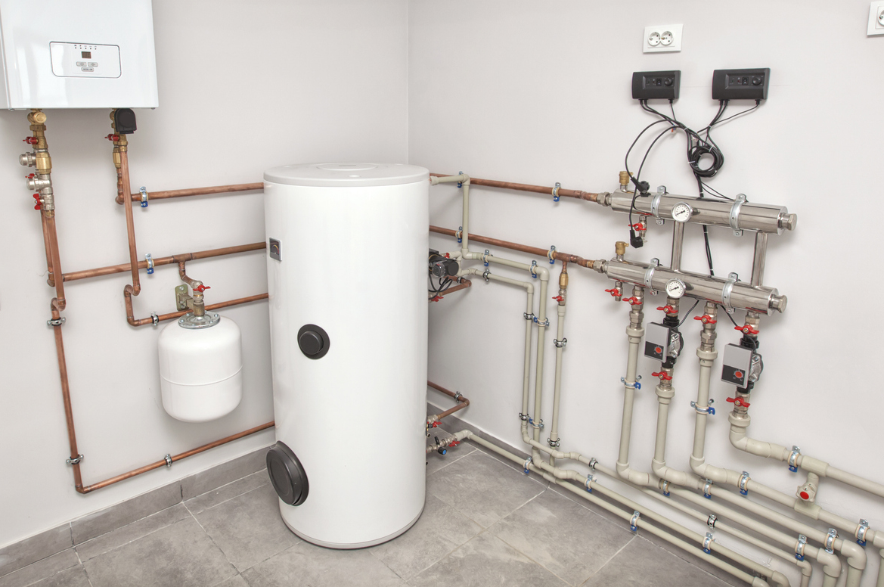
Buffer vessel and volumiser selection
Purpose: Both components can increase the active water volume within a heat-pump system, helping the unit achieve stable run times and maintain the manufacturer’s minimum operating volume.
Volumiser: Adds water volume to the primary circuit but normally remains hydraulically connected in series, without separating the heat-pump and emitter flow rates.
Buffer vessel: May add system volume and, depending on its connections, provide hydraulic separation between the heat-pump circuit and secondary heating circuits.
21
Notes:
Clarify terminology: volumiser adds volume; buffer may add volume and hydraulic separation. Reference: Heat Pump Association Controls Guide for Air-Water Heat Pump Systems: https://hpauk.org.uk/wp-content/uploads/2026/03/Heat-pump-controls-guide-FINAL-1.pdf Caleffi components for heat pump systems: https://www.caleffi.com/sites/default/files/media/external-file/03313_EN_COMPONENTS%20FOR%20HEAT%20PUMP%20SYSTEMS.pdf. Image credit: Réseau Proéco Énergies heat pump plant-room image result.
Learner takeaway: Buffers and volumisers should solve a defined hydraulic problem; they are not automatic accessories.

Slide 41
Buffer vessel and volumiser selection
Additional volume can reduce short cycling, improve operating stability and provide stored energy to support the heat pump during defrost operation.
Buffers or volumisers may be required where multiple zones close independently, thermostatic valves reduce active volume, or secondary circuits operate with variable flow.
21
Notes:
Clarify terminology: volumiser adds volume; buffer may add volume and hydraulic separation. Reference: Heat Pump Association Controls Guide for Air-Water Heat Pump Systems: https://hpauk.org.uk/wp-content/uploads/2026/03/Heat-pump-controls-guide-FINAL-1.pdf Caleffi components for heat pump systems: https://www.caleffi.com/sites/default/files/media/external-file/03313_EN_COMPONENTS%20FOR%20HEAT%20PUMP%20SYSTEMS.pdf. Image credit: Réseau Proéco Énergies heat pump plant-room image result.
Learner takeaway: Buffers and volumisers should solve a defined hydraulic problem; they are not automatic accessories.

Slide 42
Buffer vessel and volumiser selection
Selection must consider the manufacturer’s minimum water-volume and flow requirements, heat-pump output, minimum compressor run time, system ΔT and anticipated zone operation.
Where hydraulic separation is used, primary and secondary pump duties must be coordinated; flow-rate imbalance can cause mixing and raise the return temperature to the heat pump.
Poor positioning or sensor location can interfere with weather compensation, delay heat delivery or create unnecessary heat-pump cycling.
Scenario
A small zoned system short-cycles when only one zone calls. Is the issue volume, flow, controls or emitter sizing?
21
Notes:
Clarify terminology: volumiser adds volume; buffer may add volume and hydraulic separation. Reference: Heat Pump Association Controls Guide for Air-Water Heat Pump Systems: https://hpauk.org.uk/wp-content/uploads/2026/03/Heat-pump-controls-guide-FINAL-1.pdf Caleffi components for heat pump systems: https://www.caleffi.com/sites/default/files/media/external-file/03313_EN_COMPONENTS%20FOR%20HEAT%20PUMP%20SYSTEMS.pdf. Image credit: Réseau Proéco Énergies heat pump plant-room image result.
Learner takeaway: Buffers and volumisers should solve a defined hydraulic problem; they are not automatic accessories.

Slide 43
Buffer vessel and volumiser selection
A buffer should only be included to solve a defined volume, flow or hydraulic-control problem – it should not be added automatically to every heat-pump installation.
21
Notes:
Clarify terminology: volumiser adds volume; buffer may add volume and hydraulic separation. Reference: Heat Pump Association Controls Guide for Air-Water Heat Pump Systems: https://hpauk.org.uk/wp-content/uploads/2026/03/Heat-pump-controls-guide-FINAL-1.pdf Caleffi components for heat pump systems: https://www.caleffi.com/sites/default/files/media/external-file/03313_EN_COMPONENTS%20FOR%20HEAT%20PUMP%20SYSTEMS.pdf. Image credit: Réseau Proéco Énergies heat pump plant-room image result.
Learner takeaway: Buffers and volumisers should solve a defined hydraulic problem; they are not automatic accessories

Slide 44
Circulation pump sizing and selection
System design and flow rate
Purpose: Circulation pumps move the required volume of fluid through the heat pump, hot-water cylinder, emitters and associated hydraulic circuits so that the designed heat output can be transferred effectively.
Pump Selection: Must satisfy the system’s design flow rate and total resistance, expressed as the required pump duty or operating point. Design Flow Rate: Linked to heat output and system temperature difference using
Q = ṁ × cₚ × ΔT
Lower design ΔT values generally require higher flow rates.
22
Notes:
Worked example: 8 kW at 5 K requires approx. 23 L/min, but pump duty also needs head calculation. Reference: Caleffi components for heat pump systems: https://www.caleffi.com/sites/default/files/media/external-file/03313_EN_COMPONENTS%20FOR%20HEAT%20PUMP%20SYSTEMS.pdf
Learner takeaway: The pump must deliver the calculated flow at the real system resistance, not just on a catalogue page.

Slide 45
Circulation pump sizing and selection
Resistance and Fluid Properties
System resistance: Created by pipe length, diameter, bends, valves, strainers, filters, manifolds, heat exchangers, emitters and other components.
Pressure losses must be added for the most hydraulically demanding circuit.
Glycol and Antifreeze: Where used, increased viscosity and reduced heat-transfer capacity may increase both the required volumetric flow and pump head. Fluid properties must be checked at the lowest expected operating temperature.
Performance curve: Select pump using the manufacturer’s pump-performance curve, rather than pipe size or heat-pump capacity alone.
22
Notes:
Worked example: 8 kW at 5 K requires approx. 23 L/min, but pump duty also needs head calculation. Reference: Caleffi components for heat pump systems: https://www.caleffi.com/sites/default/files/media/external-file/03313_EN_COMPONENTS%20FOR%20HEAT%20PUMP%20SYSTEMS.pdf
Learner takeaway: The pump must deliver the calculated flow at the real system resistance, not just on a catalogue page.

Slide 46
Circulation pump sizing and selection
Sizing risks and settings
Undersized pump: May cause insufficient flow, excessive ΔT, reduced heat output, slow cylinder recovery, poor defrost and flow faults.
Oversized / incorrect setting: May cause high velocity, noise, erosion risk, poor control authority and high-power use.
Variable-speed settings: Proportional/constant pressure or fixed speed must suit the layout, zoning and manufacturer spec.
Commissioning and Checks
Commissioning should verify actual flow rate, pump mode, system ΔT, balancing, filter condition and operation under both full and minimum load.
Checks: Pump mode • flow rate • ΔT • balancing • filter/strainer condition • noise
22
Notes:
Worked example: 8 kW at 5 K requires approx. 23 L/min, but pump duty also needs head calculation. Reference: Caleffi components for heat pump systems: https://www.caleffi.com/sites/default/files/media/external-file/03313_EN_COMPONENTS%20FOR%20HEAT%20PUMP%20SYSTEMS.pdf
Learner takeaway: The pump must deliver the calculated flow at the real system resistance, not just on a catalogue page.

Slide 47
Expansion vessel sizing and selection
Purpose and Sizing: Absorb increased fluid volume as water, brine or solar fluid heats, maintaining stable pressure and preventing PRV discharge. Capacity must be calculated from the total system fluid volume, minimum/maximum operating temperatures, static height, cold filling pressure and pressure-relief valve setting.
Heat-pump systems: Often require larger vessels due to greater water volume in buffers, volumisers, larger emitters, underfloor-heating circuits and extended pipework.
Sealed circuits: Different circuits may require separate vessels, including space heating, unvented domestic hot water, solar thermal and ground-source brine/glycol circuits. Glycol and solar fluids expand differently from water.
23
Notes:
Use plant-room photo to identify expansion vessels. Stress that vessel sizing is a competence area requiring manufacturer data. Reference: Caleffi components for heat pump systems: https://www.caleffi.com/sites/default/files/media/external-file/03313_EN_COMPONENTS%20FOR%20HEAT%20PUMP%20SYSTEMS.pdf
Learner takeaway: Expansion-vessel size is calculated from system volume, fluid expansion and operating pressures—not simply chosen as a percentage of heat-pump output.
Learner takeaway: Expansion vessels are selected from volume and pressure conditions, not from heat-pump kW alone.

Slide 48
Expansion vessel sizing and selection
Pre-charge and Operation: Vessel pre-charge pressure must be set correctly before filling. Incorrect pre-charge reduces expansion capacity, causing rapid pressure rise, repeated PRV discharge, loss of system pressure, air ingress and recurring faults. Connect close to the pump suction or neutral pressure point.
Design standards: Sizing must follow CIBSE Domestic Heating Design Guide, BS EN 12828 and manufacturer selection data. Do not use a fixed percentage of system volume without completing full pressure and acceptance checks.
Commissioning records: Must include vessel size, pre-charge pressure, cold fill pressure, hot operating pressure and PRV rating.
Evidence
Expansion vessels are selected from volume and pressure conditions, not from heat-pump kW alone.
System volume • cold/hot pressure • pre-charge • vessel size • PRV rating • commissioning record
23
Notes:
Use plant-room photo to identify expansion vessels. Stress that vessel sizing is a competence area requiring manufacturer data. Reference: Caleffi components for heat pump systems: https://www.caleffi.com/sites/default/files/media/external-file/03313_EN_COMPONENTS%20FOR%20HEAT%20PUMP%20SYSTEMS.pdf
Learner takeaway: Expansion-vessel size is calculated from system volume, fluid expansion and operating pressures—not simply chosen as a percentage of heat-pump output.

Slide 49
Control system integration
System coordination
Purpose: Controls coordinate the heat source, emitters, hot-water cylinder, circulation pumps, motorised valves, sensors and any supplementary or backup heat source as one integrated system.
Weather compensation: Adjusts the heating-water flow temperature in response to outdoor conditions, helping the heat pump operate at the lowest practical temperature and improving seasonal efficiency.
Room sensors: Room sensors, thermostats and load compensation should influence demand without causing excessive on/off operation or overriding the intended weather-compensation strategy.
24
Notes:
Link to K1.15 controls. Refer to the HPA controls guide for buffer, zoning and weather compensation examples: Heat Pump Association Controls Guide for Air-Water Heat Pump Systems: https://hpauk.org.uk/wp-content/uploads/2026/03/Heat-pump-controls-guide-FINAL-1.pdf
Learner takeaway: Controls are the system’s decision-making centre; they must coordinate every component while maintaining comfort, safe operation and efficient heat-pump performance.
Learner takeaway: Controls are the brain of the system; hydraulic components must follow the same design intent.

Slide 50
Control system integration
Operating and Flow Strategy
DHW priority: Diverts available heat to the cylinder during recovery and may temporarily pause space heating. Cylinder temperature, recovery time and priority periods must suit household demand.
Hybrid and bivalent: Determine when the heat pump operates alone, when the secondary source assists and when full changeover occurs. Settings should maximise efficient heat-pump contribution.
Sequencing and Zoning: Pump and valve sequencing must establish the correct flow path before compressor operation. Zoning, TRVs and setback controls must prevent low-flow faults and short cycling.
24
Notes:
Link to K1.15 controls. Refer to the HPA controls guide for buffer, zoning and weather compensation examples: Heat Pump Association Controls Guide for Air-Water Heat Pump Systems: https://hpauk.org.uk/wp-content/uploads/2026/03/Heat-pump-controls-guide-FINAL-1.pdf
Learner takeaway: Controls are the system’s decision-making centre; they must coordinate every component while maintaining comfort, safe operation and efficient heat-pump performance.
Learner takeaway: Controls are the brain of the system; hydraulic components must follow the same design intent.

Slide 51
How components integrate: heating mode
Emitters and Efficiency
Heat emitters: Radiators, fan convectors or underfloor-heating circuits release heat at a rate matched to each room’s calculated heat loss at the selected flow and return temperatures.
Pressure control: The expansion vessel accommodates thermal expansion, while the filling loop, pressure gauge, air vents and pressure-relief valve maintain safe sealed-system operation.
Efficient operation: The system should provide long, stable heat-pump run times at the lowest practical flow temperature, avoiding excessive cycling, bypass flow and unnecessary backup heating.
Commissioning
Actual flow rates, system ΔT, pump settings, emitter balance, sensor readings and control
operation must be checked against the design requirements.
25
Notes:
Tutor activity: ask learners to trace heat from source to room. What happens if emitter sizing is too small? What happens if flow is too low?
Learner takeaway: In heating mode, effective performance depends on the heat source, controls, hydraulics and emitters operating as one coordinated system—not as separate components.

Slide 52
How components integrate: DHW mode
Demand and Sizing
Hot-water demand: The cylinder sensor or time programme signals the controller when stored-water temperature falls below the required setpoint.
Cylinder sizing: Stored volume and recovery performance must reflect occupancy, shower flow rates, bath use, simultaneous demand and expected hot-water availability.
Temperature sensing: Correct sensor position is essential. Poor sensor location can cause short cycling, incomplete cylinder heating or unnecessary high-temperature operation.
26
Notes:
Explain that DHW production may reduce or pause space heating temporarily. Link this to fabric stability and customer expectation.
Learner takeaway: In DHW mode, effective performance depends on coordinated controls, adequate heat-exchanger surface area, correct cylinder sizing and a clear strategy for recovery, hygiene and supplementary heat.
Learner takeaway: DHW mode is a controlled sequence; poor cylinder selection or settings can undermine the whole system.

Slide 53
Water quality and protection components
Glycol and freeze protection
Propylene glycol (MPG): Commonly used in domestic heat-pump and solar-thermal systems because it has lower toxicity, but it must contain suitable corrosion inhibitors.
Ethylene glycol (MEG): Offers better heat-transfer and viscosity characteristics, but is toxic and restricted to suitable closed systems.
Solar glycol: Solar-thermal systems use formulated high-temperature solar glycol, designed to withstand elevated temperatures and stagnation conditions.
Application: Glycol may be required in ground-source brine loops, external monobloc circuits and solar-thermal systems where there is a credible freezing risk.
27
Notes:
Reference BS 7593 via BSI and manufacturer instructions. This links K1.20 to maintenance/faults K1.43. BS 7593 water treatment reference should be checked via BSI or centre subscription.
Learner takeaway: Glycol protects against freezing, but the correct type and concentration must be verified—excessive glycol can reduce heat transfer and significantly increase pump resistance.

Slide 54
How components integrate: DHW mode
Hydraulics and Heating
Cylinder heat exchanger: A compatible coil or plate heat exchanger must provide sufficient surface area to transfer output at relatively low primary temperatures.
Hydraulic control: Pumps and motorised valves must establish the correct flow path through the cylinder circuit, while preventing unwanted circulation.
Supplementary heating: Immersion heaters or backup sources should support exceptional demand or hygiene cycles rather than compensate for undersized components..
Hygiene, Safety and Commissioning
Hygiene and Safety: Periodic pasteurisation and TMVs with secondary circulation must be considered to manage risk, standing heat loss and outlet temperatures.
Commissioning: Records should include DHW setpoints, sensor readings, recovery time, flow and return temperatures, immersion settings and customer instructions.
26
Notes:
Explain that DHW production may reduce or pause space heating temporarily. Link this to fabric stability and customer expectation.
Learner takeaway: In DHW mode, effective performance depends on coordinated controls, adequate heat-exchanger surface area, correct cylinder sizing and a clear strategy for recovery, hygiene and supplementary heat.
Learner takeaway: DHW mode is a controlled sequence; poor cylinder selection or settings can undermine the whole system.

Slide 55
Scenario: component mismatch
Scenario
ASHP fitted to existing small radiators and an older boiler cylinder.
The problem
Symptoms
High flow temperature, slow DHW recovery and frequent customer boost/immersion use.
Likely Issues
Emitters undersized and cylinder coil not suitable for lower-temperature heat transfer.
Impact and Action
Consequences
Lower COP, higher running costs and comfort complaints.
Correct approach
Review heat loss, emitter outputs, cylinder specification, flow readings and controls.
Do not blame the heat pump first—look for component mismatch and missing design evidence.
28
Notes:
Suggested evidence: heat-loss calculation, emitter outputs at design temperatures, cylinder coil rating/surface area, flow/return readings, pump settings, DHW recovery data and customer usage pattern.

Slide 56
Activity: choose components for a domestic scenario
Scenarios
Scenario A: Rural Detached
Home with land, high DHW demand and tolerance for groundworks.
Scenario B: Small New-Build
Controlled ventilation, low heat loss and limited outdoor noise tolerance.
Scenario C: Retrofit Home
Existing boiler, high heat loss and limited radiator-upgrade budget.
For each scenario:
Analyse and determine the correct low carbon technology and installation components:
Heat Source (ASHP, GSHP, etc.)
Cylinder Strategy
Emitters
Hydraulic Components
Controls
Record evidence
Justify design choices by documenting the following details in the job file:
Suitability Justification
Integration Risks
Required Evidence
Component choice should be justified by the scenario, not personal preference.
29
Notes:
Workbook task created separately. Encourage learners to use suitability factors: heat loss, site, source availability, budget, emitters, DHW demand, controls and compliance.

Slide 57
Photo activity: identify the component and its role
Core activity
1. Identify components
Use the component photographs in this deck to identify heat sources, emitters, storage and hydraulic components.
2. Analyse each image
Learners must answer:
• What is it?
• What does it do?
• What can go wrong if it is wrongly selected?
Progression tasks
Extend
Identify which evidence is needed before approving the component for a domestic system.
Stretch
Explain how the component interacts with one other part of the system.
Visual recognition must be linked to function, suitability and integration.
30
Notes:
Use images throughout deck as a review activity. All image credits and links should be added to the Artlog or tutor notes only.
Tutor guidance
Challenge learners to use correct technical language at all times.
Avoid vague terms like “that tank” or “that pump” – insist on precise professional terminology.

Slide 58
Worked example: flow rate from heat output
Input parameters
Required Heat Output
8 kW
(to heating circuit)
Design Flow/Return Diff. (ΔT)
5 K
Specific Heat Capacity (SHC)
≈ 4.18
kJ/kgK (Water)
Step-by-step calculation
1. Core Formula
Q = ṁ × SHC × ΔT
2. Solve for Mass Flow Rate (ṁ)
ṁ = 8 ÷ (4.18 × 5)
= 0.383 kg/s (≈ 0.383 L/s)
3. Convert to required design flow
0.383 × 60
= 23.0 L/min
The calculated flow rate informs pipe sizing, pump duty, balancing and minimum-flow checks.
31
Notes:
This is an appropriate Level 3 calculation. Emphasise that final pipe/pump selection still needs pressure-loss and manufacturer data, especially if glycol is present.

Slide 59
Worked example: flow rate from heat output
Important design note
Where the system fluid contains glycol or antifreeze, the flow-rate calculation must use the fluid manufacturer’s actual specific heat capacity and density, rather than assuming the properties of water.
Glycol mixtures generally transfer less heat per unit volume and have greater resistance to flow, so a higher volumetric flow rate and pump duty may be required. Always check concentration, operating temperature and manufacturer data before final sizing.
31
Notes:
This is an appropriate Level 3 calculation. Emphasise that final pipe/pump selection still needs pressure-loss and manufacturer data, especially if glycol is present.

Slide 60
Recap checkpoint
01
Why does cylinder coil surface area matter for heat pumps?
02
What is the difference between a buffer and a volumiser?
03
Why must emitter sizing match low flow temperatures?
04
Name one suitability issue for ASHP, GSHP, WSHP and EAHP.
05
How do controls link heat source, emitters, DHW and backup heat together?
If learners can answer these, they understand component science rather than just component names.
32
Notes:
Suggested answers: coil area supports heat transfer at lower temperatures; volumiser adds volume while buffer may separate circuits; low flow reduces emitter output; ASHP airflow/noise, GSHP groundworks, WSHP permissions/water quality, EAHP airflow/ventilation; controls coordinate demand, temperature, pumps, valves and source selection.

Slide 61
Any questions?
Copyright in this document belongs to and is used under licence from the Department for Education, © 2025.
‘T-LEVELS’ and ‘T Level’ are registered trademarks of the Department for Education.
WJEC is authorised by the Department for Education to develop and deliver this T Level Technical Qualification.
WJEC operates in England under the name Eduqas which is a registered trademark of WJEC.
Notes:
Capture misconceptions and signpost where to find requirements (manuals, standards, site procedures).

