Slide 1
Occupational specialism: Low Carbon Engineering
PowerPoint K1.17: Application of scientific principles and concepts

Slide 2
Introduction / Starter
Warm-up
Pair-share
Tutor Prompt
Why do heat pumps perform best with low flow temperatures?
What happens if heat loss is underestimated?
Science supports every stage of the process:
Design → Install → Commission
Understanding the scientific principles behind low-carbon heating is essential for accurate system sizing and operational efficiency.
Notes:
Stop point: 3–5 minute discussion.
Ask learners to connect answers to comfort, running cost, efficiency and callbacks.
Image source suggestion: Freepik search 'heat pump efficiency' or 'thermal image house'.

Slide 3
Objectives (K1.17)
Heat Loss & Sizing
Apply heat loss concepts to sizing decisions
Flow & Viscosity
Explain flow, viscosity and why flow rate matters
Heating & Emitters
Link low temperature heating to emitter selection and ΔT
Pipes & Pumps
Describe pipe sizing and circulation pump selection principles
Hot Water & Storage
Apply hot water demand, vessel and buffer/volumiser sizing
Performance (CoP/SCoP)
Explain CoP/SCoP and links to external services
Notes:
Deeper vapour compression cycle and detailed efficiency calculations are covered later (K1.22). This deck focuses on how the principles are applied in design and installation decisions.

Slide 4
K1.17: What ‘science’ means in practice
Heat Loss
Determines required heat output
Flow & Emitters
Optimises comfort efficiently
Hydraulics
Pipes, pumps, and ΔT to move heat effectively
Hot Water Demand
Informs cylinder sizing and recovery rates
Efficiency
CoP/SCoP impact on cost and carbon
Performance Factors
Ventilation, electricity, and drainage
Scientific principles drive practical decisions at every stage: Design → Install → Commission
Notes:
Stop point (Wordwall/Quizizz): match each scientific principle to a job stage (design, install, commission, maintain).

Slide 5

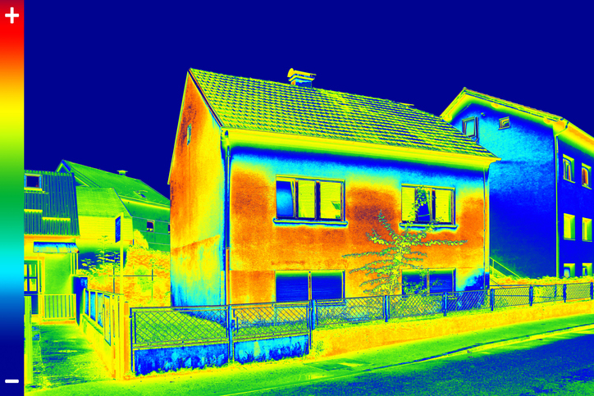
Heat loss calculations: practical method
Definition & Data Inputs
Heat loss is the rate heat leaves a building in Watts (W)
Inputs: room size, fabric, U-values, glazing, air change, design temperatures
Fabric Loss
Formula:
Area × U-value × Temperature Difference
Ventilation Loss
Concept:
Heat lost through required or unwanted air change
Key Decision Driver
Total heat loss informs heat pump size and emitter selection
Notes:
Tutor notes – learner method:
1) Decide internal design temp (e.g. living room higher than hallway) and external design temp used by the designer.
2) List each fabric element: wall, roof, floor, window, door.
3) Estimate fabric losses using the concept Area × U-value × ΔT.
4) Add ventilation/infiltration loss.
5) Total the room losses in watts.
6) Use the result to check emitter output at proposed flow temperature.
Key message: heat loss is not guessed from property size; it comes from room-by-room evidence and assumptions.
Discuss the CIBSE Domestic Heating design guide as point of reference and a way of working out Heat loss effectively.
Show YouTube video as an example; https://www.youtube.com/watch?v=r2uLnkDmRfk&t=772s

Slide 6

Worked example: heat loss assumptions
Example room: living room with external wall + window
Assumptions drive the final answer (fabric, glazing, ventilation, design temps)
The Impact of Poorer Insulation
Condition: Poorer than assumed
Result 1: Heat loss increases
Result 2: Emitter/output requirement increases
Crucial Action: Record assumptions in the design/job file
Notes:
Tutor worked example (simple, not full design calculation):
Scenario: Same living room, two different assumptions.
- Assumption A: insulated wall and modern glazing = lower heat loss.
- Assumption B: uninsulated wall and older glazing = higher heat loss.
Discussion questions:
1) Which room needs the larger emitter?
2) Which property is more likely to need higher flow temperature if emitters are not upgraded?
3) What evidence should be recorded?
Suggested learner output: 'Heat loss assumptions list' including construction, glazing, ventilation assumption and design temperatures.
Workbook task: created by others.

Slide 7
Low temperature heating (key idea)
What learners need to know
Efficiency & Flow
Heat pumps are most efficient when delivering lower flow temperatures because the compressor does less work.
Typical Operating Temperatures
35–55°C: Typical range depending on heat loss and emitters.
UFH: 30–35°C | LT Radiators: 40–45°C | Existing: 50°C+
Surfaces & Controls
Lower flows need larger heat transfer surfaces (e.g. UFH, larger rads). Weather compensation helps maintain comfort and reduce cycling.
The Trade-off
Raising flow temperature increases output but reduces COP and increases running costs.
Key Goal: Maximise efficiency by minimising flow temperatures
Notes:
Tutor explanation:
Boiler mindset = high temperatures, short bursts, rapid response.
Heat pump mindset = lower temperatures, longer stable operation, weather compensation, correctly sized emitters.
Scenario prompt: customer says 'just turn the flow temperature up'. Ask learners: what comfort benefit might this give, and what efficiency/running-cost drawback could it create?
A house has an existing radiator that worked well with a gas boiler at around 70°C flow temperature. When converted to a heat pump, the design target might be closer to 45°C flow temperature. At this lower temperature, the radiator gives off less heat, so the room may not reach design temperature unless the radiator is upgraded, the heat loss is reduced, or a different emitter is used. Raising the heat pump to 55°C may improve comfort, but it will generally reduce efficiency compared with a well-designed 40–45°C system.

Slide 8
Emitter selection and ΔT (delta T)
Fundamental Definition & Formula
ΔT (delta T) is the difference between mean water temperature and room air temperature.
ΔT = ((Flow temp + Return temp) ÷ 2) − Room temp
Standard Example For UK Radiators
Flow 75°C / Return 65°C / Room 20°C
Mean water temp = 70°C → ΔT50 (UK Standard BS EN 442)
Heat Pump Challenges
Systems operate at lower flow temps. Radiator output falls significantly unless sized for the lower ΔT.
Available Solutions
Larger radiators or fan convectors
Underfloor heating (UFH)
Mixed emitter circuits
Selection Criteria
Selection must match:
Room Heat Loss | Flow Temp | ΔT | Control Strategy
Key Takeaway: Existing radiators sized for boilers are often too small for efficient heat pump operation.
Notes:
Tutor notes – practical example:
A radiator that was adequate on a boiler system at high flow temperatures may not deliver enough heat at 45°C flow. The room heat loss has not changed, but the emitter output has reduced because the temperature difference to the room is smaller.
Learner check:
- If a room heat loss is 1.5 kW and the existing radiator can only deliver 0.9 kW at proposed low flow temp, what are the options?
Suggested answers: larger radiator, add emitter, fan convector, improve fabric, revise design/controls, consider UFH if appropriate.
The key point is that radiator output is not fixed. A radiator only gives its advertised output at the conditions it was tested or declared at. In the UK, many radiator outputs are listed at ΔT50, which is based on a mean water temperature 50°C above the room temperature. For example, if the flow is 75°C and return is 65°C, the average water temperature is 70°C. In a 20°C room, the radiator is operating at ΔT50. Some radiator manufacturers now also publish outputs at ΔT30, which is more relevant to lower-temperature systems such as heat pumps.
A heat pump may be designed around lower flow temperatures, for example 35–45°C for underfloor heating or low-temperature emitters, or around 45–55°C where upgraded radiators are used. At these lower temperatures, the mean water temperature is much closer to the room temperature, so the emitter gives off less heat. That means a radiator that was suitable for a boiler system may not meet the room heat loss when used with a heat pump unless it is resized or replaced.
Workbook: emitter selection task created by others.

Slide 9
Emitter selection and ΔT (delta T)
Worked Example for Learners
Traditional Radiator Rating (Standard)
Flow: 75°C | Return: 65°C | Room: 20°C
Step 1: Mean Temp = (75 + 65) ÷ 2 = 70°C
Step 2: ΔT = 70 − 20 = ΔT50
A radiator rated at 1,000 W at ΔT50 provides exactly 1,000 W under these conditions.
Lower-Temperature Heat Pump Example
Flow: 45°C | Return: 40°C | Room: 20°C
Calculation: Mean Temp = (45 + 40) ÷ 2 = 42.5°C
Result: ΔT = 42.5 − 20 = ΔT22.5
At ΔT22.5, that same 1,000W (ΔT50) radiator produces significantly less heat output.
Learner Takeaway
Lower water temperature = lower heat output for the same radiator.
Check radiator output at the actual design ΔT, not just the headline ΔT50 rating.
Critical: Sizing for heat pumps must be precise to maintain COP and reduce running costs.
Use manufacturer tables or software for exact output based on ΔT correction factors.
Notes:
Link to the Stelrad correction factor. Worked example for learners
https://www.stelradprofessional.com/stelrad-correction-factor

Slide 10
Fluid dynamics: Laminar vs. Turbulent Flow
Laminar Flow: Smooth & Low Mixing
Water moves in neat layers. In heating systems, this reduces effective heat transfer through exchangers and coils.
Occurs when: Flow rate is too low, pipe is oversized, or fluid is viscous.
Turbulent Flow: Mixed & High Transfer
Creates mixing that improves heat transfer. However, excessive turbulence increases pressure loss, noise, and wear.
Benefit: Generally improves heat pump efficiency in emitters and plate exchangers.
Heat Pump Requirements
Requires stable flow to transfer heat. Poor flow causes low output, high ΔT, short cycling, and lockouts.
Viscosity & Resistance
Glycol/brine is 'thicker' than water, increasing resistance. Careful pump selection is critical for these circuits.
Flow Restrictions
Air pockets, sludge, blocked strainers, and undersized pipes reduce system performance significantly.
Commissioning ensures correct flow rate, pressure, and ΔT.
Essential for proving the system operates efficiently and safely.
Notes:
Tutor explanation:
Tutor example
A heat pump is commissioned, but the house is slow to warm up and the unit keeps stopping on a flow-related fault. The engineer checks the system and finds the strainer is partly blocked and several radiators have air trapped in them. The restriction reduces flow, so the heat pump cannot transfer heat properly into the system. Once the system is cleaned, vented and rechecked, the flow improves, ΔT becomes more stable, and the heat pump can run for longer steady periods.
This is not about making learners calculate Reynolds number. It is about recognising that flow behaviour affects heat transfer, noise, resistance and performance.
Practical signs to discuss:
- Too little flow: large ΔT, slow warm-up, low output, flow alarms.
- Too much flow/velocity: noise, erosion risk, high pump energy, poor balancing.
- Restrictions: blocked strainer, air pockets, sludge, partially closed valves.
Stop point: learners match symptoms to possible causes.

Slide 11
Viscosity (temperature and glycol)
Fluid Flow Basics
Viscosity determines how easily a fluid flows. Low viscosity means easy flow; high viscosity means 'thicker' fluid.
In heating systems, higher viscosity increases resistance through pipework, valves, and emitters.
Temperature & Resistance
Cold fluids are more viscous. Heat pump outdoor pipework and ground loops operate at lower temperatures than boilers.
Glycol is thicker than water. Higher concentrations make pumps work harder to maintain flow.
Impact of Incorrect Concentration
Too little glycol risks freezing; too much reduces flow and heat transfer while increasing energy use.
Poor flow causes high ΔT, reduced output, noise, and short cycling in heat pumps.
Fluid Treatment & Efficiency
Dirty water, sludge, and air add resistance. Regular flushing, inhibitor checks, and filter maintenance are essential to protect flow and system efficiency.
Notes:
Tutor notes:
Link to GSHP brine circuits and frost protection. A brine/glycol mixture protects against freezing but can be harder to pump than plain water, especially at low temperatures.
Learner questions:
1) Why might a GSHP circuit need a different pump selection than a simple heating circuit?
2) What could happen if fluid becomes dirty or blocked by debris?
3) Why should glycol concentration be checked against manufacturer requirements?

Slide 12
Pipe sizing: practical selection logic 1
System ΔT (Circuit Drop)
For Pipe Sizing
System ΔT = Flow temp – Return temp
Heat Pump Example (ΔT5):
45°C / 40°C = 5K drop. Smaller ΔT requires a higher flow rate to move the same heat.
Radiator ΔT50 (Rating)
For Emitter Output
Based on Mean Water Temp (MWT) vs Room Temp.
Traditional Example:
75°C Flow / 65°C Return / 20°C Room.
MWT = 70°C. ΔT = 70 – 20 = ΔT50.
Key Learner Warning
They are NOT the same!
System ΔT5: Used for flow rate and pipe sizing.
Radiator ΔT50: Manufacturer rating for heat output.
Pipe Sizing Link
Pipework must keep velocity and pressure drop acceptable once flow is known.
Undersized pipes cause noise, high resistance, poor flow, and heat pump faults.
Notes:
Tutor notes
Learners often hear “ΔT5” and “ΔT50” and assume they are the same thing. They are not. In pipe sizing and pump selection, we are usually talking about the system temperature drop between flow and return. For example, a heat pump operating at 45°C flow and 40°C return has a 5K temperature drop across the circuit.
Radiator manufacturers often quote radiator output at ΔT50, which is a different calculation. That figure compares the mean radiator water temperature with the room temperature. Traditional boiler conditions such as 75/65/20°C give a mean water temperature of 70°C, and 70°C minus a 20°C room gives ΔT50.
The teaching point is:
System ΔT helps calculate required flow rate. Radiator ΔT helps determine emitter output.
Both matter, but they are used for different decisions.

Slide 13
Pipe sizing: Heat Pump Application Logic 2
1. Heat Output & ΔT
Starts with required heat moved, usually based on room-by-room heat loss.
Designers choose a ΔT (often 5K for heat pumps) following manufacturer requirements.
2. Flow Rate Estimation
Formula:
Flow (L/s) = Output (kW) ÷ (4.18 × ΔT)
Example: 8kW at ΔT5
Flow = 0.38 L/s = 22.8 L/min
Pipe must support ~23 L/min
3. Acceptable Limits
Water Velocity:
Too high = noisy and inefficient.
Pressure Drop:
Too high = pump may fail to achieve required flow.
Undersized vs. Oversized Pipes
Undersized: Causes flow errors, noise, and pump strain.
Oversized: Increases material cost, heat loss, and response time.
The Efficiency Link
Heat pumps need steady flow to transfer heat effectively. Poor sizing forces higher pump speeds, destabilising the system and making commissioning difficult.
Final Check: Design vs. Commissioning
Sizing is a design decision, but commissioning confirms reality. Check flow rates, ΔT, pump settings, balancing, and filter cleanliness before handover.
Notes:
Tutor notes – simple logic:
Required heat output and ΔT inform the required flow rate. The pipework must then carry that flow without excessive velocity or pressure loss.
A heat pump is designed to deliver 8 kW at a 5K ΔT. This requires approximately 23 L/min of flow. If the installer uses pipework that is too small or has too many restrictive fittings, the pump may not be able to move enough water. The heat pump may then show a high temperature difference between flow and return, poor output, noisy operation, or repeated flow-related faults. The solution is not simply to increase the temperature setting — the designer/installer must check pipe sizing, resistance, pump capability, balancing, valves, filters and air removal.
Learner takeaway
Pipe sizing is about moving the right amount of heat, at the right flow rate, with acceptable resistance and noise. In heat pump systems, poor pipe sizing can directly reduce comfort, efficiency and reliability.
Use the simple relationship in words: more heat or smaller ΔT usually means more flow is needed. More flow through small pipes increases pressure loss and noise.
Learner task: for three symptoms (noisy pipework, poor heat at furthest emitter, pump at max speed), identify why pipe sizing/resistance might be involved.

Slide 14
Circulation pump selection: practical principles
1. Flow Rate & Head
Flow rate: How much water moves (L/min, L/s, m³/h).
Head: Resistance the pump overcomes (m head or kPa).
Logic: Smaller ΔT = higher flow needed to move the same heat.
2. System Resistance
Resistance comes from the whole circuit: pipe length, bends, valves, emitters, and filters.
Post-installation increases:
Dirty strainers & sludge
Air locks
Partially closed valves.
3. Matching the Circuit
The Danger of Mismatch:
Too small: Cannot achieve required flow.
Too powerful: Noise, excessive velocity, and wasted energy.
Aim: Correct flow with stable, quiet operation.
Variable Speed Pumps
Adjust output to demand and resistance, reducing energy and noise. Supports zoning and changing demand but requires expert setup.
Performance Impacts
Poor selection causes: poor heat delivery, unstable ΔT, flow alarms, short cycling, noisy pipework, and slow cylinder recovery.
Final Commissioning Checks
Always verify flow rate, pump settings, air removal, filter condition, and system balancing to ensure design meets reality.
Notes:
Tutor example
A heat pump requires approximately 23 L/min through the primary circuit, but the pipework has long runs, several bends, a dirty strainer and restrictive valves. Even if the pump is running, it may not achieve the required flow because the system resistance is too high. The result could be a high flow/return ΔT, poor heat transfer, noisy operation, or repeated flow-related faults. The correct response is to check the circuit resistance, clean filters/strainers, remove air, verify valve positions, balance the system, and confirm the pump can deliver the required flow at the required head.
Tutor link: Grundfos Product Center can be used to demonstrate how required flow rate and system resistance/head are used to select a suitable circulation pump. Link: https://product-selection.grundfos.com/uk
Learner takeaway
A pump is not selected just by size or brand. It must deliver the required flow rate against the system’s resistance/head, and commissioning must prove it is doing so.
Stop point: learners classify symptoms as flow, sizing or control related.

Slide 15
Worked example: heat output → flow → pump
1. Heat Output & ΔT
Start with design heat output:
8 kW delivered to system.
Choose System ΔT:
45°C flow / 40°C return = 5K ΔT
2. Flow Rate Calculation
Formula:
Flow (L/s) = kW ÷ (4.18 × ΔT)
Calculation:
0.38 L/s (8 ÷ 20.9)
22.8 L/min (0.38 × 60)
3. Resistance & Head
System Check:
Flow must pass through pipes, bends, valves, and exchangers.
Pump Selection:
Select pump for ~23 L/min at the required head. Use a manufacturer calculator tool to assist in the selection.
System Resistance Details
The required flow must overcome the resistance of the full circuit: pipes, bends, valves, strainers, emitters, heat exchangers and fittings. High resistance may prevent the pump from achieving the target flow rate.
Final Check: Commissioning Verification
Confirm flow rate, ΔT, pump settings, and air removal. If flow is low, check for restrictions, trapped air, or incorrect pump settings. Commissioning proves the design works in practice.
Notes:
Tutor note
This example helps learners understand the chain:
heat output → ΔT → flow rate → pipe resistance → pump selection → commissioning verification.
A smaller system ΔT, such as 5K, means the same heat output must be carried by a larger volume of water. This is why many heat pump systems need good pipe sizing and correct pump selection. The pump must not only move the calculated flow; it must move that flow through the actual system resistance. That resistance comes from the pipework layout, pipe size, fittings, valves, strainers, emitters, and heat exchangers.
Learner takeaway
For heat pumps, flow rate is critical. If the pump cannot deliver the required flow through the circuit, the heat pump may suffer poor heat transfer, high ΔT, noisy operation, flow alarms or short cycling.
Learner output: 'flow and pump reasoning' note for the job file.

Slide 16
Hot water demand calculation 1
1. Property Usage
Demand is based on how the property is used. Key factors include:
Occupancy & bathrooms
Shower/bath & kitchen use
Peak demand times
2. Design Guidance
Use recognised standards:
BS EN 12831-3:2017: Method for power and storage volume.
CIBSE Guide: DHW cylinder sizing & low-temp storage.
3. Heat Pump Recovery
Heat pumps recover slower than boilers. Recovery depends on:
Available HP output
Flow temperature & coil design
Control strategy
Controls & Prioritisation
Systems often use hot water priority, temporarily pausing space heating. Design must balance user comfort, peak usage, and recovery expectations.
Cylinder & Component Sizing
Cylinder size, coil size, and flow temperature are critical. A heat pump requires a suitable heat exchanger coil and appropriate storage volume. Small coils or low temperature lead to poor recovery.
Job-file Evidence
Record all assumptions: occupants, draw-off patterns, cylinder size, HP output, recovery expectations, controls, and hygiene strategy.
Notes:
Tutor notes
Domestic hot water sizing should not be based only on a “rule of thumb”. Learners should understand that hot water demand is driven by both volume and timing. A property with four occupants showering in the morning may need a different cylinder and recovery strategy from a property with the same number of occupants but spread-out demand.
The relevant British Standard is BS EN 12831-3:2017, which covers calculation of domestic hot water system heat load and characterisation of needs. BSI describes it as a method for calculating the power and storage volume required for DHW system sizing. The NBS listing also identifies BS EN 12831-3:2017 as current and specifically linked to DHW heat load and characterisation of needs.
The CIBSE Domestic Heating Design Guide 2026 is also useful for UK domestic heating design because CIBSE states it includes a domestic hot water cylinder sizing method as per BS EN 12831-3:2017, plus coverage of DHW storage below 60°C and thermal disinfection procedures.
For heat pumps, explain that hot water production can be more sensitive than space heating because DHW usually requires a higher temperature. A correctly selected heat pump cylinder must have a suitable coil/heat exchanger surface area, and the design should account for the heat pump’s available output at DHW temperatures. MCS heat pump design guidance also links daily hot water demand with heat pump heating capacity when specifying a suitable hot water cylinder.
Simple learner example
A home has 4 occupants and most hot water is used between 6:30–8:00am. The designer needs to know:
number of showers/baths expected
target stored hot water temperature
usable stored volume
cylinder coil suitability for heat pump operation
expected recovery time
whether DHW priority will interrupt space heating
Legionella/hygiene control approach
The output is not just “choose a cylinder size”; it is a documented design decision showing demand assumptions + storage/recovery strategy + controls/hygiene approach.
Activity: quick DHW demand assumptions list (workbook created by others).

Slide 17
Hot water demand calculation 2
Scenario: DHW recovery using an 8 kW heat pump
A property has an 8 kW heat pump heating an indirect hot water cylinder (200 litres).
• Temp Rise: 10°C to 50°C (40°C )
• Specific heat capacity of water: 4.18 kJ/kg·K
• 1 litre of water ≈ 1 kg
Step 1: Calculate energy required
Formula: mass × SHC × temp rise
200 kg × 4.18 × 40 = 33,440 kJ
Convert to kWh (÷ 3,600):
Result: ~9.3 kWh
Step 2: Estimate recovery time
Formula: energy ÷ heat pump output
9.3 kWh ÷ 8 kW = 1.16 hours
Convert to minutes (× 60):
Result: ~70 minutes
Important learner note
Real recovery time can be longer based on cylinder coil size, flow temperatures, standing losses and hot water priority settings.
HP output at DHW temps vs cylinder coil heat transfer rate
Control settings and use of hot water during recovery
Notes:
Tutor notes:
Make learners list information required before sizing: number of occupants, bathrooms, shower flow rates, bath size, peak times, cylinder type, coil compatibility, target storage temperature, Legionella strategy and customer expectations.
Activity: quick DHW demand assumptions list (workbook created by others).

Slide 18
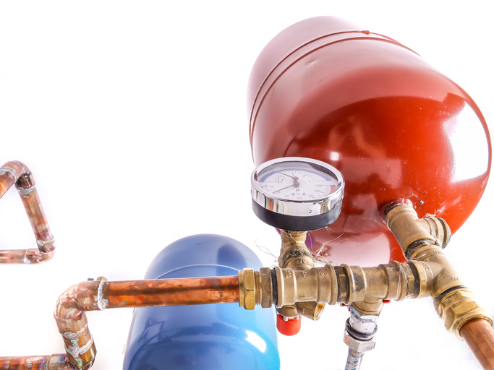
Pressure vessel sizing (awareness) 1
1. Expansion Safety
In a sealed system, water expands as it heats. An expansion vessel absorbs this volume to prevent uncontrolled pressure
rise.
2. Risks of Incorrect Sizing
Undersized or failed vessels cause rapid pressure spikes, triggering relief valves, nuisance faults, and repeat call-backs.
3. Circuit Variety
Low carbon systems often need separate vessels for:
Heating & Brine loops
DHW & Solar circuits
4. Sizing Guidance
Use CIBSE Domestic Heating Design Guide methods. Do not guess; base sizing on actual system water content.
Key Checks & Evidence
Check system volume (buffers/emitters), temp range, and static height. Commissioning records must evidence pre-charge and operating pressures.
Notes:
Tutor notes
The key teaching point is that an expansion vessel is a safety and reliability component, not just an accessory. It allows expanded water to move into the vessel as the system heats up, preventing excessive pressure rise. If the vessel is undersized, failed, wrongly charged, or isolated, the system may discharge through the pressure relief valve. When the system cools, the pressure may then be too low, leading to repeated topping up, air ingress, corrosion risk and callbacks.
For heat pumps, this becomes especially important because systems may contain more water than the old boiler system. For example, a heat pump design may include a buffer vessel, volumiser, larger radiators, underfloor heating manifold, or longer pipe runs. The existing expansion vessel from a previous boiler may not be adequate for the new total water content.
The CIBSE Domestic Heating Design Guide is useful here because it gives domestic design methods, including estimating system water content and sealed heating system considerations. A Grant UK technical article specifically highlights that the CIBSE Domestic Heating Design Guide gives a method for estimating system water content and uses selection tables in the sealed heating systems section for expansion vessel sizing.
Simple learner example
A property is converted from a gas boiler to an ASHP. The installer adds:
larger radiators
longer pipe runs to the outdoor unit
a buffer vessel
additional zone pipework
The total system water volume is now much higher than before. If the original expansion vessel is reused without checking, the vessel may be too small. When the system heats up, pressure rises, the PRV discharges, and the customer later sees low pressure faults.
Correct approach: estimate total system volume, check the required vessel size using the design guide/manufacturer method, set the pre-charge correctly, then record the commissioning values.
Learner takeaway
Expansion vessel sizing depends on system volume, pressure and temperature — not just the heat pump size.
In low carbon heating systems, added volume from buffers, volumisers and larger emitters means the vessel must always be checked as part of design and commissioning.
Ask learners: Where might we see expansion vessels? Heating circuit, unvented DHW, solar thermal, brine/ground loop.

Slide 19
Pressure vessel sizing (awareness) 2
1. System Water Volume
Worked example for an 8 kW ASHP:
Heat pump: 5 L
Pipework: 35 L
Emitters: 75 L
Buffer/volumiser: 50 L
Allowance: 10 L
Total Volume = 175 L
Awareness Check (10%):
175 L × 0.1 = 17.5 L
2. Vessel Selection
Indicative size: 18 L minimum
Round up to next suitable vessel size. 24 L may be selected based on pressure checks.
Check against:
Cold fill, static height, PRV setting, max temp, and CIBSE methods.
3. Evidence Requirements
Commissioning records must capture:
System pressure
Vessel pre-charge
PRV rating
Final operating pressure
Notes:
Tutor notes:
The 8 kW heat pump tells us the likely heating output, but it does not directly tell us the expansion vessel size. A compact 8 kW system with no buffer may need a different vessel from an 8 kW system with a 50 L buffer, large radiators and long pipe runs.
The CIBSE Domestic Heating Design Guide is the relevant UK domestic design reference, and the current version includes updated heat loss and low-temperature heating design guidance for modern systems. For vessel sizing, learners should understand the process: estimate water content → check pressure/temperature conditions → use a recognised table/calculator/manufacturer method → record commissioning values. Expansion vessel sizing is important because poor pressurisation design can affect long-term system performance and reliability.

Slide 20
Buffer and volumiser sizing
Added system volume can reduce cycling and stabilise operation
Heat pumps work best with steady run times. Low water volume causes rapid cycling (on/off), while added volume slows temperature changes for stability.
Buffer Vessel
Adds volume & hydraulic separation
Separates primary and secondary circuits
Useful for multiple zones or varying flow rates
Volumiser
Adds volume only
Installed in-line to increase water content
Used when separation is not required
Sizing Factors
Depends on minimum water volume, run time, heat pump output, and modulation range. Compare manufacturer requirements with actual system volume.
Control Strategy
Zoning (TRVs) reduces active volume. Weather compensation and open circuits can reduce the need for large buffers.
Efficiency Check: Large, poorly insulated buffers reduce COP.:
Notes:
Tutor notes:
Key distinction: buffer and volumiser are not automatically interchangeable. A buffer may affect hydraulic separation and temperature mixing; a volumiser mainly adds system volume.
A small, well-insulated property has an 8 kW heat pump connected to two heating zones. When only one small zone is calling for heat, the available water volume is low and the heat pump reaches target temperature very quickly. It switches off, cools slightly, then restarts. The customer notices inconsistent comfort and the heat pump logs frequent starts.
The designer checks the manufacturer’s minimum water volume requirement and the active system volume when only one zone is open. If the active volume is too low, a volumiser may be used to increase water content. If there are also flow separation issues between the heat pump circuit and several secondary circuits, a buffer vessel may be more appropriate.
Learner takeaway
Buffers and volumisers are not automatic add-ons. They must be selected to solve a specific design issue: minimum water volume, minimum flow, cycling, hydraulic separation or multiple-zone behaviour. Poorly selected or badly piped vessels can reduce heat pump efficiency instead of improving it.
Scenario prompt: small low-water-content system with TRVs closing frequently. Why might minimum flow/volume be a problem? What evidence would you check before adding a vessel?

Slide 21
Coefficient of Performance (CoP)
Worked Example
Input: 2 kW electricity
Output: 8 kW heat
CoP = 8 ÷ 2 = 4
Operating Conditions
Low-Temp (40°C):
Smaller lift = Higher CoP
High-Temp (55°C):
Heat pump works harder = Lower CoP
Core Concept
CoP is an efficiency ratio
CoP = useful heat output ÷ electrical input
It tells us how much heat the heat pump delivers for each unit of electricity used.
Higher CoP = More Efficiency
CoP of 3: Delivers 3 kW of heat for every 1 kW of electricity used.
Higher CoP means lower running costs and carbon impact.
Performance Factors
Temperature Lift
CoP improves when the lift (source vs. flow temp) is reduced.
Flow Temperature Impact
35–40°C: Highly efficient (e.g. UFH).
55°C: Lower efficiency (e.g. radiators).
System Dependency
Real CoP depends on installation quality, controls, and maintenance. Poor flow rates or dirty filters reduce efficiency.
Notes:
Tutor notes:
Example: If a heat pump provides 4 kW heat output using 1 kW electricity at stated conditions, CoP = 4.
Critical point: CoP is not fixed. It changes with outdoor/source temperature, flow temperature, DHW temperature, cycling and defrost. Link back to K1.6 declared vs. real performance and forward to K1.22 science.

Slide 22
Seasonal Coefficient of Performance (SCoP)
SCoP is a seasonal/annual efficiency measure that shows the average efficiency of a heat pump over a heating season, rather than at one fixed test point.
It reflects varied outdoor conditions, building heat demand, and flow temperatures.
Good Design Improves SCoP
Accurate heat loss calculation
Low design flow temperatures
Suitable emitters & sized pipework
Weather compensation controls
Good commissioning & handover
Efficiency Risks
Design & Commissioning:
High flow temps, undersized emitters, poor balancing, and frequent cycling.
User Behaviour:
Manual overrides, very high thermostat settings, and disabling weather compensation.
SCoP vs. COP
COP: Measured at specific conditions (e.g. fixed outdoor temp).
SCoP: Considers range of seasonal operating conditions; better for annual efficiency.
Note: SCoP is useful for comparison, not a guaranteed result for every home.
Tutor Example: Two identical heat pumps
Home A: Efficient Setup
Well insulated, large radiators/UFH, balanced system.
Outcome: Higher performance, lower cost.
Home B: Inefficient Setup
High heat loss, small radiators, poor balancing.
Outcome: Lower performance, higher bills.
Notes:
Tutor notes:
CoP = snapshot under stated conditions. SCoP = seasonal view.
Ask learners why seasonal performance matters more to running costs than a single test point.
Stop point: quick question – what design choices improve SCoP?

Slide 23
Ventilation and heat loss
The Basics
Quality vs. Load
Ventilation removes moisture and pollutants
Warm air replacement requires heat replacement
Infiltration
Unplanned leakage through gaps/seals
Uncontrolled: causes cold spots and higher demand
Sizing & Strategy
Calculation Impacts
Fabric and ventilation losses both matter
Wrong assumptions = incorrectly sized heat pumps
Poor Strategy Risks
Too much: increased running costs
Too little: mould, condensation, poor air quality
The Heat Pump Link
Efficiency & Design
Operate best at steady, low flow temperatures
Underestimation reduces COP
Balanced Approach
Aim: controlled ventilation, not ‘sealed’
Consider trickle vents, extract, and heat recovery
Notes:
Tutor notes:
Connect to Part F awareness from K1.4. Ventilation is not simply a 'loss' to remove; it is needed for health and moisture control. The science is balancing IAQ and heat demand.
A room has correctly sized radiators based on fabric heat loss, but the survey missed a very draughty suspended timber floor and poorly sealed external door. In winter, the room loses more heat than expected through infiltration, so the customer complains that the heat pump “doesn’t work”. The system may be forced to run at a higher flow temperature to compensate, reducing efficiency. The better approach is to identify and reduce uncontrolled draughts, update the heat loss assumptions, and confirm emitter sizing.
Learner takeaway
Ventilation is necessary, but uncontrolled air leakage is a heat loss problem. For heat pumps, accurate ventilation assumptions help protect comfort, emitter sizing, COP and customer satisfaction.
Learner prompt: What happens if an older property is draughty and heat loss calculation assumes low air leakage?

Slide 24
Electricity links to performance
Supply and Protection
Heat pumps depend on suitable electrical supply and correct capacity.
Assess if single-phase is adequate or if a three-phase upgrade is required.
Running Cost and Carbon
Efficiency depends on heat delivered per unit of electricity used.
Reduce input by keeping flow temperatures low and maintaining flow rates.
Tariffs and Scheduling
Use off-peak tariffs to pre-heat DHW or buffer stores at lower-cost times.
Balance costs against hygiene, standing losses, and comfort.
Solar PV and Battery
PV offsets daytime consumption; batteries store surplus for later use.
Integrated scheduling ensures PV, battery, and tariff strategy don't conflict.
Reliability Risks
Undersized supply or poor wiring causes nuisance tripping and lockouts.
Poor scheduling increases costs (e.g. heating water during peak tariffs).
Competent Escalation
Fixed wiring, testing, and DNO liaison must be handled by authorised persons.
Always record assumptions and escalation actions in the job file.
Notes:
Tutor notes:
Connect to K1.13. Keep the scope awareness-level: learners must recognise electricity as part of system science and operation, not undertake work beyond competence.
Tutor note / example
A design survey identifies that the property needs a larger heat pump to meet heat loss. The installer must not assume the existing electrical supply is suitable. The electrical demand of the heat pump, immersion backup, circulation pumps, controls and any EV/PV/battery equipment should be considered. If the load is too high for the existing single-phase supply, the job may need electrical design input, supply upgrade discussions, or a three-phase assessment.
In another property, the heat pump is paired with solar PV and a battery. Controls may be set so DHW reheating occurs during PV generation or low-cost tariff windows. This can reduce running cost, but only if the cylinder is correctly sized, hygiene requirements are met, and the user understands the schedule.
Prompt: How could time-of-use tariff strategy interact with DHW scheduling?

Slide 25
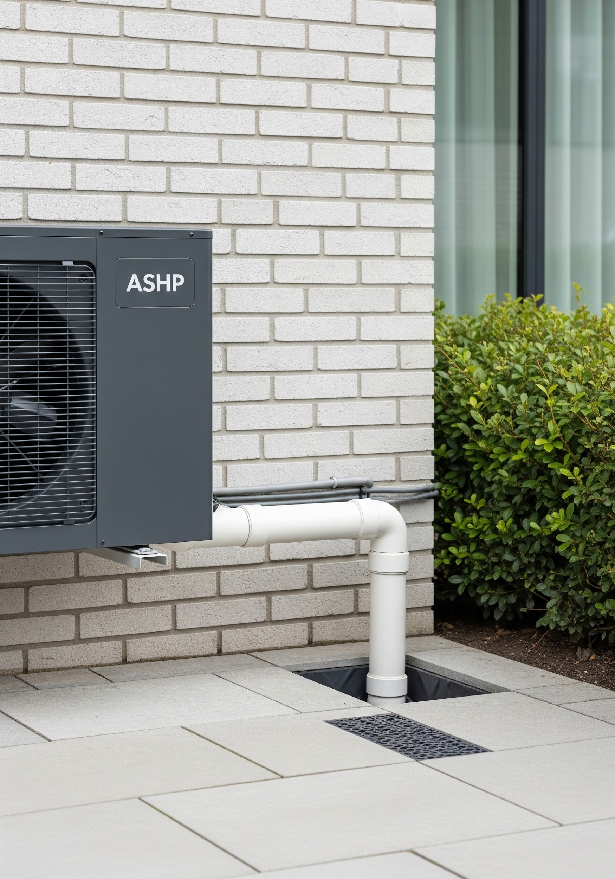
Water: drainage and capture
Key Considerations
ASHPs produce condensate/defrost water that must be managed.
Poor drainage can freeze, create slip risk or damage components.
Drain routes must be planned to avoid nuisance and property damage.
Water capture/reuse may be possible only where appropriate and compliant.
Maintenance checks should include drain routes and frost risk.
Notes:
Tutor notes:
Connect to K1.4 Part H awareness and manufacturer instructions (K1.6).
Discuss what learners should look for on site: fall, discharge location, freeze risk, blockage, pooling near walkways, damage to walls/foundations.
Image suggestion: ASHP condensate drain/frost issue (approved or reference only).

Slide 26
Recap checkpoint & questions
Why does heat loss accuracy matter to sizing?
How do low flow temperatures affect emitter selection?
What links pipe sizing, pump selection and ΔT?
CoP vs. SCoP: what is the difference?
Name one ventilation, electricity or drainage performance link.
Notes:
Suggested answers:
1) Under/oversizing affects comfort, cycling and cost.
2) Lower temperature reduces emitter output; larger/suitable emitters may be needed.
3) Required heat and ΔT imply flow; pipe resistance and pump head must support it.
4) CoP = point condition; SCoP = seasonal efficiency.
5) Ventilation increases heat load; electricity supply/tariffs affect operation; condensate must drain safely.
Wordwall/Quizizz recap placeholder (created by others).
Workbook recap task (created by others).

Slide 27
Any questions?
Copyright in this document belongs to and is used under licence from the Department for Education, © 2025.
‘T-LEVELS’ and ‘T Level’ are registered trademarks of the Department for Education.
WJEC is authorised by the Department for Education to develop and deliver this T Level Technical Qualification.
WJEC operates in England under the name Eduqas which is a registered trademark of WJEC.

