Slide 1
Occupational Specialism: Plumbing & Heating Engineering
K1.31 Types of documentation
Work programmes including Gantt charts and critical path planning

Slide 2

Starter
Warm-up:
Why do you think planning is critical to the success of a plumbing project?
Quick Activity:
Name 3 tools or documents you would use when planning work tasks.

Slide 3
Objectives
You should be able to:
Define a work programme.
Explain the use of Gantt charts.
You might also be able to:
Interpret critical path planning in construction projects.
Understand their application in the plumbing & heating sector.

Slide 4
What is a work programme?
A work programme is a structured plan outlining key tasks, durations, dependencies, and resource allocation.
It helps manage time, materials, labour, and finances effectively. Used across the industry to ensure delivery targets are met. Supports collaboration and communication across trades.
Forms part of wider project documentation and management strategies.

Slide 5
Importance of work programmes
Provides direction and clarity for all stakeholders.
Coordinates activities across multiple trades.
Identifies task dependencies and sequencing.
Reduces risks of delays and cost overruns.
Ensures compliance with health and safety and project constraints.
Question: Why might poor planning lead to safety risks on-site? Can you give an example from your own experience or studies?
Video link

Slide 6
Types of work programmes
Short-term programmes: day-to-day or weekly activities.
Long-term/master programmes: full project lifecycle.
Task-specific lists: used for focused operations or particular trades.
Procurement schedules: linked to supply chain and deliveries.
Commissioning schedules: for testing and handover stages.

Slide 7
Introduction to Gantt charts
Gantt charts are a type of bar chart that illustrate a project schedule. They show the start and finish dates of the elements of a project. Typically, they provide a clear timeline and can reveal which tasks overlap, which are dependent on others, and which are on the critical path.
In plumbing, they are often used to plan stages like first fix, second fix & commissioning. Gantt charts make it easy to spot where delays could occur and where intervention is needed to keep things on track.
Question: What kind of tasks in plumbing work do you think should be shown on a Gantt chart?

Slide 8
Sample Gantt chart
Visual Example: Gantt chart for a domestic bathroom installation.
Displays task durations: e.g. rough-in plumbing, inspection, tiling, fit-off.
Shows start and end dates for each activity.
Highlights overlapping tasks and milestones.
Colour-coded for different trades.

Slide 9
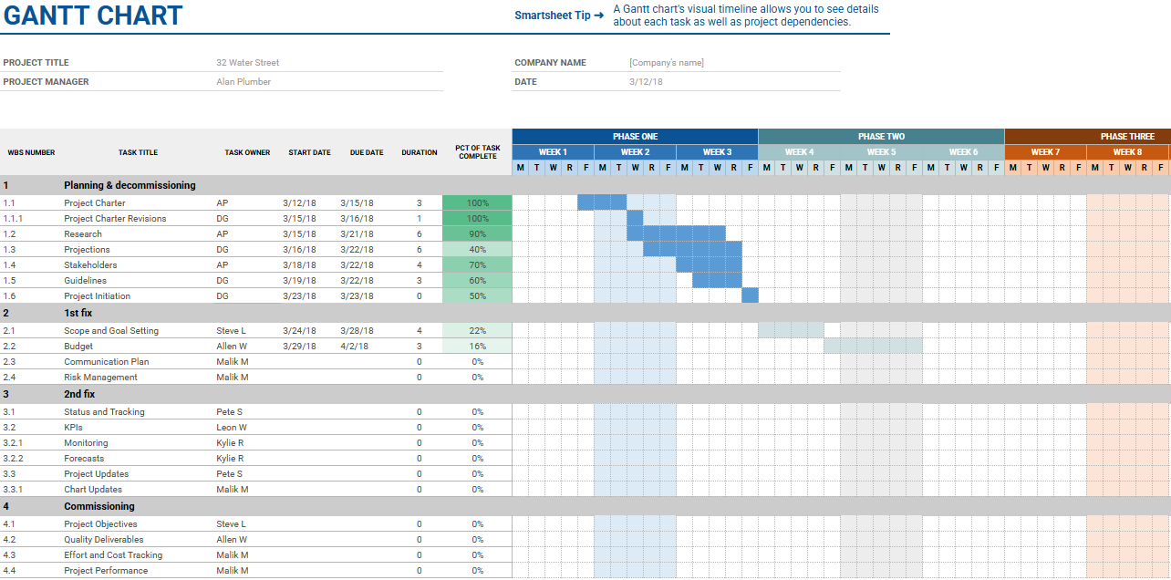
Sample Gantt chart

Slide 10
Interpreting a Gantt chart
Identify task duration: how long each activity takes.
Review task sequence and overlaps.
Note milestones (key checkpoints).
Understand resource requirements per task.
Track progress visually.

Slide 11
Advantages of Gantt charts
Clear visual overview of the entire project.
Improves time management and scheduling.
Encourages team communication.
Tracks delays and adjustments easily.
Helps allocate labour and materials appropriately.
Question: What would happen if a supplier delay wasn’t reflected on a Gantt chart?

Slide 12
Gantt Chart limitations
Can become hard to read on complex projects.
Not ideal for showing task dependencies in depth.
Requires regular updates to remain accurate.
Doesn’t easily reflect uncertainty or change.
Needs basic training to use software tools effectively.

Slide 13
Knowledge check
Q1: What are two main benefits of using Gantt charts?
Q2: Name one type of work programme.
Q3: Why is task sequencing important?

Slide 14
Knowledge check - answers
Visual tracking and improved communication.
Short-term programme (see slide 6 for other options).
To ensure logical and efficient workflow.

Slide 15
Introduction to Critical Path Method (CPM)
Critical Path Method (CPM) is a project management tool used to determine the minimum time needed to complete a project. It highlights the longest sequence of dependent tasks – this is the “critical path.” If any task on the critical path is delayed, the whole project will be delayed.
CPM is especially useful in coordinating trades and understanding the impact of delays. It also identifies which tasks have 'float' or slack time.
Question: Why might float time be useful to a site supervisor?

Slide 16
Key terms in CPM
Activity: A specific job or task in the programme.
Duration: The time needed to complete an activity.
Dependency: When one task relies on another to start/finish.
Float (Slack): Time a task can be delayed without affecting the overall project.
Milestone: A key point marking significant progress.

Slide 17
CPM activity
Create a simple critical path network for bathroom installation.
Highlight any critical tasks in red.
Non-critical tasks in blue.
Show duration and links between tasks.
Indicate float on non-critical activities.
Notes:
Optional classroom activity, or tutor to show completed CPM.

Slide 18
Benefits of CPM
Identifies essential tasks for timely completion.
Helps prioritise team focus and resources.
Allows effective sequencing and coordination.
Makes project tracking and troubleshooting easier.
Supports accurate project planning and forecasting.
Question: Which tasks in a central heating install might be on the critical path?

Slide 19
How to identify the critical path
List all project tasks with estimated durations.
Establish dependencies between tasks.
Draw a network diagram.
Calculate the earliest and latest start and finish times.
Highlight the path with zero float: this is your critical path.

Slide 20
Software for work programmes
Microsoft Project: detailed scheduling and CPM tools.
Asta Powerproject: construction-specific features.
MS Excel / Google Sheets: flexible and simple Gantt charts.
Trello/Monday.com: basic task tracking for smaller teams.
Apps improve accuracy and collaboration.

Slide 21
Planning in plumbing context
Planning is critical in coordinating plumbing tasks with other trades such as electricians, plasterers, and tilers. A typical bathroom refurbishment requires careful sequencing, such as pipework & cable first-fix before walls are boarded and tiled, followed by second fix.
Mistakes in planning can lead to rework, material waste, and conflict between teams. Including time for testing and inspection is also key to compliance. Planning ensures that safety procedures are followed and that customer expectations are met.
Question: Have you experienced or observed poor planning on site? What was the impact?

Slide 22

Risk of poor planning
Miscommunication between trades.
Delay in inspections or handovers.
Overstocking or shortage of materials.
Safety incidents due to clashing activities.
Missed client deadlines and cost overruns.

Slide 23

Collaboration in planning
Planning should involve all team leads.
Sharing plans helps identify clashes early.
Schedules should link with delivery dates.
Weekly site meetings to review progress.
Digital tools improve access to updates.
Question: Why is it important to include suppliers in your planning conversations?

Slide 24
Regulations & standards
CDM Regulations 2015: planning for safe construction.
Work at Height Regulations: timeline for scaffolding/access.
BS 6079: British Standard for project management.
Building Control inspection timelines.
Compliance with legislation must be built into the work programme.

Slide 25
Knowledge check
What does CPM stand for?
Why is float useful?
Name one type of planning software used in plumbing projects.

Slide 26
Knowledge check - answers
Critical Path Method
It allows flexibility in task scheduling
MS Project (see slide 21 for other examples)

Slide 27

Planning documentation
Risk assessments
Method statements
Schedule of works
Daily site diaries
Inspection and testing records.

Slide 28
Common pitfalls in work programmes
Overlooking dependencies between tasks.
Not allowing time for inspections.
Unrealistic durations for activities.
Ignoring delivery and lead times.
Failing to communicate changes to all parties.
Question: What would you do if your delivery date changed and affected your planned installation day?

Slide 29
Integrating work programmes into workflow
Include programmes in toolbox talks and site inductions.
Display updated plans on site noticeboards.
Use digital platforms for real-time updates.
Link procurement with planned dates.
Review progress weekly and adjust as needed.

Slide 30
Practical task
In pairs: Create a 5-task Gantt chart for a WC & washbasin installation. The customer has bought the materials from an online supplier and wants the wall above the basin to be tiled (backsplash).
Identify dependencies and estimate durations.
Calculate and highlight the critical path.
Discuss what changes could affect the path.
Present to class for feedback.

Slide 31
Group activity
Teams: Plan a one-day work programme for hot water or heating system installation.
Assign roles, estimate task times, draw Gantt and network diagram.
Compare results with another team and discuss choices made.

Slide 32
Knowledge check
What is the purpose of a work programme?
How does CPM differ from a Gantt chart?
What should be included in a plumbing risk assessment?

Slide 33
Knowledge check - answers
To organise tasks, timings, and responsibilities.
CPM is dependency-focused, Gantt is timeline-focused.
Hazards, controls, task breakdown, people at risk.

Slide 34
Summary (1)
You should now be able to:
Recall different types of work programmes used in plumbing projects.
Explain the purpose and features of Gantt charts.
Interpret critical path method (CPM) and its components.
Identify planning tools and documentation used on-site.

Slide 35
Summary (2)
You might also be able to:
Analyse a project to determine its critical path.
Create and adjust a Gantt chart for a small plumbing task.
Evaluate the impact of poor planning on project outcomes.
Justify the use of planning software for managing real site work.

Slide 36
Any questions?
Copyright in this document belongs to and is used under licence from the Department for Education, © 2025.
‘T-LEVELS’ and ‘T Level’ are registered trademarks of the Department for Education.
WJEC is authorised by the Department for Education to develop and deliver this T Level Technical Qualification.
WJEC operates in England under the name Eduqas which is a registered trademark of WJEC.

