Slide 1
Occupational Specialism: Plumbing & Heating Engineering
K1.31 Types of documentation
Risk assessments and method statements

Slide 2
Starter
Warm-up:
Have you ever had to complete or follow a risk assessment or method statement? What was it for?
Brief class discussion to establish prior experience.

Slide 3
Objectives
You should be able to:
Define what a risk assessment and a method statement are.
Explain the importance of both documents in plumbing and heating work.
You might also be able to:
Identify the key components of each.
Understand how to contribute to their creation and implementation.

Slide 4
What is a risk assessment?
A risk assessment is a process used to identify hazards and evaluate potential risks in a work environment. It is required by law under the Health and Safety at Work etc. Act 1974. The aim is to prevent accidents and harm to health.
This involves examining tasks and equipment to determine what could cause injury. Once hazards are found, control measures are chosen to manage them. Risk assessments must be reviewed regularly.
Management of Health and Safety at Work Regulations 1999

Slide 5
Purpose of risk assessments
Risk assessments help protect workers and the public by identifying and controlling hazards. They ensure compliance with health and safety legislation. They also encourage a proactive safety culture on site.
When done properly, they reduce accidents and improve awareness. Risk assessments are essential for high-risk environments like plumbing. They also help avoid legal penalties.

Slide 6
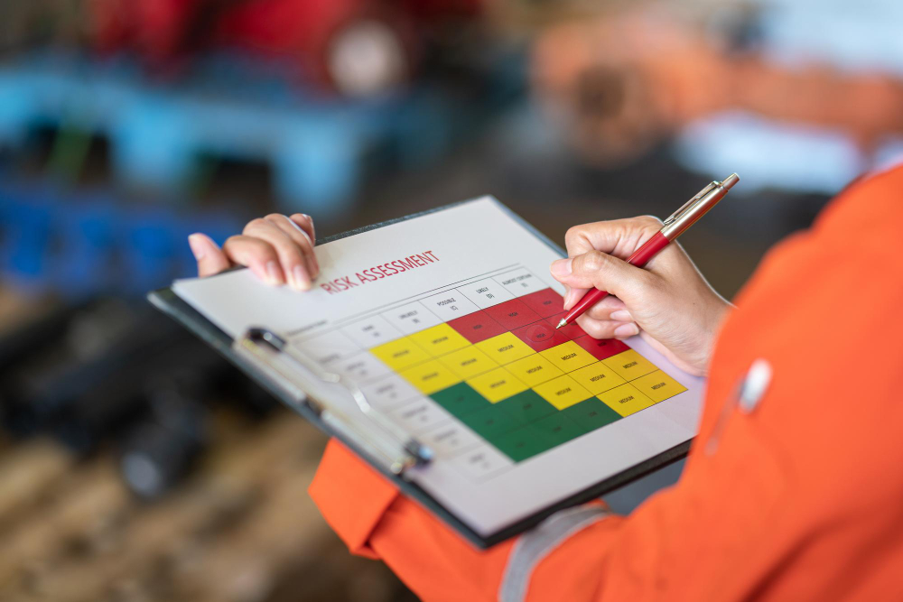
Key components of a risk assessment
Hazard identification
Who may be harmed and how
Risk evaluation
Control measures
Review and monitor

Slide 7
What is a method statement?
A method statement explains how a task will be carried out safely. It works with the risk assessment to guide workers. The document outlines the sequence of work and the safety measures in place.
It is essential for high-risk jobs like working at height or in confined spaces.
Diagrams and clear instructions may be included. It improves clarity, safety, and efficiency.

Slide 8
Purpose of method statements
Method statements guide workers in carrying out tasks safely. They provide step-by-step instructions. These documents show that risks have been considered and controlled.
They are useful for training and legal checks. A task-specific method statement is clearer and safer. It also ensures the job meets quality and legal standards.

Slide 9

Contents of a method statement
Company and job details
Work activity description
Responsibilities
PPE required
Step-by-step procedures
Emergency procedures
Notes:
Tutor to show online examples of method statements

Slide 10
Legal requirements
Management of Health and Safety at Work Regulations 1999
Construction (Design and Management) Regulations 2015
These laws require employers to manage risks and plan work safely.
Risk assessments and method statements help meet these legal duties. They are used as proof of compliance. Not following the law may lead to HSE enforcement. This can include fines or prosecution.

Slide 11
Roles and responsibilities
Employer: ensures risk assessments are done
Site Manager: reviews and enforces
Operative: follows guidance, raises concerns
Clear communication helps build accountability. Everyone must understand their safety role. Following procedures protects individuals and teams. Employers provide structure and training. Workers must report hazards. Safety is a shared responsibility.

Slide 12
Creating a risk assessment - step-by-step
Walk the site to understand the environment.
Identify risks and hazards.
Use a risk matrix to judge severity and likelihood.
Record who is at risk and the controls used.
Apply controls and inform workers.
Review the assessment as conditions change.

Slide 13
Common hazards in plumbing
Working at height
Hot surfaces
Confined spaces
Manual handling
Electrical hazards
Slips, trips and falls
Hazards depend on location and task. Controls are chosen based on risk. Planning and correct equipment reduce danger. Workers must be trained. Safety must be monitored. Supervisors must enforce good practice.
Notes:
https://www.freepik.com/premium-vector/risk-management-matrix-with-impact-likelihood-businessman-analyzing-level-risk-by-considering-category-probability-likelihood-against-category-consequence-severity_58538570.htm#fromView=search&page=1&position=20&uuid=7ea9e37c-3647-4a97-b664-7c86f4a24a69&query=Risk+Matrix+Example

Slide 14
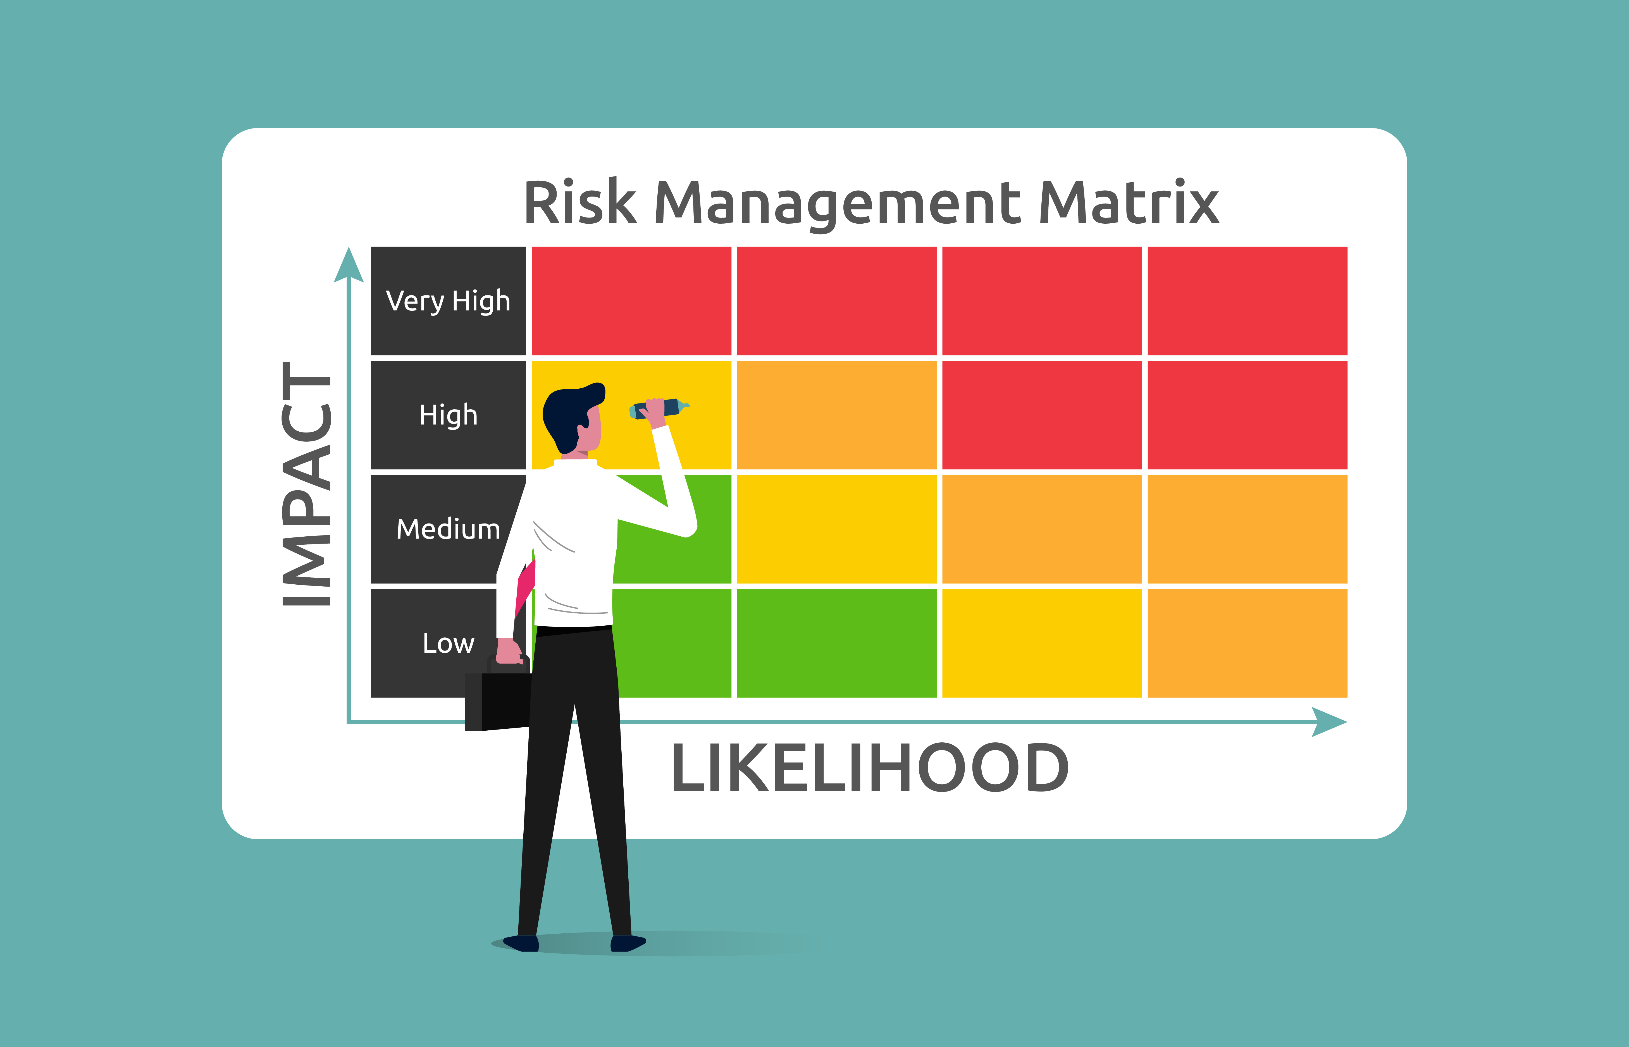
Risk matrix example
Likelihood vs. Severity/Impact.
Colour-coded risk levels.
Risk matrices help rank risks. High-severity risks need strong controls. Colours like red mean urgent attention.
Use the matrix to support planning. It helps decide when extra controls are needed.
Simple visuals aid understanding.
Notes:
https://www.freepik.com/premium-vector/risk-management-matrix-with-impact-likelihood-businessman-analyzing-level-risk-by-considering-category-probability-likelihood-against-category-consequence-severity_58538570.htm#fromView=search&page=1&position=20&uuid=7ea9e37c-3647-4a97-b664-7c86f4a24a69&query=Risk+Matrix+Example

Slide 15
Creating a method statement
Break down the task clearly.
Summarise risk findings.
Write steps with safety details.
List tools and PPE needed.
Plan waste and emergency actions.
Get approval from a competent person.
This ensures the task is completed safely.

Slide 16
Practical application example
Installing a boiler or cistern in a loft has risks. Space is often tight, and floor strength may be limited. Manual handling must be done safely.
Trip hazards must be removed. The method statement should list access steps. It must include PPE and electrical safety.

Slide 17
Knowledge check
What’s the main purpose of a risk assessment?
Who is responsible for reviewing a method statement on site?
Which regulation requires risk assessments?

Slide 18
Knowledge check - answers
To identify hazards and minimise risks
Site manager
Management of Health and Safety at Work Regulations 1999

Slide 19
Common errors in risk assessments
Too generic
Not reviewed
Incomplete hazard listing
Lack of worker input
Ignoring rare but serious risks
No follow-up checks.

Slide 20
Common errors in method statements
Not site-specific
Missing roles or steps
Confusing language
No emergency plan
Ignoring tool risks
Not updated when tasks change.

Slide 21

Dynamic risk assessments
Needed when the site changes
Example: finding asbestos
Work may need to stop
New risks are reviewed
Extra controls added
All team members are informed.

Slide 22
Communicating safety information
Effective communication of safety information is vital on any site. Toolbox talks are commonly used to deliver daily safety reminders. Clear signage and posters reinforce key points visually.
Digital alerts and messaging apps are also useful tools for spreading updates. Everyone should be encouraged to ask questions.
Open discussion improves understanding and engagement.

Slide 23
Reviewing and updating
Risk assessments and method statements are not one-off documents. They must be reviewed and updated regularly to reflect current working conditions. This includes after an incident, a change in equipment, or when new regulations are introduced.
Question: Why do you think regular reviews are important in our industry?

Slide 24
Involving workers
Workers are closest to the tasks and often spot hazards before anyone else. Involving them in writing risk assessments and method statements makes the documents more realistic. It also encourages ownership of safety procedures.
Question: Have you ever suggested a safety improvement at work?

Slide 25
Case study 1
Let’s look at a real example. In an old school, plumbers had to remove lead pipework in a confined space.
What do you think the main risks were?
They used respirators, PPE, and monitored air quality throughout. A permit system controlled who could enter the area. By planning ahead and following procedure, they avoided harm and legal issues.

Slide 26
Case study 2
In this case, engineers were replacing a heating system in a home with people still living there.
What extra things do we need to think about when working in someone’s home?
The team put up signs, timed the work to avoid residents, and used thermal gloves and barriers. This helped protect both the team and the household. Clear communication was key to keeping everyone safe and comfortable.

Slide 27
Knowledge check 2 - scenario-based
You’re fitting a boiler in a tight room.
What hazards are present?
How would you control them?
What should be in the method statement?
What PPE is needed?
How would you manage heat and electricity?
What steps keep the workspace safe?

Slide 28
Knowledge check 2 - answers
Hazards: cramped space, burns, electrical contact
Controls: isolation, PPE, lighting
Statement: step-by-step guide with safety notes
PPE: gloves, goggles, mask
Check ventilation and trip hazards
Plan exits and emergency stops

Slide 29
Summary
You should now be able to:
Define what a risk assessment and a method statement are.
Explain each document their purpose and when to use them.
Describe the process for creating and updating them.
You might also be able to:
Evaluate real-world examples of risk assessment and method statement use.
Contribute to improving safety practices on site by involving others.
Notes:
Worksheets required -
Templates for risk assessment and method statement
Example completed forms

Slide 30
Any questions?
Copyright in this document belongs to and is used under licence from the Department for Education, © 2025.
‘T-LEVELS’ and ‘T Level’ are registered trademarks of the Department for Education.
WJEC is authorised by the Department for Education to develop and deliver this T Level Technical Qualification.
WJEC operates in England under the name Eduqas which is a registered trademark of WJEC.

