Slide 1
Occupational Specialism: Plumbing & Heating Engineering
K1.30 Plumbing and heating drawing symbols and markings
Drawing types and drawing symbols

Slide 2
Starter
Task:
What kind of technical drawings have you seen before?
Think:
Why are accurate drawings essential in construction?

Slide 3
Objectives
You should be able to:
Identify different types of technical drawings used in plumbing and heating.
Interpret commonly used drawing symbols and abbreviations.
Explain how drawings support installation and safety compliance.
Apply knowledge of drawings in practical settings.

Slide 4
The role of drawings in the industry
Drawings are essential for communication in construction. They help ensure:
Accurate planning and installation.
Coordination between trades.
Compliance with regulations.
Health and safety on site.

Slide 5
Common types of technical drawings
Site plans
Floor plans
Elevations
Sections
Detail drawings

Slide 6
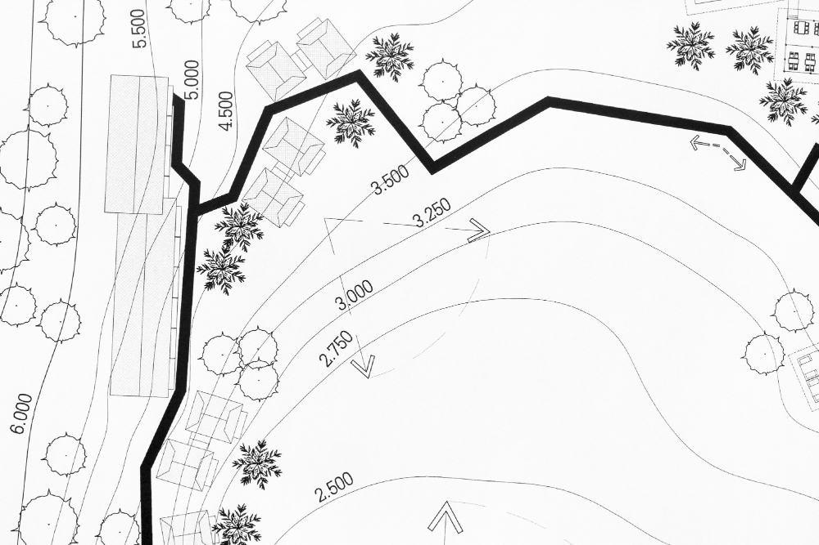
Site plans
Site plans show the entire project location, including:
Boundaries and roads.
Services (e.g., drainage, water supply).
Topography and landscaping.

Slide 7
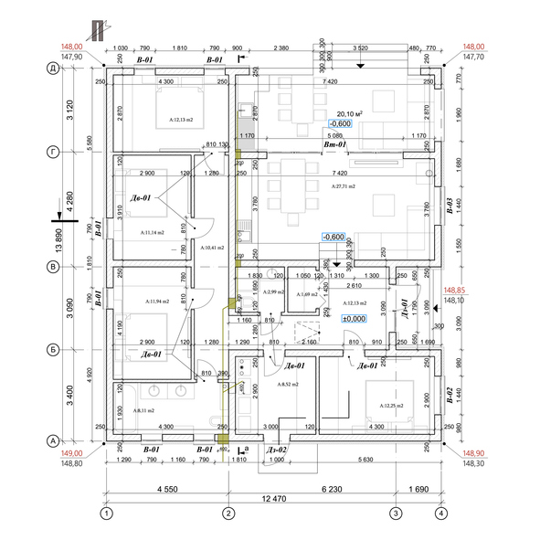
Floor plans
These show the layout of rooms and services at each floor level.
Important for routing plumbing and heating systems.
Includes positions of appliances, fixtures, and pipe runs.

Slide 8
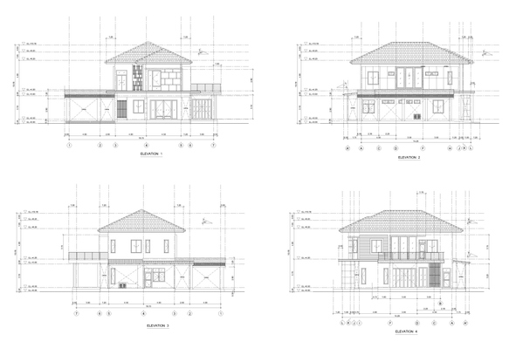
Elevations
Shows object from multiple flat views
Commonly front, plan, and side elevations
Each view at same scale
Gives precise dimensions for fabrication
Standard method in technical drawings

Slide 9
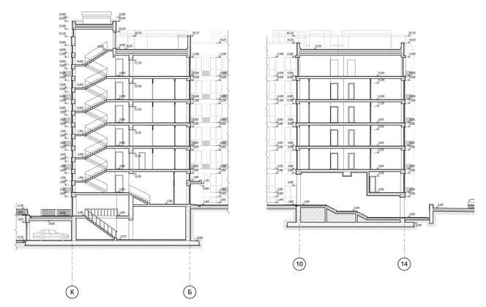
Sections
Cross-sectional views through buildings.
Show how different components align vertically.
Reveal concealed pipework.

Slide 10
Detail drawings
Close-up illustrations of complex components or connections
Clarify installation steps for specific areas.

Slide 11
Understanding drawing scales
Common scales: 1:50, 1:100, 1:500
Chosen based on required detail
Larger scales show more detail (e.g., 1:10).

Slide 12
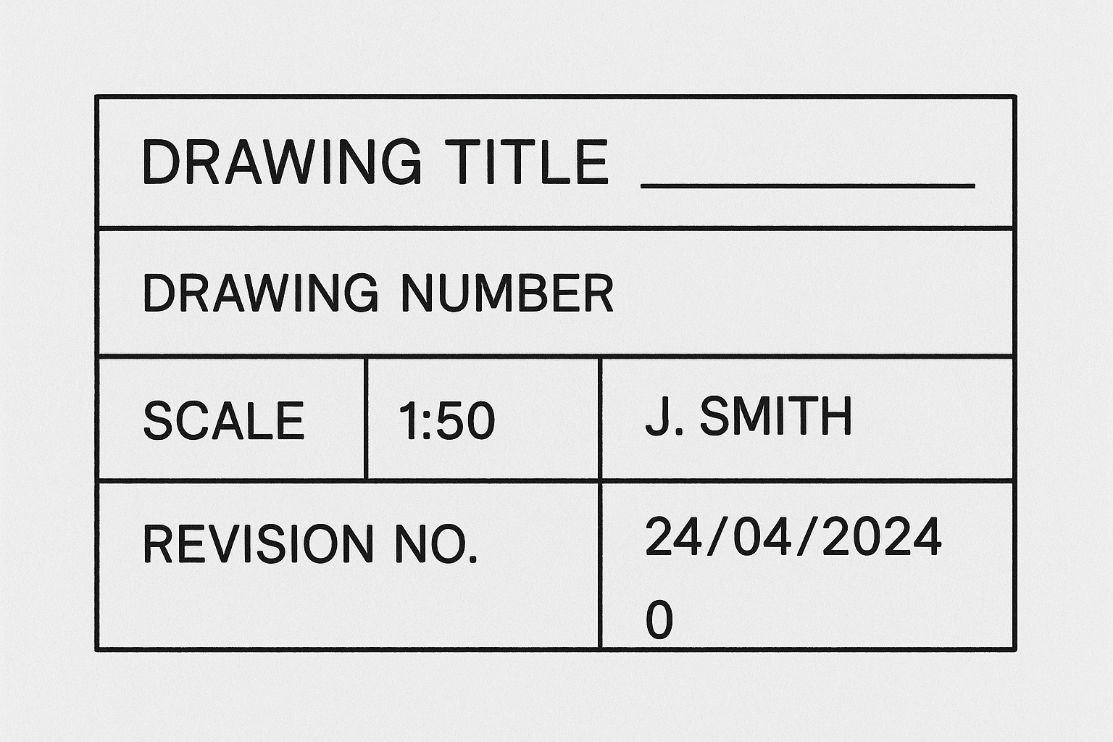
Title blocks
Title blocks contain key information:
Drawing title and number
Scale used
Author and date
Revision number

Slide 13
Revision and issue logs
Revisions track drawing updates.
Important for ensuring current information is used on site.

Slide 14
Symbols and abbreviations
Used to save space and maintain clarity.
Must be standardised across documents.
Examples: WC (water closet), SVP (soil vent pipe), RWP (rainwater pipe).

Slide 15
Common plumbing abbreviations
Cold water feed (CW)
Hot water flow (HW)
Soil pipes (SP)
Vent pipes (VP)
Radiator, sink, basin symbols
Note: other abbreviations in use - Cold Water Main (CWM) / Domestic Hot Water (DHW) / Soil & vent pipe (SVP)

Slide 16
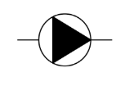
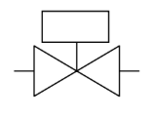
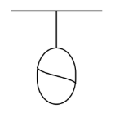
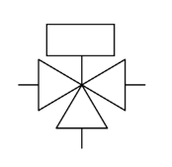
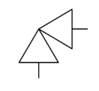
Heating system symbols
Boiler
Pump
Expansion vessel
Radiator valves
Motorised valves
B
2 port
3 port or mid-position valve

Slide 17
Interpreting symbols in practice
Symbols tell the installer:
What the component is
Where it’s located
How it connects to the rest of the system.

Slide 18

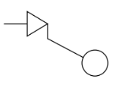


Knowledge check
Match the following symbols with their meaning:
A –
B –
C –
D –
Drain valve
Double check valve
Float valve
Gate valve

Slide 19
Knowledge check - answers
Drain valve
Double check valve
Float valve
Gate valve

Slide 20
How drawings support installation
Drawings guide the correct location and installation of systems. They ensure systems comply with building regulations and prevent costly errors.
Trades rely on them to coordinate work, avoid clashes, and verify spatial and technical compatibility.

Slide 21
Legal and regulatory role
Drawings must comply with relevant legislation like the Building Regulations and Water Supply Regulations 1999.
They may form part of contractual documents and be used during inspections or audits by authorities such as Building Control or Water Authorities.

Slide 22
Digital drawings and CAD
Modern drawings often produced with CAD (Computer-Aided Design)
Enables easy editing and clear detail
Files can be shared and printed to various scales

Slide 23

BIM integration
Building Information Modelling (BIM) provides a 3D visual model that integrates drawings with real-world data.
It helps anticipate design conflicts, manage materials, and streamline installation phases.

Slide 24
Responsibilities when using drawings
Check for the latest revision
Understand all symbols and notes
Follow installation guidelines accurately
Report errors or conflicts

Slide 25
Drawing errors and consequences
Misreading drawings can lead to costly rework, safety hazards, or system inefficiencies.
Using outdated drawings risks breaching regulations and invalidating warranties or guarantees.

Slide 26
Knowledge check
True or false?
A detail drawing shows the whole site.
All plumbing symbols are universal.
A scale of 1:10 is more detailed than 1:100.
The title block shows revision history.
Elevation drawings show vertical views.

Slide 27
Knowledge check - answers
False – A detail drawing shows a small, complex area, not the whole site.
False – While many symbols are common, not all are universal; check the legend.
True – A 1:10 scale is more detailed (larger) than 1:100.
True – Title blocks often include revision history and issue tracking.a
True – Elevation drawings show vertical views of the building.

Slide 28

Collaborative working with drawings
Multiple trades must interpret the same drawings to coordinate their work.
Clear drawing conventions and shared understanding reduce delays and help maintain compliance and quality.

Slide 29
How to learn from drawings
Review past project drawings.
Practice identifying symbols.
Cross-check with installation guides.
Ask experienced workers or supervisors for clarification.

Slide 30
Summary of key points
Types of technical drawings: site, floor, elevation, section, detail.
Common symbols and meanings.
Importance of accurate, up-to-date drawings.
Regulatory role and site responsibilities.

Slide 31
Final knowledge check
What is the purpose of a detail drawing?
Why are standardised symbols important?
Name two features found in a title block.
What software is commonly used to create drawings?
Give an example of a plumbing symbol.

Slide 32
Final knowledge check - answers
To provide a close-up view of a specific component or connection, offering precise installation guidance.
They ensure clear, consistent communication across all trades and reduce the risk of errors or misinterpretation.
Drawing number and scale used (also acceptable: author, date, revision history).
CAD (Computer-Aided Design) software, such as AutoCAD or Revit.
CW for Cold Water feed or SP for Soil Pipe (or any suitable drawn symbol)

Slide 33
Summary
You should now be able to:
Recall different types of technical drawings used in plumbing and heating.
Identify and interpret standard symbols and abbreviations.
Explain how drawings support accurate installation and safety compliance.
You might also be able to:
Evaluate the suitability of drawing types for specific plumbing tasks.
Interpret complex drawings and symbols to identify system layouts and potential issues.

Slide 34
Any questions?
Copyright in this document belongs to and is used under licence from the Department for Education, © 2025.
‘T-LEVELS’ and ‘T Level’ are registered trademarks of the Department for Education.
WJEC is authorised by the Department for Education to develop and deliver this T Level Technical Qualification.
WJEC operates in England under the name Eduqas which is a registered trademark of WJEC.

