Slide 1
Occupational Specialism: Plumbing & Heating Engineering
S2.2 Prepare a safe working environment to conduct plumbing and heating system installation
Site setup and safe working practices

Slide 2
Starter
Warm-up:
Think about a recent construction site you've seen—what signs or safety measures stood out to you?

Slide 3
Objectives
You should be able to:
Identify essential elements of safe site setup.
Explain the correct use of hand and power tools.
You should also be able to:
Describe pre-start checks and isolation procedures.
Recall emergency procedures for common site incidents.

Slide 4
Importance of safe site setup
Construction sites pose a wide range of hazards, from moving vehicles to falling materials. Proper site setup is a fundamental control measure to reduce risks to both workers and the public.
Clear planning and implementation of safety measures improve productivity, compliance, and overall well-being on site.
Poor setup often leads to disorganisation, inefficiencies, and accidents. Ultimately, everyone on site has a role in maintaining a safe environment.
Health and safety risk assessment and management

Slide 5
Key components of site setup
Physical barriers and fencing
Signage (mandatory, hazard, informational)
Adequate lighting in all work areas
Ventilation in enclosed or contaminated spaces
Good housekeeping practices throughout the site

Slide 6
Barriers and fencing
Barriers are essential for delineating site boundaries and protecting both workers and the public. They help manage foot traffic, isolate hazards, and maintain controlled access. Temporary fencing must be secure, clearly marked, and maintained regularly. Consideration should be given to emergency access and visibility. Effective barriers are a first line of defence against site-related incidents.

Slide 7
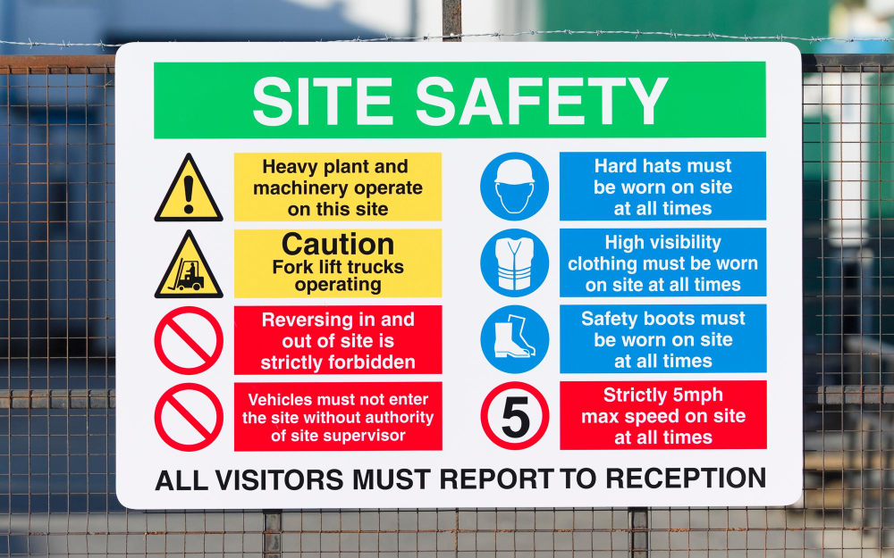
Types of safety signage
Mandatory signs (e.g. PPE required)
Prohibition signs (e.g. No unauthorised access)
Warning signs (e.g. Danger: Construction site)
Safe condition signs (e.g. First Aid)
Fire safety signs (e.g. Fire exit)

Slide 8
Lighting requirements
Adequate lighting is crucial for safety, especially in low-light environments or during night works. It improves visibility, reduces the risk of trips and falls, and allows workers to carry out detailed tasks effectively.
Lighting should be glare-free, regularly checked, and strategically placed.
Emergency lighting should also be available in high-risk areas. Consistent and appropriate lighting supports both safety and productivity.

Slide 9
Site ventilation
Ventilation ensures a continuous supply of fresh air and helps remove contaminants, especially in enclosed spaces. It is vital during operations involving dust, fumes, or gases.
Mechanical systems may be required in poorly ventilated environments. Employers must assess the need for ventilation as part of risk assessments.
Workers should be trained to recognise symptoms of inadequate air quality.

Slide 10
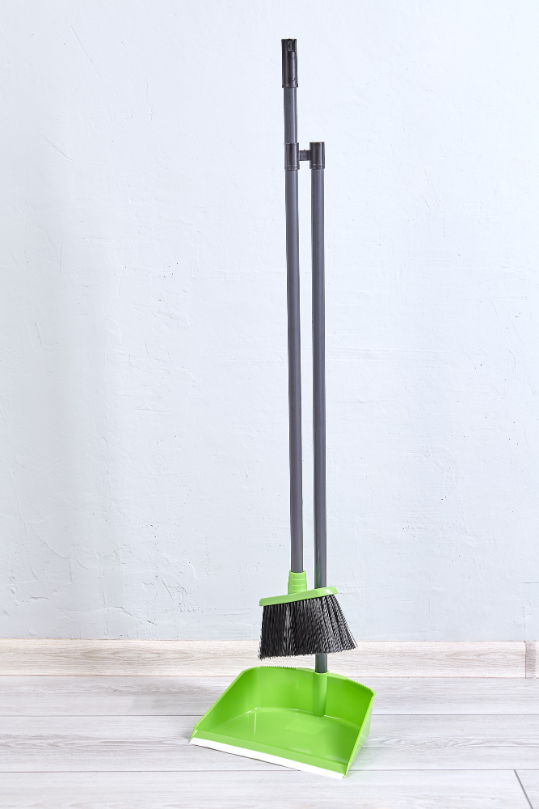
Housekeeping matters
Keep walkways and access routes clear
Dispose of waste promptly and correctly
Store materials safely
Clean spills immediately
Regularly inspect work areas

Slide 11
Safe use of hand tools
Hand tools must be fit for purpose, regularly maintained, and used correctly. Common examples include screwdrivers, hammers, chisels, and pliers. Using the wrong tool can cause injury or damage to materials.
Always inspect tools for damage before use and report defects immediately.
Training and supervision ensure tools are handled safely and effectively.

Slide 12

Common power tools on site
Cordless drills
Angle grinders
Multi-tools
Jigsaws and reciprocating saws
Heat guns
Pipe cutters and threading machines

Slide 13
Power tool safety
Using power tools requires greater caution due to their mechanical force. Operators must receive proper training and follow manufacturer instructions. PPE, such as goggles and gloves, are often mandatory.
Loose clothing or accessories can become entangled in moving parts.
Never override safety features or guards—these are designed to protect users.

Slide 14
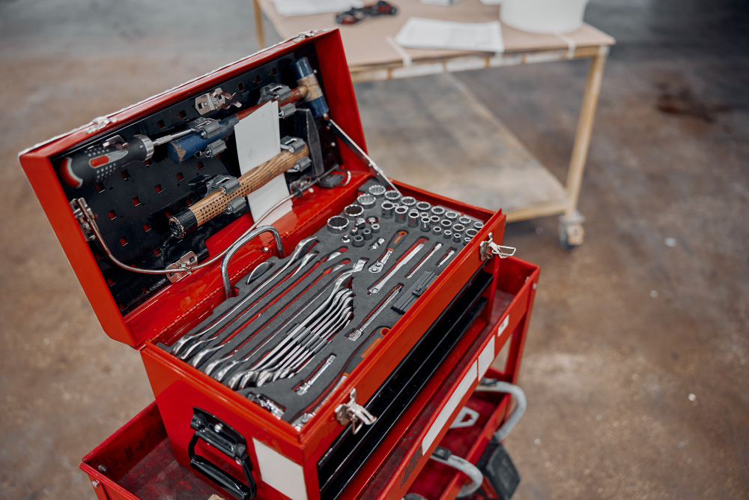
Inspection and storage of tools
Clean tools after use
Store in dry, secure locations
Tag damaged tools for repair
Keep sharp tools in protective sheaths
Never leave tools where they could fall or cause trips

Slide 15
PPE when using tools
Personal Protective Equipment must be matched to the task and tool being used. For example, cutting may require gloves, goggles, and hearing protection.
Employers have a duty to provide appropriate PPE and ensure it is worn.
Workers must report damaged PPE immediately and know how to maintain it. Proper use of PPE reduces the severity of injuries.

Slide 16
Pre-start checks – why they matter
Pre-start checks ensure that all equipment and work areas are ready for safe use. These checks prevent avoidable breakdowns and accidents. For example, checking a power tool for frayed cords or a scaffold for missing guardrails.
Regular checks also promote a safety-first culture.
All team members should know their responsibility in daily inspections.

Slide 17

What to check before starting work
Condition of tools and equipment
Surrounding area for hazards
Functionality of safety features (e.g. guards)
Emergency access routes and signage
Presence and condition of PPE

Slide 18
Isolation of services
Electrical, gas, and water supplies may need to be isolated during work. Proper isolation prevents accidental energisation or exposure. Lock-off systems, signage, and clear communication are essential.
Only trained and authorised personnel should isolate services.
Documentation, such as isolation certificates, should be completed and displayed.

Slide 19
Safe systems of work (SSOW)
Safe systems of work define the method and precautions necessary to carry out a task safely. They often include risk assessments and method statements.
A generic risk assessment identifies common hazards for routine tasks, while a RAMS (Risk Assessment Method Statement) is a more detailed, job-specific document that combines a risk assessment with a step-by-step method statement outlining exactly how to perform a high-risk or complex task safely
These systems help workers understand the risks and controls in place.
SSOW are legally required for high-risk activities. Supervisors must ensure workers understand and follow them.
Notes:
https://www.hse.gov.uk/managing/management-system/index.htm

Slide 20
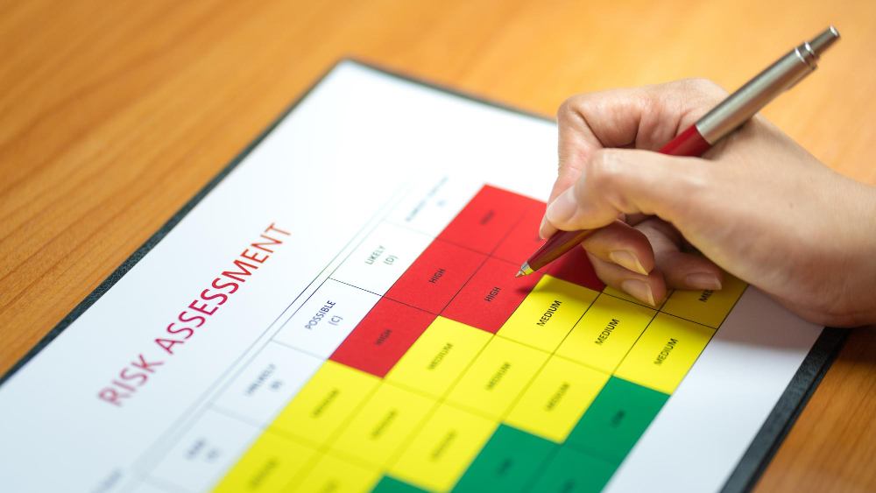
Risk assessments
Identify potential hazards
Assess who might be harmed and how
Evaluate the risk and decide on control measures
Record findings and implement actions
Review and update regularly

Slide 21
Quiz: Check your knowledge
Name two types of safety signage.
What are pre-start checks used for?
Why is ventilation important on site?
List two items to inspect before using a hand tool.
What does SSOW stand for?

Slide 22
Quiz: Check your knowledge - answers
Mandatory signs / Prohibition signs / Warning signs / Safe condition signs / Fire safety signs
To ensure equipment and work areas are safe before starting tasks.
It removes harmful fumes and ensures a supply of fresh air, especially in enclosed spaces.
Tool condition (e.g. damage or wear), correct type and size for the job.
Safe System of Work.

Slide 23
Fire safety on site
Fires are one of the most dangerous site emergencies. Combustible materials, poor housekeeping, and electrical faults are common causes.
Sites must have fire extinguishers, alarms, and clearly marked exits. Fire marshals and emergency drills should be in place.
Everyone must know the evacuation plan and meeting points.
Notes:
https://www.hse.gov.uk/managing/management-system/index.htm

Slide 24
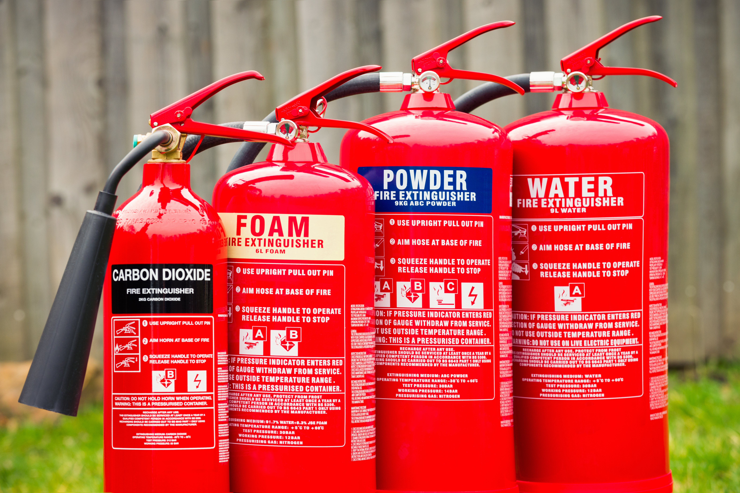
Fire extinguisher types
Panel Colour | Contents | Suitable for | Class
Red | Water | Wood / Paper | A
Black | CO2 | Electrical fires | A/E
Cream | Foam | for flammable liquids | A/B
Blue | Dry Powder |  | A/B/C/E

Slide 25
First aid procedures
Injuries can occur despite best efforts. Quick and competent first aid response can save lives. Sites should have a trained first aider and stocked first aid kits.
Minor injuries should be treated on site, while serious incidents must be reported and escalated.
A clear procedure ensures timely and effective care.
Notes:
https://www.hse.gov.uk/managing/management-system/index.htm

Slide 26

Common site injuries
Cuts and abrasions
Sprains and strains
Burns (chemical, heat)
Eye injuries
Fractures

Slide 27
Reporting and recording incidents
All incidents, no matter how minor, should be recorded. This includes near-misses, as they help identify risks. The incident report must include date, time, description, and any action taken.
Accurate reporting supports investigations and future prevention.
Confidentiality and sensitivity must be maintained.
RIDDOR
Make a report
Notes:
https://www.hse.gov.uk/managing/management-system/index.htm

Slide 28
Spillage procedures
Spills pose both slip and chemical hazards. All workers should know how to respond. Spill kits must be available and regularly replenished.
Appropriate PPE should be used when handling hazardous substances.
Clear signage and containment can prevent further contamination.
Notes:
https://www.hse.gov.uk/managing/management-system/index.htm

Slide 29
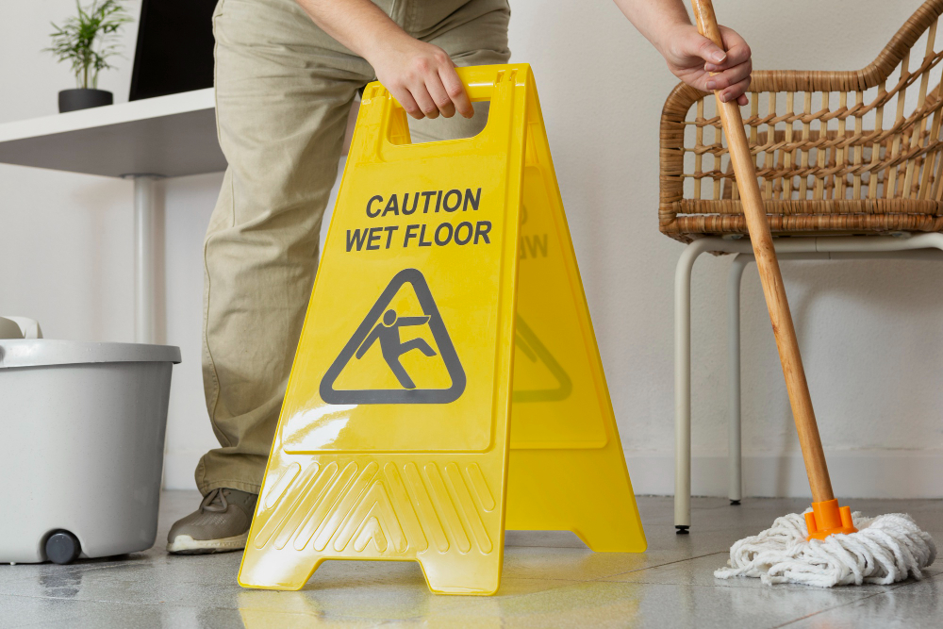
Spill response: Key steps
Alert others and assess the risk
Wear appropriate PPE
Use spill kit to absorb and contain
Dispose of waste according to COSHH
Record and report the incident

Slide 30
COSHH overview
Control of Substances Hazardous to Health (COSHH) regulations protect workers from harmful substances. Employers must assess risks and implement controls. Substances covered include chemicals, dusts, and biological agents.
Safety data sheets (SDS) must be available. Workers must be trained on safe handling and emergency procedures.
Notes:
https://www.hse.gov.uk/managing/management-system/index.htm

Slide 31
Case study: Spillage incident
A plumber accidentally knocked over a container of solvent. The area was not isolated, and another worker slipped, sustaining an injury. What went wrong?
Discuss:
Spill containment
Immediate communication
Use of signage
Availability of PPE and spill kits
Notes:
https://www.hse.gov.uk/managing/management-system/index.htm

Slide 32
Quiz: Check your knowledge
What is the purpose of an SSOW?
List three types of fire extinguishers.
What should you do if you witness a spillage?
Why must incidents be recorded?
What is COSHH and what does it cover?
Notes:
https://www.hse.gov.uk/managing/management-system/index.htm

Slide 33
Quiz: Check your knowledge – answers
To define safe methods and controls for completing high-risk tasks.
CO₂ (for electrical), Foam (for flammable liquids), Water (for paper/wood fires).
Alert others, contain the spill using a spill kit, wear PPE, and report the incident.
To support investigations, ensure legal compliance, and prevent recurrence.
Control of Substances Hazardous to Health; it covers safe use of chemicals, dusts, and biological agents.
Notes:
https://www.hse.gov.uk/managing/management-system/index.htm

Slide 34
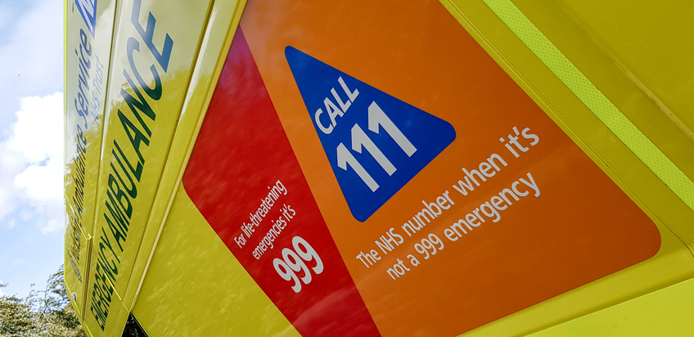
Refresher: Key emergency contacts
Site fire marshal
First aider(s)
Site supervisor
Emergency services (dial 999)
Location of muster points

Slide 35
Emergency signage and alarms
Sites must have clearly visible emergency signs and audible alarms. Everyone should know their meaning and response procedure.
Regular testing and drills are required. Alarms must be accessible to all workers, including those with disabilities.
In large sites, zonal alarms may be necessary.
Notes:
https://www.hse.gov.uk/managing/management-system/index.htm

Slide 36
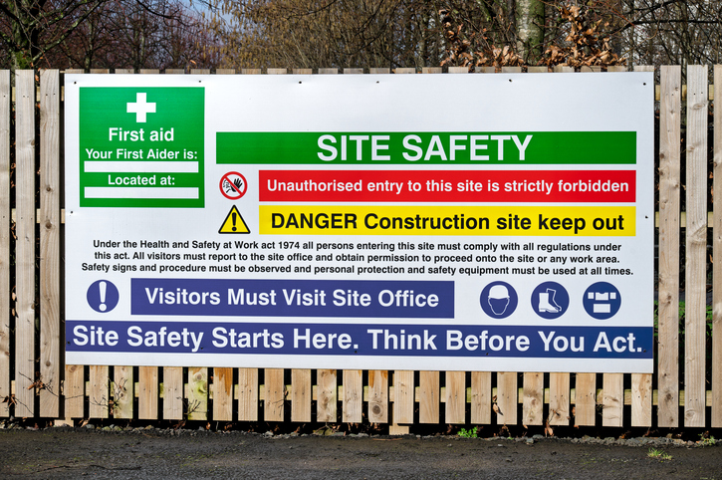
Summary: Site setup
Protects workers and public
Organises workspaces efficiently
Promotes compliance with legislation
Reduces accidents and injuries
Supports worker confidence

Slide 37
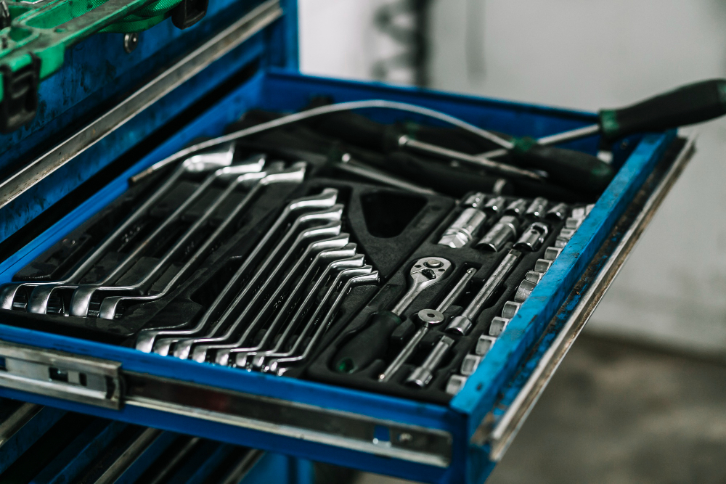
Summary: Tool and equipment safety
Use the right tool for the job
Inspect before use
Store safely
Maintain regularly
Report and replace damaged items

Slide 38

Summary: Emergency procedures
Be prepared for fire, injury, and spills
Know roles and responsibilities
Follow site procedures
Use emergency equipment properly
Learn from incidents to prevent recurrence

Slide 39
Recap questions
What’s your role in maintaining site safety?
How do you know if a tool is safe to use?
Who do you report incidents to?

Slide 40
Legislation overview
Health & Safety at Work etc. Act 1974
Management of Health & Safety at Work Regulations 1999
COSHH Regulations 2002
Personal Protective Equipment at Work Regulations 1992
Reporting of Injuries, Diseases and Dangerous Occurrences Regulations (RIDDOR) 2013

Slide 41
Industry guidance and best practice
In addition to legislation, follow:
HSE guidelines
Manufacturer’s instructions
British Standards
Site-specific policies
Professional codes of conduct

Slide 42
Responsibility hierarchy
Clarify daily objectives
Review risk assessments
Communicate site changes
Encourage reporting of concerns
Foster a culture of openness and safety

Slide 43
What would you do?
Scenario:
You notice a colleague using a power tool with a frayed cable. They insist it’s fine. What should you do?
Discuss your response, including who to report to and what actions to take.

Slide 44
Daily briefings and check-ins
Clarify daily objectives
Review risk assessments
Communicate site changes
Encourage reporting of concerns
Foster a culture of openness and safety

Slide 45
Quiz: Final knowledge check
Name one key regulation covering PPE.
What’s the purpose of a method statement?
What does good housekeeping look like?
How often should pre-start checks be completed?
Why is lighting critical to site safety?

Slide 46
Quiz: Final knowledge check – answers
Personal Protective Equipment at Work Regulations 1992.
To outline how to perform tasks safely, including steps and control measures.
Clear walkways, safe material storage, no trip hazards, tidy workstations.
Daily, or before each use of equipment or starting a task.
It ensures visibility, reduces the risk of accidents, and supports detailed work.

Slide 47
Recap and takeaways
Think back through today’s session:
What’s one thing you learned that surprised you?
What action will you take to improve safety on your next job?

Slide 48
Summary
You should now be able to:
Recall the key elements of safe site setup and housekeeping.
Explain the correct use and storage of hand and power tools.
You might also be able to:
Evaluate a site for safety improvements.
Recommend suitable emergency procedures and responses.

Slide 49
Any questions?
Copyright in this document belongs to and is used under licence from the Department for Education, © 2025.
‘T-LEVELS’ and ‘T Level’ are registered trademarks of the Department for Education.
WJEC is authorised by the Department for Education to develop and deliver this T Level Technical Qualification.
WJEC operates in England under the name Eduqas which is a registered trademark of WJEC.

