Slide 1
Occupational Specialism: Plumbing & Heating Engineering
K1.2 Typical hazards and risks associated with plumbing and heating systems
Safe use and transportation of compressed gases

Slide 2
Starter
Warm up:
Where might you encounter compressed gas cylinders in your plumbing work?
Brief discussion on risks learners may have seen or heard about.
Explain importance of understanding gas safety in daily work.

Slide 3
Objectives
You should be able to:
Identify types of compressed gases used in plumbing and heating.
Explain hazards associated with gas cylinders.
Describe safe storage, handling, and transport practices.
You might also be able to:
Interpret safety markings and regulations.
Understand roles and responsibilities regarding gas safety.

Slide 4
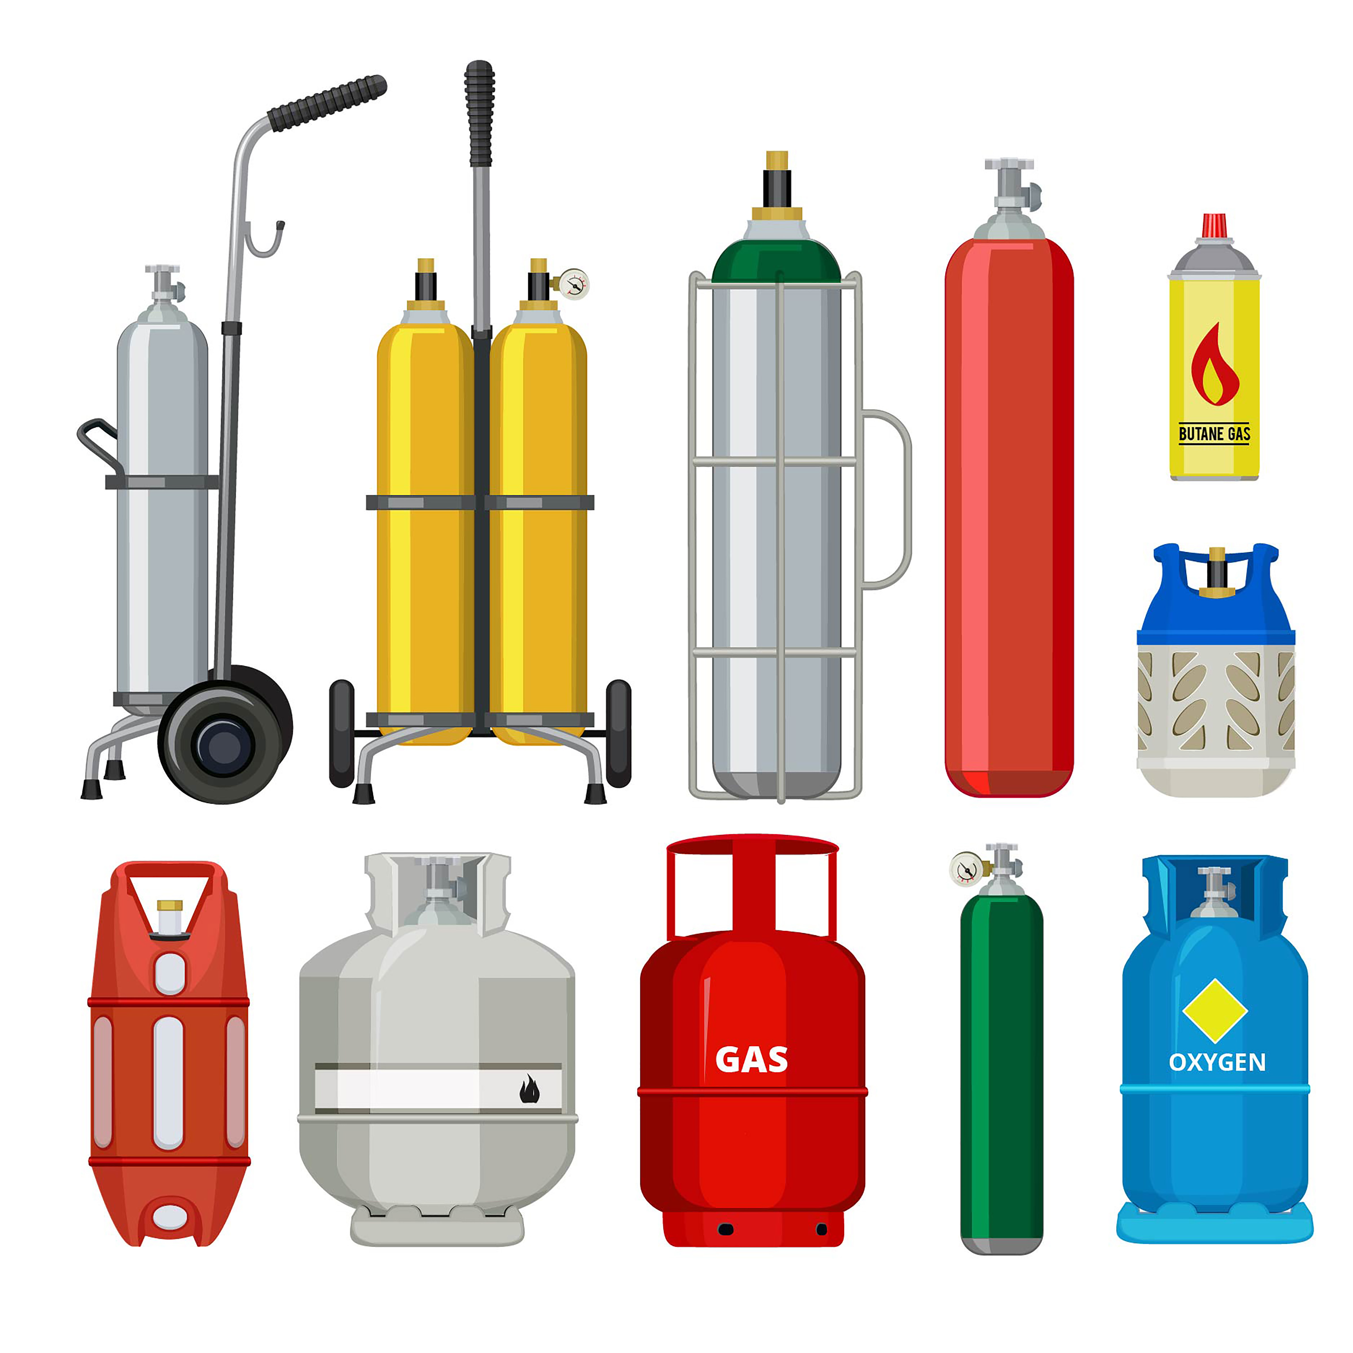
What are compressed gases?
Compressed gases are stored under high pressure in metal cylinders. They may be flammable, oxidising, inert, or toxic. Used in plumbing for brazing, purging, leak testing, etc.
Misuse or poor handling can cause serious injuries or fatalities. Proper knowledge of their behaviour is crucial to safety.

Slide 5
Common compressed gases in the industry
Oxygen (O2): accelerant in cutting/brazing with acetylene.
Acetylene (C2H2): flammable, used in welding and metalwork.
Propane (C3H8): portable fuel for heating and soldering.
Nitrogen (N2): inert gas for pressure testing and purging systems.
Carbon Dioxide (CO2): sometimes used for specific cleaning or fire suppression tasks.
MAP Pro: blend of propylene and propane and soldering and brazing.
Butane: used for portable heating and cooking (boiling point of -1°C)

Slide 6
Gas cylinder identification
Colour codes provide a quick reference, but always confirm via the label. For example, oxygen cylinders are black with a white top, and acetylene is maroon.
Check the valve threads and regulator fittings too, as incompatible types can be dangerous.
Always double-check the gas name and pressure rating.

Slide 7
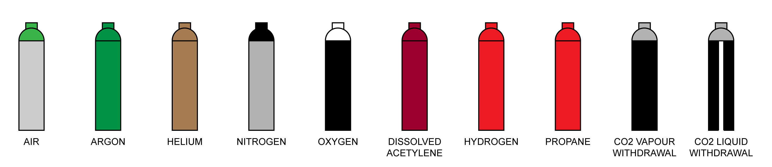
Gas cylinder identification

Slide 8
Gas cylinder identification
Labels must be legible and intact.
Expiry and test dates must be within safe range.
Pictograms show hazards: flammable, oxidising, etc.
Gases must never be used if label is missing.
Contact supplier if unsure about cylinder contents.

Slide 9
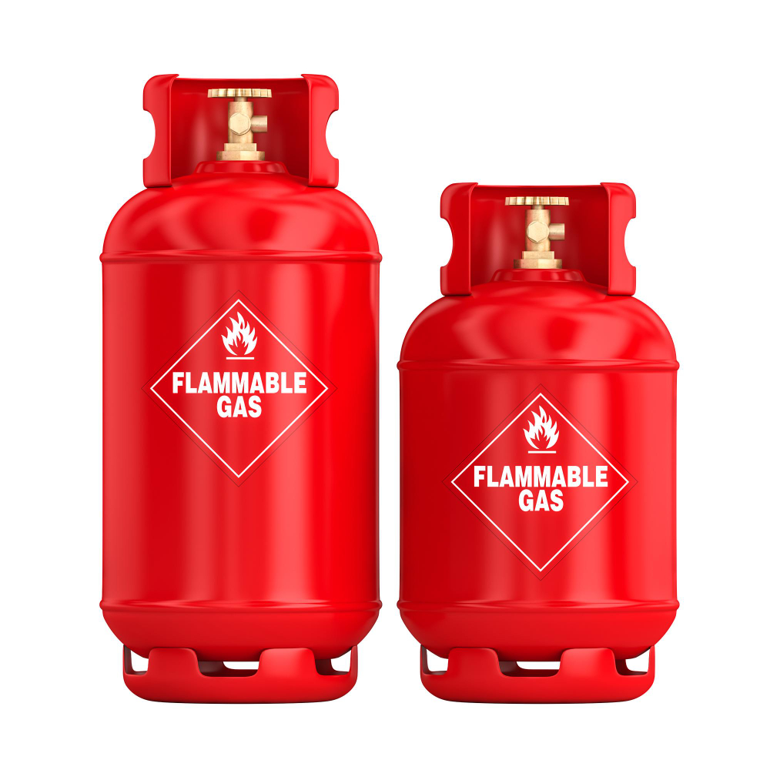
Physical properties of compressed gases
Compressed gases can expand rapidly, creating pressure and blast hazards.
Some gases displace oxygen, increasing asphyxiation risk.
Heavier gases like propane can pool in low-lying spaces.
Cold gas release can cause frostbite-like injuries.
Understanding properties helps in planning safe use.
EyeEm

Slide 10
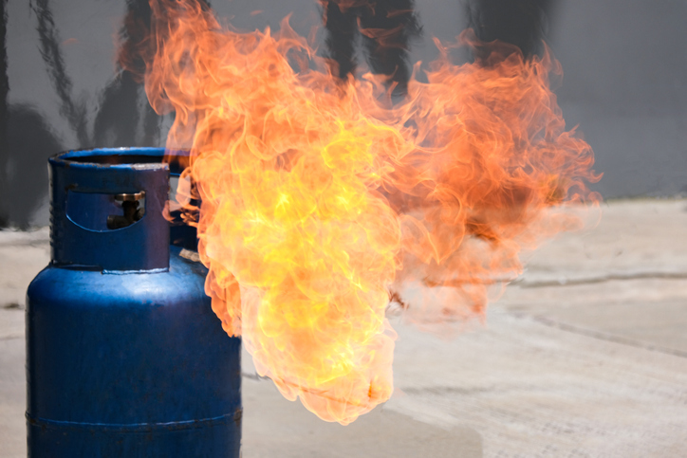
Hazards of compressed gases
Risk of explosion if gas is exposed to ignition.
Asphyxiation in poorly ventilated areas.
Gas leaks can be invisible and odourless.
Leaking cylinders can launch under pressure.
Chemical exposure may cause burns or respiratory distress.

Slide 11
Key legislation and guidance
Employers and employees must comply with UK safety laws:
Health and Safety at Work etc. Act 1974.
COSHH Regulations 2002.
Pressure Systems Safety Regulations 2000.
HSG51: Storage of flammable liquids.
INDG 327: HSE guidance on gas cylinder handling - Working with acetylene.

Slide 12
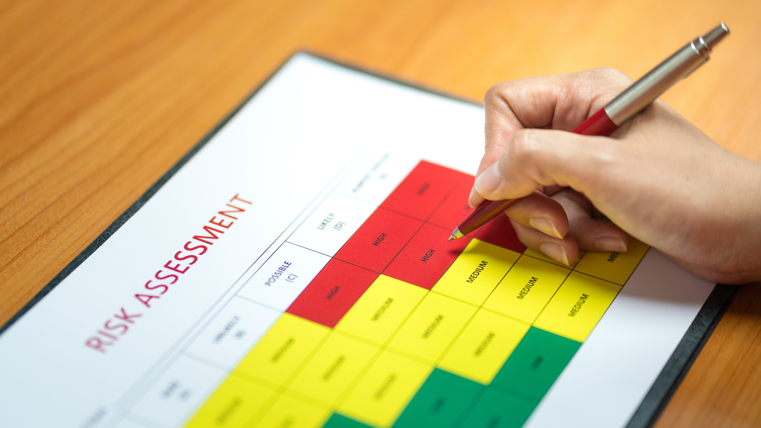
Roles and responsibilities
It is a shared duty to ensure safe practice. Employers must provide risk assessments, safety training, and correct equipment. Workers are expected to follow procedures and report issues. Supervisors check compliance and provide oversight. Ignoring these roles can lead to injury or prosecution.
A hot work permit is a formal written document that authorises and controls high-risk activities that produce heat, sparks, or flames.

Slide 13
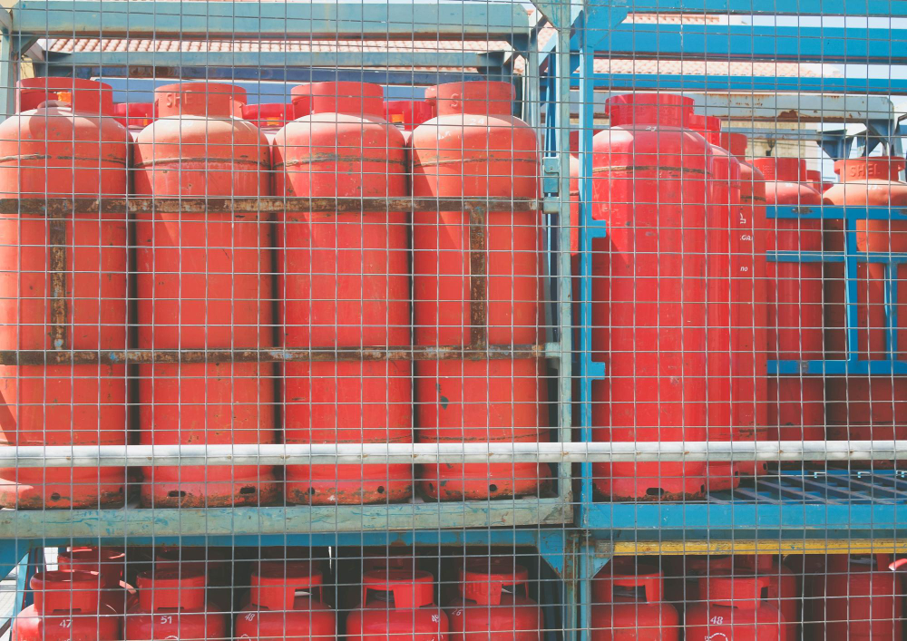
Storage of compressed gases (Part 1)
Cylinders must always be stored vertically and secured.
A chain or rack should be used to prevent tipping.
Storage areas must be dry, cool, and well-ventilated.
Keep away from ignition sources and exits.
Signage should indicate the hazards clearly.

Slide 14
Storage of compressed gases (Part 2)
Segregate flammable and oxidising gases.
Empty cylinders should be clearly marked.
Store with valve caps in place.
Check for corrosion or leaks routinely.
No smoking or open flames in or near storage areas.

Slide 15
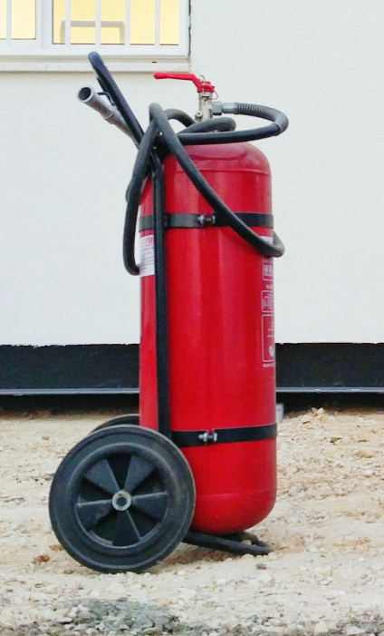
Safe handling practices (Part 1)
When moving cylinders, use a proper trolley with straps. Never roll or drag them across the floor.
Do not lift a cylinder by its valve or regulator. Keep caps on during transport.
Movement should always be slow and controlled.
BCGA Guidance

Slide 16
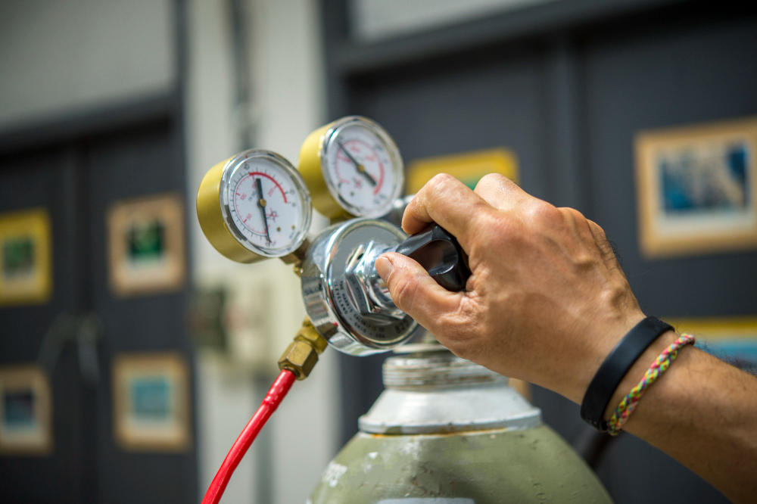
Safe handling practices (Part 2)
Always open the valve slowly and away from your body.
Ensure you use a compatible regulator.
Check for leaks using a soapy solution—never a flame.
After use, shut the valve and release pressure in the regulator.
Never attempt to modify or repair a cylinder.

Slide 17
Quiz: Check your knowledge
Which gas is most commonly used with oxygen for welding?
Name one hazard of storing propane indoors.
What colour code is used for oxygen cylinders?
True or False: Cylinders should be laid flat in vehicles.
What should you do if you suspect a gas leak?

Slide 18
Quiz: Check your knowledge – answers
Which gas is most commonly used with oxygen for welding? Acetylene.
Name one hazard of storing propane indoors. Explosion risk due to the accumulation of gas in an enclosed space.
What colour code is used for oxygen cylinders? Black body with a white shoulder.
True or False: Cylinders should be laid flat in vehicles. False.
What should you do if you suspect a gas leak? Evacuate the area, alert a supervisor, and shut off the valve if safe.

Slide 19
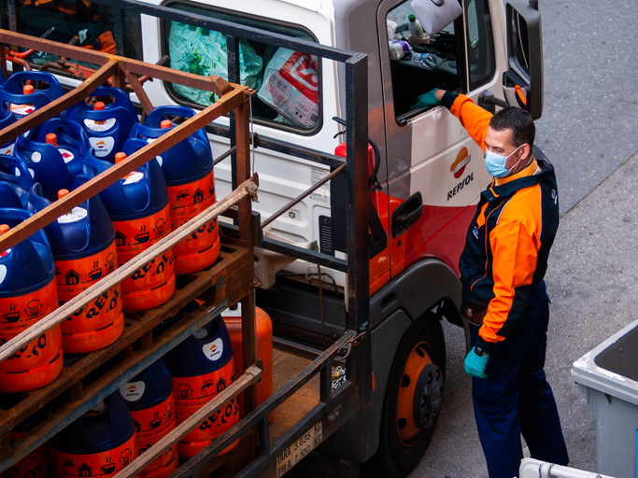
Transportation of cylinders (Part 1)
Gas cylinders must always be secured during transport. They should remain upright and supported to prevent movement.
Transport them in a ventilated compartment separate from the driver.
Avoid exposing cylinders to direct sunlight or extreme heat.
Cylinders should never be left in unattended vehicles.
HSE Guidance

Slide 20
Transportation of cylinders (Part 2)
Use valve caps during transport.
Display ADR signage for hazardous goods if required.
Drivers must be trained in emergency procedures.
Carry Safety Data Sheets (SDS) for each gas onboard.
Do not transport near ignition sources.
Notes:
https://www.hse.gov.uk/cdg/commonproblems/adr-imdg.htm
https://www.hse.gov.uk/cdg/manual/consignment.htm

Slide 21
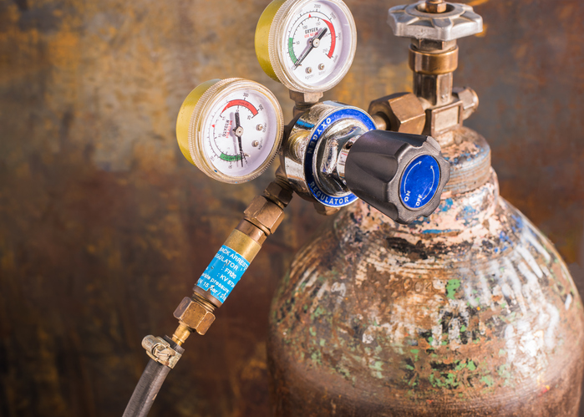
Regulator safety and flashback arrestors
Regulators control the pressure output to a safe working level.
Always match regulator to the gas type – typically left-hand threaded for fuel gases.
Flashback arrestors stop flames travelling back into hoses or cylinders. These devices must be fitted on both fuel and oxygen lines.
Regular inspection is essential for safety.

Slide 22
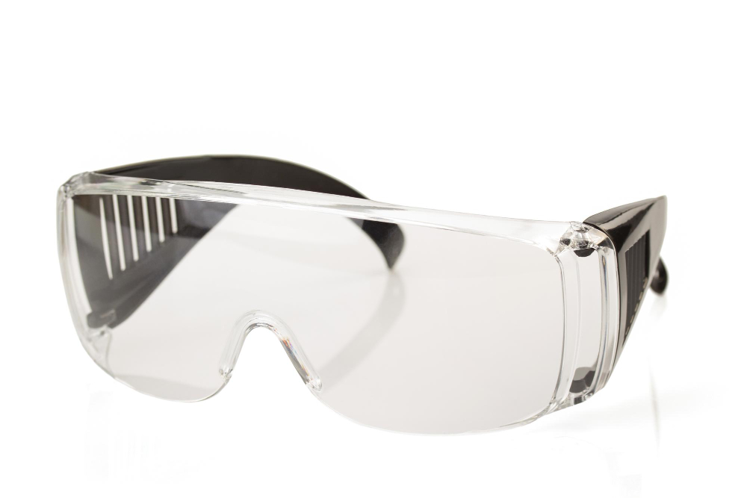

Personal Protective Equipment (PPE)
Wearing appropriate PPE reduces injury risk. Safety goggles or face shields protect from gas blasts and debris.
Gloves should resist heat and chemical contact. Flame-resistant clothing and non-slip footwear are essential.
PPE should be worn consistently and checked for wear.

Slide 23
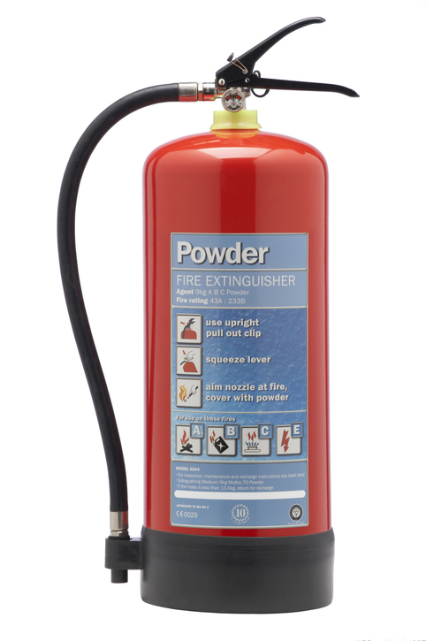
Emergency procedures
In case of a gas leak, evacuate the area and notify a supervisor.
Shut valves only if safe to do so, and do not use phones or electronics near leaks.
Use dry powder or CO2 extinguishers—not water. Know your site’s emergency plan in advance.

Slide 24
Environmental considerations
Releasing gas to the environment can harm air quality and soil. All waste and used cylinders should be returned via approved routes.
Never discharge gas unless absolutely necessary and under supervision.
Record incidents for environmental audits. Prevention is better than clean-up.
HSE guidance

Slide 25
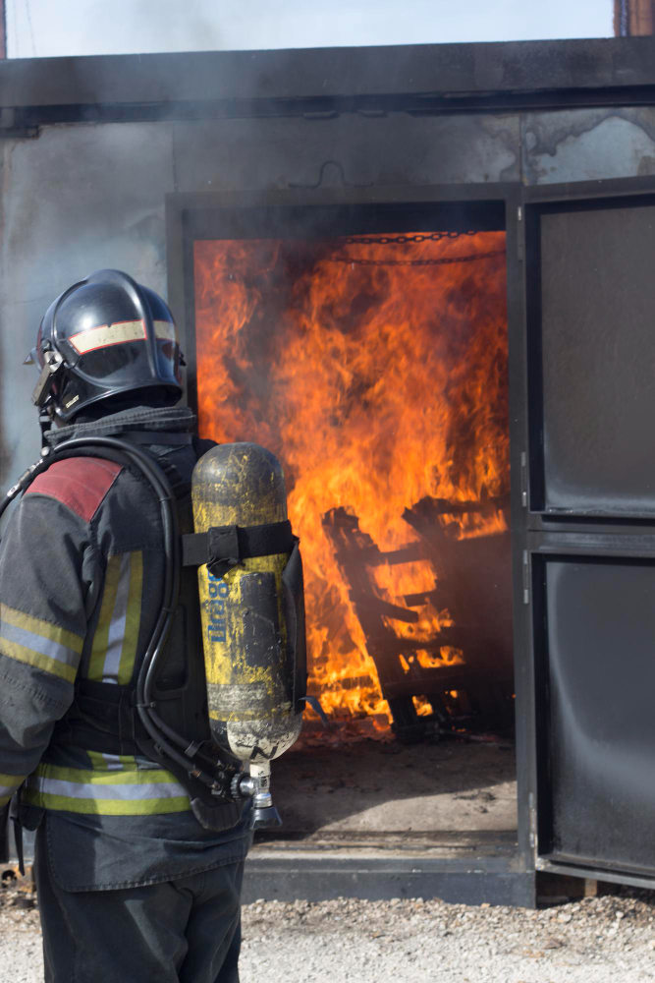
Case study: Real incident review
A plumbing team stored acetylene near a heat source, ignoring guidance. A fire broke out, causing damage and injury. Investigations showed no flashback arrestors and lack of ventilation.
Discuss what safety measures were missed.
Consider how simple checks could have prevented the incident.

Slide 26
Discussion activity
Groups are shown a photo of unsafe gas storage.
In teams, identify at least three safety breaches.
Discuss your answers with the class.
Suggest improvements using session knowledge.
Notes:
Builds observation and application skills.

Slide 27
Reinforcement of best practice
Safe gas use is about habits.
Always identify the gas, wear the correct PPE, and secure cylinders. Ventilation, inspections, and proper storage prevent most accidents.
Read labels and never make assumptions. Share knowledge with others on site.

Slide 28
Toolbox talks and site briefings
Toolbox talks are short, focused briefings. They raise awareness and remind teams of critical safety steps.
Topics include valve safety, PPE checks, and emergency response. Make them regular and interactive. Keep a record of who attends.

Slide 29
Quiz: Recap your knowledge
What regulator must be used with propane?
State two differences between oxygen and nitrogen cylinders.
How should you respond to a hissing sound from a cylinder?
Which regulation covers pressure system safety?
True or False: PPE is optional when using compressed gases.

Slide 30
Quiz: Recap your knowledge – answers
A propane-compatible regulator, typically left-hand threaded for fuel gases.
Colour code: Oxygen is black/white, Nitrogen is grey. Oxygen supports combustion; Nitrogen is inert.
Evacuate, isolate the area, and report the incident.
Pressure Systems Safety Regulations 2000.
True or False: PPE is optional when using compressed gases. - FALSE

Slide 31
Practical demonstration (optional)
The tutor demonstrates safe handling and connection of a cylinder.
Learners observe proper leak checks using soapy water.
Flashback arrestor setup is shown step-by-step.
Where safe, learners can handle dummy cylinders.
Notes:
Reinforces theory through practice.

Slide 32
Learner reflection activity
Take 5 minutes to write three safety practices you will improve.
Share your top point with a partner or the group.
Reflect on how you’ve seen gas handled unsafely before.
Notes:
This helps reinforce personal responsibility.
Reflection strengthens memory and encourages action.

Slide 33
Additional resources
Organisation | Website
British Compressed Gases Association | www.bcga.co.uk
HSE safety guides | www.hse.gov.uk
Supplier SDS | Air Products
Direct Advice Sheets | HSE direct advice

Slide 34
Summary
You should now be able to:
Identify common types of compressed gases used in plumbing and heating.
Explain the hazards, handling, and legal controls for safe use and transport.
You might also be able to:
Evaluate storage practices in a real site environment.
Propose safer handling methods based on legislation and best practice.

Slide 35
Any questions?
Copyright in this document belongs to and is used under licence from the Department for Education, © 2025.
‘T-LEVELS’ and ‘T Level’ are registered trademarks of the Department for Education.
WJEC is authorised by the Department for Education to develop and deliver this T Level Technical Qualification.
WJEC operates in England under the name Eduqas which is a registered trademark of WJEC.

