Slide 1
Occupational Specialism: Plumbing & Heating Engineering
K1.2 Typical hazards and risks associated with plumbing and heating systems
Awareness, identification and control understanding asbestos types, where it's found, and how to manage risks safely

Slide 2
Starter
Discuss in pairs:
Have you seen materials you suspect might contain asbestos?
What made you think they might be dangerous?
Share your answers with the group.

Slide 3
Objectives
You should be able to:
Identify the types of asbestos.
Recognise locations where asbestos is commonly found.
Understand the health risks associated with asbestos exposure.
Follow procedures to deal with asbestos safely.
Know who to contact and what the legal responsibilities are.

Slide 4
What is asbestos?
Asbestos is a naturally occurring fibrous mineral. Used widely in the 20th century for insulation, fireproofing and strength.
Banned in the UK since 1999 due to serious health risks but is still present in many older buildings.
Asbestos fibres are hazardous when disturbed and inhaled. Resistant to heat, electricity, and chemical corrosion.
VICE - Why the Deadly Asbestos Industry is Still Alive and Well – 20 mins
Notes:
https://www.youtube.com/watch?v=HONZz1dsgVk&ab_channel=HealthandSafetyExecutive

Slide 5
Why asbestos is dangerous
Asbestos fibres are invisible and airborne when disturbed. Inhalation can lead to serious diseases:
Asbestosis (lung scarring)
Mesothelioma (cancer of the lung lining)
Lung cancer
Pleural thickening – no known safe level of exposure. Symptoms often appear decades after exposure.

Slide 6
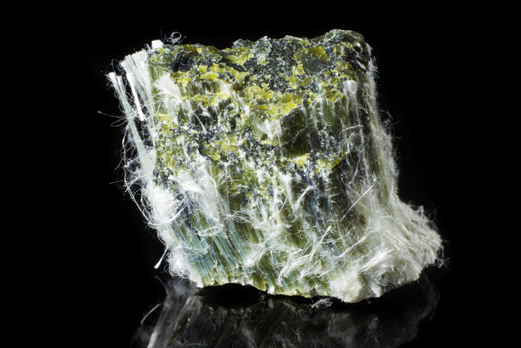
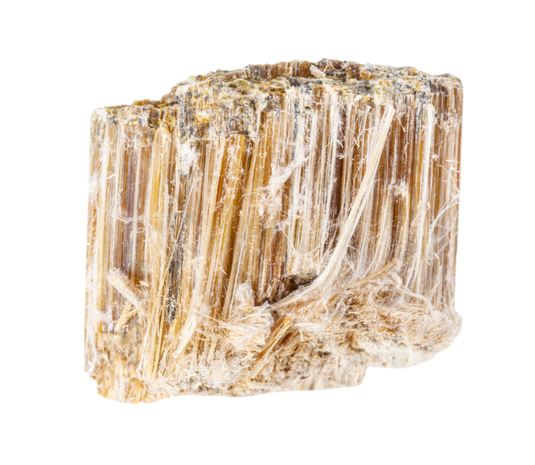
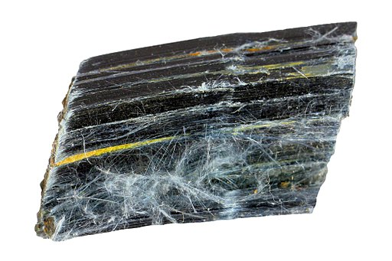
Types of asbestos
Most common:
Chrysotile (White Asbestos)
Most hazardous:
Amosite (Brown Asbestos)
Most dangerous:
Crocidolite (Blue Asbestos)

Slide 7
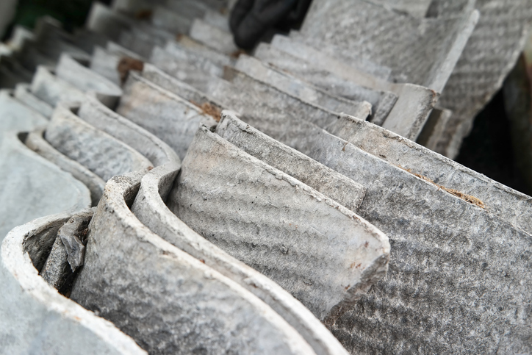
Where you might find asbestos (1)
In domestic and non-domestic buildings built before 2000:
Ceiling tiles
Floor tiles and adhesives
Lagging on pipes and boilers
Asbestos insulation boards (AIB)
Cement roofing sheets – often found in schools, hospitals, factories, and pre-1985 homes.

Slide 8
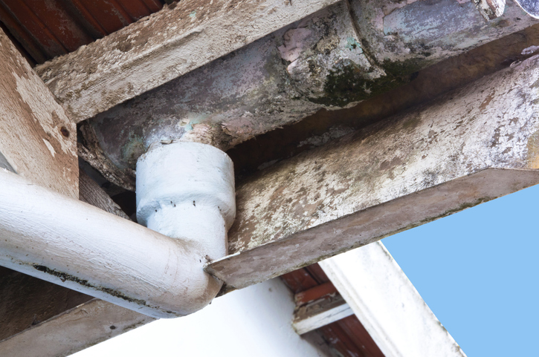
Where you might find asbestos (2)
Other typical locations:
Guttering and downpipes
Soffits and fascias
Artex textured coatings
Fire doors and panels
Electrical fuse boards (backing panels). Always assume materials contain asbestos unless proven otherwise.
Check asbestos register or conduct a survey.

Slide 9
Types of asbestos surveys
Management survey:
Identifies and manages asbestos in normal occupation.
Refurbishment and demolition survey:
More intrusive; required before major works. Surveys must be done by competent professionals. Survey results inform risk assessments and control plans. Compliance is mandatory before any intrusive work.

Slide 10
Identifying suspect materials
Visual inspection can help, but asbestos can look like many materials. If unsure – do not disturb.
Seek expert testing
Samples should only be taken by trained personnel.
Check the asbestos register before starting work.
An asbestos register is a document that records the location and condition of asbestos-containing materials (ACMs) within a building or premises. It's a key component of an asbestos management plan and is crucial for ensuring the safety of building occupants and anyone carrying out work on the premises.
Notes:
https://www.hse.gov.uk/asbestos/duty/register-and-assess-risk.htm

Slide 11
Procedures for suspected asbestos
Stop work immediately.
Report the finding to your supervisor.
Do not attempt to remove or disturb it.
Mark and isolate the area.
Follow the organisation’s asbestos management plan.
Use signage to warn others.
Notes:
https://www.hse.gov.uk/asbestos/duty/register-and-assess-risk.htm

Slide 12
Control measures for working near asbestos
Avoid work that may disturb asbestos unless trained.
Use PPE (e.g. Type 5 coveralls, P3 respirator).
Control dust with damp methods and low-disturbance techniques.
Use sealed enclosures if permitted.
Dispose of waste through licensed routes.
Air monitoring may be required.
Notes:
https://www.hse.gov.uk/asbestos/duty/register-and-assess-risk.htm

Slide 13
Employer Duties under CAR 2012
Risk Assessment – Identify asbestos, assess risks, and plan management.
Prevent/Control Exposure – Design work to avoid or minimise exposure.
Training & Information – Provide staff with asbestos awareness, instruction, and supervision.
Health Surveillance – Arrange medical checks for exposed workers.
Equipment & PPE – Supply protective clothing, PPE, and cleaning procedures.
Notes:
https://www.hse.gov.uk/asbestos/duty/register-and-assess-risk.htm

Slide 14
Employee Duties under CAR 2012
Co-operate – Follow training, procedures, and instructions.
Use Controls Properly – Wear PPE correctly and report defects.
Report Hazards – Notify employer of asbestos risks or incidents.
No Misuse – Do not tamper with safety equipment.
Responsibility – Protect own health and that of others.
Notes:
https://www.hse.gov.uk/asbestos/duty/register-and-assess-risk.htm

Slide 15
Emergency procedures
If asbestos is accidentally disturbed:
Stop work.
Evacuate area.
Prevent access.
Inform your supervisor and site manager.
Contact an asbestos specialist for clean-up.
Follow HSE guidance.
Record incident and actions taken.

Slide 16

Health surveillance and training
Employees potentially exposed to asbestos must receive awareness training. Supervisors and planners may need higher-level training and health surveillance may be required based on risk.
Refresher training ensures procedures remain current and all training must meet HSE standards and be documented.

Slide 17
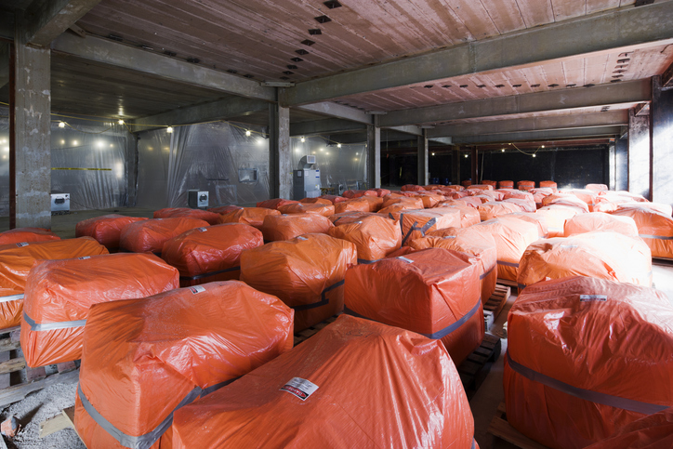
Waste handling and disposal
Asbestos waste is classified as hazardous waste. Double bag materials in UN-approved red bags.
These asbestos disposal bags are fully U.N. Certified to hold 25 kilos of asbestos waste. These heavy duty rubbish bags meet all UK legislation for Asbestos waste.
Label clearly and store in locked skips or rooms. Dispose only through licensed waste contractors. Records must be kept of all disposals. Consignment notes must accompany waste.

Slide 18
Responsibilities of employers and employees
Employers must ensure risk assessments are carried out and they must provide training and PPE where necessary.
Workers must follow instructions, avoid unauthorised work, and report issues. Removal must only be carried out by licensed contractors
Both have legal obligations under CAR 2012. Failure to comply can lead to enforcement action, prosecution, and health risks.
Notes:
CAR 2012 - https://www.hse.gov.uk/pubns/books/l143.htm

Slide 19

Working with licensed contractors
High-risk work (e.g. removing sprayed coatings) must be done by licensed asbestos contractors.
The HSE issues licenses and monitors compliance. Licensed work requires detailed notification and planning.
Contractors must use specific equipment and follow strict procedures. Always verify licensing and credentials before work starts.

Slide 20
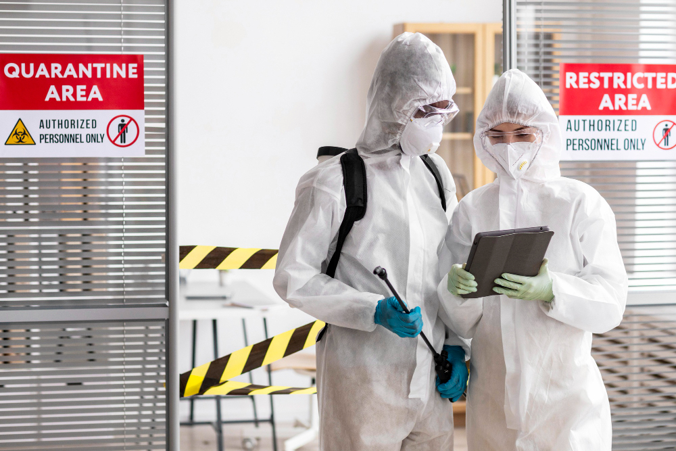
Air monitoring and clearance procedures
Air monitoring measures fibre concentration during or after work and clearance procedures ensure an area is safe to re-enter.
Visual inspection + air test = reoccupation certificate
Conducted by UKAS-accredited analysts.
Part of the 4-stage clearance process after licensed work.
Notes:
https://www.legislation.gov.uk/uksi/2012/632/regulation/20

Slide 21
Summary of key points
Asbestos was widely used and remains in many buildings.
All types are hazardous and banned in the UK.
The Control of Asbestos Regulations 2012 governs work.
Only trained personnel can work with or near asbestos.
Safe procedures and disposal protect health and legal standing.

Slide 22
Quiz: Check your knowledge
Name one health effect of asbestos exposure.
What year was asbestos fully banned in the UK?
List one material that may contain asbestos.
What PPE is recommended when working near asbestos?
Who must carry out refurbishment surveys?

Slide 23
Quiz: Check your knowledge – answers
Mesothelioma, asbestosis, lung cancer, or pleural thickening.
1999
Ceiling tiles, floor tiles, AIB, cement sheets, Artex, etc.
Type 5 disposable coveralls, P3 mask/respirator.
Competent surveyors – usually UKAS-accredited specialists.

Slide 24
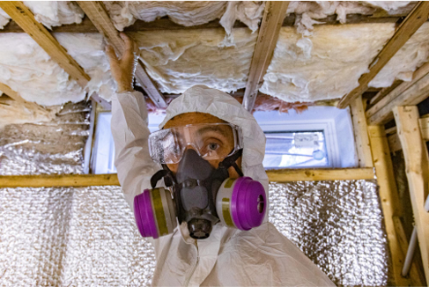
Asbestos in domestic properties
Homes built or renovated before 2000 may contain asbestos. Loft insulation and old boilers may have asbestos-containing components. Bathroom panels, pipe lagging, and old fuse boards are common locations.
DIY work poses risks when cutting, drilling, or sanding suspect materials. Homeowners should request surveys before major refurbishment.

Slide 25
Asbestos in commercial and industrial buildings
Warehouses, schools, hospitals, and offices often contain legacy asbestos. Found in structural fireproofing, duct insulation, and machinery linings.
Duty holders must maintain an up-to-date asbestos register. Occupants and contractors must be informed of the risks. Control plans are essential for ongoing management.

Slide 26
Key definitions and terminology
ACM: Asbestos Containing Material
AIB: Asbestos Insulating Board
RPE: Respiratory Protective Equipment
CAR 2012: Control of Asbestos Regulations
UKAS: United Kingdom Accreditation Service. Understanding these terms ensures accurate communication on site.

Slide 27

Managing asbestos on site
Display asbestos warning signs and update site files.
Coordinate with supervisors and contractors.
Keep asbestos-containing areas secure and undisturbed.
Plan routes and access to avoid potential exposure zones.
Have emergency response steps displayed on site.

Slide 28

Toolbox talks and briefings
Hold asbestos awareness toolbox talks for relevant trades.
Use simple visuals and real-life case studies.
Reinforce stop-work procedures and reporting steps.
Encourage workers to ask questions and raise concerns.
Provide regular refresher briefings as work progresses.

Slide 29
Common myths about asbestos
Myth: "Only blue asbestos is dangerous." – False, all types are hazardous.
Myth: "New buildings are asbestos-free." – False, reused materials can pose risks.
Myth: "Small exposure is safe." – False, no known safe level.
Clarifying misconceptions improves safe behaviour. Misinformation can lead to dangerous assumptions.

Slide 30
Review activity: Group discussion
Scenario: You discover a suspect board while drilling. Discuss:
What should you do immediately?
Who should you inform?
What steps must follow?
How might this affect project timings?
Group feedback to reinforce correct procedures.

Slide 31
Quiz: Check your knowledge
Name one type of asbestos.
Which regulator issues licenses and monitors compliance?
What is the regulation that covers asbestos?
What should you do if you disturb a suspect board?
Name one place you might find AIB.

Slide 32
Quiz: Check your knowledge – answers
Chrysotile, Amosite, Crocidolite
HSE
Control of Asbestos Regulations 2012
Stop work, inform supervisor, isolate area
Ceiling tiles, panel walls, soffits

Slide 33
Summary
You should now be able to:
Recall types and risks of asbestos.
Explain legal responsibilities and correct procedures.
You might also be able to:
Examine where it may be found and how to recognise it.
Implement safe behaviour and clear reporting methods.

Slide 34
Any questions?
Copyright in this document belongs to and is used under licence from the Department for Education, © 2025.
‘T-LEVELS’ and ‘T Level’ are registered trademarks of the Department for Education.
WJEC is authorised by the Department for Education to develop and deliver this T Level Technical Qualification.
WJEC operates in England under the name Eduqas which is a registered trademark of WJEC.

