Slide 1
Occupational Specialism: Plumbing & Heating Engineering
K1.1 Key requirements of Codes of Practice (CoP), Building Regulations and the Water Regulations
Overview of Codes of Practice and their role in industry

Slide 2
Starter
Warm-up: What are regulations or codes you already follow in your personal or work life?
Have you ever seen a poor installation? What do you think caused it?
Why do you think the plumbing and heating industry needs rules and guidance?
Task:
Write down three reasons why standards are important for installers.
Be ready to share your thoughts with the group.

Slide 3
Objectives
You should be able to:
Understand the purpose of codes of practice and regulations.
Identify key building regulation parts (G, H, L).
Describe the Water Regulations 1999.
Explain responsibilities for compliance in industry.
Apply these concepts to everyday installation and maintenance scenarios.

Slide 4
What are Codes of Practice?
Codes of Practice are written guidelines that promote consistent and professional working standards.
They provide recommendations on installation, servicing, and inspection.
They are not law but are often cited in legal or contractual contexts.
Organisations such as CIPHE and BSI publish recognised codes.
Their use enhances system quality, safety, and industry reputation.

Slide 5
Why use Codes of Practice?
They help practitioners make informed decisions.
Offer clarity where regulations are general or ambiguous.
Support consistent outcomes across different sites and installers.
They align industry with environmental, legal, and safety goals.
Following codes demonstrates due diligence and competence.

Slide 6
Examples of codes in use
CIPHE’s Plumbing Engineering Services Design Guide.
BS EN 806 and BS 6700 for water supply design and installation.
WRAS Guidance Notes for backflow prevention and fittings.
British Standard BS 7671 for electrical work linked to plumbing systems.
Use of these documents is considered good practice and defensible in dispute.
Notes:
Link to CIPHE: https://www.ciphe.org.uk/members-and-shop/shop/design-guide/heating/
Note to learners – After the publication of BS EN 806-5, BS 6700 was withdrawn on 01 August 2012 and BS 8558 is the lead document in the area of domestic water supply.
Link to BSI site: https://knowledge.bsigroup.com/products/design-installation-testing-and-maintenance-of-services-supplying-water-for-domestic-use-within-buildings-and-their-curtilages-specification
Link to WRAS: https://www.wrasapprovals.co.uk/

Slide 7
What are Regulations?
Regulations are statutory (legal) rules issued by the government.
They must be followed and enforced by HSE, local authorities and water undertakers.
They form part of the legal responsibilities of employers and installers.
Non-compliance can lead to enforcement action, fines, or prosecution.
They aim to protect users, workers, and the public.

Slide 8
Difference between regulations and codes
Regulations are mandatory; codes of practice are advisory.
Codes help interpret and implement regulations.
Following both leads to best practice and legal compliance.
Regulations tend to be broad – codes add technical detail.
Together, they provide a full framework for responsible practice.

Slide 9

Overview of UK Building Regulations
Building Regulations are statutory documentation divided into Approved Documents A–S.
Each document supports a different part of the building design and construction process.
They set minimum requirements for safety, health, energy efficiency, and usability.
Approved Documents G, H, and L are especially relevant for plumbing and heating.
All trades must be familiar with the parts relevant to their work.

Slide 10
Overview of All Approved Documents (A–T)
Approved Document | Scope
A | Structure
B | Fire safety
C | Site preparation and resistance to contaminates and moisture
D | Toxic substances
E | Resistance to sound
F | Ventilation
G | Sanitation, hot water safety and water efficiency
Notes:
Link to approved document overview: https://www.gov.uk/government/collections/ approved-documents

Slide 11
Overview of All Approved Documents (A–T)
Approved Document | Scope
H | Drainage and waste disposal
J | Combustion appliances and fuel storage systems
K | Protection from falling, collision and impact
L | Conservation of fuel and power
M | Access to and use of buildings
O | Overheating
P | Electrical safety
Notes:
Link to approved document overview: https://www.gov.uk/government/collections/approved-documents

Slide 12
Overview of All Approved Documents (A–T)
Approved Document | Scope
Q | Security in dwellings
R | Infrastructure for electronic communications
S | Infrastructure for charging electric vehicles
T | Toilet accommodation
7 | Material and workmanship: Approved Document 7
Notes:
Link to approved document overview: https://www.gov.uk/government/collections/approved-documents

Slide 13
Part G: Introduction
Part G sets the standard for safe water systems and sanitation.
It includes provisions for water efficiency, hot water safety, and prevention of contamination.
Applies to domestic and some non-domestic systems.
Promotes sustainable use and safe delivery of water.
Important for bathroom, kitchen, and system design.

Slide 14
Part G: Key requirements
Control of scald risk via TMVs (e.g. bath outlets).
Ensure access to wholesome water for drinking and food prep.
Efficient water usage: max 125 litres per person per day.
Minimise contamination from pipework layouts or poor backflow prevention.
Fit-for-purpose WC and washing provisions in new builds.

Slide 15
Part H: Introduction
Focuses on effective removal of wastewater and rainwater.
Includes guidance on underground drainage and soakaways.
Aims to avoid flooding, contamination, and nuisance odours.
Covers all sanitary pipework, treatment systems, and rainwater drainage.
Protects health, environment, and system performance.

Slide 16
Part L: Introduction
Aimed at improving energy efficiency and reducing carbon footprint.
Applies to heating systems, insulation, and controls.
Requires accurate calculation of heat loss and system sizing.
Compliance involves SAP ratings and other energy modelling tools.
Links closely with the UK’s net-zero emissions strategy.

Slide 17
Part L: Subsections explained
L1A: New dwellings – focus on full building performance (fabric, heating, renewables).
L1B: Existing dwellings – covers upgrades, extensions, retrofits.
L2A: New non-domestic buildings – includes industrial/commercial systems.
L2B: Existing non-domestic – energy improvements on refurbishments.
Installers must know which part applies to their project.

Slide 18
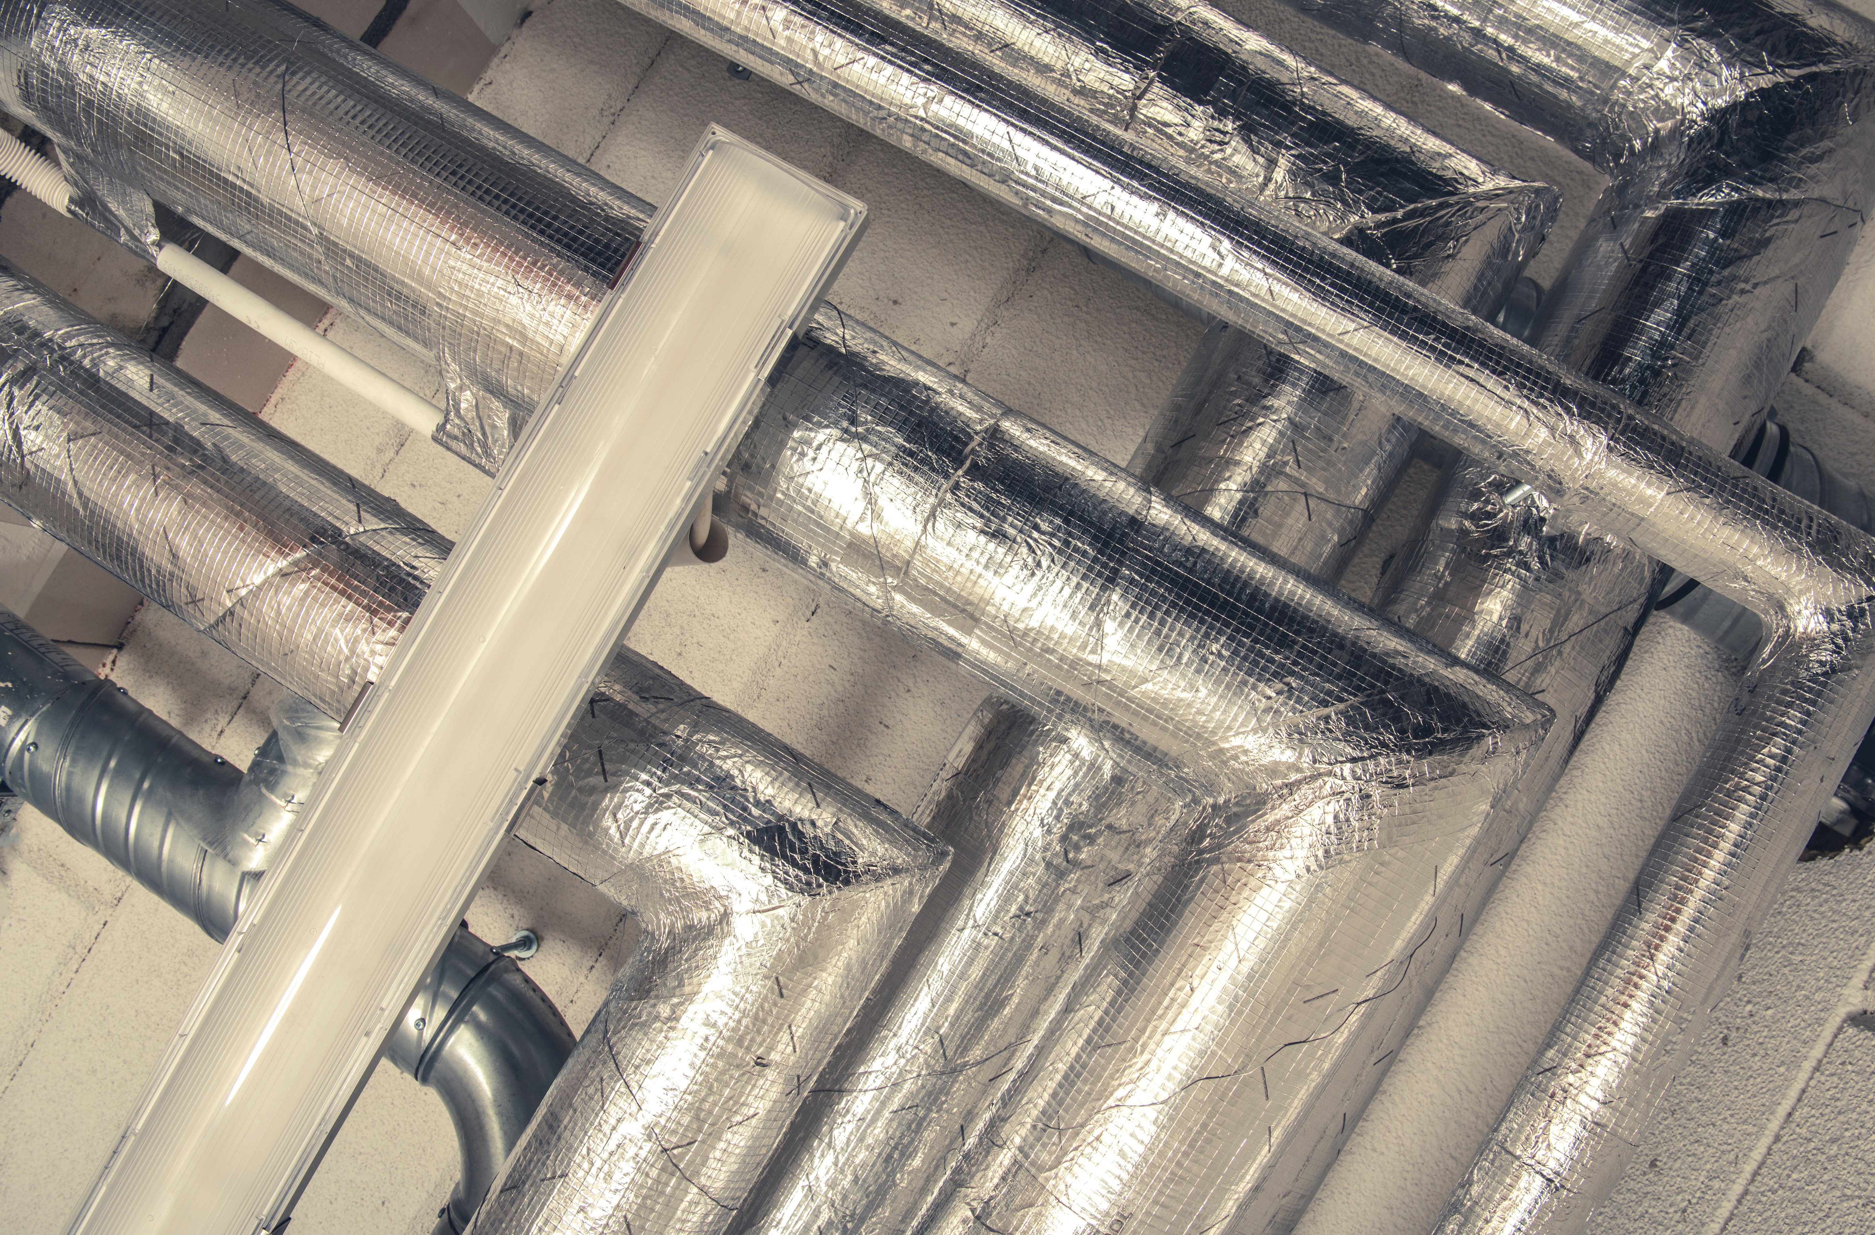
Part L: Impact on heating installations
Mandates high-efficiency boilers and controls.
Requires lagging of all pipework and cylinders.
Zoning and thermostatic control to minimise waste.
Low temperature system design becoming standard.
Work must be tested and documented to prove efficiency.

Slide 19
Summary: G, H, L compared
G: Clean water and sanitation.
H: Safe and effective wastewater disposal.
L: Energy conservation and low carbon heating.
Each document connects to plumbing and heating in different ways.
Understanding their differences ensures compliant and integrated installations.

Slide 20
Introduction to Water Regulations 1999
The Water Supply (Water Fittings) Regulations 1999 replaced previous regional byelaws.
They apply to all plumbing systems connected to the public mains supply.
The goal is to protect water quality and ensure efficient use of water.
Enforced by water undertakers (e.g. Thames Water, Severn Trent).
Compliance is a legal requirement across domestic and commercial sectors.

Slide 21
Principles of the Water Regulations
The water regulations main aims are to prevent;
Waste of water – leaks due to poor installation or maintenance
Erroneous measurement – bypassing a water meter etc.
Contamination of drinking water (e.g. by backflow)
Undue consumption – using more water than is necessary for a process (reduced flushing capacities for WC cisterns)
Misuse – accessing a hydrant without permission or using water mains pressure to power a micro-hydro turbine

Slide 22
Categories of Fluid Risk (Fluid Categories 1–5)
Fluid Category | Description
1 | Wholesome water – no risk
2 | Aesthetic change/ impairment only (e.g. taste/temperature)
3 | Slight hazard – substances of low toxicity
4 | Significant hazard – toxic substance
5 | Serious health risk – human waste, animal waste, etc.
Correct backflow prevention must be selected based on fluid category.
Notes:
https://www.waterregsuk.co.uk/information/glossary/fluid-categories/

Slide 23
Common backflow prevention devices
Device / arrangement | Description | Protection up to
Single check valves | used internally to protect appliances (monoflow mixer tap) | Category 2
Double check valve (DCV) | commonly used for domestic appliances (conventional filling loop) | Category 3
Reduced pressure zone (RPZ) valves | for high-risk applications | Category 4
Air gap (Type AA/AB) | used where highest protection is needed (e.g. WC cisterns) | Category 5
Correct selection and placement are crucial for compliance.

Slide 24
Notification requirements
Some installations require advance notification to the local water authority:
Bidets with flexible hoses.
Large water heaters and unvented cylinders.
Rainwater harvesting systems.
Systems with storage capacity >500 litres.
Any supply to non-domestic premises or food production areas.

Slide 25
Role of WRAS (Water Regulations Advisory Scheme)
Provides guidance and approval for fittings and products.
Helps manufacturers, installers, and inspectors maintain standards.
WRAS-approved products meet the required performance and safety standards.
WRAS diagrams assist in understanding system layouts and compliance.
Though not a legal requirement, WRAS approval is industry standard.

Slide 26
Installer responsibilities
Ensure installation is completed using compliant products.
Understand local water authority requirements.
Notify authorities where required and retain records.
Apply best practice and follow WRAS/CIPHE guidance.
Ensure system design meets fluid category and backflow protection rules.

Slide 27
Water supplier responsibilities
Monitor compliance and inspect notified installations.
Enforce the Water Regulations within their jurisdiction.
Issue guidance and support where necessary.
Have powers to disconnect unsafe or illegal connections.
Work closely with plumbing professionals to uphold standards.

Slide 28
Practical examples: Good and poor compliance
Example 1: WC fitted with Type AA air gap = compliant.
Example 2: Garden tap without check valve = non-compliant.
Example 3: RPZ valve on a commercial kitchen rinse arm = compliant.
Visual checks and referencing WRAS tables ensure right choices.
Field experience and product familiarity reduce errors.

Slide 29
Consequences of non-compliance
Legal enforcement and potential fines.
Service disconnection by the water supplier.
Invalidation of insurance and certification.
Damage to reputation and customer relationships.
Health hazards due to cross-contamination or leaks.

Slide 30
Roles and responsibilities summary
Installers: Design and install to regulations and notify where required.
Designers: Choose appropriate components and ensure full compliance.
Supervisors: Ensure staff are trained and work is quality controlled.
Water Suppliers: Enforce and support safe practice.
Clients: Must cooperate with notifications and act on advice.

Slide 31
Coordination with other standards
Ensure installations also meet Building Regs Parts G, H, L.
Electric connections must follow BS 7671 and Part P.
Gas appliances must comply with Gas Safety Regulations.
Sustainable systems should align with MCS standards.
Whole-system compliance improves safety and efficiency.

Slide 32
Site planning and documentation
Include regulatory checks in project planning.
Highlight WRAS notification items during design.
Document backflow prevention and fitting specifications.
Store certificates of compliance and notifications.
Build in access for future maintenance and inspection.

Slide 33
Site inspection readiness
Label systems clearly and provide as-fitted diagrams.
Ensure all fittings are visible and accessible.
Test systems before inspection and correct visible issues.
Prepare WRAS paperwork and product information.
Support learning culture across installation teams.

Slide 34
Case study: Office kitchenette
Scenario: Small office installs water heater and sink.
Key Issues: Bidet-style spray head added later, no notification.
Outcome: Inspection failed, had to retrofit backflow device.
Lesson: Always assess additions to original install.
Communication with client and documentation is essential.

Slide 35
Quiz: Check your knowledge
What fluid category is domestic hot water?
Give two examples of notifiable installations.
What device prevents backflow from a garden tap?
Who enforces the Water Regulations?
Why use WRAS-approved products?

Slide 36
Quiz: Check your knowledge – answers
Domestic hot water is typically Fluid Category 2 – water that has undergone a change in temperature or taste, but still poses no significant health risk.
A bidet with an integral flexible hose (risk of backflow) & a water storage system with a capacity over 500 litres (or any other suitable answer).
A double check valve (or hose union backflow prevention valve) is typically used to prevent backflow from a garden tap.
The Water Regulations are enforced by the local water undertakers (e.g. Thames Water, United Utilities).
WRAS-approved products have been tested and certified to meet UK Water Regulations. Using them helps ensure compliance, safety, and ease of inspection.

Slide 37
Group activity: Spot the compliance risks
Break into pairs and review system diagrams.
Identify which components require backflow prevention.
Decide which ones require WRAS notification.
Discuss whether the design complies with Parts G and H.
Share your findings with the group.
Notes:
Suitable system diagrams and worksheets to be provided. Sanitation, hot water and heating layouts to include examples of fluid risk.

Slide 38
Summary
You should now be able to:
Recall Codes of Practice and Regulations.
Explain WRAS, fluid categories, and why notification procedures are critical.
You might also be able to:
Examine the purpose of Building Regs Parts G, H, L.
Select and justify the most suitable installation layout to meet requirements.

Slide 39
Moving forward
Stay updated through CPD, WRAS guides, and manufacturer literature.
Ensure all work aligns with the latest Building and Water Regs.
Embrace a culture of safety, quality, and compliance.

Slide 40
Any questions?
Copyright in this document belongs to and is used under licence from the Department for Education, © 2025.
‘T-LEVELS’ and ‘T Level’ are registered trademarks of the Department for Education.
WJEC is authorised by the Department for Education to develop and deliver this T Level Technical Qualification.
WJEC operates in England under the name Eduqas which is a registered trademark of WJEC.

