Slide 1
Occupational Specialism: Gas Engineering
K1.5 Operation and handling requirements of tools, equipment and materials
PowerPoint 1.5b: Maintenance and calibration of tools and equipment

Slide 2
Starter
You’ve just finished testing a new gas pipe installation using a digital manometer. The tool shows a steady 21 mbar – but the tool hasn’t been calibrated for 3 years.
Quick discussion (Pairs or Group):
What might be the consequences?
Who is responsible?
What steps should have been taken before testing?

Slide 3
Objectives
By the end of this session, you should be able to:
Describe routine inspection and maintenance procedures for gas tools.
Explain how and why tools are calibrated.
Understand how tools should be safely stored on-site and in transit.

Slide 4
Inspection checklist – what to look for
Daily/weekly tool inspection
Check for: | Why it matters
Cracked Casings | Can expose components to moisture, dirt or physical shock
Frayed Leads | Electric shock or false readings
Blocked/Dirty Sensors | Leads to inaccurate measurements
Missing Calibration Labels | May void test results and compliance
Corrosion or Loose Parts | Indicates poor storage or unsafe usage

Slide 5
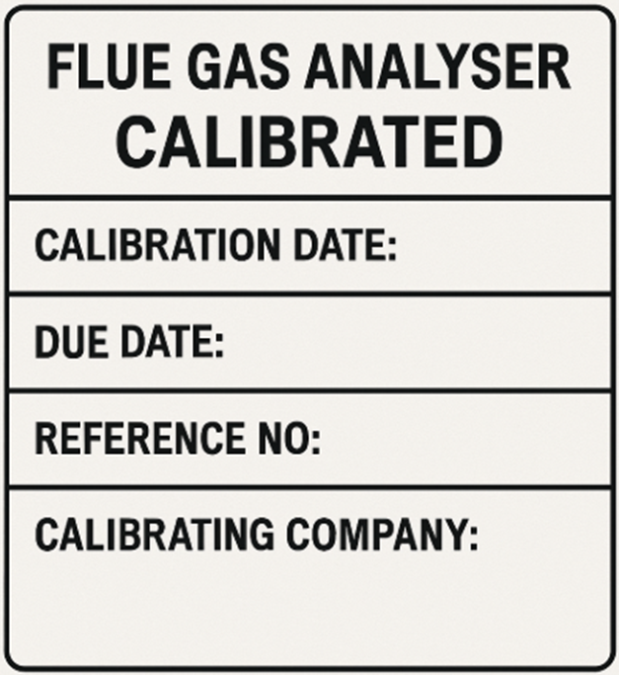
Calibration – What, Why and When
What is calibration?
Setting a measuring instrument to match an accurate standard.
Tools that need regular calibration:
Flue Gas Analysers, Digital Manometers, Gas Leak Detectors, Multimeters
Frequency:
Typically once every 12 months – required for Gas Safe and most employer policies.

Slide 6
Consequences of incorrect calibration
Issue | Result
Inaccurate Pressure or Combustion Reading | Unsafe installation – leads to gas escape or CO risk
Appliance Setup Errors | Poor performance or customer complaints
Regulatory Breach | Could be classed as Immediately Dangerous (ID) under IGEM G/11
Invalid Warranty or Evidence Trail | May result in fines, job loss, or de-registration from Gas Safe

Slide 7
Maintenance logs and compliance
The importance of maintaining logs
Logs demonstrate due diligence in audits, assist in incident investigations, and aid in planning calibration schedules.
Essential information to document:
Tool identification and serial number
Date of inspection or calibration
Name of the engineer
Issues identified and actions taken

Slide 8
Maintenance logs and compliance
Who oversees it?
Competent Person (as defined by HSE and Gas Safe)
Employer’s Health & Safety officer or senior engineer

Slide 9
Equipment maintenance
Equipment type | Maintenance required
Combustion performance analyser | Calibrate annually or per MI. Incorrect readings may lead to misdiagnosis or CO safety issues.
Pressure gauges | Visually inspect for cracks or dislodged fluid. Protect from freezing and store upright.
Leak detectors | Replace batteries and test sensor response.​ Spray bottles must be stored upright and cleaned.
Cutting tools | Clean cutting wheels and lubricate pivot points.​ Store in dry conditions to prevent rust.

Slide 10
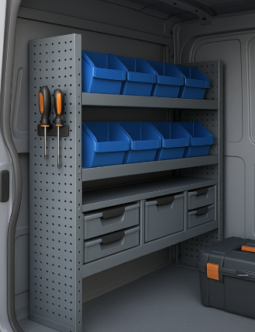
Storage requirements (Workshop and Site)
Correct storage includes:
Dry, locked cupboards or cases (indoors or in vehicles).
Environmental protection – e.g. protect FGAs from frost or damp.
Original packaging or padded boxes for sensitive equipment.
Clearly labelled toolkits and cases.

Slide 11
Case study – unsafe situation due to neglected equipment
Scenario
Mark is an installer who uses an FGA last calibrated 2.5 years ago. He records a “safe” combustion reading on a new boiler and signs it off.
Two days later, the appliance is flagged for dangerously high CO output during a homebuyer’s survey.
What should Mark have done before using the analyser?
How can the company prevent this in future?
What would the Gas Safe Register likely do?

Slide 12
Summary
You should now be able to:
Describe routine inspection and maintenance procedures for gas tools.
Explain how and why tools are calibrated.
Understand how tools should be safely stored on-site and in transit.

Slide 13
Any questions?
Copyright in this document belongs to and is used under licence from the Department for Education, © 2025.
‘T-LEVELS’ and ‘T Level’ are registered trademarks of the Department for Education.
WJEC is authorised by the Department for Education to develop and deliver this T Level Technical Qualification.
WJEC operates in England under the name Eduqas which is a registered trademark of WJEC.

