Slide 1
Occupational Specialism: Gas Engineering
K1.6 Types of components and their suitability for different appliances and types of systems
PowerPoint 1.6f: Appliance types and matching components

Slide 2
Objectives
You should be able to:
Identify major domestic gas appliance types.
Describe key components unique to each appliance.
Explain how system type affects component selection.
You might also be able to:
Compare traditional and emerging appliances (e.g. hydrogen-ready).
Assess component compatibility based on appliance use.

Slide 3
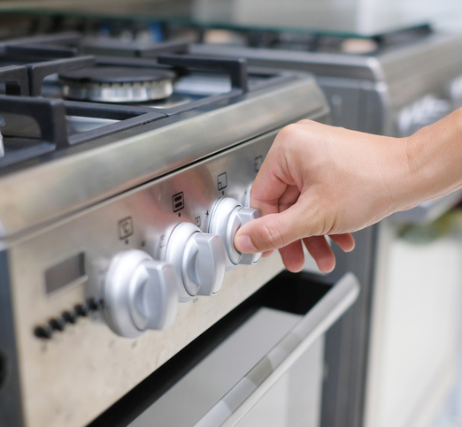
Cookers and ovens – key components
Burners with adjustable air inlets
Allow for precise control of the air-gas mixture, ensuring complete combustion and efficient operation.
These can be fixed or adjustable depending on the cooker model and may require different maintenance approaches.

Slide 4
Cookers and ovens – key components
Flame Supervision Devices (FSDs)
Thermocouple-based safety devices that shut off gas supply if the flame is extinguished.
These are mandatory for all domestic cooker installations under current Gas Safe regulations.

Slide 5
Cookers and ovens – key components
Manual control knobs
Unlike boilers, most cookers use simple mechanical controls without printed circuit boards (PCBs).
However, some modern hob models now incorporate electric ignition systems.

Slide 6
Cookers and ovens - faults and regulatory requirements
Gas Safe regulation: Cookers must have flame supervision for all domestic installations.
Frequent issues include:
FSD failure leading to unsafe operation
Blocked injectors causing poor flame quality
Incorrect orifice installation (LPG vs Natural Gas)
Inadequate ventilation in the cooking area.

Slide 7
Water heaters (instantaneous) – key components
Ignition system
May utilise either a permanent pilot light or electronic ignition. The pilot system requires a thermocouple for flame supervision, while electronic systems typically use an ionisation probe.
Thermistor
Monitors the domestic hot water (DHW) flow temperature to ensure consistent output temperature, preventing scalding and ensuring comfort.

Slide 8
Water heaters (instantaneous) – key components
Air Pressure Switch (APS)
Found in fan-assisted models, this safety device prevents operation if proper air flow isn't detected, protecting against combustion problems.
Modulating valve
Controls gas flow to maintain consistent water temperature despite variations in flow rate, ensuring comfortable and efficient operation.

Slide 9
Water heaters (instantaneous)
Applications and considerations
Instantaneous water heaters are commonly used in:
Flats where space is at a premium
Older systems where full boiler replacement isn't practical
As alternatives to combi boilers in certain situations.
These units are compact but require adequate ventilation and appropriate flueing to operate safely.
Their efficiency is generally lower than modern condensing combi boilers, but they offer a cost-effective solution for hot water only requirements.

Slide 10
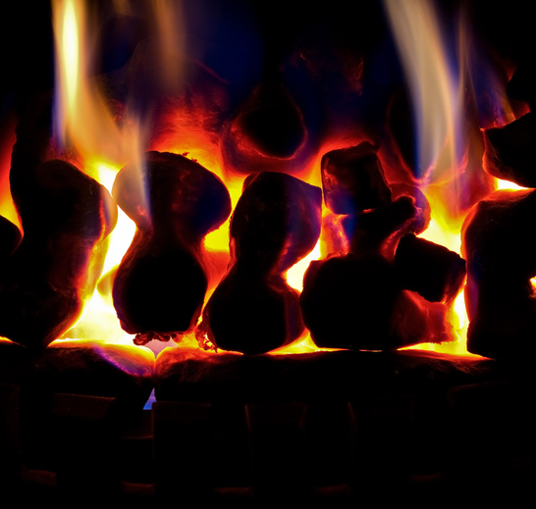
Space heaters and gas fires
Configuration options
Space heaters and gas fires can be configured in various ways:
Flue type: Room-sealed or open flued
Air supply: Fan-assisted or natural draught
Design: Radiant, convector, or decorative.
While many modern gas fires are primarily decorative, they still produce real combustion that must be properly supervised and vented.

Slide 11
Space heaters and gas fires – key components
Flame Supervision Device (FSD)
Mandatory safety component that ensures gas supply is cut if the flame extinguishes. Usually thermocouple-based but may be electronic in newer models.
Air Pressure Switch (APS)
Required for fan-assisted models to confirm proper ventilation before allowing operation, preventing dangerous products of combustion from entering the living space.

Slide 12
Space heaters and gas fires – key components
Control systems
May include room thermostats, flame effect controllers, and in more sophisticated models, remote control functionality with electronic PCB controls.
Common issues
Frequent problems include flue blockage, soot buildup due to incomplete combustion, and poor flame picture caused by incorrect gas pressure or burner alignment.

Slide 13
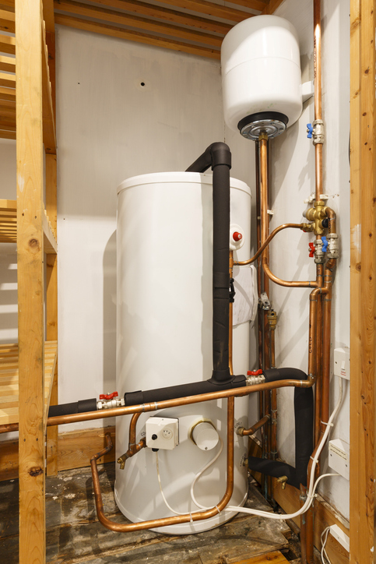
Types of domestic central heating boilers
Heat-only boilers
Require separate hot water cylinder and cold water storage tanks. Suitable for properties with high hot water demand and existing gravity-fed systems.
System boilers
Include expansion vessel and pump but still require separate hot water cylinder. Ideal for properties with multiple bathrooms and moderate space constraints.

Slide 14
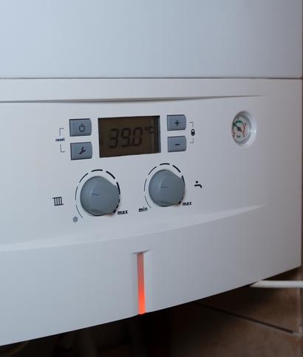
Types of domestic central heating boilers
Combination boilers
Provide both heating and hot water on demand without separate cylinders or tanks. Perfect for smaller properties with limited space and moderate hot water demands.
Condensing technology
Modern boilers must be condensing type, which extract additional heat from flue gases to improve efficiency (typically >90% compared to 70-80% for non-condensing).

Slide 15
Central heating boilers - components
Component | Function
PCB | Controls all logic operations and manages safety functions
Fan | Provides air supply for combustion and forces flue gases out
Thermistors | Measure flow and return temperatures to regulate operation
Ratio valve | Maintains proper air/gas balance for efficient combustion
APS | Ensures proper airflow before allowing ignition
Modulating valve | Adjusts flame output based on demand
Components vary by flue type, output size, and modulation capability. Always consult the manufacturer's instructions when servicing or replacing parts.

Slide 16
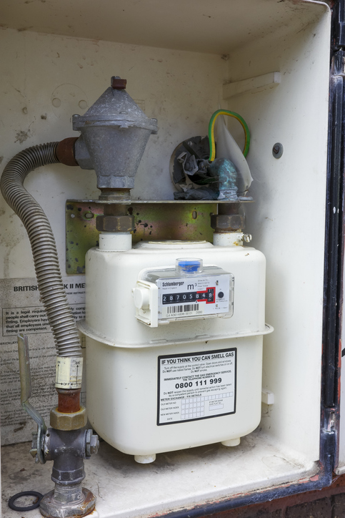
Gas meters (≤ 6 m³/h) – function and location
Gas meters are essential metering devices that:
Accurately measure gas volume usage for billing purposes.
Provide a convenient isolation point via the Emergency Control Valve (ECV).
Are typically installed at property boundaries or in meter boxes.
While not technically an appliance, meters form a critical part of the overall gas system and must be understood by gas engineers.

Slide 17
Gas meters (≤ 6 m³/h) – key components
Diaphragm chamber
The primary measuring component that expands and contracts with gas flow, driving the counting mechanism. This mechanical system is precise but sensitive to physical damage.
Counting mechanism
Either traditional mechanical gears or modern electronic pulse readers in smart meters. Both systems convert the diaphragm movement into readable consumption data.

Slide 18
Gas meters (≤ 6 m³/h) – key components
Emergency Control Valve (ECV)
A quarter-turn valve that provides immediate isolation of the gas supply to the property. Must be accessible and operable by occupants.
Important: Gas engineers must not tamper with meter internals unless specifically qualified to do so. Only registered meter installers may break meter seals or adjust calibration.

Slide 19
Hydrogen-ready boilers
These innovative appliances are designed to operate initially on natural gas, but can be converted to run on 100% hydrogen when the necessary infrastructure becomes available.
Key modifications compared to standard boilers include:
Specialised burner designs optimised for hydrogen combustion.
Advanced flame detection systems suitable for hydrogen's invisible flame.
Modified jets and injectors with appropriate sizing for hydrogen flow.
Gas valves specifically rated and tested for hydrogen compatibility.

Slide 20
Heat pumps
While not combustion appliances, heat pumps are increasingly integrated with gas systems in hybrid configurations.
No combustion components
Heat pumps extract thermal energy from air, ground or water sources rather than burning fuel, eliminating the need for burners, FSDs, and flues.
Control systems
Sophisticated PCBs manage operation based on input from multiple thermistors, flow switches, and external temperature sensors.

Slide 21
Hybrid systems
Hybrid systems intelligently switch between heat pump and gas boiler operation based on efficiency calculations and demand.
These systems still integrate with central heating distribution networks using similar control logic to traditional boilers, making them familiar to gas engineers with appropriate additional training.

Slide 22
Appliance and component matching table
Various gas appliances use specific parts depending on their purpose, efficiency, and safety needs. This comparison outlines the common components for each type.
Note: ✅/❌ indicates that the component may be present depending on the specific model and configuration of the appliance. Modern variants typically include more electronic components than older models.
Appliance | Fan | APS | PCB | FSD | Thermistor
Combi Boiler | ✅ | ✅ | ✅ | ✅ | ✅
Cooker | ❌ | ❌ | ❌ | ✅ | ❌
Space Heater | ✅/❌ | ✅/❌ | ✅/❌ | ✅ | ✅/❌
Gas Fire | ❌ | ✅/❌ | ✅ | ✅ | ❌
Water Heater | ✅/❌ | ✅ | ✅ | ✅ | ✅
H₂ Boiler | ✅ | ✅ | ✅ | ✅ | ✅

Slide 23
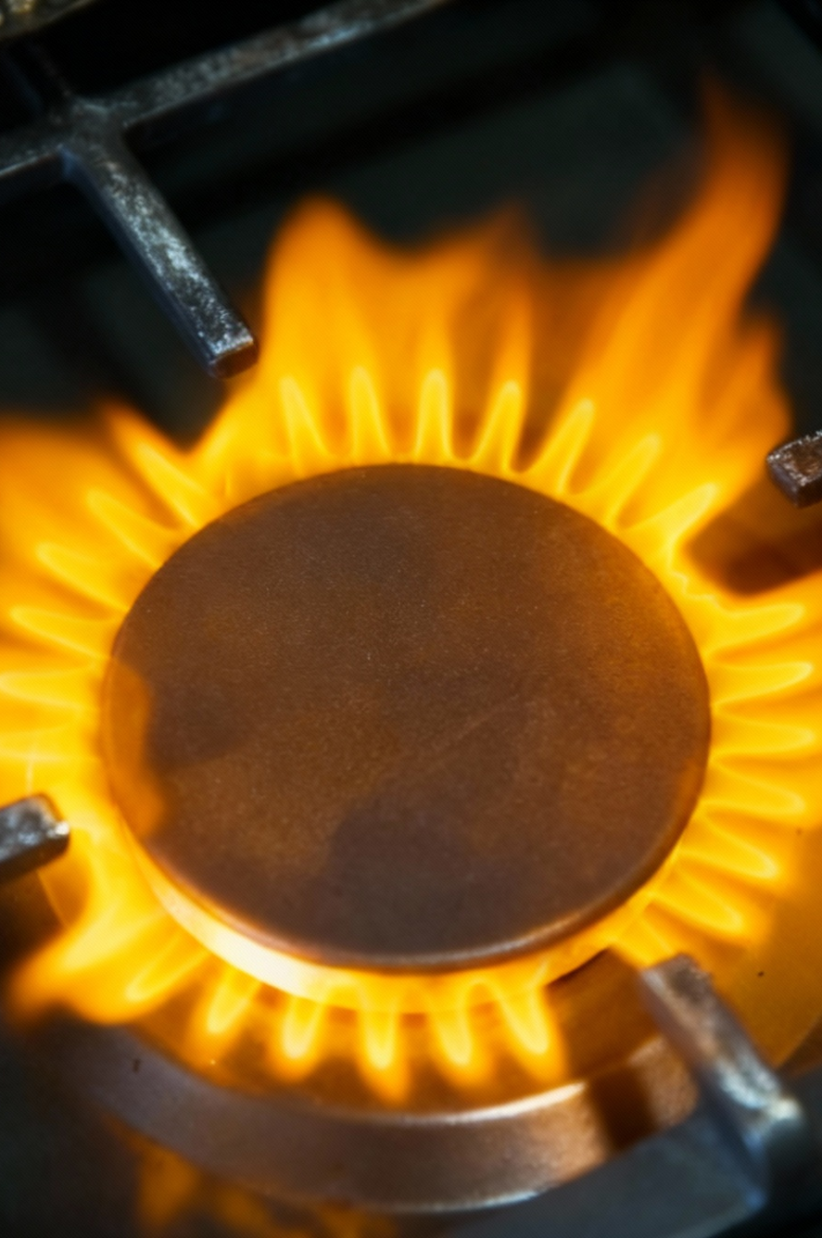
Scenario task: Charlie installs the wrong valve
Scenario
Charlie, a newly qualified gas engineer, is called to service a cooker in a rural property.
During the service, he identifies that the gas valve needs replacement and fits a standard Natural Gas (NG) gas valve into a cooker that is actually running on Liquefied Petroleum Gas (LPG).
After installation, Charlie notices the flame is large, yellow and unstable, with signs of incomplete combustion. The customer reports a strong gas smell when the cooker is in use.

Slide 24
Scenario task: Charlie installs the wrong valve
Group task
Why did this happen? - Consider the differences between NG and LPG components, particularly regarding operating pressures and injector sizes.
What components must match the gas type? - Identify all components that require specific versions for different gas types and explain why.
What classification would you give this fault? - According to the Gas Industry Unsafe Situations Procedure (GIUSP), how would you classify this situation?

Slide 25
Fan-assisted boiler operation
Airflow pathway
Primary air enters through the dedicated air inlet (often coaxial with flue).
Fan creates positive pressure differential across the system.
Air passes through venturi where gas is introduced.
Air/gas mixture enters burner for combustion.
Products of combustion (POC) pass through primary heat exchanger.
In condensing appliances, POC then pass through secondary heat exchanger.
Cooled POC exit via flue terminal.

Slide 26
Summary
You should now be able to:
Identify major domestic gas appliance types.
Describe key components unique to each appliance.
Explain how system type affects component selection.
You might also be able to:
Compare traditional and emerging appliances (e.g. hydrogen-ready).
Assess component compatibility based on appliance use.

Slide 27
Any questions?
Copyright in this document belongs to and is used under licence from the Department for Education, © 2025.
‘T-LEVELS’ and ‘T Level’ are registered trademarks of the Department for Education.
WJEC is authorised by the Department for Education to develop and deliver this T Level Technical Qualification.
WJEC operates in England under the name Eduqas which is a registered trademark of WJEC.

