Slide 1
Occupational Specialism: Gas Engineering
K1.15 Types of gas appliances and their system
requirements
PowerPoint 1.15b: Appliance system requirements

Slide 2
Starter
Instructions: Match each appliance type to its critical system requirement.
Appliances:
Open-flued gas fire
Combi boiler
Flueless space heater
Cooker
U6 diaphragm meter
System features to match:
Requires air vents and combustion air
Must be bonded to equipotential earth
Needs a sealed flue to the outdoors
Requires a catalytic converter and ventilation
Requires a minimum 1 m³ clearance above

Slide 3
Objective
By the end of this session, you will be able to:
Identify the system requirements for different gas appliance types.
Describe ventilation, flueing, and siting rules for each category.
Apply MI guidance and Building Regs when planning appliance installs.
Explain how system setup ensures safe appliance operation.

Slide 4
Why system requirements matter
Gas appliances depend on properly designed systems to ensure safety and efficiency in UK homes. Inadequate installation can lead to dangerous conditions and non-compliance with UK regulations.
Key system functions include:
Providing safe combustion air supply
Removing waste gases via appropriate flueing
Ensuring stable gas pressure and adequate supply
Preventing property damage or personal injury.

Slide 5
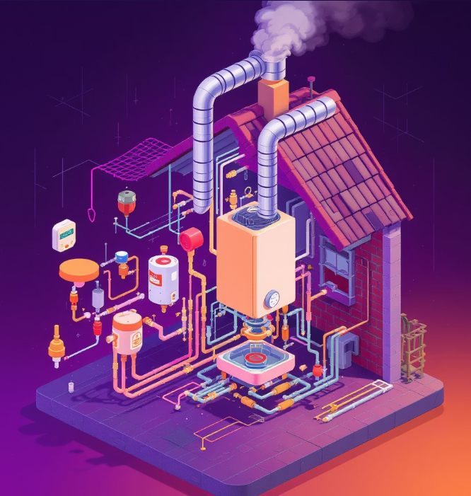
Why system requirements matter
UK compliance framework:
Gas Safety (Installation & Use) Regulations
Building Regulations Part J (Combustion)
IGEM/UP/1 & 1B standards
BS 5440 Parts 1 & 2

Slide 6
Flueing requirements by appliance type
Appliance type | Flue requirement | UK Standard Reference
Combi boiler | Room-sealed balanced flue required | BS 5440-1
Open-flued fire | Chimney or suitable vertical flue | BS 5871-3
Flueless heater | No flue – room must be permanently ventilated | BS 5871-4
Cooker | Usually no flue – unless commercial setting | BS 6172
Water heater | Open or room-sealed depending on model | BS 5546

Slide 7
Ventilation requirements
Proper ventilation is critical for gas appliances in UK homes, especially with modern airtight building construction.
Requirements vary significantly between appliance types:
Appliance type | Ventilation requirement
Open-flued fire | High and low-level fixed vents
Combi boiler | Often none (room-sealed), MI confirms
Flueless heater | Large permanent vent, ≥100 cm², no closure
Cooker | Airflow across hob, not reliant on openable windows

Slide 8
Ventilation requirements
Important considerations:
Always calculate ventilation using current BS 5440-2
5cm² of free area per kW input above 7kW (open-flued)
Consider the property's air permeability index
Refer to Manufacturer's Instructions for specific requirements
Never rely on mechanical ventilation for open-flued appliances.

Slide 9


Calculating ventilation requirements
Open-flued appliances
For input exceeding 7kW:
Example: 20kW open-flued boiler requires 5 × (20-7) = 65cm² free area.
Flueless appliances
For domestic flueless heaters:
Plus adequate room size (typically minimum 40m³).

Slide 10

Calculating ventilation requirements
Multiple appliances
When different appliance types are present:
Consider the interaction between appliances and pressure effects.
Always refer to current Building Regulations and IGEM guidance for UK-specific requirements.

Slide 11
Pressure, gas supply and controls
Adequate working pressure
Natural gas: 19-23 mbar at appliance inlet
LPG: 37 mbar (propane) or 28 mbar (butane)
Pressure must be within MI limits.
Gas pipe sizing factors
Pipe material (copper, steel, PE)
Distance from meter to appliance
Number of appliances on system
Calculated using IGEM/UP/2 methods.

Slide 12
Pressure, gas supply and controls
Control systems
CH boilers: time, temperature, interlock controls
Fires: manual or automatic ignition with ODS
Cookers: Flame Supervision Devices (FSDs)
All appliances require an isolation valve within 1m
Accessible Emergency Control Valve (ECV)

Slide 13
Safety devices and system protection
UK gas installations require specific safety devices for each appliance type to comply with Gas Safety Regulations.
Boilers
Overheat thermostat
Flue gas thermostat (open-flued)
Pressure relief valve
Low water pressure switch
Flame failure device

Slide 14
Safety devices and system protection
Gas fires
Oxygen Depletion Sensor (ODS)
Flame Supervision Device (FSD)
Thermal cut-off for glass fronted fires
Blocked flue detection (when applicable)

Slide 15
Safety devices and system protection
Flueless appliances
CO detector required in room
Catalytic converter (flueless heaters)
Atmosphere sensing device
FSDs on all burners

Slide 16
Safety devices and system protection
Gas installation
Meter regulator
Emergency Control Valve (ECV)
Equipotential bonding
Additional LPG controls (Over Pressure Shut-Off and UPSO – Under Pressure Shut-Off)
Absence of required safety devices classifies an installation as At Risk (AR) or Immediately Dangerous (ID).

Slide 17
Understanding gas risk classifications
Immediately Dangerous (ID)
Situations that present an immediate danger to life or property that must be made safe before leaving:
Gas escape that cannot be stopped
Unsafe products of combustion in the living space
Unstable appliance that could cause injury
No ODS on open-flued fire in bedroom.
Action: Turn off, disconnect, attach a warning label, inform the responsible person, and notify Gas Emergency Service if required.

Slide 18
Understanding gas risk classifications
At Risk (AR)
Situations that could become dangerous over time:
Inadequate ventilation for open-flued appliance
Partially blocked flue
Incorrect operating pressure
Missing safety controls but no immediate danger.
Action: Inform customer, issue warning notice, recommend remedial action with timescale, and document clearly.

Slide 19
Siting and installation considerations
Location restrictions
No instantaneous water heaters in bathrooms (GSIUR Reg.30)
Restrictions on gas fires in bedrooms (ODS required)
Boiler compartments must meet ventilation requirements
Cookers require minimum clearances from combustible materials

Slide 20
Siting and installation considerations
Clearances
Follow MI specifications for clearances above, beside and below
Typically 300mm above, 150mm sides for access
Cookers require minimum 1m³ clearance above
Room-sealed terminals have specific positioning requirements

Slide 21
Siting and installation considerations
Access requirements
Provide access for servicing and maintenance
Clear access to controls and safety devices
Allow for replacement of components
Consider future inspection requirements

Slide 22
Space heaters: classifications and requirements
Flue terminal positioning
Flue terminals must be positioned correctly to prevent combustion products from re-entering the building or adjacent properties. UK regulations specify minimum distances:
Position | Minimum Distance
Below openable window | 300mm
Below eaves | 200mm
From vertical drain/soil pipe | 75mm
From internal/external corner | 300mm
From another terminal | 1200mm
From openable window or boundary | 600mm
Always refer to current Building Regulations Part J and manufacturer's instructions for specific models.

Slide 23
Central heating system requirements
Water quality and treatment
System must be thoroughly flushed before commissioning
Chemical inhibitor required to prevent corrosion
Consider water treatment for hard water areas
Follow BS 7593 for water treatment.

Slide 24
Central heating system requirements
System controls
Time and temperature control required
Boiler interlock to prevent dry cycling
Zoning for properties over 150m²
Thermostatic Radiator Valves (TRVs)

Slide 25
Metering and installation requirements
Gas meter installation
Must be accessible for reading and maintenance
Semi-concealed meters require removable cover
No electrical equipment within 150mm
Not installed in sleeping accommodation
Regulator vent positioned to discharge safely

Slide 26
Metering and installation requirements
Electrical requirements
Equipotential bonding (min 10mm² cable)
Connection within 600mm of meter
Permanent electrical supply for boilers
RCD protection for outdoor appliances

Slide 27
Metering and installation requirements
Testing and commissioning
Tightness testing to IGEM/UP/1B
Purging procedures for new installations
Standing and working pressure tests
Gas rate checks using U6 meter (6ft³/hr)
Combustion analysis for condensing appliances

Slide 28
Summary
You should now be able to:
Identify the system requirements for different gas appliance types.
Describe ventilation, flueing, and siting rules for each category.
Apply MI guidance and Building Regs when planning appliance installs.
Explain how system setup ensures safe appliance operation.

Slide 29
Any questions?
Copyright in this document belongs to and is used under licence from the Department for Education, © 2025.
‘T-LEVELS’ and ‘T Level’ are registered trademarks of the Department for Education.
WJEC is authorised by the Department for Education to develop and deliver this T Level Technical Qualification.
WJEC operates in England under the name Eduqas which is a registered trademark of WJEC.

