Slide 1
Occupational Specialism: Gas Engineering
K1.11 Gas and the combustion process
PowerPoint 1.11d: Gas properties – CV, heat input, flame speed, ignition temperature

Slide 2
Starter
Scenario
Mark is testing an LPG heater in a cold shed. The burner keeps failing to stay lit. The gas bottle feels icy cold.
Discussion prompts:
Why might LPG behave differently in cold temperatures?
What gas properties could affect the flame’s behaviour?

Slide 3
Objectives
By the end of this session, you should be able to:
Define the calorific value and ignition temperature of different gas types.
Calculate heat input and heat output.
Explain the significance of flame speed and ignition behaviour.
Apply gas properties to appliance setup and safety decisions.

Slide 4
What is calorific value?
Calorific Value (CV) is the amount of energy released when 1 cubic metre of gas is completely combusted under standardised conditions. It is a fundamental property that determines the energy content of different fuel gases.
Gas type | Typical CV (MJ/m³) | Notes
Natural Gas (NG) | 38.76 | Primarily methane (CH₄), lighter than air, lower energy density
Propane (LPG) | 93.20 | C₃H₈, denser than air, over twice the energy content per m³ compared to NG
Butane (LPG) | 121.00 | C₄H₁₀, highest energy density, but poor vaporisation below 0°C

Slide 5
What is calorific value?
The higher calorific value of LPG has significant implications for appliance design:
LPG appliances require smaller injector orifices to maintain proper heat input
Converting appliances between gas types requires proper injector sizing
Higher energy density makes LPG more efficient for portable applications.

Slide 6
Heat input Gross/Net
Gross Heat Input: The total energy released when gas is burned, including the heat used to vaporise water formed during combustion.
Used in older UK standards and some manufacturer data plates.
Net Heat Input: The actual usable heat available from combustion, excluding the latent heat lost as water vapour.
Used in modern appliance specifications, efficiency ratings, and regulatory documents.
Conversion: Net Input = Gross Input
1.11

Slide 7
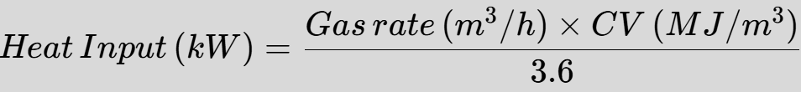
Heat input and output calculations
Heat input formula:
Where 3.6 is a conversion factor from MJ/h to kW.
Heat output formula:
The difference between input and output represents energy lost in the combustion process.

Slide 8
Heat input and output calculations
Practical applications:
Sizing gas supply - Ensuring pipe diameter can deliver required volume
Burner selection - Matching burner capacity to application requirements
Commissioning - Verifying the correct gas rate during installation
Servicing - Checking performance against manufacturer specifications.
Heat input calculations are essential for ensuring appliances operate within safe parameters and deliver the expected performance. They form the foundation of proper gas engineering practice.

Slide 9
Ignition temperature
Ignition temperature is the minimum temperature required for a gas to spontaneously ignite without an external flame or spark.
This property is critical for understanding combustion safety and appliance design requirements.
Lower ignition temperatures present increased risks in case of gas leakage, as these gases require less thermal energy to ignite when mixed with air.
Gas | Ignition temp (°C) | Behaviour
Methane (NG) | 595°C | Highest ignition temperature, less prone to accidental ignition
Propane | 470°C | Intermediate ignition point, ignites more readily than methane
Butane | 405°C | Lowest ignition temperature, most easily ignited of common fuel gases

Slide 10
Ignition temperature
Ignition temperature affects:
Ignition system design requirements
Pilot flame sizing and positioning
Safety controls and thermocouple specifications
Risk assessment for different environments.
Always consider the specific gas properties when designing, installing or servicing appliances to ensure appropriate safety measures are implemented.

Slide 11
Flame speed
Flame speed (or flame velocity) describes how quickly the flame front propagates through a combustible air-gas mixture. This property significantly impacts burner performance and flame stability.
Gas | Relative flame speed | Characteristics
Methane (NG) | Moderate (0.4 m/s) | Stable flame in most burner designs
Propane | Fast (0.5 m/s) | Prone to flame lift or blow-off at high pressures
Butane | Medium (0.45 m/s) | Good stability but affected by low temperature vaporisation issues

Slide 12
Engineering implications of gas properties
Calorific value
Determines injector sizing requirements
Affects heat output and efficiency
Influences gas rate calculations
Critical for appliance conversion between gas types.

Slide 13
Engineering implications of gas properties
Ignition temperature
Dictates spark generator requirements
Influences pilot flame design
Affects ignition sequence timing
Impacts safety control sensitivity.

Slide 14
Engineering implications of gas properties
Flame speed
Determines burner port configuration
Affects air/gas mixture requirements
Influences flame stability characteristics
Critical for preventing flame lift or lightback.

Slide 15
Engineering implications of gas properties
Heat input
Used to confirm correct gas supply
Essential for commissioning verification
Determines appliance operating range
Basis for efficiency calculations.

Slide 16
Engineering implications of gas properties
Using incorrect gas type or components for a specific appliance can lead to serious safety issues including:
Incomplete combustion producing carbon monoxide
Overheating of appliance components
Flame instability causing operational failures
Damage to heat exchangers or other components.
Engineers must always verify the compatibility of gas properties with appliance specifications before installation or modification.

Slide 17
Worked example: Heat input calculation
Problem
An appliance is rated at 20 kW heat input. If using natural gas with a CV of 38.76 MJ/m³, what gas rate is required?

Slide 18
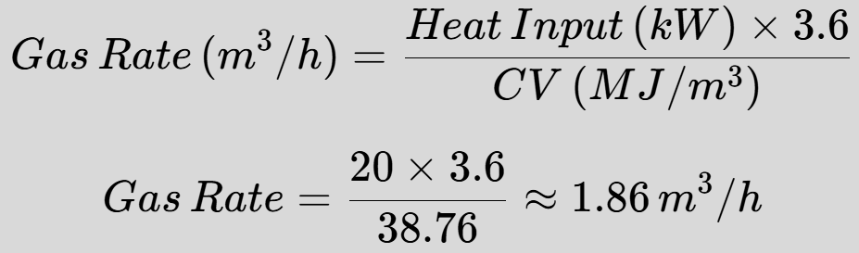
Worked example: Heat input calculation
Problem
An appliance is rated at 20 kW net heat input. If using natural gas with a CV of 38.76 MJ/m³, what gas rate is required?
Solution
Therefore, the appliance requires a gas flow rate of 1.86 cubic metres per hour to achieve its rated heat input.

Slide 19
Worked example: Heat input calculation
Application
This calculation would be used during:
Initial commissioning to verify correct gas supply
Routine servicing to confirm appliance performance
Troubleshooting when heat output seems insufficient
System design to ensure adequate pipe sizing.
The calculated gas rate should be compared with actual meter readings taken over a timed period to verify correct operation.

Slide 20
Advanced example: LPG conversion
Problem
A 24 kW natural gas boiler is being converted to propane. The original gas rate was 2.23 m³/h with natural gas (CV = 38.76 MJ/m³). What should the new gas rate be with propane (CV = 93.20 MJ/m³)?

Slide 21

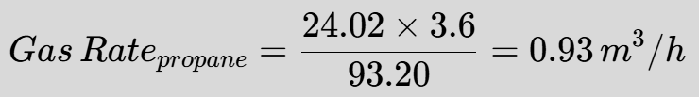
Advanced example: LPG conversion
Solution
Step 1: Confirm the heat input using original values
Step 2: Calculate the new gas rate needed to maintain the same heat input

Slide 22
Advanced example: LPG conversion
Solution
Step 3: Determine the required injector size reduction
Since propane has a CV approximately 2.4 times higher than natural gas, the injector area should be reduced by a similar factor to maintain proper combustion characteristics.
Converting appliances between gas types requires manufacturer-approved conversion kits and must only be performed by appropriately qualified engineers in accordance with manufacturer instructions.

Slide 23
Advanced example: LPG conversion
This calculation demonstrates why LPG appliances have significantly smaller injector orifices than equivalent natural gas appliances, and explains why using incorrect components can create dangerous conditions.

Slide 24
Case study: LPG in cold conditions
Returning to our initial scenario:
"Mark is testing an LPG heater in a cold shed. The burner keeps failing to stay lit. The gas bottle feels icy cold.“
Analysis based on gas properties:
Vaporisation issue: In cold temperatures, liquid propane struggles to vaporise sufficiently, reducing available gas pressure.
Endothermic process: As liquid propane vaporises, it absorbs heat from its surroundings, further cooling the cylinder.
Flame stability: Lower pressure can affect the flame speed balance, causing flame lift or extinction.

Slide 25
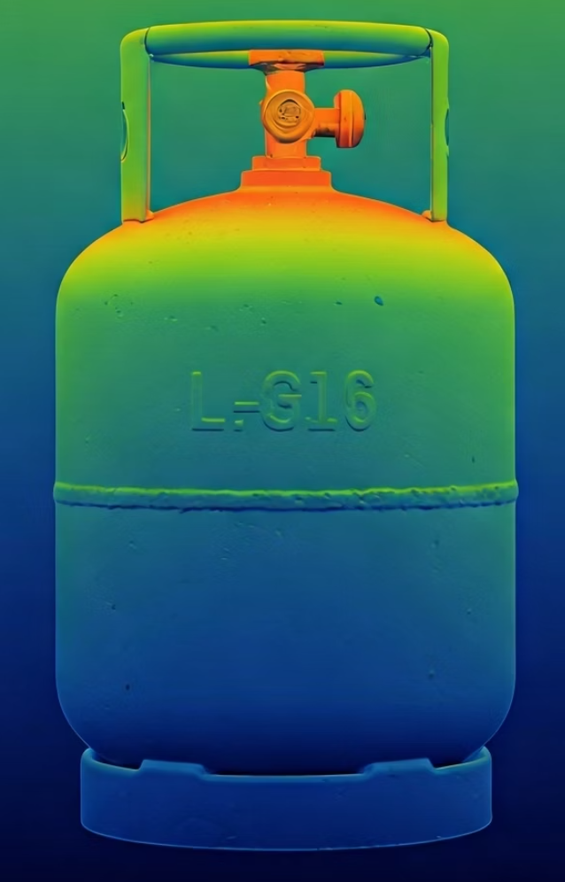
Case study: LPG in cold conditions
Solutions
Understanding gas properties suggests these potential solutions:
Move cylinder to warmer location
Use a larger cylinder with more surface area for heat absorption
Install cylinder warming equipment for commercial applications
Switch to propane-butane mix in warmer months, pure propane in cold
Consider a natural gas connection if continuous operation in cold environments is required.

Slide 26
Knowledge check
Question 1
Which gas has a higher calorific value – propane or methane?
Question 2
What is the formula to calculate heat input?
Question 3
Why is flame speed important for burner design?
Question 4
What happens if heat input is too low relative to appliance specifications?

Slide 27
Knowledge check
Answer 1
Propane (93.20 MJ/m³) has a significantly higher calorific value than methane (38.76 MJ/m³), which is why LPG appliances require smaller injectors.
Answer 2
Heat Input (kW) = Gas rate (m³/h) × CV (MJ/m³) ÷ 3.6

Slide 28
Knowledge check
Answer 3
Flame speed must be balanced with gas-air mixture velocity to prevent flame lift (if too slow) or lightback (if too fast), ensuring stable and complete combustion.
Answer 4
Insufficient heat input can lead to incomplete combustion, flame extinction, cycling of safety devices, reduced efficiency, and potential condensation issues in flue passages.

Slide 29
Key considerations for practical applications
Installation - Ensure correct gas type, pressure, and injector size. Verify heat input matches appliance rating. Check burner performance across operating range.
Commissioning - Measure actual gas consumption against calculated requirements. Test for flame stability. Verify safe ignition and shutdown. Document all readings.
Servicing - Check for changes in combustion quality. Verify ongoing compliance with heat input specifications. Inspect for signs of incomplete combustion.
Troubleshooting - Use gas property knowledge to diagnose issues. Consider flame speed for stability problems. Check calorific value implications for underperformance.

Slide 30
Key considerations for practical applications
Remember that gas properties interact with environmental conditions:
Temperature effects: Cold conditions affect vaporisation of LPG and can change combustion characteristics.
Ventilation impacts: Proper air supply is essential for complete combustion and stable flame behaviour.
System aging: Components like injectors can become partially blocked over time, altering the designed heat input.

Slide 31
Summary
You should now be able to:
Define the calorific value and ignition temperature of different gas types.
Calculate heat input and heat output.
Explain the significance of flame speed and ignition behaviour.
Apply gas properties to appliance setup and safety decisions.

Slide 32
Any questions?
Copyright in this document belongs to and is used under licence from the Department for Education, © 2025.
‘T-LEVELS’ and ‘T Level’ are registered trademarks of the Department for Education.
WJEC is authorised by the Department for Education to develop and deliver this T Level Technical Qualification.
WJEC operates in England under the name Eduqas which is a registered trademark of WJEC.

