Slide 1
Occupational Specialism: Gas Engineering
K1.16 Scientific principles and concepts as applied to gas engineering
PowerPoint 1.16c: Properties of fuels

Slide 2
Starter
“Why can’t we just use the same gas appliance for both natural gas and LPG?”
Take 2 minutes to think about this with a partner.
What problems might come up? Is gas just gas?

Slide 3
Objectives
By the end of this session, you should be able to:
Identify key properties of natural gas and LPG.
Explain the significance of calorific value and Wobbe Number.
Interpret how fuel properties affect appliance compatibility.
Compare gas behaviours under different temperatures and pressures.

Slide 4
What is a fuel?
A fuel is any material that stores energy and can release that energy when it combusts (burns) in the presence of oxygen.
This energy is typically released in the form of heat and light.

Slide 5
Fuels in domestic gas engineering
In the UK, gas engineers commonly work with two types of fuel gases:
Fuel type | Name | Chemical formula | Where it's found
Natural Gas | Methane | CH₄ | Mains gas network, piped to homes
LPG (Propane) | Propane | C₃H₈ | Bottled gas or bulk tank storage
LPG (Butane) | Butane | C₄H₁₀ | Portable canisters & caravans

Slide 6
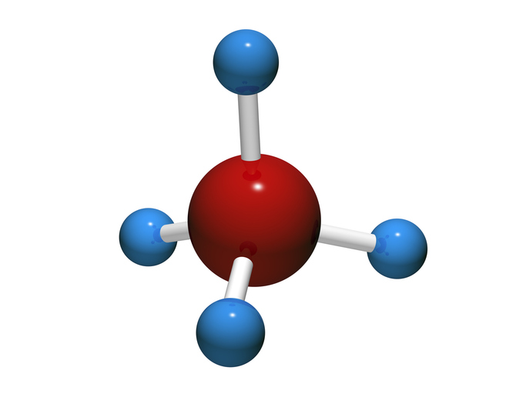
The methane molecule – CH4
Structure:
1 Carbon (C) atom in the centre.
4 Hydrogen (H) atoms surrounding it.
This is a simple hydrocarbon – all domestic gases are hydrocarbons, meaning they’re made from carbon (C) and hydrogen (H) atoms.

Slide 7
Combustion of methane (CH₄) in oxygen (O₂)
CH₄ + 2O₂ → CO₂ + 2H₂O + Heat
This shows complete combustion.
When methane burns:
Carbon atoms combine with oxygen to make carbon dioxide (CO₂)
Hydrogen atoms combine with oxygen to make water vapour (H₂O)
Energy (heat) is released.

Slide 8
Combustion of methane (CH₄) in oxygen (O₂)
So, what happens if you use a burner designed for methane but supply it with propane?
You’re changing the fuel molecule size.
The air-fuel ratio, flame speed, and pressure all change.
The appliance might burn incorrectly, dangerously, or inefficiently.

Slide 9
Fuel comparison table
“Which of these would produce more heat in a smaller volume?”
Property | Natural Gas (CH₄) | Propane (LPG) | Butane (LPG)
State at room temp | Gas | Liquid | Liquid
Storage pressure | Low | High (7 bar) | High (2 bar)
Calorific value (MJ/m³) | ~38 | ~95 | ~120
Ignition temp (°C) | ~600 | ~500 | ~405
Density (air = 1) | 0.6 | 1.5 | 2.0
Flame speed (m/s) | 0.4 | 0.46 | 0.49

Slide 10
Calorific value
Expressed in MJ/m³ (Megajoules per cubic metre), this metric indicates the amount of energy produced when a specific volume of gas is combusted.
LPG possesses a significantly higher calorific value compared to natural gas.
A higher value signifies more energy, which means that smaller jets or orifices are necessary.
Incorrect usage may lead to incomplete combustion or unsafe pressure levels.

Slide 11
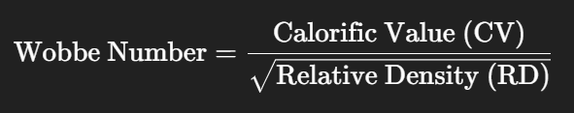
The Wobbe Number
The Wobbe Number (WN) is a calculated value used in gas engineering to determine the interchangeability of different fuel gases for use in the same appliance.
Calorific Value (CV): The amount of energy released when a given volume of gas is burned.
Relative Density (RD): How heavy a gas is compared to air.

Slide 12
The Wobbe Number - why it matters in industry
Interchangeability:
If two gases have the same Wobbe Number, they will:
Deliver a similar amount of energy through the same burner or injector.
Maintain similar flame characteristics (size, speed, and temperature).
Require minimal burner adjustment, simplifying appliance design and safety assurance.

Slide 13
The Wobbe Number - why it matters in industry
Mismatch consequences:
Using a gas with a very different Wobbe Number in an appliance not designed for it can cause:
Incomplete combustion
Overheating
Flame lift-off or instability
Carbon monoxide production
Appliance or system failure.

Slide 14
Real-world Wobbe Numbers (MJ/m³)
Gas type | Approx. Wobbe Number
Natural Gas (Methane) | ~50 MJ/m³
Propane (LPG) | ~75 MJ/m³
Butane (LPG) | ~80 MJ/m³

Slide 15
Why can’t we use LPG in a natural gas appliance?
Using LPG in appliances meant for natural gas is hazardous due to differences in energy density and air-fuel ratio.
LPG's higher Wobbe Number means it releases more energy per volume.
Appliance injectors and burners are set for natural gas's lower energy, leading to:
Overheating
Flame instability
Higher carbon monoxide risk
Non-compliance with Gas Safety regulations.

Slide 16
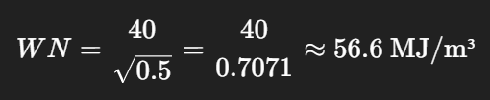
Worked example
A gas has a CV of 40 MJ/m³ and a relative density of 0.5 What is its Wobbe Number?
This WN indicates that the gas may be compatible with appliances designed for gases in the 55–60 MJ/m³ range—but a full compatibility check is still required!

Slide 17
Other important fuel properties
Ignition temperature (or Autoignition Temperature) refers to the minimum temperature at which a gas can ignite on its own, without an external flame or spark.
This is a vital safety measure—when the temperature is reached in the presence of gas, ignition may happen without a visible flame.
The ignition temperatures vary among gases, impacting:
Appliance design, material selection, ventilation and monitoring, risk assessment in confined areas.

Slide 18
Other important fuel properties
Flame speed refers to the velocity at which a flame front moves through a gas-air mixture post-ignition, typically measured in metres per second (m/s).
It is a crucial combustion characteristic impacting appliance safety and efficiency.
Flame speed affects burner design, air-fuel ratio settings, and overall safety and performance.
A slow flame speed may result in extinguishment, while a fast speed can lead to instability or damage.

Slide 19

Other important fuel properties
Relative Density (RD) — also known as Specific Gravity in gas engineering — is the ratio of the density of a gas to the density of air.
If RD > 1 → The gas is heavier than air (it sinks) If RD < 1 → The gas is lighter than air (it rises)

Slide 20
Other important fuel properties
Relative Density (RD)
Design Area | Impact of Relative Density
Flue Design | Lighter gases (e.g. methane) rise easily through flues — ideal for natural draught
Leak Detection | Heavy gases (e.g. LPG) pool near the floor ➝ require low-level detection
Ventilation Design | Placement of vents must match the gas behaviour — high level for methane, low level for LPG
Safety Planning | Prevents dangerous gas accumulation in voids or pits

Slide 21
Behaviour under pressure and temperature
Different gases behave differently under pressure and temperature - this influences how they are stored, transported, and used in gas appliances.
Gas type | Storage state | Typical pressure | Notes
LPG (Propane/Butane) | Stored as a liquid in pressurised containers | 5–10 bar in cylinders | Vaporises when released into atmosphere — used as a gas
Natural Gas (Methane) | Supplied as a gas through mains pipework | ~21 mbar (low pressure) | Stays gaseous throughout its journey from grid to appliance

Slide 22
Behaviour under pressure and temperature
LPG and low temperatures
Propane: Effectively vaporises in sub-zero conditions (as low as about -40˚C).
Butane: Has difficulty vaporising at temperatures below 0˚C.
The liquid remains in the cylinder ➝ resulting in no usable gas.
This is a frequent problem with portable cabinet heaters that use butane cylinders.

Slide 23
Behaviour under pressure and temperature
Why does this happen?
As the temperature drops, the vapour pressure inside the cylinder decreases.
If pressure becomes too low ➝ not enough gas is released to feed the appliance.
The colder it gets, the slower the liquid evaporates into usable gas.

Slide 24
Appliance suitability and gas type
Appliances are designed for a specific gas (injector size, burner pressure, combustion chamber).
Incorrect fuel = unsafe combustion
Gas Safe Register requirements:
Only convert appliances with the manufacturer’s instructions
Use certified conversion kits.
Example: Calor conversion kits for LPG cooking hobs.

Slide 25
Fault-finding based on gas properties
A customer attaches an LPG cylinder to a hob intended for natural gas. Not long after, they report:
Yellow flames
Black soot on cookware
Intense gas odour
Consider what the problem might be.

Slide 26
Knowledge check
Which gas has the highest calorific value?
What does the Wobbe number allow us to compare?
Why is relative density important for ventilation design?
What problems might occur if the ignition temperature is too low?

Slide 27
Summary
You should now be able to:
Identify key properties of natural gas and LPG.
Explain the significance of calorific value and Wobbe Number.
Interpret how fuel properties affect appliance compatibility.
Compare gas behaviours under different temperatures and pressures.

Slide 28
Any questions?
Copyright in this document belongs to and is used under licence from the Department for Education, © 2025.
‘T-LEVELS’ and ‘T Level’ are registered trademarks of the Department for Education.
WJEC is authorised by the Department for Education to develop and deliver this T Level Technical Qualification.
WJEC operates in England under the name Eduqas which is a registered trademark of WJEC.

