Slide 1
Occupational Specialism: Air Conditioning Engineering
K1.9 Air conditioning design to reduce environmental impact
PowerPoint 1.9: Reduce environmental impact

Slide 2
Objectives
By the end of this session, you should be able to:
Explain how low GWP refrigerants, renewable electricity and heat recovery reduce carbon footprint.
Describe when adiabatic cooling is suitable and why climate matters.
Identify design and maintenance choices that extend equipment life and cut waste.
Explain how better building insulation reduces cooling load and electricity use.
Notes:
Suggested approach: read outcomes, then do a quick “traffic light” self-assessment (green/amber/red).

Slide 3
      Starter: What do you already know?
1. What does “GWP” stand for and what is CO₂’s GWP?
2. Which causes more emissions for most AC systems: electricity use or refrigerant leaks?
3. Name one way an AC system can recover heat instead of dumping it outside.
4. When would an adiabatic cooler work best: humid or dry air?
Notes:
Answers:
GWP = Global Warming Potential; CO₂=1
Often electricity dominates
Heat recovery VRF/heat reclaim
Adiabatic works best in dry air

Slide 4
      Carbon footprint of air conditioning (big picture)
Direct emissions: refrigerant leaks (high-GWP gases have a big impact).
Indirect emissions: electricity used to run compressors, fans, pumps and controls.
Maintenance matters: leak prevention, correct charge, clean heat exchangers and good controls.
Notes:
Emphasise that “green” design is not only about the refrigerant. Efficient operation and maintenance reduce energy use.

Slide 5
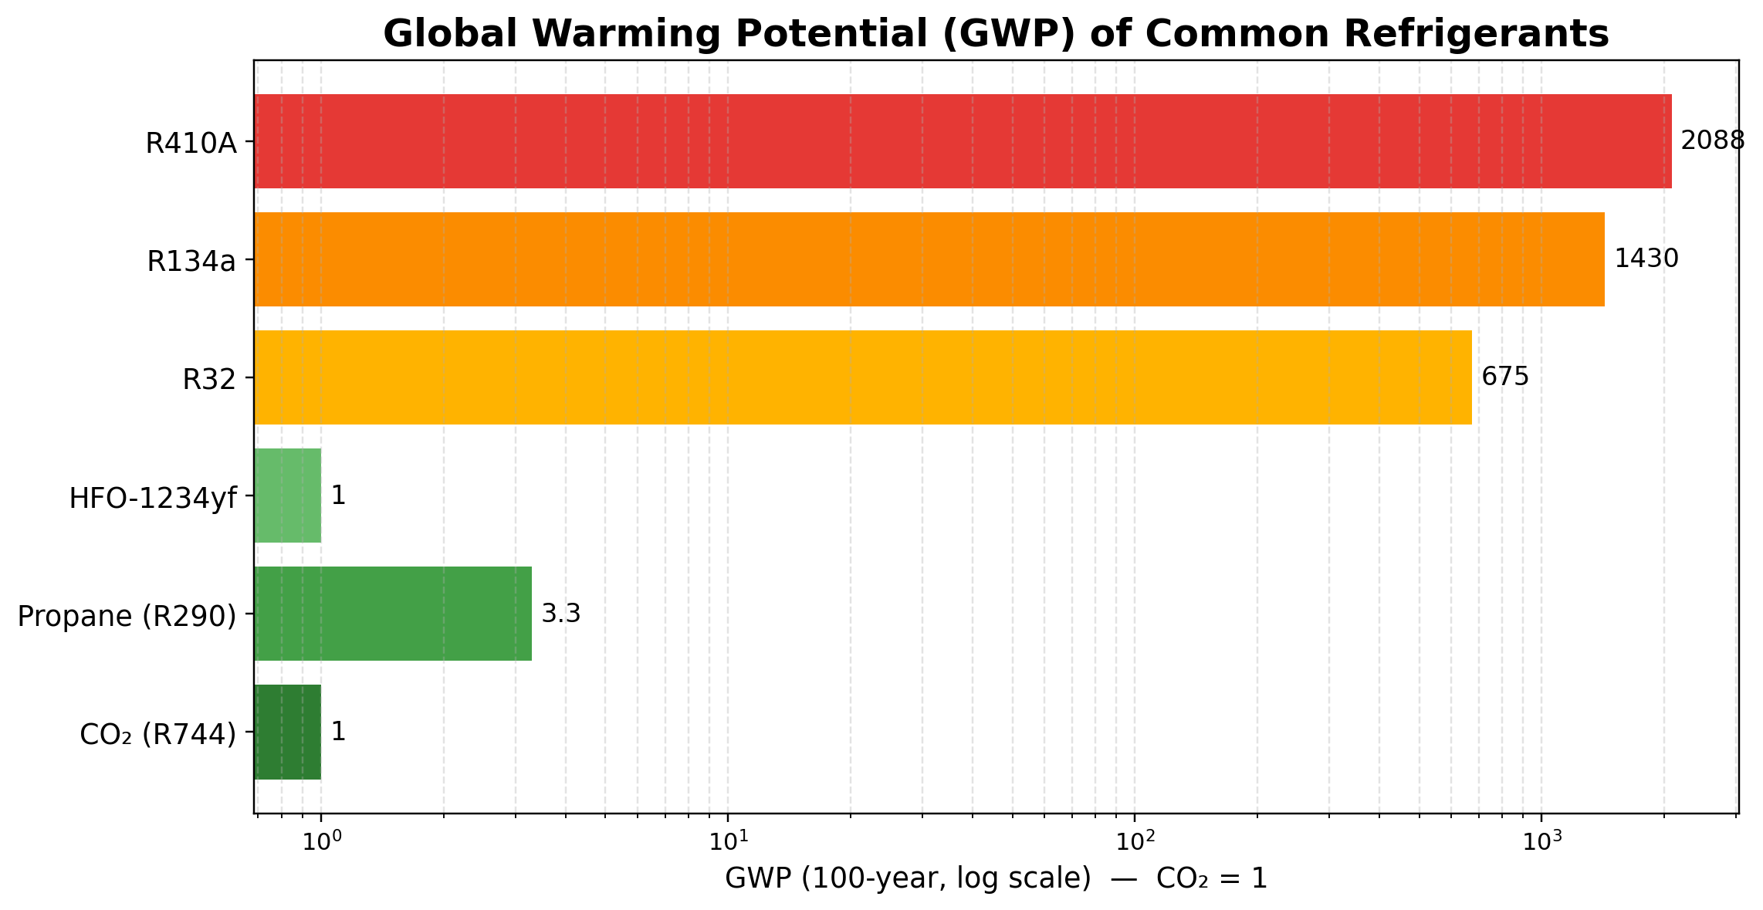
      Low GWP refrigerants (overview)
Notes:
Use log scale. Example: 1 kg R410A leak ≈ 2,088 kg CO₂e. Sources: US EPA GWP reference table; GHG Protocol IPCC GWP values.

Slide 6
      Low GWP refrigerants: What the families mean
HFOs: very low GWP (e.g. HFO‑1234yf) but often mildly flammable (A2L).
Hydrocarbons: very low GWP (e.g. propane R290) but higher flammability (A3) – low charge systems common.
Natural refrigerants: CO₂ (R744), ammonia (R717), water (R718) – low GWP but design/safety/pressure considerations.
Notes:
Link refrigerant choice to application, standards, and safe handling.

Slide 7
      Activity: Refrigerant match-up
In pairs: match each refrigerant family to the best “use case”.
Choose: split AC, supermarket refrigeration, heat pump, vehicle AC, data centre, cold room.
Discuss: performance needs, safety, pressures, and environmental impact.
Share back: 1 minute per pair.

Slide 8
      Powering AC with renewable/low-pollution electricity
The carbon impact of 1 kWh depends on how the electricity is generated.
Fossil fuels are carbon intensive; renewables are “carbon-free” at generation.
Using cleaner electricity + efficient equipment cuts operational emissions.
Notes:
Introduce “carbon intensity (gCO₂/kWh)” and daily variation. Source: NESO carbon intensity dashboard

Slide 9
      How can a site use cleaner electricity?
On-site generation: solar PV, wind (where feasible).
Procurement: renewable tariff, power purchase agreement (PPA).
Operational strategy: shift cooling to times of lower grid carbon intensity (pre‑cooling, thermal storage).

Slide 10
Mini task: Carbon savings from cleaner electricity
A classroom uses 12 kWh for cooling in an afternoon.
Estimate CO₂ savings if carbon intensity drops from 200 gCO₂/kWh to 50 gCO₂/kWh.
Convert gCO₂/kWh to kgCO₂/kWh
Multiply by 12 kWh
Compare totals
Notes:
Activity: 10 mins
Answer: 2.4 kg CO₂ vs 0.6 kg CO₂ → saving 1.8 kg CO₂.
Method:
1. Convert gCO₂/kWh to kgCO₂/kWh
200 gCO₂/kWh = 0.200 kgCO₂/kWh
50 gCO₂/kWh = 0.050 kgCO₂/kWh
2. Multiply by 12 kWh
Before:
0.200 kgCO₂/kWh × 12 kWh = 2.4 kg CO₂
After:
0.050 kgCO₂/kWh × 12 kWh = 0.6 kg CO₂
3. Compare totals
CO₂ savings = 2.4 kg − 0.6 kg = 1.8 kg CO₂ saved

Slide 11
      Heat recovery: Stop wasting useful heat
Cooling moves heat from indoors to outdoors — that heat can sometimes be reused.
Heat recovery captures waste heat for hot water or space heating.
Best when a building needs cooling in one place and heat in another (zone diversity).
Notes:
Source: US DOE waste heat recovery basics.

Slide 12
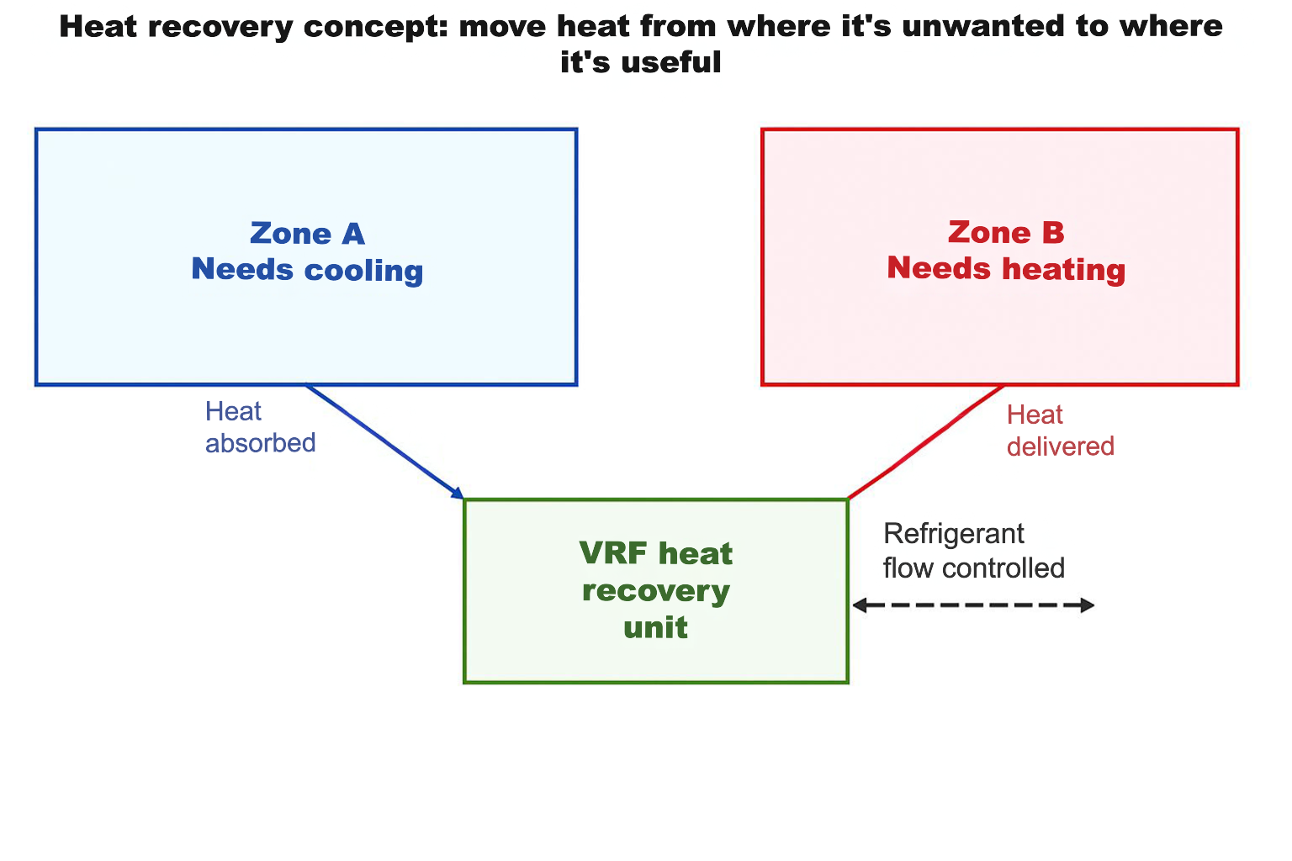
      Heat recovery example: VRF
Notes:
Explain “simultaneous heating and cooling”. Source: Mitsubishi Electric heat recovery article.

Slide 13
      Heat recovery chillers (heat reclaim)
A chiller rejects heat at the condenser — heat reclaim uses that heat for hot water.
Useful for: hotels, leisure centres (pools), hospitals, campuses.
Maintenance: keep heat exchangers clean; water treatment; sensors calibrated.
Notes:
Source: Carrier heat reclaim guidance.

Slide 14
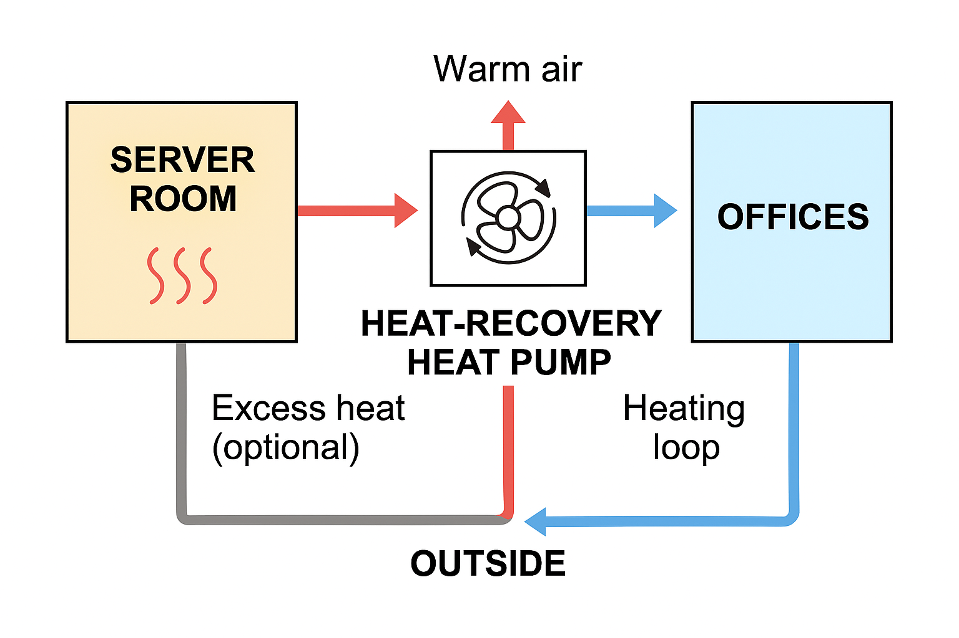
      Activity: Plan a heat recovery opportunity
You have a building with a server room (cooling all year) and offices (heating in winter).
How would you use heat recovery?
Sketch a block diagram (zones + heat recovery unit).
List 3 benefits and 2 challenges (controls, sizing, pipework, commissioning).
Share 1 idea with the class.
Notes:
Timing: 15 min.
Server room → heat pump → heating loop → office heating

Slide 15
      Maintenance actions that reduce emissions
Leak detection + prompt repair reduces direct emissions.
Clean coils/filters to reduce compressor work.
Correct refrigerant charge, airflow and controls tuning improves efficiency.
Record data (kWh, temps, pressures) to spot drift early.

Slide 16
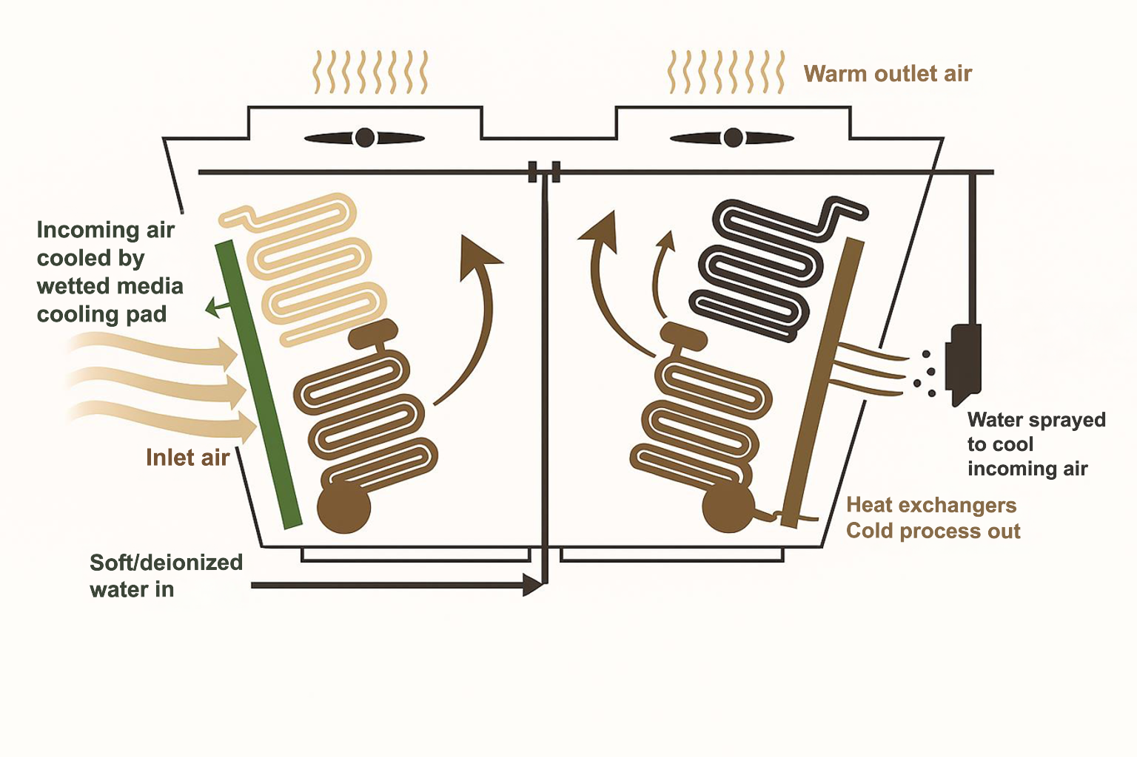
      Adiabatic cooling (evaporative pre-cooling)
Uses evaporation of water to cool incoming air before it hits a coil/heat exchanger.
Improves heat rejection on hot days → can reduce fan/compressor energy.
Water is used only when needed (many systems run dry most of the year).
Notes:
Source: Güntner adiabatic cooling overview.
Good websites and images to reference:
https://www.researchgate.net/figure/Psychrometric-chart-showing-adiabatic-cooling-in-a-two-stage-cool-tower-in-which-air_fig11_223628349
https://www.bds-energy.com/how-do-adiabatic-cooling-systems-work/

Slide 17
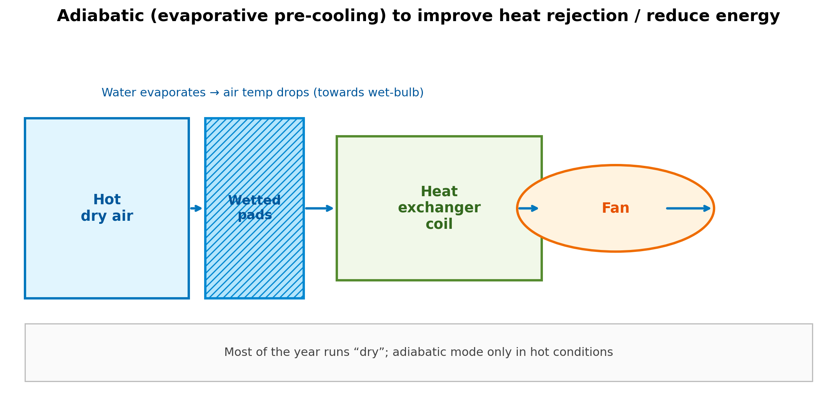
      How adiabatic pre-cooling works
Notes:
Explain climate dependence. Source: Chem-Aqua adiabatic explainer.

Slide 18
      Where is adiabatic cooling suitable?
Best in hot, dry climates (low humidity) – biggest temperature drop possible.
Less effective in humid climates (smaller wet‑bulb depression).
Often used as “trim cooling” for condensers/dry coolers on peak days.
Notes:
Timing: 8 min. Quick sketch demo. Keep safe and conceptual.

Slide 19
      Activity: Climate check
In groups: choose 2 UK locations and 2 global locations where adiabatic cooling would be most effective.
Explain why this would be, using “humidity” and “wet-bulb”.
Pick locations (e.g. London, Cardiff, Dubai, Madrid, Singapore).
Rank most → least suitable.
Share your ranking and reasoning.
Notes:
Timing: 12 min.

Slide 20
      Designing hardware for longer life
Robust materials + corrosion protection (especially coastal/industrial sites).
Serviceability: accessible filters, coils, fans, sensors.
Modular components + documentation to speed repairs.
Plan for replacement parts availability (avoid premature end-of-life).
Notes:
EU policy context: Directive on repair of goods promotes repair and spare parts access.

Slide 21
      Guarantees and replacement parts: Why it matters
Parts unavailable → early replacement → more waste and embodied carbon.
Repair-friendly design supports circular economy.
Keep records: model/serial, parts list, service history.

Slide 22
      Reducing demand: Insulation and building fabric
Lower heat gain = less cooling needed.
Improving insulation and airtightness cuts cooling loads and peak demand.
Improves comfort and resilience during heatwaves.
Notes:
Sources: GOV.UK internal wall insulation guide; RICS retrofit guidance.

Slide 23
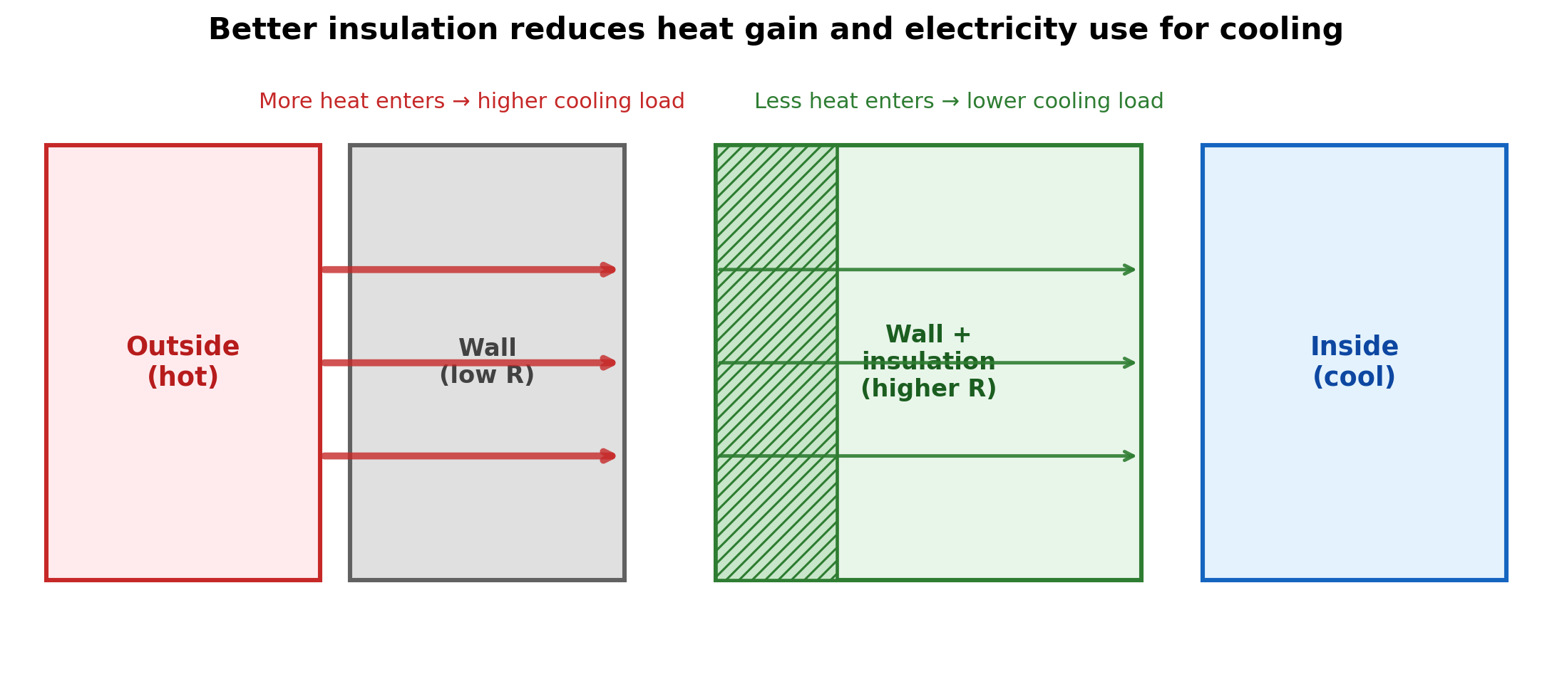
      Insulation reduces cooling load

Slide 24
      Activity: Insulation → cooling energy
Cooling demand drops by 15% after insulation + shading.
If it used 20 kWh/day, what is the new usage and daily savings?
Calculate 15% of 20 kWh
Subtract from 20 kWh
Give one maintenance implication
Notes:
Timing: 8 min.
Answer: new use 17 kWh/day; saving 3 kWh/day.

Slide 25
      Putting it together: Carbon reduction checklist
Use low‑GWP refrigerants suited to the application (and manage safety).
Maximise efficiency through design + commissioning + maintenance.
Use renewable/low-carbon electricity where possible.
Capture and reuse waste heat (heat recovery).
Reduce demand with insulation and good building fabric.
Notes:
.

Slide 26
      Quick check
1. Why does switching from R410A to a low‑GWP option reduce climate impact?
2. Give two ways renewable electricity can power AC systems.
3. Describe one example of heat recovery in air conditioning.
4. Why does adiabatic cooling work better in dry climates?
5. Explain how insulation can allow for smaller AC equipment.
Notes:
Answers on next slide

Slide 27
      Quick check – answers
1. If the refrigerant leaks, low‑GWP gases warm the planet much less than R410A. Some also make the AC use less electricity.
2. Solar panels on the building (optionally with a battery). Buy 100% renewable electricity from your energy supplier (green tariff/PPA).
3. A heat exchanger uses the warm air leaving the building to pre‑warm the fresh air coming in (or pre‑cool it in summer).
4. Dry air can absorb more water, so more evaporation happens and that causes more cooling.
5. Good insulation keeps heat out, so the building needs less cooling. With a smaller load, you can pick a smaller AC unit.

Slide 28
      Activity: Payback period
Calculate the Payback Period if a high-efficiency inverter system costs £500 more than a fixed-speed system but it saves £150 a year in electricity.
How long until the customer breaks even?
Notes:
Timing: 10 min.

Slide 29
      Activity answers
Given: Additional cost of high‑efficiency inverter: £500
Yearly electricity savings: £150 per year
Method: The payback period tells you how long it takes for yearly savings to equal the extra upfront cost.
Payback Period = Extra Cost
Annual Savings
​Substituting the numbers:
Payback Period = £500 = 3.33 years
£150
Answer: Break even in approximately 3.3 years (about 3 years and 4 months).
Notes:
Timing: 10 min.

Slide 30
      Summary
You should now be able to:
Explain how low GWP refrigerants, renewable electricity and heat recovery reduce carbon footprint.
Describe when adiabatic cooling is suitable and why climate matters.
Identify design and maintenance choices that extend equipment life and cut waste.
Explain how better building insulation reduces cooling load and electricity use. ​
Notes:
Timing: 3–4 min. Ask learners: ‘one thing you learned’ + ‘one question you still have’.

Slide 31
Any questions?
Copyright in this document belongs to and is used under licence from the Department for Education, © 2025.
‘T-LEVELS’ and ‘T Level’ are registered trademarks of the Department for Education.
WJEC is authorised by the Department for Education to develop and deliver this T Level Technical Qualification.
WJEC operates in England under the name Eduqas which is a registered trademark of WJEC.

