Slide 1
Occupational Specialism: Air Conditioning Engineering
K1.8 Supply and storage of energy from renewable resources
PowerPoint 1.8: Energy supply and storage

Slide 2
Objectives
By the end of this session, you should be able to:
Describe how energy is supplied from a range of renewable resources​.
Explain turbine → generator principles for wind, hydroelectric and tidal power.​
Describe electricity generation using biofuels and waste-to-energy systems.​
Explain battery and thermal storage and how they support renewable supply​.
Explain DSR/DSM and propose flexibility actions for HVAC/cooling systems​.
Notes:
Success criteria: Learners can draw and explain 3 supply pathways + 2 storage pathways and apply them to a cooling scenario.

Slide 3
Starter: What powers cooling?
Think–Pair–Share (5 min):
1) Where does the electricity for an air conditioner come from? 2) Why might a low‑carbon grid change how we design/operate HVAC? 3) What’s the difference between saving energy and shifting energy?
Notes:
Timing: 7–8 min. Capture misconceptions: ‘renewables always available’, ‘storage creates energy’, etc.

Slide 4
Key terms
Power (kW) vs energy (kWh).
Renewable resource, intermittency, capacity factor.
Generation vs. storage vs. flexibility.
Solar PV (electricity for the compressor) vs. solar thermal (hot water/absorption cooling).
Demand Side Response (DSR) / Demand Side Management (DSM).
Notes:
Prompt examples: AC nameplate (kW) vs. daily energy use (kWh).

Slide 5
Why this matters (UK context)
Reducing heat gain is the first step in energy efficiency. Typical examples are:
use of insulation
solar shading techniques
low-emissivity glazing
minimising air leakage.
Notes:
Tutor references (for notes/handout):
• GOV.UK ‘Clean Power 2030 Action Plan’ (updated 15 Apr 2025)
• National Grid explainer on UK renewables mix

Slide 6
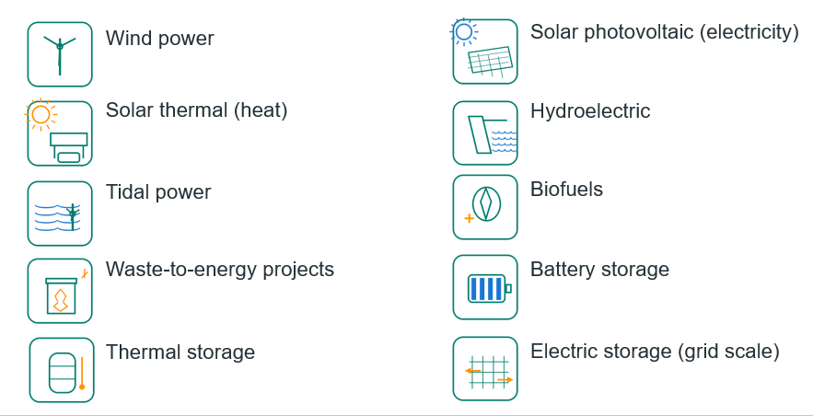
Renewable supply & storage (overview)
Notes:
Timing: 3 min. Explain we will cover each and keep linking back to cooling systems.

Slide 7
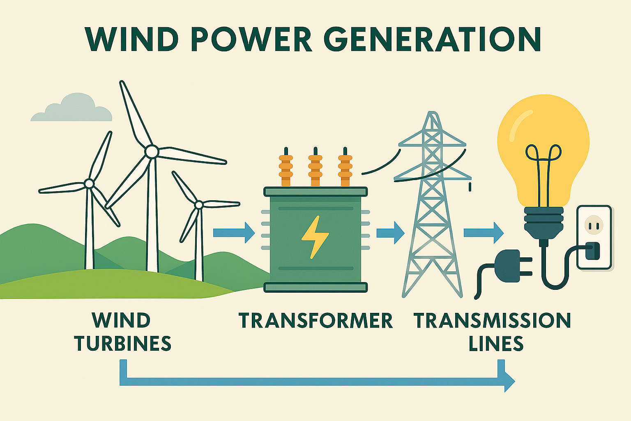
Wind power: supply
Turbines convert kinetic energy in moving air into rotation, then electricity via a generator.
Output varies with wind speed; best sites have strong wind resource + grid connection.
Typical scales: onshore wind farms and offshore wind.
HVAC link: windy nights can mean low-carbon electricity—opportunity to shift loads.
Notes:
Timing: 6–8 min. Add a local example and ask: how does this relate to cooling demand?

Slide 8
Solar power: two routes
Solar PV: sunlight → electricity (DC), then an inverter makes AC.
Solar thermal: sunlight → heat to warm water/fluids (hot water, process heat, absorption cooling).
Daily pattern is predictable; weather and seasons change output.
Often paired with storage to use energy beyond daylight.
Notes:
Timing: 6–8 min. Add a local example and ask: how does this relate to cooling demand?

Slide 9
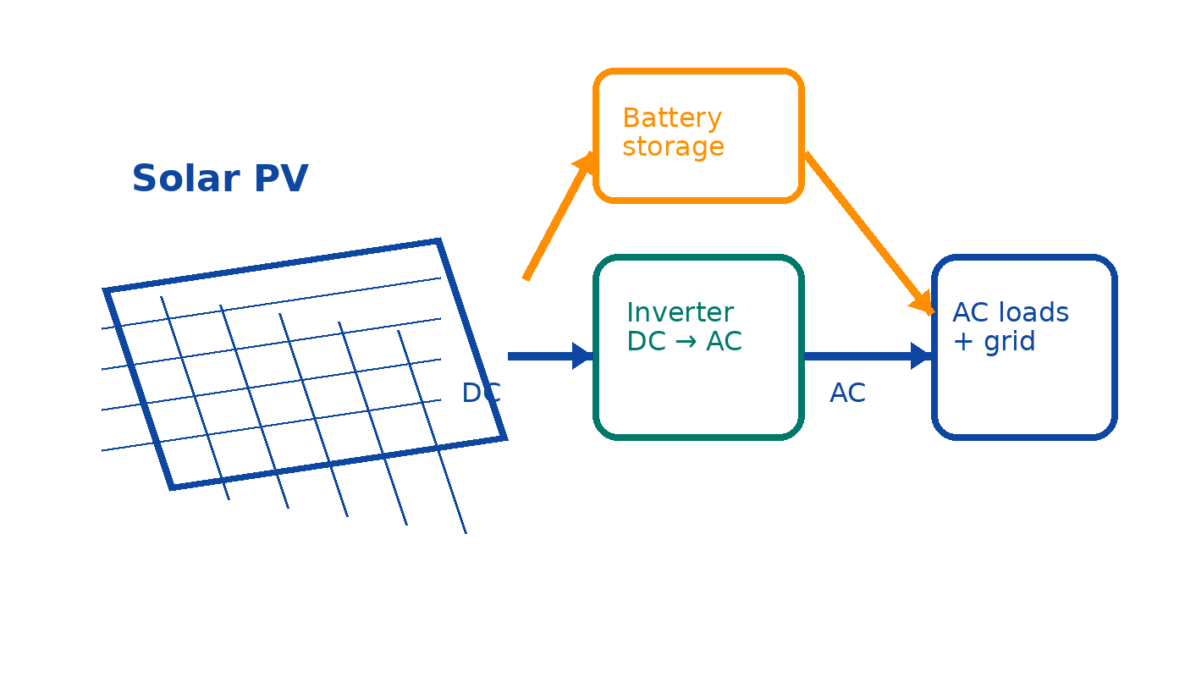
Solar PV: electricity + storage
Notes:
Timing: 6 min. Explain DC/AC and inverter. Use Energy Saving Trust solar PV explanation in tutor handout.

Slide 10
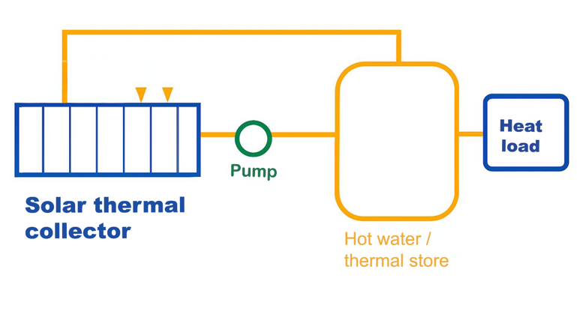
Solar thermal: heating water/fluids
Notes:
Timing: 5 min. Use Energy Saving Trust solar water heating description in tutor handout.

Slide 11
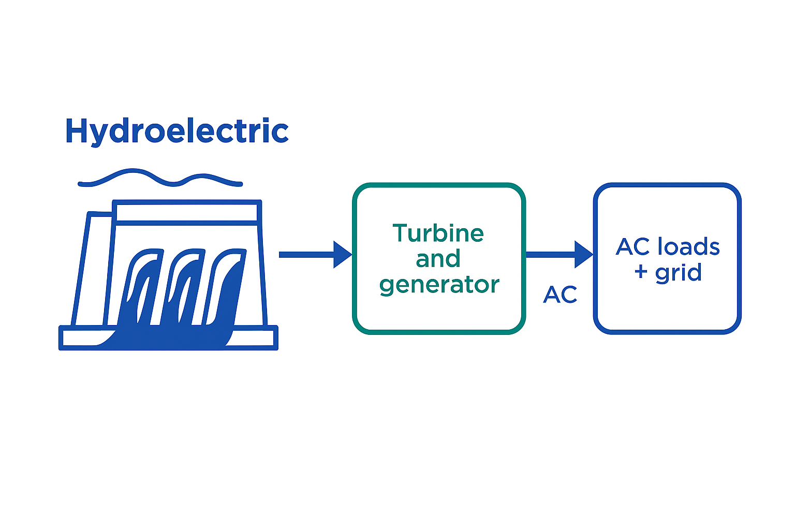
Hydroelectric power
Flowing/falling water turns a turbine; generator converts rotation to electricity.
Run-of-river has limited storage; reservoirs and pumped storage add flexibility.
Fast response can help balance the grid.
Same turbine→generator principle as tidal systems.
Notes:
Timing: 6–8 min. Add a local example and ask: how does this relate to cooling demand?

Slide 12
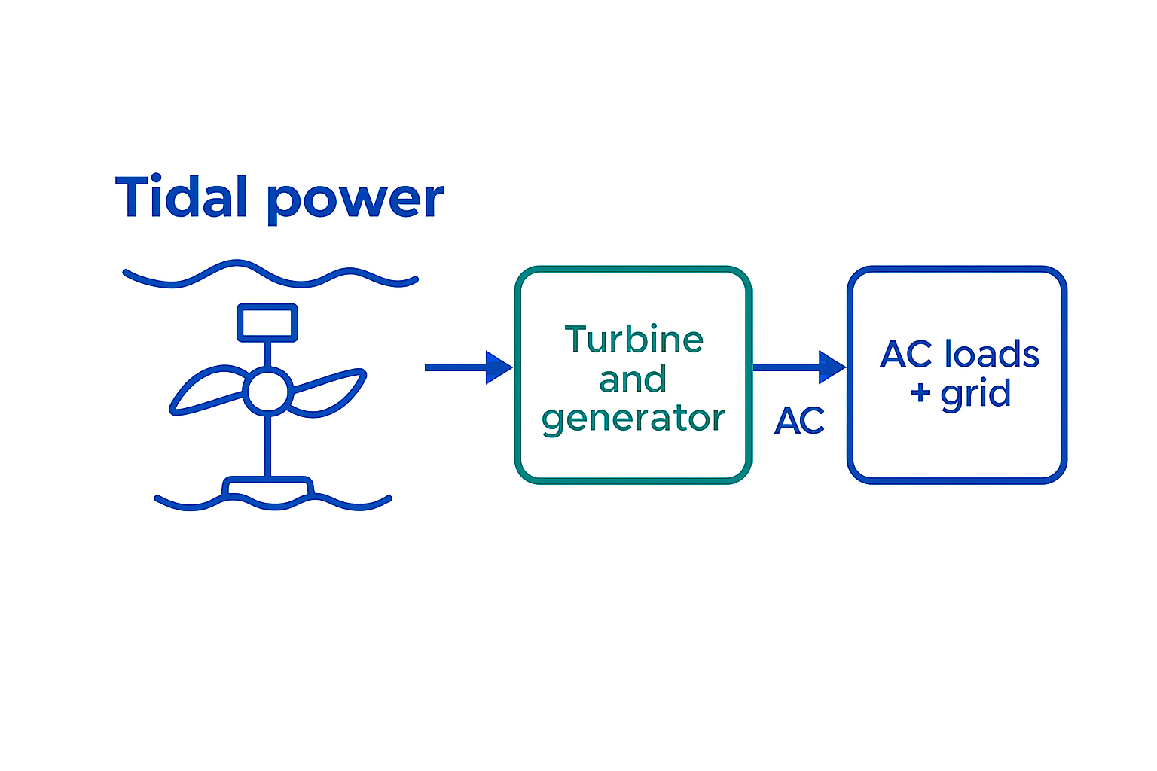
Tidal power
Tidal stream: underwater turbines in fast currents.
Tidal range: barrages/lagoons use height difference between high and low tide.
Predictable cycles help planning.
Challenges: marine maintenance, corrosion, ecology.
Notes:
Timing: 6–8 min. Add a local example and ask: how does this relate to cooling demand?

Slide 13
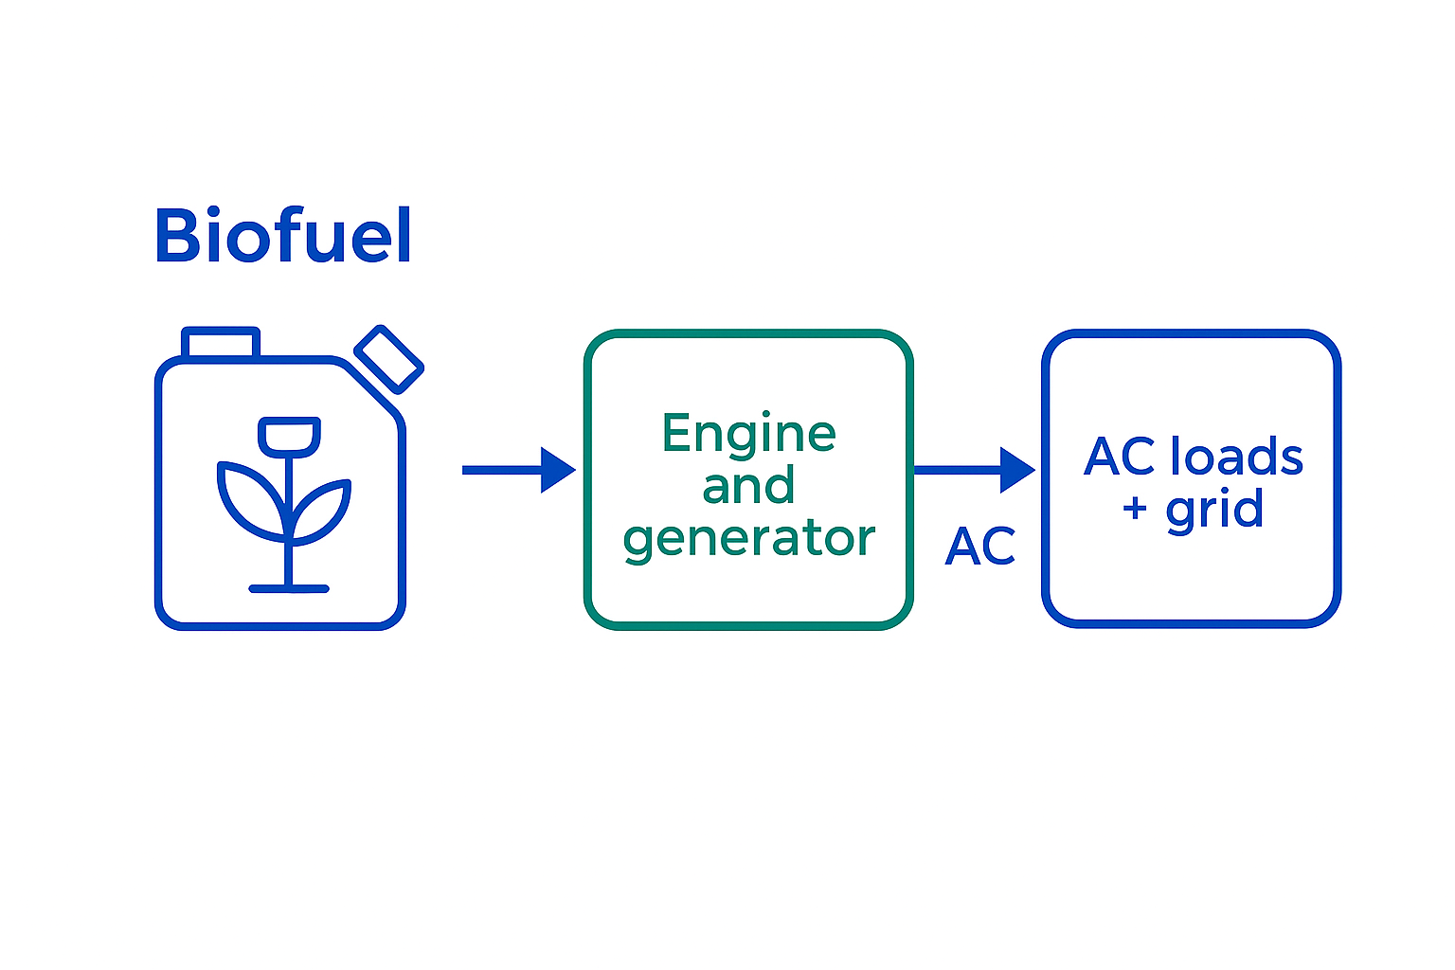
Biofuels
Store energy chemically in biomass (plants/waste-derived fuels).
Can be burned in engines/turbines to generate electricity (often CHP).
Dispatchable: can run when needed, but sustainability depends on feedstock.
Building services link: CHP heat can be used for absorption chillers.
Notes:
Timing: 6–8 min. Add a local example and ask: how does this relate to cooling demand?

Slide 14
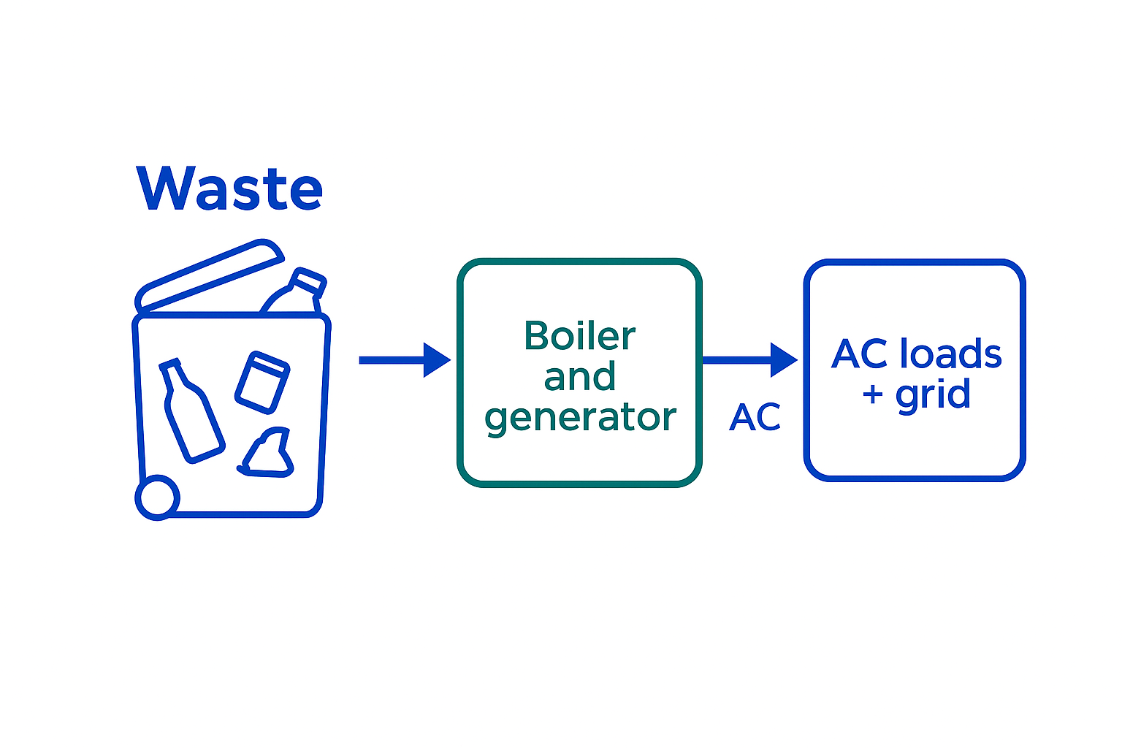
Waste-to-energy projects
Incineration with energy recovery: heat → steam → turbine → generator.
Anaerobic digestion: biogas → engine/turbine → generator.
Often used as CHP to boost overall efficiency.
Trade-offs: emissions control, waste hierarchy, local acceptance.
Notes:
Timing: 6–8 min. Add a local example and ask: how does this relate to cooling demand?

Slide 15
Knowledge check 1
1) Which makes electricity directly from sunlight: PV or solar thermal?
2) Name two renewables that use turbines connected to generators.
3) Give one reason storage is useful on a high-renewables grid.
4) True/False: DSR always means using less energy overall.

Slide 16
Knowledge check 1
Which makes electricity directly from sunlight: PV or solar thermal?
PV
2) Name two renewables that use turbines connected to generators.
Wind, hydro, tidal, wave, geothermal, steam turbines
3) Give one reason storage is useful on a high-renewables grid.
It smooths out variability
4) True/False: DSR always means using less energy overall.
False
Notes:
Answers. 1) Which makes electricity directly from sunlight: PV or solar thermal? PV (photovoltaic) makes electricity directly from sunlight. Solar thermal heats a fluid first, and that heat is then used to generate power. 2) Name two renewables that use turbines connected to generators. Examples include: Wind power Hydropower (Others: tidal, wave, geothermal, steam turbines) 3) Give one reason storage is useful on a high‑renewables grid. It smooths out variability – storing excess energy when wind/solar output is high and releasing it when output drops. (Other reasons: frequency stabilisation, peak‑shaving, reducing curtailment.) 4) True/False: DSR always means using less energy overall. False. Demand‑side response is mainly about shifting when energy is used, not necessarily reducing total consumption.

Slide 17
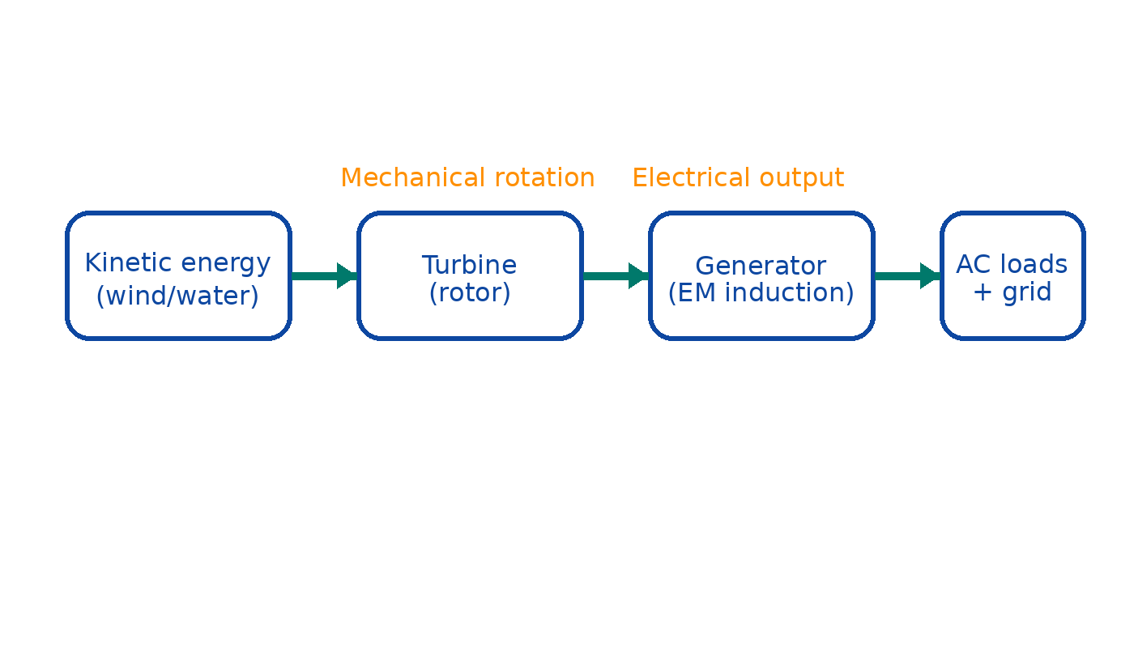
Mechanical generation of electricity: the core idea
Notes:
Timing: 8 min. Explain conversion chain + losses. Connect to wind/hydro/tidal.

Slide 18
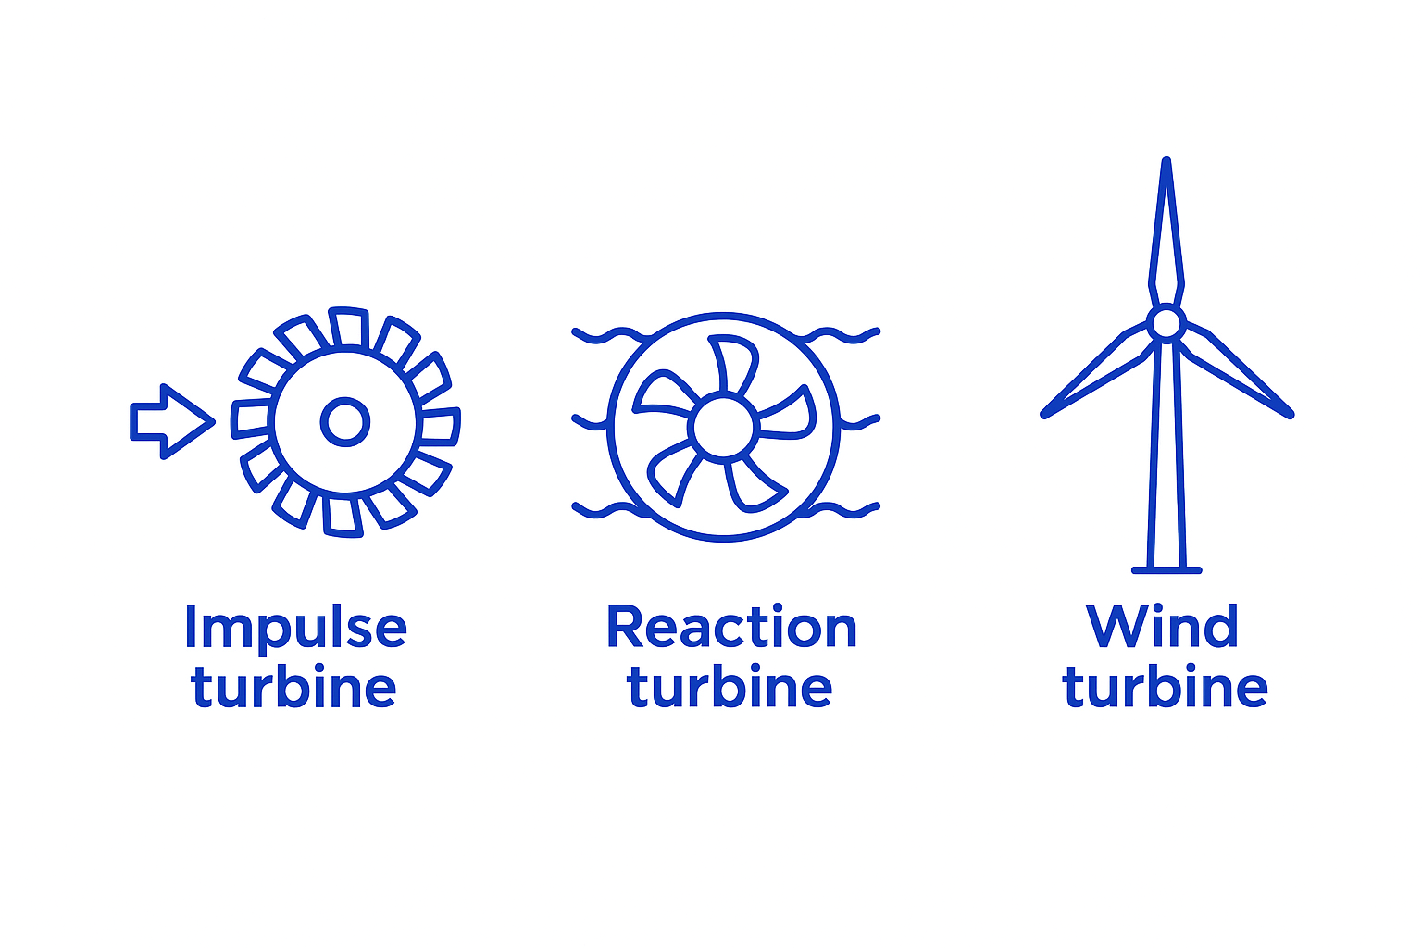
Turbines: converting flow to rotation
Impulse turbines: jets strike blades (often high-head hydro).
Reaction turbines: pressure drop across blades (common in hydro/tidal).
Wind turbines: aerofoil blades create lift → torque.
Key variables: flow speed, density, swept area, head, efficiency.
Notes:
Timing: 10 min. Extension: conceptual wind power relationship (v³).

Slide 19
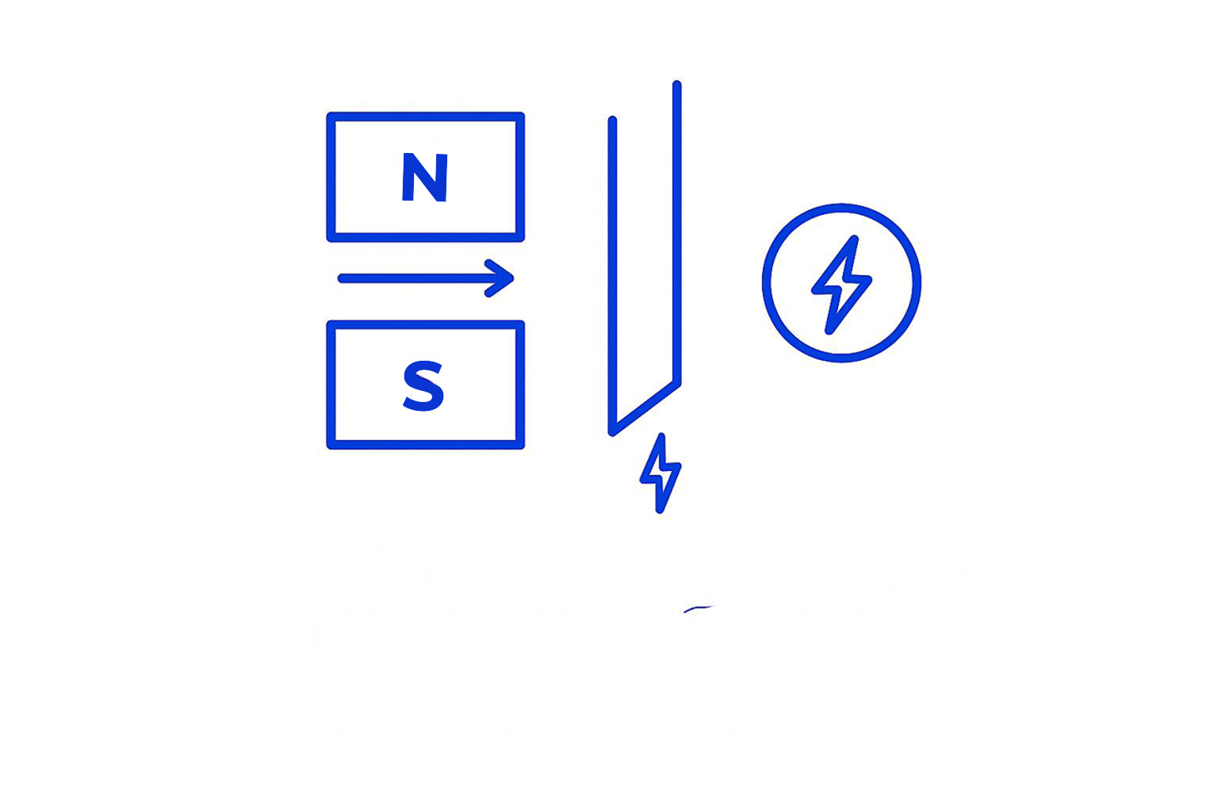
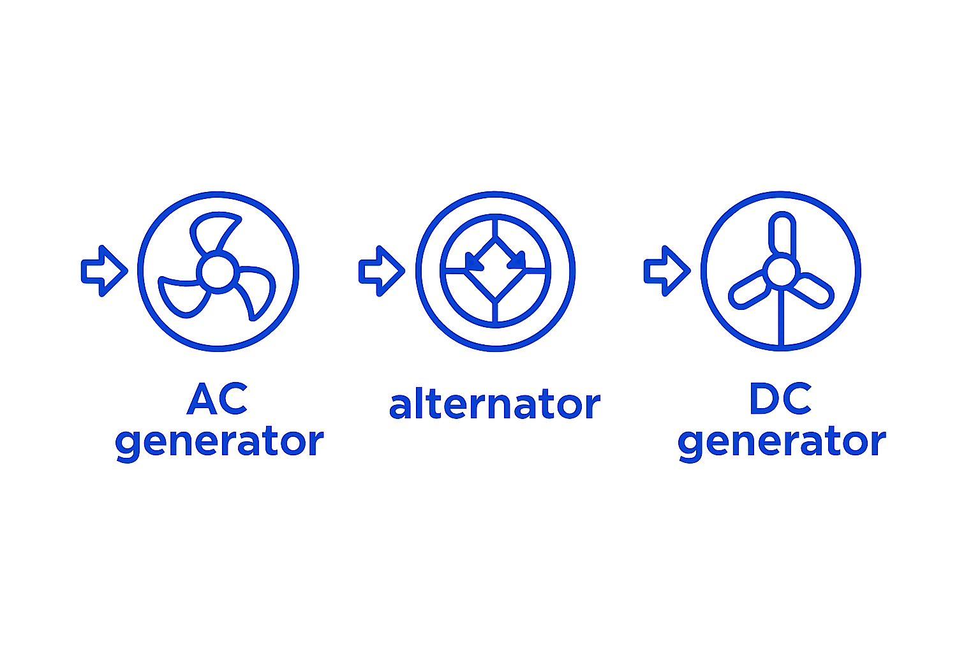
Generators: electromagnetic induction (simple view)
Moving a conductor in a magnetic field induces a voltage.
Rotation + coils + magnets → alternating current.
Grid frequency in GB is 50 Hz (speed control matters).
Power electronics help connect variable-speed renewables to the grid.
Notes:
Timing: 8 min. Quick sketch demo. Keep safe and conceptual.

Slide 20
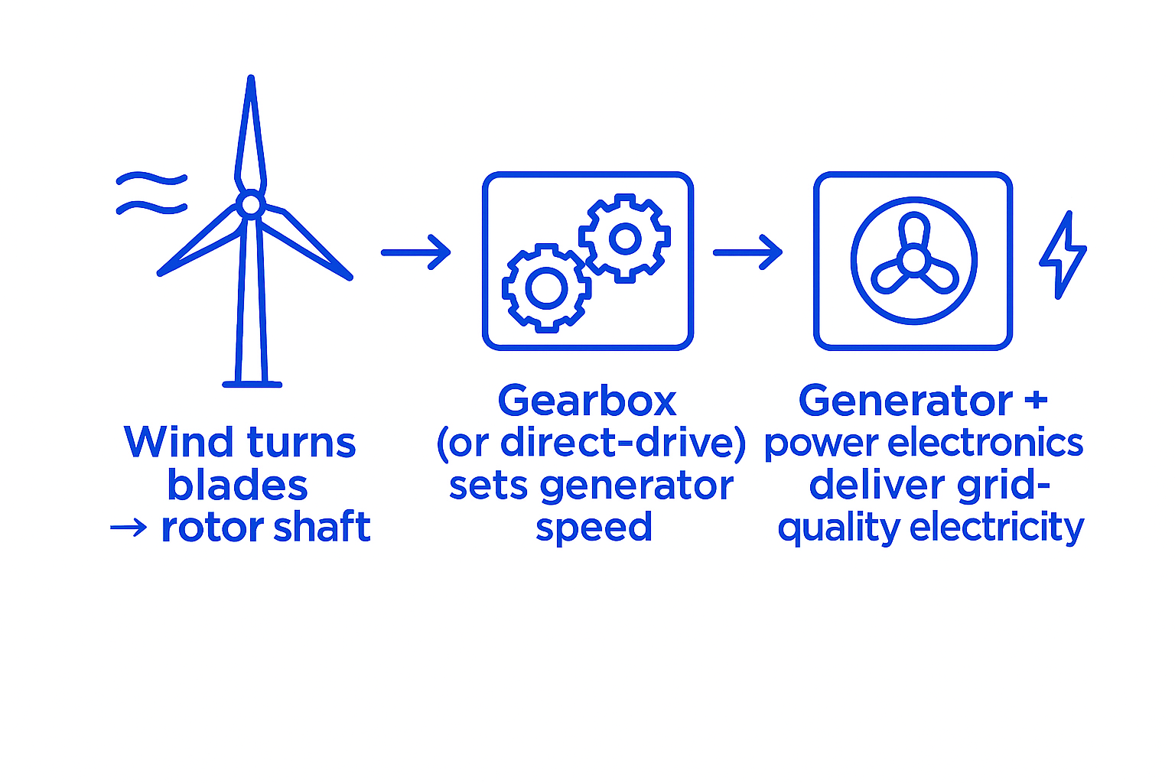
Wind power: mechanical → electrical pathway
Wind turns blades → rotor shaft.
Gearbox (or direct-drive) sets the generator speed.
Generator + power electronics deliver grid-quality electricity.
Controls: yaw, pitch, braking for safety.
Notes:
Timing: 7 min. Activity: learners label a turbine diagram on paper.

Slide 21
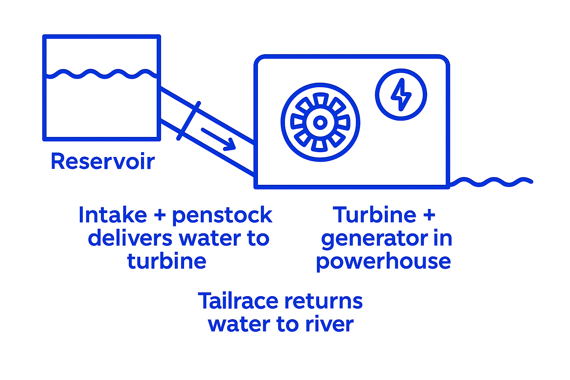
Hydroelectric: key components
Intake + penstock delivers water to the turbine.
Turbine + generator in powerhouse.
Tailrace returns water to the river.
Reservoir or pumped storage adds ‘energy shifting’ capability.
Notes:
Timing: 7 min. Extension: pumped storage works like a big ‘water battery’.

Slide 22
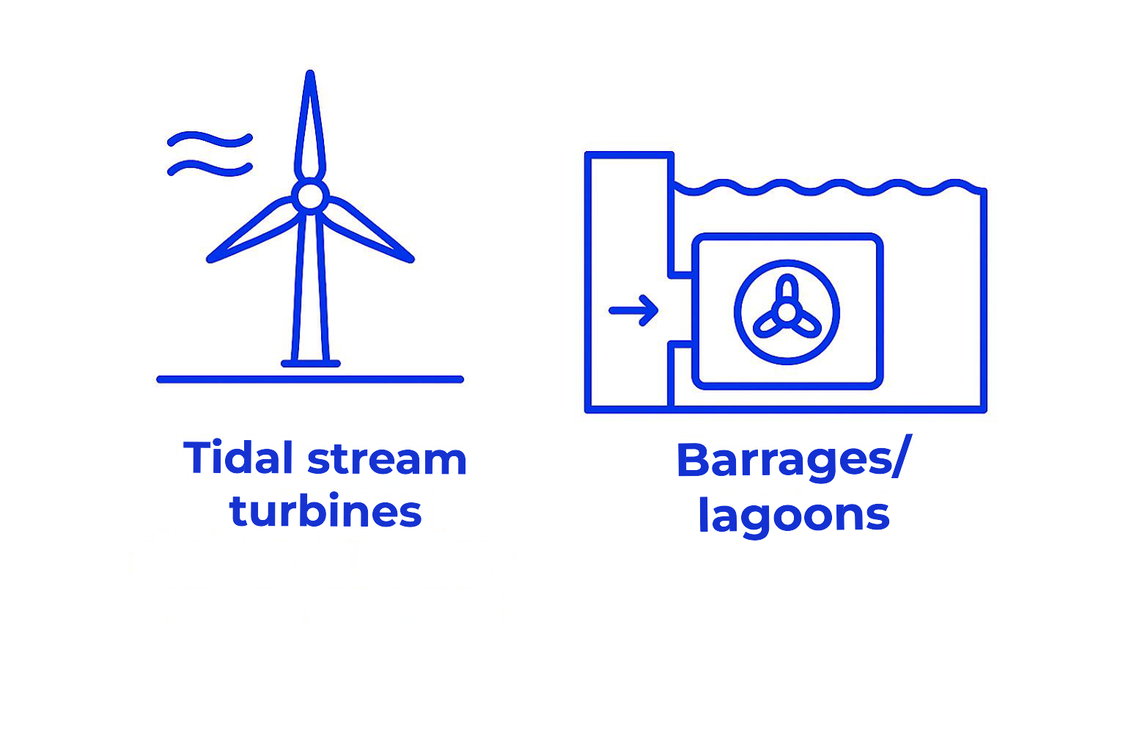
Tidal electricity: two approaches
Tidal stream turbines: similar to underwater wind turbines.
Barrages/lagoons: controlled flow through turbines.
Marine environment drives design (sealing, corrosion, maintenance).
Predictability supports planning and flexibility services.
Notes:
Timing: 7 min. Compare barrage vs. stream impacts.

Slide 23
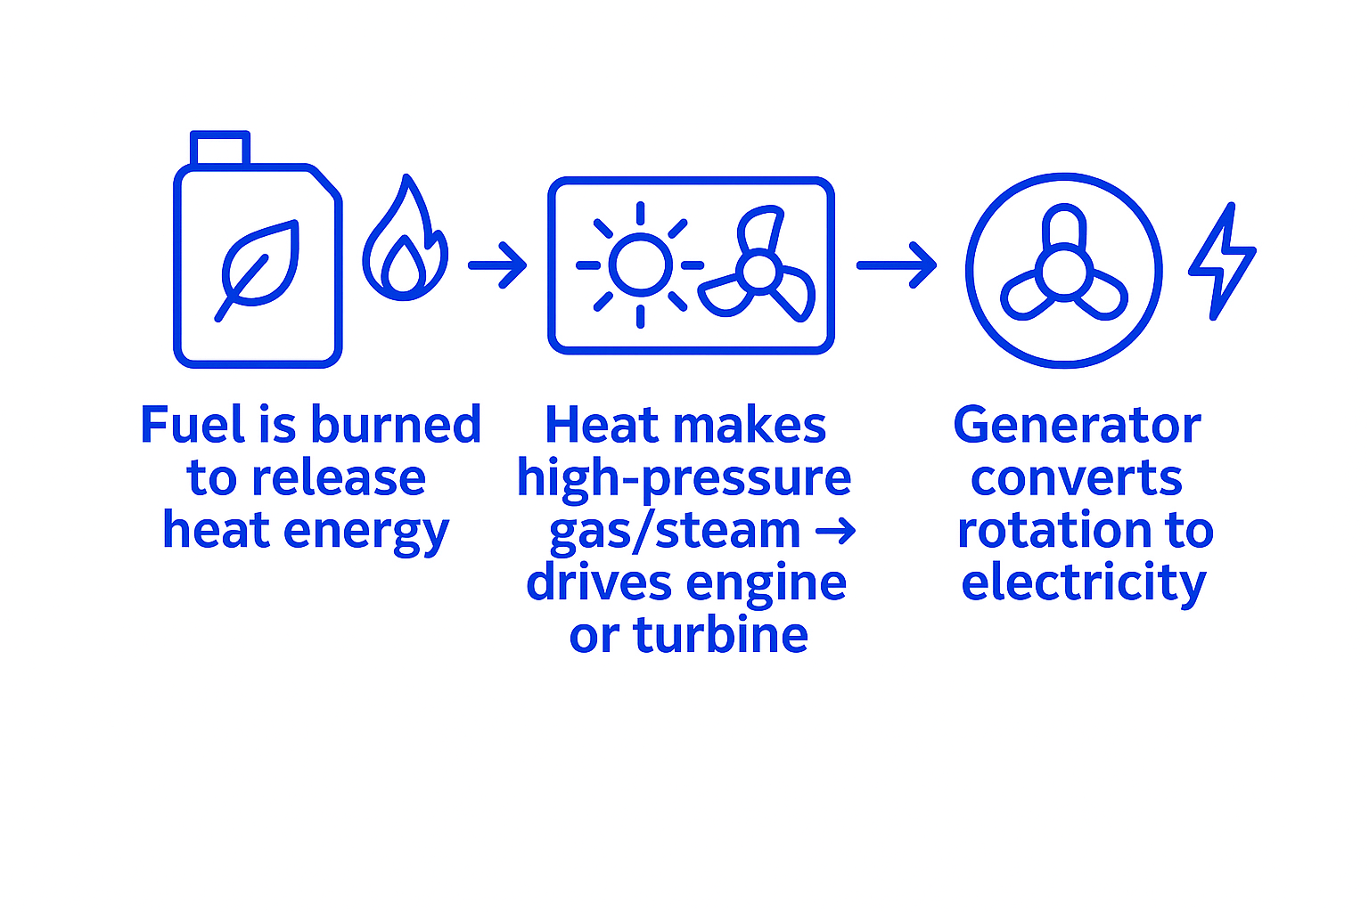
Mechanical generation with biofuels
Fuel is burned to release heat energy.
Heat makes high-pressure gas/steam → drives engine or turbine.
Generator converts rotation to electricity.
CHP uses waste heat: higher overall efficiency
.
Notes:
Heat recovery systems can also assist in moisture control, especially in humid environments like pools.

Slide 24
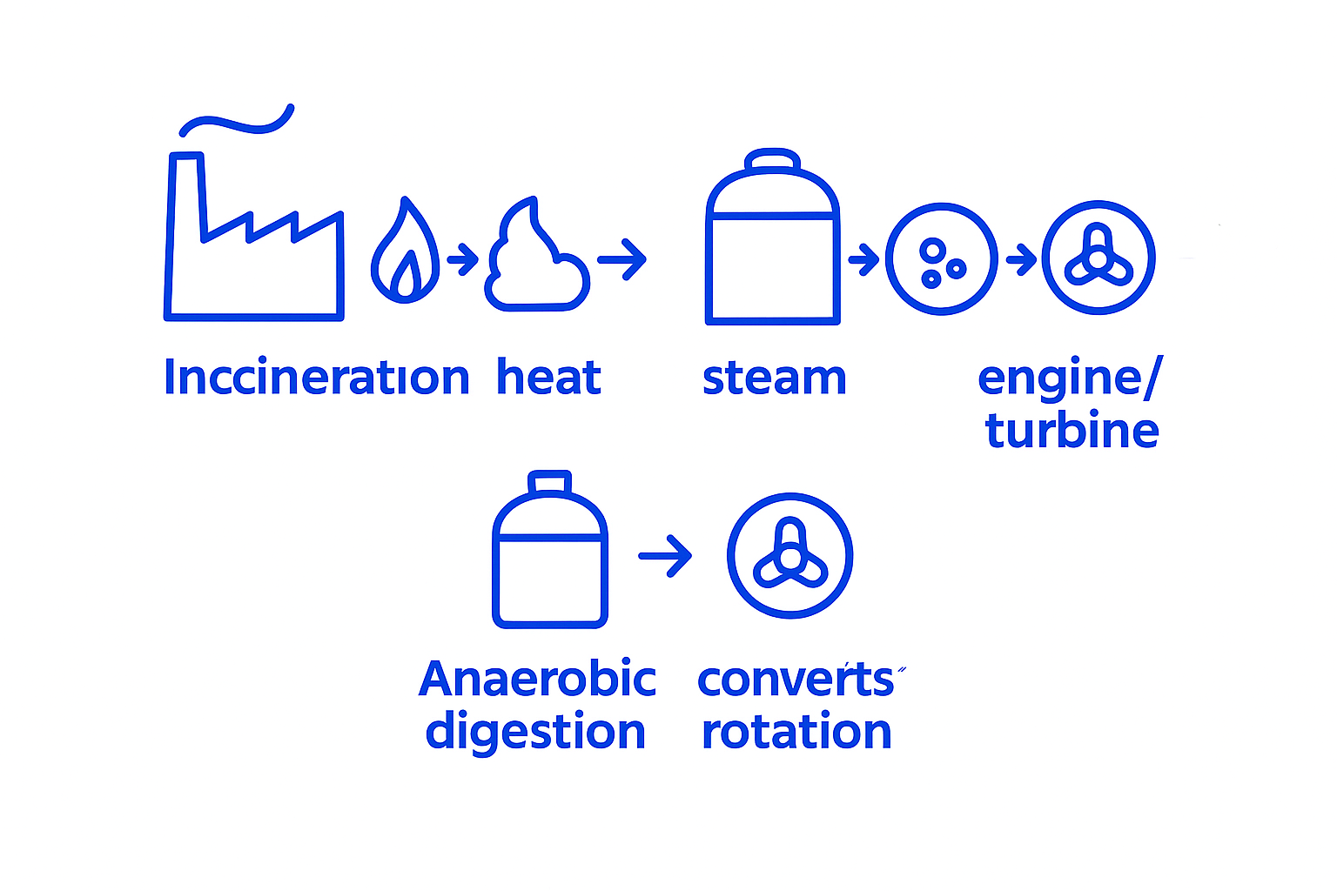
Mechanical generation with waste-to-energy
Incineration: heat → steam → steam turbine → generator.
Anaerobic digestion: biogas → engine/turbine → generator.
Energy recovery is improved with CHP and district heat.
Discuss sustainability: waste hierarchy and emissions control.
Notes:
Timing: 8 min. Prompt: where does the ‘waste heat’ go if not recovered?

Slide 25
Activity: Draw the energy pathway
In groups, choose 2 renewable supplies and 1 storage method. On A3 paper, draw a block diagram showing: • Energy source → conversion steps → electricity/heat output. • Where losses occur. • How you could use it to support a cooling system. Be ready to explain in 60 seconds.
Notes:
Timing: 10–12 min. Circulate, prompt correct use of terms (kW/kWh). Use peer feedback.

Slide 26
Why storage matters
Wind and solar are variable: supply doesn’t always match demand.
Storage absorbs excess energy and releases it later (time-shifting).
Supports grid stability services (e.g. fast response).
Storage can be grid-scale or behind-the-meter (buildings).
Notes:
Timing: 6 min. Use IEA batteries report in tutor notes to show importance of batteries.

Slide 27
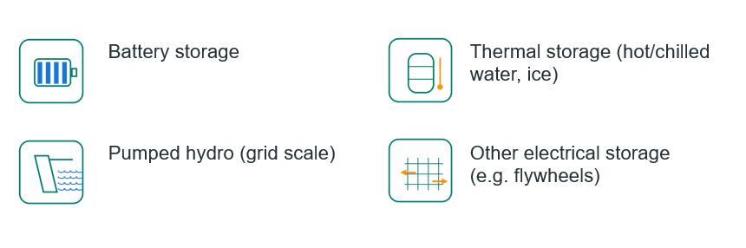
Storage options (focus for HVAC)
Notes:
Timing: 4 min. Emphasise batteries + thermal stores are most relevant to buildings.

Slide 28

Battery storage: how it works
Stores energy chemically; charging moves ions/electrons into higher-energy states.
Discharging reverses the reaction, producing electrical current.
Systems include inverter + Battery Management System (BMS).
Uses: energy shifting, peak shaving, backup, frequency response.
Notes:
Timing: 10 min. Link to PV + batteries at homes and colleges.

Slide 29
Storing daylight PV: PV + battery + inverter
Notes:
Timing: 7 min. Ask: when would you charge/discharge if you want low-cost/low-carbon cooling?

Slide 30

Thermal storage: storing heat or ‘cold’
Stores energy as temperature change (sensible heat) or phase change (latent heat).
Examples: hot water cylinders, thermal stores, chilled water tanks, ice storage.
Often cheaper per kWh than batteries (depends on use case).
Very relevant to HVAC: you can store cooling capacity.
Notes:
Use these questions to review key concepts. Encourage discussion or short written answers.

Slide 31
Other electrical storage (overview)
Pumped hydro: uses electricity to pump water uphill; later generates electricity when released.
Flywheels: store energy as rotation; very fast response, short duration.
Compressed air / liquid air storage: store energy in pressurised/cryogenic form.
Hydrogen: electricity → hydrogen (electrolysis) → later electricity/heat (longer-term).
Notes:
Timing: 6 min. Keep at overview level; focus remains batteries + thermal for this lesson.

Slide 32
DSR/DSM: what do they mean?
DSM (Demand Side Management): broad strategies to reduce or shift demand over time.
DSR (Demand Side Response): short-term, flexible changes in electricity use in response to a signal.
Signals can be price (time-of-use), carbon intensity, or a direct request/event.
Key idea: balancing supply and demand can be helped by moving demand, not just building more generation.
Notes:
Timing: 8 min. Tutor references: Ofgem DSR discussion paper; UK Parliament POSTnote on DSR; NESO flexibility intro.

Slide 33
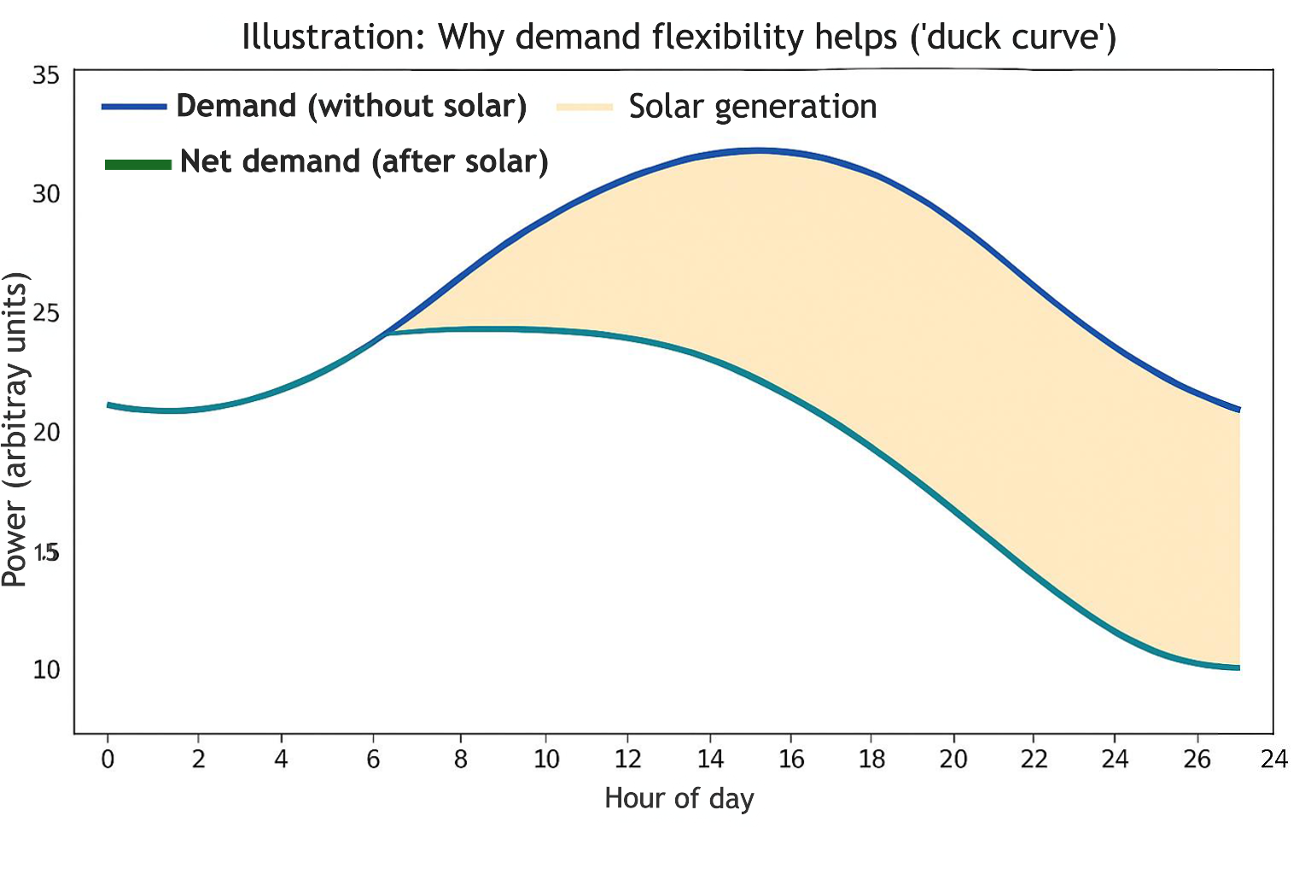
Why flexibility matters: net demand can change fast
Notes:
Timing: 6 min. Ask: where are steep ramps? Which assets could respond? Link to cooling loads and storage.
.

Slide 34
How HVAC can provide flexibility
Examples:
Pre-cool or pre-heat within comfort limits before peak periods.
Use thermal mass (building fabric) as short-term storage.
Shift non-critical loads (e.g. ice-making, chilled-water charging) to off-peak.
Optimise setpoints and schedules using smart controls and occupancy.
Coordinate with on-site PV + batteries to reduce grid import during peaks.
Notes:
Timing: 10 min. Emphasise maintaining comfort/IAQ/safety. Discuss ‘constraints’ and measurement.

Slide 35
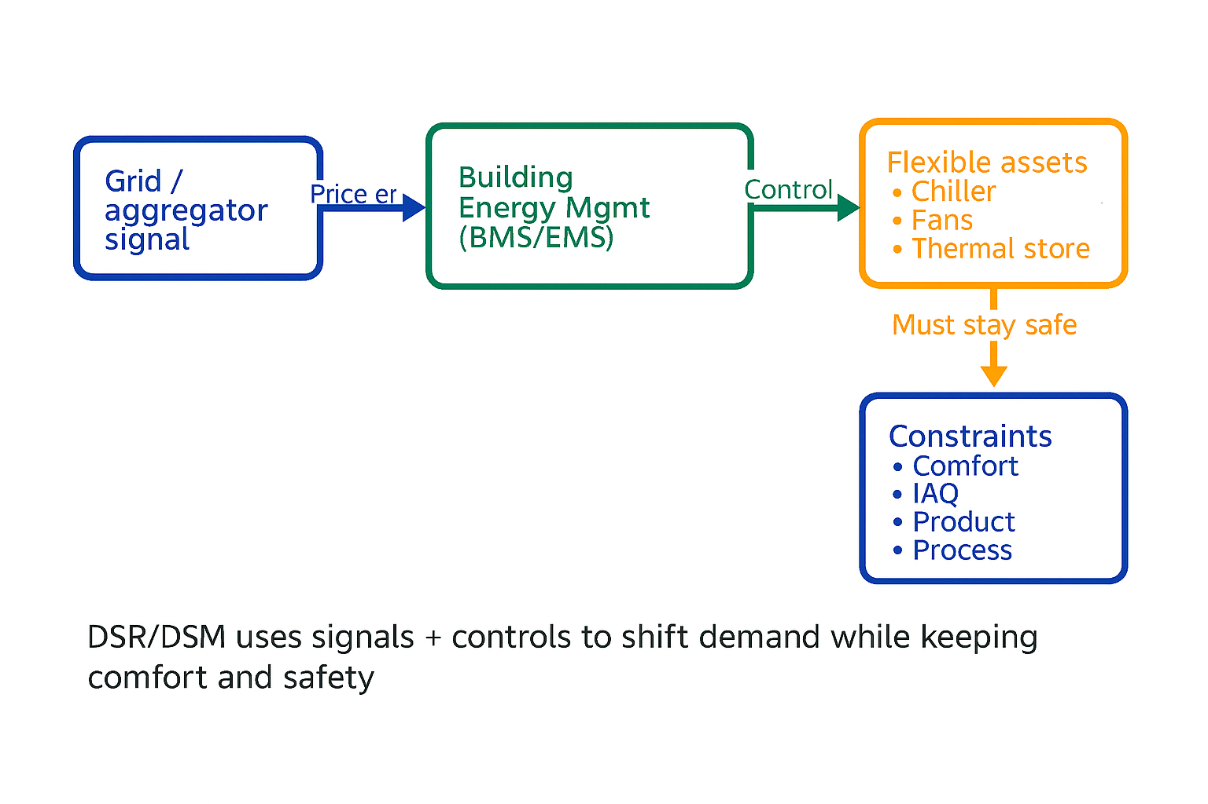
DSR/DSM control loop: signal → building controls → flexible HVAC
Notes:
Timing: 6 min. Discussion: what sensors and controls are needed? What could go wrong?

Slide 36
Case study: Make a cooling system more sustainable
Scenario: A college has a small rooftop PV array and a central chiller serving IT rooms and classrooms. On hot afternoons the site hits peak demand and gets high electricity prices. Task (groups): Propose a 3-part plan using (a) renewables, (b) storage, and (c) DSM/DSR. Include: what you would control, when you would shift, and how you protect comfort. Output: 1 slide worth of bullet points + a sketch.
Notes:
Timing: 15 min. Encourage realistic controls: setpoint bands, pre-cooling windows, ice-tank charging, battery discharge.

Slide 37
Knowledge check 2
1. Explain (in 2–3 sentences) how a wind turbine generates electricity.
2. Compare battery storage and thermal storage for supporting cooling demand.
3. Describe one way PV + battery can reduce grid imports at peak times.
4. Define DSR and give one example action an HVAC system could take.
Exam-style: ‘A site has high PV at midday but peak cooling at 5pm. Propose a solution using storage and DSM.’
Notes:
Timing: 12–15 min. Use peer marking or model answers. Push learners to use correct terminology.

Slide 38
Task
Use Google Maps to look at the roof of your building.
Estimate how many solar panels could fit and calculate if that would be enough to power the IT suite's air conditioning.

Slide 39
Task – method
Measure usable roof area
Divide by 2 m² to estimate number of panels
Multiply panels × 0.4 kW → system size (kW)
Multiply system size × 900 kWh/year to estimate annual output
Calculate AC electrical demand:
find cooling load
divide by cop
multiply by annual operating hours
Compare solar generation vs. AC demand
Notes:
Method:
1. Use Google Earth "measure" tool
Usable roof area example: If total roof is 800 m², assume 70% can take panels: 800 × 0.7 = 560 m² usable800 \times 0.7 = 560\ \text{m² usable}800×0.7=560 m² usable
2. Estimate how many panels fit on the roof
Panel area – A standard solar panel is approx: 1.7 m × 1.1 m = 1.87 m². Round to 2 m² per panel including spacing.
Number of panels: Panels = Usable area/2 m² ​
3. Estimate electricity generation
A modern panel ≈ 400 W (0.4 kW).
System size: 280 panels × 0.4 kW = 112 kW peak
Typical UK output = ~900 kWh per kW per year (varies by region).
Annual solar output: 112 × 900 = 100,800 kWh/year
4. Estimate the AC power demand of the IT suite
You need:
Number of AC units
Cooling capacity (kW)
Energy efficiency ratio (EER/COP)
Hours used per year
Typical values for an IT suite:
Cooling load: 50–80 W per m²
Or roughly 5–10 kW for a small server/IT room
AC electrical demand ≈ cooling load ÷ COPCOP ≈ 3.5 for modern systems
5. Compare solar output vs AC demand
Solar output (from step 3): 100,800 kWh/year
IT suite AC demand (step 4): 5,720 kWh/year

Slide 40
Summary
You should now be able to:
Describe how energy is supplied from a range of renewable resources​.
Explain turbine → generator principles for wind, hydroelectric and tidal power​.
Describe electricity generation using biofuels and waste-to-energy systems​.
Explain battery and thermal storage and how they support renewable supply​.
Explain DSR/DSM and propose flexibility actions for HVAC/cooling systems​.
Notes:
Timing: 3–4 min. Ask learners: ‘one thing you learned’ + ‘one question you still have’.

Slide 41
Any questions?
Copyright in this document belongs to and is used under licence from the Department for Education, © 2025.
‘T-LEVELS’ and ‘T Level’ are registered trademarks of the Department for Education.
WJEC is authorised by the Department for Education to develop and deliver this T Level Technical Qualification.
WJEC operates in England under the name Eduqas which is a registered trademark of WJEC.

