Slide 1
Occupational Specialism: Air Conditioning Engineering
K1.7 Environmental technologies employed in the sector
PowerPoint 1.7: Sustainable technologies

Slide 2
Objectives
By the end of this session, you should be able to:
Understand the importance of sustainability in air conditioning.
Explore energy efficiency methods and technologies.
Learn about heat exchangers and heat recovery systems.
Understand capacity and inverter controls.
Examine Building Management Systems (BMS).
Recognise the role of maintenance and operating conditions.
Notes:
These objectives outline what learners should achieve by the end of the session. Emphasise that this knowledge is crucial for modern HVAC professionals.

Slide 3
Starter
Discuss in small groups:
What environmental technologies are used in modern air conditioning systems to reduce energy use and environmental impact?
How do controls and smart sensors help improve sustainability?

Slide 4
Why sustainability matters
Improving sustainability in air conditioning systems focuses on energy efficiency, low‑impact refrigerants, and smart system design.
Air conditioning systems consume significant energy.
They contribute to greenhouse gas emissions.
They use refrigerants with high global warming potential.
UK regulations promote energy efficiency (e.g. Part L, F-Gas).
Notes:
Explain how HVAC systems impact the environment and why regulations are in place to reduce their footprint. Highlight the importance of sustainable practices.

Slide 5
Reducing heat gain
Reducing heat gain is the first step in energy efficiency. Typical examples are:
use of insulation
solar shading techniques
low-emissivity glazing
minimising air leakage.
Notes:
Reducing heat gain is the first step in energy efficiency. Discuss how building design and materials can reduce the need for cooling.

Slide 6
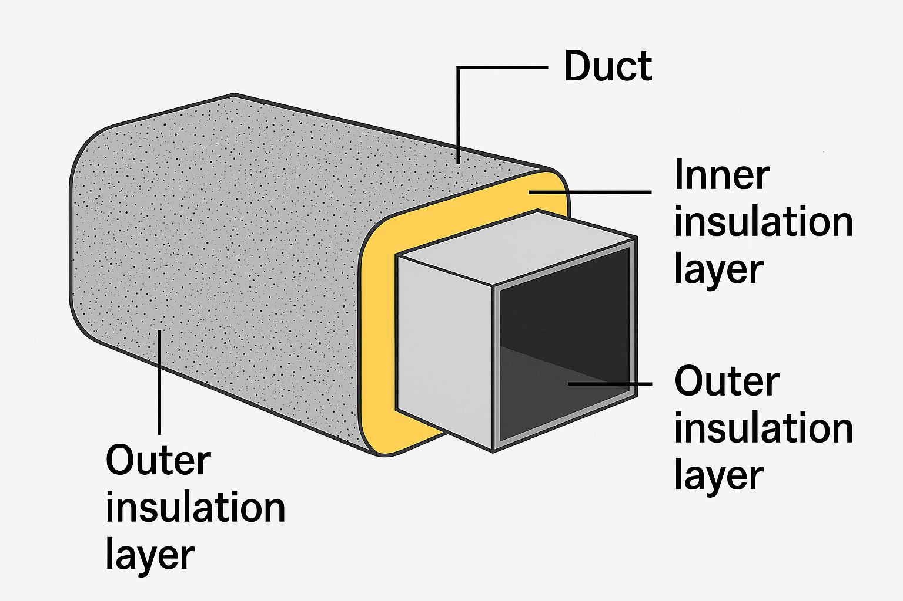
Reducing heat gain
Use of insulation:
heat moves from hotter to cooler areas — insulation slows that transfer
use insulated ductwork to prevent heat gain between the air handler and diffusers.

Slide 7
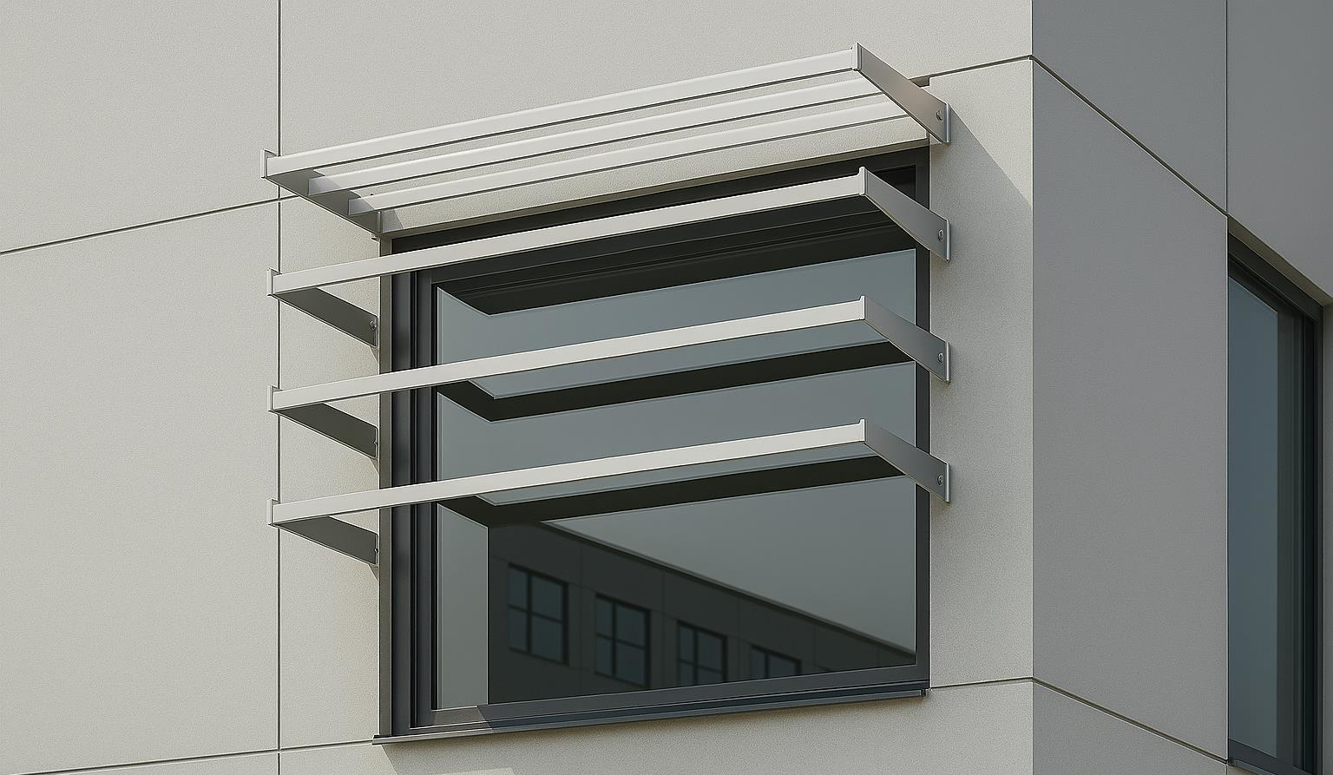
Reducing heat gain
Solar shading techniques:
Solar shading reduces the amount of direct sunlight and therefore heat entering a building.
Solar heat gain mainly enters through windows, so shading focuses on controlling sunlight before it hits the glass.

Slide 8
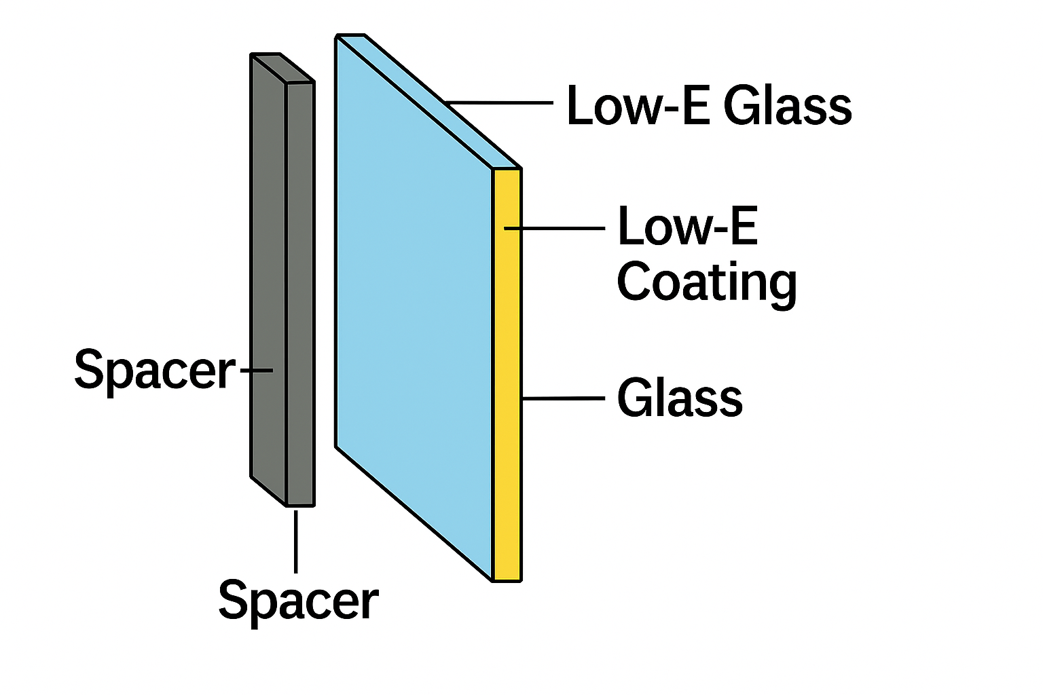
Reducing heat gain
Low-emissivity glazing:
Low‑E glazing is a type of high‑performance window glass coated with an ultra‑thin, transparent metallic layer that reflects infrared (heat) radiation while still allowing visible light to pass through.

Slide 9
Reducing heat gain
Minimising air leakage:
Air leakage (also called infiltration) is the uncontrolled movement of air into and out of a building through cracks, gaps, and openings.
In warm weather, it allows hot, humid outdoor air to enter, increasing cooling loads and driving up AC energy use.

Slide 10
Activity: Reducing heat gain
Find three "Passive" design features (e.g. solar shading, thermal mass, or natural ventilation stack effect) that could reduce the required cooling capacity (kW) of an AC system before it is even installed.
Notes:
Timing: 10-15 mins. Learners to research one item and present their findings.

Slide 11
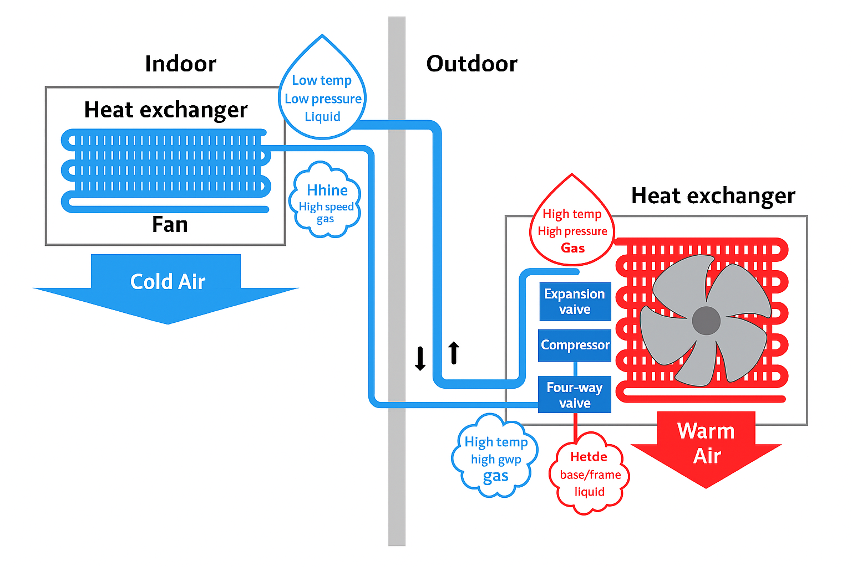
Heat exchangers – overview
Transfer heat between air streams or fluids.
Used for heat recovery and energy savings.
Improve overall system efficiency.
Notes:
Introduce the concept of heat exchangers and their role in HVAC systems. These are key to recovering energy and reducing load.
Better image to reference: https://showcase.ulvac.co.jp/en/solution/lifestyle/air-conditioner-01.html

Slide 12
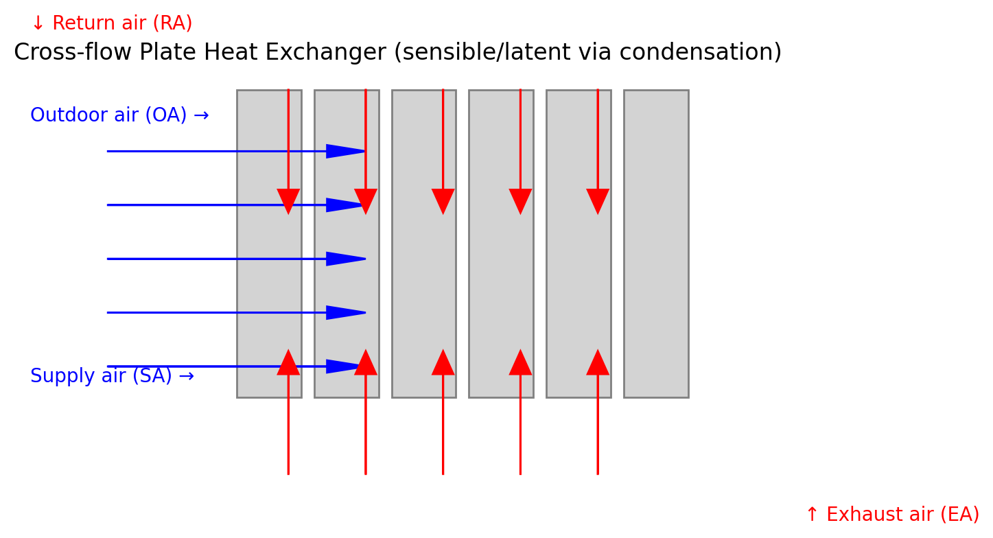
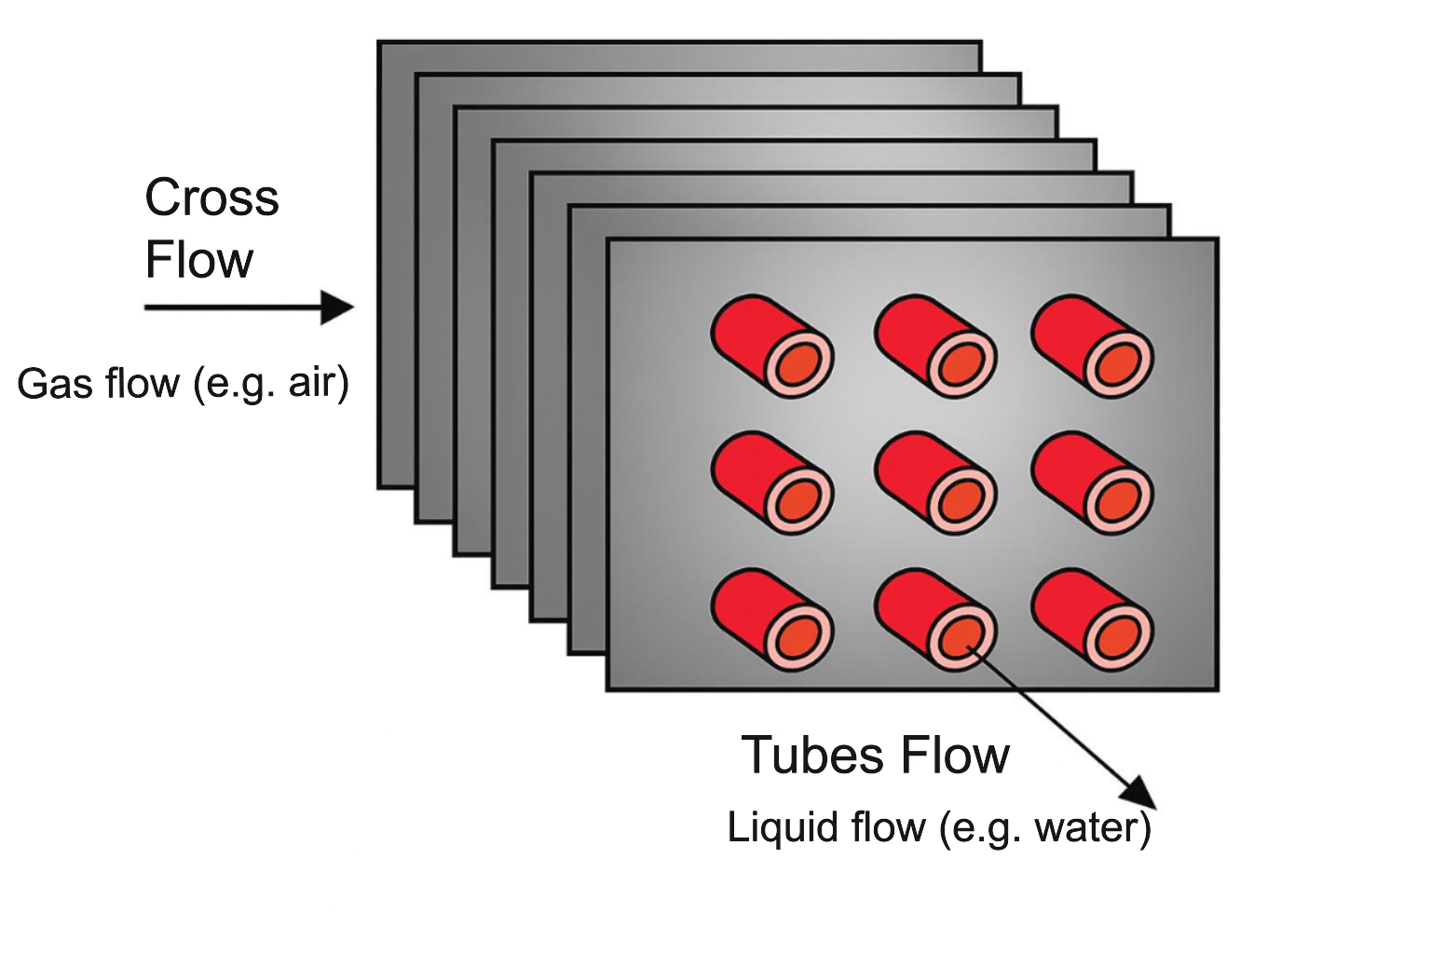
Cross‑flow heat exchangers
Air streams pass at 90° angles.
Heat transfers through a separating plate.
No mixing of air streams.
Simple, reliable, low maintenance.
Typical thermal efficiency 40–65%; dual/counterflow up to ~75–85%.
Notes:
Describe how cross-flow heat exchangers work and their benefits. Common in ventilation systems.
- Explain principle and placement in AHU/DX.
- Discuss efficiency ranges and appropriate applications.
- Ask: What risks (pressure drop, frosting, carryover, control)?
- Activity: Groups identify college areas to apply and estimate savings.
Good diagrams and images here:
https://www.linquip.com/blog/cross-flow-heat-exchangers/#Types_of_Cross_Flow_Heat_Exchangers
https://www.iqsdirectory.com/articles/heat-exchanger.html

Slide 13
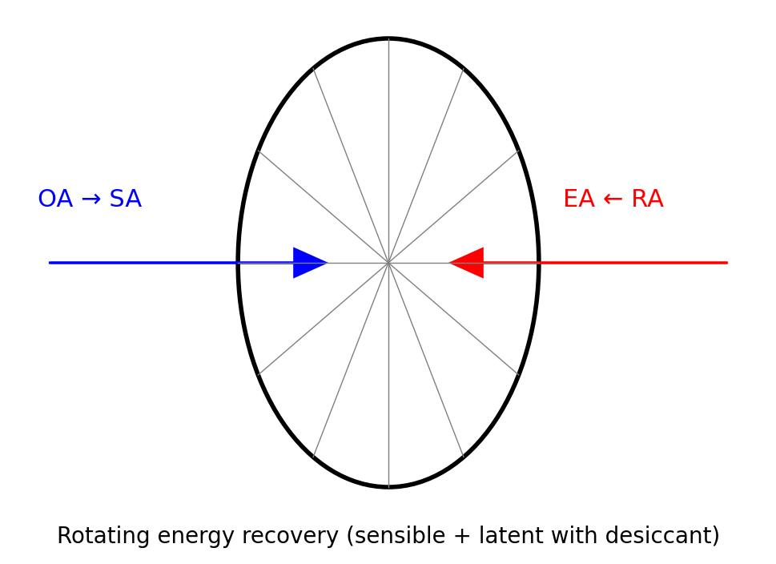
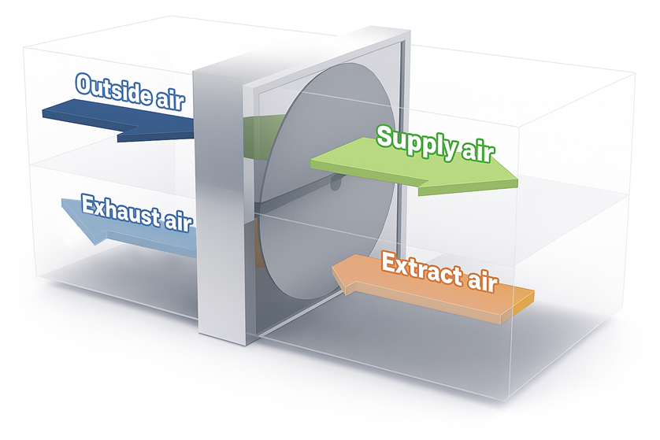
Thermal heat recovery wheels
Rotating wheel absorbs and transfers heat and moisture.
Transfers heat between outgoing exhaust air to incoming fresh air.
High efficiency (85–90%).
Notes:
Explain the operation and benefits of rotary wheels. Used in systems where high efficiency is needed.
- Explain principle and placement in AHU/DX.
- Discuss efficiency ranges and appropriate applications.
- Ask: What risks (pressure drop, frosting, carryover, control)?
- Activity: Groups identify college areas to apply and estimate savings.
images https://theengineeringmindset.com/hvac-heat-exchangers-explained/rotary-wheel-heat-exchanger-ahu-hvac-heat-exchangers-explained/
http://www.klingenburg.uk/knowledge/rotary-heat-exchangers/

Slide 14
Run‑around coils
A run‑around coil system is a closed‑loop heat recovery system consisting of:
exhaust air coil (extract side)
supply air coil (fresh air side)
pump circulating a heat‑transfer fluid (usually water or water‑glycol mixture)
pipework linking the two coils.
It transfers heat from one air stream to another without mixing the air streams.
Effectiveness commonly ~45–60% – can exceed this with optimised multi-coil arrangements.
Notes:
Run-around coils are ideal for systems with distant ducts or contamination concerns.
- Explain principle and placement in AHU/DX.
- Discuss efficiency ranges and appropriate applications.
- Ask: What risks (pressure drop, frosting, carryover, control)?
- Activity: Groups identify college areas to apply and estimate savings.
images and details https://spc-hvac.co.uk/products/runaround-coils/

Slide 15
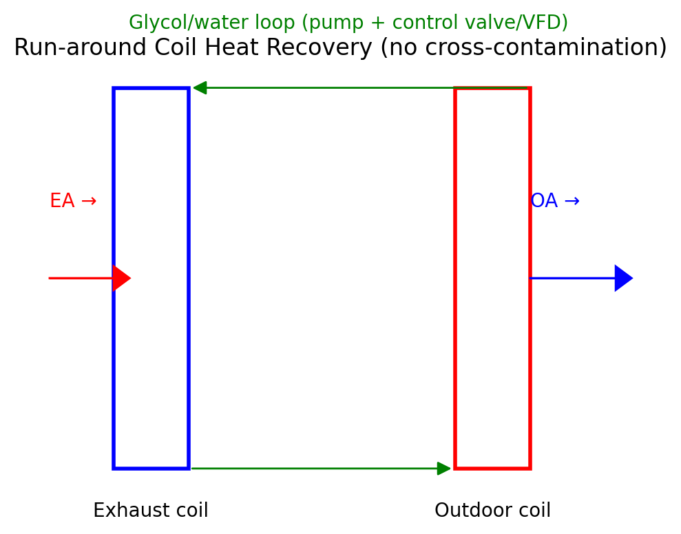
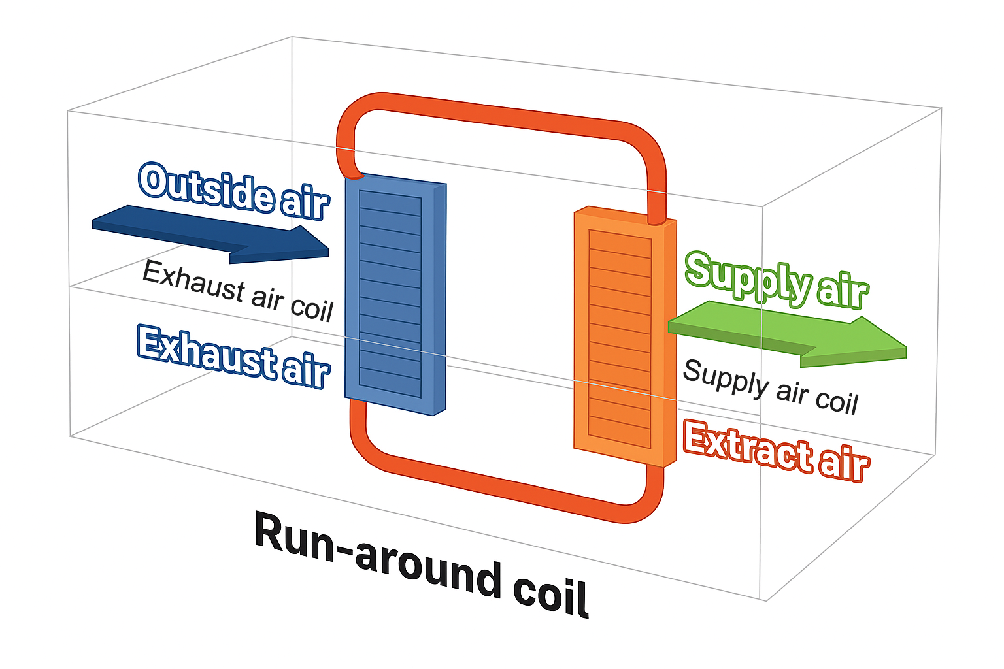
Run‑around coils
Notes:
Run-around coils are ideal for systems with distant ducts or contamination concerns.

Slide 16
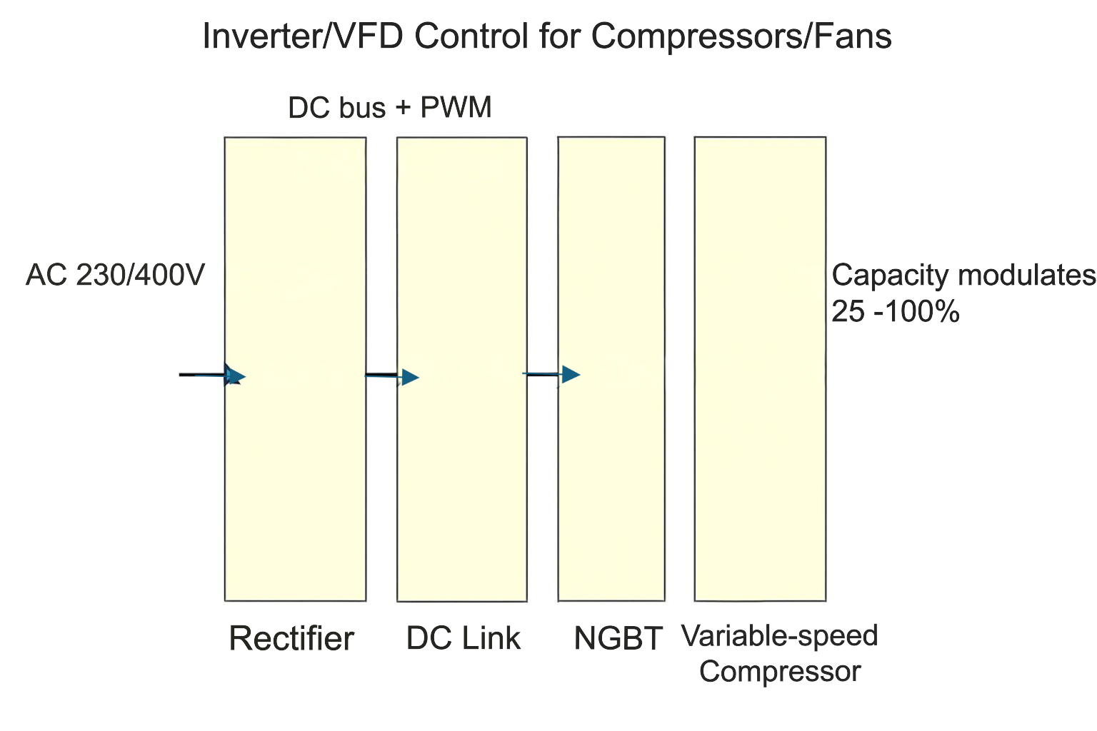
Capacity controls
Adjust output to match demand.
Types: On/off, step control, inverter.
Improves energy efficiency.
Reduces wear and tear.
Notes:
Discuss how capacity controls help systems run more efficiently by avoiding overcooling or excessive cycling.
Standard & inverter:
- Explain principle and placement in AHU/DX.
- Discuss efficiency ranges and appropriate applications.
- Ask: What risks (pressure drop, frosting, carryover, control)?
- Activity: Groups identify college areas to apply and estimate savings.

Slide 17
Inverter controls
Adjust compressor speed continuously.
Provide infinite load positions.
Improve efficiency and comfort.
Reduce energy use and noise.
Notes:
Inverter controls are a key technology for modern HVAC systems. They allow precise control and energy savings.

Slide 18
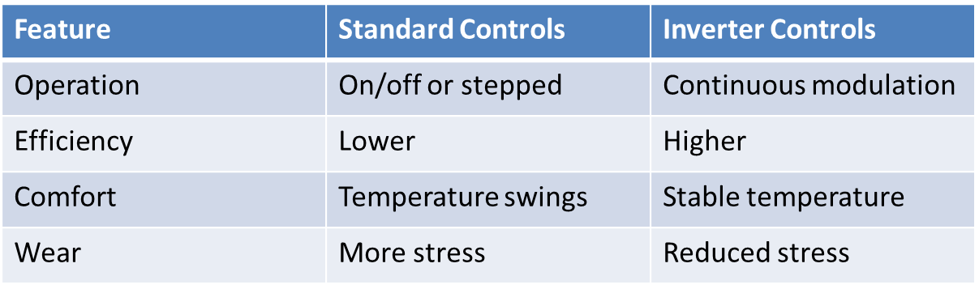
Standard vs. Inverter controls
Summary
Notes:
Use this table to compare traditional and inverter controls. Highlight the advantages of inverter systems.

Slide 19
Building Management Systems (BMS)
Monitor and control HVAC, lighting, and energy use
Enable load shedding and scheduling (e.g. widen setpoints, stage equipment, VFD turndown)
Improve efficiency and comfort
Detect faults early
Notes:
BMS are essential in large buildings. They automate energy-saving strategies and improve system reliability.
- Explain principle and placement in AHU/DX.
- Discuss efficiency ranges and appropriate applications.
- Ask: What risks (pressure drop, frosting, carryover, control)?
- Activity: Groups identify college areas to apply and estimate savings.
Good information and images on here regarding BMS https://www.linkedin.com/pulse/building-management-system-bms-raju-gajjelli-xqhjf/

Slide 20
Load shedding
In commercial buildings, load shedding is commonly integrated into Building Management Systems (BMS).
Reduces energy use during peak demand
Adjusts setpoints or reduces output
Lowers energy bills and grid strain
Often triggered by peak tariff periods or demand response agreements. Not just energy saving but also grid compliance.
Notes:
Explain how load shedding works and why it's important during peak energy times.

Slide 21
Load shedding
Common HVAC-related loads that can be shed:
chillers (staged or cycling off compressors)
AHU supply fans (reduced speed via VSDs)
extraction fans
electric reheat coils
non-critical zone cooling
domestic hot water heaters.
Notes:
Explain how load shedding works and why it's important during peak energy times.

Slide 22
High‑efficiency heat exchangers
Use microchannel designs
Enhanced fin surfaces
Lower refrigerant charge
Improved heat transfer
Microchannel designs have a smaller internal volume and a better heat transfer surface area to refrigerant ratio.
Notes:
Modern heat exchangers are more compact and efficient. Discuss how design improvements help reduce energy use.

Slide 23
Heat recovery and dehumidification
Pre-heat or pre-cool incoming air
Improve dehumidification efficiency
Reduce compressor workload
Notes:
Heat recovery systems can also assist in moisture control, especially in humid environments like pools.

Slide 24
Importance of maintenance
Clean filters and coils
Check refrigerant levels
Inspect fans and belts
Improves efficiency and lifespan
Notes:
Maintenance is critical for keeping systems efficient. Poor maintenance leads to higher energy use and breakdowns.

Slide 25
Efficient operating temperatures
Lower condensing pressure reduces compression ratio, and a lower compression ratio improves compressor efficiency and reduces discharge temperature.
Improves volumetric efficiency and COP.
Reduces compressor workload.
Clean coils/filters and correct charge to improve heat transfer.
Notes:
Explain how temperature settings affect system performance. Use diagrams if available, e.g. next slide.
- Explain principle and placement in AHU/DX.
- Discuss efficiency ranges and appropriate applications.
- Ask: What risks (pressure drop, frosting, carryover, control)?
- Activity: Groups identify college areas to apply and estimate savings.

Slide 26
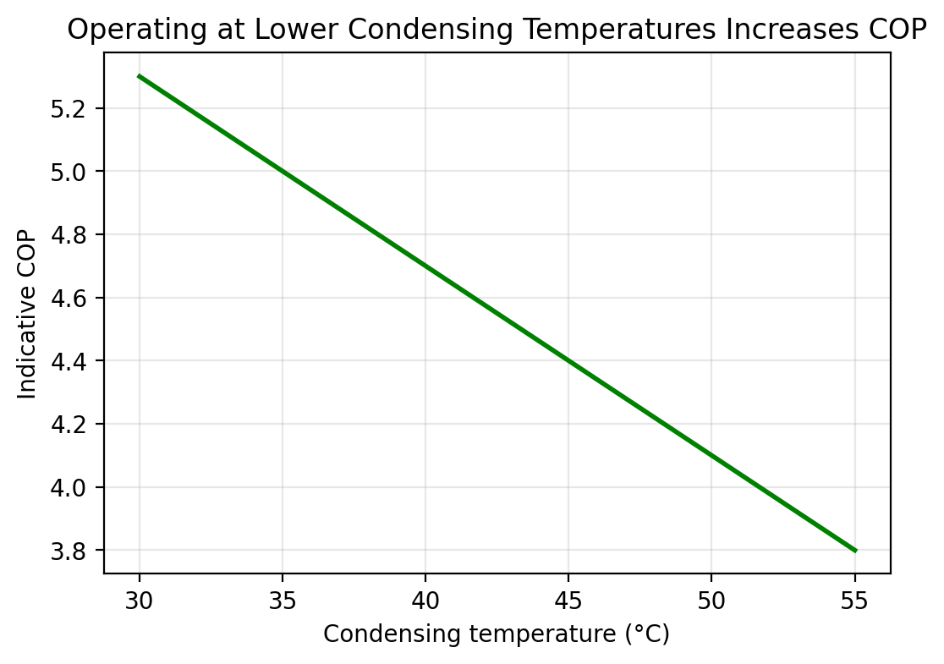
Efficient operating temperatures
Notes:
Explain how temperature settings affect system performance. Use diagrams if available.

Slide 27
Real‑world example
Supermarkets use heat recovery from refrigeration
Integrate HVAC with BMS
Optimise condensing temperatures
Reduce energy and carbon footprint

Slide 28
Knowledge check
1. What is the purpose of a heat recovery wheel?
A heat recovery wheel (also known as a thermal wheel or enthalpy wheel) transfers heat (and in some cases moisture) between the supply air and exhaust air streams.
Notes:
Use these questions to review key concepts. Encourage discussion or short written answers.

Slide 29
Knowledge check
2. Why are inverter controls more efficient?
Inverter controls (variable-speed drives) adjust the speed of compressors, fans, or pumps instead of running them at full power.
Notes:
Use these questions to review key concepts. Encourage discussion or short written answers.

Slide 30
Knowledge check
3. What does a BMS do?
A Building Management System (BMS) monitors, controls, and optimises building services.
A BMS typically manages:
HVAC systems (temperature, airflow, setpoints)
Lighting
Energy metering
Alarms and fault detection
Scheduling and optimisation
Load shedding and demand control
Notes:
Use these questions to review key concepts. Encourage discussion or short written answers.

Slide 31
Knowledge check
4. Name two maintenance tasks that improve efficiency.
Cleaning or replacing air filters
Cleaning condenser and evaporator coils
Checking and correcting refrigerant charge
Ensuring ductwork is sealed
Lubricating motors and bearings
Checking belts for tension and wear
Removing debris around outdoor units
Notes:
Use these questions to review key concepts. Encourage discussion or short written answers.

Slide 32
Knowledge check
5. Why is condensing temperature important?
Condensing temperature affects the amount of work the compressor must do.
Higher condensing temperature = higher pressure that the compressor works against.
This increases power consumption, reduces cooling capacity, and lowers efficiency.
Keeping the condensing temperature as low as possible (typically by ensuring good airflow, clean coils, and correct refrigerant charge) greatly improves system performance.
Notes:
Use these questions to review key concepts. Encourage discussion or short written answers.

Slide 33
Sustainability task
Rank by greatest potential energy saving in a large office (highest to lowest):
Maintenance
Insulation
Load shedding
Heat recovery
Inverter drives
Notes:
This activity helps learners apply what they've learned to real scenarios. Encourage justification.

Slide 34
Sustainability task – answer
Rank by greatest potential energy saving in a large office (highest to lowest):
Insulation
Heat recovery
Inverter drives
Maintenance
Load shedding
Notes:
This activity helps learners apply what they've learned to real scenarios. Encourage justification.

Slide 35
Group activity
Choose a building type (school, hospital, office, shop)
Identify useful environmental technologies
Explain your choices
Present to the class
Notes:
This activity helps learners apply what they've learned to real scenarios. Encourage creativity and justification.

Slide 36
Summary
You should now be able to:
Understand the importance of sustainability in air conditioning.
Explore energy efficiency methods and technologies.
Learn about heat exchangers and heat recovery systems.
Understand capacity and inverter controls.
Examine Building Management Systems (BMS).
Recognise the role of maintenance and operating conditions.

Slide 37
Any questions?
Copyright in this document belongs to and is used under licence from the Department for Education, © 2025.
‘T-LEVELS’ and ‘T Level’ are registered trademarks of the Department for Education.
WJEC is authorised by the Department for Education to develop and deliver this T Level Technical Qualification.
WJEC operates in England under the name Eduqas which is a registered trademark of WJEC.

