Slide 1
Occupational Specialism: Air Conditioning Engineering
K1.4 Comfort in terms of temperature, humidity, carbon
monoxide, metabolism
PowerPoint 1.4: Air quality

Slide 2
Objectives
By the end of this session, you should be able to:
Understand air quality and its effect on human comfort.
  Explain physical properties of air.
  Describe humidity, water content & temperature types.
  Recognise key pollutants and their impacts.
  Apply maintenance checks to sustain air quality.

Slide 3
      Starter: What do you already know?
Discuss:
What do we mean by “air quality”, and why is it important inside buildings?
Think about:
What makes air “good” or “poor”.
How indoor air can become polluted.
How ventilation and filtration affect health and comfort.
Why air quality matters in classrooms, offices, workshops, and homes.
Notes:
Can be done in pairs, small groups or as a whole class.

Slide 4
      What is air quality?
Definition: cleanliness, composition and freshness of indoor air.
Indoor vs. outdoor air: sources and control.
Why it matters: health, productivity, and HVAC efficiency.

Slide 5
      Air composition
Typical composition of dry air (by volume):
Nitrogen (N₂) 78.08%
Oxygen (O₂) 20.95%
Argon (Ar) 0.93%
Carbon dioxide (CO₂) 0.04% (varies slightly)
Trace amounts of Neon, Helium, Krypton, Hydrogen.
Variable component: water vapour (humidity).
Pollutants affect comfort & safety.

Slide 6
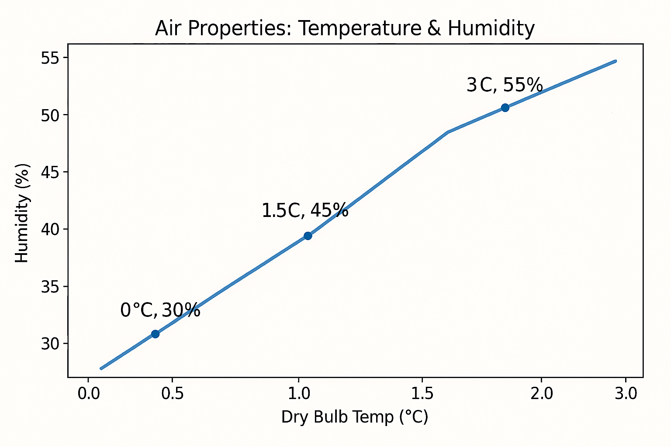
Air property diagram
Notes:
Tutor Script + Answers (8 min)
Explain: heating air (no moisture added) lowers RH; cooling raises RH, may hit dew point → condensation.
Q: “Why does a warm classroom feel dry in winter?”
A: Cold outdoor air brought in has low absolute moisture; once heated, RH drops → dry sensation.
Good reference websites:
https://www.engineeringtoolbox.com/docs/documents/2008/Air%20phase%20diagram%20C.jpg
https://www.engineeringtoolbox.com/air-properties-d_156.html

Slide 7
      Dry-bulb vs. Wet-bulb temperature
Dry‑bulb temperature is the temperature of air measured by a standard thermometer exposed to air but kept dry.
Known as normal air temperature.
Wet‑bulb temperature is taken using a thermometer with a wet wick wrapped around the bulb. As water evaporates from the wick, it cools the thermometer.
The temperature that air can cool to by evaporation.
The difference between them tells you how humid the air is:
Large difference → dry air.
Small difference → humid air.

Slide 8
      Dry-bulb temperature (DBT)
What it represents
The actual air temperature (what you see on a thermostat or weather report).
A measure of the sensible heat in the air.
Does not account for moisture/humidity.
Why it matters in air conditioning
Used for heating and cooling load calculations.
Forms part of the psychrometric chart.
Helps determine comfort levels and system sizing.

Slide 9
      Wet-bulb temperature (WBT)
What it represents
A measure of evaporative cooling potential.
Indicates how much moisture the air contains.
Always equal to or lower than dry‑bulb temperature (except at 100% humidity where DBT = WBT).
Why it matters in air conditioning
Used to calculate humidity, enthalpy, and latent heat.
Essential for understanding cooling coil performance, evaporative coolers, and heat pump efficiency.
Key parameter in the psychrometric process.

Slide 10
      DBT vs WBT – simple omparison
Property | Dry‑Bulb (DBT) | Wet‑Bulb (WBT)
Measures | Sensible heat | Moisture + evaporative cooling
Affected by humidity? | No | Yes
Typical reading | Higher | Lower (unless 100% RH)
Instrument | Standard thermometer | Thermometer with wet cloth & airflow
Used for | HVAC sizing, comfort | Humidity, enthalpy, evaporative cooling processes, determine cooling tower performance

Slide 11
      Humidity concepts
Relative vs absolute humidity (g/kg dry air).
Dew point: the temperature at where condensation begins.
Comfort & building fabric: mould, condensation, static.
Notes:
Tutor Script + Answers (15 min)
Demo: breathe on cold glass to show dew point.
Q: “Can RH be high in a cold room with little moisture?”
A: Yes—same moisture content at lower temperature can mean higher RH.
Target (contextual): often 40–60% RH in occupied spaces.

Slide 12
      Human comfort factors
Thermal comfort = temperature, humidity, air speed, radiation.
Metabolism & clothing: activity level and insulation matter.
Acceptable ranges vary with season & expectations.
Notes:
Tutor Script + Answers (15 min)
Ask: “Why might a workshop feel cooler than a classroom at same DBT?”
A: Higher air speed; different clothing; radiant surfaces; higher activity (metabolic heat).
Introduce Clo and metabolic rate concepts.
Look at: https://smartairdefense.com/wp-content/uploads/2025/10/ASHRAE-Standard-55.pdf

Slide 13
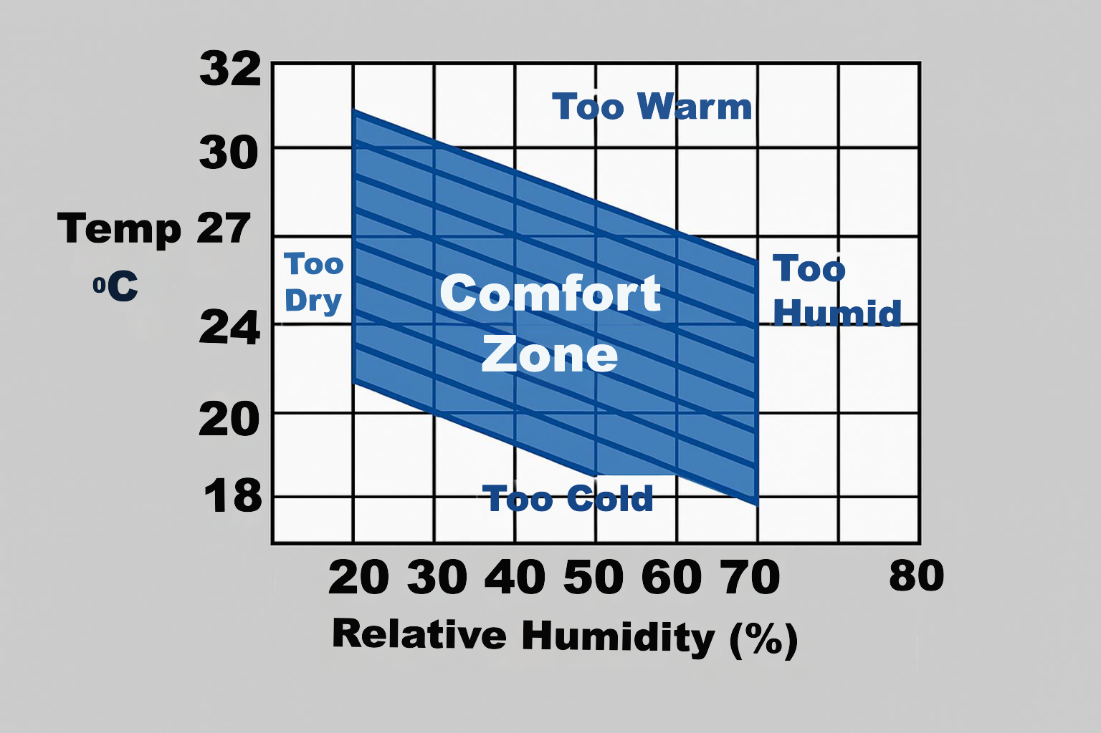
      Human comfort zone
Notes:
Tutor Script + Answers (10 min)
Show typical comfort region (context-dependent ~20–24°C, 30–60% RH).
Q: “Where would exam conditions sit and why?”
A: Typically cooler end (to reduce drowsiness), mid RH to avoid dryness/discomfort.
Image on this website is better and good description: https://c03.apogee.net/mvc/home/hes/land/el?utilityname=mp&spc=pq&id=1347

Slide 14
      Pollutants and air quality issues
Carbon Dioxide (CO₂) – Ventilation indicator
What it is: Carbon dioxide is a natural component of air and a gas we exhale when we breathe.
Indoors, CO₂ levels rise when ventilation is insufficient for the number of occupants.
Why it matters:
CO₂ itself (at typical indoor levels) is not toxic, but it is an excellent indicator of ventilation.
High CO₂ usually means:
stale air
buildup of other pollutants
inadequate fresh air supply.
Notes:
Tutor Script + Answers (18 min)
Prompt: “Name a source and a control for each pollutant.”
Answers: CO₂—occupants → increase fresh air; CO—faulty combustion → service/monitor; VOCs—paints/cleaners → low‑VOC products & ventilation; PM—outdoor/indoor dust → filtration & cleaning.

Slide 15
      Pollutants and air quality issues
Health & performance effects
When CO₂ rises above certain thresholds:
1,000 ppm — drowsiness and reduced concentration.
1,500 ppm+ — noticeably reduced cognitive performance.
2,000 ppm+ — headaches, poor decision‑making, and “stuffy air” feeling.
So CO₂ is used as a proxy for indoor air freshness and ventilation adequacy, but it is not a safety limit.
Occupational exposure limits are far higher.
Notes:
Tutor Script + Answers (18 min)
Prompt: “Name a source and a control for each pollutant.”
Answers: CO₂—occupants → increase fresh air; CO—faulty combustion → service/monitor; VOCs—paints/cleaners → low‑VOC products & ventilation; PM—outdoor/indoor dust → filtration & cleaning.

Slide 16
      Pollutants and air quality issues
Carbon Monoxide (CO) – Colourless, odourless, dangerous.
CO is a toxic gas produced by incomplete combustion.
Common sources: faulty boilers, gas heaters, car exhaust entering buildings, blocked chimneys, generators.
Why it is dangerous:
colourless and odourless → cannot be detected without sensors
co-binds to haemoglobin 200+ times more strongly than oxygen
this prevents blood from delivering oxygen to tissues.
Notes:
Tutor Script + Answers (18 min)
Prompt: “Name a source and a control for each pollutant.”
Answers: CO₂—occupants → increase fresh air; CO—faulty combustion → service/monitor; VOCs—paints/cleaners → low‑VOC products & ventilation; PM—outdoor/indoor dust → filtration & cleaning.

Slide 17
      Pollutants and air quality issues
Health effects:
low exposure: headache, nausea, dizziness
medium exposure: confusion, disorientation
high exposure: loss of consciousness, cardiac arrest
severe exposure: fatal without immediate treatment.
Notes:
Tutor Script + Answers (18 min)
Prompt: “Name a source and a control for each pollutant.”
Answers: CO₂—occupants → increase fresh air; CO—faulty combustion → service/monitor; VOCs—paints/cleaners → low‑VOC products & ventilation; PM—outdoor/indoor dust → filtration & cleaning.

Slide 18
      Pollutants and air quality issues
VOCs & Particulates (PM2.5 / PM10)
These represent different classes of indoor pollutants.
VOCs (Volatile Organic Compounds)
A broad group of carbon‑based chemicals that evaporate easily into the air.
Common sources:
paints, varnishes, adhesives
cleaning products, disinfectants
furniture, carpets, new building materials
air fresheners, perfumes
printers and office equipment.
Notes:
Tutor Script + Answers (18 min)
Prompt: “Name a source and a control for each pollutant.”
Answers: CO₂—occupants → increase fresh air; CO—faulty combustion → service/monitor; VOCs—paints/cleaners → low‑VOC products & ventilation; PM—outdoor/indoor dust → filtration & cleaning.

Slide 19
      Pollutants and air quality issues
Health effects:
eye/nose/throat irritation
headaches
nausea or dizziness
long-term exposure to some VOCs (e.g., formaldehyde, benzene) can increase cancer risk.
Particulate Matter (PM2.5 / PM10)
PM10 = particles ≤10 microns (dust, pollen)
PM2.5 = particles ≤2.5 microns (smoke, combustion particles)
PM2.5 is the more dangerous form because it penetrates deep into the lungs and even the bloodstream.
Notes:
Tutor Script + Answers (18 min)
Prompt: “Name a source and a control for each pollutant.”
Answers: CO₂—occupants → increase fresh air; CO—faulty combustion → service/monitor; VOCs—paints/cleaners → low‑VOC products & ventilation; PM—outdoor/indoor dust → filtration & cleaning.

Slide 20
      Pollutants and air quality issues
Common sources
Indoors:
cooking (especially frying, gas hobs)
wood stoves, candles, tobacco smoke
vacuuming or dust disturbance
Health effects:
respiratory irritation
asthma flare-ups
cardiovascular strain
Outdoors (can enter indoors):
traffic pollution
industry
wildfire smoke
dust storms
increased long‑term risk of heart and lung disease
PM2.5 especially linked to increased mortality from chronic exposure
Notes:
Tutor Script + Answers (18 min)
Prompt: “Name a source and a control for each pollutant.”
Answers: CO₂—occupants → increase fresh air; CO—faulty combustion → service/monitor; VOCs—paints/cleaners → low‑VOC products & ventilation; PM—outdoor/indoor dust → filtration & cleaning.

Slide 21
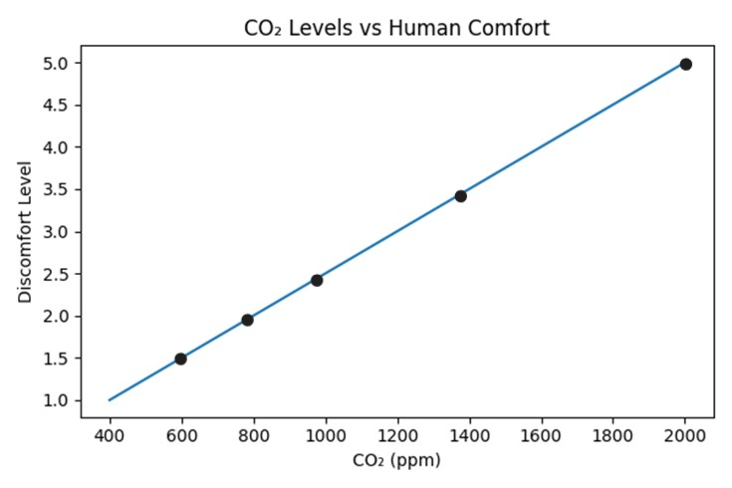
      CO₂ impact on comfort
Unacceptable level
Significant discomfort
Noticeable discomfort
Comfort threshold
Mild discomfort
Optimal range
Notes:
Tutor Script + Answers (8 min)
Explain ppm ranges conceptually (outdoor fresh air ~400–450 ppm; rising indoor levels suggest ventilation need).
Q: “What learner behaviours raise CO₂ quickly?”
A: Many occupants with doors/windows closed; low or blocked ventilation; long sessions without purge.

Slide 22
      CO₂ impact on comfort
CO₂ discomfort levels
Although CO₂ itself is not harmful at typical indoor concentrations, comfort decreases noticeably as CO₂ rises, because higher levels signal poor ventilation, stale air, and the buildup of heat, humidity, and odours.
≈ 600–800 ppm – Optimal / Fresh
Air generally feels fresh and comfortable.
Typical for well‑ventilated offices and classrooms.
(No discomfort indicated in research at these levels.)
≈ 800–1000 ppm – Mild discomfort begins
Air may begin to feel slightly stuffy or warm.
Occupants may notice reduced freshness, especially in crowded rooms.

Slide 23
      CO₂ impact on comfort
1000 ppm is widely used as a comfort threshold in many guidelines, often tied to odour dissatisfaction.
Poor ventilation at this range can also start contributing to subtle reductions in perceived air quality.
≈ 1000–1400 ppm – Noticeable discomfort
Stuffy, stale air becomes apparent to most people.
Indicates inadequate air exchange, contributing to rising humidity, heat and odours.
Cognitive dullness, tiredness, and headaches may appear, adding to overall discomfort.

Slide 24
      CO₂ impact on comfort
≈ 1400 – 2000 ppm – Significant discomfort
Air feels heavy, oppressive, and unpleasant.
Strong perception of stale air due to CO₂ buildup and stagnant conditions.
Symptoms like sleepiness, reduced alertness, and stronger SBS‑type complaints become more common.
> 2000 ppm – Unacceptable for comfort
Air quality becomes poor to very poor, with high levels considered unacceptable for occupied spaces.
Strong “bad air” sensation due to combined pollutants, odours, and heat.
Occupants may experience headaches, fatigue, and pronounced discomfort.

Slide 25
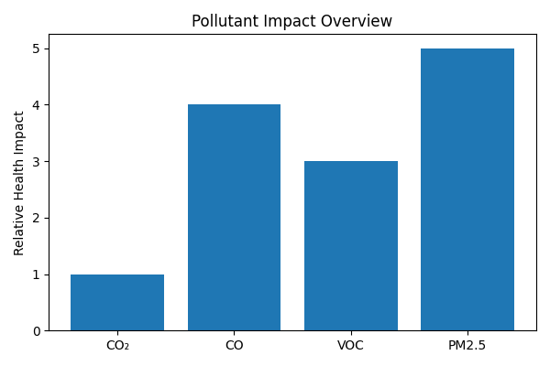
      Pollutant impact chart
Notes:
Tutor Script + Answers (8 min)
Compare relative impacts; match controls: source control, filtration, ventilation, humidity management.
Q: “Which single action helps most across pollutants?”
A: Adequate ventilation + correct filtration; also eliminate sources where possible.

Slide 26
      Pollutant impact
Relative Health Impact 1–5 is a conceptual index.
The 1–5 index is qualitative, designed for relative comparison across pollutants and ranges, not for quantitative risk assessment.

Slide 27
      Maintenance for good air quality
Filters: selection (efficiency ratings), fit & change intervals.
Ventilation: outdoor air dampers, fans, flow verification.
Moisture: drain pans, coils, dehumidification checks.
Notes:
Tutor Script + Answers (20 min)
Checklist demo: inspect filters (fit/bypass), coils (clean), drains (clear), dampers (position).
Q: “What’s a sign of bypass around a filter?”
A: Dust downstream, streaking on coils, visible gaps in frames or seals.

Slide 28
      Applied maintenance scenarios
Scenario 1: High CO₂, drowsy learners, windows closed
What do you do?
Scenario 2: Condensation on windows, musty smell
What do you do?
Scenario 3: Complaints of dryness & static in winter
What do you do?
Notes:
Tutor Script + Model Answers (20 min)
S1 Expected fix: increase OA ventilation, open windows briefly if appropriate, check dampers/fans, schedule purge.
S2 Expected fix: improve dehumidification/ventilation, check for water ingress, clean/replace filters, verify drainage.
S3 Expected fix: add humidification (if available) or adjust setpoints, reduce overheating, educate on hydration/antistatic measures.

Slide 29
      Activity: Air quality analysis
Measure/estimate: temperature, RH, and ventilation cues.
  Identify comfort issues: too hot/cold, too dry/humid.
  Propose improvements & link to maintenance actions.

Slide 30
      Knowledge check
Define:
DBT vs. WBT
RH vs. absolute humidity
Explain how high CO₂ relates to ventilation.
List 3 routine maintenance tasks to support IAQ.

Slide 31
      Summary
You should now be able to:
Understand air quality and its effect on human comfort.
  Explain physical properties of air.
  Describe humidity, water content & temperature types.
  Recognise key pollutants and their impacts.
  Apply maintenance checks to sustain air quality.

Slide 32
Any questions?
Copyright in this document belongs to and is used under licence from the Department for Education, © 2025.
‘T-LEVELS’ and ‘T Level’ are registered trademarks of the Department for Education.
WJEC is authorised by the Department for Education to develop and deliver this T Level Technical Qualification.
WJEC operates in England under the name Eduqas which is a registered trademark of WJEC.

