Slide 1
Occupational Specialism: Air Conditioning Engineering
K1.3 Scientific principles of air conditioning
PowerPoint 1.3h: Impact on system performance

Slide 2
Objectives
By the end of this session, you should be able to:
Understand and apply the impact on system performance of:
• flash gas
• oil return
• velocity
• saturation temperature
• mass flow rate
• cooling/heating capacity
• refrigerants
• operating temperatures and pressures
• efficiency
• pressure drop versus velocity.

Slide 3
Starter: What do you already know?
Discuss in small groups: What factors can affect how well an air conditioning system works, and why do they make a difference?
Identify and describe the main factors.
Notes:
The main factors include:
Outdoor temperature
Airflow
Refrigerant charge (amount of refrigerant)
Cleanliness of coils and filters
Size of the system vs. size of the room
Maintenance
Key idea: An air conditioner works best when it has the right refrigerant charge, good airflow, clean components, proper sizing, and regular maintenance.

Slide 4
Impact on system performance
Many factors can affect system performance – some with positive effects, others with negative effects. These include:
Flash gas
Flash gas reduces the amount of liquid refrigerant available for evaporation.
Too much flash gas = lower cooling capacity and reduced system efficiency.
• Oil return
Refrigerant velocity must be high enough to carry compressor oil back to the compressor.
Poor oil return = compressor wear, overheating, and potential failure.
.

Slide 5
Impact on system performance
• Velocity
Refrigerant velocity affects oil return, pressure drop, and system noise.
Too low → poor oil return.
Too high → increased pressure drop and energy use.
• Saturation temperature
This is the temperature at which the refrigerant changes phase at a given pressure.
Lower evaporating temp → higher cooling, lower efficiency.
Higher condensing temp → more compressor work, lower efficiency.

Slide 6
Impact on system performance
• Mass flow rate
More refrigerant mass flow generally increases system capacity.
However, too high mass flow → pressure drop and inefficient heat transfer.
• Cooling/heating capacity
Capacity depends on refrigerant mass flow, heat exchanger size, operating pressures, and temperatures.
Undersized or poorly charged systems deliver reduced performance.

Slide 7
Impact on system performance
• Refrigerants
Different refrigerants have different thermodynamic properties.
Affects:
efficiency
operating pressures
environmental impact
capacity
choosing the correct refrigerant is critical.

Slide 8
Impact on system performance
• Operating temperatures and pressures
These determine system efficiency and capacity.
Higher pressure difference across the compressor = higher energy use and lower lifespan.
Stable conditions = better system performance.

Slide 9
Impact on system performance
• Efficiency
Efficiency depends on compressor work vs. heat moved.
Affected by:
refrigerant choice
ambient temperature
saturation temperatures
system charge
component sizing.
Higher efficiency = lower running costs.

Slide 10
Impact on system performance
• Pressure drop vs. velocity
Pressure drop increases with line velocity.
High pressure drop = loss of capacity, increased compressor work.
Balance is needed for:
proper oil return
minimal energy loss.

Slide 11
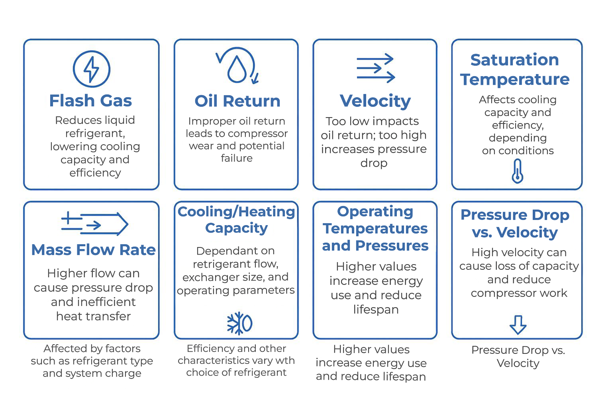
Impact on system performance
Summary

Slide 12
Summary
You should now be able to:
Understand and apply the Impact on system performance of:
• flash gas
• oil return
• velocity
• saturation temperature
• mass flow rate
• cooling/heating capacity
• refrigerants
• operating temperatures and pressures
• efficiency
• pressure drop versus velocity.

Slide 13
Any questions?
Copyright in this document belongs to and is used under licence from the Department for Education, © 2025.
‘T-LEVELS’ and ‘T Level’ are registered trademarks of the Department for Education.
WJEC is authorised by the Department for Education to develop and deliver this T Level Technical Qualification.
WJEC operates in England under the name Eduqas which is a registered trademark of WJEC.

