Slide 1
Occupational Specialism: Air Conditioning Engineering
K1.3 Scientific principles of air conditioning
PowerPoint 1.3e: Filtration

Slide 2
Objectives
By the end of this session, you should be able to:
Understand and apply the principles of filtration.
Understand and use different types of filters:
air filter (panel, bag, high efficiency particulate air (HEPA, carbon)
water
refrigerant.

Slide 3
Starter: What do you already know?
Work in pairs and answer the question:
What problems can occur in an air conditioning system if air filters are not used or not cleaned regularly?
Identify at least 3 different issues.
Notes:
If an air conditioner has no filters, or dirty filters, dust and debris can enter the system. This causes several issues:
Coils get clogged with dirt
Reduced airflow
Higher energy use
Increased wear and damage
Poor indoor air quality
Key idea: Air filters protect both the system and the people using the building. No filters = more dust, more problems, and higher costs.

Slide 4
Filtration
Filtration is important because it improves indoor air quality, protects equipment, and ensures efficient system performance.
Filters remove dust, pollen, pollutants
HEPA/activated carbon for sensitive spaces
Clogged filters increase energy use

Slide 5
Filtration
Filtration in air conditioning is governed by several methods:
mechanical filtration: sieving, interception, impaction
diffusion: Brownian motion capturing ultrafine particles
electrostatic attraction: charged fibres drawing particles in
adsorption: activated carbon capturing gases & odours
microbial control: UV and antimicrobial strategies.
Together, these ensure a balance of air quality, system performance, and energy efficiency.

Slide 6
Uses of filters
Improve indoor air quality:
removes dust, allergens, pollutants, microorganisms.
Protect HVAC components:
prevents dust buildup on coils, fans, and ducts.
Enhance system efficiency:
clean airflow reduces resistance → lower energy consumption.
Ensure occupant health and comfort:
especially important in hospitals, cleanrooms, and high‑occupancy buildings.

Slide 7
Principles of filtration types
Mechanical filtration
Principle: Captures particles by physically trapping them in the filter media.
Mechanisms:
sieving – large particles cannot pass through small openings
interception – particles following airflow touch and stick to fibres
impaction – heavier particles deviate from the airflow and collide with fibres.

Slide 8
Principles of filtration types
Diffusion
Principle: Very small particles move randomly (Brownian motion) and collide with filter fibres.
Used for:
ultrafine particles such as smoke and aerosols.
Common in: HEPA/ULPA filters.

Slide 9
Principles of filtration types
Electrostatic attraction
Principle: Charged fibres attract and hold oppositely charged particles.
Includes:
electret filters (permanently charged fibres)
electrostatic precipitators (actively charge particles).

Slide 10
Principles of filtration types
Adsorption
Principle: Gas molecules, odours, and VOCs adhere to the surface of porous adsorbents.
Common material: Activated carbon.
Used for:
odour removal
chemical vapour control.

Slide 11
Principles of filtration types
Microbial control
Principle: Inactivates or captures microorganisms to prevent growth and recirculation.
Methods include:
UV‑C irradiation
antimicrobial coatings
photocatalytic oxidation (PCO)
high‑efficiency filters trapping microbes.

Slide 12
Air filters used in air conditioning
Panel filters
Description: Flat, simple filters made of fibreglass or synthetic media.
Function: Capture large dust particles and debris; protect equipment.
Typical efficiency: Low (MERV 1–4).
Used in:
residential AC units
pre‑filtration stages.

Slide 13
Air filters used in air conditioning
Bag filters (pocket filters)
Description: Deep, multi‑pocket filters that increase surface area.
Function: Capture medium to fine particles; high dust‑holding capacity.
Typical efficiency: Medium (MERV 8–14).
Used in:
commercial HVAC systems
hospitals
offices.

Slide 14
Air filters used in air conditioning
High‑Efficiency Particulate Air (HEPA) filters
Description: Dense fibre filter capable of extremely high particle capture.
Function: Remove 99.97% of particles ≥0.3 microns.
Captures: Bacteria, fine dust, smoke, allergens.
Used in:
cleanrooms
medical facilities
high‑purity environments.

Slide 15
Air filters used in air conditioning
Carbon (activated carbon) filters
Description: Filters containing activated carbon granules or impregnated sheets.
Function: Adsorb gases, chemicals, VOCs, and odours.
Used in:
odour control
chemical labs
indoor air quality systems.
Note: Often used together with particulate filters, because carbon does not remove dust.

Slide 16
Water filters
Water can function as a filtering medium in certain types of air‑conditioning and ventilation systems.
Water filtration uses water sprays, curtains, or scrubbing systems to wash dust and contaminants from the air before cooling, mainly for pre‑filtration and industrial applications.
This method is often called ‘wet filtration’ or ‘water‑wash filtration’.

Slide 17
Water filters
1. Water spray filters (Water‑wash filters)
How they work:
air passes through a chamber where water is sprayed or cascaded downward
dust and particles are captured when they come into contact with water droplets
dirt‑laden water drains away, leaving cleaner air.
Purpose:
removes dust, pollen, and large particulate contaminants
helps wash the air before it enters cooling coils
Used in:
large AHUS (air handling units)
older HVAC systems
industrial ventilation

Slide 18
Water filters
2. Wet scrubbers (Air scrubbers)
How they work:
air flows through a scrubbing liquid (usually water)
particles, chemical vapours, and aerosols dissolve or get trapped in the water
clean air exits; dirty water is treated or drained.
Purpose:
removes particulate matter, gases, and odours
can handle very dirty or contaminated air
Used in:
industrial AC systems
kitchens and fume extraction
pollution control systems

Slide 19
Water filters
3. Evaporative air washers (Air‑wash cooling)
How they work:
air passes through wet pads or across a water curtain
particles stick to the water‑soaked surfaces
evaporation also provides cooling.
Purpose:
basic filtration + cooling
humidifies and cleans air at the same time
Used in:
evaporative coolers
comfort cooling in dry climates

Slide 20
Water filters
Water filtration can:
remove large dust particles
remove pollen and fibres
reduce airborne contaminants
clean air entering coil sections
Water filtration cannot:
remove fine particles (e.g. smoke, PM2.5)
remove microorganisms effectively
replace HEPA, carbon, or electrostatic filters

Slide 21
Refrigerant
Refrigerant is not used as a filter in air‑conditioning systems.
Instead, refrigerant is used for heat transfer, not for air cleaning.
However, refrigerant plays an indirect role in keeping the air clean by working inside components that do remove moisture or contaminants.

Slide 22
Refrigerant
1. Refrigerant removes moisture through the cooling coil (dehumidification)
Although the refrigerant itself does not filter the air, the evaporator coil (where refrigerant evaporates) becomes very cold.
When warm, humid air passes over this coil:
water vapour condenses on the coil surface
moisture drips away into the drain pan
dust and some impurities may get trapped in the moisture
This acts as a moisture filter, reducing humidity and removing some airborne contaminants with the condensed water.

Slide 23
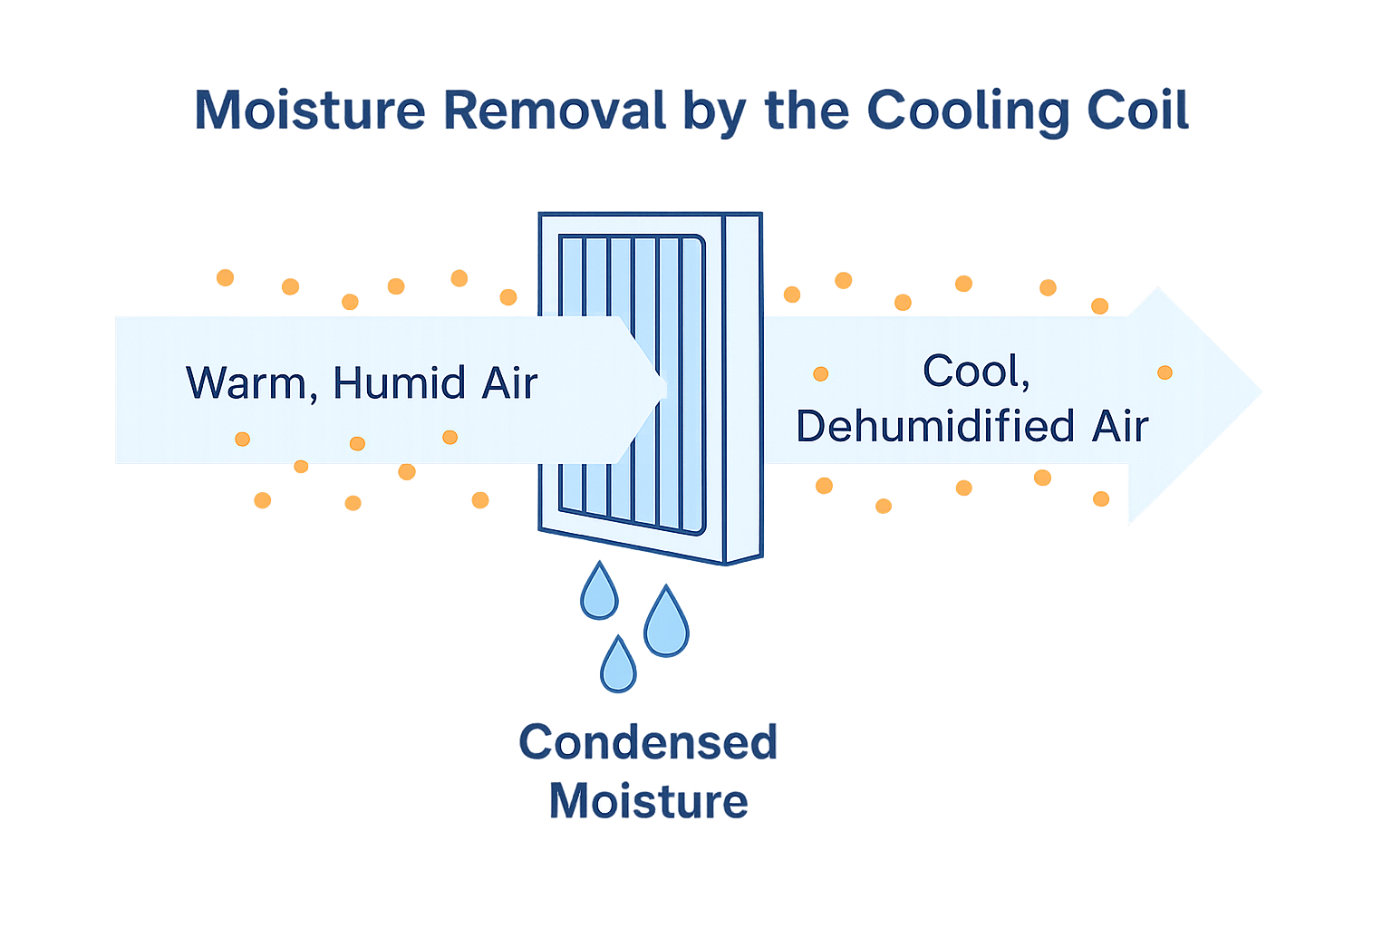
Refrigerant

Slide 24
Refrigerant
2. Refrigerant enables coil-surface “washing” of air
The cold coil can capture:
fine dust
aerosols
micro‑particles.
As these stick to the wet surface, they are flushed away with condensate.
This is not a true filter, but it helps reduce the airborne load.

Slide 25
Refrigerant
What refrigerant does NOT do
Refrigerant cannot:
filter dust
capture gases
remove odours
kill microorganisms
replace mechanical or carbon filters.
These tasks require panel filters, bag filters, HEPA, carbon, or UV systems.

Slide 26
Summary
You should now be able to:
Understand and apply the principles of filtration
Understand and use different types of filters:
air filter (panel, bag, high efficiency particulate air (HEPA, carbon)
water
refrigerant.

Slide 27
Any questions?
Copyright in this document belongs to and is used under licence from the Department for Education, © 2025.
‘T-LEVELS’ and ‘T Level’ are registered trademarks of the Department for Education.
WJEC is authorised by the Department for Education to develop and deliver this T Level Technical Qualification.
WJEC operates in England under the name Eduqas which is a registered trademark of WJEC.

