Slide 1
Occupational Specialism: Air Conditioning Engineering
K1.3 Scientific principles of air conditioning
PowerPoint 1.3d: Fluid flow

Slide 2
Objectives
By the end of this session, you should be able to:
Understand and apply the principles of fluid flow.
Understand pipe characteristics.
Demonstrate the impact on system performance.

Slide 3
      Starter: What do you already know?
Work in pairs to answer the question:
How does fluid flow inside the pipes and coils of an air conditioning system help move heat from indoors to outdoors?
Think about the different components in an air conditioning system:
evaporator
condenser
expansion device.
Notes:
Fluid flow in air conditioning refers to the movement of the refrigerant (a special fluid) through the system’s pipes, coils, and components.
The way this fluid flows is essential because the refrigerant is what carries heat from one place to another.
Key idea: Air conditioning works because refrigerant flows continuously through a closed loop, absorbing heat indoors and releasing it outdoors. Without proper fluid flow:
Heat cannot be carried away
Pressures become unbalanced
The system can’t cool effectively

Slide 4
      Fluid flow
Air conditioning systems rely heavily on how air flows (in ducts) and how refrigerant flows (inside the refrigeration circuit).
Both are essential to cooling performance, efficiency, and comfort.
Airflow = pressure + duct design
Fans move air; pumps move chilled water
Too much resistance → low air changes
.

Slide 5
      Airflow in air conditioning systems
AC units move heat using air.
Understanding air flow is essential because:
too little airflow = freezing coils
too much airflow = poor dehumidification and noise
correct airflow = peak performance and comfort.

Slide 6
      Airflow in air conditioning systems
How airflow works: Fans create pressure differences.
The blower fan in an air handling unit (AHU) or indoor AC unit does two things:
suction side: pulls warm return air through the filter
discharge side: pushes air across the evaporator coil and into supply ducts.
Air flows from high pressure → low pressure

Slide 7
      Airflow in air conditioning systems
Key airflow terms
1. CFM (Cubic Feet per Minute) / L/s – the measure of how much air is flowing.
Typical residential AC:350–450 CFM per ton of cooling (≈ 170–220 L/s per kW)
2. Static pressure – the resistance to airflow caused by ducts, filters, coils, and grilles.
High static pressure means:
low airflow
noisy ducts
strained blower motors.

Slide 8
      Airflow in air conditioning systems
3. Velocity – how fast air moves through a duct.
High velocity = noise, drafts
Low velocity = poor air throw
Typical duct velocities:
Main trunk: 6–9 m/s
Branches: 3–5 m/s
Diffusers: 1–3 m/s

Slide 9
      Airflow in air conditioning systems
Pressure drops in AC airflow
Air loses pressure as it moves through:
filters
bends and elbows
coils
dampers
flexible ducts
long duct runs.
Designers calculate the pressure drop to ensure the fan is powerful enough.

Slide 10
      Refrigerant flow in air conditioning
Air conditioning is basically refrigerant moving heat from indoors → outdoors.
Refrigerant flow depends on:
the compressor
metering device (TXV, capillary tube, EEV)
pipe sizes
temperatures and pressures.

Slide 11
      Refrigerant flow in air conditioning
Refrigerant flow fundamentals
Compressor → creates high-pressure refrigerant flow.
It pumps refrigerant around the system:
Low-pressure vapour enters
High-pressure vapour exits
This pressure difference induces refrigerant flow, just like a pump.

Slide 12
      Refrigerant flow in air conditioning
2. Metering device → controls refrigerant flow into the evaporator.
It creates a sharp pressure drop from the high‑pressure liquid line into the low-pressure evaporator.
If it’s restricted → low flow → coil freezes.
If it’s overfeeding → liquid floodback → can destroy the compressor.

Slide 13
      Refrigerant flow in air conditioning
3. Evaporator coil
Warm indoor air blows over the cold coil → refrigerant absorbs heat and evaporates.
Refrigerant must flow at the correct rate to:
prevent coil freezing
achieve proper superheat
ensure efficient cooling.

Slide 14
      Refrigerant flow in air conditioning
4. Condenser coil
Refrigerant releases heat outdoors.
Proper flow ensures:
correct condensing temperature
reduced compressor load
efficient cooling.

Slide 15
      Common fluid flow problems in air conditioning
Low airflow over evaporator
Dirty filters
Blocked return grilles
Undersized ductwork
Failed blower motor
Excessive static pressure
Refrigerant underflow
Low charge
Restriction in the liquid line
TXV malfunction
Blocked filter-drier

Slide 16
      Common fluid flow problems in air conditioning
Refrigerant overflow
Overcharged system
Oversized TXV
Flooded evaporator

Slide 17
      Why fluid flow matters in AC
Proper fluid flow ensures:
maximum cooling output
energy efficiency
lower electricity bills
quiet operation
longer equipment life
better humidity control.

Slide 18
      Pipe characteristics in AC Systems
In air conditioning systems, pipes carry refrigerant and drain condensate.
The performance, efficiency, and reliability of an AC system depend heavily on the correct pipe:
• diameter
• length
• bends
• fittings
• orientation
• equation of continuity.

Slide 19
      Types of pipes used in AC Systems
Refrigerant pipes (Copper)
Used to carry refrigerant between:
indoor unit (evaporator)
outdoor unit (condenser)
expansion devices.
Characteristics:
made of copper, typically ACR (air conditioning & refrigeration) grade
cleaned, dehydrated, nitrogen‑charged
soft-drawn (annealed) or hard-drawn copper
designed to handle high pressures (especially with R410A and R32 systems).

Slide 20
      Types of pipes used in AC Systems
2. Condensate drain pipes (Plastic or copper)
Carry water removed from indoor air.
Characteristics:
PVC or ABS plastics are common
low‑pressure, gravity‑drained or pump-assisted
must be properly sloped to prevent blockages.

Slide 21
      Pipe sizing – diameter
Correct pipe sizing ensures:
proper refrigerant velocity
oil returns to the compressor
stable cooling performance.
Diameter
Typical sizes:
Liquid line: smaller diameter (e.g. 1/4", 3/8")
Suction line: larger diameter (e.g. 1/2", 5/8", 7/8")
If suction line is too small → high pressure drop, reduced cooling.
If suction line is too large → poor oil return, compressor damage.

Slide 22
      Pipe sizing – length
Length
Longer pipes = more friction = reduced performance.
Manufacturers specify:
maximum pipe lengths
maximum vertical rises
maximum bends/elbows.
Every elbow, tee, and fitting increases the equivalent pipe length.

Slide 23
      Pipe construction – bends
Bends
Every bend in a pipe creates:
friction
turbulence
pressure loss
reduced refrigerant velocity
possible oil retention issues
Incorrect bends can lead to system faults such as:
reduced cooling capacity
compressor overheating
oil not returning to the compressor
refrigerant starvation
blocked condensate flow

Slide 24
      Pipe construction – bends
How bends affect refrigerant flow
Equivalent length increase
Every bend adds “equivalent length” to the total pipe run.
Typical equivalent lengths:
90° bend: 1–2 m equivalent length
45° bend: 0.5–1 m equivalent length
More length = more friction = reduced refrigerant flow.

Slide 25
      Pipe construction – bends
2. Pressure drop
Sharp bends create turbulence.
This causes:
higher pressure drop in suction and liquid lines
reduced mass flow of refrigerant
poor system performance.

Slide 26
      Pipe construction – bends
3. Oil return
Oil travels with refrigerant at specific velocities.
Bends affect this by:
slowing velocity
allowing oil to pool
causing compressor oil starvation.
Common problems caused by incorrect pipe bends
Kinked pipes
Too many 90° bends
Bends too sharp
Improper oil traps (U-bends).

Slide 27
      Pipe fittings
Air conditioning (AC) systems use a variety of pipe fittings to connect, route, and control the flow of refrigerant and condensate drainage.
The correct selection and installation of fittings affects:
refrigerant flow
pressure drop
oil return
system reliability
efficiency and performance.

Slide 28
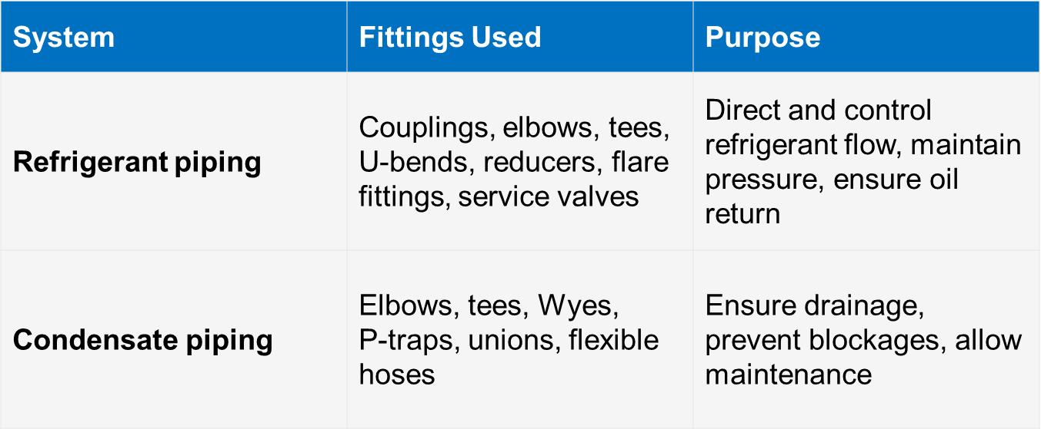
      Pipe fittings
Summary

Slide 29
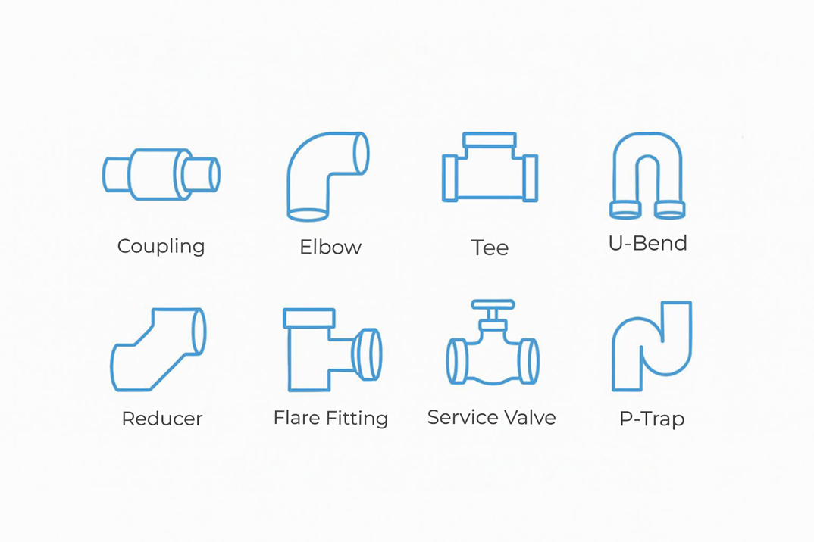
      Pipe fittings
Pipe fittings in air conditioning systems

Slide 30
      Pipe orientation
How pipes are positioned, angled, sloped, and routed determines how effectively refrigerant and condensate move through the system.
Poor pipe orientation can cause:
oil trapping
loss of refrigerant flow
compressor failure
water leaks
reduced cooling capacity
noise and vibration.

Slide 31
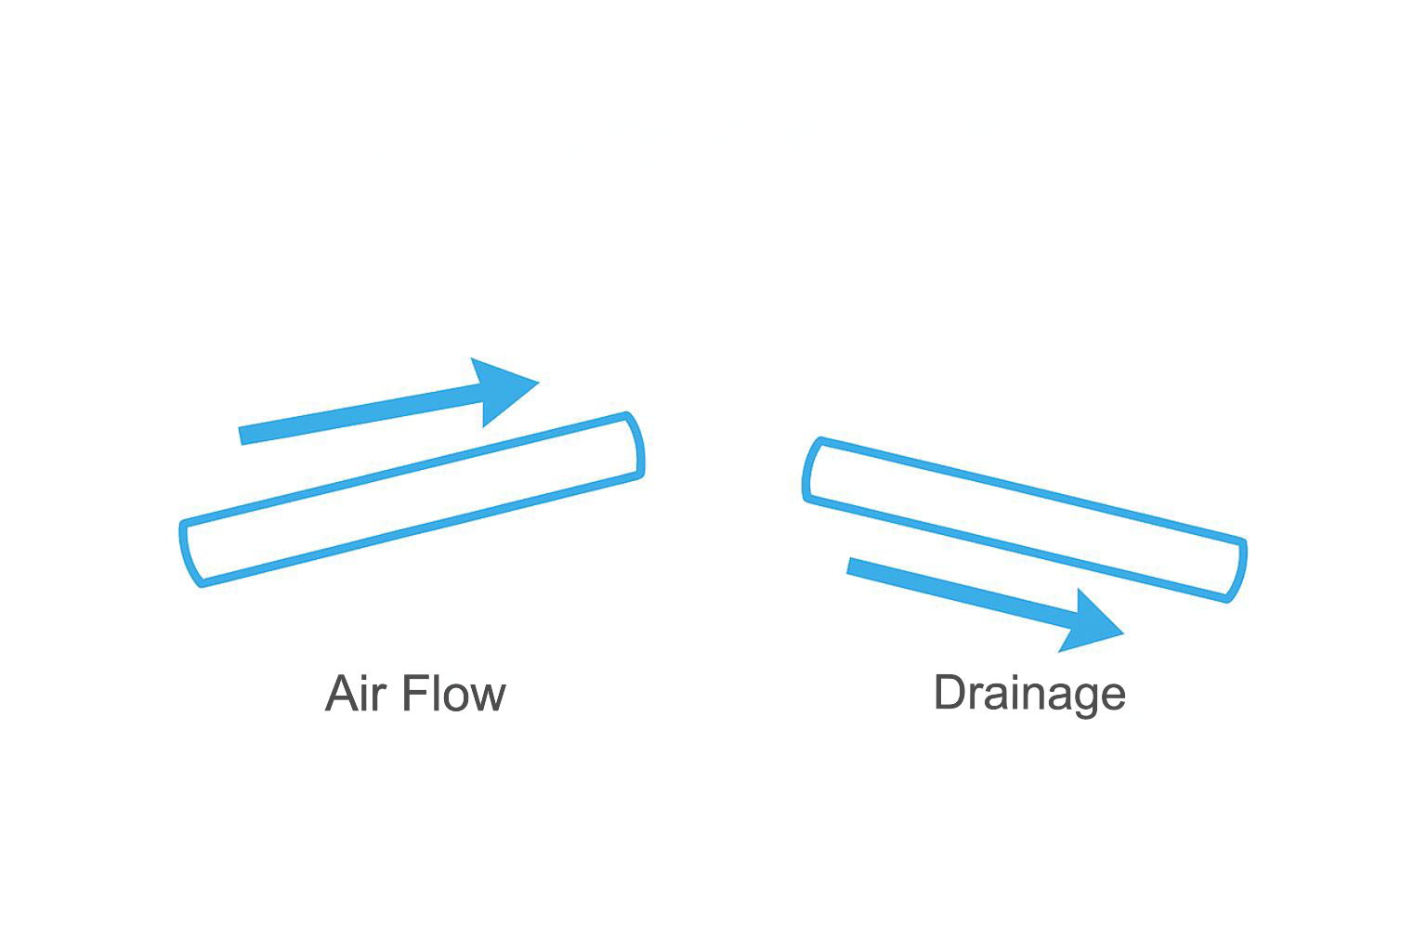
      Pipe orientation
Correct pipe slopes for refrigerant piping (oil return) and condensate drainage.

Slide 32
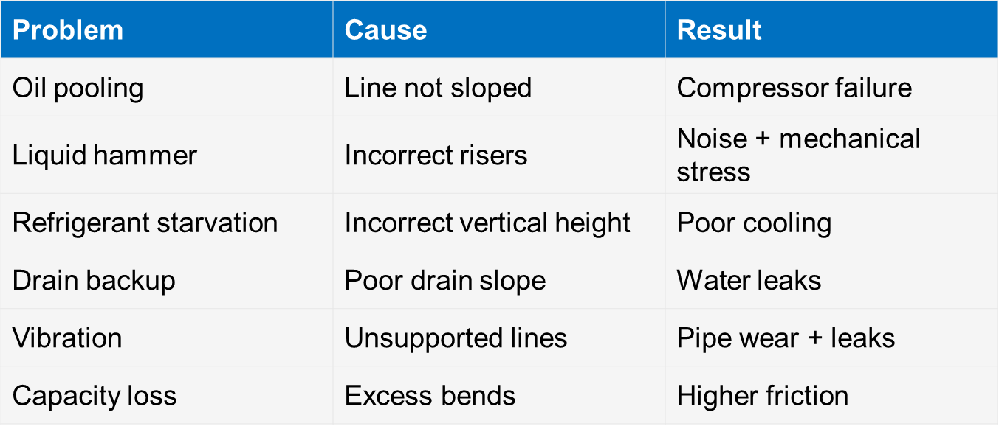
      Pipe orientation
Consequences of incorrect orientation

Slide 33
      Equation of continuity
The Equation of Continuity is a fundamental fluid‑flow principle that applies directly to airflow in ducts and refrigerant flow in pipes.
It expresses mass conservation:
A₁V₁ = A₂V₂
Where:
A = cross‑sectional area of the duct or pipe
V = fluid velocity
This means:
if the duct/pipe gets smaller, velocity increases
if the duct/pipe gets larger, velocity decreases
Air and refrigerant behave the same way.

Slide 34
Why continuity is essential in air conditioning
Airflow:
determines correct CFM/L/S delivery
impacts static pressure
affects comfort and noise levels.
Refrigerant flow:
affects cooling capacity
controls evaporator performance
ensures the compressor receives oil
prevents liquid floodback and overheating.
Notes:
See also: https://www.thermopedia.com/content/966/

Slide 35
      Example – reducing a pipe diameter
A duct is reduced in diameter from 400 mm to 200 mm.
Since the area decreases by a factor of 4:
velocity increases ×4
noise increases
pressure drop increases
fan load increases.
This is exactly what continuity predicts.
Notes:
Answer: Boyle’s Law

Slide 36
      Summary
You should now be able to:
Understand and apply the principles of fluid flow.
Understand pipe characteristics.
Demonstrate the impact on system performance.

Slide 37
Any questions?
Copyright in this document belongs to and is used under licence from the Department for Education, © 2025.
‘T-LEVELS’ and ‘T Level’ are registered trademarks of the Department for Education.
WJEC is authorised by the Department for Education to develop and deliver this T Level Technical Qualification.
WJEC operates in England under the name Eduqas which is a registered trademark of WJEC.

