Slide 1
Occupational Specialism: Air Conditioning Engineering
K1.3 Scientific principles of air conditioning
PowerPoint 1.3c: Psychrometrics

Slide 2
Objectives
By the end of this session, you should be able to:
Understand and apply the principles of psychrometrics:
properties of air
measuring devices
psychrometric chart plot points
psychrometric processes.

Slide 3
      Starter: What do you already know?
Work in small groups.
Look up and research ‘psychrometrics’ to answer the question:
What is psychrometrics, and how does it help an air conditioning system control both temperature and humidity in a room?
Notes:
Psychrometrics is the study of the properties of moist air—things like temperature, humidity, moisture content, and dew point.
Air conditioning systems use psychrometrics to understand and control how air behaves when it is cooled, heated, humidified, or dehumidified.
Key idea: Air conditioning isn’t just about temperature — it’s about controlling the moisture in the air, and psychrometrics tells us how to do that.

Slide 4
      Psychrometrics
The study of moist air – particularly the thermodynamic properties of air-water vapour mixtures.
Psychrometrics includes topics like:
humidity (absolute, relative, specific)
dew point and wet-bulb temperature
enthalpy of moist air
air-conditioning and HVAC processes
evaporation and condensation behaviour.
.

Slide 5
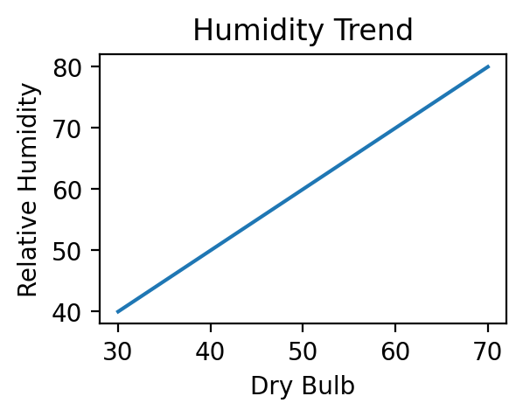
      Psychrometrics
Boyle’s Law
Humidity affects comfort & heat load.
Humidity control is essential for comfort.
AC systems often cool + dehumidify.

Slide 6
      Properties of moist air
1. Dry-Bulb Temperature (DBT)
The temperature measured by a standard thermometer.
It does NOT account for moisture.
2. Wet-Bulb Temperature (WBT)
The lowest temperature air can reach by evaporative cooling.
Measured with a wetted thermometer and airflow.
Drops as evaporation occurs.
3. Dew-Point Temperature (DPT)
The temperature at which water vapour begins to condense.
Direct indicator of moisture content.

Slide 7
      Properties of moist air
4. Relative Humidity (RH)
Ratio of actual water vapour in the air to the maximum possible at that temperature.
Expressed as a percentage.
5. Humidity Ratio (or Specific Humidity)
Mass of water vapour per mass of dry air.
Often expressed as grams of water per kg of dry air.
6. Specific volume
Volume occupied by a unit mass of dry air plus associated water vapour.
Typically, m³/kg of dry air.

Slide 8
      Properties of moist air
7. Enthalpy of moist air
Total heat content of air + water vapour.
Important in heating/cooling calculations.
8. Vapour pressure
Partial pressure exerted by water vapour within the air.

Slide 9
      Measuring devices
The instruments used to measure the physical properties of moist air.
1. Dry-Bulb Thermometer
What it measures: The ordinary air temperature (dry‑bulb temperature).
Where used:
HVAC systems
weather stations
laboratories.

Slide 10
      Measuring devices
2. Wet-Bulb Thermometer
What it measures: The wet‑bulb temperature using a thermometer wrapped in a wet wick.
Why important: Used with dry‑bulb temperature to calculate:
relative humidity
dew point
humidity ratio
Enthalpy.

Slide 11
      Measuring devices
3. Sling psychrometer
A handheld device containing two thermometers:
  Dry-bulb thermometer.
  Wet-bulb thermometer.
How it works: You swing it through the air so evaporative cooling can lower the wet‑bulb reading.
This is the classic tool used in psychrometric calculations.

Slide 12
      Measuring devices
4. Hygrometer
General term for instruments that measure humidity.
Types include:
mechanical (hair) hygrometers
electronic/capacitive hygrometers (common in modern HVAC)
dew point hygrometers.

Slide 13
      Measuring devices
5. Electronic humidity sensors
These are used in modern buildings, HVAC systems, and weather stations.
They measure:
relative humidity
temperature
sometimes dew point.
Types:
resistive sensors
capacitive sensors
thermal conductivity sensors.

Slide 14
      Measuring devices
6. Dew point meter / chilled mirror hygrometer
What it measures: The temperature at which condensation forms (dew point).
Where used:
high‑accuracy laboratory environments
calibration of other humidity instruments.

Slide 15
      Measuring devices
7. Anemometer (Not a humidity device, but essential in air‑conditioning psychrometrics)
What it measures:
air velocity
airflow rate.
Used for:
ventilation studies
air distribution testing
calculating heat load.

Slide 16
      Measuring devices
8. Barometer
What it measures: Atmospheric pressure.
Why important: Psychrometric calculations depend on atmospheric pressure, especially at different altitudes.

Slide 17
      Measuring devices
9. Data loggers
Modern devices that continuously record:
temperature
relative humidity
pressure
sometimes CO₂ and volatile organics.
Used in warehouses, museums, labs, offices, and HVAC commissioning.

Slide 18
      Psychrometric chart plot points
A simplified chart includes:
Dry-Bulb Temperature (°C)
Shown on the horizontal axis.
Humidity Ratio (kg water/kg dry air)
Shown on the vertical axis.
Relative Humidity Curves
Lines often drawn for 10%, 30%, 50%, 70%, and 90% RH.
Saturation Curve (100% RH)
The upper boundary of the chart.

Slide 19
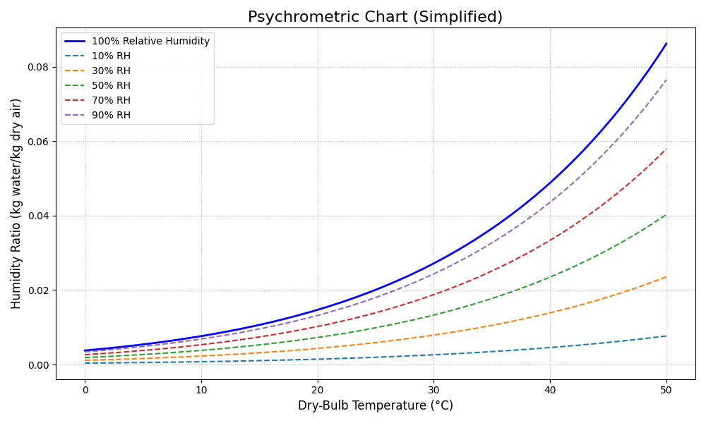
      Psychrometric chart plot points

Slide 20
      Psychrometric chart plot points
If you know two properties, you can locate a point and determine all the others.
Example: Let’s say you have air at:
30°C
dry-bulb 50% RH.
How to plot it:
go to 30°C on the bottom axis → go straight up.
find the 50% RH curve.
where the vertical temperature line meets the RH curve = your air condition point.

Slide 21
      Psychrometric chart plot points
From that point, you can read:
Humidity ratio
Dew point (by moving horizontally left to the saturation curve)
Enthalpy (on a full chart)
Wet‑bulb temperature (on a full chart)
Specific volume (on a full chart)

Slide 22
      Psychrometric chart plot points
Psychrometrics lets you visualise processes such as:
Cooling
Move left (dropping DBT) → moisture unchanged unless dew point is reached.
Heating
Move right (increasing DBT) → moisture unchanged.
Humidification
Move up (humidity ratio increases).
Dehumidification
Move down (humidity drops, usually after cooling below dew point).
Evaporative cooling
Move up-left along a constant wet-bulb line (not shown on simplified chart).

Slide 23
      Psychrometric processes
Psychrometric processes describe how air properties change when it is heated, cooled, humidified, dehumidified, or mixed.
Each process follows a distinct path on a psychrometric chart.
The main ones are:
Sensible heating
Sensible cooling
Dehumidification
Humidification
Evaporative cooling
Mixing of air streams

Slide 24
      Psychrometric processes
1. Sensible heating
What happens:
dry‑bulb temperature increases
moisture content stays constant
relative humidity decreases.
On the chart: A horizontal line to the right.
Example: Air passing through a heater.

Slide 25
      Psychrometric processes
2. Sensible cooling
What happens:
dry‑bulb temperature decreases
moisture content stays constant (unless dew point is reached)
relative humidity increases.
On the chart: A horizontal line to the left.
Example: Cooling air with a coil above dew point temperature.

Slide 26
      Psychrometric processes
3. Cooling and Dehumidification
What happens:
air is cooled below its dew point
water vapor condenses
both temperature and humidity ratio drop
On the chart: A line that moves down‑left, toward the saturation curve.
Example: Air passing over a cold cooling coil that condenses moisture.

Slide 27
      Psychrometric processes
4. Heating and Humidification
What happens:
air temperature increases
moisture content increases
On the chart: An upward‑right line.
Example: Air passing through a warm steam humidifier.

Slide 28
      Psychrometric processes
5. Humidification (Adiabatic)
What happens:
no heat added or removed
water is added by evaporation
moisture increases
temperature decreases slightly (due to evaporative cooling).
On the chart: A line moving up‑left, along a constant wet‑bulb temperature line.
Example: Evaporative coolers (swamp coolers).

Slide 29
Psychrometric processes
6. Adiabatic Mixing of Two Air Streams
What happens:
two air streams mix with no heat added or lost
result lies between the two points, proportional to mass flow rates.
On the chart: A straight line connecting the conditions of the two air streams.
The final state lies somewhere on that line.
Example: Mixing outside air with return air in an HVAC system.
Notes:
See also: https://www.thermopedia.com/content/966/

Slide 30
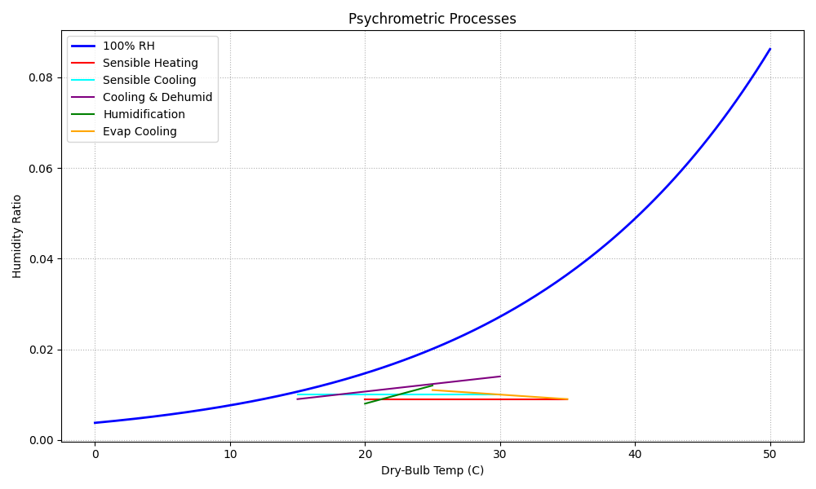
      Psychrometric processes – chart
Notes:
Answer: Boyle’s Law

Slide 31
      Applications of Psychrometrics
Moist air properties used in Air Conditioning.
Commissioning requires Dry Bulb/Wet Bulb readings and humidity ratio.
Commissioning tasks (DB/WB measurement, coil performance checks).
Determines latent vs sensible load.
Example:
During commissioning, if the off‑coil wet‑bulb temperature is too high,
it often indicates either low airflow or a refrigerant undercharge.
Notes:
Answer: Charles’s Law

Slide 32
      Summary
You should now be able to:
Understand and apply the principles of psychrometrics:
properties of air
measuring devices
psychrometric chart plot points
psychrometric processes.

Slide 33
Any questions?
Copyright in this document belongs to and is used under licence from the Department for Education, © 2025.
‘T-LEVELS’ and ‘T Level’ are registered trademarks of the Department for Education.
WJEC is authorised by the Department for Education to develop and deliver this T Level Technical Qualification.
WJEC operates in England under the name Eduqas which is a registered trademark of WJEC.

