Slide 1
Occupational Specialism: Air Conditioning Engineering
K1.3 Scientific principles of air conditioning
PowerPoint 1.3b: Gas laws

Slide 2
Objectives
By the end of this session, you should be able to:
Understand and apply the ideal gas laws.
Understand the units of pressure.
Use pressure scales.

Slide 3
Starter: What do you already know?
Discuss in small groups:
Why does an air conditioner need a refrigerant gas, and what role does this gas play in cooling a room?
Describe the role of the refrigerant and what it does in the:
evaporator (inside)
compressor
condenser (outside).
Notes:
Air conditioners use a refrigerant gas because it can easily change between liquid and gas at low temperatures. This ability allows it to absorb heat inside the room and release it outside.
Key idea: The gas is the “heat carrier” – it picks up heat indoors and dumps it outdoors. Without this special refrigerant gas, the air conditioner couldn’t move heat around.

Slide 4
Application of Gas Laws
Used when pressure‑testing pipework pressure stability = leak‑free pipework
Helps detect leaks before charging refrigerant.
Example
Before refrigerant is added to a split system, engineers pressurise the pipework with dry nitrogen and wait for stabilisation. A rising pressure during solar exposure is normal; falling pressure indicates a leak.

Slide 5
Ideal gas laws
Boyle’s Law
Relationship: Pressure ↔ Volume
Law: At constant temperature, the pressure of a gas is inversely proportional to its volume.
P₁V₁ = P₂V₂
Meaning: If you squeeze a gas into a smaller space, its pressure increases.

Slide 6
Boyle’s Law – AC example
Refrigerant compression
Inside the compressor, refrigerant gas is forced into a smaller space (volume ↓).
Boyle’s Law states that pressure increases.
Real AC effect: High‑pressure gas is essential before the condenser so the refrigerant releases heat as it cools back into a liquid.
Compressor squeezes refrigerant → volume decreases → pressure rises

Slide 7
Ideal gas laws
Charles’s Law
• Relationship: Volume ↔ Temperature
Law: At constant pressure, a gas’s volume is directly proportional to its temperature (in Kelvin).
V₁ = V₂​​ T₁ T₂
Meaning: Heat a gas and it expands.

Slide 8
Charles’s Law – AC example
Expansion valve cooling
After high‑pressure refrigerant exits the condenser, it moves to the expansion valve.
The refrigerant suddenly expands (volume ↑).
By Charles’s Law, temperature drops (T ↓).
Real AC effect: This is exactly why the refrigerant becomes cold before entering the evaporator.
Refrigerant expands → volume increases → temperature drops → cooling effect

Slide 9
Ideal gas laws
Gay‑Lussac’s Law
• Relationship: Pressure ↔ Temperature
Law: At constant volume, pressure is directly proportional to temperature (in Kelvin).
P₁ = P₂
T₁ T₂
​​
Meaning: Heat a gas in a sealed container and the pressure increases.

Slide 10
Gay-Lussac’s Law – AC example
Heating in the compressor
When the refrigerant is compressed, not only does pressure increase – temperature rises too.
Real AC effect: This is why the gas leaving the compressor is hot before entering the condenser.
Compressing gas → temperature increases because pressure increases.

Slide 11
Ideal gas laws
Combined Gas Law
• This merges Boyle’s, Charles’s, and Gay‑Lussac’s laws
P₁V₁ = P₂V₂
T₁ T₂
​​Useful when multiple variables change.

Slide 12
Combined Gas law – AC example
Operation in different outdoor temperatures
When outdoor temperature changes, all three variables (P, V, T) shift together in the refrigerant cycle.
Real AC effects:
On a hot day, outdoor coil temperature rises → refrigerant pressure rises → compressor works harder.
On a cold day, pressure drops → system may struggle to operate efficiently.
Use this law when checking refrigerant pressures vs. temperatures.
Pressure, volume, and temperature all shift together as weather conditions change.

Slide 13
Ideal gas laws
Avogadro’s Law
Relationship: Volume ↔ Amount of gas
Law: At constant temperature and pressure, volume is directly proportional to moles of gas.
V₁ = V₂​​ n₁ n₂
Meaning: More gas particles = larger volume.

Slide 14
Avogadro’s Law – AC example
Refrigerant charge levels
If an AC is undercharged (not enough refrigerant), there are fewer gas molecules.
Fewer moles (n ↓) → smaller gas volume circulating (V ↓).
Real AC effect:
poor cooling
low suction pressure
evaporator coil may freeze.
If you add more refrigerant, more moles (n ↑) → larger volume (V ↑), improving cooling – up to the correct charge.
More refrigerant → more cooling capacity.

Slide 15
Ideal gas laws
Ideal Gas Law
Brings everything together:
PV = nRT
Where:
P = pressure
V = volume
n = number of moles
R = gas constant
T = temperature (Kelvin)

Slide 16
Ideal gas law – AC example
Diagnosing system performance
Use the ideal gas law indirectly when interpreting:
suction and discharge pressures
refrigerant temperatures
superheat and subcooling.
Every measurement in an AC system reflects relationships in the ideal gas law.
Real AC effect: It helps determine whether the system has the correct refrigerant charge and is functioning efficiently.
The whole refrigeration cycle depends on the ideal gas law.

Slide 17
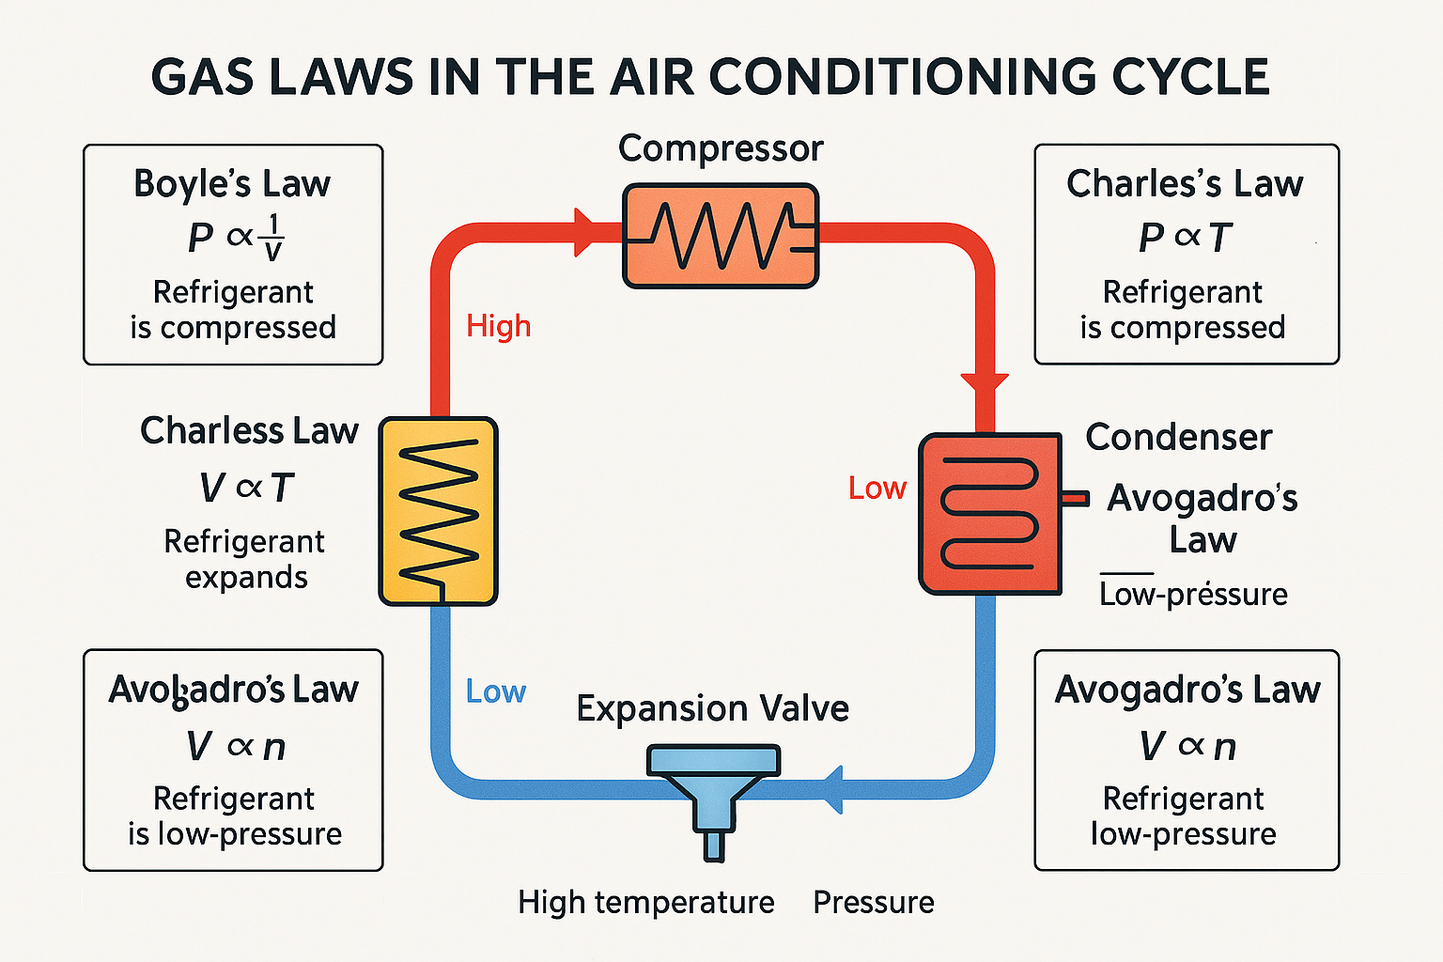
AC cycle showing each gas law

Slide 18
Ideal gas laws
Dalton’s Law
The total pressure of a mixture of gases is equal to the sum of the pressures each gas would exert if it were alone in the container.
In symbols:
P_{total}=P₁+P₂+P₃+… Where each P_{n}​ is the partial pressure of one gas in the mixture.
A partial pressure is the pressure a single gas would exert on its own, even if it’s mixed with other gases. Think of each gas as acting independently.

Slide 19
Dalton’s Law – AC example
Moist air entering an evaporator
Suppose room air pressure is 101 kPa, made of:
Dry air: 98 kPa
Water vapour: 3 kPa
Total air pressure: P_{total}= 98+3 = 101 kPa
If the coil cools the air and removes some moisture, the water vapour partial pressure might drop to 1.5 kPa.
New total pressure: P_{new}= 98+1.5 = 99.5 kPa
Air becomes drier, which increases comfort.
Notes:
See also: https://www.thermopedia.com/content/966/

Slide 20
Revision questions
1. In the compressor, the refrigerant gas is squeezed into a smaller space.
Which gas law best describes the resulting increase in pressure?
Charles’s Law
Boyle’s Law
Avogadro’s Law
Ideal Gas Law
√
Notes:
Answer: Boyle’s Law

Slide 21
Revision questions
2. When refrigerant expands in the expansion valve, its temperature drops.
Which law explains this?
Gay‑Lussac’s Law
Boyle’s Law
Charles’s Law
Avogadro’s Law
√
Notes:
Answer: Charles’s Law

Slide 22
Revision questions
3. Which part of the AC system becomes hot due to an increase in pressure?
Evaporator
Condenser
Compressor
Expansion valve
√
Notes:
Answer: Compressor

Slide 23
Revision questions
4. If water vapour increases in moist air, Dalton’s Law says the total pressure will:
Decrease
Stay the same
Increase
Drop to zero
√
Notes:
Answer: Increase

Slide 24
Units of pressure
The common units of pressure used in HVAC are:
• Pascal
• bar
• millimetres of Hg

Slide 25
Units of pressure – Pascal
The Pascal (Pa) is the SI unit of pressure.
It is defined as: 1 Pa = 1 N/m²
​This means that 1 Pascal is the pressure created when a force of one newton is applied uniformly over an area of one square metre.
Pressure is: P = F
A
​So the Pascal measures how much force is acting on each unit of area.

Slide 26
Example – pressure in Pascals
Everyday examples
Atmospheric pressure = 101,325 Pa (about 101 kPa)
Car tyre pressure ≈ 220,000 Pa (220 kPa)
A fingertip pressing lightly = 5,000–10,000 Pa
Air conditioning pressures are usually much larger, so we use:
kPa (kilopascal) = 1,000 Pa
MPa (megapascal) = 1,000,000 Pa
bar (1 bar = 100,000 Pa)
psi (pounds per square inch — common in gauges)
Example: A low‑side pressure of 60 psi ≈ 414 kPa.

Slide 27
Units of pressure – bar
The bar is a metric unit of pressure defined as:
1 bar = 100,000 Pa
​This makes the bar very close to standard atmospheric pressure, which is:
1 atm = 101,325 Pa = 1.01325 bar
The bar is easy to work with because:
it is a round, simple number (100,000 Pa)
it is close to natural atmospheric pressure
it avoids large numbers like 101,325 Pa.

Slide 28
Example – pressure in bar
In HVAC and refrigeration, pressures are often expressed in bar or bar(g).
Two common forms:
1. bar(a) — bar absolute
Measured relative to a perfect vacuum.
2. bar(g) — bar gauge Measured relative to atmospheric pressure.
Example: If a gauge reads 2 bar(g), the absolute pressure is: 2 bar(g)+1 bar(atmospheric)=3 bar(a).

Slide 29
Units of pressure - millimetres of Hg
A traditional unit of pressure based on the height of a column of mercury supported by atmospheric pressure in a barometer.
1 mmHg ≈ 133.322 Pa ​ This means that if atmospheric pressure can support a 1‑mm‑high column of mercury, the pressure at the base is 1 mmHg

Slide 30
Example – pressure in millimetres of Hg
In HVAC, mmHg is most relevant in vacuum measurement during system evacuation.
A deep vacuum may be measured in mmHg below atmospheric pressure
Full atmospheric pressure = 760 mmHg
A good AC system evacuation aims for near zero mmHg absolute, or equivalently 500 microns (0.5 mmHg)

Slide 31
Units of pressure – torr
The torr is a unit of pressure defined as: 1 torr = 1760 atm
​This is based on the traditional definition of atmospheric pressure: 1 atm = 760 torr1
The name torr comes from Evangelista Torricelli, the inventor of the mercury barometer.
It is designed to be almost identical to millimetres of mercury (mmHg).
Historically: 1 torr = 1 mmHg
In exact terms: 1 torr = 133.322 Pa
So, 1 mmHg = 133.322387 Pa

Slide 32
Example – pressure in torr
In HVAC, the torr is mainly used for deep‑vacuum measurements, especially in refrigeration evacuation procedures.
Typical vacuum readings:
760 torr = atmospheric pressure
0 torr = perfect vacuum
A good AC system evacuation:
≈0.5 torr = 500 microns

Slide 33
Pressure scales
The common pressure scales used in HVAC are:
• absolute
• vacuum
• gauge.

Slide 34
Pressure scales – Absolute pressure
Absolute pressure is pressure measured relative to a perfect vacuum (zero pressure). It uses zero vacuum as its reference point. It tells us the true pressure inside a system, unaffected by weather or altitude.
It includes all pressure acting on a system:
Pabsolute = Pgauge+Patmospheric
​​Atmospheric pressure at sea level is approximately:
101,325 Pa
101 kPa
1 bar
760 mmHg
14.7 psi

Slide 35
Example – Absolute pressure
Absolute pressure is essential in HVAC when:
using the ideal gas law
determining saturation temperature of refrigerants
performing deep vacuum measurements
reading absolute pressure sensors on digital gauges.
Example: A vacuum of 500 microns is 0.5 torr absolute or 0.00066 bar absolute.

Slide 36
Pressure scales – Vacuum pressure
Vacuum pressure is pressure below atmospheric pressure.
It tells you how much lower the pressure in a system is compared to normal atmospheric pressure.
A vacuum exists whenever pressure is less than atmospheric pressure.
Vacuum pressure = Atmospheric pressure − Absolute pressure
​
It uses atmospheric pressure as its zero (reference) point.

Slide 37
Example – Vacuum pressure
Vacuum pressure is essential in HVAC for:
1. Evacuation before charging refrigerant
A vacuum pump removes:
air
moisture
non‑condensables.
This prepares the system for refrigerant.
2. Using microns to measure the depth of the vacuum
500 microns → good deep vacuum
1 micron = 0.001 torr

Slide 38
Example – Vacuum pressure
3. Checking for leaks
A system that won’t hold a vacuum is likely to have:
a leak
moisture boiling off
contaminated oil.

Slide 39
Pressure scales – Gauge pressure
Gauge pressure is pressure measured relative to atmospheric pressure.
A gauge (like those used in HVAC manifolds) is calibrated so that:
P_{gauge} = 0 when exposed to the atmosphere
​This means it only shows how much higher or lower the measured pressure is compared to the surrounding air.
It uses atmospheric pressure as its zero (reference) point.
Relationship to Absolute pressure:
P_{absolute} ​= P_{gauge}​+P_{atmospheric}​
Always switch to Absolute pressure for calculations.

Slide 40
Example – Gauge pressure
Most refrigeration and HVAC pressure measurements use gauge pressure, including:
suction pressure (low side)
discharge pressure (high side)
charging refrigerant
diagnosing superheat and subcooling
testing system performance.
Gauges show pressure relative to the surrounding air because it:
simplifies reading
aligns with equipment ratings
reflects operational conditions more directly.

Slide 41
Summary
You should now be able to:
Understand and apply the ideal gas laws.
Understand the units of pressure.
Use pressure scales.

Slide 42
Any questions?
Copyright in this document belongs to and is used under licence from the Department for Education, © 2025.
‘T-LEVELS’ and ‘T Level’ are registered trademarks of the Department for Education.
WJEC is authorised by the Department for Education to develop and deliver this T Level Technical Qualification.
WJEC operates in England under the name Eduqas which is a registered trademark of WJEC.

