Slide 1
Occupational Specialism: Air Conditioning Engineering
K1.3 Scientific principles of air conditioning
PowerPoint 1.3a: Thermodynamics

Slide 2
Objectives
By the end of this session, you should be able to:
Understand and apply the principles of thermodynamics:
• temperature scales (Celsius, Kelvin)
• laws of thermodynamics (first law, second law)
• heat transfer (conduction, convection, radiation)
• latent heat processes (melting (fusion), freezing, sublimation, condensation, evaporation, boiling)
sensible heat processes (superheating, sub-cooling).

Slide 3
Starter: What do you already know?
In groups, discuss:
How does an air conditioner move heat from inside a room (cooler area) to the outside (warmer area)?
Think about the equipment used:
evaporator inside the room
compressor outside
condenser outside the house
expansion valve.
Notes:
Key point - Air conditioners don’t destroy heat—they move it, using thermodynamic cycles powered by electrical work.
Thermodynamic principle:
Heat is moved from low temperature (inside your room) to high temperature (outside) because work is added by the compressor.
Without that added work, the process would violate the Second Law.

Slide 4
Temperature scales
Two main temperature scales:
Celsius (°C) – Commonly used in everyday life e.g. weather, cooking, etc. Based on the properties of water.
Kelvin (K) – The SI unit for temperature – used in science, physics, and engineering. Absolute scale. Same size degree as Celsius.

Slide 5
Temperature scales
Relationship Between Celsius and Kelvin
The scales are offset by 273.15.
Conversions:
K = °C + 273.15
°C = K − 273.15
Examples:
25 °C → 298.15 K
0 °C → 273.15 K
100 °C → 373.15 K

Slide 6
Temperature scales
Summary
Property | Celsius (°C) | Kelvin (K)
Used for | Daily life | Science, engineering
Zero point | Freezing point of water (0 °C) | Absolute zero (the theoretical point where all particle motion stops)
Boiling point (of water) | 100 °C | 373.15K
Negative values | Yes | No
Relationship between the scales | Kelvin and Celsius use the same size degree, but have different starting points

Slide 7
Laws of Thermodynamics
First Law of Thermodynamics – Law of energy conservation
Energy cannot be created or destroyed – only transferred or transformed.
Total energy in a closed system remains constant.
Example: When you heat water, electrical energy → thermal energy, but the total amount of energy stays the same.
Summary: Energy in = Energy out (in some form).

Slide 8

Laws of Thermodynamics
Example – Air Conditioning
An air conditioner does not destroy heat; it moves it from inside the room to outside.
Electrical energy powers the compressor and fans.
The refrigerant absorbs heat from indoor air (evaporator).
The same amount of heat + work is released outdoors (condenser).
Key point: The energy entering the system (electricity) equals the energy leaving (heat expelled + cooling produced).
Summary: Heat moves from hot to cold. An AC transfers heat; it doesn’t make cold out of nothing.

Slide 9
Laws of Thermodynamics
Second Law of Thermodynamics – Entropy always increases.
The entropy (disorder) of an isolated system always increases over time.
Heat flows naturally from hot → cold, never the reverse without work.
No process is perfectly efficient; some energy is always “lost” as heat.
Summary: Everything tends toward disorder.
No heat engine is 100% efficient.

Slide 10
Laws of Thermodynamics
Example – Air conditioning
Heat naturally flows from hot → cold, but AC forces the opposite: it pumps heat from inside (cooler space) to outside (often hotter).
Since this goes against the natural flow, the AC must do work (running the compressor).
Also, some energy is wasted as heat, increasing entropy.
This is why air conditioner outdoor units feel very hot. Key point: No AC is 100% efficient – some energy is always wasted as unusable heat.
Summary: Your AC works hard because nature wants heat to stay in your house!

Slide 11
Laws of Thermodynamics
Third Law of Thermodynamics – Zero Entropy at absolute zero.
As the temperature approaches absolute zero (0 K), the entropy of a perfect crystal approaches zero.
At 0 K, particles would be perfectly ordered.
Absolute zero can never be reached in practice.
Summary: Perfect order exists only at absolute zero – something we can approach but never achieve.

Slide 12
Laws of Thermodynamics
Example – Air Conditioning
Air conditioners can cool your room, but they cannot reach absolute zero
(0 K = –273.15 °C).
Why? Removing the final bits of heat would require an infinite amount of energy.
Refrigerants cannot operate at extremely low temperatures and materials would fail long before reaching that limit.
Key point: An AC can cool effectively, but there is a fundamental limit — absolute zero is impossible.
Summary: Your AC can’t freeze your room to outer‑space temperatures because physics won’t allow it.

Slide 13
How pressure-enthalpy diagrams relate to the laws of thermodynamics
A P‑h diagram plots pressure (vertical axis) vs. specific enthalpy (horizontal axis) and shows the behaviour of a refrigerant as it moves through the refrigeration cycle (evaporation, compression, condensation, expansion).
The following slides show how this connects to each thermodynamic law.

Slide 14
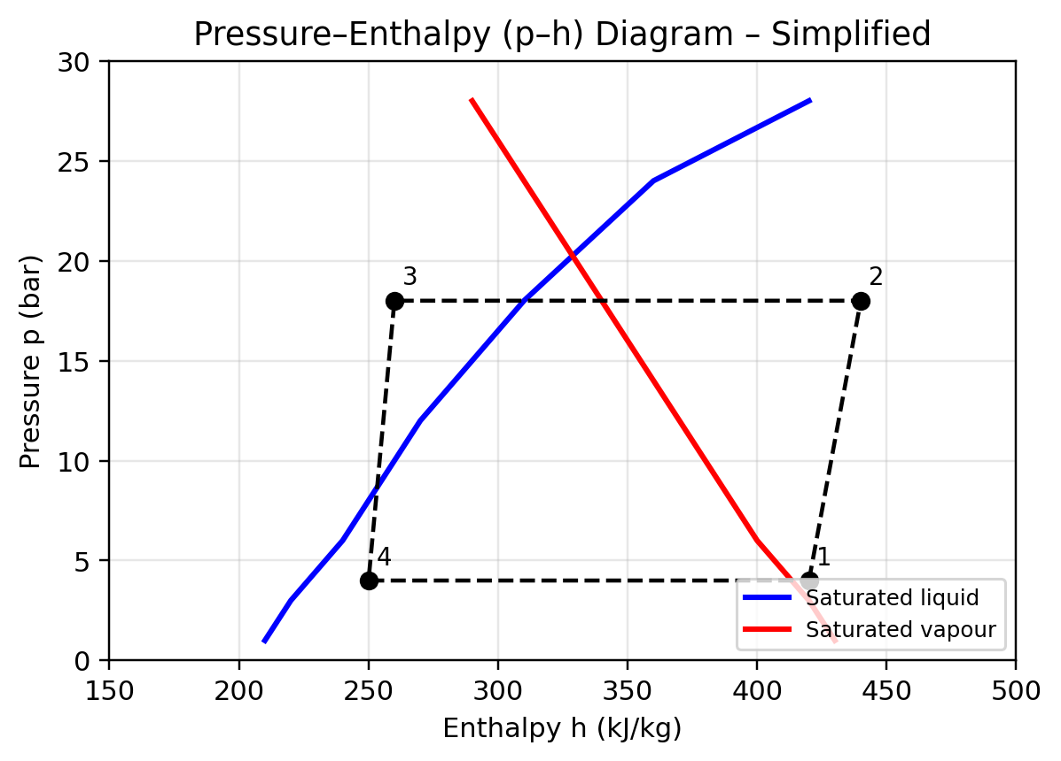
Pressure-enthalpy (p–h) diagram
Shows refrigeration cycle stages:
1. Evaporation
2. Compression
3. Condensation
4. Expansion
Used to reason about capacity (Δh) and pressures for a given refrigerant.
Notes:
See also https://www.researchgate.net/figure/Simple-vapour-compression-refrigeration-cycle-on-P-h-diagram_fig1_346765777

Slide 15
Laws of Thermodynamics on a pressure-enthalpy diagram
Thermodynamic Law | What it says | How It appears on a p‑h diagram
1st Law | Energy is conserved | Horizontal movement = heat/work transfer; compressor adds enthalpy; condenser/evaporator remove/add heat
2nd Law | Entropy increases; work needed to move heat uphill | Compression curve shows work input & inefficiencies; heat flow from cold → hot only possible with work
3rd Law | Entropy → 0 at absolute zero | Limits on evaporator temperatures; shape of saturation dome; refrigerant can't reach zero entropy

Slide 16
Mollier diagram
A Mollier diagram is a graphical chart used in thermodynamics to show how a substance behaves when it undergoes heating, cooling, compression, or expansion – especially in refrigeration, air‑conditioning, and steam systems.
Most commonly, “Mollier diagram” refers to an enthalpy-entropy (h‑s) diagram.

Slide 17
Mollier diagram
A typical Mollier (h‑s) diagram plots:
Vertical axis → Enthalpy (h)
Horizontal axis → Entropy (s)
On the diagram you will also see:
Lines of constant pressure
Lines of constant temperature
Saturation dome (boundary between liquid and vapour)
Regions for:
Subcooled liquid
Two‑phase mixture
Superheated vapour

Slide 18
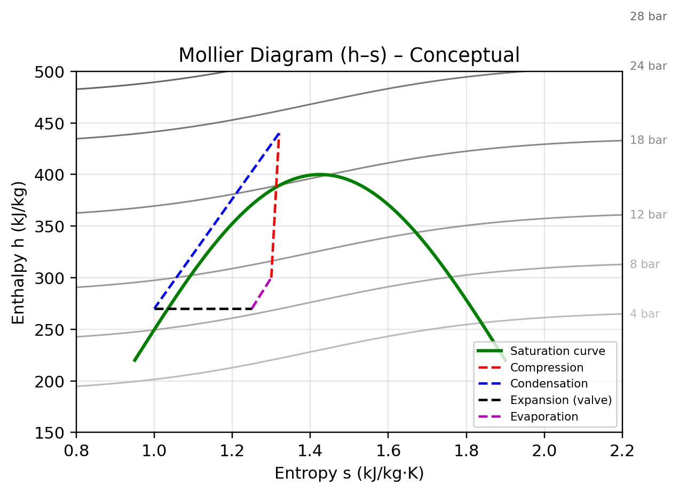
Mollier diagram
Plot of enthalpy (h) vs entropy (s) with isobars.
Visualise compression (near-constant s), condensation, expansion (≈iso‑h), evaporation.
Notes:
See also: https://www.thermopedia.com/content/966/

Slide 19
Mollier diagram – what it is used for
A Mollier diagram helps engineers analyse:
Refrigeration cycles (evaporation → compression → condensation → expansion).
Steam turbine and boiler processes (expansion, heat addition, work output).
Compressor performance (enthalpy rise across the compressor).
Air‑conditioning calculations (heat removal, work of compression, cooling capacity).

Slide 20
Mollier diagram – why it is useful
It allows you to determine:
heat transfer
work input/output
refrigeration effect
Coefficient of Performance (COP)
changes in state at each point of the cycle – without heavy calculations, simply by reading the diagram.

Slide 21
Mollier Diagram vs. Pressure‑Enthalpy (P‑h) Diagram
Feature | Mollier (h-s) diagram | Pressure-Enthalpy (p-h) diagram
Axes | Enthalpy vs Entropy | Pressure vs Enthalpy
Best for | Steam and theoretical analysis | Refrigeration and HVAC
Shows entropy directly? | Yes | No

Slide 22
Heat transfer
Heat transfer refers to conduction, convection and radiation. How they are managed within a building will directly affect that building’s ‘environmental footprint’.
Heat loss in a building is affected by the fabric, the extent and type of ventilation and the internal air temperature.

Slide 23
Heat transfer – conduction
Conduction refers to heat moving through a material or from one material to another via direct contact.
The heat is transported as atoms vibrate with kinetic energy.
Some materials (e.g. metals) conduct efficiently, whereas non-metals and gases are poor conductors.

Slide 24
Heat transfer – convection
Heat energy is transferred from hot places to cooler places by convection.
Convection occurs when particles in a liquid or gas with a lot of heat energy move and take the place of particles with less heat energy.

Slide 25
Heat transfer – radiation
Unlike conduction and convection, which require particles in a solid, liquid or gas, infrared radiation is a type of electromagnetic radiation that involves waves.
The sun is 150 million km away, but we still experience its heating effects via radiation.

Slide 26
Latent heat processes
Latent heat processes are phase changes in which a substance absorbs or releases heat without changing its temperature.
The energy goes into changing the state (solid, liquid, gas), not the temperature.
The key processes are:
melting (fusion)
freezing
sublimation
condensation
evaporation
boiling.

Slide 27
Latent heat processes – summary
Process | State Change | Heat Flow | What Happens
Melting (Fusion) | Solid → Liquid | Heat is absorbed | Particles gain energy and break from fixed positions.
Freezing | Liquid → Solid | Heat is released | Particles lose energy and lock into a fixed structure.
Sublimation | Solid → Gas | Heat is absorbed | Solid particles gain enough energy to jump directly into gas phase.
Condensation | Gas → Liquid | Heat is released | Gas particles lose energy and form a liquid.
Evaporation | Liquid → Gas (surface only) | Heat is absorbed | Faster particles escape from the surface into the air.
Boiling | Liquid → Gas (throughout liquid) | Heat is absorbed | Liquid reaches boiling point and forms vapour bubbles internally.

Slide 28
Sensible heat processes
Sensible heat is the heat added or removed from a substance that causes a temperature change but does not change its state.
When sensible heat is added → temperature goes up.
When sensible heat is removed → temperature goes down.
The substance stays solid, liquid, or gas throughout the process.
These processes are shown on refrigeration P‑h diagrams as temperature changes outside the saturation dome.

Slide 29
Sensible heat processes – superheating
Superheating is when a vapour is heated above its saturation (boiling) temperature at a given pressure.
Key points:
it is a sensible heat process – the refrigerant stays a gas
happens after all liquid has boiled off in the evaporator
ensures only dry vapour enters the compressor (protects the compressor).
Example in HVAC – Refrigerant leaving the evaporator at:
Saturation temperature: 5°C
Actual vapour temperature: 15°C→ Superheat = 10°C

Slide 30
Sensible heat processes – sub-cooling
Sub‑cooling is when a liquid is cooled below its saturation (condensing) temperature at a given pressure.
Key points:
a sensible cooling process – the refrigerant stays a liquid
occurs after full condensation in the condenser
improves system efficiency by ensuring no vapour enters the expansion device.
Example in HVAC – Refrigerant leaving the condenser at:
Saturation temperature: 40°C
Actual liquid temperature: 32°C→ Subcooling = 8°C

Slide 31
Summary
You should now be able to:
Understand and apply the principles of thermodynamics:
• temperature scales (Celsius, Kelvin)
• laws of thermodynamics (first law, second law)
• heat transfer (conduction, convection, radiation)
• latent heat processes (melting (fusion), freezing, sublimation, condensation, evaporation, boiling)
sensible heat processes (superheating, sub-cooling).

Slide 32
Any questions?
Copyright in this document belongs to and is used under licence from the Department for Education, © 2025.
‘T-LEVELS’ and ‘T Level’ are registered trademarks of the Department for Education.
WJEC is authorised by the Department for Education to develop and deliver this T Level Technical Qualification.
WJEC operates in England under the name Eduqas which is a registered trademark of WJEC.

