Slide 1
Occupational Specialism: Air Conditioning Engineering
K1.2 Air Conditioning and ventilation in a modern economy
PowerPoint 1.2: Air conditioning and ventilation

Slide 2
Objectives
By the end of this session, you should be able to:
Describe the uses of air conditioning in modern society.
Explain comfort cooling vs process cooling.
Explain what ventilation is and why it matters.
Describe fresh air requirements and air changes.
Explain how to remove stale, polluted or harmful air.

Slide 3
      Starter: What do you already know?
As a class discuss:
What is the difference between air conditioning and ventilation, and why do buildings need both?
Notes:
Encourage learners to think about:
what each system actually does
how ventilation focuses on air quality (bringing in fresh air and removing stale air)
how air conditioning focuses on temperature, humidity, and comfort
why both systems work together in most buildings.

Slide 4
      Uses of air conditioning
Human comfort: maintaining safe and comfortable indoor conditions.
Commercial uses: shops, offices, classrooms.
Industrial uses: cooling machinery, data centres, manufacturing lines.
Special environments: hospitals, labs, clean rooms.

Slide 5
      Comfort cooling vs Process cooling
1. Purpose
Comfort cooling - designed to maintain a pleasant indoor environment.
Focuses on thermal comfort, humidity control, and good air quality.
Typical applications:
classrooms
offices
homes
retail environments.

Slide 6
      Comfort cooling vs Process cooling
Process cooling – designed to remove heat generated by industrial or technical processes.
The priority is to protect equipment, products, or processes, not human comfort.
Typical applications:
server rooms/data centres
manufacturing lines
food production
laboratory environments
medical equipment cooling.

Slide 7
      Comfort cooling vs Process cooling
2. Temperature and humidity control requirements
Comfort cooling
Follows human comfort guidelines (e.g. 20–24 °C).
Relative Humidity (RH) is the ideal range for human comfort, health, and reduced microbial growth.
ASHRAE and EPA recommendations place indoor RH ideally between 40% and 60% to minimise mould, dust mites, and respiratory irritation.

Slide 8
      Comfort cooling vs Process cooling
Comfort cooling
UK indoor RH commonly drops below 40% in winter, which is associated with occupant discomfort, dryness, and irritation – reinforcing 40–60% as the ideal target range.
Focus is on:
preventing occupants from feeling too warm/cold
avoiding high humidity (stuffiness, mould risk)
maintaining acceptable indoor air quality.

Slide 9
      Comfort cooling vs Process cooling
Process cooling
Requires much tighter tolerances.
Small temperature swings may:
overheat equipment
damage products
interrupt manufacturing
cause contamination.
Humidity may need to be extremely low or controlled within narrow bands (e.g. in electronics, pharmaceuticals).

Slide 10
      Comfort cooling vs Process cooling
3. Ventilation requirements
Comfort cooling
Ventilation is for:
fresh air
dilution of co₂ and pollutants
odour control.
Follows building ventilation standards (e.g. room occupancy rates).

Slide 11
      Comfort cooling vs Process cooling
Process cooling
Ventilation needs vary widely depending on the process:
cleanrooms need filtered, pressurised air
industrial spaces may require the extraction of fumes/heat
food production may need filtered makeup air.
In many cases, ventilation systems run independently of the cooling system.

Slide 12
      Comfort cooling vs Process cooling
4. Equipment differences
Comfort cooling
Common technologies:
split AC systems
VRF/VRV
heat pumps
fan coil units
air handling units (AHUs).
Designed for:
moderate cooling loads
quiet operation
energy efficiency for occupied spaces.

Slide 13
      Comfort cooling vs Process cooling
4. Equipment differences
Process cooling
Common technologies:
chillers (air‑cooled or water‑cooled)
process cooling units (PCUs)
industrial refrigeration
close-control CRAC/CRAH units.
Designed for:
continuous, reliable operation
high cooling loads
precise and accurate control
operation in harsh or 24/7 environments
high reliability over efficiency.

Slide 14
      Comfort cooling vs Process cooling
5. Operating hours
Comfort cooling
Typically operates during occupied hours.
Can be switched off or set back when the building is empty.
Process cooling
Often runs 24/7, because:
equipment runs continuously
products require constant conditions
data centres never shut down.

Slide 15
      Comfort cooling vs Process cooling
6. Load characteristics
Comfort cooling
Load mainly comes from:
people
sunlight/solar gain
lighting
small appliances.
Loads fluctuate with:
time of day
weather
occupancy levels.

Slide 16
      Comfort cooling vs Process cooling
Process cooling
Load mainly comes from:
machines
production processes
chemical reactions
heat from servers/electronics.
Loads tend to be:
high
consistent
not linked to outdoor weather.

Slide 17
      Comfort cooling vs Process cooling
7. Failure impact
Comfort cooling
Discomfort
Reduced productivity
Complaints from occupants
Process cooling
Equipment failure
Production shutdown
Overheating risk (servers, machinery)
Product spoilage
Significant financial losses

Slide 18
      Comfort cooling vs Process cooling
8. Examples
Comfort cooling
Classroom cooled to 20–22°C for student comfort.
Office AC designed for 10–12 people occupancy.
Retail space maintaining steady temperatures for shoppers.
Process cooling
Data centre cooling holding temperature at 18–21°C with <60% RH.
Injection moulding machine requiring continuous chilled-water cooling.
Meat processing plant needing strictly controlled low temperatures.
Notes:
See website: https://vision-energy.co.uk/bb101-guidelines-what-schools-need-to-know-about-ventilation-thermal-comfort-and-indoor-air-quality/#:~:text=Minimum%20Ventilation%20Rates,the%20outdoor%20running%20mean%20temperature.

Slide 19
Summary: Comfort cooling vs Process cooling
Feature | Comfort Cooling | Process Cooling
Main Purpose | Human comfort | Protect equipment/process
Temperature Tolerance | Moderate | Very tight
Humidity Requirements | General comfort | Precise control
Ventilation Needs | Fresh air, CO₂ control | Process‑specific (e.g. cleanrooms, extraction)
Operating Hours | Occupied times | 24/7 often required
Load Drivers | People, solar gain | Machines, processes
Impact of Failure | Discomfort | Equipment or product loss
Common Systems | Split AC, VRF, AHUs | Chillers, CRAC/CRAH, industrial refrigeration
Notes:
Central plant: stress scalability and air quality advantages.

Slide 20
      What is ventilation?
Ventilation is the movement of outdoor (fresh) air into a building and indoor air out of a building.
Used to dilute and remove stale, polluted or harmful air.
Essential in schools, homes, workplaces and industrial spaces.
Legal & Regulatory requirements e.g. Building Regulations, Workplace exposure limits, Cleanroom ISO classifications.

Slide 21
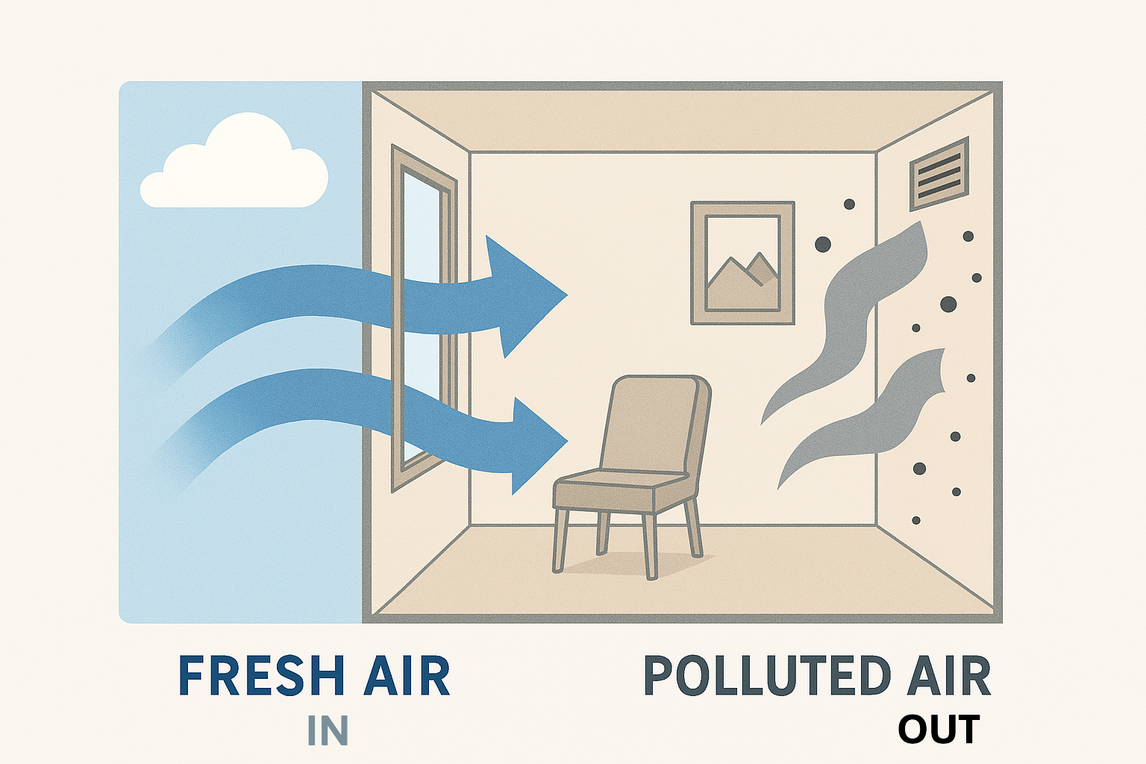
      Fresh air supply and exhaust

Slide 22
      Fresh air requirements
Air conditioning systems often include ventilation.
Fresh air is needed to maintain safe CO₂ levels and indoor air quality.
Measured as 'air changes per hour' (ACH).
Higher ACH needed for kitchens, workshops, labs.

Slide 23
      Why is ventilation important?
Removes stale air and brings in fresh air
Replaces used, stale indoor air with outdoor air.
Why it matters:
prevents the buildup of unpleasant odours
removes airborne pollutants from people, furniture, and activities
prevents indoor environments from feeling stuffy, hot, or humid and keeps them feeling fresh and comfortable.

Slide 24
      Why is ventilation important?
2. Controls CO₂ levels
People exhale carbon dioxide (CO₂). Without ventilation, CO₂ levels rise quickly – especially in crowded rooms.
High CO₂ levels can cause:
drowsiness
headaches
loss of concentration
reduced learning and productivity.
Fresh air supply dilutes CO₂, helping maintain a healthier, more alert indoor environment.

Slide 25
      Why is ventilation important?
3. Reduces indoor air pollutants
Ventilation helps control and remove contaminants such as:
VOC emissions from cleaning products and furnishings
dust and particles
humidity that can cause mould
fumes or chemicals in workshops or labs.
Good ventilation reduces health risks and maintains good indoor air quality (IAQ).

Slide 26
      Why is ventilation important?
4. Controls humidity
Moisture generated from people, cooking, showers, and equipment needs to be removed.
Without ventilation, humidity builds up and causes:
condensation on windows
dampness and mould growth
damage to building materials
poor comfort (air feels “heavy” or “muggy”).
Ventilation helps maintain comfortable humidity levels (typically 40–60% RH).

Slide 27
      Why is ventilation important?
5. Supports thermal comfort
Ventilation helps distribute fresh, cooler outdoor air and removes excess indoor heat, helping HVAC systems maintain:
correct temperature
even air movement
prevention of hotspots or drafts.
This supports human comfort and reduces reliance on mechanical cooling.

Slide 28
      Why is ventilation important?
6. Essential for process environments
In manufacturing, labs, food production, and data centres, ventilation is critical to:
remove process heat
maintain air cleanliness
control airborne particles
meet hygiene or safety standards.
Poor ventilation can cause equipment damage, product spoilage, or even unsafe working conditions.

Slide 29
      Why is ventilation important?
7. Helps prevent the spread of airborne illnesses
Modern IAQ guidance highlights ventilation as a key method to reduce the transmission of airborne pathogens, especially in:
classrooms
health settings
public buildings.
Fresh air helps dilute and remove infectious particles.

Slide 30
      Air Changes per Hour (ACH)
Room Volume: 60 m³
ACH = 6
→ 360 m³/h fresh air needed
Formula:
Fresh air required (m³/h) = Room Volume × ACH Fresh air required (m³/h)
= Room Volume × ACH
Calculation:
60 m³ × 6 = 360 m³/h

Slide 31
      Removing stale, harmful or polluted air
Modern air‑conditioning (AC) systems do more than just cool a room – they can improve indoor air quality by replacing, filtering, and cleaning the air:
  Ventilation removes moisture, smells and CO₂.
  Critical in areas with fumes, chemicals or dust.
  Mechanical extract fans are used in toilets, kitchens, workshops.
  Industrial extract used for welding fumes and dust collection.

Slide 32
      Removing stale, harmful or polluted air
1. Fresh air intake (Ventilation)
Many AC systems introduce fresh outdoor air into the building. This helps remove stale indoor air by diluting it with cleaner, oxygen‑rich air.
Benefits:
removes buildup of carbon dioxide (co₂)
reduces odours
decreases humidity
helps flush out pollutants that accumulate indoors.
Not all AC units do this automatically—HVAC systems and central AC usually do but small window or split units may not unless designed with ventilation modes.

Slide 33
      Removing stale, harmful or polluted air
Air filtration
As air circulates through the system, it’s pushed through filters that catch particles.
Common filter types:
basic filters (mesh filters): Trap dust and large particles.
HEPA filters: Capture very fine particles like pollen, mould spores, smoke and bacteria
carbon filters: Absorb gases, odours, and harmful chemicals (VOCs)
electrostatic filters: Use an electrical charge to attract particles.
What filters can remove:
dust, dirt, and pet dander, pollen and allergens, smoke particles, some harmful gases (with activated carbon).

Slide 34
      Removing stale, harmful or polluted air
3. Removal of microorganisms (Optional add‑ons)
Some AC systems include technologies that target microscopic contaminants.
Examples:
UV‑C light: Kills or disables bacteria, viruses, and mould on coils or in ducts
Ionisers/plasma air cleaners: Clump particles so filters catch them more easily.
These features help reduce harmful biological pollutants.

Slide 35
      Removing stale, harmful or polluted air
4. Exhaust of indoor polluted air
In systems with mechanical ventilation (like those in commercial buildings), stale indoor air is pushed out through exhaust ducts.
This ensures:
continuous removal of indoor pollutants
fresh‑air exchange per air‑quality standards
reduction in humidity, preventing mould growth.

Slide 36
      Removing stale, harmful or polluted air
5. Humidity control
While not a filtration method, AC lowers humidity—a major factor in indoor air quality.
High humidity encourages:
mould growth
dust mites
musty, stale-smelling air by lowering moisture levels, the AC reduces harmful biological growth.

Slide 37
      Different types of AC systems and which are best for air quality
Central HVAC Systems (Ducted Systems)
Best for: Large buildings, offices, homes with ducts
VRF/VRV Systems (Variable Refrigerant Flow)
Best for: Schools, offices, medium–large buildings
Split-System Air Conditioners (includes wall-mounted domestic units)
Best for: Homes, small offices
Window Air Conditioners
Best for: Single rooms
Portable Air Conditioners
Best for: Temporary cooling
Notes:
Heat pumps: connect to decarbonisation and running cost savings.

Slide 38
      Best types of AC systems for air quality
System Type | Fresh Air | Filtration Quality | Purification Options | Overall Air Quality
AHU + HVAC | ⭐⭐⭐⭐⭐ | ⭐⭐⭐⭐⭐ | ⭐⭐⭐⭐⭐ | ⭐⭐⭐⭐⭐
VRF + Ventilation Unit | ⭐⭐⭐⭐ | ⭐⭐⭐⭐ | ⭐⭐⭐⭐ | ⭐⭐⭐⭐
Central HVAC (basic) | ⭐⭐⭐⭐ | ⭐⭐⭐⭐ | ⭐⭐–⭐⭐⭐⭐ | ⭐⭐⭐⭐
Split System | ⭐ | ⭐⭐ | ⭐⭐–⭐⭐⭐ | ⭐⭐
Window Unit | ⭐⭐ | ⭐ | ⭐ | ⭐⭐
Portable AC | ⭐ | ⭐ | ❌ | ⭐⭐
Notes:
Heat pumps: connect to decarbonisation and running cost savings.

Slide 39
      Energy and sustainability
Energy consumption in HVAC.
Demand-controlled ventilation.
Heat recovery ventilation.
Impact of over-ventilation on heating loads.

Slide 40
      Summary
You should now be able to:
Describe the uses of air conditioning in modern society.
Explain comfort cooling vs process cooling.
Explain what ventilation is and why it matters.
Describe fresh air requirements and air changes.
Explain how to remove stale, polluted or harmful air.

Slide 41
Any questions?
Copyright in this document belongs to and is used under licence from the Department for Education, © 2025.
‘T-LEVELS’ and ‘T Level’ are registered trademarks of the Department for Education.
WJEC is authorised by the Department for Education to develop and deliver this T Level Technical Qualification.
WJEC operates in England under the name Eduqas which is a registered trademark of WJEC.

