Slide 1
Occupational Specialism: Air Conditioning Engineering
K1.1 The function and operation of air conditioning systems
PowerPoint 1.1: Air conditioning systems

Slide 2
Objectives
By the end of this session, you should be able to:
Explain how Air Conditioning (AC) moves heat from indoors to outdoors
Describe: Direct Expansion (DX), central plant, heat pumps, Variable Refrigerant Volume/Variable Refrigerant Flow (VRV/VRF), chillers
Match systems to building types
Notes:
Good website to use for air conditioning information: https://www.fantasticfridges.com/

Slide 3
Starter: What do you already know?​
As a group discuss:
What do you think an air conditioning system actually does inside a building?
Does it only cool, or does it also control humidity?
Why is AC important in classrooms, offices, or IT rooms?
What happens to the heat removed from indoors?

Slide 4
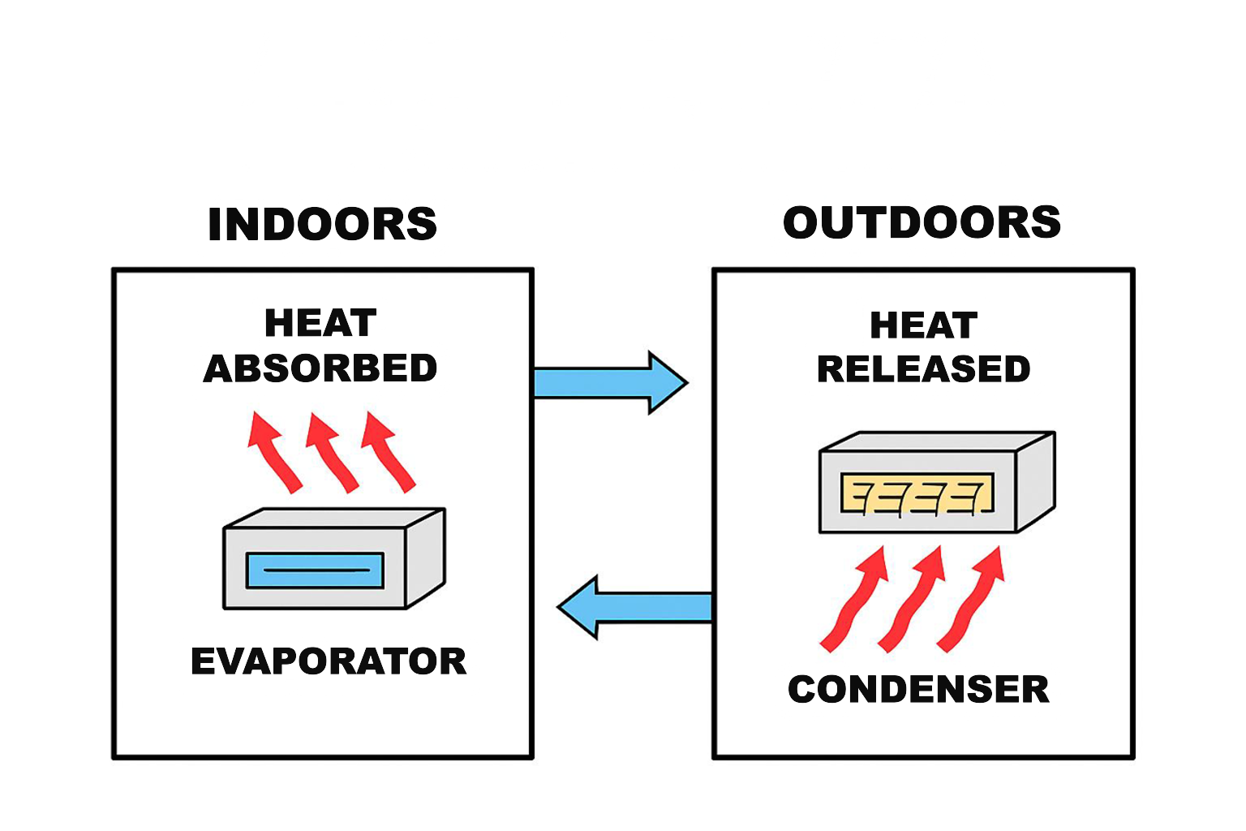
The big idea: AC is a heat-moving machine
Air conditioning absorbs heat indoors at the evaporator and moves it outside at the condenser.
Refrigerant is the fluid that carries heat around the loop.
Evaporator (cold)
Condenser (hot)
Compressor
Expansion
valve
Notes:
Explain the refrigeration cycle using the diagram. Emphasise: absorb heat indoors, reject outdoors.

Slide 5
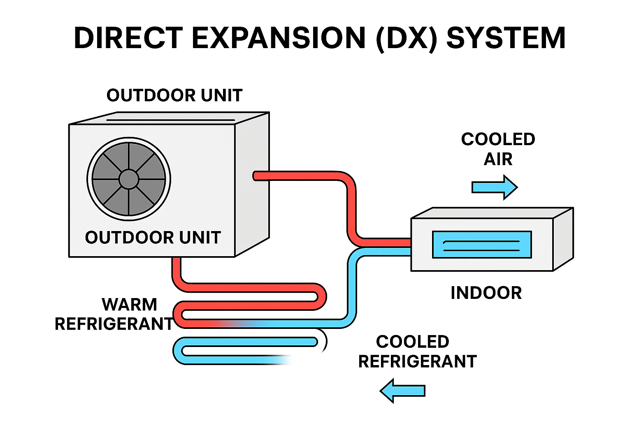
Direct Expansion (DX) systems
Refrigerant directly connects indoor (evaporator coil) and outdoor (compressor and condenser) units
Used in homes, small shops and small offices
Pros: simple, low cost, quick install
Cons: limited capacity/zoning in large buildings
Notes:
DX is great for small buildings. Link to local examples learners know.

Slide 6
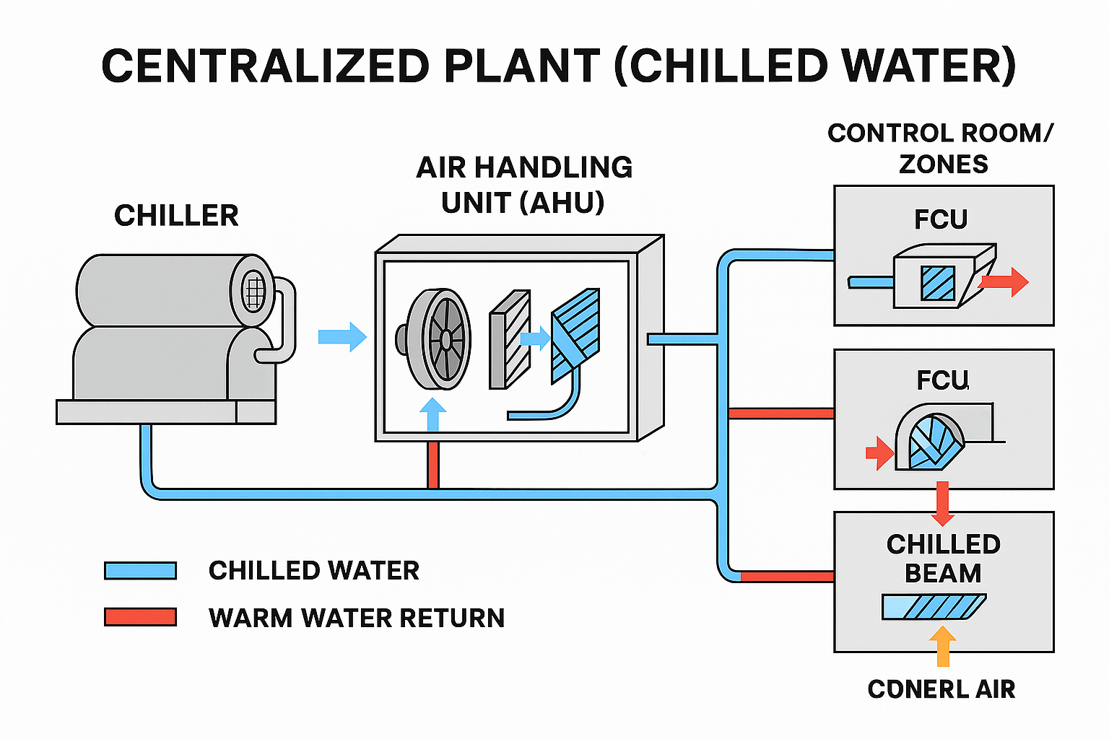
Centralised plant (chilled water)
Chillers make chilled water for the whole building
Air Handling Units (AHUs) distribute air
Fan Coil Units (FCUs) control rooms/zones
Chilled beams: quiet, efficient cooling
Used in hospitals, universities, big offices
Notes:
Central plant: stress scalability and air quality advantages.

Slide 7
Centralised plant - chiller
A chiller is a large refrigeration unit designed to remove heat from water.
It works by circulating chilled water (typically 6–12°C) through air‑handling units or fan‑coil units, where the cold water absorbs heat from the indoor air.
The warmed water then returns to the chiller for cooling again.
Overall process:
Evaporator: absorbs heat
Compressor: raises pressure & temperature
Condenser: rejects heat
Expansion valve: drops pressure

Slide 8
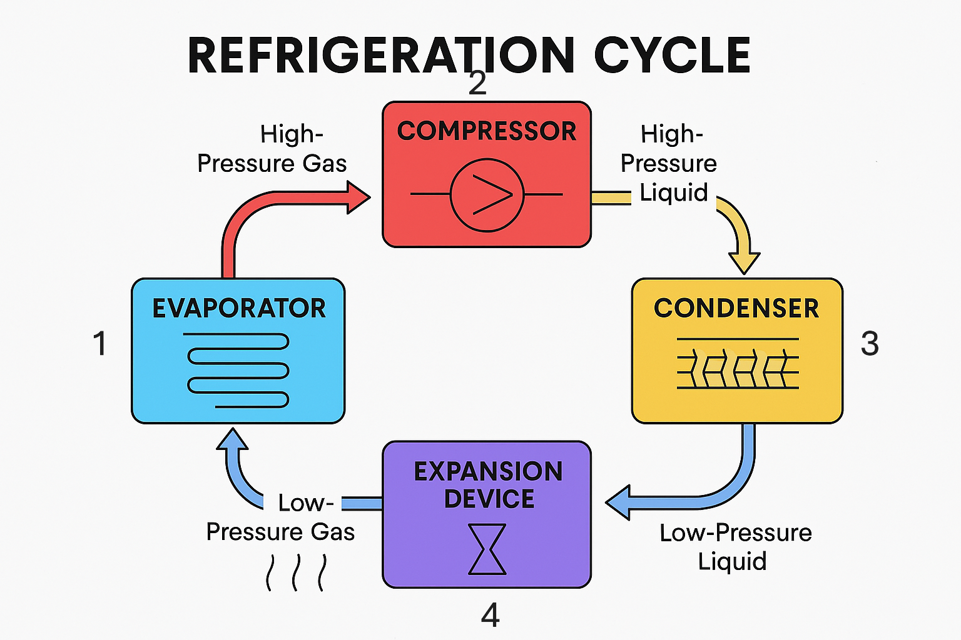
1. The refrigerant enters the evaporator as a low‑pressure liquid–vapour mixture
Inside the evaporator coils, it absorbs heat from the chilled‑water loop or surrounding air
This is where the cooling takes place
2. The compressor draws in the vapour
It compresses the vapour, significantly increasing its pressure and temperature
This hot, high‑pressure liquid is discharged to the condenser
4. The high‑pressure liquid passes through an expansion.
The device creates a sudden drop in pressure.
This converts the refrigerant into a low‑pressure, cold mixture of liquid and vapour.
3. The high‑pressure liquid enters the condenser
Heat is sent to an air‑cooled chiller or a water‑cooled chiller
As heat is removed, the refrigerant condenses into a high‑pressure liquid

Slide 9
Quick check
Where is heat absorbed?
Where is pressure highest?
What state enters the compressor?
What state leaves the condenser?
Notes:
Timing: 2-3mins. Refer to previous diagram for answers

Slide 10
Centralised plant – Air Handling Unit (AHU)
A central component of an air‑conditioning system that is responsible for circulating, cleaning, and conditioning air before distributing it throughout a building.
It draws in return air from the building (and sometimes fresh outdoor air), filters it, adjusts its temperature and humidity, and then supplies the conditioned air back into the space through ductwork.
Commonly used in commercial buildings, hospitals, schools, and large HVAC systems.

Slide 11
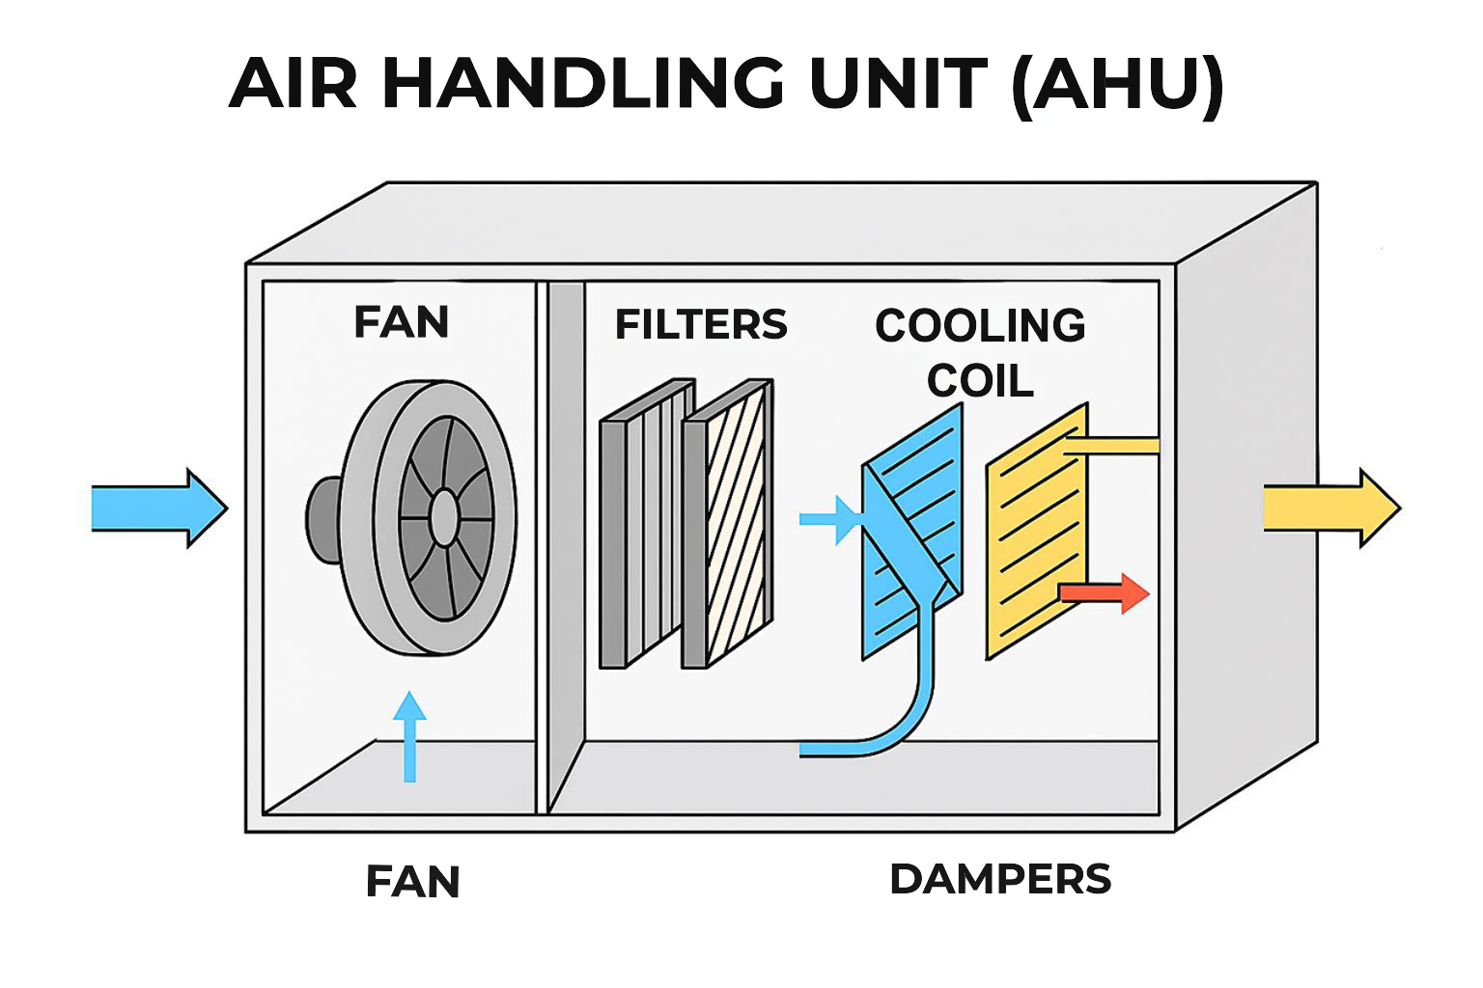
Air Handling Unit (AHU)
Key features:
Air filtration - removes dust, pollen, and contaminants.
Cooling/Heating - uses chilled‑water or hot‑water coils to adjust air temperature.
Ventilation - mixes outdoor air with indoor air to maintain air quality.
Air distribution - fans push conditioned air through ducts to occupied spaces.
Humidity control - adds or removes moisture depending on system design.

Slide 12
Centralised plant – Fan Coil Unit (FCU)
A compact air‑conditioning device that uses a fan and a heating/cooling coil to condition and circulate air within a single room or small zone.
It draws air from the room, passes it over the coil where the air is either cooled or heated, and then delivers the conditioned air back into the space.
As FCUs serve individual rooms or zones, they allow local temperature control and are commonly used in offices, apartments, hotels, and small commercial areas.

Slide 13
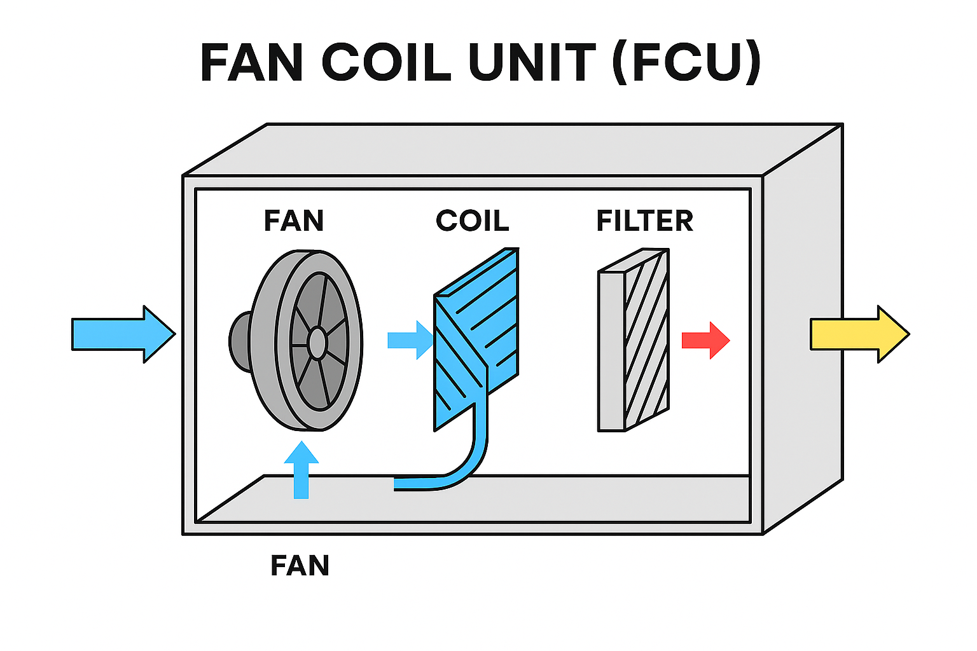
Fan coil unit (FCU)
Key features:
Local temperature control for individual spaces
Uses a chilled‑water coil for cooling and sometimes a hot‑water coil for heating
Contains a fan to move air and a basic filter
Can be connected to ducted or non‑ducted air distribution
Simple design → low cost, easy installation, and easy maintenance.

Slide 14
Centralised plant – chilled beam
A ceiling‑mounted unit that uses chilled water running through a coil to absorb heat from the surrounding air.
As warm room air rises and passes over the coil, it cools and sinks back down into the room.
This process can work passively (using natural convection only) or actively (using a small amount of supply air from an AHU to increase cooling performance).

Slide 15
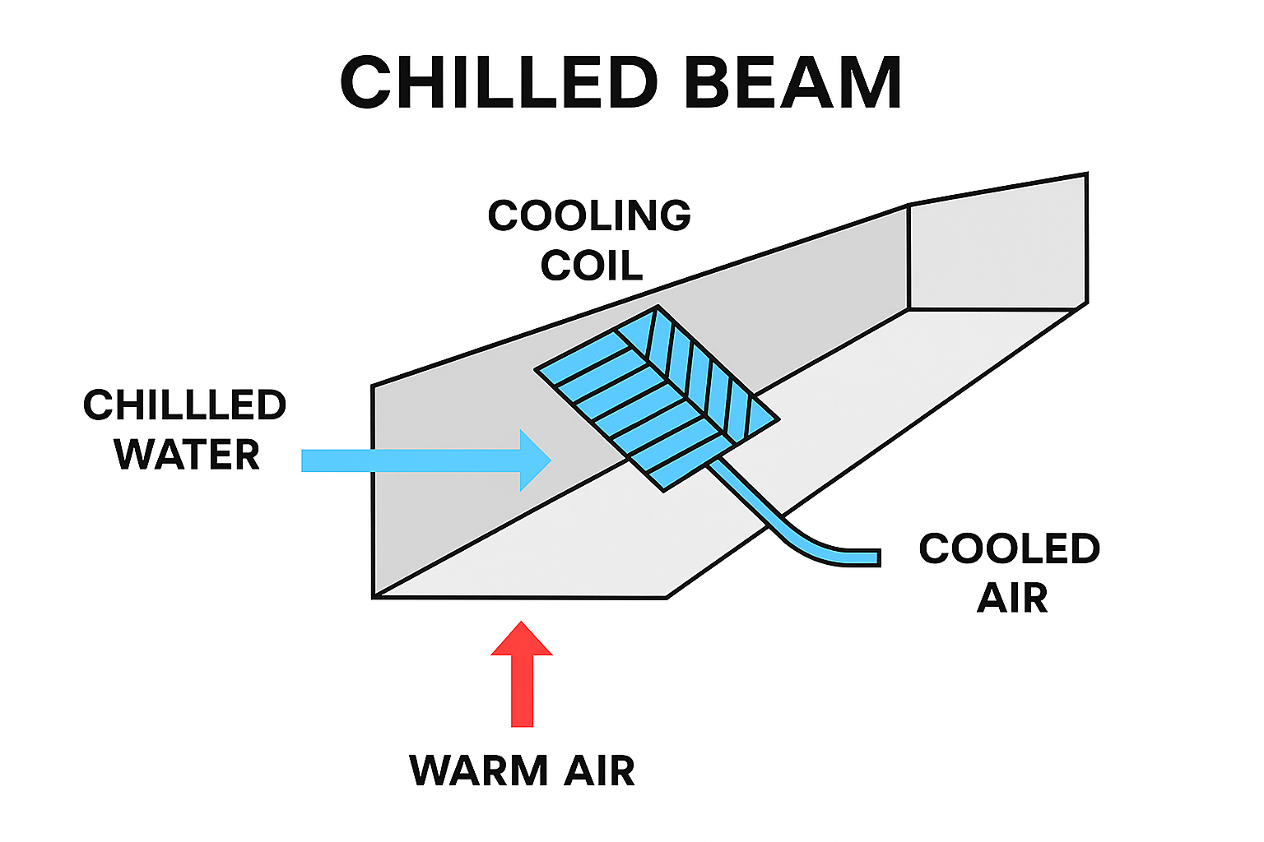
Chilled beam
Key features:
Highly energy‑efficient because water carries heat more efficiently than air
Quiet operation due to minimal or no fans
Provides localised cooling and/or heating
Often used in offices, hospitals, and modern energy‑efficient buildings

Slide 16
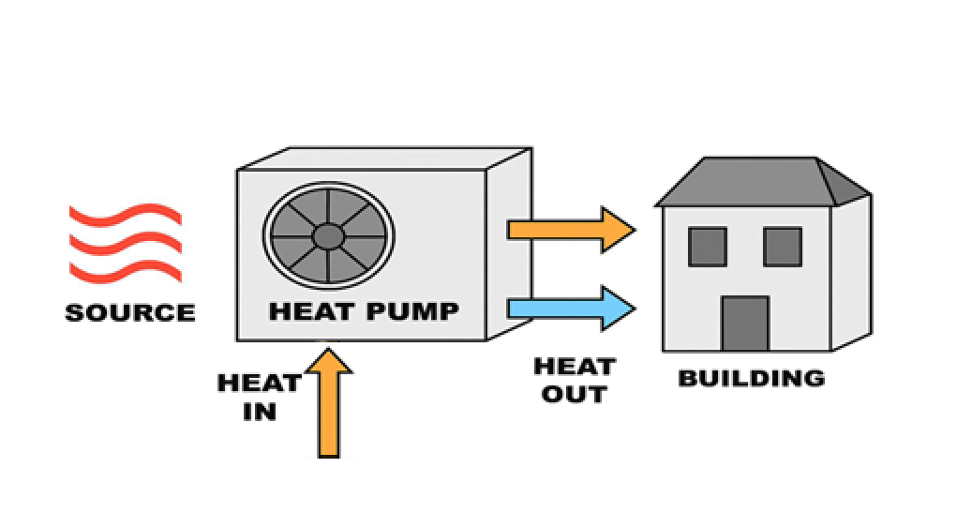
Heat pump systems
Move heat rather than 'make' it - can heat AND cool
Types: air source, ground source, water source
High efficiency and lower carbon vs boilers
Work with radiators, underfloor heating and fan coils
Good for new build homes
Notes:
Heat pumps: connect to decarbonisation and running cost savings.

Slide 17
Types of heat pump system – air source
Works on the same basic refrigeration cycle as an air‑conditioner but can operate in two modes:
Cooling mode: it removes heat from indoors and releases it outside
Heating mode: it extracts heat from the outdoor air – even in cold weather – and transfers it indoors.
In an air‑conditioning system, the ASHP supplies heated or chilled water (in hydronic systems) or conditioned refrigerant (in direct expansion systems) to fan coil units, air handling units, or other terminal devices.
Because it moves heat rather than creating it by burning fuel, it provides high energy efficiency and lower carbon emissions.

Slide 18
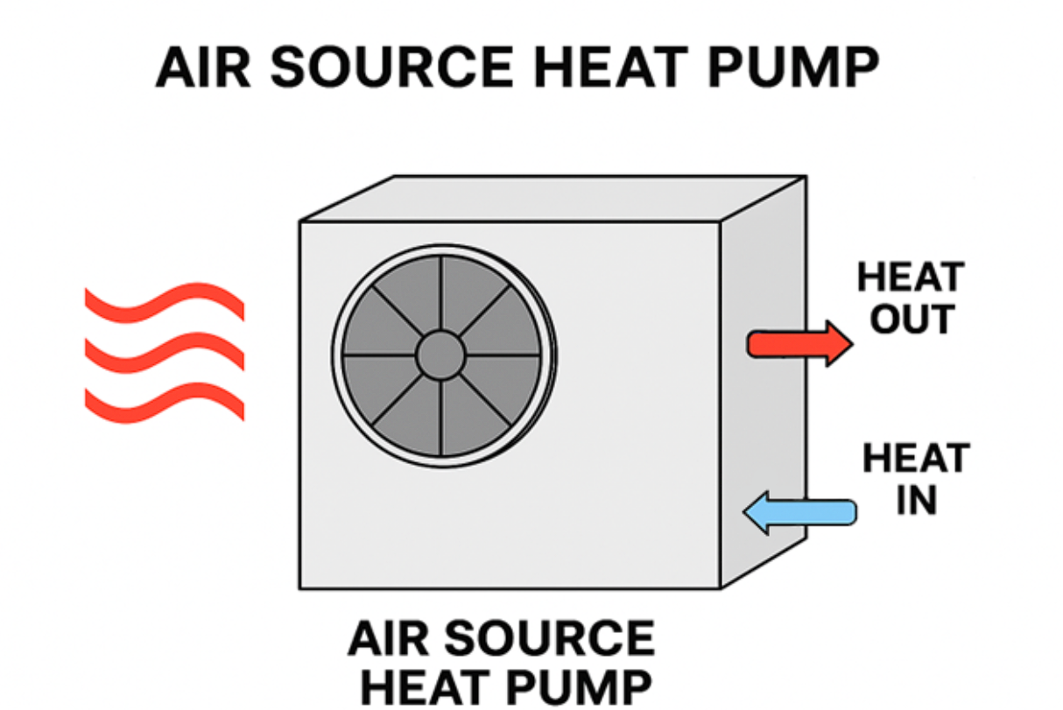
Air source heat pump
Key features:
Uses outdoor air as the heat source or heat sink
Provides both heating and cooling
Works efficiently even in low outdoor temperatures
Often used as a low‑carbon alternative to boilers
Suitable for homes, offices, and commercial buildings

Slide 19
Types of heat pump system – ground source
Circulates a water‑based fluid through a network of pipes buried in the ground (either vertically in boreholes or horizontally in trenches).
As the ground maintains a nearly constant temperature throughout the year, the system can extract heat from the earth for heating or reject heat back into the ground for cooling.
The heat pump then uses a refrigeration cycle to raise or lower the temperature of this energy and deliver it as heated or chilled water to fan coil units, air handling units, underfloor heating, or chilled beams.

Slide 20
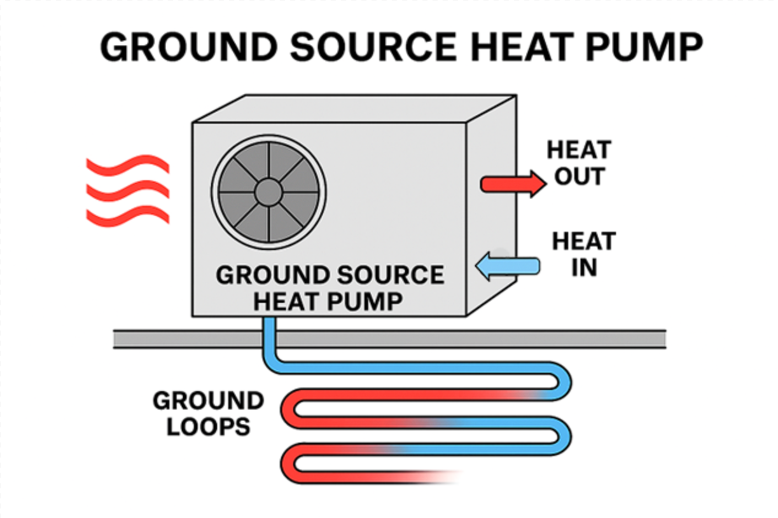
Ground source heat pump
Key features:
Very high energy efficiency due to stable ground temperatures
Provides both heating and cooling
Uses buried ground loops - vertical or horizontal
Ideal for buildings seeking low‑carbon, low‑energy HVAC solutions
Quiet, reliable, and long‑lasting underground infrastructure

Slide 21
Types of heat pump system – water source
A heating and cooling unit that transfers heat to and from a common water loop shared by multiple units within a building.
Instead of exchanging heat directly with outdoor air, it uses the building’s internal water loop—kept within a moderate temperature range by central plant equipment such as boilers, cooling towers, or chillers.
In cooling mode, the pump removes heat from indoor air and transfers it into the water loop.
In heating mode, the pump extracts heat from the water loop and brings it into the conditioned space.

Slide 22
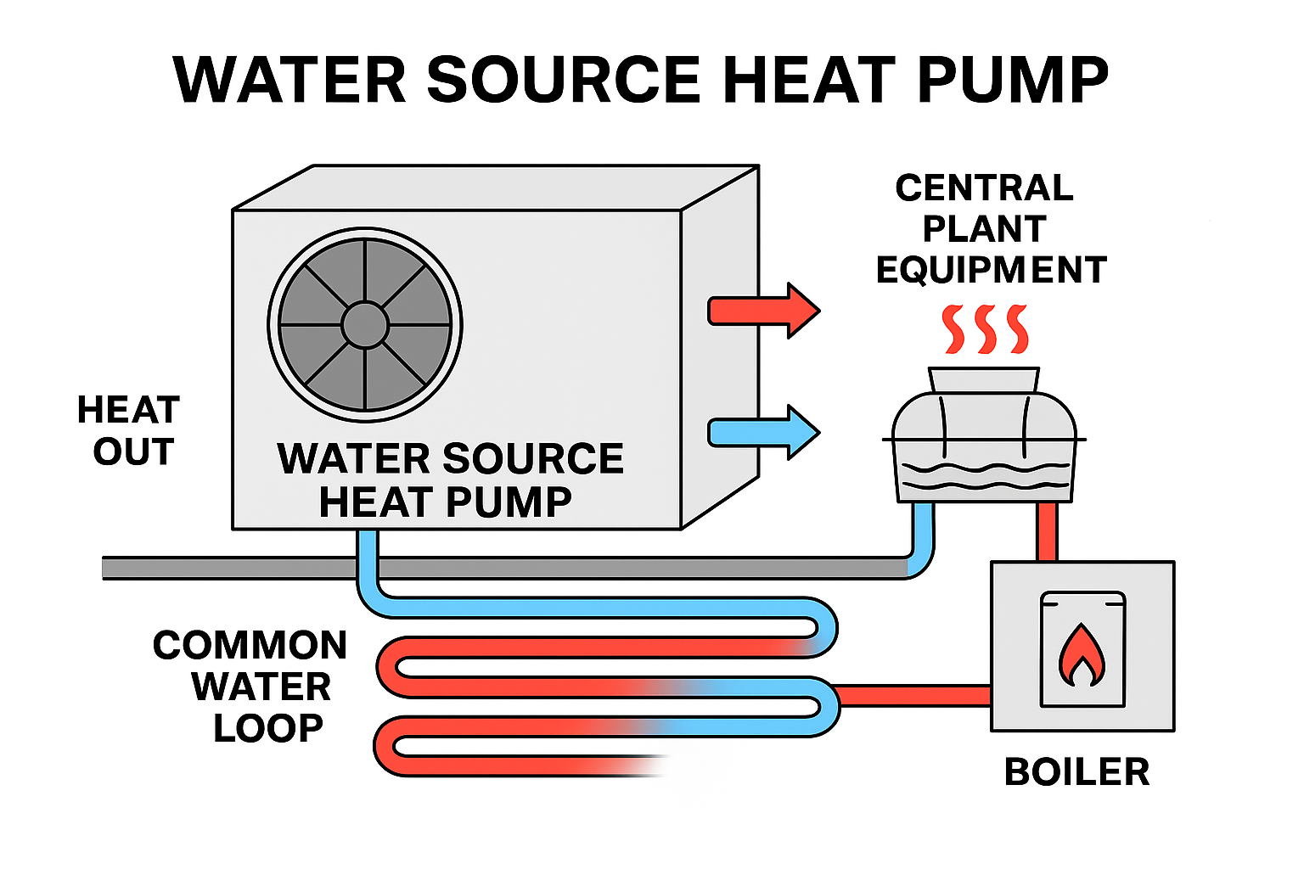
Water source heat pump
Key features
Uses a shared water loop instead of outdoor air
Provides both heating and cooling in different zones simultaneously
Very energy-efficient, especially in buildings with varying heat loads
Modular: each room or zone has its own WSHP unit
Water loop temperature remains relatively stable, so the heat pump operates very efficiently

Slide 23
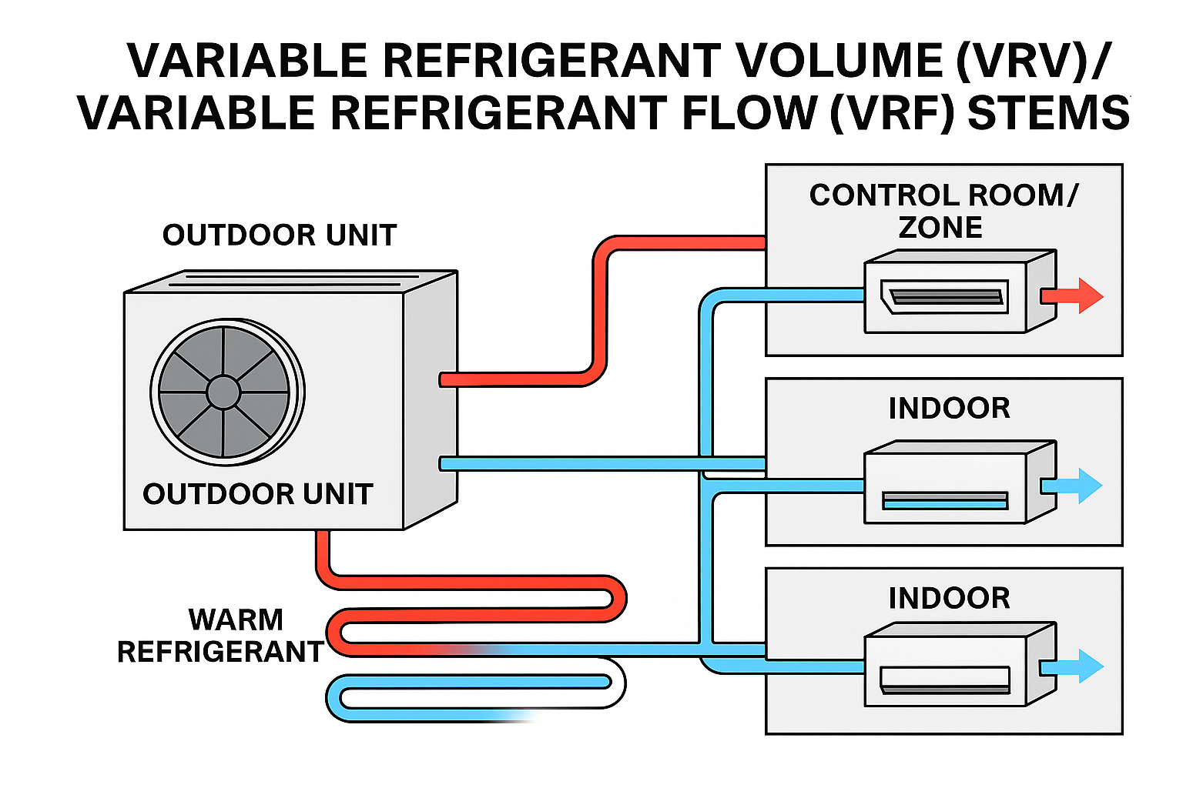
Variable Refrigerant Volume (VRV)/ Variable Refrigerant Flow (VRF) systems
One outdoor unit serves many indoor units
Precise control and zoning across rooms
Heat recovery: move heat from warm to cool zones
Good for hotels, offices and mixed-use buildings

Slide 24


Water chillers
Remove heat from water to make chilled water
Air-cooled (easier) vs water-cooled (more efficient)
Feed AHUs, FCUs and chilled beams in big buildings

Slide 25
How systems interact
Chillers supply AHUs/FCUs with chilled water for multiple zones
VRF heat recovery transfers heat between zones to save energy
Heat pumps integrate with underfloor heating or fan coils
Ventilation brings in fresh air and controls humidity

Slide 26
Try it: Which system fits?
1. A small salon with two treatment rooms
2. A 12-storey hospital with operating theatres
3. A college building with 20 classrooms and mixed schedules
4. A new-build home aiming for low carbon
Notes:
Activity answers: 1) DX split 2) Central plant + AHUs/FCUs 3) VRF 4) Air Source Heat Pump

Slide 27
Answers: Which system fits?
1. A small salon with two treatment rooms
DX split
2. A 12-storey hospital with operating theatres
Central plant + AHUs/FCUs
3. A college building with 20 classrooms and mixed schedules
VRF
4. A new-build home aiming for low carbon
Air Source Heat Pump
Notes:
Activity answers: 1) DX split 2) Central plant + AHUs/FCUs 3) VRF 4) Air Source Heat Pump

Slide 28
Key terms
Refrigerant: fluid that can be hot or cold, depending on the type of system:
cold when absorbing heat inside the evaporator and
hot when releasing heat outside the condenser.
Evaporator: a cold heat exchanger that absorbs heat indoors
Condenser: a hot heat exchanger that rejects heat outdoors
AHU/FCU: units that move and condition air
Heat recovery: re-using waste heat to cut energy use

Slide 29
Summary
You should now be able to:
Explain how Air Conditioning (AC) moves heat from indoors to outdoors
Describe: Direct Expansion (DX), central plant, heat pumps, Variable Refrigerant Volume/Variable Refrigerant Flow (VRV/VRF), chillers
Match systems to building types

Slide 30
Any questions?
Copyright in this document belongs to and is used under licence from the Department for Education, © 2025.
‘T-LEVELS’ and ‘T Level’ are registered trademarks of the Department for Education.
WJEC is authorised by the Department for Education to develop and deliver this T Level Technical Qualification.
WJEC operates in England under the name Eduqas which is a registered trademark of WJEC.

