Slide 1
Occupational Specialism: Air Conditioning Engineering
K1.18 Inspection of an air conditioning system
PowerPoint 1.18: Inspection process
Notes:
Make it as practical as possible with demonstrations and practical assessments using simulation rigs or live systems. The theory should be on. What are:
compressor
fans
bearings
loose panels
vibration
oil seepage
high temperatures
disturbed wiring.
Annotated diagrams to be used.

Slide 2
Objectives
By the end of this session, you should be able to:
Explain the purpose of inspection during commissioning.
Use sight/hearing/touch/smell to spot fault clues.
Identify abnormal operation and unexpected noise sources.
Inspect key areas: compressor, fans, bearings, panels, wiring.
Record findings clearly and decide next actions safely.
Notes:
Suggested approach: read outcomes, then do a quick “traffic light” self-assessment (green/amber/red).

Slide 3
Starter: What do you already know?
In pairs or small groups, discuss:
Why do we inspect air conditioning systems, and what kinds of issues are we looking for?
Consider:
What simple visual checks can reveal problems before instruments are used?
How can noises, smells, or vibrations help identify faults?
What might happen if an AC system is never inspected?
Notes:
Timing: 5–8 minutes. Use mini-whiteboards or sticky notes. Don’t over-teach here—just surface prior knowledge.

Slide 4
What is inspection in commissioning?
Inspection is a structured check to spot abnormal operation before handover.
Finds issues early: noise, vibration, overheating, leaks, loose parts.
Protects safety: disturbed wiring, hot surfaces, moving parts.
Protects performance: a small issue can reduce efficiency or cause a breakdown.
Creates a baseline: “what normal sounds/looks like” for future maintenance.

Slide 5
Safety boundaries
Always:
follow site rules and instructions
keep hands clear of moving fans and belts
assume metal surfaces can be hot
use senses to detect clues – then confirm safely.
Never:
bypass guards or safety devices
touch electrical terminations
open electrical panels unless authorised/competent
ignore burning smells, severe vibration, or sudden noise changes.
Notes:
Tutor: Clarify what can be observed in a classroom vs what must be completed by competent, authorised personnel in the workplace.

Slide 6
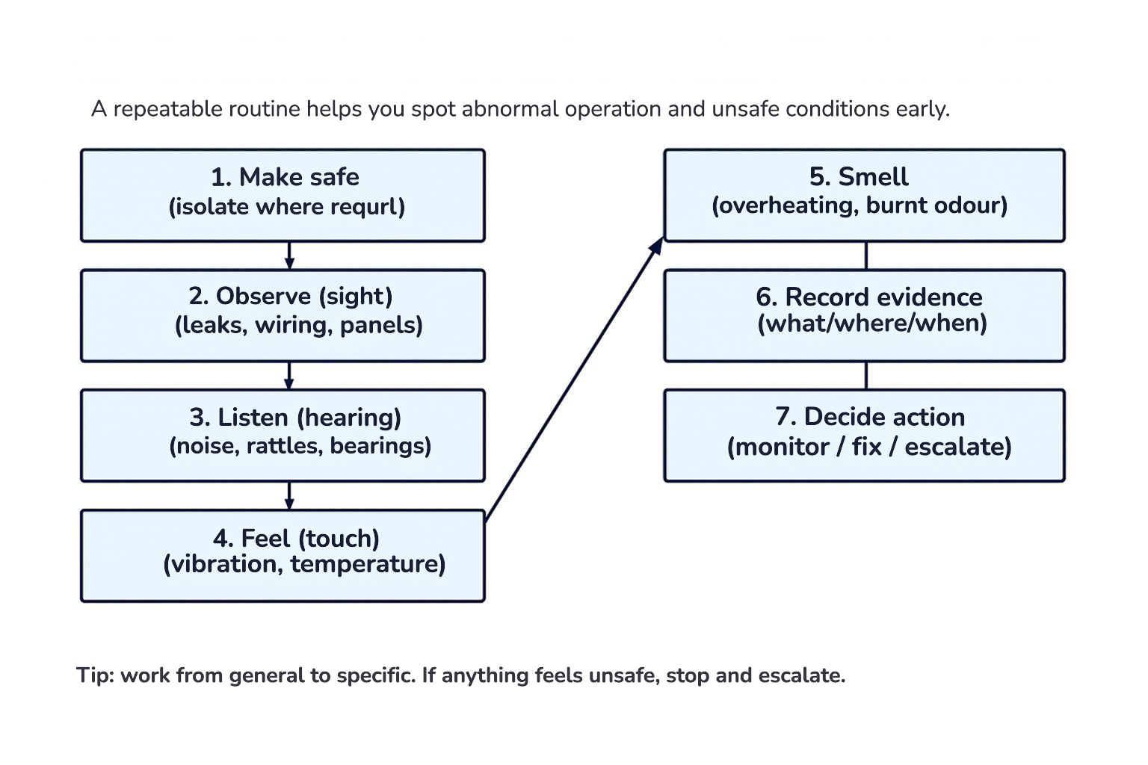
Inspection workflow (repeatable routine)
Notes:
Walk through the steps. Emphasise: make safe, observe, listen, feel, smell, record, decide action.

Slide 7
Using human senses to spot fault conditions
Sense | What you look for | Examples in AC systems | What to do next
Sight | Leaks, damage, misalignment, loose parts | Oil seepage at joints; loose panels; disturbed wiring | Take photos; isolate if unsafe; check fixings; record location
Hearing | Abnormal noise patterns | Rattle (panel); squeal (belt/bearing); knocking (compressor/pipes) | Identify source; tighten mounting/bearings; stop if severe
Touch | Vibration and temperature (carefully) | Excess vibration on casing; unusually hot motor housings | Stop equipment if extreme; check mounts; improve airflow
Smell | Overheating or electrical burning | Hot insulation smell; burnt wiring; oil/refrigerant odour | Isolate power; inspect wiring; escalate; check for leaks
Notes:
Key idea: senses give clues. Instruments and safe checks confirm.

Slide 8
Sight: The first 30-second scan
Start wide, then zoom in. Look for anything “out of place”.
Oil staining or wet patches around joints and compressor base.
Loose or missing fixings on panels/guards.
Vibration marks: shiny rub points, worn paint, metal dust.
Disturbed wiring: pulled cables, damaged insulation, loose glands.
Discolouration: overheated components often look browned or brittle.
Notes:
Activity (3 min): show a photo set (tutor-provided) or describe a scenario and ask “what stands out?”

Slide 9
Oil seepage (sight): Why it matters
Oil around joints or the compressor base is a strong clue.
Oil can indicate a refrigerant leak path (oil travels with refrigerant).
Even small leaks can reduce performance and increase energy use.
Record location, size, and whether it’s fresh or old staining.
Do not wipe evidence away before it is recorded.
Notes:
Tutor: Reinforce that leak investigation/repair must follow workplace procedures and competence rules.

Slide 10
Disturbed wiring (sight): Red flags
What to look for:
loose glands/strain relief (cables can rub and fail)
insulation damage or exposed copper
cable ties missing where required; cables near hot pipes
signs of overheating: browning, melting, brittle insulation.
Immediate actions:
if burning smell/heat present: isolate and escalate
record where the cable is damaged (photo/notes)
do not move wiring unless authorised
check that covers/blanking plates are present.
Notes:
Use this to teach “stop and escalate” thresholds.

Slide 11
Loose panels and fixings (sight + hearing)
Loose panels often cause rattles and can become a safety issue.
Look for missing screws, bent brackets, damaged guards.
Check panel edges for rubbing marks.
A quick test: gently press a suspect panel (only if safe) to see if the noise changes.
Record what changed when you pressed (helps pinpoint the source).

Slide 12
Hearing: listening for ‘normal vs abnormal’
Listen for changes in pattern, not just loudness.
Is it a new noise or a change from baseline?
Is it constant or only at start-up/shut-down?
Does it change with fan speed or compressor load?
Can you locate the source by moving carefully around the unit?
Notes:
Tutor: Emphasise safe distance from moving parts. Use “point and describe” rather than touching.

Slide 13
Noise patterns: quick guide
Unexpected operational noise: what it might mean
Match the noise pattern to a likely cause, then confirm safely.
Noise description | Often linked to… | Common first checks
Rattle / buzzing | Loose panels, cable tray, pipework touching | Press gently to locate; tighten fixings; add isolation/clearance
Squeal | Worn bearing, belt slip (if belt‑driven), dry motor | Check bearing play; listen at motor; inspect belt tension/alignment
Grinding / scraping | Fan blade contacting guard/casing; bearing failure | Inspect clearances; check fan alignment; stop if severe
Knock / clunk | Compressor issue, mount failure, loose components | Check mounts; check for movement; escalate if persistent
High‑pitched whine | Fan speed control/inverter normal vs abnormal | Compare to normal baseline; check for resonance; confirm settings
Notes:
Use as a discussion tool. Stress it guides first checks; manufacturer data and safe procedure decide actions.

Slide 14
Fans: Abnormal noises to investigate
Common descriptions:
scraping/grinding (blade contacting guard/casing)
wobble/low-frequency rumble (imbalance)
whine (high speed control or resonance)
ticking (foreign object or cracked blade).
First checks (safe):
visually check guard, clearances and blade condition
check that fixings are tight and the fan is not rubbing
look for debris and ensure airflow path is clear
escalate if contact/grinding is suspected.

Slide 15
Bearings: Abnormal noises to investigate
Common descriptions:
squeal (dry/worn bearing)
rumbling (bearing wear)
grinding (advanced failure)
noise increases with speed/load.
First checks (safe):
listen near motor housing (keep safe distance)
check for overheating around motor/bearing area
record whether noise changes with fan speed
escalate if grinding/overheating is present.
Notes:
Good website and images to explain https://mepacademy.com/superheat-vs-subcooling-explained/

Slide 16
Touch: Feel vibration safely
Touch should be cautious. Use the back of the hand near surfaces first.
Never touch moving parts or electrical terminals.
Use touch to compare areas: e.g. ‘this panel vibrates more than that one’.
If a surface is too hot to touch briefly, treat it as abnormal and confirm with a thermometer/IR.
Be aware of Discharge Lines and Crankcase Heaters, which can cause instant burns.
Record where vibration is strongest to help locate the source.
Notes:
Tutor: If no live kit is available, simulate vibration with a small battery device on a panel to demonstrate resonance.

Slide 17
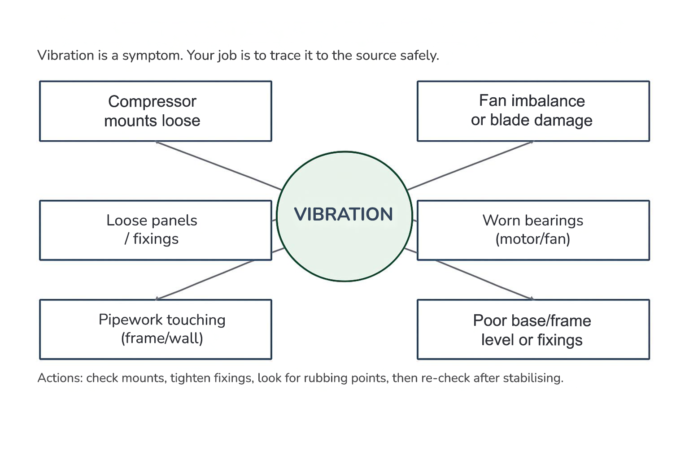
Vibration: Common sources and what they indicate
Notes:
Use as a brainstorming tool: “If vibration is here, what are the likely causes?”

Slide 18
Loose panels and resonance: Finding the rattle
A rattle is often a vibrating part contacting another surface.
Look for rub marks and shiny edges.
Check whether pipework touches the frame/wall.
Check grommets, isolators and missing screws.
After tightening/adjusting, re-check at the same operating condition.

Slide 19
High temperatures: What to check
Where overheating shows up:
motor housings and bearing areas
electrical terminations and cable insulation
compressor discharge area (compare to expected “hot”)
blocked airflow areas (condenser/evaporator surfaces).
Safe approach:
do not rely on touch alone — confirm with IR/thermometer
look for discolouration or melting insulation
if burning smell or smoke: isolate immediately and escalate
record location and conditions (load, ambient).

Slide 20
Smell: What your nose can tell you
Smell is an early warning. Treat strong odours seriously.
Burnt smell can indicate overheating wiring or motor issues.
Hot “electrical” smell often comes before visible damage.
Oil/refrigerant odour can suggest leakage or contamination.
Smell of acidic burnout – if a valve is opened and a vinegary odour is smelled, stop immediately.
If you smell burning: stop, isolate, and escalate.
Notes:
Tutor: Reinforce “stop work” triggers: burning smell, smoke, arcing sound, severe vibration.

Slide 21
Inspection focus: compressor
.
Check for abnormal operation and noise without touching unsafe areas.
Visual: mounts, oil staining, damaged insulation, loose components.
Hearing: knocking/clunking, unusual humming or metallic sounds.
Touch (careful): excessive vibration transmitted to casing/panels.
Temperature: compare to normal expectations; confirm with thermometer/IR.
Record: when noise occurs (start-up, steady running, shut-down).

Slide 22
Inspection focus: fans
Fans are a common source of noise, vibration and rubbing faults.
Visual: guard secure, no debris, blade condition, clearance to casing.
Hearing: scraping, ticking, wobble rumble, abnormal whine.
Vibration: feel on casing/panels (safe); check fixings.
Airflow clues: blocked inlet/outlet can create noise and high temperatures.
Record: fan speed setting and whether noise changes with speed.

Slide 23
Inspection focus: bearings
Bearings often fail gradually—early detection prevents breakdown.
Hearing: squeal or rumble that increases with speed.
Temperature: local hot-spot on motor/bearing area.
Vibration: rough running transmitted into panels.
Record: when noise occurs and whether it changes with load/speed.
Escalate: grinding noises or rapid heating.

Slide 24
Inspection focus: oil seepage & leaks (visual clues)
Oil staining is a key clue during inspection.
Look at joints, valves, compressor base and pipe connections.
Fresh oil is wet/shiny; old staining may be dusty but still important.
Oil spots on a joint don't just mean a leaking oil.
Record exact location and photo evidence before cleaning.
Treat as a potential leak path and escalate to competent personnel.
Notes:
Use as a discussion tool. Stress this is a guide, not a diagnosis.

Slide 25
Inspection focus: high temperatures
Overheating can be caused by airflow problems, electrical issues, or mechanical stress.
Check coil cleanliness and airflow paths (blocked airflow raises temperatures).
Look for discolouration or softened insulation.
Compare temperatures at similar components (one motor much hotter than another).
If severe overheating is suspected: stop and escalate.

Slide 26
Inspection focus: disturbed wiring
Disturbed wiring is a safety issue and must be treated seriously.
Look for rub damage, loose glands, missing grommets, cable strain.
Check cables are not touching hot pipework.
Look for burn marks, melting or brittle insulation.
If burning smell/heat present: isolate and escalate.

Slide 27
Record what you find (evidence-based)
A good inspection record helps someone else fix the issue quickly and safely.
Describe the symptom: noise/vibration/heat/leak/wiring issue.
State location: which unit, which side, which panel/connection.
State conditions: mode, load, fan speed, time since start.
Add evidence: photo, quick sketch, temperature reading (if taken).
State action: monitor, fix, escalate, isolate.

Slide 28
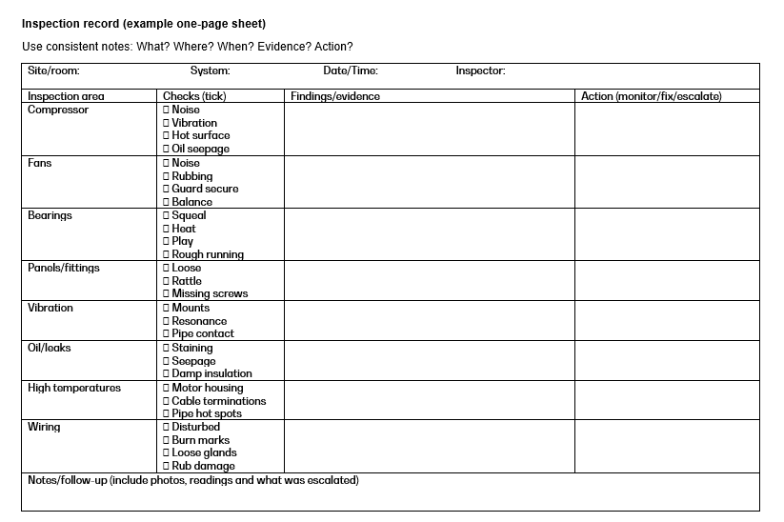
Example inspection record sheet
Notes:
Activity: give learners 5 minutes to complete a blank log for a scenario described by the tutor

Slide 29
Deciding action: Monitor/fix/escalate
Monitor (watch & re-check) | Escalate immediately
Small rattle that stops when the panel is tightened Minor vibration with a clear cause and safe correction No safety risk and performance not affected | Burning smell, smoke, arcing sounds Grinding fan/bearing or contact with guard Disturbed wiring, exposed conductors Severe vibration (risk of parts coming loose)
Notes:
Tutor: Reinforce decision-making: safety first, then protect equipment and performance.

Slide 30
Practical task 1: ‘Sensory walkaround’ simulation
In groups, rotate around stations and record observations.
Station ideas:
loose panel rattle (prop)
‘disturbed wiring’ photo set
oil stain photo
fan rub – example audio.
At each station: write what you noticed using the correct sense.
Decide: monitor/fix/escalate.
Record: what/where/when/evidence/action in your log.

Slide 31
Practical task 2: Noise matching (card sort)
Match each noise description to a likely cause and first checks.
Rattle/buzzing
Squeal
Grinding
Knock/clunk
Whine
Write one safe first check for each.
Share answers and justify using evidence.
Discuss when you would stop and escalate.

Slide 32
Practical task 3: Measuring vibration safely
Use a simple method to compare vibration levels (if permitted).
Option A: compare by touch on casing/panels (safe, no moving parts).
Option B: smartphone accelerometer app on a fixed panel (tutor-controlled).
Record “before/after” when a fixing is tightened.
Discuss limits: numbers are less important than trends and location.
Notes:
An optional activity

Slide 33
Practical task 4: temperature awareness
Use safe props to discuss hot spots and reporting.
Tutor demonstrates an IR thermometer on safe objects (not live electrical).
Learners list where overheating commonly appears in AC systems.
Discuss: why blocked airflow increases temperatures.
Write a sample note describing an overheating finding.

Slide 34
Case study A: What is the most likely issue?
Read the symptoms and decide your first three safety checks.
Noise: scraping increases with fan speed.
Sight: fan guard appears slightly bent.
Touch: vibration felt on the outdoor unit panel.
No burning smell.
Question: monitor/fix/escalate? Explain why.
Notes:
Expected direction: suspect fan contact/guard clearance. Escalate/stop if scraping suggests contact risk.

Slide 35
Case study A: Model discussion points
Good answers use evidence and safety first.
Likely cause: fan blade contacting guard/casing OR damaged/loose guard.
First checks: isolate/stop if safe; visual clearance check; check fixings; check debris.
Record: when it occurs, speed setting, location and evidence.
Action: escalate if contact/grinding confirmed.

Slide 36
Case study B: What is the most likely issue?
Read the symptoms and decide your next actions.
Smell: hot electrical/burning smell near the indoor unit.
Sight: discoloured cable insulation near the terminal area.
Hearing: intermittent buzzing.
Touch: area feels unusually warm (do not touch terminals).
Question: What do you do immediately, and what do you record?
Notes:
Expected: isolate power, stop, escalate. Record exact location, photos, smell description, time/conditions.

Slide 37
Case study B: Model discussion points
Good answers show “stop and escalate” behaviour.
Immediate: stop/isolate (following procedures) and escalate to a competent person.
Do not open electrical panels unless authorised/competent.
Record: smell, buzzing, visible discolouration, location, time, operating mode.
Explain risk: overheating terminations can lead to arcing/fire.

Slide 38
How to report findings professionally
Good reporting includes:
what the symptom is (noise/vibration/heat/leak/wiring)
where it is (unit, side, panel, connection)
when it occurs (start-up/steady/shut-down; speed)
evidence (photo, readings, sketch)
your action taken (monitor/fix/escalate).
Avoid:
vague terms (‘it’s loud’) without description
changing multiple things without recording
ignoring safety cues (burning smell, severe vibration)
assuming the cause without evidence.

Slide 39
Quick check
Name the four senses used in inspection.
Give two visual signs of oil seepage/leak clues.
What noise might a worn bearing make?
What is one cause of vibration on an outdoor unit?
Give one sign of disturbed wiring.
When should you stop and escalate immediately?
Why record operating conditions with findings?
What is the quickest way to locate a loose panel rattle (safely)?
Where can overheating show up on a system?
What five things make a good inspection note?

Slide 40
Quick check – answers
1. Name the four senses used in inspection.
Sight (visual checks).
Sound (listening for abnormal noises).
Smell (burning smells, chemical odours).
Touch (feeling vibration, unusual temperature).
2. Give two visual signs of oil seepage/leak clues.
Oil stains or wet patches around joints, valves, or pipework.
Dirt or dust stuck to oily surfaces, creating dark “grimy” areas.

Slide 41
Quick check – answers
3. What noise might a worn bearing make?
A worn bearing typically makes:
grinding,
rumbling, or
screeching noises.
4. What is one cause of vibration on an outdoor unit?
Loose or unbalanced fan blades.
(Other causes include loose mounting bolts, failing compressor mounts, or uneven ground.)

Slide 42
Quick check – answers
5. Give one sign of disturbed wiring.
Loose or displaced cables, connectors pulled out, or insulation damaged.
(Other signs include missing cable ties, rubbed-through wires, or exposed conductors).
6. When should you stop and escalate immediately?
Stop work and escalate straight away if you encounter any of the following:
Electrical hazards (burnt wiring, arcing, smoking components).
Refrigerant leak suspected in a confined space.
Pressure vessel or compressor safety issue.
Serious overheating of cables, motors, or control boards.
Any condition unsafe to you, the plant, or the building.

Slide 43
Quick check – answers
7. Why record operating conditions with findings?
Because operating conditions give context for your observations and help:
Explain why a fault is happening.
Allow accurate diagnosis.
Provide a baseline for future comparison.
Support warranty, F‑Gas, or compliance documentation.
Show whether the system was at full load or part load when inspected. 8. What is the quickest way to locate a loose panel rattle (safely)?
Gently press or place a hand on each panel one at a time while the unit is running.
When the rattle stops, you’ve found the loose panel.
(Always avoid moving parts and stay clear of the fan area.)

Slide 44
Quick check – answers
9. Where can overheating show up on a system? Overheating may appear on:
Electrical components (contactors, terminals, relays, PCB).
Motors and bearings (fan motors, compressor).
Cables and connections (discoloured insulation, hot spots).
Compressor shell (running abnormally hot).
10. What five things make a good inspection note? A good inspection note should include:
What you found (clear observation).
Where it was (location/component).
When you saw it (date/time under what conditions).

Slide 45
Summary
You should now be able to:
Explain the purpose of inspection during commissioning.
Use sight/hearing/touch/smell to spot fault clues.
Identify abnormal operation and unexpected noise sources.
Inspect key areas: compressor, fans, bearings, panels, wiring.
Record findings clearly and decide next actions safely.
​
​
Notes:
Timing: 3–4 min. Ask learners: ‘one thing you learned’ + ‘one question you still have’.

Slide 46
Any questions?
Copyright in this document belongs to and is used under licence from the Department for Education, © 2025.
‘T-LEVELS’ and ‘T Level’ are registered trademarks of the Department for Education.
WJEC is authorised by the Department for Education to develop and deliver this T Level Technical Qualification.
WJEC operates in England under the name Eduqas which is a registered trademark of WJEC.

