Slide 1
Occupational Specialism: Air Conditioning Engineering
K1.17 System operation requirements to be checked for commissioning
PowerPoint 1.17: Commissioning process
Notes:
Explain this lesson sits in system maintenance: understanding the cycle helps diagnose faults and performance issues.

Slide 2
Objectives
By the end of this session, you should be able to:
Explain why data must be taken at steady-state​
Record the required commissioning measurements​
Calculate and interpret superheat & subcooling​
Compare the design data and plan adjustments​
Describe leak testing and what must be recorded​
Notes:
. Suggested approach: read outcomes, then do a quick “traffic light” self-assessment (green/amber/red).
Appendices with additional useful information are at the end of this slide deck

Slide 3
      Starter: What do you already know?
In pairs, discuss:
What does it mean to “commission” an air conditioning system, and why is it important?
Think about:
What commissioning actually involves
Why new or repaired systems must be checked
How commissioning affects performance, efficiency, and safety
What might go wrong if a system is not commissioned properly
Notes:
Timing: 5–8 minutes. Use mini-whiteboards or sticky notes. Don’t over-teach here—just surface prior knowledge.

Slide 4
      Safety and compliance
Before you measure:
risk assess (electric shock, rotating fans, hot surfaces)
use correct PPE and safe access (ladders/steps)
check hose condition and tight connections
never vent refrigerant - use recovery equipment
Records and responsibilities:
only competent/certified personnel handle f-gases
record refrigerant added/removed and leak checks
follow manufacturer instructions and site procedures
document settings changes and final configuration
Notes:
Use the diagram to highlight heat in at the evaporator and heat out at the condenser. Reinforce energy balance: Q_out = Q_in + W_in.

Slide 5
      Steady-state operation
Steady-state means the system has stabilised and readings change slowly.
At start-up, pressures/temps swing while refrigerant redistributes.
Controls may ramp compressor/fans, so early readings can mislead.
Record only when stable (and note the operating condition and load).
Notes:
.Prompt: “How could recording too early lead to a wrong diagnosis (e.g. adding refrigerant)?”

Slide 6
      What to record: The minimum data set
A good commissioning log includes conditions + air side + refrigerant side + electrical.
Ambient outdoor temperature near outdoor unit inlet
Room temperature moving to set point (down to or up to set point)
Air on/off temperatures for ALL indoor units (return and supply)
Refrigerant pressures (low and high) + convert to saturation temperatures
Pipe temperatures (suction + liquid) for superheat/subcooling
Running current at full load and near set point
Refrigerant charge added beyond base charge + leak test details
Notes:
.

Slide 7
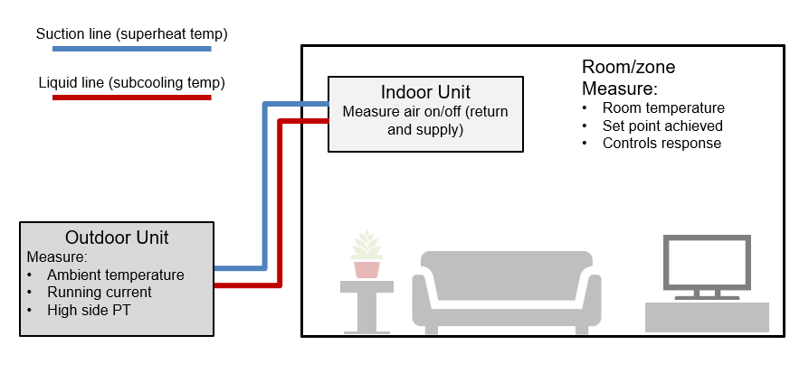
      Typical measurement locations on a split system
Notes:
Explain what “air on/off” means, and where to measure suction and liquid line temperatures.

Slide 8
      Tools and accuracy
Common instruments:
manifold gauges or digital pressure probes
pipe clamp temperature probes + air probes
clamp meter for running current
refrigerant scales (charge by mass)
leak detector + bubble solution (and OFN kit where used)
Good measurement practice:
use calibrated instruments at all times.
insulate clamp probes from ambient air
be consistent with air probe location
record system state (mode, fan speed, load)

Slide 9
      Running pressures (steady-state)
Pressures are only meaningful with context (temperature, load, airflow).
Record low-side (suction) and high-side (discharge) pressures.
Convert each pressure to saturation temperature using PT data for the correct refrigerant.
Compare to the manufacturer’s expected ranges for the ambient/load and system mode.

Slide 10
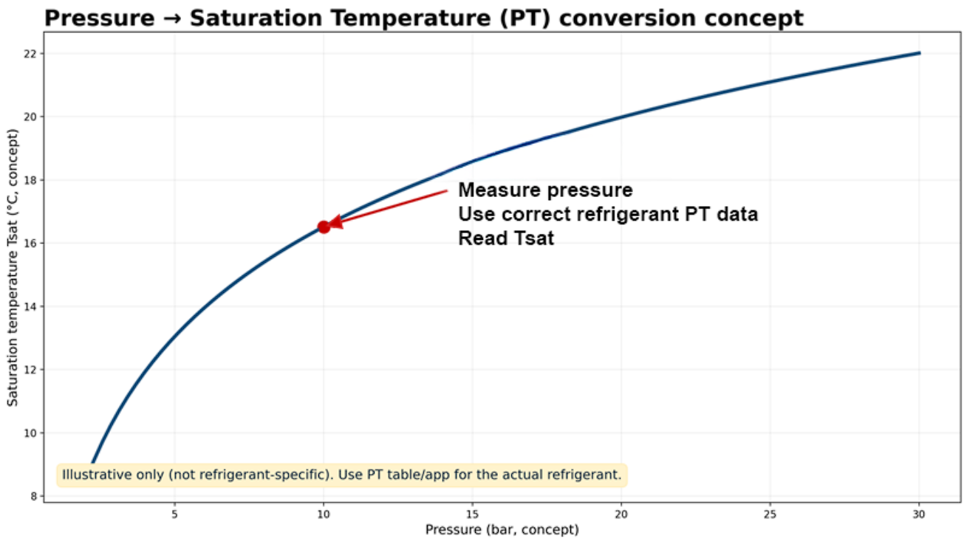
      Pressure to saturation temperature (PT) concept
Notes:
Tutor: Demonstrate PT conversion using a PT app for a common refrigerant and one sample pressure.

Slide 11
      Temperatures to record (air side)
Air temperatures show the heat transfer and comfort outcome.
Indoor return air (air on) and supply air (air off) for each unit.
Room air temperature at a consistent location (occupant level).
Outdoor ambient temperature (affects condensing/heat rejection).
If accessible: outdoor unit air on/off for performance check.

Slide 12
Temperatures to record (refrigerant side)
Refrigerant-side temperatures are used with pressure to calculate SH/SC.
Suction line temperature (measured with insulated clamp probe).
Liquid line temperature (measured with clamp probe).
Optional: discharge line temperature (if required by procedure).
Always note measurement location and probe insulation.

Slide 13
      Measuring air on/off correctly
Do:
Place probe in free airflow
Allow time to stabilise
Keep location consistent across tests
Use multiple points if airflow is uneven
Avoid:
Touching metal with the sensor
Blocking airflow with your body
Measuring during ramping/defrost
Comparing readings taken in different spots
Notes:
.

Slide 14
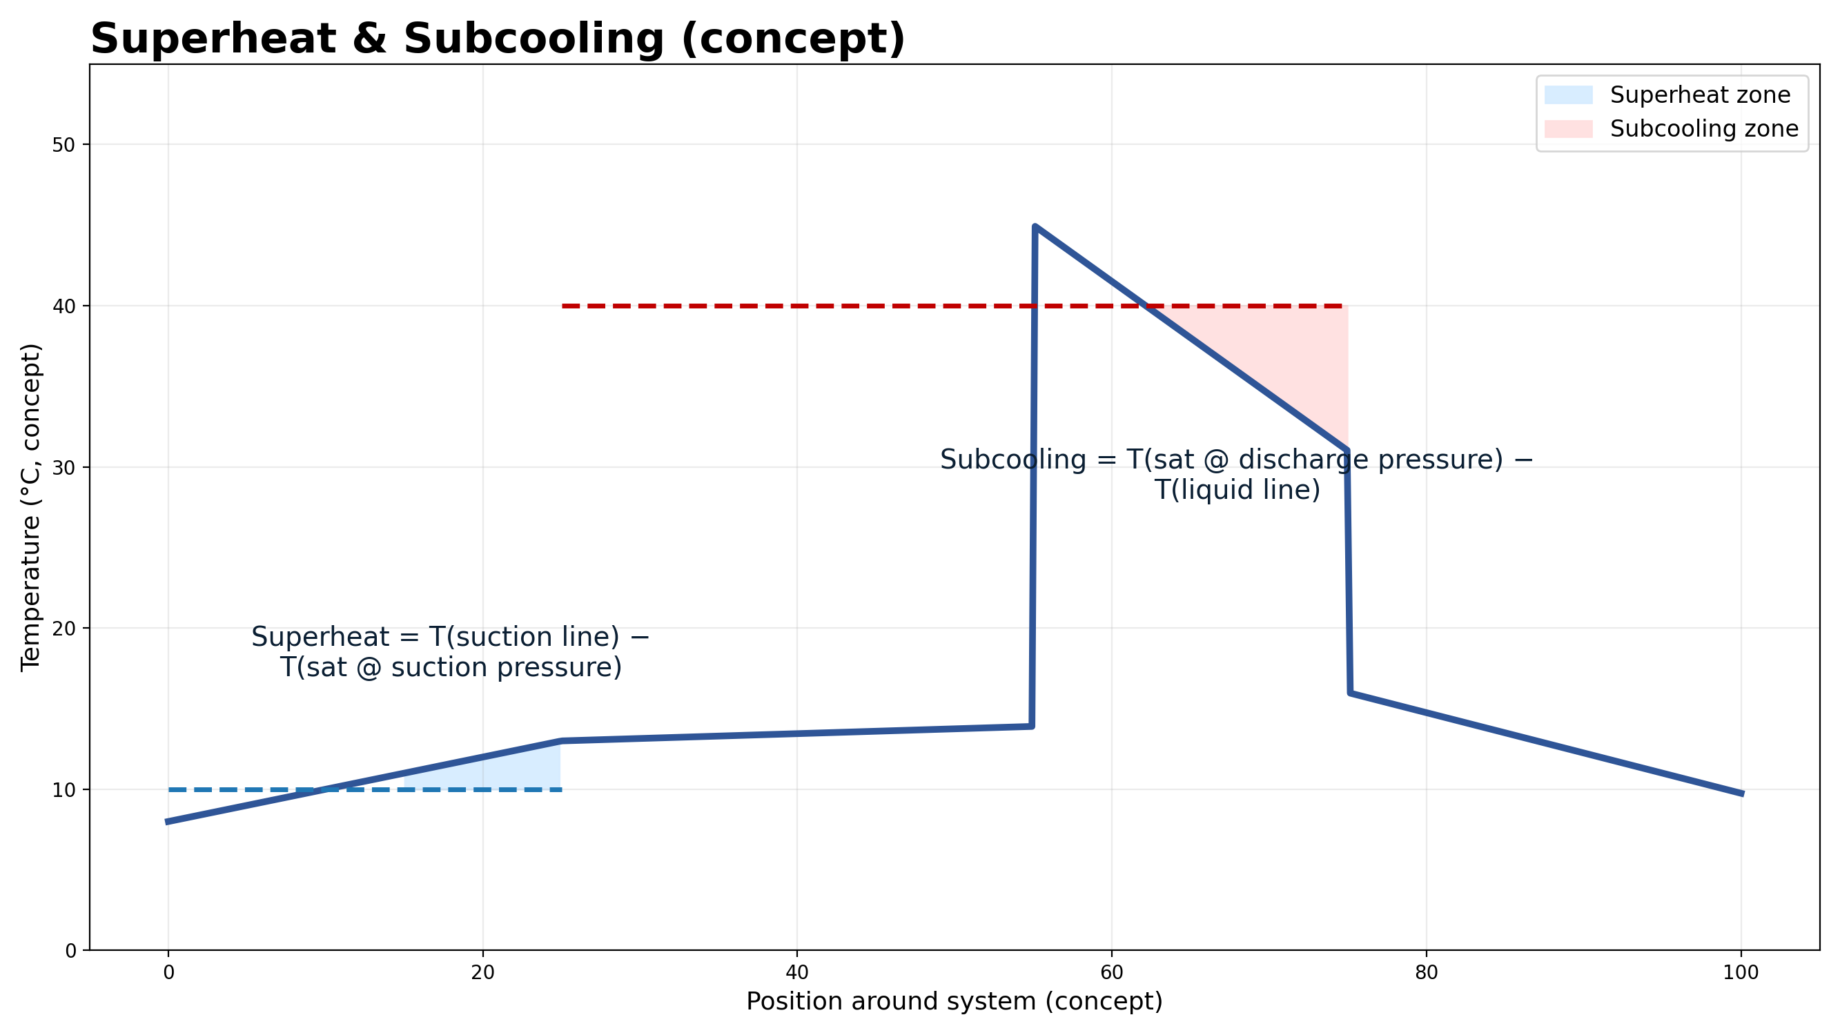
      Superheat and subcooling (concept)
Notes:
Explain what SH protects (compressor) and what SC protects (expansion device).

Slide 15
      Superheat: Definition and purpose
Superheat is how much hotter the suction vapour is than its saturation temperature.
It helps ensure only vapour returns to the compressor (reduces floodback risk).
Too low SH can risk compressor damage; too high SH can reduce capacity and efficiency.
Target SH depends on system type and manufacturer controls.
When calculating Superheat, use the Dew Point.
Notes:
Good website and images to explain https://mepacademy.com/superheat-vs-subcooling-explained/

Slide 16
      Worked example: Calculate superheat
Use PT data for the correct refrigerant.
1. Measure suction pressure (steady-state).
2. Convert suction pressure → Tsat (PT).
3. Measure suction line temperature (insulated clamp).
4. Superheat = T(suction line) − Tsat(suction).
Example: Tsat 7°C, suction line 15°C → SH = 8 K.
Notes:
Pause: learners do a second example in pairs using a different pressure/temperature.

Slide 17
      Interpreting superheat
If superheat is low:
possible floodback risk
overfeeding metering device or low airflow
check airflow (filters, fan, coil)
check control/metering device behaviour
If superheat is high:
evaporator may be underfed
possible low charge, restriction, or very high airflow
check charge-by-mass requirement
check for restrictions (drier/valves)

Slide 18
      Subcooling: Definition and purpose
Subcooling is how much cooler the liquid is than its saturation temperature on the high side.
It helps ensure a solid column of liquid reaches the expansion device.
Too low SC can mean flash gas and unstable expansion; too high SC can indicate overcharge/restriction.
Target SC depends on system design and manufacturer guidance.
When calculating Subcooling, use the Bubble Point.

Slide 19
      Worked example: Calculate subcooling
Use PT data for the correct refrigerant.
1. Measure high-side/discharge pressure (steady-state).
2. Convert high-side pressure → Tsat (PT).
3. Measure liquid line temperature.
4. Subcooling = Tsat(discharge) − T(liquid line).
Example: Tsat 45°C, liquid line 39°C → SC = 6 K.
Notes:
Pause: learners do a second example in pairs. Emphasise correct pressure/temperature pairing.

Slide 20
      Interpreting subcooling
If subcooling is low:
possible undercharge or low load
possible measurement error
check charge by mass (if required)
check condenser airflow and ambient temperature
If subcooling is high:
possible overcharge or restriction
higher head pressure and power use
check condenser cleanliness and fan
check liquid line restrictions

Slide 21
      Running current (amps): What to record
.
Record current at different operating states to understand load and efficiency.
Measure running current at full load.
Measure running current when rooms are near set point (normal operation).
Compare against nameplate ratings under similar conditions.
Record voltage if available for power discussions.

Slide 22
      Running current (amps): How to interpret
Amps help spot stress or abnormal operation.
High amps can be caused by high head pressure, overcharge, condenser issues, or mechanical problems.
Low amps can indicate undercharge, low load, or control limiting.
Always interpret with pressures, temperatures and operating mode.

Slide 23
      Refrigerant charge: Recording and method
Commissioning records must show what refrigerant is in the system.
Record base (factory) charge from nameplate/manual.
Record additional charge added for pipe length/accessories (kg).
Prefer charging by mass where the manufacturer specifies (use scales).
Where possible, record SH and SC after charging and stabilising.

Slide 24
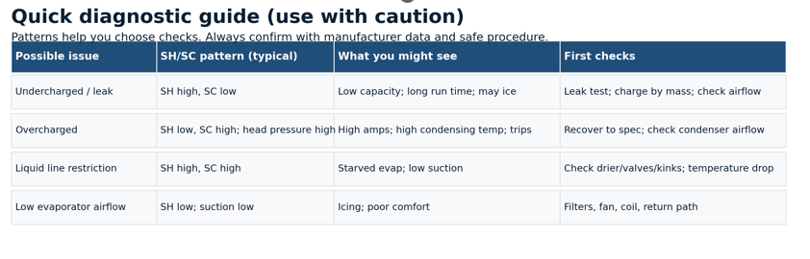
      Quick diagnostic patterns (guide)
Notes:
Use as a discussion tool. Stress this is a guide, not a diagnosis.

Slide 25
      Leak testing: Why it matters
Leak testing is part of commissioning because leaks waste energy and damage performance.
Low charge reduces efficiency and can cause abnormal compressor operation.
Leaks release greenhouse gases; controls exist to prevent and manage leakage.
Commissioning must record the leak test method and outcomes.

Slide 26
      Leak testing methods
Direct methods:
electronic leak detector (correct sensor for refrigerant)
bubble solution at joints/valves
UV dye (where permitted/appropriate)
OFN pressure test after recovery (procedure-led)
Indirect methods:
pressure/temperature trend analysis
monitor running current and performance
track recharge volumes over time
visual inspection for oil staining

Slide 27
      Leak testing sequence (practical)
A safe, repeatable sequence improves the reliability of results.
Visual inspection: oil staining, damaged pipework, missing caps
Check joints, valves (stems), seals, and vibration points
Use a direct method (detector/bubbles) at high-risk locations
If pressure test needed: recover refrigerant, then pressurise with OFN to specified test pressure
Record results, repairs, and retest after any fix

Slide 28
      F‑Gas requirements (summary)
Commissioning documentation supports legal and environmental compliance.
Prevent leakage and take action if leaks are found (repair and verify).
Keep records of refrigerant quantities added/removed and leak checks.
Leak checks occur at intervals based on CO₂‑equivalent charge and detection systems.
Only appropriately certified personnel should handle F‑gases.
Notes:
Tutor: signpost learners to current official guidance and workplace procedures. Avoid memorising thresholds in class.

Slide 29
      Commissioning log template
Category | Details to Record
Conditions | Ambient (°C), room temp (°C), mode, set point, steady‑state confirmed
Pressures | Suction P, discharge P; convert both to saturation temperatures (PT data)
Temperatures | Suction line T, liquid line T; indoor air on/off (each unit); outdoor air on/off
Calculated | Superheat (K), subcooling (K), air‑side ΔT (K)
Electrical | Running current at full load and near set point; voltage if available
Refrigerant | Base charge, additional charge added (kg), method used, cylinder details if required
Leak testing | Method used (detector/bubbles/OFN), result, repairs made, retest outcome
Controls | Test all end‑user controls; record settings changed and final configuration
Sign‑off | Engineer, date/time, notes, handover summary
Notes:
Activity: learners explain why each category is recorded. Option: build a mock log from a scenario.

Slide 30
      Compare to design: The key step
Commissioning is not just measuring; it is using evidence to meet design conditions.
Compare your readings to the manufacturer’s expected ranges and design intent.
Compare room pull-down/up to set point and air on/off data to design conditions.
Make ONE change at a time, then re-stabilise and re-measure.
Document every adjustment: what, why, and before/after values.

Slide 31
      Adjustment ‘levers’ (typical)
Air side:
fan speed settings/airflow balancing
filter and coil cleanliness
obstructions to inlet/outlet airflow
duct/grille positions (where relevant)
Refrigerant & controls:
charge by mass to spec (where required)
check metering device behaviour (TXV/EEV)
verify sensors and control parameters
confirm schedules/deadband/limits

Slide 32
      Test end-user controls
These must be done.
Controls testing proves the system works for the occupant/user.
On/Off and mode selection (cool/heat/auto/fan)
Set point changes and response
Fan speed changes
Timers/schedules and any lockouts/limits
Alarms/indications (what the user sees)
Any integrated controls (BMS/remote sensor)

Slide 33
      Case study (group task): Readings
Use these steady-state readings to calculate SH and SC and suggest the next checks.
Ambient 18°C; Room 26°C; Set point 21°C; Mode Cooling
Suction pressure 6.0 bar(g) → Tsat 6°C (from PT)
Discharge pressure 19 bar(g) → Tsat 42°C (from PT)
Suction line temp 20°C; Liquid line temp 41°C
Indoor air on/off 26→20°C; Outdoor air on/off 18→30°C
Running current: high vs spec
Notes:
Group task 10–15 min: calculate SH/SC, identify likely causes, list first three checks before any charge change.

Slide 34
      Case study: Prompts
Discuss and justify your answers using evidence.
What is superheat? What is subcooling?
What does the SH/SC pattern suggest (charge/airflow/restriction/control)?
Which measurements would you re-check to rule out error?
What are the first three safe checks you would do next?
What should be recorded before and after any adjustment?
Notes:
Answers
1. What is superheat?
Superheat is the temperature of a vapour above its saturation (boiling) temperature at a given pressure.
Measured on the suction line.
Indicates how much heat the refrigerant absorbed in the evaporator after fully boiling off.
Prevents liquid floodback to the compressor.
Formula:
Superheat = Suction line temperature – Saturation temperature (from suction pressure)
2. What is subcooling?
Subcooling is the temperature of a liquid refrigerant below its saturation (condensing) temperature at a given pressure.
Measured on the liquid line.
Shows how fully the refrigerant has been condensed before it reaches the metering device.
Ensures no flash gas at the expansion valve.
Formula:
Subcooling = Saturation temperature (from head pressure) – Liquid line temperature
3. What does the SH/SC pattern suggest?
Use the common diagnostic patterns:
High Superheat + Low Subcooling
Low refrigerant charge
Excess airflow over evaporator
Blocked metering device (TXV stuck closed or restriction)
Low Superheat + High Subcooling
Overcharged system
TXV stuck open / faulty control
Flooded evaporator
High Superheat + High Subcooling
Restriction between condenser and evaporator (liquid-line restriction, receiver issue, blocked filter-drier)
Low Superheat + Low Subcooling
Poor heat transfer on both coils
Low airflow or dirty evaporator
Compressor not pumping efficiently
4. Which measurements would you re-check to rule out error?
When values look “off,” always re-confirm:
✔ Pressures
Suction and discharge gauges fully seated, no gauge error
Compare against standard saturation tables
✔ Line Temperatures
Clean surface
Tight thermocouple placement
Proper insulation over strap
✔ Airflow Measurements
Filter condition
Fan speed settings
Blocked grilles or dampers
✔ Electrical Inputs
Voltage, current, and compressor load
Ensure stable supply
5. What are the first three safe checks you would do next?
Typical safe and non-invasive checks:
1. Inspect system airflow path
Check filters, blower, fan speed, coil cleanliness
Restriction here can mimic charge faults
2. Visual inspection of refrigeration circuit
Oil stains (leaks)
Frost patterns (blockages)
Kinks or damaged insulation
3. Safety device status
Reset high-pressure/low-pressure switches only after the cause is understood
Confirm condenser fans and evaporator fans operating correctly
(Only after safe checks do you consider touching the refrigerant charge.)
6. What should be recorded before and after any adjustment?
Always document:
Before adjustments
Ambient temperature (indoor & outdoor)
Suction & discharge pressures
Superheat and subcooling values
Airflow readings or static pressure
Compressor amps and voltage
Coil temperatures
Any observed fault symptoms
After adjustments
Updated SH/SC values
New pressures & temperatures
Improved airflow readings
Verification that system is operating within manufacturer specs
Notes on what was changed (charge added/removed, cleaning, repairs, etc.)

Slide 35
      Case study: Example discussion outcomes
Possible reasoning pathways (not a single correct answer):
If SH is very high: consider underfeeding (low charge or restriction) - but confirm with leak checks and airflow checks.
If head pressure and amps are high: consider condenser airflow issues or overcharge - confirm coil/fan condition and ambient.
If readings conflict: revisit probe placement and confirm PT conversion uses the correct refrigerant.
Always prioritise safety, follow procedures, and document decisions.

Slide 36
      Quick check
Answer without notes, then compare with a partner.
What does steady-state mean?
Name four temperatures you should record.
What two values do you need to calculate superheat?
What does high superheat often suggest?
What does high subcooling often suggest?
Notes:
Answers
1) What does steady‑state mean?
Steady‑state means the air‑conditioning system has been running long enough that all operating conditions have stabilised.
Pressures are no longer drifting
Temperatures have levelled off
Airflow and compressor performance have settled
This ensures that any readings you take are accurate and representative of true system performance.
2) Name four temperatures you should record.
Common required temperature measurements include:
Suction line temperature (at evaporator outlet)
Liquid line temperature (near metering device inlet)
Indoor air temperatures (return air and supply air)
Outdoor air temperature (ambient entering condenser)
Other useful temperatures: coil surface temps, discharge line temp, SAT/RAT profiles.
3) What two values do you need to calculate superheat?
To calculate superheat, you need:
Actual suction line temperature
Saturation temperature at suction pressure (from pressure gauge + PT chart)
Superheat = Suction line temp – Saturation temp
4) What does high superheat often suggest?
High superheat usually indicates the refrigerant is evaporating too early or not enough refrigerant is present in the evaporator.
Common causes:
Low refrigerant charge
Restricted metering device (TXV/EEV restriction or cap tube problem)
Excessive airflow over the evaporator
Evaporator starved of refrigerant
5) What does high subcooling often suggest?
High subcooling typically indicates too much liquid refrigerant in the condenser or liquid line.
Common causes:
Overcharged system
Restricted liquid line or filter-drier
TXV not feeding properly (underfeeding)
Condenser overperforming (rare, but possible in low ambient conditions)

Slide 37
      Quick check (cont’d)
6. Why record running current at full load AND near set point?
7. Name two direct leak detection methods.
8. What do you compare your readings against?
9. Why make only one adjustment at a time?
10. What should you do if you suspect a refrigerant leak?
Notes:
Answers
6) Why record running current at full load AND near set point?
Because motor/compressor current changes with system load, and checking both conditions tells you how healthy the system is across its operating range.
At full load (high demand):
Confirms the compressor and fans are not over‑amping
Ensures the system can handle peak conditions safely
Helps detect restrictions or airflow issues that only appear under heavy load
Near set point (light load / cycling):
Shows how the system behaves when capacity reduces
Helps identify issues like short‑cycling, control faults, or low load inefficiencies
Confirms the compressor isn't drawing excessive current while unloading or stabilising
Together, these readings give a complete performance picture.
7) Name two direct leak detection methods.
Two standard direct detection techniques are:
Electronic leak detector (“sniffer”) – detects refrigerant molecules in the air.
Soap bubble solution – applied to joints; bubbles form at leak points.
Other direct methods: UV dye, ultrasonic detectors.
8) What do you compare your readings against?
Always compare field measurements to:
Manufacturer specifications (pressures, SH/SC, airflow, current draw)
System design data (COP, duty, coil temperatures, rated conditions)
PT charts (to confirm saturation temperatures)
Previous service records (for trend analysis)
This ensures your diagnosis is based on evidence, not guesswork.
9) Why make only one adjustment at a time?
Because making multiple adjustments together makes it impossible to know which change caused which effect.
Only altering one parameter at a time ensures:
Clear cause‑and‑effect understanding
Accurate fault confirmation
Avoidance of over‑correcting
Safe, controlled optimisation of system performance
It’s a core principle of safe HVAC troubleshooting.
10) What should you do if you suspect a refrigerant leak?
Follow correct engineering and safety protocol:
Do NOT add refrigerant until the leak is confirmed and repaired.
Use direct detection (sniffer, bubbles, dye) to locate the leak.
Isolate the system if necessary to prevent further loss.
Recover refrigerant safely if repair requires opening the circuit.
Repair the leak (brazing, component replacement, tightening).
Pressure test and evacuate to confirm tightness.
Recharge to manufacturer specification using correct SH/SC checks.
Record the leak, repair, and refrigerant quantities (mandatory under F‑Gas rules).

Slide 38
      Summary: What great commissioning looks like
Commissioning is evidence-based verification to meet design and maximise efficiency.
Record pressures, temperatures, SH/SC, and amps at steady-state.
Convert pressures to saturation temperatures using correct PT data.
Compare to design/manufacturer data and adjust methodically.
Record refrigerant additions beyond base charge and leak testing outcomes.
Test end-user controls and document final settings for handover.

Slide 39
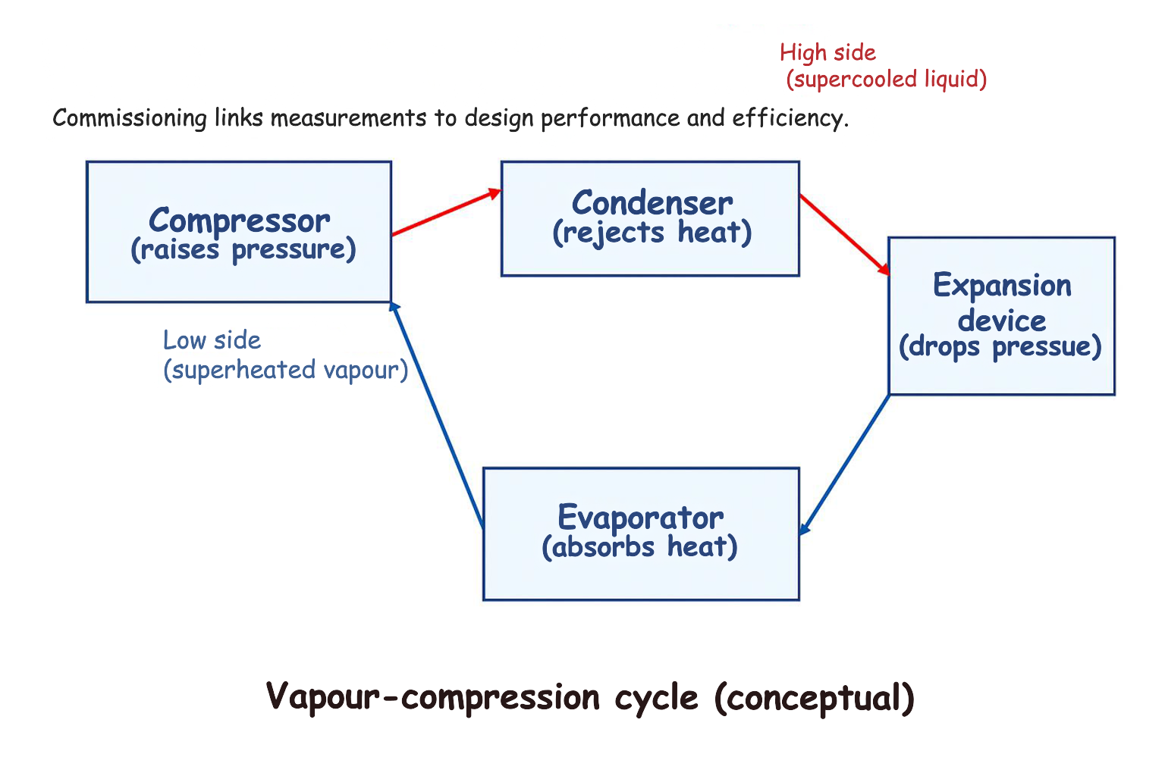
      Appendix: Refrigeration cycle (reference)

Slide 40
      Appendix: Formula sheet
Use these with the correct refrigerant PT data.
Superheat (K) = T(suction line) − Tsat(suction pressure)
Subcooling (K) = Tsat(discharge pressure) − T(liquid line)
Air-side ΔT (K) = T(return air) − T(supply air)
For differences (SH/SC/ΔT), Kelvin and °C differences are numerically the same.
To convert Kelvin to degrees Celsius, you can use the formula:
°C = K - 273.15
For example, to convert 300 Kelvin to Celsius, you would calculate:
300 K - 273.15 = 26.85 °C.
Notes:
Note: Additionally, it's important to note that 0 Kelvin is equal to -273.15 °C, which is known as absolute zero, the lowest possible temperature where all atomic motion stops.

Slide 41
      Image copyright and reuse
All diagrams and graphics in this deck are original and created specifically for this presentation.
They are copyright-free for your educational use and can be reused in handouts/VLE materials.
If you add external photos later, use openly licensed images (e.g. CC BY) and keep attribution in slide notes.

Slide 42
      Extension: Energy efficiency links
Commissioning data helps reduce energy use by preventing inefficient operation.
Correct charge and airflow reduce compressor work and prevent long run times.
Stable controls (set point, deadband, schedules) prevent short cycling.
Documented baselines support future optimisation and maintenance.

Slide 43
      Extension: Documenting adjustments
A professional commissioning record should include before/after evidence.
Record what was changed (e.g. fan speed, control parameter, charge mass).
Record why it was changed (what evidence suggested it).
Re-stabilise, re-measure and record the improvement (or not).
If not improved, revert safely or escalate per procedure

Slide 44
      Summary
You should now be able to:
Explain why data must be taken at steady-state​
Record the required commissioning measurements​
Calculate and interpret superheat & subcooling​
Compare the design data and plan adjustments​
Describe leak testing and what must be recorded​
​
Notes:
Timing: 3–4 min. Ask learners: ‘one thing you learned’ + ‘one question you still have’.

Slide 45
Any questions?
Copyright in this document belongs to and is used under licence from the Department for Education, © 2025.
‘T-LEVELS’ and ‘T Level’ are registered trademarks of the Department for Education.
WJEC is authorised by the Department for Education to develop and deliver this T Level Technical Qualification.
WJEC operates in England under the name Eduqas which is a registered trademark of WJEC.

