Slide 1
Occupational Specialism: Air Conditioning Engineering
K1.10 The principles of operation of heat pumps
PowerPoint 1.10: Heat pumps
Notes:
Quick diagnostic question: “Where does the heat come from when it’s cold outside?”
Explain this lesson sits in system maintenance: understanding the cycle helps diagnose faults and performance issues.

Slide 2
Objectives
By the end of this session, you should be able to:
Explain how a vapour-compression heat pump moves heat from a source to a sink
Interpret a pressure–enthalpy (p–h) chart for a basic heat pump cycle
Calculate heating COP from enthalpy changes (Δh)
Compare potential efficiency of air source vs ground source heat pumps
Compare heat pump efficiency against gas boilers and electric resistance heating
Link performance changes to maintenance/fault symptoms (e.g. low charge, dirty coils)
Notes:
. Suggested approach: read outcomes, then do a quick “traffic light” self-assessment (green/amber/red).

Slide 3
Starter: What do you already know?
In pairs:
Name the 4 main components of a vapour-compression system
Which component adds energy to the refrigerant?
Where is heat absorbed? Where is heat rejected?
What is “superheat”? What is “subcool”?
Share answers as a class.
Notes:
Timing: 5–8 minutes. Use mini-whiteboards or sticky notes. Don’t over-teach here—just surface prior knowledge.

Slide 4
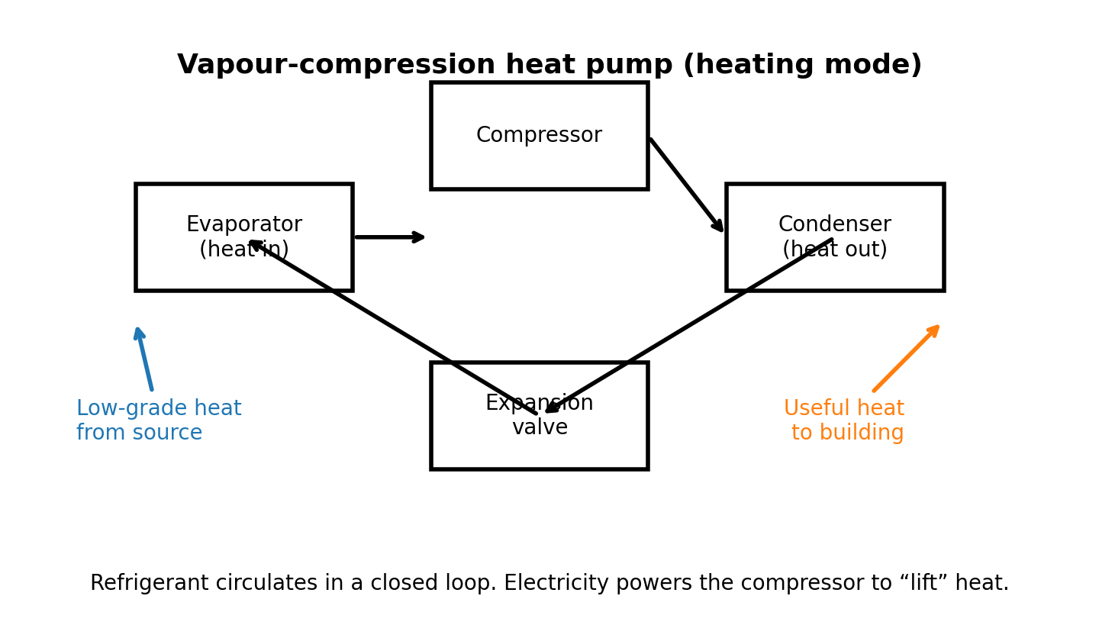
Heat pump: the big idea
A heat pump moves heat from a colder place (source) to a warmer place (sink).
It needs electrical energy (compressor work) to “lift” heat to a higher temperature.
In heating mode, the building receives heat at the condenser.
Same basic hardware as refrigeration/AC, but the *useful* side is different.
Notes:
Use the diagram to highlight heat in at the evaporator and heat out at the condenser. Reinforce energy balance: Q_out = Q_in + W_in.
More details: https://www.nationalgrid.com/stories/energy-explained/how-do-heat-pumps-work

Slide 5
Core components (maintenance link)
Evaporator: absorbs low-grade heat; pressure and saturation temperature are low.
Compressor: raises pressure and temperature; biggest electrical load.
Condenser: rejects heat to heating water/air; pressure and saturation temperature are high.
Expansion valve/device: drops pressure; controls superheat (TXV/EEV) or flow (capillary).
Key measurements during maintenance: pressures, temperatures, superheat, subcool, power draw, airflow/waterflow.
Notes:
Discuss why each component matters for performance and fault symptoms. Emphasise safe working and correct instruments.
.

Slide 6
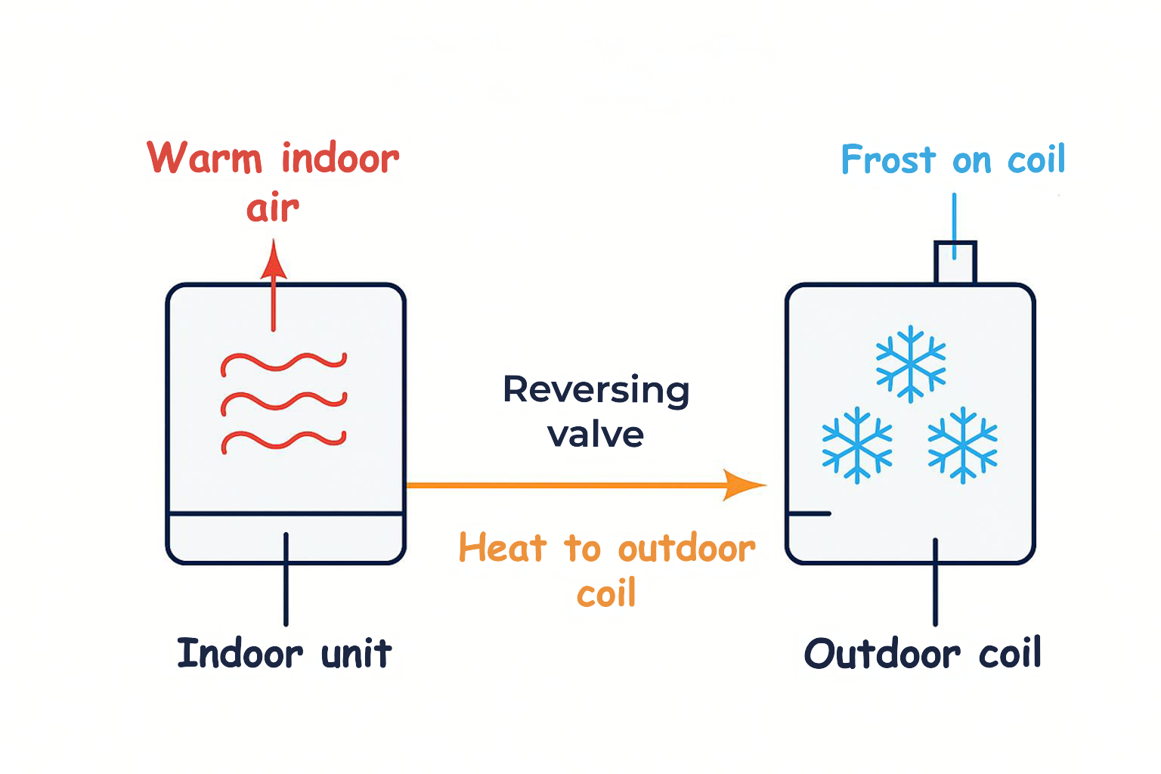
Defrost cycle
In heating mode, the outdoor coil can freeze.
Frost stops the system from absorbing heat from the air.
The heat pump enters a defrost cycle to melt the ice.
It temporarily switches back to cooling mode to send heat outside.
After the ice melts, the system returns to heating mode automatically.
Notes:
Discuss why each component matters for performance and fault symptoms. Emphasise safe working and correct instruments.
.

Slide 7
Heat flows and COP (Coefficient of Performance)
Heating COP (COP_{h}) = Useful heat output / Electrical input
COP_{h} = Q_{out} / Wi_{n}
Because the heat pump moves heat *and* adds compressor work, COP can be > 1.
Higher COP means less electricity for the same heat output.
COP is not fixed: it changes with temperatures, defrost, controls, and maintenance condition
Notes:
Use a simple example: if COP=3, then 1 kWh of electricity gives ~3 kWh of heat to the building (at the condenser).
Good site to use for COP https://www.geeksforgeeks.org/physics/coefficient-of-performance-formula/

Slide 8
What changes COP? (The ‘temperature lift’)
Temperature lift = (sink temperature) − (source temperature)
Bigger lift → compressor works harder → COP decreases.
Typical ways to improve COP:
lower heating flow temperature (e.g., larger radiators/ufh)
warmer source (ground loop, or mild outdoor temperature)
clean heat exchangers and correct airflow/waterflow
correct refrigerant charge and expansion control
Notes:
Relate to maintenance: dirty coils/fouled filters reduce heat transfer and force higher lift (worse COP).

Slide 9
Introducing the pressure–enthalpy (p–h) chart
A p–h chart is a map of refrigerant states and processes.
x-axis: enthalpy (kJ/kg) – energy content of the refrigerant.
y-axis: pressure (bar) – often shown on a log scale.
The “dome” shows saturated liquid/vapour region; outside the dome = superheated vapour or subcooled liquid.
We plot the cycle to see where heat is absorbed/rejected and how much compressor work is required.
Notes:
Explain this is schematic. In real service, manufacturers provide p–h charts for specific refrigerants (R32, R410A, R134a, etc.).

Slide 10
p–h chart: the four key processes
Refer to the chart on the next slide:
1 → 2 Compression: pressure rises; enthalpy rises (work input).
2 → 3 Condensation: heat rejected; enthalpy falls at high pressure.
3 → 4 Expansion: big pressure drop; enthalpy ~constant (throttling).
4 → 1 Evaporation: heat absorbed; enthalpy rises at low pressure.
On a p–h chart, enthalpy differences (Δh) tell us heat and work per kg of refrigerant

Slide 11
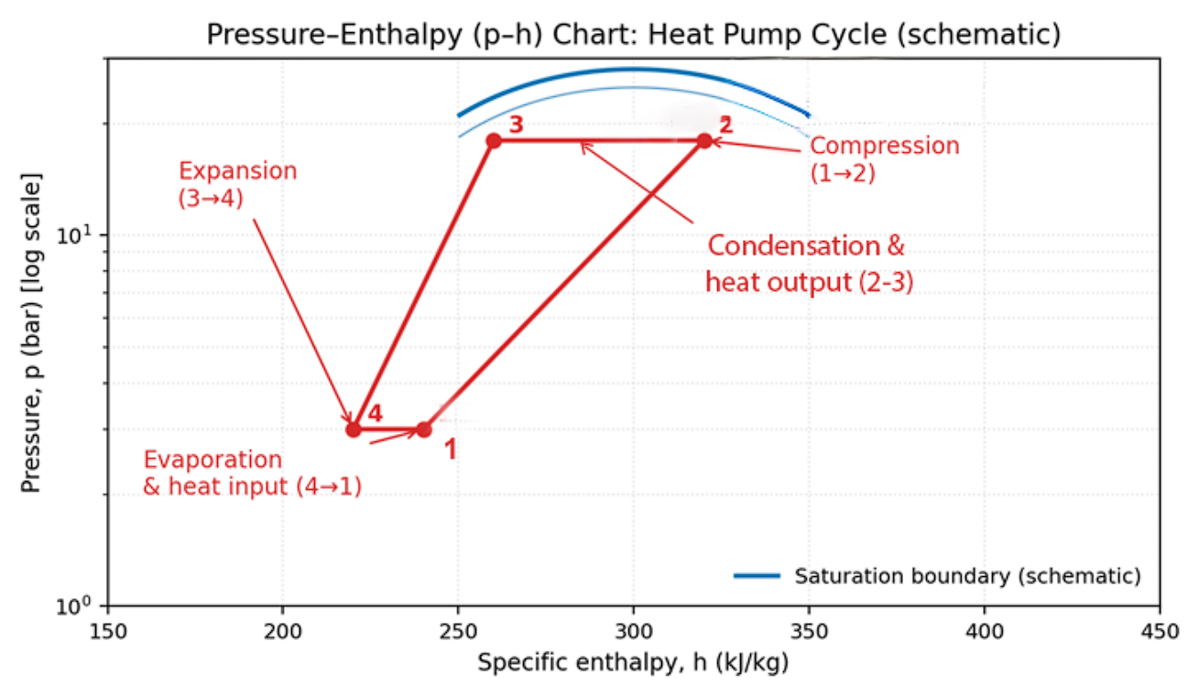
Introducing the pressure–enthalpy (p–h) chart
Notes:
Ask learners: which line represents the expansion valve? (the near-vertical constant-enthalpy line).

Slide 12
Activity: Label the cycle (p–h chart)
In pairs, annotate a printed p–h chart (or your notes):
Mark points 1–2–3–4
Circle where heat is absorbed and where it is delivered to the building
Draw arrows showing refrigerant flow direction
Write one maintenance check linked to each process (e.g., check superheat at evaporator outlet)
Be ready to share one key point.
Notes:
Activity: 10 minutes.
Provide a worksheet if possible. Circulate and prompt: “Where would you measure subcooling?” “Where is compressor work shown?”
Good diagram to use: https://www.tecquipment.com/assets/documents/downloads/Pressure-Enthalpy-Diagram-poster.pdf
interactive website on plotting p h chart https://tlk-energy.de/en/phase-diagrams/pressure-enthalpy

Slide 13
COP from enthalpy (using the p–h chart)
On a p–h chart (per kg of refrigerant):
heat delivered at condenser, q_{out} ≈ h2 − h3
compressor work, Wi_{n} ≈ h2 − h1
So: COP_{h} ≈ (h2 − h3) / (h2 − h1)
This is a simplified ideal calculation - real systems have losses
Notes:
Explain units: h in kJ/kg, so differences are kJ/kg of heat/work. COP is unitless.
.

Slide 14
Worked example (class calculation)
Assume (from a chart) the following enthalpies:
h1 = 410 kJ/kg (compressor inlet)
h2 = 460 kJ/kg (compressor outlet)
h3 = 260 kJ/kg (condenser outlet)
Calculate COP_{h}:
Q_{out} = h2 − h3 = 200 kJ/kg
W_{in} = h2 − h1 = 50 kJ/kg
COP_{h} = 200 / 50 = 4.0
Notes:
Ask learners to do it on calculators. Then discuss: what would reduce COP in reality? (fan/pump power, pressure drops, non-ideal compression, defrost, cycling).

Slide 15
Maintenance: what the p–h chart helps you spot
Changes in pressures and enthalpy differences change COP and capacity.
Common issues that shift the cycle:
low refrigerant charge: low suction pressure, high superheat, reduced capacity
restricted filter/drier or blocked expansion device: abnormal pressure drop/subcool changes
dirty evaporator/condenser: reduced heat transfer → higher lift → lower cop
air/water flow issues: incorrect approach temperatures, nuisance trips
A p–h plot supports diagnosis when combined with temperature/pressure readings.
Notes:
Stress: p–h charts support diagnosis; always follow manufacturer guidance and safe procedures. For T Level, keep it conceptual.

Slide 16
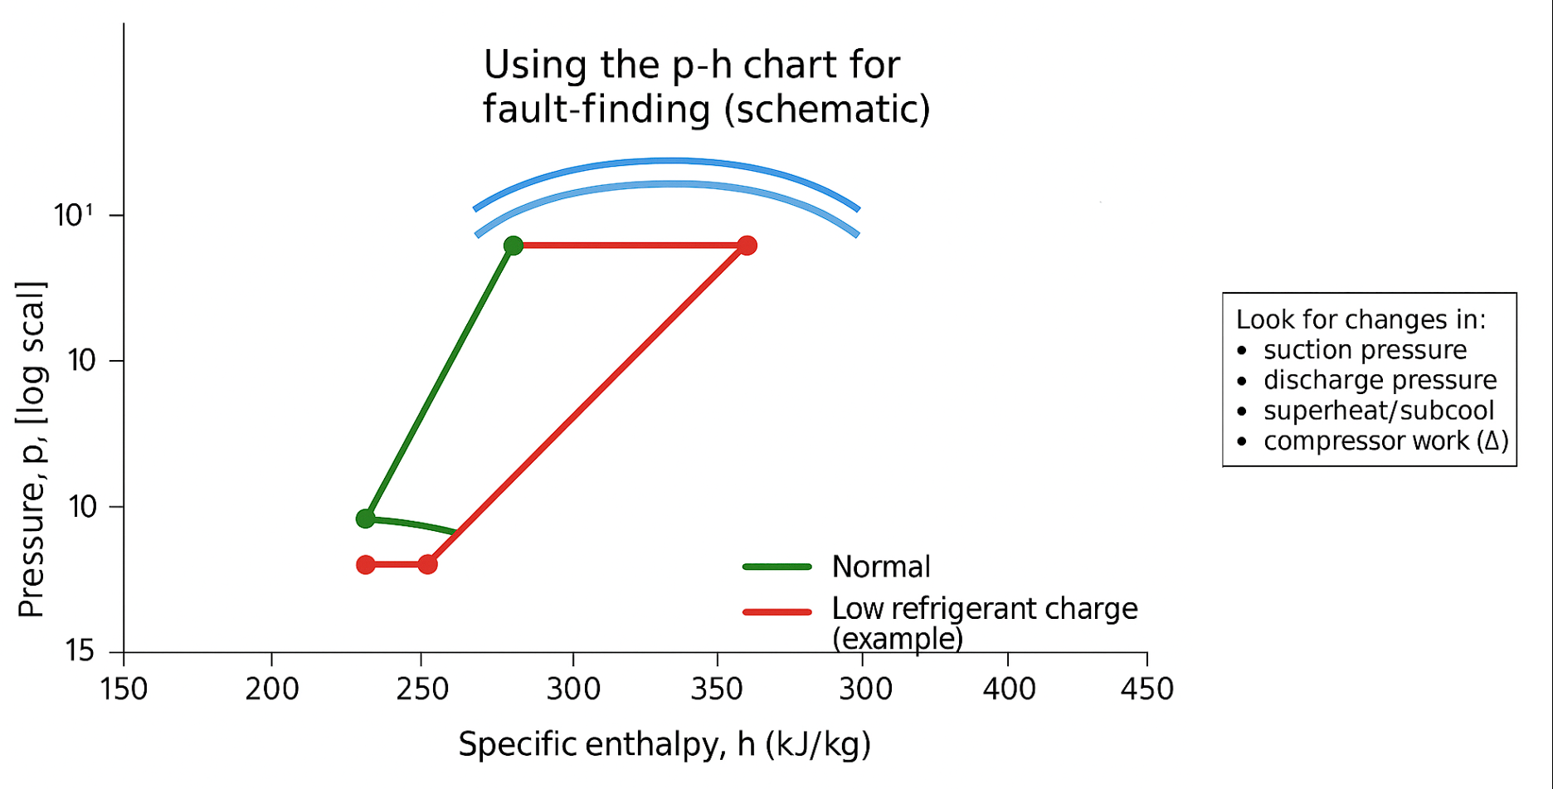
Maintenance: what the p–h chart helps you spot
Notes:
Stress: p–h charts support diagnosis; always follow manufacturer guidance and safe procedures. For T Level, keep it conceptual.

Slide 17
Air Source Heat Pumps (ASHP): Where the heat comes from
Heat source: outdoor air (even in winter, air contains thermal energy).
Outdoor unit contains the evaporator coil + fan; indoor unit delivers heat to water or air.
Common configurations:
air-to-water (radiators/UFH/hot water via cylinder)
air-to-air (warm air delivery; similar to split AC)
Maintenance focus: outdoor coil cleanliness, airflow, defrost, fan operation, condensate drainage.
Notes:
Discuss practical maintenance tasks: remove debris, check clearances, verify defrost cycle, inspect electrical connections and vibrations.

Slide 18
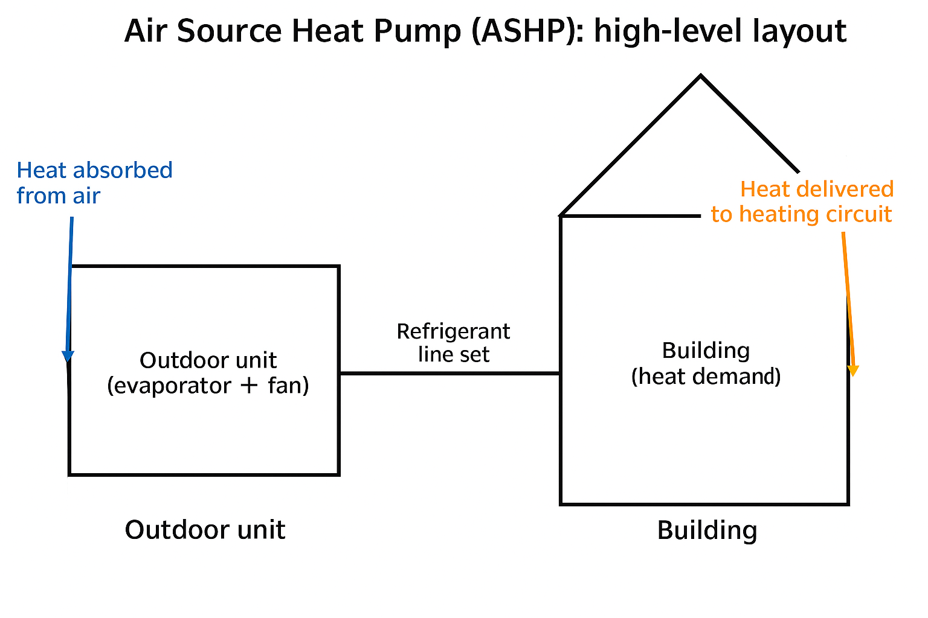
Air Source Heat Pumps (ASHP): Where the heat comes from
Notes:
Timing: 15 min.
Server room → heat pump → heating loop → office heating

Slide 19
ASHP performance factors
Outdoor temperature affects evaporating temperature → affects COP.
Higher heating flow temperature increases condensing temperature → reduces COP.
Defrost cycles temporarily reduce net heat output and efficiency.
Good design and maintenance protect performance: correct sizing, low flow temps, clean coils, correct charge.

Slide 20
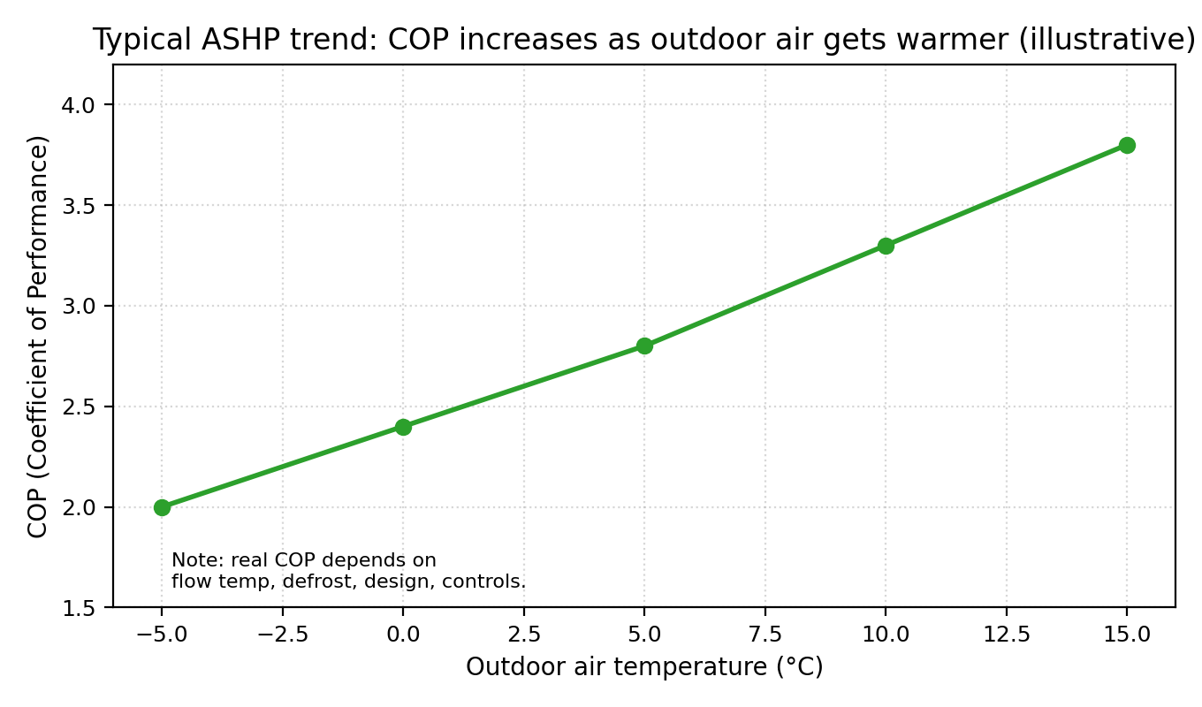
ASHP performance factors
Notes:
Use the graph as an illustrative trend. Ask: Why does COP drop in cold weather? Link to increased lift and defrost.

Slide 21
Ground Source Heat Pumps (GSHP): where the heat comes from
.
Heat source: ground or water (more stable temperature year-round).
Uses a ground loop (brine/antifreeze) to collect heat; the heat exchanger transfers heat to the refrigerant.
Loop types:
horizontal trenches (needs land area)
vertical boreholes (deep drilling)
water source loops (lakes/rivers – permissions required)
Maintenance focus: circulation pumps, brine pressure/flow, antifreeze concentration, air removal, filters/strainers.
Notes:
Explain why ground temperature stability can give steadier COP compared with air source

Slide 22
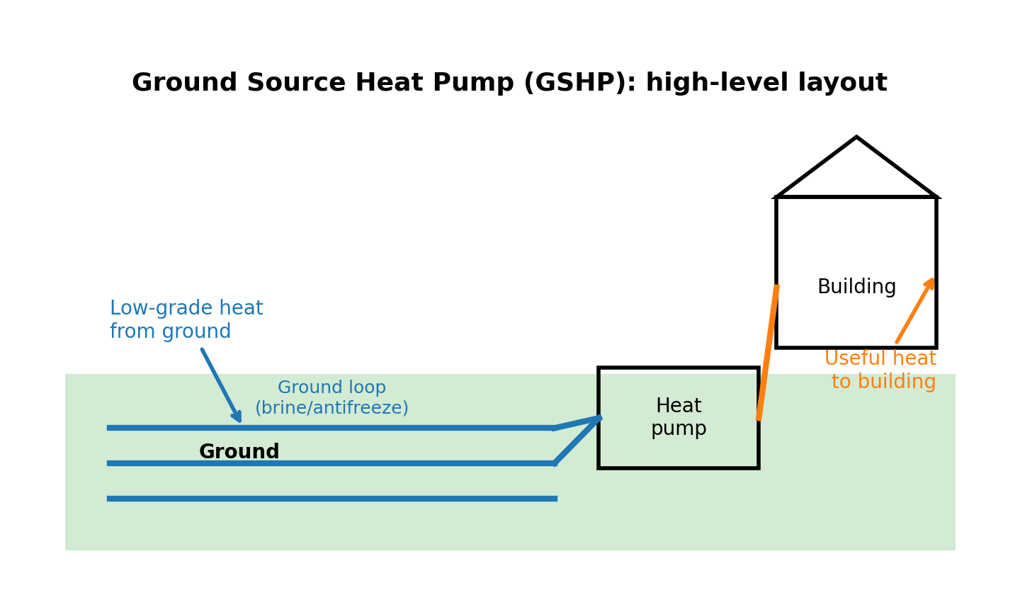
Ground Source Heat Pumps (GSHP): where the heat comes from
.
Notes:
Source: Güntner adiabatic cooling overview.

Slide 23
ASHP vs GSHP (high-level comparison)
ASHP advantages: lower installation cost, easier retrofit, no ground works.
ASHP challenges: performance varies with weather; defrost; needs good airflow and siting.
GSHP advantages: stable source temperature → steadier COP; no defrost.
GSHP challenges: higher capital costs; ground-loop complexity; space/drilling requirements.
Both need: correct system design, good controls, and regular maintenance for best efficiency.
Notes:
Encourage learners to think about site constraints. Ask: Which would you choose for a small urban home? For a campus with land?

Slide 24
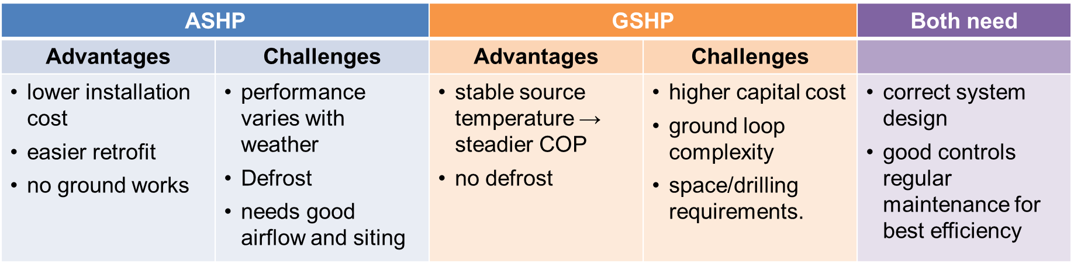
ASHP vs GSHP (high-level comparison)
Notes:
Explain climate dependence. Source: Chem-Aqua adiabatic explainer.

Slide 25
Traditional heating method: Gas/condensing boilers
Gas boilers burn fuel to create hot combustion gases that heat water via a heat exchanger.
Condensing boilers recover extra heat by condensing water vapour in flue gases.
Seasonal efficiency can be high (often around ~90%+), but cannot exceed 100% because no heat is “moved” from outside.
Maintenance: combustion safety checks, flue/condensate checks, heat exchanger cleanliness, controls, water quality.
Notes:
Keep comparison fair: gas boiler efficiency is good, but it is limited by combustion physics; heat pumps can exceed 1.0 COP by moving heat.

Slide 26
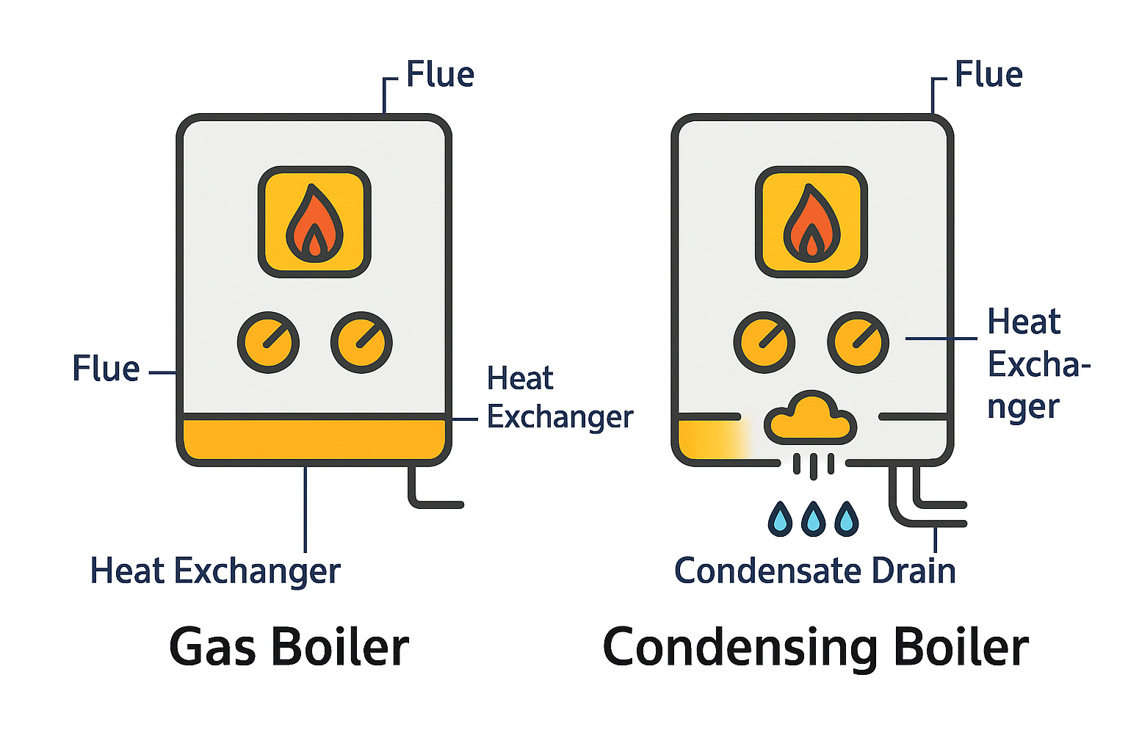
Traditional heating method: Gas/condensing boilers
Notes:
Keep comparison fair: gas boiler efficiency is good, but it is limited by combustion physics; heat pumps can exceed 1.0 COP by moving heat.

Slide 27
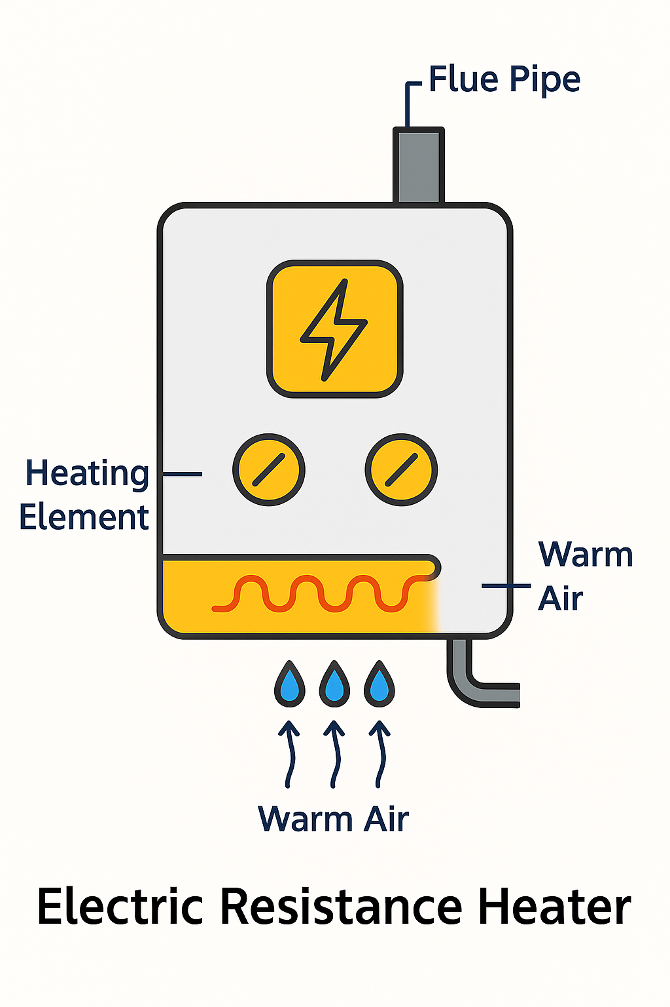
Traditional heating method: Electric resistance heating
Electric resistance heaters convert electrical energy directly into heat (e.g. panel heaters).
At the point of use, 1 kWh electricity → ~1 kWh heat (≈100%).
Simple and low maintenance, but running costs and emissions depend on electricity price and grid mix.
Heat pumps can provide more heat per kWh electricity when COP > 1.
Notes:
Clarify: “100% efficient” here means point-of-use. System-wide impacts depend on how electricity is generated.

Slide 28
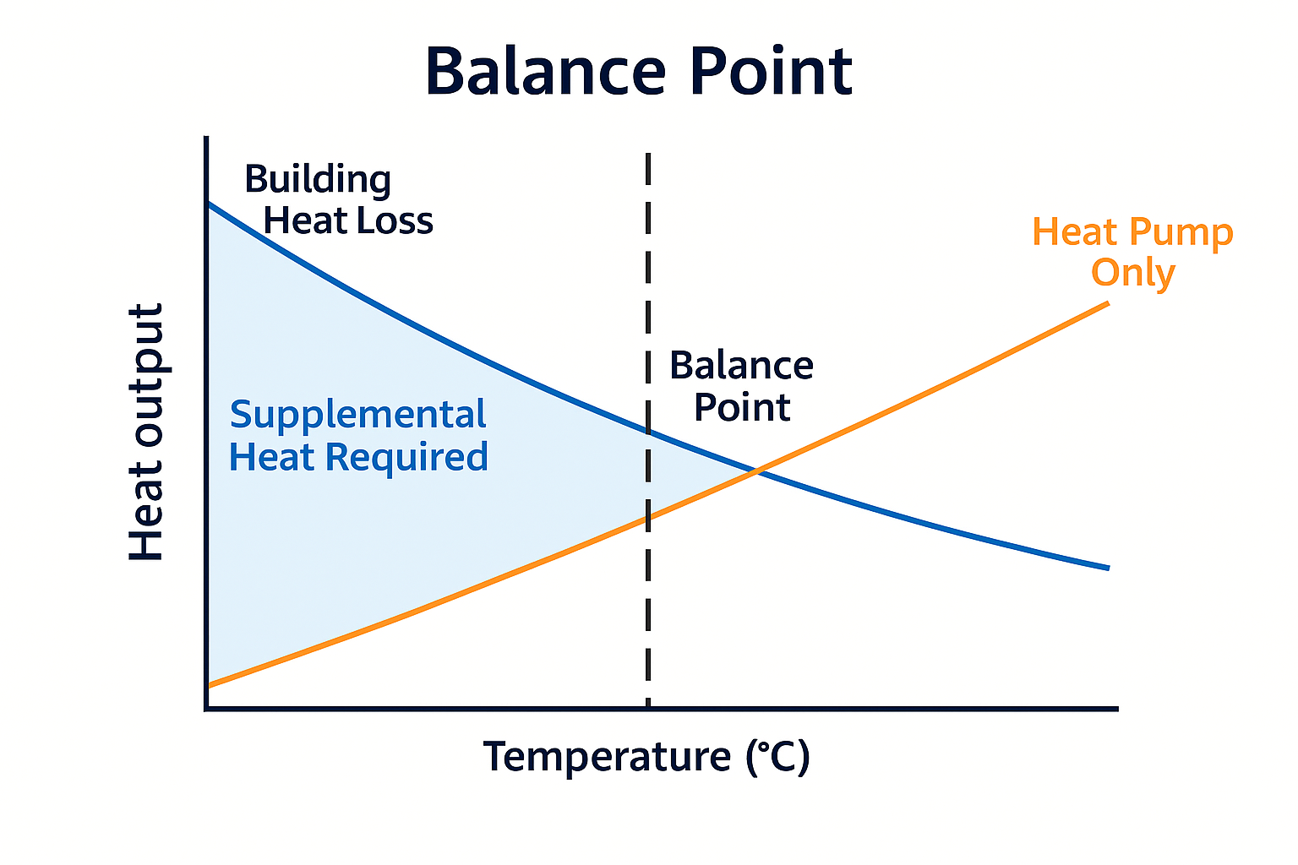
Supplemental electric heat
A heat pump can struggle at low outdoor temperatures.
When it can’t keep up, supplemental electric heat switches on automatically.
The balance point is the temperature where the heat pump alone can no longer match the building’s heat loss.
Supplemental heat fills the gap, ensuring comfort even in cold weather.

Slide 29
Efficiency comparison (point of use)
Compare heat delivered per 1 kWh of energy input:
ASHP with COP 3 → ~3 kWh heat per 1 kWh electricity
GSHP with COP 4 → ~4 kWh heat per 1 kWh electricity
Gas boiler at 90% → ~0.9 kWh heat per 1 kWh gas
Electric resistance → ~1.0 kWh heat per 1 kWh electricity
This is why heat pumps are described as “high efficiency”.

Slide 30
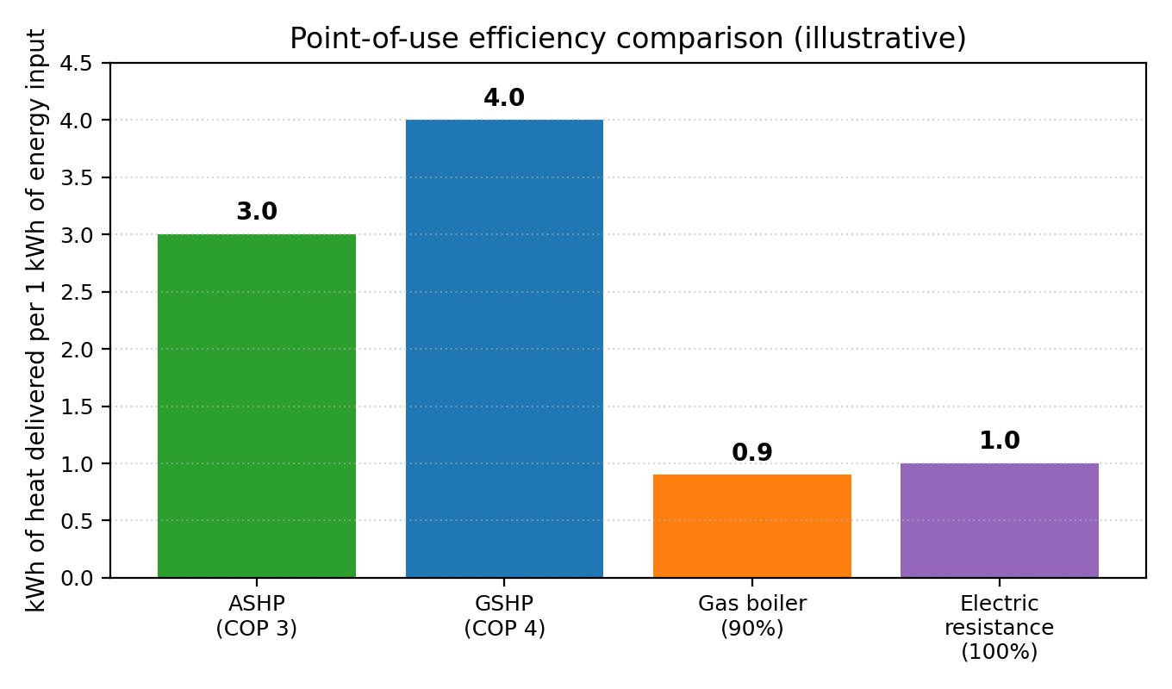
Efficiency comparison (point of use)
Notes:
Use the bar chart to provoke discussion. Ask: what conditions would make a heat pump COP fall? What maintenance actions prevent this?

Slide 31
Activity: Running cost comparison
Scenario: A home needs 12,000 kWh of heat over a heating season.
Assume:
gas boiler seasonal efficiency = 90%
ashp seasonal cop = 3.0
electric resistance = 100%
Task:
Calculate energy input required for each system
If you have local tariffs, estimate the annual running cost
Discuss: what maintenance/design choices could change the result?
Notes:
Run activity in small groups.
Scenario: A home needs 12,000 kWh of heat over a heating season.
Assume:
Gas boiler seasonal efficiency = 90%
ASHP seasonal COP = 3.0
Electric resistance = 100%
Task:
Calculate energy input required for each system
If you have local tariffs, estimate annual running cost
Discuss: what maintenance/design choices could change the result?

Slide 32
How to calculate energy input (quick method)
Energy input = Heat demand
Efficiency
Examples:
Gas: input gas (kWh) = heat demand / 0.90
ASHP: input electricity (kWh) = heat demand / COP
Electric resistance: input electricity (kWh) = heat demand / 1.00
This is the basis for cost and carbon comparisons.
Notes:
After groups attempt, reveal method and run through one example on the board.

Slide 33
Worked solution
Using the provided numbers:
If heat demand = 12,000 kWh:
Gas input = 12,000 / 0.90 = 13,333 kWh gas
ASHP electricity = 12,000 / 3.0 = 4,000 kWh electricity
Electric resistance = 12,000 / 1.0 = 12,000 kWh electricity
Interpretation: lower input energy generally means lower running costs (tariff-dependent).
Notes:
Discuss tariffs and why “kWh” comparisons matter. Mention that electricity is often more expensive per kWh than gas, so COP must be high enough to offset this.

Slide 34
System maintenance: Checks that protect efficiency
Air side (ASHP):
Clean coils and filters; keep clearances; check fan and defrost operation
Water/brine side (ASHP/GSHP):
Correct flow rates, strainers, air removal, pump condition, water quality
Refrigerant circuit:
Leak checks where required; correct charge; verify superheat/subcool; check compressor amperage
Controls:
Weather compensation, setpoints, cycling, sensor calibration
Notes:
Connect back to COP and p–h chart: poor heat transfer increases lift and reduces COP. Emphasise safe practice and F-gas requirements (where applicable).

Slide 35
Activity: Fault symptoms → cycle changes
Work in pairs
Match the symptom to the likely cause:
Low heat output + high superheat + low suction pressure
High discharge pressure + poor heat output
Frosting/icing + frequent defrost
High power draw + noisy compressor
Then decide: what maintenance action would you take first?
Notes:
Timing:10 minutes. Encourage evidence-based answers: what measurements would confirm? Keep within learner competence—no unsafe procedures.

Slide 36
Quick check
1. On a p–h chart, which process is approximately constant enthalpy?
2. If COP = 3, how much heat is delivered per 1 kWh of electricity (approx.)?
3. What happens to COP when heating flow temperature increases?
4. Name one key maintenance check for ASHP outdoor units.
5. Why can GSHP performance be steadier than ASHP?
Notes:
Timing: 5mins.
Run as hands-up or mini-whiteboards. Use to identify any misconceptions before plenary.

Slide 37
Quick check - answers
1. The throttling/expansion process (from liquid line through the expansion valve). This is an isenthalpic process, so h ≈ constant. 2. A COP of 3 means: 1 kWh of electricity → 3 kWh of heat output
3. COP decreases. Higher flow temperatures require the compressor to work harder, reducing efficiency.
4. Any of the following is acceptable:
Clear debris from coils and fan.
Check for ice build‑up or blocked airflow.
Inspect refrigerant connections for leaks.
Verify fan operation.
5. Because ground temperatures remain relatively stable year-round, whereas air temperatures fluctuate. This gives GSHPs a more consistent heat source, improving performance stability and seasonal efficiency.
.
Notes:
1. Throttling is assumed to be an adiabatic process where no work is done and changes in kinetic/potential energy are negligible, resulting in no change in the enthalpy of the refrigerant.

Slide 38
Summary
You should now be able to:
Explain how a vapour-compression heat pump moves heat from a source to a sink
Interpret a pressure–enthalpy (p–h) chart for a basic heat pump cycle
Calculate heating COP from enthalpy changes (Δh)
Compare potential efficiency of air source vs ground source heat pumps
Compare heat pump efficiency against gas boilers and electric resistance heating
Link performance changes to maintenance/fault symptoms (e.g. low charge, dirty coils)
​
Notes:
Timing: 3–4 min. Ask learners: ‘one thing you learned’ + ‘one question you still have’.

Slide 39
Any questions?
Copyright in this document belongs to and is used under licence from the Department for Education, © 2025.
‘T-LEVELS’ and ‘T Level’ are registered trademarks of the Department for Education.
WJEC is authorised by the Department for Education to develop and deliver this T Level Technical Qualification.
WJEC operates in England under the name Eduqas which is a registered trademark of WJEC.

