Slide 1
Occupational Specialism: Refrigeration Engineering
K1.8 The operating principles for defrost systems
PowerPoint 1.8

Slide 2
Introduction
Where and when do you need to worry about defrosting coils?

Slide 3
Objectives
You should be able to:
Recall different methods of defrosting systems.
Explain the basic principles behind defrost systems.
You might also be able to:
Examine complex defrost systems.
Select and justify the best method of defrosting a system.

Slide 4
What is defrost?
Defrost means to clear a heat exchanger coil of FROST and ICE.

Slide 5
Why defrost?
Refrigeration systems operating with saturated suction temperatures below freezing will eventually experience an accumulation of frost on the evaporator coil tubes and fins.
The frost serves as an insulator between the heat to be transferred from the space and the refrigerant, resulting in a reduction in evaporator efficiency, possible refrigerant flood-back and oil logging.

Slide 6
Definition of defrost
Can be split into two categories:
Natural Defrost – Off-cycle defrost
Supplementary Heat Defrost – Electric, Hot gas, Saturated gas
When properly set up, each method will achieve the same desired result of melting the frost accumulation.

Slide 7
Natural or off-cycle defrost
This method of defrost is the simplest and one of the most commonly used methods in the high temperature range (+1.5°C) and is also the most cost-effective method.
Off-cycle involves an automatic or manual shutdown of the evaporator, allowing the heat in the refrigerated space to melt the frost from the evaporator.

Slide 8
Natural or off-cycle defrost
The control of off-cycle defrost can be as simple as manually shut-off of the evaporator,
or more commonly;
Automatic off-cycle defrost, which can be controlled by a low-pressure switch, thermostat or air flow pressure differential sensing.

Slide 9
Low pressure switch defrost
The switch is set to allow the shutdown of the system based on the system's low-side pressure. The box set point temperature is used as a cut-out, and the cut-in is set to a value that allows the evaporator to melt the frost.
This method is now somewhat antiquated and is generally only found in old systems.

Slide 10
Thermostat defrost
The thermostat is set to allow the shutdown of the system based on the system temperature. The box set point temperature is used as a cut-out (2°C) and a cut-in (4.5°C), allowing the heat in the space to melt the frost from the evaporator.
This method is both simple and cost-effective.

Slide 11
Air flow pressure differential sensing
The defrosting function of a differential pressure sensor activates when a pressure drop occurs.
The air-on and air-off air flow pressures are measured across the evaporator.
Ice and frost build up on the coil will cause a pressure drop when the pressure drop across it exceeds a certain threshold, defrosting until the pressure drop is back within limit.

Slide 12
Air flow pressure differential sensing
Assuming a constant air flow is provided, such as in an air handling system. The airflow pressure differential sensors enable efficient operation and optimal defrost conditions.
As an accurate location of the air flow pressure differential sensor is required to achieve correct defrost, its practical use is limited, and so time/temperature devices are more commonly used.

Slide 13
Electric defrost
A defrost timer (or electronic system controller) is usually used to sequence activities.
Where defrost periods are to be shortened, and frost build-up is heavy, electric heater elements are placed in the coil of the evaporator, the drain pan and the drain line.

Slide 14
Electric defrost
The timer/controller stops the cooling cycle together with the evaporator fans while defrost heaters are initiated.
Controllers are programmed to allow for a delay in compressor start up and fan start up, allowing for draining time or drip time.
Cooling is then started, allowing for any water droplet residue to be frozen to the coil and the heat from the defrost cycle to be removed ensuring neither are blown in to the refrigerated space.

Slide 15
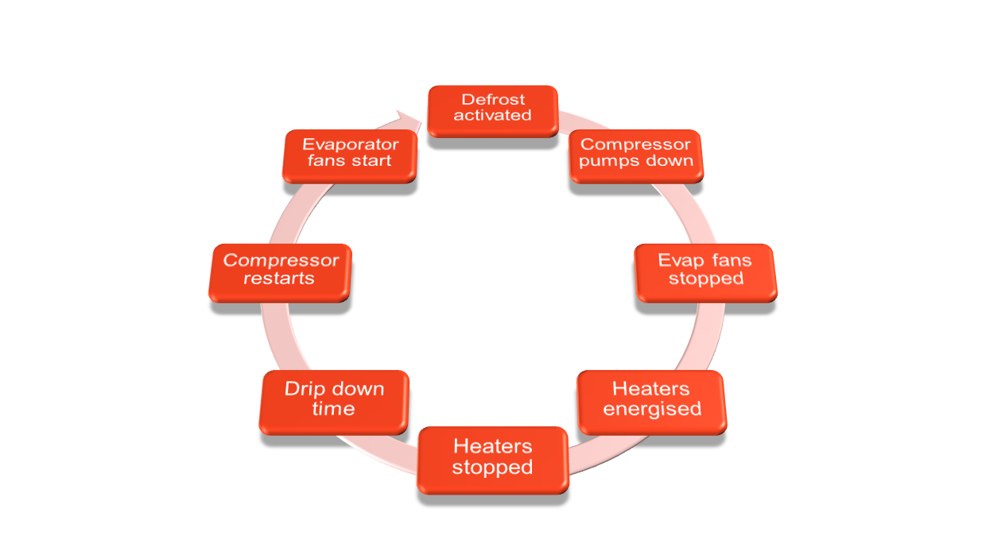
Defrost sequence

Slide 16
Electric defrost
A more advantageous method is ‘defrost on demand’, which senses the coil temperatures and then initiates the defrost. Once the coil reaches a pre-set temperature, the heaters switch off and cooling recommences.

Slide 17
Electric defrost
By definition, a freezer will require more defrosts and have a greater duration than a chiller. Application, location and method of defrost vary in duration and termination temperatures.
Freezer defrost intervals: 6 Intervals per day, every 4 hours
Freezer defrost duration: 20 mins
Chiller defrost intervals: 4 intervals per day, every 6 hours
Chiller defrost duration: 10mins

Slide 18
Gas defrost
Gas defrost uses the system’s internal energy to defrost the evaporator, using the high temperature discharge vapour to add the required heat to accomplish a defrost cycle.
Advantages of hot gas defrost:
Reduced defrost duration.
Hot gas defrost is less likely to raise humidity levels inside the cold room, due to the temperature of the electric heater.

Slide 19
Gas defrost
There are negative implications associated with hot gas defrost:
By passing the condenser, hot gas defrost increases compressor work.
Part of this energy is transferred back to the refrigerated space.
Time used for defrost is not used for cooling.
Mechanical stress undergone by key components.

Slide 20
Gas defrost
Although we have listed some negatives, there are ways to negate the increase in energy usage:
Variable speed compressors: Reduce energy consumption during defrost by minimising unnecessary bypass flow.
Defrost on demand: Utilising algorithms and sensors, initiate defrost only when needed.
Properly sized components: Optimized evaporator design and water drainage, especially on large systems.

Slide 21
Gas defrost
The hot gas defrost cycle is started and stopped by a controller/timer. Hot refrigerant gas is diverted from the compressor through a dedicated hot gas defrost valve, just after the expansion valve, allowing it to flow into the evaporator coils.
The hot gas raises the temperature of the coils, effectively melting any accumulated frost and restoring airflow.
Once the frost has melted, water drains away from the evaporator, and normal refrigeration resumes as the system returns to its cooling mode.
Notes:
Provide various types of hot gas defrost valves

Slide 22
Methods of gas defrost
There are different methods to achieve this depending on system size and design:
Two-port valve: Branch line from the discharge line of small systems.
Three or four-port valve: Multi-evap systems.
Four-port slide or ball valve: Reversed cycle defrosting, as it says, the evap becomes the condenser and the condenser the evap.

Slide 23
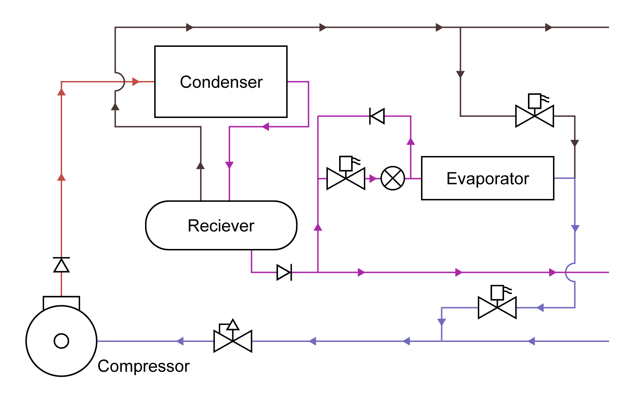
Saturated gas defrost
Saturated gas defrost uses saturated vapour from the top of the liquid receiver rather than superheated vapour from the discharge, as it does with a hot gas defrost system.
It benefits from a quicker defrost than when using Superheat discharge vapour.
But why? Logic would say it should defrost quicker when using superheated discharge vapour.
Notes:
Provide a low pressure switch

Slide 24
Saturated gas defrost
The saturated vapour from the receiver is much denser than the superheated discharge vapour. Its heat content is greater per kilogram than that of the less dense discharge vapour.
Think of the flame on a match, which burns at somewhere between 300ºC and 450ºC versus a litre of water at 40ºC. Clearly, the match’s flame is much hotter than the water.
But due to the water’s mass, its heat content per kg is considerably greater.
Notes:
Provide a hot gas defrost valve for candidates

Slide 25
Saturated gas defrost
E
B
A
C
D
Notes:
Provide a hot gas defrost valve for candidates

Slide 26
Saturated gas defrost: How does it work?
When the controller has actuated a defrost, valves ‘A’ and ‘C’ close and valve ‘B’ opens, allowing saturated vapour into the evaporator, in reverse to its normal cycle.
The saturated vapour is turned to liquid by the heat it rejects to the surface area of the evaporator while defrosting.
As valve ‘A’ is closed, the liquid will bypass the expansion valve, taking the alternative route through valve ‘E’. As its pressure is greater than the receiver, it will return to the system via the liquid line.
Notes:
Provide a hot gas defrost valve for candidates

Slide 27
Saturated gas defrost: How does it work?
When the defrost cycle has been completed, valve ‘B’ closes, and the system will remain like this for approximately 5 mins allowing all the water to clear the evaporator and drain (drain/drip down period).
After this period, valves ‘A’ and ‘C’ will open while valve ‘D’ will regulate the suction gases returning to the compressor.
The refrigeration cycle is now taking place, and the defrost cycle is completed.
Notes:
Provide a hot gas defrost valve for candidates

Slide 28
Saturated gas defrost
The only difference between a hot gas and a saturated vapour layout is that, in the saturated vapour system, the liquid line has a non-return differential spring valve fitted. This allows the vapour to remain at a slightly greater pressure than the liquid.
Notes:
Provide a hot gas defrost valve for candidates

Slide 29
Summary
You should now be able to:
Recall different methods of defrosting systems.
Explain the basic principles behind defrost systems.
You might also be able to:
Examine complex defrost systems.
Select and justify the best method of defrosting a system.

Slide 30
Any questions?
Copyright in this document belongs to and is used under licence from the Department for Education, © 2025.
‘T-LEVELS’ and ‘T Level’ are registered trademarks of the Department for Education.
WJEC is authorised by the Department for Education to develop and deliver this T Level Technical Qualification.
WJEC operates in England under the name Eduqas which is a registered trademark of WJEC.

