Slide 1
Occupational Specialism: Refrigeration Engineering
K1.7 Refrigeration system components
PowerPoint 1.7: Types of components for refrigeration systems

Slide 2
Introduction
In this session you will learn about the different refrigeration components and their suitability in different situations. Direct expansion and flooded systems have been covered in K1.6. This session will cover:
Pump overfeed
Cascade, Compound and Booster
Trans-critical
Blast freezing, cold storage and chill storage.

Slide 3
Objectives
You should be able to:
Recall different types of industrial component systems.
Explain the basic principles of how different systems function.
You might also be able to:
Examine the application of different designs.
Select and justify the best design solution for a given refrigeration project.

Slide 4
Full flooded evaporator
This diagram shows a refrigeration circuit for a cold room application using an evaporator that is fully flooded with refrigerant.
INDUSTRIAL REFRIGERATION – large capacity systems (as shown) i.e., process cooling (-30ºC).

Slide 5
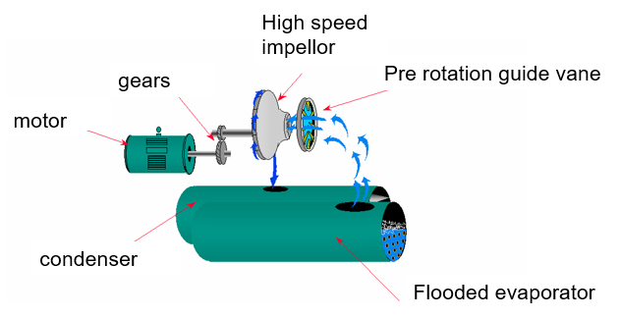
Full flooded evaporator
This type of evaporator is again fully flooded and has water flowing through the copper tubes.
Chilling water is common for air conditioning applications @ 6ºC.
Industrial applications could involve cooling a different fluid (brine) at lower temperatures, such as -5ºC.

Slide 6
Pump overfeed
This type of refrigeration system pumps liquid refrigerant through an evaporator at a faster rate than is required for evaporation.
This improves efficiency and ensures the coils/tubes are completely wetted; thus heat transfer is improved.
A mechanical pump would be used to pump liquid refrigerant from a low-pressure surge drum (accumulator/liquid separator) to an evaporator/s, returning a two-phase mixture to the receiver for separation.

Slide 7
Pump overfeed
condenser
Discharge gas
High pressure receiver
Outdoor
Machine room
Liquid control
Motor & Compressor
Dry suction gas
Wet suction gas
Low Pressure
Surge drum
Oil separator
evaporators
Liquid pump
Notes:
Tutor to explain the circuit has a liquid pump feeding remote evaporators.

Slide 8
Cascade cooling system
Multi-stage system utilising two refrigeration circuits to achieve very low temperatures in the evaporator (typically, below -40ºC).
Different refrigerants are used in each circuit.
Can provide higher overall efficiency (COP) than a single stage system but is costly to install and higher skills to commission and maintain.
Refrigerant
NH₃
condenser
High stage
Heat exchanger
Low stage
evaporator
Refrigerant
CO₂
Notes:
Tutor to explain the circuit and suggest operating temperature

Slide 9
Compound system
This system is also known as a multistage system.
Operates by compressing refrigerant in two or more stages using separate compressors or cylinder groups (in one compressor).
An intercooler (heat exchanger) is used to improve efficiency in the compression stage.
Industrial applications requiring very low temperatures (-40ºC).
condenser
High stage compressor
intercooler
evaporator
Low stage compressor
Notes:
Tutor to explain the circuit and suggest operating temperatures

Slide 10
Compound system
The intercooler stage acts to protect the high stage compressor from high suction temperatures.
The intercooling stage is typically achieved by using an intermediate cooler or flash chamber to reduce the temperature of the low stage discharge vapour.
Condenser liquid would be flashed into the intercooler using a TXV.
condenser
TXV
High stage compressor
intercooler
TXV
evaporator
Low stage compressor is normally
3 times swept volume of high stage
Notes:
Tutor to explain the circuit and suggest operating temperatures

Slide 11
Booster system
Screw compressor is the lead compressor. Operates above 80% of full load of the system cooling capacity.
When the load drops below 80%, the screw drops out, and the reciprocating compressor takes the remaining load.
The advantage is less power consumed by the reciprocating compressor at low load.
condenser
receiver
Reciprocating
Compressor (below 80% of screw capacity)
Float
evaporator
Screw
Compressor (80 to 100%)
Notes:
Tutor to explain the circuit and suggest operating temperatures

Slide 12
Trans-critical cooling
Gas cooler 115ºC
HP Valve
Critical point for CO₂ occurs at approximately 32ºC (72.8bar).
Beyond this, CO₂ enters trans-critical zone, where it behaves as a fluid without a vapour/liquid state (no temp/pressure relationship exists).
MT
TXV
Flash gas bypass Valve
LT
TXV
Receiver -7ºC
Medium temp compressor
Medium pressure lower temp (-7ºC) evaporator
Low temp (Sub critical)
compressor
Low temp (-32ºC) evaporator

Slide 13
Trans-critical cooling
Gas cooler 115ºC
HP Valve
Gas cooler function - the refrigerant has a sensible heat change.
High pressure valve is a metering device.
It reduces the pressure down into the saturation (curve) phase.
MT
TXV
LT
TXV
Flash gas bypass Valve
Receiver -7ºC
Medium temp compressor
Medium pressure lower temp (-7ºC) evaporator
Low temp (Sub critical)
compressor
Low temp (-32ºC) evaporator

Slide 14
Trans-critical cooling
Gas cooler 115ºC
HP Valve
Receiver: state is saturated refrigerant.
The flash gas bypass valve improves liquid quality by diverting flash gas to the medium temperature compressor.
This ensures liquid at the expansion valves.
Medium temperature TXV drops CO₂ to medium temp through MT evaporator.
Low temperature TXV drops CO₂ temperature to low temperature through LT evaporator.
MT
TXV
Flash gas bypass Valve
LT
TXV
Receiver -7ºC
Medium temp compressor
Medium pressure lower temp (-7ºC) evaporator
Low temp (Sub critical)
compressor
Low temp (-32ºC) evaporator

Slide 15
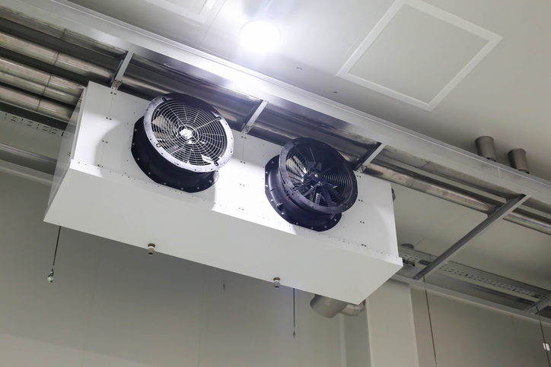
Blast freezing
A blast freezer refrigeration circuit works by utilising an evaporator with powerful forced air convection fans circulating air at -28ºC to -38ºC to rapidly remove heat from a food product.
A standard refrigeration cycle is used for rapid heat transfer.
Instantly freezing food to -18ºC or lower to minimize ice crystal damage and retain moisture in the product.

Slide 16
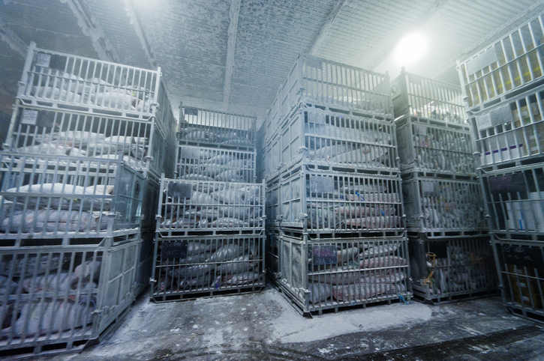
Cold storage
A cold store refrigeration circuit works by utilising an evaporator with forced air convection fans circulating air at -18ºC to -25ºC to maintain the cold temperature of a food product.
Blast freezer takes the main heat load from a food product, a cold store maintains the low temperature e.g. -18ºC or lower.

Slide 17
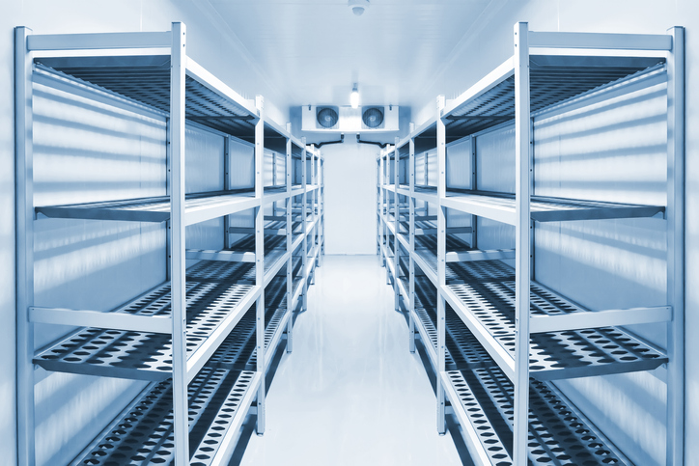
Chill storage
A cold store refrigeration circuit works by utilising an evaporator with forced air convection fans circulating air at typically +2ºC to +8ºC to maintain the chill temperature of a food product. Storage conditions for all products can be found in AHRAE journals.
The critical factor in a cold store is maintaining the humidity level for the specific products in the store, otherwise the food product can be damaged.
Notes:
Tutor to explain what AHRAE means.

Slide 18
Summary
You should now be able to:
Recall different types of industrial component systems.
Explain the basic principles of how different systems function.
You might also be able to:
Examine the application of different designs.
Select and justify the best design solution for a given refrigeration project.

Slide 19
Any questions?
Copyright in this document belongs to and is used under licence from the Department for Education, © 2025.
‘T-LEVELS’ and ‘T Level’ are registered trademarks of the Department for Education.
WJEC is authorised by the Department for Education to develop and deliver this T Level Technical Qualification.
WJEC operates in England under the name Eduqas which is a registered trademark of WJEC.

