Slide 1
Occupational Specialism: Refrigeration Engineering
K1.6 Refrigeration system components
PowerPoint K1.6h: The function and operating principles of fans and motors used to drive them

Slide 2
Introduction
In this session you will learn about the operating principles of a range of fans and motors used in refrigeration and air conditioning systems.
It covers the configuration and types of fans most common to a range of applications.

Slide 3
Objectives
You should be able to:
Recall different types of fans and motors used to drive them.
Explain the basic principles of fans and motor drives.
You might also be able to:
Examine the structural integrity of different designs.
Select and justify the best design solution for a given refrigeration or air conditioning installation project.

Slide 4
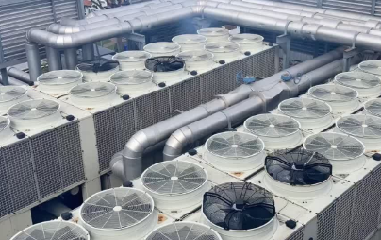
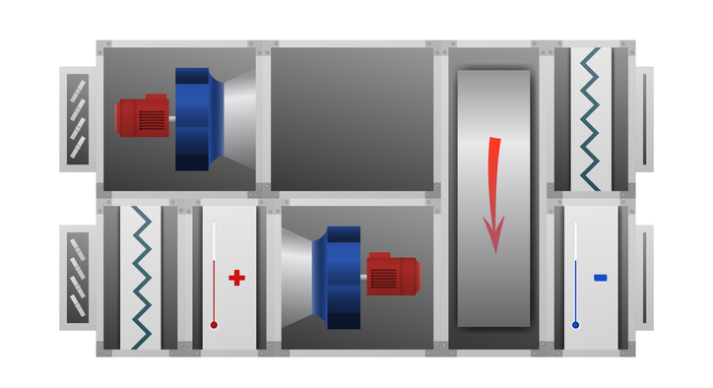
Fans
The fan is a fundamental component associated with the heat exchangers in a refrigeration and air conditioning system.
Fans also provide the air distribution around a building.
Supply air
Extract air

Slide 5

Fan types
Axial air flow (air movement in a linear direction)
Propeller air flow (typically used in air conditioning units to reject heat from outdoor units)
Centrifugal air flow (most commonly used in central building air handling units)

Slide 6
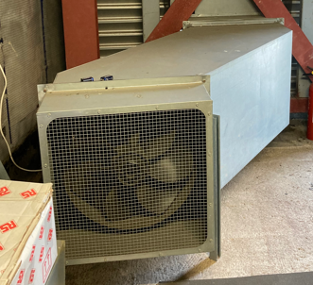
Fan types – Axial
Also known as axial flow fans.
Similar blade design to propeller fans, but are typically mounted in rectangular casings with an inlet and outlet.
Blades are usually shorter and wider by comparison.
Air flow is drawn in parallel to the shaft.
Their application is common for airflow required over a long distance where higher resistance exists.

Slide 7
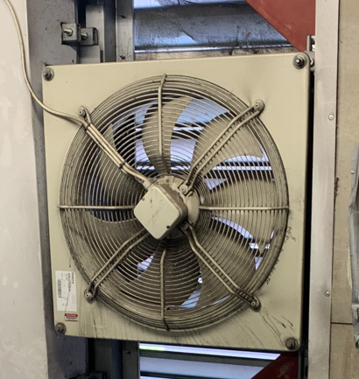
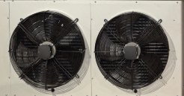
Fan types – Axial / Propeller
A simple design where a set of blades are mounted on a central hub.

Slide 8
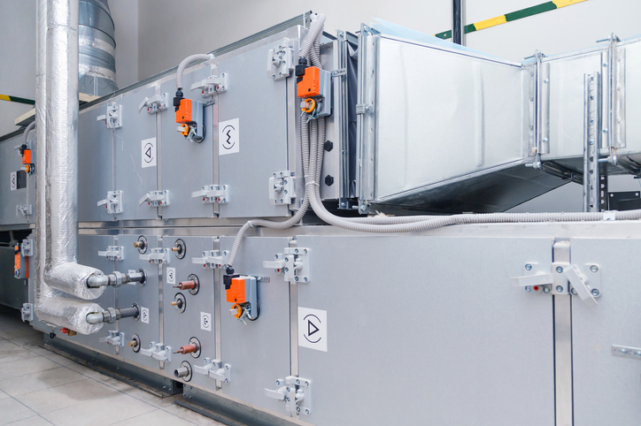
Fan types - centrifugal
Centrifugal fans are more commonly used in air handling units.

Slide 9
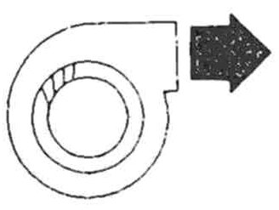
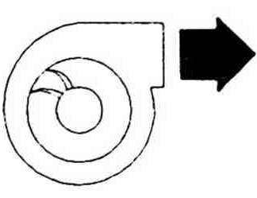
Fan types – centrifugal
Forward Curved
Used for high volume at lower static pressures.
Larger number of blades, slower speeds (smaller shaft & bearings), lower cost.
Maximum efficiencies 60% to 70%.
Backward Curved
Used for high volumes at higher static pressures.
Operates at higher speeds, stronger construction, higher cost.
Maximum efficiencies 75% to 85%.

Slide 10
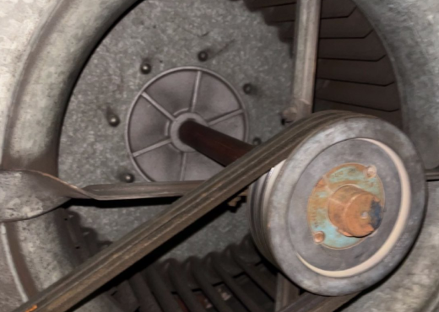
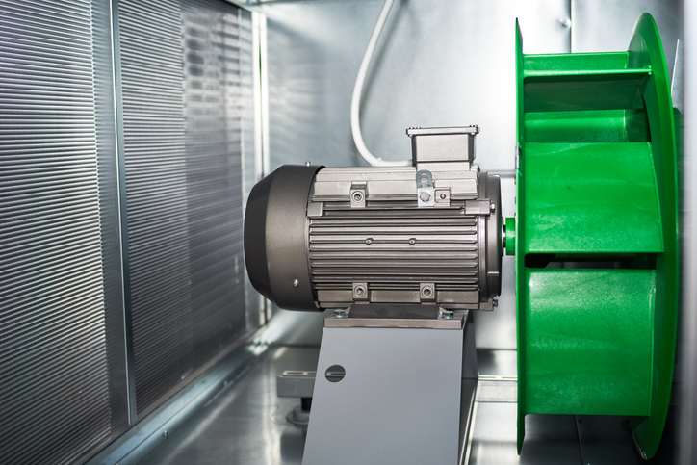
Fan drive methods
To obtain air movement, the fan has to be driven by a power source.
The most common methods used in refrigeration and air conditioning are from an electric motor.
We will focus on two methods of fan motor drives.
Belt drive
Direct drive

Slide 11
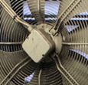
Fan drives – direct motor drive
A directly driven fan motor is described as when the motor shaft is directly connected to the fan shaft.

Slide 12
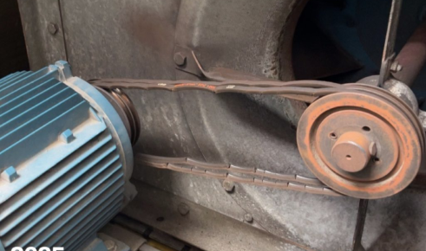
Fan drives – belt driven
The fan is turned by being connected to the motor via a set of one or more pulley belts.
The motor turns at 1450 revolutions per minute (RPM).
The speed of the fan rotation is dependent on the size of the disc the pulleys are mounted on.
The motor energy is transferred via the pulley belt to the fan shaft.
The pulley belt can wear out over time and will need replacement.
Notes:
Tutor to expand on the importance of the belt quality and tension be at its optimum to ensure the motor is not overloaded.

Slide 13
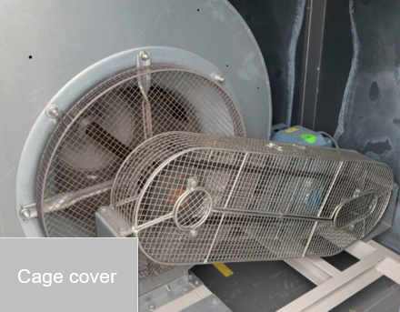
Fan drives – belt driven
Moving parts must be protected from anyone potentially entering the air handling unit when the drive is operating.
Notes:
Tutor to expand on the importance of the belt quality and tension be at its optimum to ensure the motor is not overloaded.

Slide 14
The fan motor
This section will not discuss electrical theory.
Fan motor components are shown here.
Two voltage types:
Single phase (220 to 240 volt)
Three phase (380 to 415 volt)
Variable speed drives can also be used

Slide 15
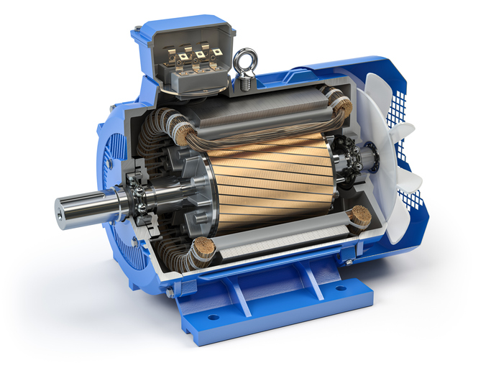
The fan motor
The fan motor can look similar even when it has a single phase or three phase power supply.
Notes:
Tutor to explain the shaft, rotor, stator, cooling fan, bearings, casing and power supply entry

Slide 16
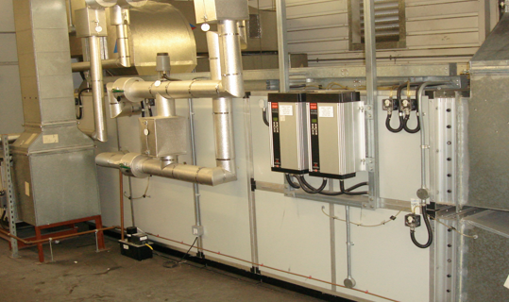
The fan motor – variable speed drive
The fan motor can have its speed controlled by a special drive unit called a variable speed drive (VSD).
The image shows a VSD for both the supply and extract fan in an air handling unit.

Slide 17
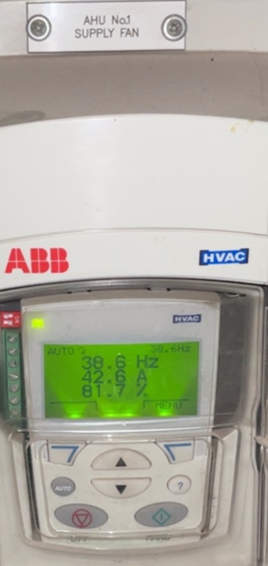
The fan motor – variable speed drive
The VSD controls the speed of an AC motor by adjusting the voltage and frequency delivered to the motor.
This is a common energy efficient method of matching the motor speed to the load from the building i.e. if more air is required, the fan speeds up, and visa versa.
The start up torque is also reduced by slowly increasing the motor speed, therefore less power is consumed on motor start up.

Slide 18
Fan motors and drives
We have shown just a few motors and drive mechanisms used in RAC/ventilation applications.
There are many configurations of air movement systems, however all have the same objective: to supply and/or extract air at a design rate that is required for the use of the treated space.

Slide 19
Summary
You should now be able to:
Recall different types of fans and motors used to drive them.
Explain the basic principles of fans and motor drives.
You might also be able to:
Examine the structural integrity of different designs.
Select and justify the best design solution for a given refrigeration or air conditioning installation project.

Slide 20
Any questions?
Copyright in this document belongs to and is used under licence from the Department for Education, © 2025.
‘T-LEVELS’ and ‘T Level’ are registered trademarks of the Department for Education.
WJEC is authorised by the Department for Education to develop and deliver this T Level Technical Qualification.
WJEC operates in England under the name Eduqas which is a registered trademark of WJEC.

