Slide 1
Occupational Specialism: Refrigeration Engineering
K1.6 Refrigeration system components
PowerPoint K1.6g: The function and operating principles of control valves in industrial and commercial systems

Slide 2
Introduction
In this session you will learn about the operating principles of a range of control valves used in refrigeration and air conditioning systems:
Four-way reversing valve
Solenoid
Evaporator pressure regulators
Crankcase pressure regulators
Differential pressure regulators
Non-return valves

Slide 3
Objectives
You should be able to:
Recall different types of control valves.
Explain the basic principles of control valves.
You might also be able to:
Examine the structural integrity of different components.
Select and justify the best component solution for a given refrigeration or air conditioning installation project.

Slide 4
Four-way reversing valve
The four-way reversing valve is used in refrigeration and air conditioning to reverse the refrigerant flow.
They are mainly used on heat pump systems, meaning the system is capable of providing either heating or cooling.
When the system is operating in the cooling mode, the valve directs the refrigerant to the outdoor coil, and when the system is in the heating mode, the refrigerant is directed to the indoor coil.

Slide 5
Four-way reversing valve
DISCHARGE
ALWAYS REMAINS THE SAME
The four-way reversing valve has 4 ports.
Discharge
Suction
Evaporator
Condenser
CONDENSER
SUCTION
ALWAYS REMAINS THE SAME
EVAPORATOR

Slide 6
Four-way reversing valve
The valve is operated by pressure.
A solenoid valve diverts the pressure to either end of the main body.
When the solenoid valve is de-energised, the compressor high side pressure pushes the internal shuttle to the other side.
The shuttle has diverting passages which divert the flow of refrigerant from the indoor unit to the outdoor unit.

Slide 7
Four-way reversing valve
This diagram shows the two valve positions (cooling and heating).
The compressor’s ‘suction’ and ‘discharge’ ALWAYS remain in the same position.
suction
INDOOR
OUTDOOR
suction
INDOOR
OUTDOOR
COOLING
HEATING
discharge
discharge

Slide 8
Reversing valve question
With the reversing valve selected for cooling operation, what is the function of the outdoor heat exchanger?
a. Absorb heat to change liquid to vapour
b. Absorb heat to change vapour to liquid
c. Reject heat to change liquid to vapour
d. Reject heat to change vapour to liquid
suction
INDOOR
OUTDOOR
COOLING
discharge
Notes:
Answer D

Slide 9
Reversing valve question
With the reversing valve selected for heating operation, what is the function of the outdoor heat exchanger?
a. Absorb heat to change liquid to vapour
b. Absorb heat to change vapour to liquid
c. Reject heat to change liquid to vapour
d. Reject heat to change vapour to liquid
suction
INDOOR
OUTDOOR
HEATING
discharge
Notes:
Answer A

Slide 10
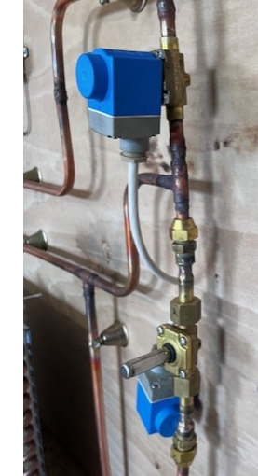
Solenoid valve
The solenoid is a device for controlling the flow of refrigerant within a system.
It comprises of a body and a head/coil.
The body size can vary dependent on the size of the system pipework.
The head is an electromagnet which opens and closes the valve by turning on and off when power is energised.

Slide 11
Solenoid valve
They are found in many applications other than refrigeration and air conditioning systems.
Direct acting and servo-operated electrical controlled valves.
For closing and opening the flow of refrigerant liquid and vapour and also oil circuits.

Slide 12
Solenoid
Solenoids come in a variety of shapes and sizes, however their function remains the same.
The function of the valve is used for many operations such as:
Controlled defrost cycle
Pump down
Start / Stop
Open and close of other ancillaries such as the four-way reversing valve.

Slide 13
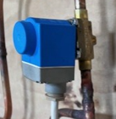
Solenoid
The valve head is wired to a control centre or mechanical switches, which have sensors and pressure regulators built in.
When the control centre detects a change in the system operating conditions, one or more solenoids can open and close to rectify the system conditions.
The magnetic coil energises and controls a plunger within the valve body, allowing the flow of refrigerant to be controlled.

Slide 14
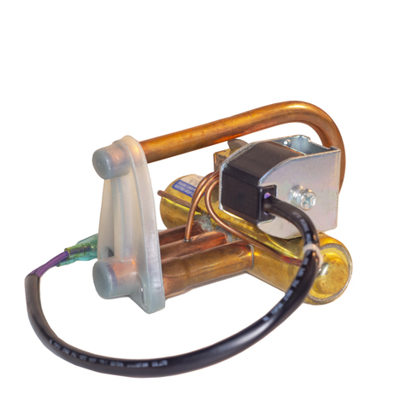
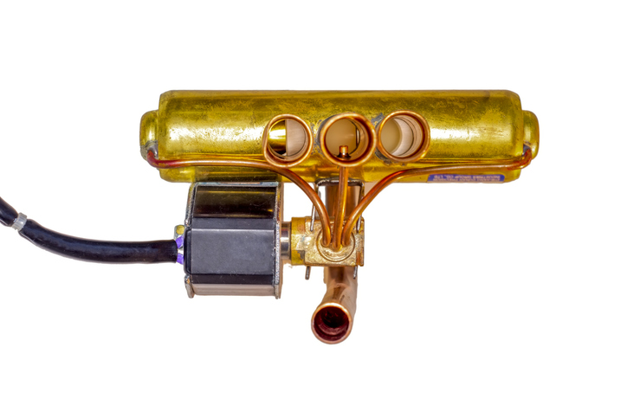
Solenoid

Slide 15
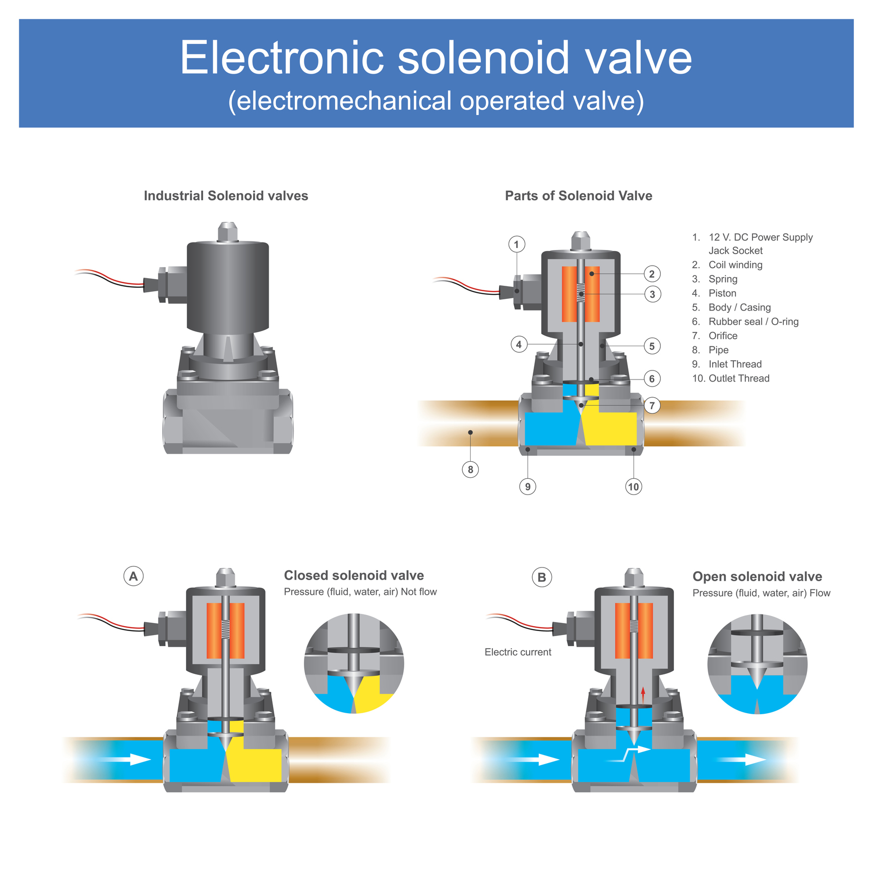
Solenoid - operation

Slide 16
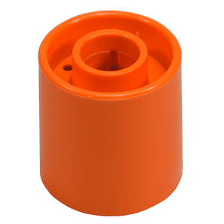
Solenoid
If a coil has failed, it can be removed from the body and simply replaced with a new coil.
The solenoid valve can be tested by using a manual solenoid magnet to check the operation of the internal plunger.
Simply place the magnet over the plunger and listen and feel for the valve clicking open and shut.

Slide 17
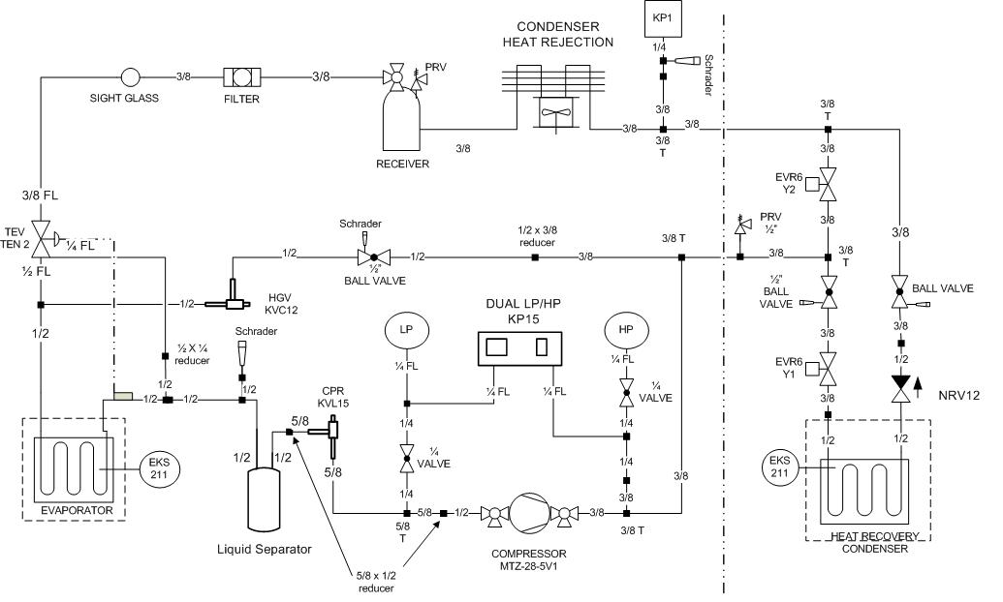
Solenoids and control valves

Slide 18
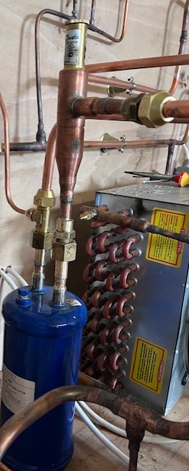
Evaporator pressure regulators
An evaporator pressure regulator (EPR) is installed within the suction line to maintain and regulate the evaporator pressure and temperature.
The regulator acts as a control device to ensure a required pressure/temperature is maintained in the evaporator.
The EPR is installed at the outlet of the evaporator.

Slide 19
Evaporator pressure regulators
The EPR can be adjusted to obtain the desired saturation pressure/temperature by turning the stem clockwise/anticlockwise with a hexagon spanner.
It is recommended that the valve be adjusted in small increments and then let the system run for a period of time to monitor the changes that have been made.
One compressor can handle multiple evaporators operating at different temperatures by using EPRs.

Slide 20
Evaporator pressure regulators
How does it work?
When the pressure in the evaporator drops below the desired set point, the internal valve spring slightly closes the diaphragm, which reduces the amount of refrigerant leaving the evaporator so that the pressure can build up again.
When the pressure in the evaporator rises above the desired set point, the internal valve spring forces the diaphragm to open, allowing more refrigerant into the evaporator, which lowers the evaporator pressure.

Slide 21
Evaporator pressure regulators
Mechanical EPR
The mechanical EPR is adjusted to the desired set point by rotating the valve stem in either direction, which increases or decreases the force applied to the spring and diaphragm arrangement.
The electronic EPR is controlled from a number of sensors that are placed on the pipework of the evaporator. These sensors are connected to the electronic controls of the system which determine whether the valve needs to open or close to achieve the desires pressure and temperature.

Slide 22
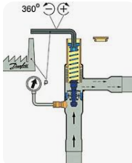
Evaporator pressure regulator
SUCTION VAPOUR RETURN
EVAPORATOR PRESSURE REGULATOR
PHIAL
EVAPORATOR
SATURATION
TEMP/PRESSURE
0 ºC
4.99 bg
4ºC
10ºC
LIQUID SOLENOID VALVE
(LLSV)
SIGHT GLASS
(SG)
TXV
LOW PRESSURE FLASH LIQUID/VAPOUR MIX

Slide 23

Evaporator pressure regulator
PHIAL
EVAPORATOR PRESSURE REGULATOR
SUCTION VAPOUR RETURN
0.2 bg
PHIAL
EVAPORATOR
SATURATION
TEMP/PRESSURE
-18 ºC
0.2 bg
EVAPORATOR
SATURATION
TEMP/PRESSURE
0 ºC
4.99 bg
LIQUID
SOLENOID
VALVE
(LLSV)
SIGHT
GLASS
(SG)
LLSV
SG
TXV
TXV

Slide 24
Crankcase pressure regulators

Slide 25
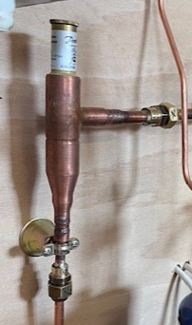
Crankcase pressure regulators
A crankcase pressure regulator (CPR) is installed within the suction line before the compressor to prevent a pressure overload.
The regulator acts as a control device and protects the compressor from high starting torque (motor current draw).
It ensures the pressure entering the compressor is kept to a minimum during start-up or high load demands, such as after a defrost cycle.

Slide 26
Crankcase pressure regulators
CPRs are available in various shapes and sizes, however they all perform the same function.
Some are mechanical and others are electronic.
They are mainly used in low temperature refrigeration systems.

Slide 27
Crankcase pressure regulators
How does it work?
Placed between the evaporator outlet and the compressor suction, it senses the pressure exiting the evaporator and restricts the pressure to the desired set point.
The set point has to be below the compressor maximum suction pressure to ensure the compressor does not overload.
If the compressor works too hard, the compressor will draw excessive current, which could exceed the FLA (full load amps), causing compressor motor damage.

Slide 28
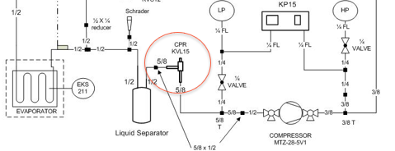
Crankcase pressure regulators
Installation location:

Slide 29
Non-return valves
Non-return valves are an essential component within the refrigeration system.
They allow refrigerant to flow in one direction to components that require it, whilst protecting other components from liquid or vapour flowing back.
There are various types of return valves:
Spring-loaded
Swing
Ball check

Slide 30
Non-return valves
They are available in various styles and sizes to suit the system.

Slide 31
Non-return valves
How do they work?
Spring loaded valves have a flap with a seal and spring within the main body that allows the refrigerant to push past it in one direction, and if the refrigerant were to try to return, the spring would simply close the flap and seal the valve off.
Swing type valves rely on a flap and a seal on a hinge that closes if the refrigerant flow changes direction.
It is important to note that they are directional and must be installed in the correct orientation.

Slide 32
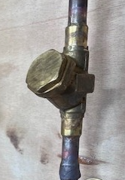
Non-return valves
The refrigerant will push past the seal in one direction but cannot return due to the hinge and seal mechanism closing when force is applied from the opposite direction.
Valve body
hinge
Flow
Seal
Internal mechanism

Slide 33
Non-return valves
The role that the valves play in a heat pump is to direct the flow of the refrigerant when the system is either in heating or cooling.
A heat pump has two metering devices with a check valve installed at each location.

Slide 34
Summary
You should now be able to:
Recall different types of control valves.
Explain the basic principles of control valves.
You might also be able to:
Examine the structural integrity of different components.
Select and justify the best component solution for a given refrigeration or air conditioning installation project.

Slide 35
Any questions?
Copyright in this document belongs to and is used under licence from the Department for Education, © 2025.
‘T-LEVELS’ and ‘T Level’ are registered trademarks of the Department for Education.
WJEC is authorised by the Department for Education to develop and deliver this T Level Technical Qualification.
WJEC operates in England under the name Eduqas which is a registered trademark of WJEC.

