Slide 1
Occupational Specialism: Refrigeration Engineering
K1.6 Refrigeration system components
PowerPoint K1.6f: The function of system storage pressure vessels in industrial and commercial systems

Slide 2
Introduction
In this session you will learn about the operating principles of a range of storage vessels used in refrigeration and air conditioning systems.
It covers the configuration and types of vessels most common to a range of applications.

Slide 3
Objectives
You should be able to:
Recall different types of pressure vessels.
Explain the basic principles of storage vessels.
You might also be able to:
Examine the structural integrity of different designs.
Select and justify the best design solution for a given refrigeration or air conditioning installation project.

Slide 4
Storage and pressure vessels
System storage vessels are typically known as:
High-pressure liquid receiver
Low-pressure liquid separator
Surge drums
They can also be shell and tube types of condensers and evaporators.

Slide 5
Liquid receiver
Installed as close to the condenser outlet as possible.
To store excess liquid refrigerant, therefore ensuring a constant supply of liquid to the metering device (expansion valve) as the load in the evaporator fluctuates.
Storage capacity should be based on 80% of its internal volume.
Should have isolation valves and pressure relief valves/rupture disc or similar fitted.
Notes:
(EN378: 2016)

Slide 6
Function of liquid receiver
The function of a liquid receiver is to:
Act as a holding tank.
Compensate for load fluctuation in the evaporator.
Used for maintenance by storing liquid after pump down, so that other parts of the system can be worked on.
Optimises condenser efficiency by preventing overfilling of the condenser during low load conditions.

Slide 7
Liquid receiver types
inlet
outlet
inlet
outlet
Horizontal receiver
Vertical receiver

Slide 8
The location of the liquid receiver
Accumulator
Hot Gas Bypass

Slide 9
Function of suction accumulator/surge drum
Often referred to as a liquid separator or buffer vessel.
Located between the evaporator and compressor.
Primary function is to prevent liquid refrigerant from entering the compressor.
Surge drums (low-pressure receiver) are used on larger flooded evaporator systems where the risk of load variations can exist.
vapour
vapour & liquid

Slide 10
Function of suction accumulator/surge drum
Low pressure vapour return to compressor
Low pressure
liquid
Low pressure vapour return to compressor
Surge drum
Flooded
evaporator
Liquid separator
Low pressure liquid

Slide 11
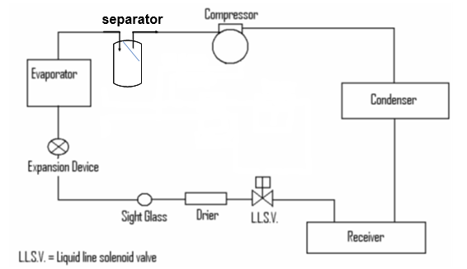
Liquid receiver and liquid separator location

Slide 12
Summary
You should now be able to:
Recall different types of storage vessels.
Explain the basic principles of storage vessels.
You might also be able to:
Examine the structural integrity of different designs.
Select and justify the best design solution for a given refrigeration and air conditioning project.

Slide 13
Any questions?
Copyright in this document belongs to and is used under licence from the Department for Education, © 2025.
‘T-LEVELS’ and ‘T Level’ are registered trademarks of the Department for Education.
WJEC is authorised by the Department for Education to develop and deliver this T Level Technical Qualification.
WJEC operates in England under the name Eduqas which is a registered trademark of WJEC.

