Slide 1
Occupational Specialism: Refrigeration Engineering
K1.6 Refrigeration system components
PowerPoint K1.6e: The function and operating principles of a variety of ancillary devices.

Slide 2
Introduction
In this session you will learn about the operating principles of a range of ancillary devices used in refrigeration and air conditioning systems.
Sight glasses
Driers (suction and liquid)
Pressure relief valves
Strainers
Service valves
Oil separators.

Slide 3
Objectives
You should be able to:
Recall different types of ancillary devices.
Explain the basic principles of the ancillary devices.
You might also be able to:
Examine the structural integrity of different components.
Select and justify the best component for a given refrigeration or air conditioning installation project.

Slide 4
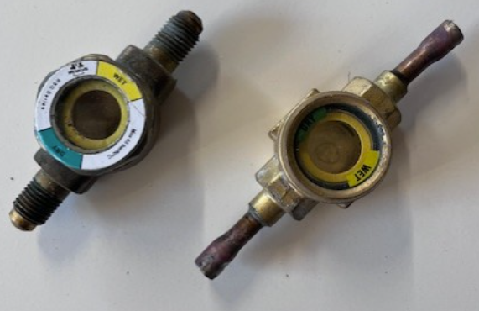
Sight glasses
A sight glass is used so that you have a visual of the refrigerant within a system.
They have an extra-large crystal clear sight glass for viewing the Refrigerant within the system.
A combined sight glass/moisture indicator is also available.
The moisture indicator provides a true moisture indication of the refrigerant within the system.
Green indicates dry, and bright yellow indicates wet.

Slide 5
Sight glasses
The sight glass is fitted in the liquid line to give a visual indication of the refrigerant in the system.
The sight glass is a simple device. It's there to show if the liquid line has a full line of liquid or if it has bubbles in it. It also shows if moisture is present within the refrigerant.
If we see bubbles, we'll know that the refrigerant is a liquid/vapour mix.
If it is situated directly after the drier, then it can also be used to let you know if there is a blockage within the liquid line drier or a shortage of refrigerant within the system.

Slide 6
Combined sight glass and moisture indicator
Flared
Brazed

Slide 7
Filter driers
There are 2 types of driers used within a refrigeration or air conditioning system:
Liquid line drier
Suction line drier
They are available in a range of sizes to suit the system capacity.
Filter driers are critical to the efficiency and reliability of the system by keeping it free from moisture, acid and debris.
Filter driers are usually equipped with a fine-mesh filter to collect particles and a desiccant to absorb moisture.

Slide 8
Liquid line driers
The filter/drier removes moisture from the refrigerant by adsorbing and retaining it deep within the desiccant granules.
Filter/drier will filter out scale, solder particles, carbon, sludge, dirt, and any other foreign matter with little to no pressure drop.
Fine particles that would go through an ordinary strainer are removed down to a minimum size in a one-pass filtration.
The large filtering area of the filter/drier core permits it to collect a large amount of dirt without clogging.

Slide 9
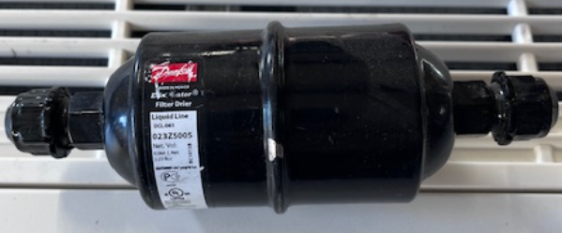
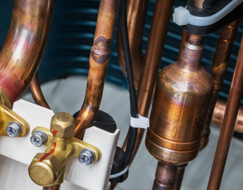
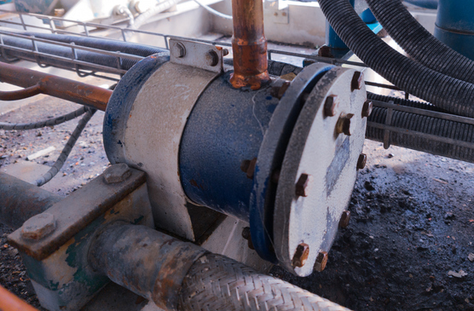
Liquid line driers
Flared type
Copper type used in small refrigeration systems such as domestic fridges.
Desiccant can type

Slide 10
Suction line driers
Suction line driers are designed for maximum protection for the compressor.
They are designed for clean-up after a motor burn-out (to prevent acid entering the new motor windings), or when major work has been carried out on the system.
It’s there to collect and hold any dirt that is in the evaporator or suction line on start up.
It is recommended that systems with long refrigerant lines should have one and they are available in a range of sizes to suit the system capacity.

Slide 11
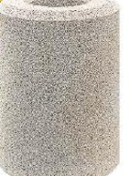
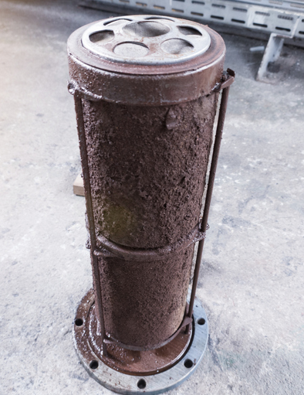
Suction line driers
Replaceable core filter drier housing , which is used in larger refrigeration systems such as supermarket pack systems, also provides protection and high liquid flow capacities. They can also be used as replaceable filter blocks for protection against acid, moisture and solids.
The filter housing is made from steel and has a removable cap that is sealed by means of a fibrous gasket.
Replaceable core filter drier (clean and dirty)

Slide 12
Driers for reversible systems
This drier is for the use in a heat pump application with the capability of refrigerant flow in either direction.
In other applications (non heat pump) the drier will be directional.
An arrow will indicate the direction on the side of the drier and must be placed in the direction of the refrigerant flow.
If it is a liquid line drier, then it will point away from the condensing unit and toward the evaporator coils.
If it is a suction line drier, then it will point away from the evaporator coils and toward the compressor.

Slide 13
Pressure relief valves
Pressure relief valves are installed on a system as a safety device.
This is so that the refrigerant can be vented off if the system reaches dangerous temperatures, such as a plant room fire.
If a pressure relief vale is not installed, then the system could explode as the pressure builds up and has nowhere to go.

Slide 14
Pressure relief valves & fusible plugs
There are 2 types of pressure relief valves:
Fusible plugs
Mechanical pressure relief valve (PRV).

Slide 15

Fusible plug
A fusible plug is a brass housing which has a low melting point alloy running through the centre.
When the system reaches a dangerously high temperature, the alloy in the centre melts, and the contents of the system are vented off into the atmosphere.

Slide 16
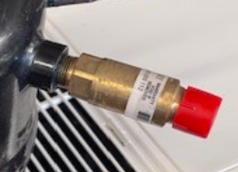
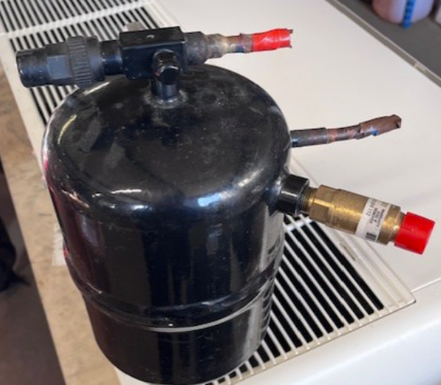
Pressure relief valve
A mechanical pressure relief valve is a brass housing which has a mechanical device inside consisting of a valve spring and diaphragm. When the system reaches a dangerously high temperature, the valve opens and vents off the refrigerant to the atmosphere until the system pressure equalises with the valve set point.
Valves are designed with different set points to match the specific system. Some valves have an adjustable pressure screw.
The advantage of the mechanical valve over the fusible plug is that the whole refrigerant charge is not vented to the atmosphere.

Slide 17
Strainers
Strainers are a critical component within a refrigeration or air conditioning system. They act as a protection device to protect other components, such as the compressor and the metering device.
The strainer requires regular inspections and maintenance to ensure that it is kept clean.
A clogged strainer can cause symptoms such as high discharge pressure and low suction pressure.

Slide 18
Strainers
There are several types of strainer:
Y strainer
Basket strainer
T-Strainer
Conical strainer

Slide 19
Strainers
The strainer has a woven mesh basket inside the housing that collects the debris as the refrigerant passes over or through the strainer.
The installation of a strainer is usually to collect any foreign objects that may be present within the system from the installation process, such as welding spatter or solder.

Slide 20
Service valves
Service valves are used for many reasons. A service valve can be used to pressure test, evacuate, charge or isolate certain parts of the system during maintenance, the replacement of a part, or simply to attach gauges to retrieve system pressures and saturated temperatures.
Some valves have hand valves that can be operated without the use of any tools, whilst others use a ratchet or hex key to open and close them.
Schrader valves operate when a refrigerant hose is directly attached to them (like a car tyre).

Slide 21
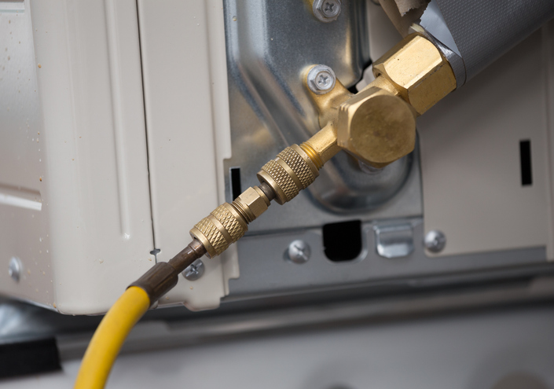
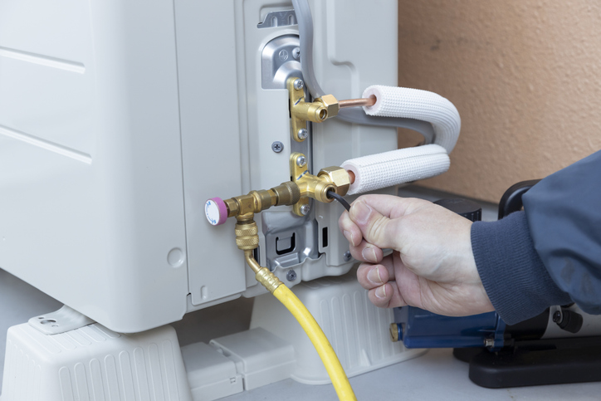
Service valves
This type of valve is used on air conditioning systems. It has a Schrader valve for attaching gauges and can also be isolated by removing the brass dust cap and turning the screw with a hex key.
Once a gauge line is attached to the Schrader, the refrigerant will exit the valve, so it is important to make sure that the gauges are closed before attaching it.
Schrader
valve
AC service valve

Slide 22
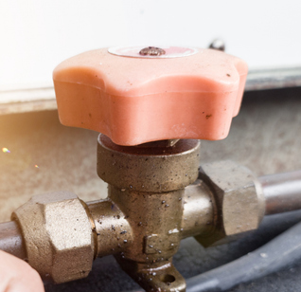
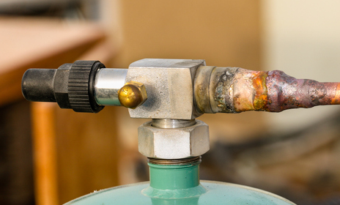
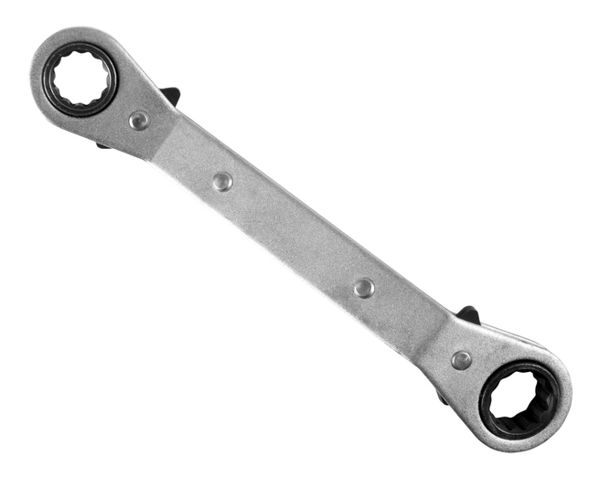
Service valves
Hand valve
A service key /ratchet spanner is required to rotate the centre shaft which is located beneath the black dust cover to gain access to the system pressures.
Simply operated by rotating the valve by hand
Service valve

Slide 23
Oil separators
Oil separators are used to return oil back to the compressor to ensure the compressor is lubricated.
The oil is absorbed into the refrigerant due to its high miscibility, meaning that the refrigerant and the oil mix together easily.
This oil needs to be removed from the refrigerant and returned to the compressor.
The vessels can be small and very large.

Slide 24
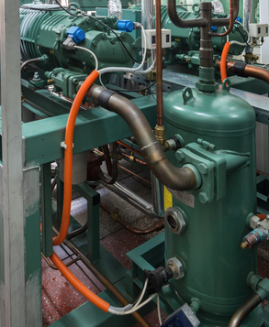
Types of oil separators
Centrifugal (helical)
Impingement (Baffle)
Coalescent (filter) type greater than 99% efficiency.
Notes:
Tutor to show different oil separators

Slide 25
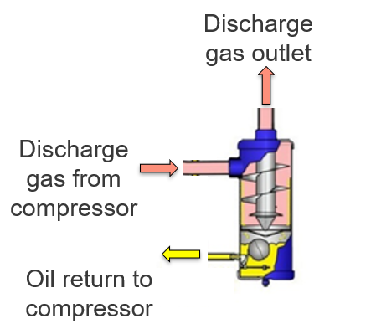
Helical oil separator
The oil is separated from the refrigerant and returned to the compressor crankcase.
Helical oil separator as shown.
Notes:
Self made image Coriolis international

Slide 26
Summary
You should now be able to:
Recall different types of ancillary devices.
Explain the basic principles of the ancillary devices.
You might also be able to:
Examine the structural integrity of different components.
Select and justify the best component for a given refrigeration or air conditioning installation project.

Slide 27
Any questions?
Copyright in this document belongs to and is used under licence from the Department for Education, © 2025.
‘T-LEVELS’ and ‘T Level’ are registered trademarks of the Department for Education.
WJEC is authorised by the Department for Education to develop and deliver this T Level Technical Qualification.
WJEC operates in England under the name Eduqas which is a registered trademark of WJEC.

