Slide 1
Occupational Specialism: Refrigeration Engineering
K1.6 Refrigeration system components
PowerPoint K1.6d: The function and operating principles of metering devices

Slide 2
Introduction
In this session you will learn about the operating principles of a range of metering devices used in refrigeration and air conditioning systems.
It covers the types of metering devices most common to a range of applications.

Slide 3
Objectives
You should be able to:
Recall different types of metering devices.
Explain the basic principles of a metering device.
You might also be able to:
Examine the structural integrity of different designs.
Select and justify the best design solution for a given refrigeration or air conditioning installation project.

Slide 4
Metering device - function
The metering device controls the flow of liquid refrigerant to the evaporator to ensure the correct superheat is maintained at the evaporator outlet.
It’s located between the liquid line and the evaporator.
It causes the refrigerant to instantly drop in pressure and temperature.
It prevents liquid from entering the compressor and causing damage after leaving the evaporator.

Slide 5
Metering device
condenser
compressor
evaporator
Metering device

Slide 6
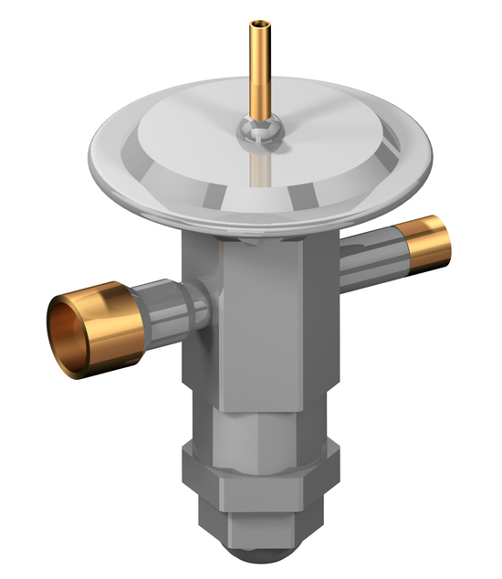
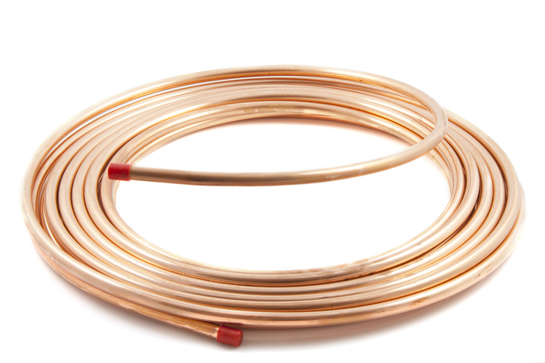
Types of metering devices
There are many types of metering devices:
Capillary tubes
Thermostatic Expansion Valves (TXV)
Electronic Expansion Valves (EEV)
Automatic Expansion Valves (AEV)
High side float
Low side float.
TXV
Capillary tube
Notes:
At this point it is worth mentioning metering devices are either fixed; giving a constant flow of refrigerant
or modulating; giving a variable flow of refrigerant.

Slide 7
Capillary
Simply a length of small-bore copper tube.
The length and bore are designed and selected to create a desired pressure drop.
Used in both residential and commercial systems and is commonly used on domestic refrigeration systems.
The length and internal dimension cause refrigerant liquid to ‘back up’, creating a high-pressure side, while dropping to a low-pressure side at its outlet.
Notes:
These can vary in length up to roughly 20 feet.

Slide 8
Capillary
A capillary acts similarly to a drinking straw; if you pinch the straw while trying to blow into it, it gets harder and builds up a lot of back pressure.
The refrigerant charge and system cleanliness are critical to avoid compressor damage.
Notes:
These can vary in length up to roughly 20 feet.

Slide 9
Capillary
compressor
Advantages:
No moving parts to wear out or maintain.
The pressures are balanced out when the system stops running which in turn places a minimum starting torque on the compressor.
evaporator
condenser
Capillary tube

Slide 10
Capillary
compressor
Disadvantages:
Can easily become blocked.
Unable to vary when the load is increased or decreased.
Has to be critically charged.
evaporator
condenser
Capillary tube

Slide 11
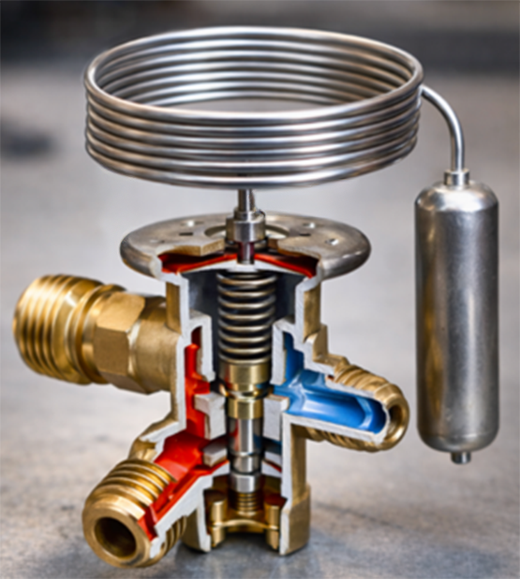
Thermostatic expansion valve (TXV)
TXV devices are mostly used in commercial systems.
The refrigerant pressure drops through an orifice (small hole).
The flow of refrigerant is controlled and regulated by a needle valve and diaphragm arrangement.
The TEV modulates the flow of refrigerant to accommodate the demand, so a liquid receiver is a required accessory.

Slide 12
Thermostatic expansion valve (TXV)
When there’s a greater load on the evaporator, the TEV can feed a greater rate of liquid from the liquid receiver and still maintain the required superheat.
The receiver has the extra refrigerant required to keep up with the increased flow rate and demand.

Slide 13
Operation of the TXV
The diaphragm is moved by pressure generated inside the controlling phial/bulb, which is attached 100mm downstream of the evaporator outlet.
The bulb/phial senses the temperature of the refrigerant superheat as it leaves the evaporator.
The temperature should be approximately 5°C above the evaporator to ensure there is no liquid returning to the compressor.
It’s superior to a capillary tube because it can vary the flow of refrigerant to meet varying load conditions.

Slide 14
Operation of the TXV
There are 2 closing forces in the TXV:
P2 (evaporator pressure)
P3 (spring pressure)
There is one opening force:
P1 (bulb pressure).
P1 = P2+P3.
If the evaporator pressure was to increase while the bulb pressure stayed the same, the valve would close.
P2 + P3 would be greater than P1.
Now if the bulb pressure was to increase to a larger amount, the valve would open.
P1 is greater than P2+P3.

Slide 15
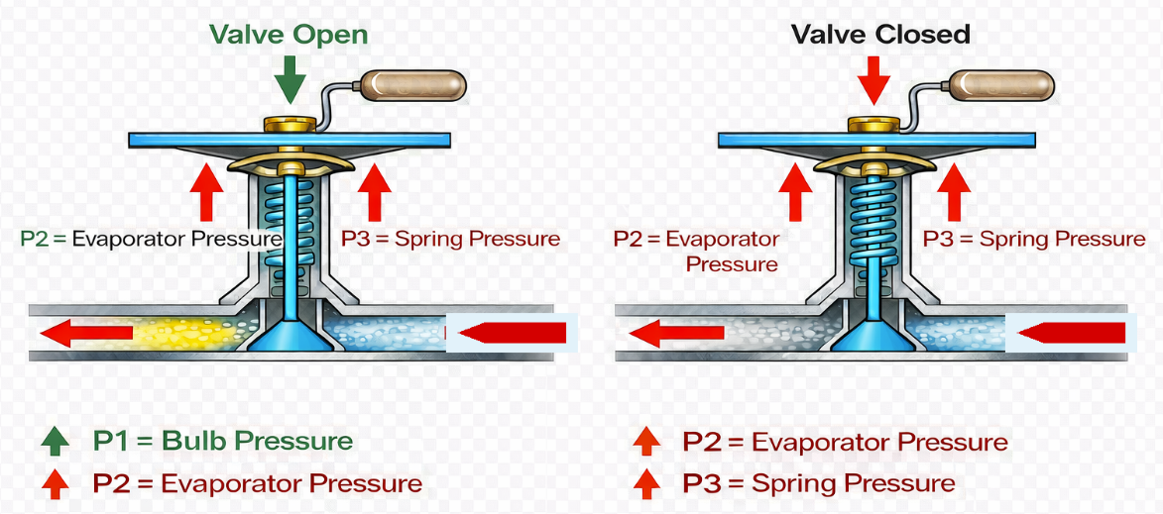
Operation of the TXV
The 3 forces:
When P1 is greater than P2 & P3, the valve will open.
When P2 or P3 are greater than P1, the valve will close.

Slide 16
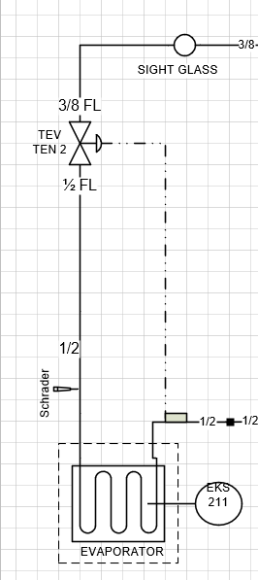
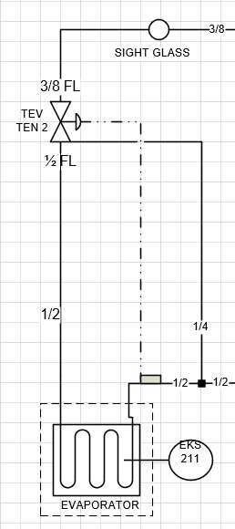
Types of TXV
There are 2 types of TXV:
Internally equalised
Externally equalised

Slide 17
Types of TXV
Internally equalised:
The low side pressure (suction) and the sensing bulb pressure tend to equalise.
The total expansion valve force overpowers the sensing bulb force, the needle is forced firmly into its seat and the refrigerant flow stops.

Slide 18
Types of TXV
Externally equalised:
The equalising line compensates for any pressure drop through the evaporator whilst the compressor is running.
The equalising line balances the pressure between the suction line at the valve and the pipe where the sensing bulb is located.
This is used where a pressure drop through the evaporator occurs, and it will starve the evaporator of liquid refrigerant and increase the superheat. Thus, less efficient operation.

Slide 19
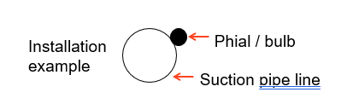
Types of TXV
compressor
Phial / bulb
Bulb location:
It should be mounted on a horizontal portion of the line.
The bulb should be mounted at different places on the circumference of the line depending on the line size.
On a small line, it should be mounted on top.
The larger the line, the closer to the bottom it should be mounted, but never on the bottom as oil is circulating which can act as an insulator.
condenser
evaporator
TXV
Suction pipeline

Slide 20
Types of TXV
Bulb location for externally equalised TXV:
The bulb should be located before the connection for the external equaliser line.
Because if the valve had an internal leak, it would give a false reading and starve the evaporator coil of refrigerant.
The bulb and line should be well insulated with no air passing over the sensing bulb.
Can you think what would happen if the sensing bulb was not insulated around the pipe?
compressor
Phial / bulb
condenser
evaporator
TXV
Notes:
Answer: If the bulb is un-insulated, it will give a false reading as it will be reading the temperature of the cooled space.

Slide 21
Electronic Expansion Valve (EEV)
An EEV works in the same way that a TXV works, however the open and closing of the valve and control of refrigerant flow is carried out by sensors being placed on the system.
The sensors are connected to a system controller, which controls the expansion valve and the working conditions of the system.
The head of the valve is a stepper motor that pulses to rotate the internal needle valve, causing the valve to open or close in precise increments.

Slide 22
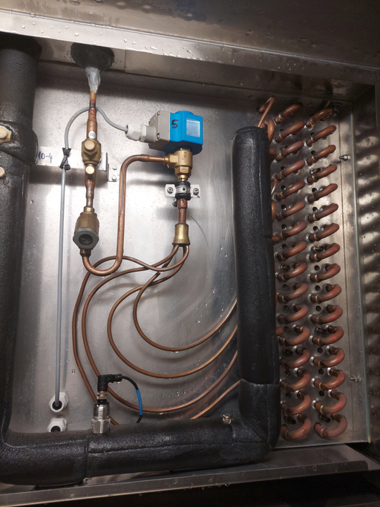
Electronic Expansion Valve (EEV)
compressor
Temperature sensors are located before and after the evaporator to open and close the valve to a preset superheat setting.
condenser
evaporator
EEV
Notes:
Photo shows the EEV connected to the evaporator and the sensor at the outlet

Slide 23
Automatic Expansion Valve (AEV)
An AEV maintains the system set pressure by a diaphragm, spring and needle arrangement which is located in the valve body.
This type of valve is commonly used on small self-contained refrigeration systems that have a steady load, such as a water cooler or small freezers.

Slide 24
Automatic Expansion Valve (AEV)
When the cooling load decreases, the evaporator pressure increases which causes the diaphragm to close, in turn the needle valve closes which reduces the refrigerant flow to the evaporator.
When the cooling load increases, the evaporator pressure decreases which causes the diaphragm to open, in turn the needle valve opens which increases the refrigerant flow to the evaporator.

Slide 25
Liquid level control
Liquid level control is a method of regulating and monitoring the amount of liquid refrigerant within a liquid receiver or evaporator, to ensure the system operates efficiently whilst protecting other components such as the compressor.

Slide 26
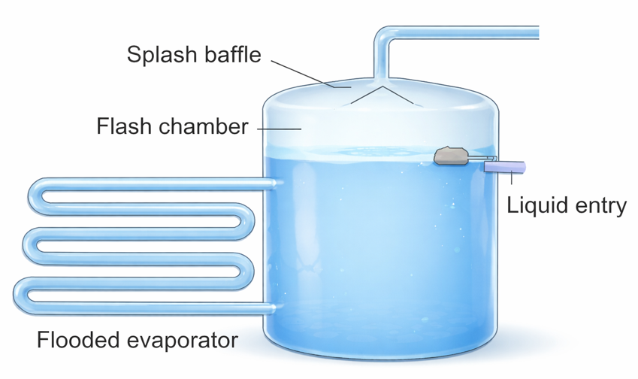
Liquid level control
This is carried out by means of float valves and switches, which can be electronic or mechanical.
Sensors are also used which monitor the presence of refrigerant.
1 float
2 float mechanism
3 orifice
4 Balance tube
1
Low pressure
outlet
High pressure
liquid inlet

Slide 27
Summary
You should now be able to:
Recall different types of metering devices.
Explain the basic principles of a metering device.
You might also be able to:
Examine the structural integrity of different designs.
Select and justify the best design solution for a given refrigeration or air conditioning installation project.

Slide 28
Any questions?
Copyright in this document belongs to and is used under licence from the Department for Education, © 2025.
‘T-LEVELS’ and ‘T Level’ are registered trademarks of the Department for Education.
WJEC is authorised by the Department for Education to develop and deliver this T Level Technical Qualification.
WJEC operates in England under the name Eduqas which is a registered trademark of WJEC.

