Slide 1
Occupational Specialism: Refrigeration Engineering
K1.6 Refrigeration system components
PowerPoint K1.6c: The function and operating principles of evaporators

Slide 2
Introduction
In this session you will learn about the operating principles of a range of evaporators used in refrigeration and air conditioning systems.
It covers the configuration and types of evaporators most common to a range of applications.

Slide 3
Objectives
You should be able to:
Recall different types of evaporators.
Explain the basic principles of evaporators.
You might also be able to:
Examine the structural integrity of different designs.
Select and justify the best design solution for a given refrigeration or air conditioning installation project.

Slide 4
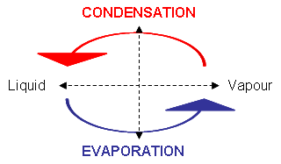
Evaporators
An evaporator can be any heat transfer surface in which a volatile liquid is vapourised for the purpose of removing heat from the refrigerated space or product.
They are constructed in many shapes and sizes for different applications.
To maintain a cool environment or product, the refrigerant inside a forced draft evaporator must be substantially lower, e.g. for a room temperature of 5°C, the refrigerant would need to be 7 to 15K lower.

Slide 5
Evaporator types – direct expansion v flooded
Direct expansion evaporators have the refrigerant flowing through the tubes.
Flooded evaporators have refrigerant surrounding the tubes.
Direct expansion - Natural convection evaporator.
Frequently used in applications where low air velocity and minimum dehydration is desired (domestic refrigerators).

Slide 6
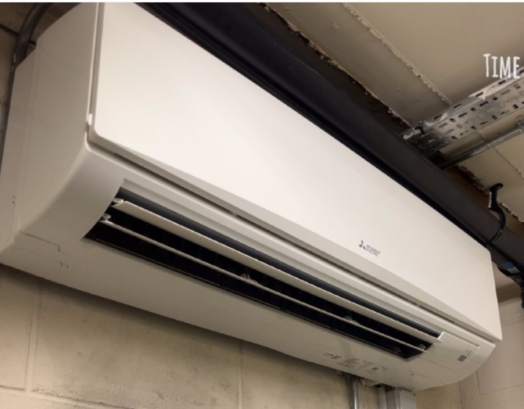
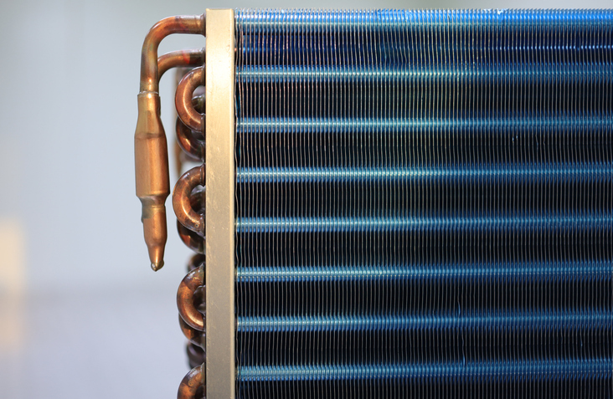
Evaporator type – direct expansion
Forced convection evaporator
These are essentially bare-tubes / finned-tube coils encased in a metal housing and equipped with one or more fans to provide air circulation (cold rooms and air conditioning units).
Fans are used to increase air flow over the evaporator, allowing the refrigerant inside the tubes to absorb more heat.

Slide 7
Evaporator type – direct expansion
Forced convection evaporator
The space (gap) between the aluminium fins varies according to application:
Positive temperature application = 4 to 6 mm gap
Negative temperature application = 6 to 16 mm gap
Why does a negative temperature application require a larger evaporator fin spacing?
Notes:
_{Tutor led open discussion.}
The function is to remove heat from the surrounding air
In low temperature applications the refrigerant will be below zero.
The moisture in the air will freeze on the tubes, hence ice builds up and will eventually restrict air flow
Therefore Low temperature evaporators also need defrost systems

Slide 8
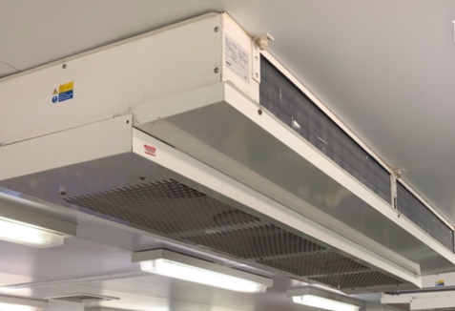
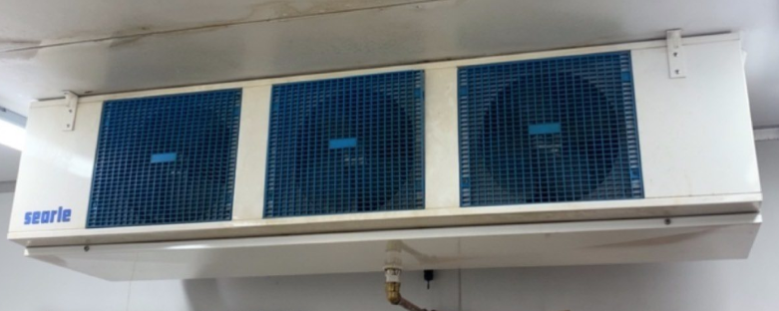
Evaporator type – direct expansion
Forced convection evaporators

Slide 9
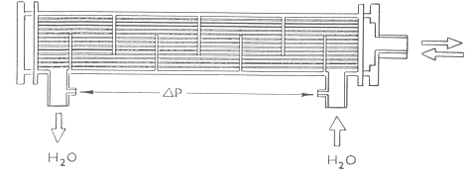
Evaporator – direct expansion
Shell and tube
Refrigerant flow is usually via a thermostatic metering device.
Cold liquid enters and heat exchange occurs causing the liquid to change to vapour.
Additional heat is absorbed before leaving the evaporator tubes (superheat).
Refrigerant vapour leaves the tube bundle
12ºC
2ºC
Refrigerant liquid flows into the tube bundle
7ºC
12ºC
Notes:
Temperatures may differ slightly depending on refrigerant used.

Slide 10

Evaporator – direct expansion
Tube Sheet
Low Pressure Superheated Refrigerant Vapour
Refrigerant Baffle
End Plate
Chilled Water Outlet (7°C)
End Plate
Evaporator shell
Copper Tubes and Galvanised Steel Water Baffles
Refrigerant Baffle
Chilled Water Inlet (12°C)
Low Pressure Low Temperature Liquid Refrigerant
Rifled copper tube to enhance turbulence

Slide 11
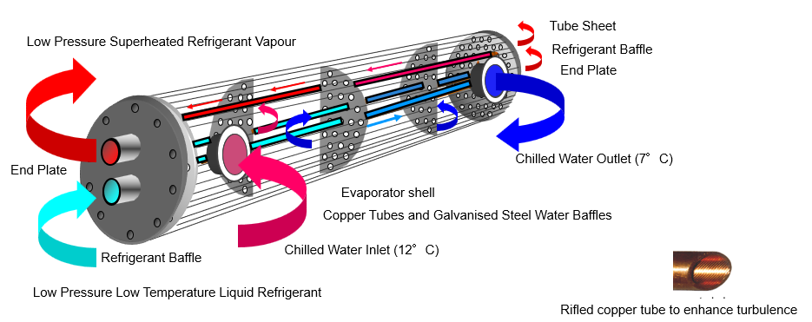
Evaporator – direct expansion
Shell and tube evaporators must have water treatment to prevent oxidation between the copper and steel shell.

Slide 12
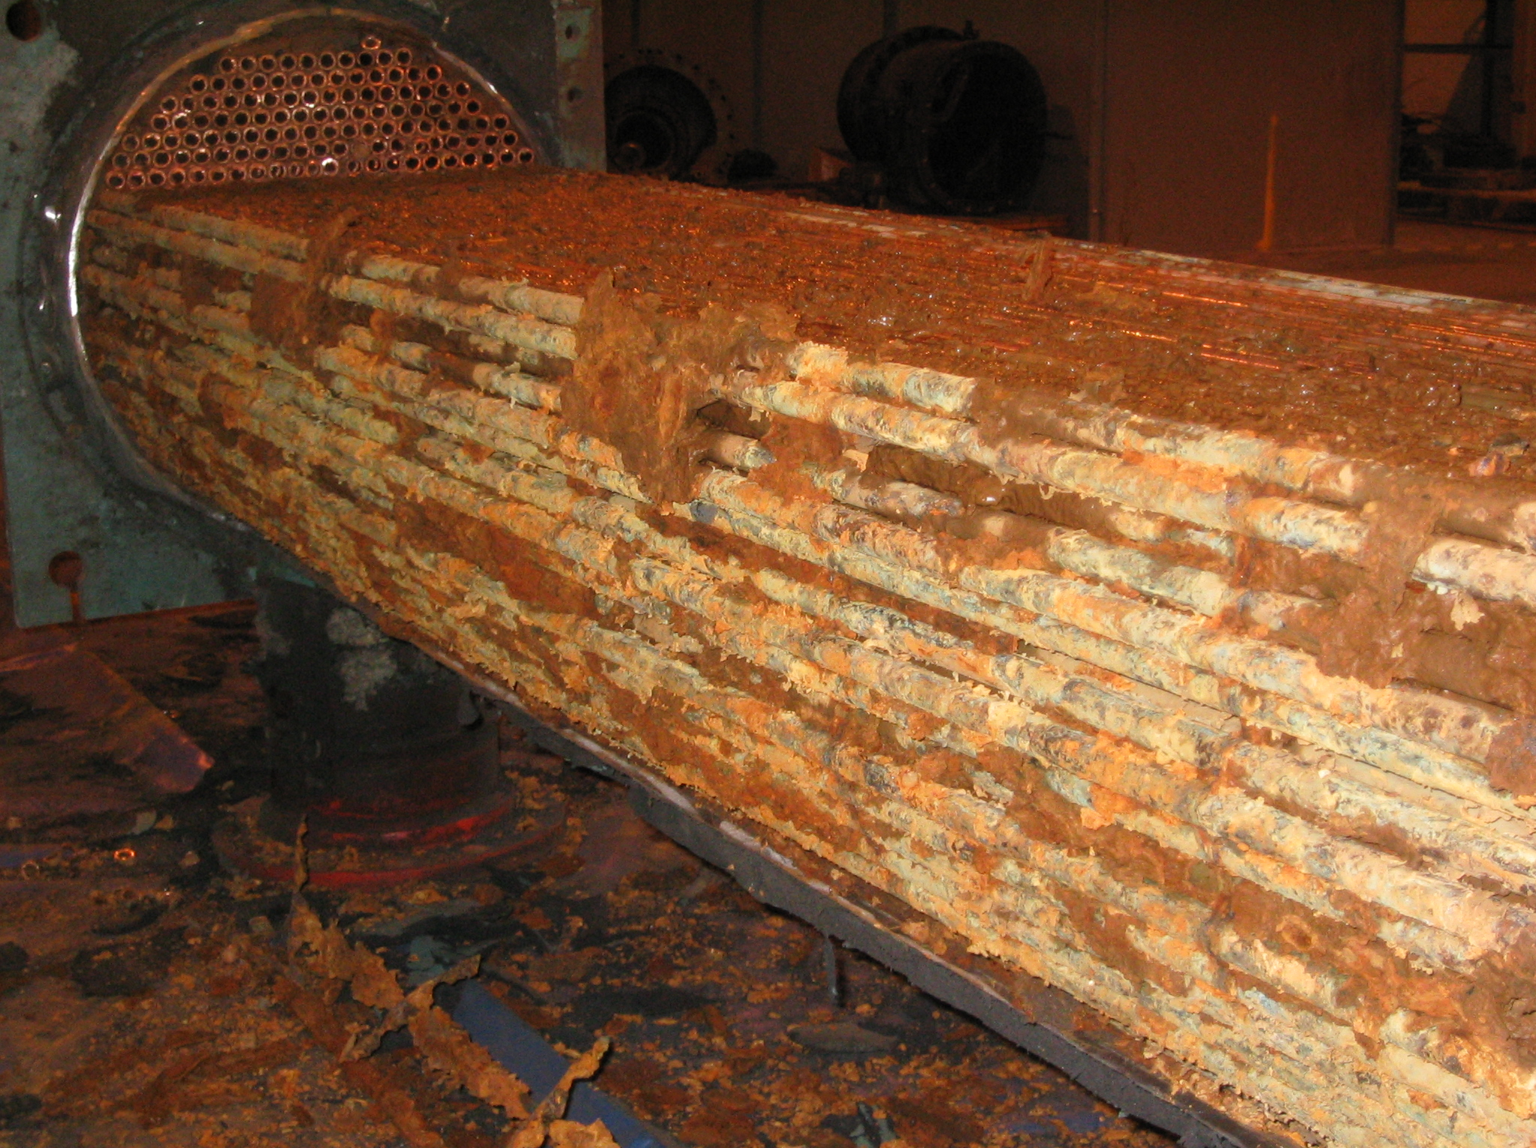
Evaporator – direct expansion
Steel shell and copper tube type heat exchanger (evaporator).
The rust surrounding the copper tubes is a result of untreated water running around the copper tubes.
The tubes should look like shiny copper.

Slide 13
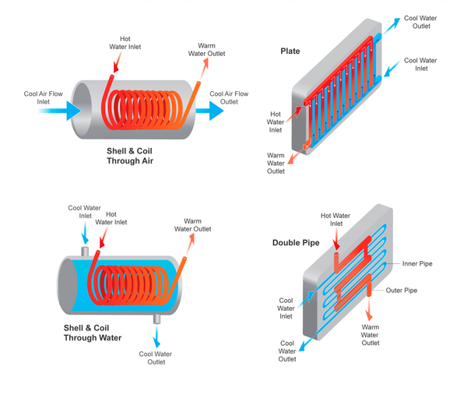
Evaporator
Other shell and tube heat exchangers:
Shell and Coil
Plate

Slide 14
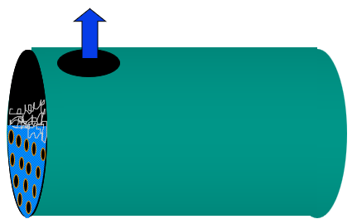
Evaporator type – fully flooded
Fully flooded evaporator
The refrigerant surrounds the tubes.
The tubes have the chilled liquid flowing through them.
The vapour returns to the compressor.
This type is often found on larger capacity systems where screw or centrifugal compressors are fitted.

Slide 15
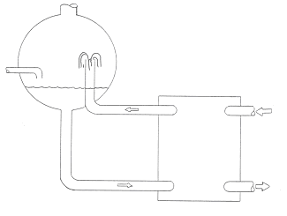
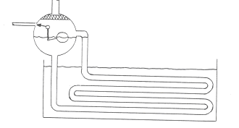
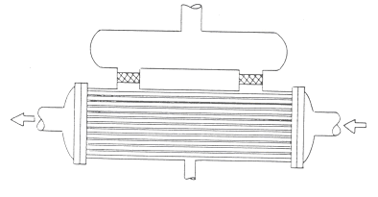
Evaporator types – full flooded
Shell and tube
Refrigerant entry
Bare Coil
Refrigerant entry
Refrigerant entry
Plate Type

Slide 16
Evaporators
What type of evaporator is shown?
Notes:
_{Answer: Fully flooded}

Slide 17
Function of evaporator
The function of an evaporator is to:
Absorb heat into the refrigerant to change saturated refrigerant (liquid/vapour mix) back to a vapour at constant pressure.
To do this, the cooling medium must be below the temperature of the refrigerant.

Slide 18
The vapour compression cycle
Refrigerant in the condenser gives up its heat to the cooling tower water circuit
Cooling tower
High Pressure
Sub-cooled Liquid
25ºC
20ºC
High Pressure
Superheated Vapour
25ºC
Condenser
70ºC
Metering
Device
Motor
Drive
Compressor
2ºC
Evaporator
12ºC
Low Pressure
Superheated Refrigerant Vapour
Low Pressure / Low Temperature
Refrigerant
Liquid / Vapour mix
12ºC
7ºC
Refrigerant in the evaporator absorbs heat from the
chilled water circuit
Notes:
Tutor to recap on the function of compressor, condenser and metering device and how it all works by firstly using the evaporator to absorb heat from the given heat load – in this case a building filled with people working and using office equipment.
Tutor to ask the learners to think of what we mean by a building load?
i.e. Heat from people (metabolic load), computers, lighting, solar gain etc.
Tutor to commence evaporation subject by explaining liquid to vapour process is called evaporation.
_{Note:}
Temperatures are an example only and will differ with different refrigerants or ambient temperatures

Slide 19
Evaporator
The function of the evaporator is to:
Absorb heat from the product load.
Change the refrigerant liquid to a refrigerant vapour.
Imagine a pan of water being heated on the cooker.
The first bubble of vapour that appears in the pan of water is known as the bubble point.
When the last drop of liquid in the pan evaporates, this condition is known as the dew point.

Slide 20
Evaporator – superheating
The additional heat added to the refrigerant above its saturation temperature (at constant pressure).
Superheat is a sensible heat change.
The evaporated refrigerant (100% vapour condition) at saturation temperature is further heated to a condition known as the ‘superheated temperature’.

Slide 21
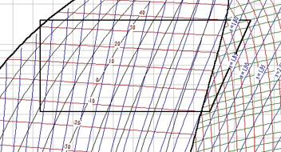
Evaporator superheat
Condenser
100% Saturated liquid
(bubble point)
Compression
E
Evaporation
H
F
G
Temperature entering compressor
Evaporator saturation temperature
(dew point temperature)
Temperature leaving evaporator
Superheat value (K) =
Actual temperature leaving the evaporator - Evaporator Saturation temperature
Notes:
_{Tutor to explain.}
The blue line represents evaporation process.
Superheated temperature at G is higher than the saturation temperature at F
Saturation temperature at F is also known as the dew point / 100% vapour.
When a refrigerant is a blend of different refrigerants (Zeotropic) a difference between E and F will be observed as shown

Slide 22
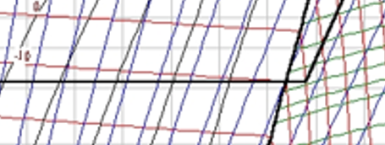
Evaporator superheat and non useful superheat
Evaporation
H is known as what?
F is known as what?
G is known as what?
Non useful superheat is the difference in temperature between point H and G (expressed in Kelvin)
Therefore; if H was 0ºC and G was -5ºC. The non useful superheat value would be 5K (Kelvin).
And if; F was -10ºC the superheat value would be 5K. Total superheat = 10K
Notes:
F is saturated vapour temperature
G is temperature leaving evaporator
H is temperature entering compressor

Slide 23
Summary
You should now be able to:
Recall different types of evaporators.
Explain the basic principles of evaporators.
You might also be able to:
Examine the structural integrity of different designs.
Select and justify the best design solution for a given refrigeration or air conditioning installation project.

Slide 24
Any questions?
Copyright in this document belongs to and is used under licence from the Department for Education, © 2025.
‘T-LEVELS’ and ‘T Level’ are registered trademarks of the Department for Education.
WJEC is authorised by the Department for Education to develop and deliver this T Level Technical Qualification.
WJEC operates in England under the name Eduqas which is a registered trademark of WJEC.

