Slide 1
Occupational Specialism: Refrigeration Engineering
K1.6 Refrigeration system components
PowerPoint K1.6b: The function and operating principles of condensers

Slide 2
Introduction
In this session you will learn about the operating principles of a range of vapour compression system condensers used in refrigeration and air conditioning systems.
It covers the configuration and types of condensers most common to a range of applications.

Slide 3
Objectives
You should be able to:
Recall different types of condensers.
Explain the basic principles of the condensing process.
You might also be able to:
Examine the structural integrity of different designs.
Select and justify the best design solution for a given refrigeration or air conditioning installation project.

Slide 4
Condensers
The condenser is one of four main components in any refrigeration vapour compression system.
What are the four main components?
Industrial refrigeration
Large capacity systems often utilise the most efficient condenser design.
An ‘evaporative condenser’ is shown within the red dotted box.
Notes:
Answer: Compressor, Condenser, Metering device, Evaporator

Slide 5
Condenser applications
Commercial air conditioning
Packaged systems that provide water cooling to serve an air handling unit or fan coil unit e.g. 6ºC.
Split systems that have an outdoor unit connected to an air handling unit or individual indoor units.

Slide 6
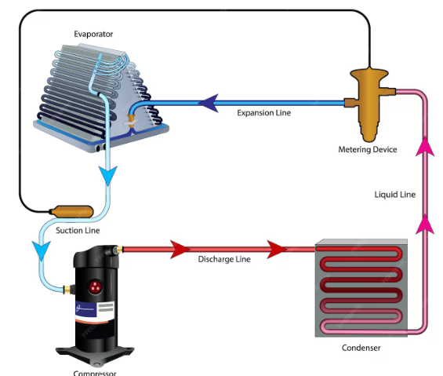
Condenser applications
Domestic refrigeration
Small capacity systems i.e. food products chilled (4ºC), frozen (-18ºC).
The condenser for a domestic refrigerator can be seen on the reverse of the refrigerator.
Evaporator
Expansion line
Metering device
Liquid line
Suction line
Discharge line
Condenser
Compressor

Slide 7
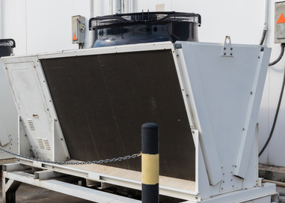
Function of condenser
45ºC
The function of a condenser is to:
Remove heat from the refrigerant (reject heat) in order to change vapour to liquid at constant pressure.
To do this, the cooling medium must be below the temperature of the refrigerant.
In this picture, what would you expect the temperature of the refrigerant to be inside the condenser tubes?
Ambient air
30ºC
Notes:
_{Tutor led discussion}
_{Ambient air on @ 30°C}
_{Air off condenser @ 45°C}
Therefore; refrigerant temperature anywhere from 45 to 60°C
The higher the difference the less efficient the condenser.
This could be because of poor air flow.

Slide 8
Condenser – heat rejection phases
The 3 phases of heat rejection in a condenser:
DESUPERHEATING (sensible heat change).
CONDENSING (latent heat change of state from 100% vapour to 100% liquid).
SUB-COOLING (sensible heat change).

Slide 9
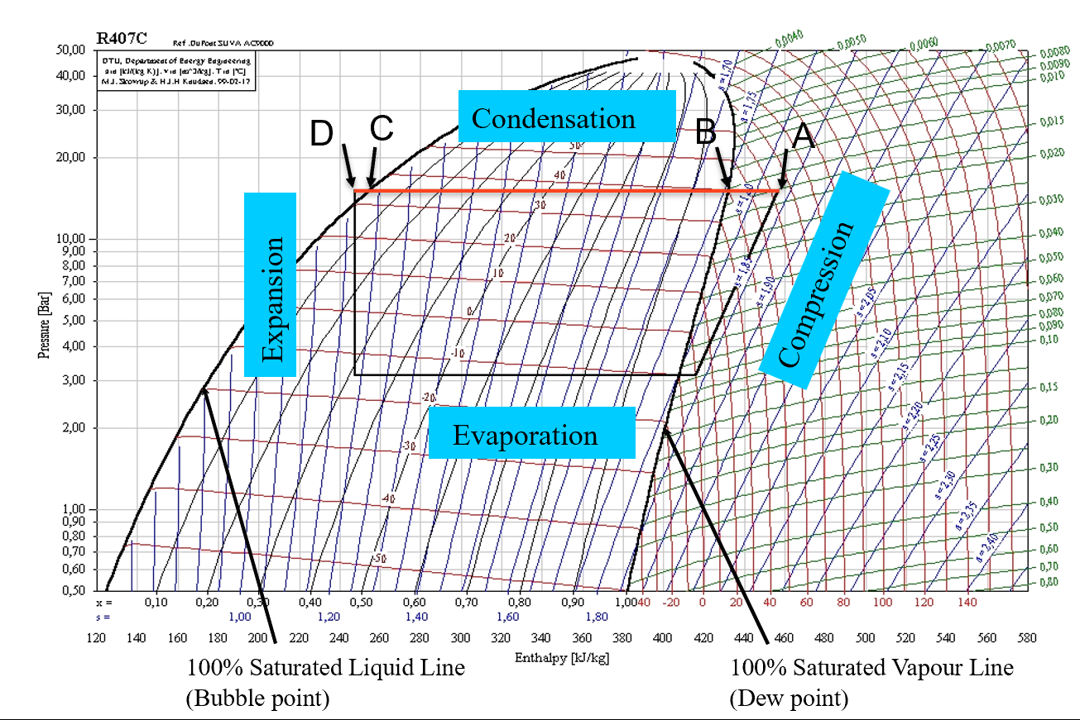
Condenser – heat rejection phases
The 3 phases of heat rejection in a condenser:
DESUPERHEATING: A to B
(sensible heat change)
CONDENSING: B to C
(latent heat change)
SUB-COOLING: C to D
(sensible heat change)

Slide 10
Condenser – heat rejection phases
The 1st phase of heat rejection in a condenser.
Desuperheating (sensible heat change):
Accounts for approximately 15% of total heat rejected.
The highly superheated discharge vapour temperature is reduced to the ‘dew point’ of the refrigerant.
Dew point condition is where 100% saturated vapour is present (zero liquid).

Slide 11
Condenser – heat rejection phases
The 2nd phase of heat rejection in a condenser (refer to the image on slide 9).
Condensing (B to C is a latent heat change):
Approximately 80% of total heat rejected.
The condition of refrigerant in this phase is known as ‘saturation’.
The heat contained in the refrigerant is withdrawn by the cooling medium until it reaches a condition known as the ‘bubble point’ where 100% liquid is present, therefore zero vapour is present.
Notes:
Show B to C on the image on slide 9

Slide 12
Condenser – heat rejection phases
The 3rd phase of heat rejection in a condenser.
Sub-cooling (sensible heat change):
Approximately 5% of total heat rejected.
The condensed refrigerant (100% liquid) at saturation temperature is further cooled down to a condition known as the ‘subcooled temperature’.

Slide 13
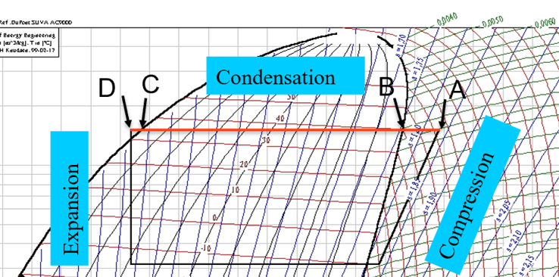
Questions
In the diagram:
Which two points represent Subcooling?
Which two points represent Saturation?
Notes:
Subcooling temperature at C down to temperature at D
Saturation temperature at B (dew point / 100% vapour) and temperature at C (bubble point / 100% liquid)
When a refrigerant is a blend of different refrigerants (Zeotropic) a difference between B and C will be observed.

Slide 14
Condenser types and configurations
Types​ | Natural convection
 | Air cooled
 | Water cooled
 | Evaporative (combination of air and water cooling)
Configuration | Fin and tube (Aluminium or copper fin on copper tube)
 | Shell and tube (single or multiple pass)
 | Shell and coil

Slide 15
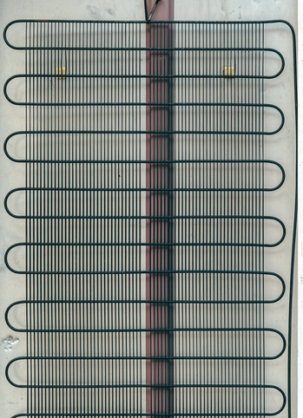
Condenser – natural convection
The least efficient condenser type.
Commonly found mounted to the back of a domestic refrigerator.
Utilising refrigerant through the tube with a static wire crossing the tube.
Cold air rises and as it passes over the high temperature tube, the air becomes warmer and the refrigerant exits the tube in a cooler (condensed) liquid condition.

Slide 16
Condenser - air cooled
Air cooled condensers are usually external to the building and have many shapes and sizes to manage the heat rejection capacity of the system.
Noise can be an issue and therefore come with high, medium and low noise options.
Variable speed fan control is available to manage condensing temperature.
Three common designs are tube and fin, spine and fin and microchannel.

Slide 17
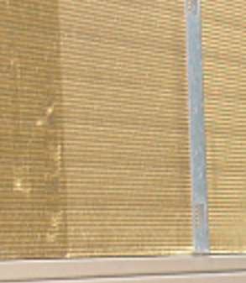
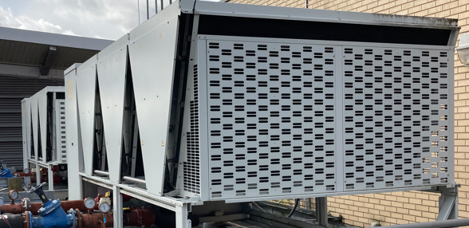
Condenser – air cooled
Tube and Fin
Copper tube with aluminium fins (most common).
Copper tube with copper fins or special coated .
Higher cost usually for aggressive environments.
Spine and Fin - durable
Aluminium tube with aluminium fins.
Microchannel – most efficient
Flat aluminium tube with aluminium fin.

Slide 18
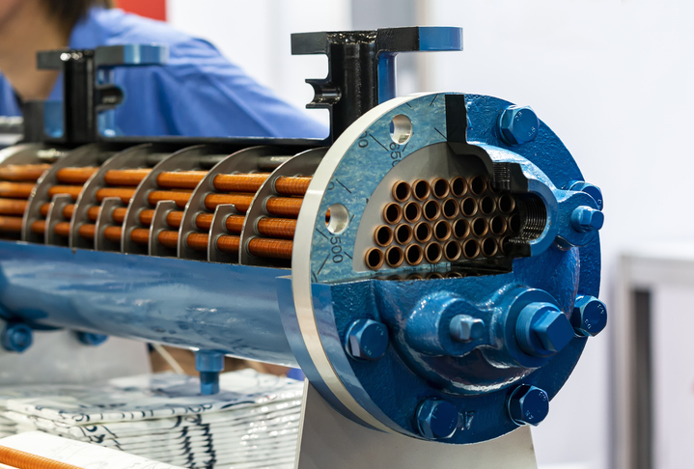
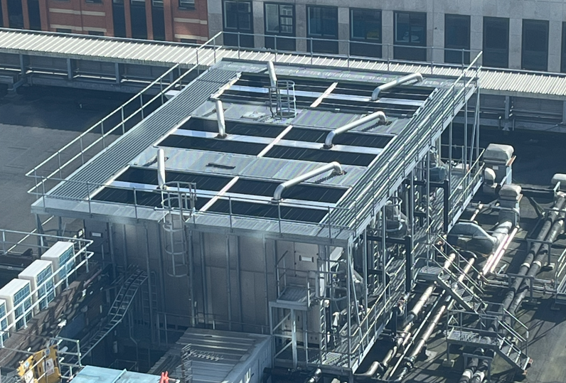
Condenser – water cooled
Shell and Tube – most common
Copper tube inside a steel vessel.
Generally designed for use with mains (treated) water or in conjunction with a cooling tower on commercial systems.
Special marine constructions can be found for use with seawater as the cooling medium.

Slide 19
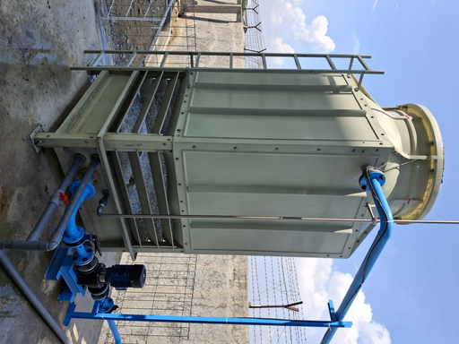
Condenser – evaporative
A combination of air and water used for efficient cooling.
Generally found in industrial cold room applications.

Slide 20
Summary
You should now be able to:
Recall different types of condensers.
Explain the basic principles of the condensing process.
You might also be able to:
Examine the structural integrity of different designs.
Select and justify the best design solution for a given refrigeration or air conditioning installation project.

Slide 21
Any questions?
Copyright in this document belongs to and is used under licence from the Department for Education, © 2025.
‘T-LEVELS’ and ‘T Level’ are registered trademarks of the Department for Education.
WJEC is authorised by the Department for Education to develop and deliver this T Level Technical Qualification.
WJEC operates in England under the name Eduqas which is a registered trademark of WJEC.

