Slide 1
Occupational Specialism: Refrigeration Engineering
K1.6 Refrigeration system components
PowerPoint K1.6a: The function and operating principles of compressors

Slide 2
Introduction
In this session you will learn about the operating principles of a range of vapour compressors used in refrigeration and air conditioning systems.
It covers the configuration and types of compressors most common to a range of applications.

Slide 3
Objectives
You should be able to:
Recall different types of compressors.
Explain the basic principles of vapour compression.
You might also be able to:
Examine the structural integrity of different designs.
Select and justify the best design solution for a given refrigeration or air conditioning installation project.

Slide 4
Compressors
The compressor is one of the four main components in any refrigeration vapour compression system.
INDUSTRIAL REFRIGERATION – large capacity systems (as shown) i.e., process cooling (-30ºC).

Slide 5
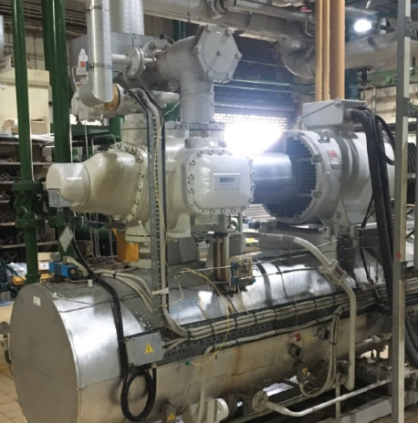
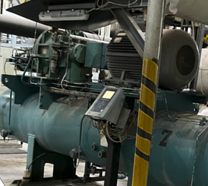
Industrial refrigeration
Larger compressors connected to motors via a direct coupling arrangement.

Slide 6
Compressor applications
Commercial air conditioning
Packaged systems that provide water cooling to serve an air handling unit or fan coil unit e.g. 6ºC.
Split systems that have an outdoor unit connected to an air handling unit or individual indoor units.

Slide 7
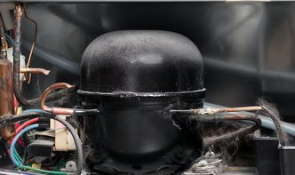
Compressor applications
Domestic refrigeration
Small capacity systems, i.e. food products chilled (4ºC), frozen (-18ºC).
These are often driven by motors contained within the same body as the compressor housing and are known as hermetically sealed.

Slide 8
Compressor types and configurations
Types​ | Reciprocating
 | Centrifugal
 | Screw
 | Rotary / Scroll
Configuration | Open drive
 | Semi hermetic
 | Hermetic
Notes:
Open drive screw compressor shown

Slide 9
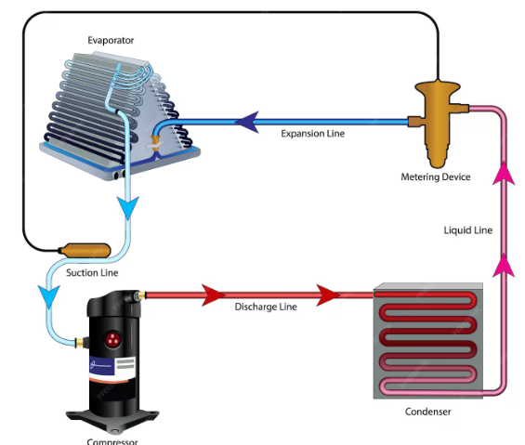
Function of compressor
Circulate refrigerant around the system.
Increase the refrigerant pressure and saturation temperature above the ambient or condensing temperature.
Draw refrigerant vapour at low pressure from the evaporator, thereby maintaining a low evaporating pressure and saturation temperature.
Evaporator
Expansion line
Metering device
Liquid line
Suction line
Discharge line
Condenser
Compressor

Slide 10
Positive displacement v dynamic compressors
Two basic principles for the compression of a fluid vapour.
Positive displacement compression is when mechanical devices increase gas pressure by trapping a fixed volume of vapour within a chamber and reducing that volume using pistons, screws, or vanes.
Dynamic displacement compressors draw vapour into rotating impellor blades that accelerate the vapour to high velocity. The vapour is then discharged through a special shaped outlet chamber known as a diffuser. This kinetic energy is transformed into static pressure.

Slide 11
Positive displacement compressors
Compression chamber reduces in volume to compress the gas.
Applicable to the following compressor types:
Reciprocating
Scroll
Rotary
Screw.

Slide 12
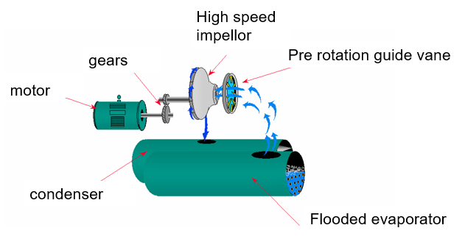
Dynamic compressors
This type of compressor uses high speed rotating vanes (impellor) to compress large volumes of vapour (gas).
Applicable to the following compressor type:
Centrifugal

Slide 13
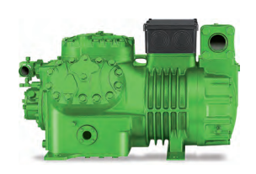
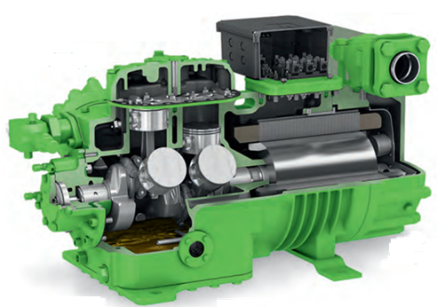
Reciprocating compressors
The image shown is for a multiple piston (semi hermetic) compressor.
Each piston attached to a connecting ‘rod’ and each rod is connected to the main crankshaft which is driven by a motor.
All mechanical parts are lubricated by an oil system.

Slide 14
Reciprocating compressors
As the crankshaft rotates, the connected piston lowers drawing in vapour through the suction valve.
As the crankshaft continues to rotate the piston compresses the vapour through the discharge valve plate.

Slide 15
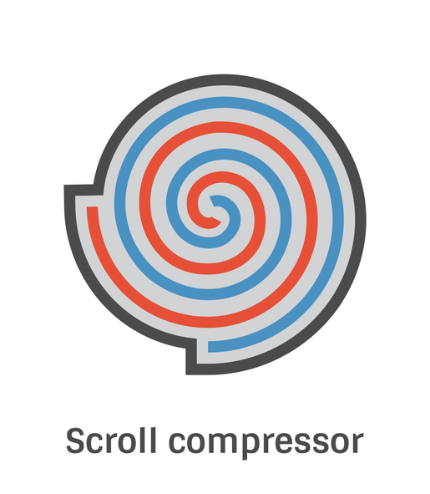
Scroll compressors
Popular within small systems.
Two helical scrolls – one a fixed concentric, the other a moving eccentric.
The eccentric scroll rolls around the fixed scroll, inducing suction vapour.
Vapour becomes trapped between the moving and fixed scrolls and is compressed until it discharges at the centre of the two meshed scrolls.

Slide 16
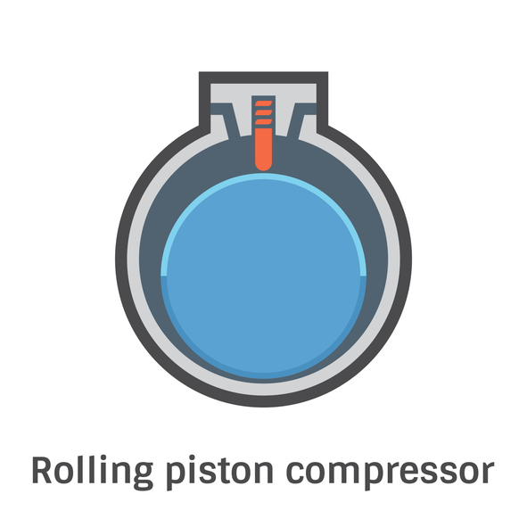
Rotary compressors
Construction is either of two designs.
An eccentrically driven drum rolling against the inside of a concentric cylinder.
or
A concentric drum turning inside an eccentric cylinder.

Slide 17
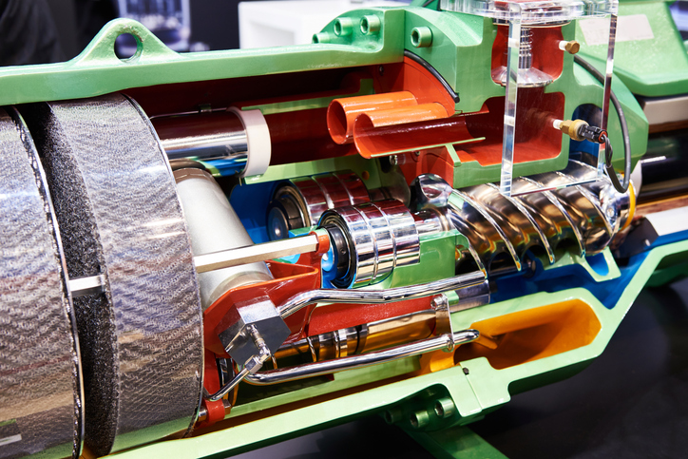
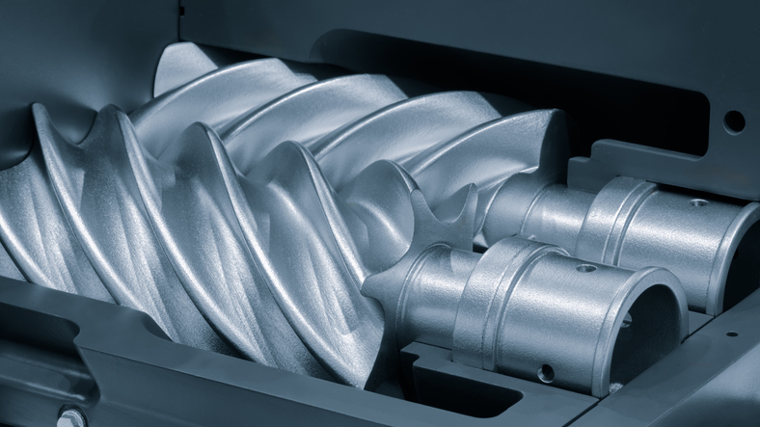
Screw compressors
Compression is achieved by the rotary meshing of lobes of the male rotor to flutes of the female rotor.
Different number of male lobes to female flutes exist.
The male rotor normally drives the female.
A speed increasing ratio is created by the ratio of lobes to flutes.
Is this a positive displacement or dynamic compressor type?
Notes:
Answer : Positive displacement type.

Slide 18
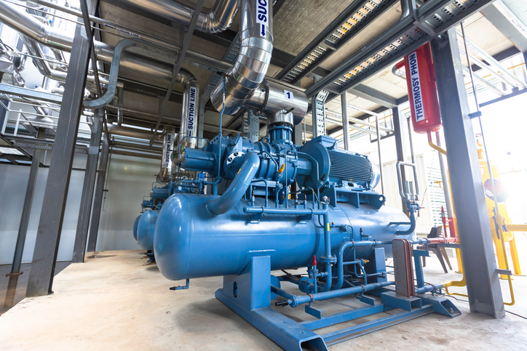
Centrifugal compressors
An impellor rotating at high speed within a cast housing known as a volute or diffuser.
Suction vapour enters the ‘eye’ of the impellor, where the vapour is subjected to centrifugal and aerodynamic forces, providing the vapour with both radial and tangential velocities.
The vapour leaving the impeller flows directly to the diffuser which allows velocity of the discharge vapour to reduce.
Is this a positive displacement or dynamic compressor type?
Notes:
Answer : Dynamic type.

Slide 19
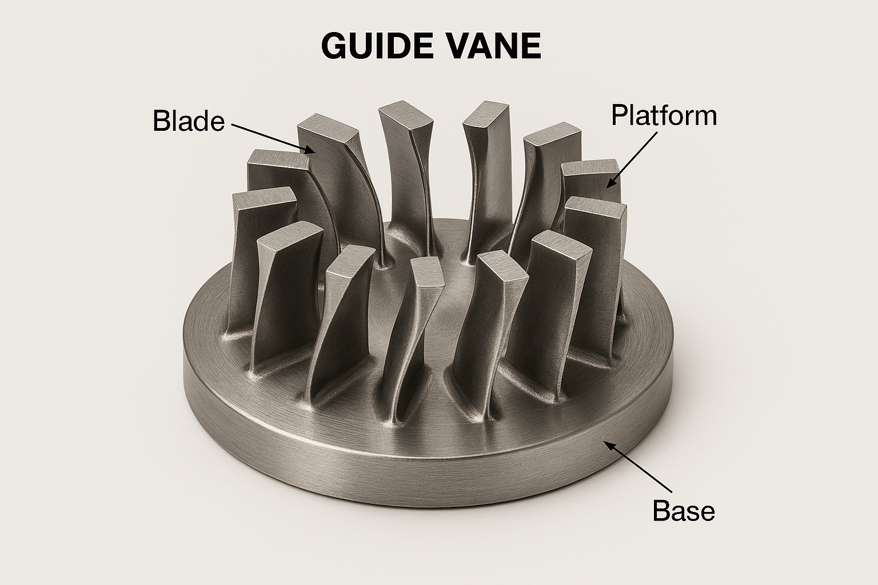
Compressor capacity control
This can be achieved by a variety of methods:
Inverter drive - varying the speed of the compressor motor can reduce the volume flow rate of refrigerant around the system.
Guide vanes – capacity control achieved by varying the volume of vapour entering the impeller eye from the evaporator. Moveable aerodynamic inlet guide vanes are shown.

Slide 20
Compressor capacity control
Offloading – reciprocating compressors with multiple cylinders employ unloading mechanisms to reduce the flow rate.
25% capacity (2 cylinders always active)
50% capacity (4 cylinders)
75% capacity (6 cylinders)
100% capacity (8 cylinders)

Slide 21
Compressor capacity control
Multiple compressors – increasing or decreasing the number of compressors within the circuit can therefore change the flow rate around the system in direct relationship with the evaporator load.
Notes:
I

Slide 22
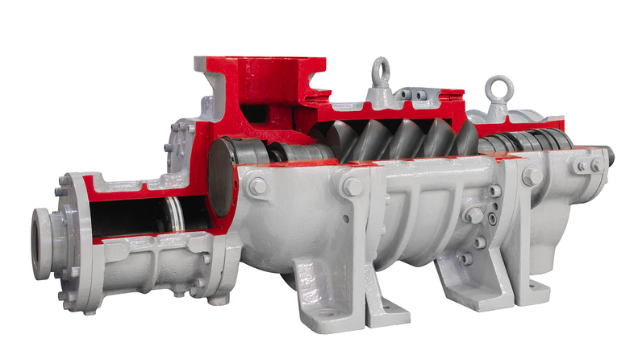
Compressor capacity control
This can be achieved by a variety of methods:
Slide (stepped) control – applicable to screw compressors where a sliding vane is used to reduce the internal volume ratio.

Slide 23
Summary
You should now be able to:
Recall different types of compressors.
Explain the basic principles of vapour compression.
You might also be able to:
Examine the structural integrity of different designs.
Select and justify the best design solution for a given refrigeration or air conditioning installation project.

Slide 24
Any questions?
Copyright in this document belongs to and is used under licence from the Department for Education, © 2025.
‘T-LEVELS’ and ‘T Level’ are registered trademarks of the Department for Education.
WJEC is authorised by the Department for Education to develop and deliver this T Level Technical Qualification.
WJEC operates in England under the name Eduqas which is a registered trademark of WJEC.

