Slide 1
Occupational Specialism: Refrigeration Engineering
K1.29 Disassembly techniques
PowerPoint 1.29
Notes:
Introduce scope and expectations.

Slide 2
Objectives
You should be able to:
Identify hazards and controls when disassembling refrigeration systems.
Select and use appropriate tools for unbrazing/brazing and component removal.
Apply safe electrical isolation (lockout/tagout) and prove-dead procedures.
You might also be able to:
Carry out compliant refrigerant recovery and environmental handling.
Refer to and use manufacturer instructions, method statements and risk assessments.
Notes:
Outcomes linked to K1.29.

Slide 3
Introduction
Why do we need to understand disassembly techniques before working on refrigeration systems?
What could happen if a system is taken apart without proper planning or documentation?
How does careful disassembly help with later commissioning and diagnostics?
Why is using the correct tools and safety controls essential during system disassembly?
Which industry standards influence how we safely take systems apart — and why do they matter?

Slide 4
Commissioning vs. Disassembly: why it matters
Disassembly often precedes corrective commissioning e.g., replacing faulty thermal expansion valve (TXV).
Quality of disassembly affects reinstatement, evacuation and leak integrity.
Documentation during strip-down speeds reassembly and commissioning checks.
Notes:
Relate to commissioning sequence

Slide 5
UK safety & standards you must know
Electricity at Work Regulations 1989; HSE GS38 for test equipment.
F‑gas (GB) obligations: competent handling, leak checks, recovery, records.
BS EN 378 framework for safety across design, installation, operation.
Company RAMS (risk assessments and method statements), and manufacturer instructions.
Notes:
Regulatory context

Slide 6
Risk assessment for disassembly (5 steps)
1) Identify hazards: pressure, hot work, live electrics, sharp edges, refrigerants.
2) Decide who might be harmed and how.
3) Evaluate risk & choose controls (hierarchy of control).
4) Record significant findings & responsibilities.
5) Review when things change (different refrigerant, layout, access).
Use a site-specific template aligned to your centre policy.
Notes:
Use examples

Slide 7
Method statement essentials (for disassembly tasks)
Scope and sequence of work (isolate, recover, unbraze, remove, cap, tidy).
Competence and roles (supervision, hot‑work fire watch).
Permits (hot work, live systems) and emergency arrangements.
Tools/plant and PPE; inspection status.
Quality checks and hold points (leak test after capping, cleanliness).
Notes:
RAMS demo

Slide 8
Tooling for safe disassembly
Hand tools: spanners, torque wrenches, tube cutters and deburrers.
Brazing kit: oxy‑acetylene/oxy‑propane, heat mats, silver/phos‑copper rods.
Nitrogen cylinder, regulator & flowmeter for purge while brazing.
Recovery unit & approved cylinders; calibrated scales.
Vacuum pump (fresh oil), micron gauge, core removal tools.
Two‑pole voltage indicator (GS38 compliant), lock‑off kit & tags.
Notes:
Inspect gear

Slide 9
Unbrazing – clean separation without collateral damage
Shield combustibles; set up fire watch; place heat mats and extinguisher.
Purge oxygen‑free nitrogen at low flow through the circuit to prevent oxidation (black scale) from forming inside the pipework.
Evenly heat the fitting; gently twist/pull once alloy re‑melts.
Cap and label open ends; keep moisture and debris out.
Notes:
Stress cleanliness

Slide 10
Brazing – joints fit for commissioning
Prep: cut square, deburr, clean to bright metal; maintain capillary gap.
Flow nitrogen (‘a whisper’) throughout heat/cool; avoid pressurising the tube.
Heat the fitting first, feed alloy when the base metal draws it in.
Allow to air cool; wipe and visually inspect circumference.
Notes:
Nitrogen flow demo

Slide 11
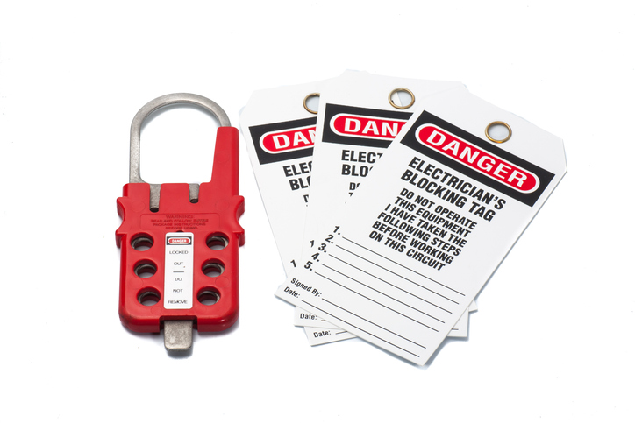
Safe electrical isolation (lockout/tagout) – sequence
Plan work; identify all sources incl. spurs/controls.
Switch off & isolate at appropriate device.
Lock off & tag; control the key.
Prove your voltage indicator on a proving unit.
Test all poles – prove dead.
Re‑prove your indicator; post warning signs.
Notes:
GS38 emphasis

Slide 12
Lockout / Tagout: do this / not this
Do: lock the isolator and keep the key on your person
Do: prove dead before and after using GS38‑compliant gear
Don’t: rely on a non‑contact tester or just turning a switch off
Don’t: forget parallel/induced or back‑fed supplies
Notes:
Common pitfalls

Slide 13
Refrigerant recovery – legal and safe practice
Identify refrigerant type and labelling; check cylinder compatibility.
Use certified recovery equipment; follow manufacturer procedures.
Weigh recovered charge; label cylinders; maintain records.
Avoid venting; manage oil removal and contaminated gas appropriately.
Notes:
F‑gas compliance

Slide 14
Typical recovery setup
Pre‑checks: ID refrigerant, inspect hoses & ports.
Connect manifold & recovery machine; place cylinder on scales.
Purge hoses; recover vapour then liquid if applicable.
Monitor weights/pressures; avoid overfill (80% fill rule).
Shut down; isolate; record recovered mass.
Notes:
Discuss hot‑gas bypass

Slide 15
After reassembly: evacuation & cleanliness
Fit core‑removal tools; use large‑bore hoses; fresh pump oil.
Target deep vacuum verified with a micron gauge (e.g., ≈500 microns).
Isolate and perform decay test to confirm dryness and tightness.
Only then charge by weight per nameplate.
Notes:
Micron gauge use

Slide 16
Component removal considerations
Compressors: isolate electrically; recover fully; pinch‑off & cap to prevent oil spill.
Heat exchangers: support weight; avoid stressing stubs; protect fins.
Valves & driers: replace drier after open‑circuit work; orientate correctly.
Pipework: avoid work‑hardening; keep bends smooth; maintain cleanliness.
Notes:
Examples from DX

Slide 17
Working with A2L/flammable refrigerants (overview)
Control ignition sources; verify ventilation; use non‑sparking tools where needed.
Follow manufacturer and standard guidance on charge and leak detection.
Purge/ventilate work area before hot work; use gas monitors if required.
Notes:
EN 378 link

Slide 18
Using manufacturer’s instructions effectively
Locate hot‑work allowances, service valves, and recovery procedures.
Check torque values, brazing clearances, and approved fillers.
Follow evacuation and charging specs; update settings where applicable.
Notes:
Bring manuals

Slide 19
Activity 1: Build a mini method statement
In pairs: pick a component (filter‑drier, TXV, service valve).
Draft a 6‑step method including isolation, recovery and unbrazing.
Add tools, PPE and a quality check at the end.
Swap and peer‑review for clarity & safety.
Tutor debrief: sequencing and missing controls.
Capture best example to share.
Notes:
20 mins total

Slide 20
Activity 2: Case study
Scenario: TXV suspected blocked after compressor change.
Plan safe strip‑down and replacement steps.
Decide measurements/checks before opening the circuit.
List documents to complete during/after the job.
Notes:
Diagnostic thinking

Slide 21
Quick knowledge check
Which instrument is acceptable for proving dead under GS38?
Why do we flow nitrogen during brazing?
Notes:
Discuss answers

Slide 22
Quick knowledge check - answers
Which instrument is acceptable for proving dead under GS38?
Two pole voltage indicators/detectors.
2. Why do we flow nitrogen during brazing?
To prevent oxidation (black scale) from forming inside the pipework.
Notes:
Discuss answers

Slide 23
Tutor demo prompts (practical)
Set up of nitrogen flow for brazing (with flowmeter).
Lockout/tagout & prove‑dead on a condensing unit panel.
Recovery machine and cylinder set‑up; reading the scales.
Notes:
Film clips if possible

Slide 24
Workshop housekeeping for disassembly tasks
Fire watch and hot‑work permit controls.
Trip‑free hose routing; hot metal management.
End caps and cleanliness; waste segregation.
Notes:
Assign roles

Slide 25
Key takeaways
Plan with RAMS and manufacturer instructions; don’t improvise.
Isolate electrically and prove dead before opening any circuit.
Recover refrigerant lawfully; never vent; keep accurate records.
Prevent contamination: nitrogen purge, cap ends, deep evacuation.
Notes:
Final questions

Slide 26
Summary
You should be able to:
Identify hazards and controls when disassembling refrigeration systems.
Select and use appropriate tools for unbrazing/brazing and component removal.
Apply safe electrical isolation (lockout/tagout) and prove-dead procedures.
You might also be able to:
Carry out compliant refrigerant recovery and environmental handling.
Refer to and use manufacturer instructions, method statements and risk assessments.
Notes:
Outcomes linked to K1.29.

Slide 27
References & further reading
HSE GS38 & Electricity at Work Regulations
GOV.UK F‑gas user guidance
IOR/EN 378 safety frameworks
Nitrogen‑purge & brazing best practice
Evacuation and recovery procedures
Notes:
Provide handout/links

Slide 28
Any questions?
Copyright in this document belongs to and is used under licence from the Department for Education, © 2025.
‘T-LEVELS’ and ‘T Level’ are registered trademarks of the Department for Education.
WJEC is authorised by the Department for Education to develop and deliver this T Level Technical Qualification.
WJEC operates in England under the name Eduqas which is a registered trademark of WJEC.

