Slide 1
Occupational Specialism: Refrigeration Engineering
K1.2 The safe recovery, recycling and disposal of equipment and hazardous waste transfer
PowerPoint 1.2

Slide 2
Introduction to hazardous waste
What is hazardous waste?
Do you produce any? Encounter any?
What do you do with it?
Do you, as an engineer, have any legal obligations in respect of that waste?
These are the important questions and will be covered in this presentation.

Slide 3
Objectives
You should be able to:
Recall what hazardous waste is.
Explain how safe recovery, recycling and the disposal of waste affects you.
You might also be able to:
Explain the current regulation and law applicable.
Select and justify the most applicable method of controlling the hazardous waste you produce.

Slide 4
Classification of waste
All business waste needs to be checked to ensure:
if the waste is hazardous or contains POP (Persistent organic pollutants)
check how the waste must be handled when it is moved
make sure that only an authorised organisation takes the waste
fill in waste paperwork correctly
prevent harm to people and the environment.

Slide 5
POP (Persistent organic pollutants)
POPs are chemical substances that do not break down in the environment.
They are dangerous to human health and the environment.

Slide 6
Regulation and law
There are numerous regulations that cover the safe recovery, recycling and disposal of equipment that affect the RACHP industry:
Fluorinated Greenhouse Gases Regulations 2015 (F gas regulations)
Waste Electrical and Electronic Equipment (WEEE) Regulations 2013
Both are covered under the Environmental Protection Act 2013.

Slide 7
Regulation and law
Under the Environmental Protection Act 1990, refrigerant, or at least refrigerant that is NOT intended to be recharged into a system, is classified as waste refrigerant under the Hazardous Waste (England and Wales) Regulations 2005.

Slide 8
Hazardous Waste Regulation 2005
Scope: Defines the legal framework for how hazardous waste is classified, stored, transported and disposed of.
Key Requirements:
Classification of hazardous waste.
Definition of hazardous waste and storage, and record keeping.
Duty of care and waste management hierarchy.
Licensing and permits.

Slide 9
Hazardous Waste Regulation 2005
The roles of personnel that are involved with the production and transfer of hazardous waste have been defined as:
Producer: Usually a site owner, operator employee, or contractor.
Holder: Can be the producer or a person in possession of the waste.
Consignee: The receiver of the waste for reprocessing or destruction.

Slide 10
Hazardous Waste Regulation 2005
Consignor: Person requiring the waste to be moved from site.
Carrier: Transporter of the waste from site to the consignee.
You, as an engineer, could be either of these roles, depending on whether you remove the waste and carry it in your van, or leave the waste at the site for a carrier to collect later.
Regardless, you must sign the consignment note.

Slide 11
Waste transfer / consignment note
The waste cannot be moved until a waste transfer note or consignment note is generated.
A waste transfer note or consignment note is a mandatory legal document that must accompany the waste.
Notes:
Guidance notes for consignment notes can be found on the gov.uk website

Slide 12
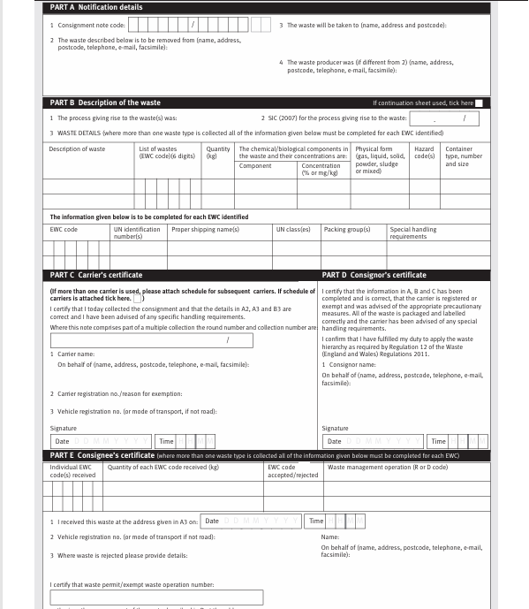
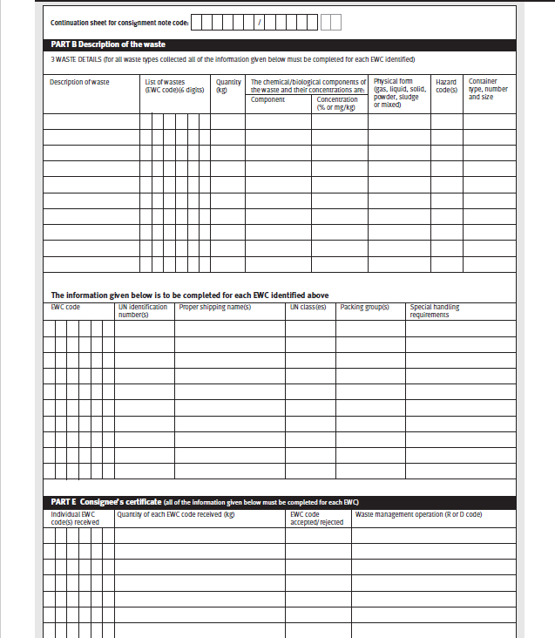

Consignment note and continuation sheet

Slide 13
Consignment code
The waste transfer note must have a unique consignment code.
The consignment code format is XXXXXX/YYYYY
XXXXXX is the first 6 digits of your company name, if less than 6 digits the Q must used to complete the 6 digits.
YYYYY is an identifying code, that can be chosen often numerical. Symbols or spaces cannot be used.
Notes:
Guidance notes for consignment notes can be found on the gov.uk website

Slide 14
Hazard classification and EWC
For CFCs, HCFCs and HFCs Hazard classification code is
H14 Ecotoxic
The European Waste Catalogue number is
14 06 01
The SIC Code used is the same as that provided to Companies House to identify the nature of the company's business.
Notes:
Guidance notes for consignment notes can be found on the gov.uk website.

Slide 15
Record keeping
Stringent record keeping by all parties must be maintained.
Producers must keep a register of all waste sent.
Waste transfer notes must be kept for three years.
Quarterly returns must be kept for six years.
Schedules of carriers must be kept for one year.
Notes:
Guidance notes for consignment notes can be found on the gov.uk website

Slide 16
F gas Regulations 2015
Scope: The F gas regulations include measures to reduce the use and emissions of fluorinated greenhouse gases.
Key requirements:
Mandates certified engineers, record keeping, leak checking, storage, use, recovery, transport, and destruction of F gases.
Imposing conditions on the specific uses of F gases.
Imposing conditions establishing quantitative limits for the placing on the market of hydrofluorocarbons (HFCs) and specific products and equipment containing F gases.

Slide 17
Methods of safe recovery
Recycling: Refrigerants can be recovered and reused in other systems.
Reclamation/resale: Recovered refrigerants can be purified and resold.
Legal destruction: Ensures compliance with environmental laws.

Slide 18
Methods of safe recovery: Recycling
The refrigerant is recovered onsite into a recovery cylinder, which is used as a temporary storage vessel during maintenance operations. The refrigerant can be reclaimed into the original system or another system.
Recycling is the most common method of safe recovery.

Slide 19
Methods of safe recovery: Reclamation
A specialist refrigerant waste management company is used to reprocess the refrigerant back to virgin specification.
The reclaimed refrigerant can then be offered for resale.
This process is especially useful for quota purposes with gases that have GWP above 2500, reclaimed refrigerant can be used in new or existing systems reducing the requirement for virgin refrigerant.

Slide 20
Methods of safe recovery: Destruction
Where a refrigerant has been cross-contaminated or is banned under F gas legislation, the refrigerant is destroyed in a certified way, which does not cause environmental damage.
A consignment fee is now charged under the Hazardous Waste Regulations 2005.

Slide 21
WEEE (Waste Electrical and Electronic Equipment) Regulations (2025)
Scope: Applies to producers, importers, and distributors of electrical/electronic equipment​.
Key requirements: ​
Register as a producer and finance the collection and recycling of WEEE.​
Mark products with the crossed-out wheelie bin symbol​.
Provide information on safe disposal and treatment.

Slide 22
Disposal of:
Electrical Equipment: Includes components such as compressors, motors, and electrical controls that require specialised disposal methods. Requires certified disposal and/or destruction.
Oil: Used oil from refrigeration systems can be contaminated with refrigerants or other hazardous substances. Both require certified disposal.

Slide 23
Disposal of:
Ammonia contaminated water is a toxic substance and can be harmful to health and the environment depending on ammonia concentration.
Secondary refrigerants include glycol-based substances, confirm with the manufacturer's guidance on the correct procedure to dispose of and destruction.

Slide 24
National environment agencies
For business and commercial waste disposal guidance, contact the national agencies:
England: Environment Agency
Wales: Natural Resources Wales
Scotland: Scottish Environment Protection Agency
Northern Ireland: Northern Ireland Environment Agency
Notes:
Local hazardous waste disposal services can be found using Gov.uk

Slide 25
Removal and disposal of electrical equipment
Identify circuit: Confirm the circuit to be isolated using diagrams and labels.
Isolate power: Switch off and secure the isolation device.
Lock and tag: Apply lock and warning signs to prevent reconnection.
Verify isolation: Prove Test Prove with approved voltage indicator to confirm isolation.

Slide 26
GS38 compliance
Insulated handles covering all conductive parts​
Finger guards to prevent contact with live parts​
Minimum exposed metal at probe tips​
Fused leads where appropriate
GS 38 provides guidelines for electrical test equipment used by electricians.

Slide 27
Summary
You should be able to:
Recall what hazardous waste is.
Explain how safe recovery, recycling and the disposal of waste affects you.
You might also be able to:
Explain the current regulation and law applicable.
Select and justify the most applicable method of controlling the hazardous waste you produce.

Slide 28
Any questions?
Copyright in this document belongs to and is used under licence from the Department for Education, © 2025.
‘T-LEVELS’ and ‘T Level’ are registered trademarks of the Department for Education.
WJEC is authorised by the Department for Education to develop and deliver this T Level Technical Qualification.
WJEC operates in England under the name Eduqas which is a registered trademark of WJEC.

